Slide 1
CSE 552/652
Hidden Markov Models for Speech Recognition
Spring, 2006
Oregon Health & Science University
OGI School of Science & Engineering
John-Paul Hosom
Lecture Notes for May 24
Acoustic-Model Strategies for Improved Performance

Slide 2
Next Topics: Improving Performance of an HMM
Search Strategies for Improved Performance
  Null States
  Beam Search
  Grammar Search
  Tree Search
  Token Passing
  “On-Line” Processing
  Balancing Insertion/Deletion Errors
  Stack (A*) Search
Acoustic-Model Strategies for Improved Performance
  Semi-Continuous HMMs
  State Tying / Clustering
  Cloning
  Pause Models
  Summary: Steps in the Training Process

Slide 3
Next Topics: Improving Performance of an HMM
Acoustic Model: Model of state observation probabilities and
state transition probabilities (the HMM model λ) for
mapping acoustics (observations) to words.
(π values are usually specified by what words (and phonemes within these words) can begin an utterance, and/or is otherwise ignored.)
Typically, focus of Acoustic Model is on state observation probabilities, because model of state transition probabilities is quite simple.
Language Model: Model of how words are connected to form
sentences.

Slide 4
Semi-Continuous HMMs (SCHMMs)
HMMs require a large number of parameters:
  One 3-state, context-dependent triphone with 16 mixture
  components and 26 features (e.g. MFCC + ΔMFCC):
  (26×2×16+16) × 3 = 2544 parameters
  45 phonemes yields 91125 triphones
  2544 × 91125 = 231,822,125 parameters for complete HMM
If ΔΔMFCC features are used, then 39 features to model an observation and 345,546,000 parameters in the HMM.
If want 10 samples (frames of speech) per feature dimension and per mixture component for training acoustic model, need
121.5 hours of speech assuming that all training data is distributed perfectly and evenly across all states. In practice,
some triphones are very common and many are very rare.
Methods of addressing this problem: semi-continuous HMMs or state tying

Slide 5
Semi-Continuous HMMs (SCHMMs)
So far, we’ve been talking about continuous and discrete HMMs.
“Semi-continuous” or “tied mixture” HMM combines advantages of continuous and discrete
Instead of each state having separate GMMs, each with its own set of mixture components, a SCHMM has one GMM. All states share this GMM, but each state has different mixture weights.
no quantization error
more accurate results
slow
many parameters
quantization error
less accurate results
fast
few parameters

Slide 6
Semi-Continuous HMMs (SCHMMs)
Result has a continuous probability distribution but each state
has only a few parameters (mixture component weights)
Less precise control over probabilities output by each state, but
much fewer parameters in estimation because the number of
Gaussian components is independent of the number of states.
SCHMMs are more effective the more parameters can be shared; sharing can occur the more the feature space for different states overlaps.
So, SCHMMs are most effective with triphone-model HMMs
(as opposed to monophone HMMs) because the region of feature space for one phoneme contains about 2000 triphone units
(45 left contexts × 45 right contexts per phoneme = 2025).
SCHMMs also more effective when amount of training data is limited.

Slide 7
Semi-Continuous HMMs (SCHMMs)
Semi-Continuous HMMs
In continuous HMMs, each GMM estimates probability of observation data given a particular state:
0.0
State A
1.0
0.0
State B
1.0
In SCHMMs, use one set of Gaussian components for all states:
0.0
1.0
This is the semi-continuous HMM “codebook.” (In real applications, means of each component are not necessarily
evenly distributed across the feature space as shown here.)

Slide 8
Semi-Continuous HMMs (SCHMMs)
Semi-Continuous HMM then varies only the mixture component weights for each state. (The mean and covariance data remains the same for all states.)
State A has 7 parameters for b_{A}(o_{t}), state B has 7 parameters for b_{B}(o_{t}), plus including 7 sets of mean and covariance data for
SCHMM codebook.
0.4
0.3
0.2
0.1
0.0
0.0
State A
State B
1.0
State A: c₁ = 0.15, c₂ = 0.39, c₃ = 0.33, c₄ = 0.10, c₅ = 0.03, c₆ = 0.00, c₇=0.00
State B: c₁ = 0.00, c₂ = 0.05, c₃ = 0.13, c₄ = 0.36, c₅ = 0.25, c₆ = 0.12, c₇=0.09

Slide 9
Semi-Continuous HMMs (SCHMMs)
Semi-Continuous HMMs
Historically, there was a significant difference between continuous HMMs and SCHMMs, but more recently continuous HMMs use large amount of state tying, so advantage of SCHMMs is reduced.
SPHINX (CMU) is most well-known SCHMM (and has accuracy levels at least as good as other (continuous) HMMs)
Number of parameters for SCHMM:
  (number of parameters per Gaussian component ×
  number of mixture components) +
  (number of states × number of mixture components)
is usually less than number of parameters for continuous HMM,
and almost always less if don’t store unnecessary (zero) values.

Slide 10
Semi-Continuous HMMs (SCHMMs)
Semi-Continuous HMMs
For example, 3-state, context-dependent triphone SCHMM with 1024 mixture components and 26 features (e.g. MFCC + ΔMFCC):
((26×2×1024) + (91125×1024)) = 93,365,248 parameters
or about half the number of parameters of a comparable continuous HMM.
If we only store about 16 non-zero components per state along with information about which state is non-zero (again comparable to continuous HMM), then
  ((26×2×1024) + (91125×16×2)) = 3,022,496 parameters
or about 1% to 2% the size of a comparable continuous HMM
Fewer number of parameters for modeling the same amount of data can yield more accurate acoustic models if done properly.

Slide 11
Semi-Continuous HMMs (SCHMMs)
Advantages of SCHMMs:
  Minimizes information lost due to VQ quantization
  Reduces number of parameters because probability density functions are shared
  Allows compromise for amount of detail in model based on amount of available training data
  Can jointly optimize both codebook and other HMM parameters (as with discrete or continuous HMMs) using
  Expectation Maximization
  Fewer number of parameters yields faster operation (which can, in turn, be used to increase the beam width during Viterbi search for improved accuracy instead of faster operation).

Slide 12
State Tying/Clustering
State Tying: Another method of reducing number of parameters in an HMM
Idea: If two states represent very similar data (GMM parameters
are similar) then replace these two states with a single state
by “tying” them together.
Illustration with 3-state context-dependent triphones:
/s-ae+t/
/k-ae+t/
/s-ae+k/
/s-ae+t/
1
/s-ae+t/
2
/s-ae+t/
3
/k-ae+t/
1
/k-ae+t/
2
/k-ae+t/
3
/s-ae+k/
1
/s-ae+k/
2
/s-ae+k/
3
tie these
2 states
tie these
2 states

Slide 13
State Tying/Clustering
“Similar” parameters then become the same parameters, so
decreases ability of HMM to model different states.
Can tie more than 2 states together.
“Logical” model still has 45 × 45 × 45 = 91125 triphones. But
“physical” model has fewer parameters (M × 45 × N, where
M and N are both less than 45)
Multiple “logical” states map to single “physical” state
The question is then which states to tie together? When are two or more states “similar” enough to tie? If states are tied, will HMM performance increase (because of more parameters for estimating model parameters) or decrease (because of reduced ability to distinguish between different states)?

Slide 14
State Tying/Clustering
Tying can be performed at multiple levels…
But typically we’re most interested in tying states (or, more
specifically, GMM parameters)
The process of grouping states (or other levels of information) together for tying is called clustering.
HMM
state
GMM
a_{ij}
components
μ_{jk} Σ_{jk} c_{jk}

Slide 15
State Tying/Clustering
How to decide which states to tie? ⇒ Clustering algorithm
Method 1:
  Knowledge-Based Clustering
  e.g. tie all states of /g-ae+t/ to /k-ae+t/ because (a) not enough
  data to robustly estimate /g-ae+t/ and (b) /g/ is acoustically
  similar to /k/.
  e.g. tie /s-ih-p/ state 1 to /s-ih-k/ state 1 (same left context)
Method 2:
  Data-Driven Clustering
  Use distance metric to merge “close” states together
Method 3:
  Decision-Tree Clustering
  Combines knowledge-based and data-driven clustering

Slide 16
State Tying/Clustering: Data-Driven Clustering
Given:
  all states initially having individual clusters of data
  a distance metric between clusters A and B
    (weighted) distance between the means
    Kullback-Liebler distance
  measure of cluster size
    e.g. largest distance between points X and Y in cluster
  thresholds for largest cluster size, minimum number of clusters
Algorithm:
  (1) Find pair of clusters A and B with minimum (but non-zero)
  cluster distance
  (2) Combine A and B into one cluster
  (3) Tie all states in A with all states in B
  (4) Repeat from (1) until thresholds reached
Optional: (5) while any cluster has less than a minimum number of data points, merge that cluster with nearest cluster

Slide 17
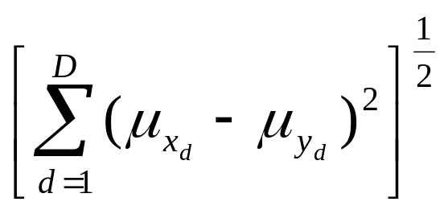
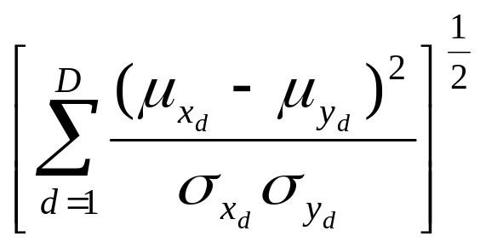
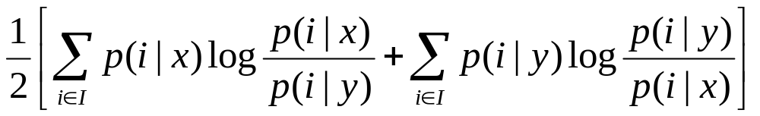
State Tying/Clustering: Data-Driven Clustering
Distance Metrics:
(Weighted) Euclidean Distance Between Means
(D=dimension of feature space, x and y are two clusters)
Euclidean Distance Weighted Euclidean Distance
between the means or Mahalanobis Distance
Symmetric Kullback-Liebler Distance
(i = data point in training data set I)

Slide 18
State Tying/Clustering: Data-Driven Clustering
Example with 1-dimensional, weighted Euclidean distance,
where M_{X,Y} is the distance between two clusters X and Y:
cluster1 cluster2 cluster3 cluster4
0.10 0.40 0.60 0.95
0.15 0.30 0.65 0.80
0.05 0.45 0.50 0.95
0.10 0.30 0.70 0.85
mean= 0.10 0.36 0.61 0.89
st.dev.= 0.0408 0.075 0.0854 0.075
M_{1,1}=0.0 M_{1,2}=4.70 M_{1,3}=8.64 M_{1,4}=14.28
M_{2,2}=0.0 M_{2,3}=3.12 M_{2,4}=7.07
M_{3,3}=0.0 M_{3,4}=3.50
M_{4,4}=0.0
So we group clusters 2 and 3.
data points
in cluster

Slide 19
State Tying/Clustering: Data-Driven Clustering
Example, continued…
cluster1 cluster 2,3 cluster 4
0.10 0.40, 0.60 0.95
0.15 0.30, 0.65 0.80
0.05 0.45, 0.50 0.95
0.10 0.30, 0.70 0.85
mean= 0.10 0.49 0.89
var.= 0.0408 0.1529 0.075
M_{1,1}=0.0 M_{1,23}=4.94 M_{1,4}=146.3
M_{23,23}=0.0 M_{23,4}=3.73
M_{4,4}=0.0
So we group clusters (2,3) and 4.

Slide 20
State Tying/Clustering: Decision-Tree Clustering*
What is a Decision Tree?
  Automatic technique to cluster similar data based on knowledge of the problem
  (combines data-driven and knowledge-based methods)
Three components in creating a decision tree:
  1. Set of binary splitting questions
  Ways in which data can be divided into two groups
  based on knowledge of the problem
  2. Goodness-of-split criterion
  If data is divided into two groups based on a binary
  splitting question, how good is a model based on
  these two new groups as opposed to the original group?
  3. Stop-splitting criterion
  when to stop splitting process
*Notes based in part from Zhao et al 1999 ISIP tutorial

Slide 21
State Tying/Clustering: Decision-Tree Clustering
Problem with data-driven clustering: If there’s no data for
a given context-dependent triphone state, it can’t be merged with other states using a data-driven approach… we often need to be able to tie a state with no training data to “similar” states.
Decision-Tree Clustering:
Given:
  a set of phonetic-based questions that provides complete
  coverage of all possible states.
  Examples:
  Is left-context phoneme a fricative?
  Is right-context phoneme an alveolar stop?
  Is right-context phoneme a stop?
  Is left-context phoneme a vowel?
  the likelihood of the model given pooled set of tied states,
  assuming a single mixture component for each state.

Slide 22
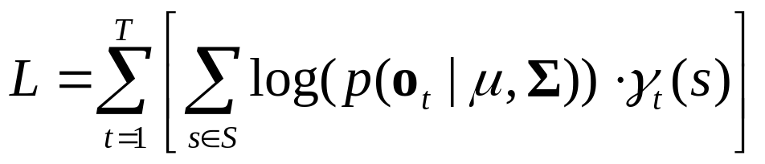
State Tying/Clustering: Decision-Tree Clustering
The expected value of the log-likelihood of a (single-Gaussian) leaf node (S) in the tree, given observations O=(o₁,o₂,…o_{T}), is computed by the log probability of o_{t} given this node, weighted by the probability of being in this leaf node, and summed over all times t. (Note similarity to Lecture 12, slide 11)
where s = a state in the leaf node S which contains a set of tied states, γ_{t}(s) = probability of being in state s at time t (from Lecture 11 Slide 6). The sum of all γ values is the probability of being in the tied state at time t, which is defined as having a single mixture component, with mean μ and covariance matrix Σ.
The log probability of a multi-dimensional Gaussian is
where n is the dimension of the feature space.
transpose

Slide 23
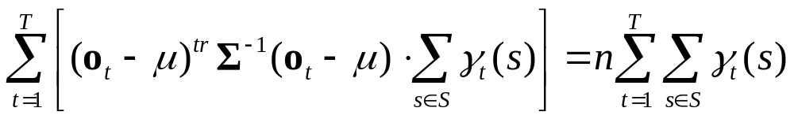
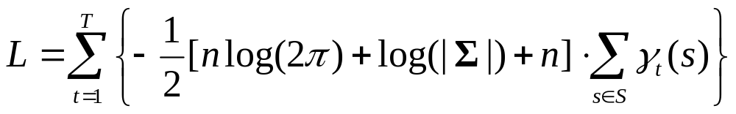
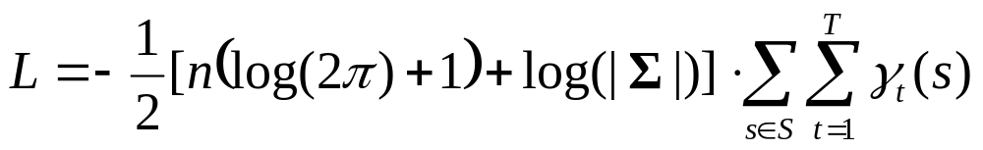
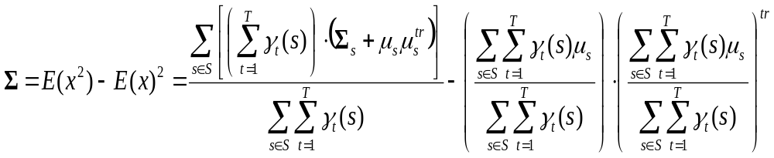
State Tying/Clustering: Decision-Tree Clustering
It can be shown (e.g. Zhao et al., 1999) that
and so the log likelihood can be expressed as
and the covariance matrix of the tied state can be computed as
where μ_{s} and Σ_{s} are the mean and covariance of state s.
or

Slide 24
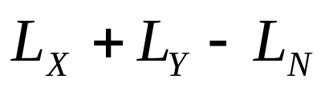
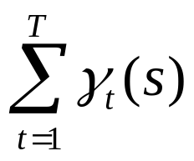
State Tying/Clustering: Decision-Tree Clustering
Therefore, if we have a node N that is split into two sub-nodes
X and Y based on a question, the increase in likelihood obtained by
splitting the node can be calculated as
where L_{N} is the likelihood of node N, L_{X} is the likelihood of sub-node X, and L_{Y} is the likelihood of sub-node Y.
The term can be computed once and stored for each state.
Then, note that the increase in log-likelihood depends only on the
parameters of the Gaussian states within the nodes and the γ values for states within the nodes, not on actual observations o_{t}. So, computation of the increase in likelihood can be done quickly.
Intuitively, the likelihood of the two-node model will be at least as good as the likelihood of the single-node model, because there are more parameters in the two-node model (i.e. two Gaussians instead of one) that are modeling the same data.

Slide 25
State Tying/Clustering: Decision-Tree Clustering
Algorithm:
1. start with all states contained in root node of tree
2. Find the binary question that maximizes the increase in the
likelihood of the data being generated by the model.
3. split the data into two parts, one part for the “yes” answer,
one part for the “no” answer.
4. For both of the new clusters, go to step (2), until the increase
in likelihood of data falls below threshold.
5. For all leaf nodes, compute log-likelihood of merging with
another leaf node. If decrease in likelihood is less than
some other threshold, then merge the leaf nodes.
Note that this process models each cluster (group of states) with a
single Gaussian, whereas the final HMM will model each cluster
with a GMM. This discrepancy is tolerated because using a single Gaussian in clustering allows fast evaluation of cluster likelihoods.

Slide 26
State Tying/Clustering: Decision-Tree Clustering
Illustration:
s-ih+t
s-ih+d
s-ih+n
f-ih+d
f-ih+n
f-ih+t
d-ih+t
d-ih+d
d-ih+n
this question was the one
yielding highest likelihood
is left context a fricative?
Y
N
s-ih+t
s-ih+d
s-ih+n
d-ih+t
d-ih+d
d-ih+n
f-ih+t
f-ih+d
f-ih+n
(no question causes sufficient
increase in likelihood)
is right context a nasal?
Y
N
s-ih+n
s-ih+t
s-ih+d
f-ih+n
f-ih+t
f-ih+d

Slide 27
State Cloning
The number of parameters in an HMM can still be very
large, even with state tying and/or SCHMMs.
Instead of reducing number of parameters, another approach
to training a successful HMM is to improve initial estimates
before embedded training.
Cloning is used to create triphones from monophones.
Given: a monophone HMM (context independent) that has
good parameter estimates
Step 1: “Clone” all monophones, creating triphones with
parameters equal to monophone HMMs.
Step 2: Train all triphones using embedded training.

Slide 28
State Cloning
Example:
ih
ih
ih
45
cloning
s-ih+t
s-ih+t
s-ih+t
f-ih+n
f-ih+n
f-ih+n
90,000
f-ih+t
f-ih+t
f-ih+t
then train all of these models using forward-backward and
embedded training; then cluster similar models

Slide 29
Pause Models
The pause between words can be considered as one of two
types: long (silence) and short (short pause). The short-
pause model can skip the silence-generating state entirely,
or emit a small number of silence observations. The silence
model allows transitions from the final silence state back to
the initial silence state, so that long-duration silences can be
generated.
0.2
states are tied
0.3
(Figure from Young et. al,
The HTK Book)

Slide 30
Pause Models
The pause model is trained by
  initially training a 3-state model for silence
  creating the short-pause model and tying its parameter values to the middle state of silence
  adding transition probability of 0.2 from states 2 to 4 of
  state silence (other transitions are re-scaled to sum to 1.0)
  adding transition probability of 0.2 from states 4 to 2 of
  state silence
  adding transition probability of 0.3 from states 1 to 1 of
  the short pause state
  re-training with embedded training

Slide 31
Steps In the Training Process
Steps in HMM Training:
Get initial segmentation of data
(flat start, hand labeled data, forced alignment)
Train single-component monophone HMMs using forward-backward training on individual phonemes
Train monophone HMMs with embedded training
Create triphones from monophones by cloning
Train triphone models using forward-backward training
Tie states using decision tree
Double number of mixture components using VQ
Train with embedded training
Repeat steps (7) and (8) until get desired number of components

Slide 32
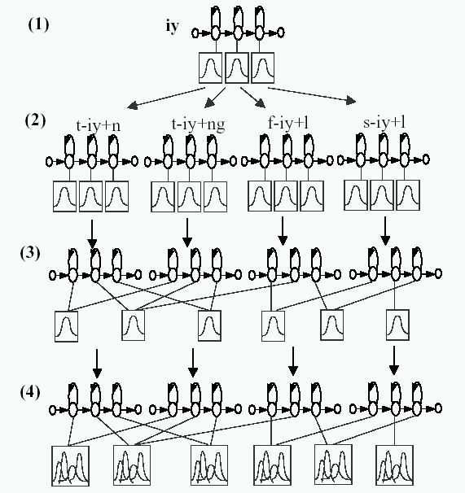
Steps In the Training Process
train initial
monophone models
cloning to create
triphones;
do embedded training
tie states based on
decision tree clustering
double number of
mixture components;
do embedded training
(Figure from Young, Odell,
Woodland, 1994)

