Slide 1
CSE 552/652
Hidden Markov Models for Speech Recognition
Spring, 2006
Oregon Health & Science University
OGI School of Science & Engineering
John-Paul Hosom
Lecture Notes for May 31, morning
Language Models

Slide 2
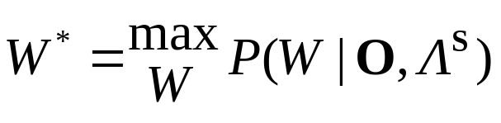
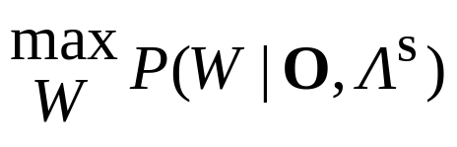
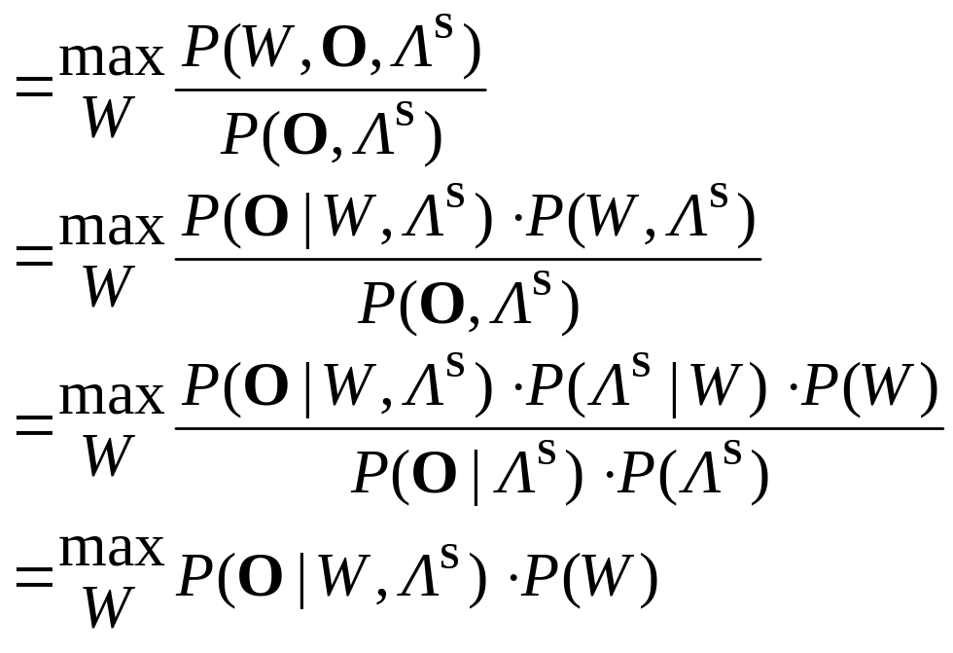
Language Models
We want the most probable word sequence given an utterance and a super-model HMM, which can be expressed as follows:
where Λ^{S} is one model that can represent all word sequences,
W is one of the set of all possible word sequences, and W*
is the best word sequence.
Using multiplication rule, this can be re-written as:
P(Λ^{S}) doesn’t depend on W
this term cancels
out with same term
above
only one Λ^{S} and one O,
so P(O|Λ^{S}) is constant

Slide 3
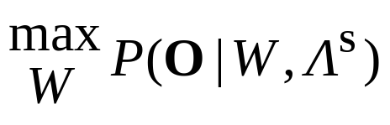
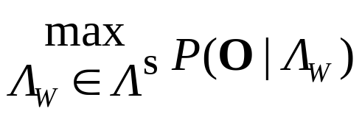
Language Models
Because Λ^{S} is a super-model that represents all possible word sequences, a word sequence W and the super-model Λ^{S} (the intersection of the two) can be considered a model of just that word sequence, Λ_{W}.
So, we can write as
can be estimated using Viterbi search, as
described in Lecture 13, slides 31-35. This term in the equation is often called the acoustic model. This maximization yields the best state sequence, but this best state sequence can be mapped directly to the best corresponding word sequence.
P(W) is the probability of the word sequence W, computed using the language model, which is the topic of this lecture.
There is another way of deriving the same result, as follows
on the next slides…

Slide 4
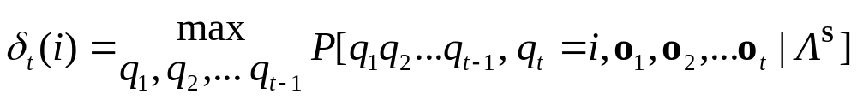
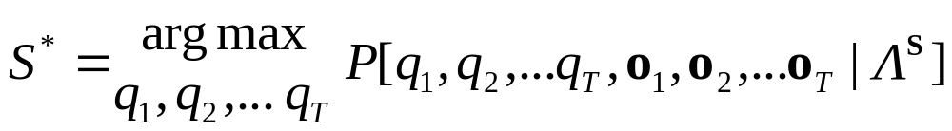
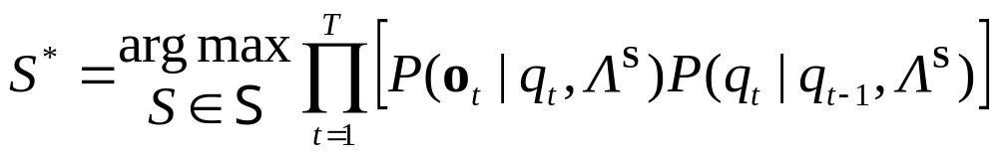
Language Models
Until now, we have focused on word recognition using Viterbi search (one-pass search) by computing
which, after maximizing at time T (Lecture 5, Slide 17), yields the most likely state sequence
Making independence and first-order Markov assumptions,
where S is a state sequence {q₁, q₂, … q_{T}} out of the set of all possible state sequences S in the super-model Λ^{S}
We then find the word sequence corresponding to this best state sequence by directly mapping states to their corresponding words.
(Lecture 7, Slide 5)
[1]
[2]
[3]

Slide 5
Language Models
But, in connected word recognition, we have not only probabilities of observations and states, but also probabilities of word sequences
W = w₁, w₂, … w_{M}
where w_{m} is an individual word and M is the number of hypothesized words in an utterance.
We want to find the best word sequence W* given an observation sequence O and model Λ^{S}. If we compute this by maximizing over all possible state sequences, we will also have implicitly evaluated the corresponding set of all possible word sequences, because a word sequence is determined directly from a state sequence.
So, we can consider the problem as follows: Find the best word sequence by maximizing the probability of all word and state sequences, given an observation sequence and model, determined over all possible state sequences:

Slide 6
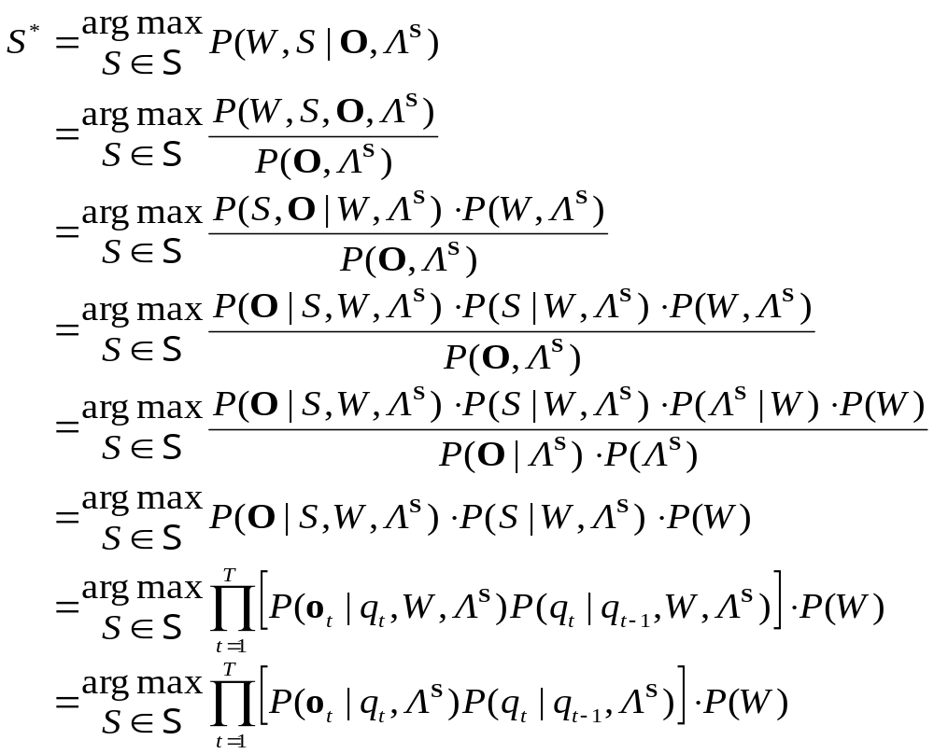
Language Models
[4]
reasoning to follow on next slide…
[5]
[6]
[7]
[8]
[9]
[10]
[11]
then W* is the word sequence corresponding to S*

Slide 7
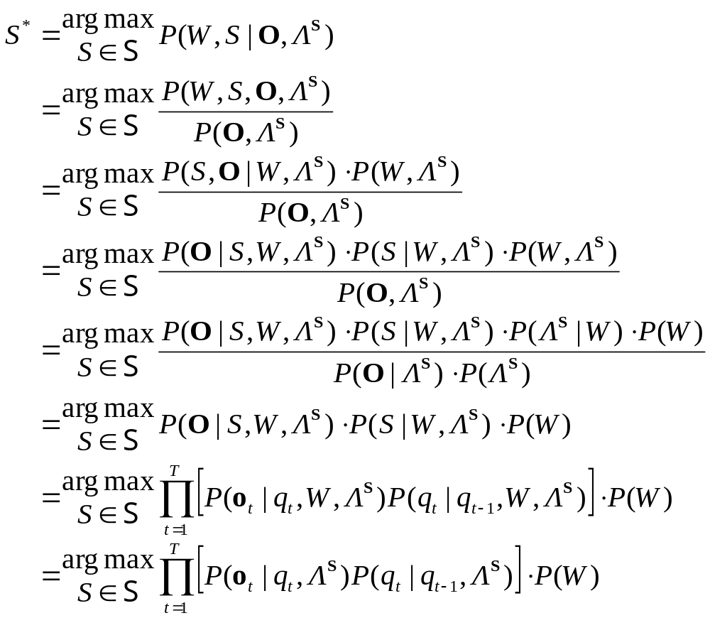


Language Models
W is word sequence corresponding to S
multiplication rule
multiplication rule
multiplication rule
P(Λ^{S}) doesn’t depend on W.
P(O|Λ^{S}) is constant for all S,W
assume independence between observations
first-order Markov assumption
assume single o_{t} is indep. of complete word sequence
we are maximizing the probability of q_{t} given word sequence W;
if W is consistent with q_{t}, then probability is same as p(q_{t} | q_{t-1}), and
if W is not consistent with q_{t}, then probability is zero. Since we’re
maximizing the probability, then W has no effect on outcome.

Slide 8
Language Models
So, finding the best word sequence W* given an observation sequence and model of all possible word sequences is equivalent to finding the highest-probability observation sequence, state sequence, and word sequence corresponding to this state sequence.
This is the same as normal Viterbi search, but includes probabilities of word sequences W that correspond to hypothesized state sequences S.
So, when doing Viterbi search, every time we hypothesize a state sequence at time t that includes a new word, we factor in the probability of this new word in the word sequence.
The probability of a word sequence, P(W), is computed by the Language Model.
This lecture is a brief overview of language models; the topic is covered in more detail in CSE 562/662 Natural Language Processing

Slide 9
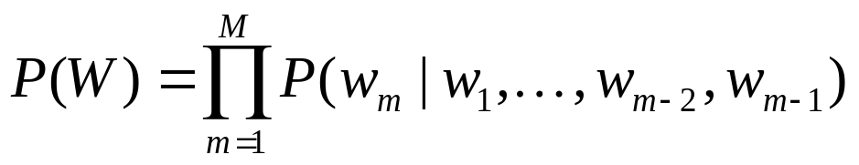
Language Models
We want to compute P(W) = P(w₁, w₂, w₃, …, w_{M})
From the multiplication rule for three or more variables,
Or, equivalently,
We can call w₁, …, w_{m-2},w_{m-1} the history up until word position
m, or h_{m}.
But, computing P(w_{m} | h_{m}) is impractical; we need to compute it for every word position m, and as m increases, it quickly becomes impossible to find data (sentences) containing a history of all words in each sentence position for computing the probability.
[12]
[13]

Slide 10


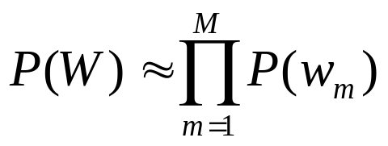
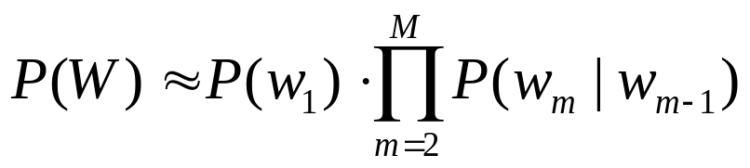
Language Models
Instead, we’ll approximate
where N is the order of the resulting N-gram language model.
If N = 1, then we have a unigram language model, which is the
a priori probability of word w_{m}:
If N = 2, we have a bigram language model:
[14]
[15]
[16]
[17]
[18]

Slide 11
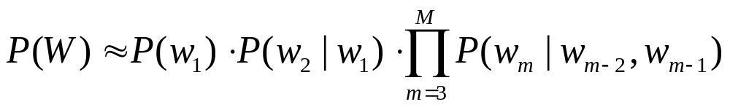
Language Models
If N = 3, we have a trigram language model:
Quadrigram (N=4), Quingram (N=5), etc. are also possible.
The choice of N depends on the availability of training data; the best value of N is the largest value at which probabilities can still be robustly estimated.
In practice, trigrams are common (typical corpora allow performance improvement from bigram to trigram, but getting reliable quadrigram estimates is more difficult).
[19]
[20]

Slide 12
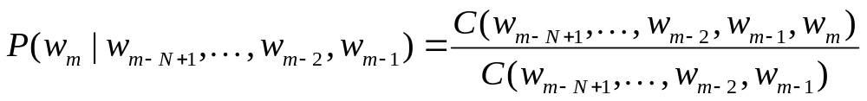
Language Models
Given an order for the language model (e.g. trigram), how do we compute P(w_{m} | w_{m-2}, w_{m-1})?
In theory, this is easy… we count occurrences of word combinations in a database, and compute probabilities by
dividing the number of occurrences of a word sequence
(w_{m-N+1}, … w_{m-2}, w_{m-1}, w_{m}) by the number of occurrences
of word sequence (w_{m-N+1}, … w_{m-2}, w_{m-1})
In practice, it’s more difficult. For example, a 10,000 word vocabulary has 10¹² (one trillion) trigrams, requiring a very large corpus of word sequences to robustly estimate all trillion probabilities.
In addition, the success of a language model depends on how similar the text used to estimate language-model parameters is to data seen during evaluation.
[21]

Slide 13
Language Models
Applying a language model trained on one type of task (e.g. legal dictation) does not generalize to other types of tasks (e.g. medical dictation, general-purpose dictation).
In one case (IBM, 1970’s), 1.5 millions words of training data, 300,000 words of test data, vocabulary size of 1000 words. In this case, 23% of trigrams in test data did not occur in training data. In another case, with 38 million words of training data, over 30% of trigrams in test data did not occur in training.
How do we estimate P(w_{m} | w_{m-2}, w_{m-1}) if (w_{m-2}, w_{m-1}, w_{m}) never occurs in the training data? We can’t use Equation [21]… a probability of zero is an underestimation because our training data is incomplete.
Common techniques:
  smoothing
  back-off and discounting

Slide 14
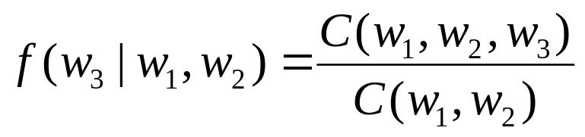
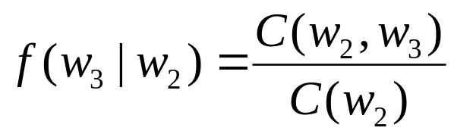
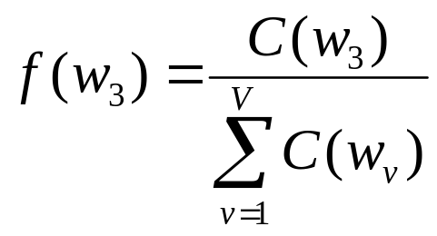

Language Models: Linear Smoothing
Linear Smoothing (Interpolation) (Jelinek, 1980):
where
and λ_{i} are non-negative with
[22]
[23]
[24]
[25]
[26]

Slide 15
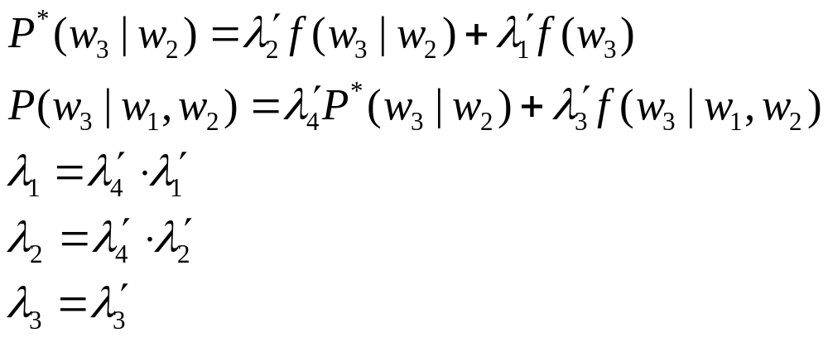
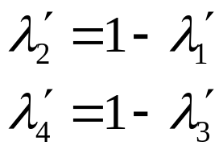
Language Models: Linear Smoothing
First we re-formulate the equations to separate into 2 parts,
P*(w₃ | w₂) and P(w₃ | w₁, w₂):
We can satisfy the constraint if
Note that λ’_{i} should depend on the counts, C, of word sequences, since higher counts leads to a more robust estimates.
[27]
[28]
[29]
[30]
[31]
(equivalent to λ₂ = λ’₄ − λ₁)
[32]
(equivalent to λ’₄ = 1 − λ₃, ∴ λ₂ = 1 − λ₃ − λ₁)
[33]

Slide 16
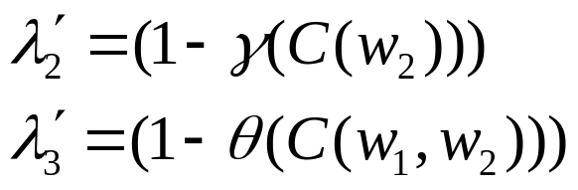
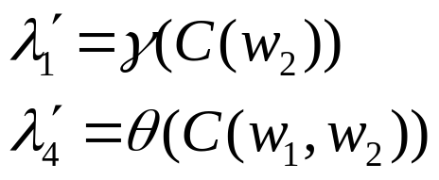
Language Models: Linear Smoothing
In particular, λ’₂ should be a function of C(w₂), because larger values of C(w₂) will yield more robust probabilities of f(w₃ | w₂), and λ’₃ should be a function of C(w₁, w₂) for the same reason.
Because of this, we can set
and therefore
and we now need to estimate two functions, γ(C(w₂)) and θ(C(w₁,w₂)) in order to compute λ₁, λ₂, and λ₃.
First, we make one more simplification: λ’₂ and λ’₃ are a function of a range of counts of C(w₂) and C(w₁, w₂), respectively.
Let R(w₂) be the range of counts associated with C(w₂).
[34]
[35]
[36]
[37]

Slide 17
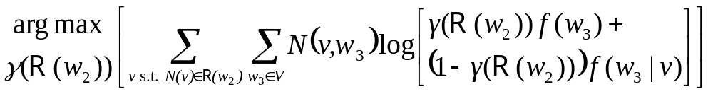
Language Models: Linear Smoothing
Ranges are chosen empirically so that sufficient counts are associated with each range.
We therefore want to compute γ(R(w₂)) and θ(R(w₁,w₂)) for all ranges of word counts, instead of for all C(w₂) and C(w₁, w₂).
To compute γ(R(w₂)) for one range R(w₂), use the following procedure:
  Divide all training data into two partitions: “kept” and “held-out”, where the size of “kept” is larger than “held-out”.
  Compute f(w₃ | w₂) and f(w₃) using the “kept” data.
  Count N(w₂, w₃), the number of times (w₂, w₃) occurs in the “held-out” data.
  Find the value of γ(R(w₂)) that maximizes
[38]

Slide 18
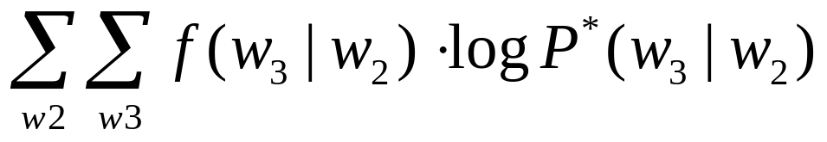
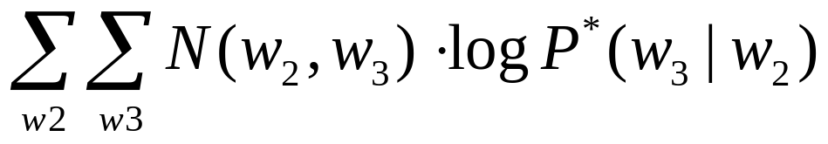
Language Models: Linear Smoothing
How did we get:
Start: We want a function that maximizes the expected value of the frequency of w₃ given w₂ in the held-out data, i.e. we want to maximize E[f(w₃ | w₂)], because this data is more informative than just f(w₃) when computing P(w₃ | w₁, w₂). In a similar way that we maximized the Q function in Lecture 12, we can consider maximizing
which, since f(w₃ | w₂) depends on N(w₂, w₃) in the numerator,
is the same as maximizing

Slide 19
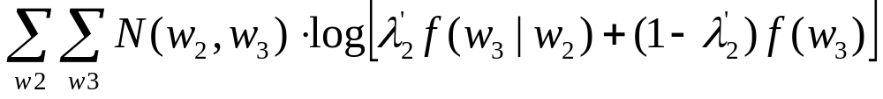
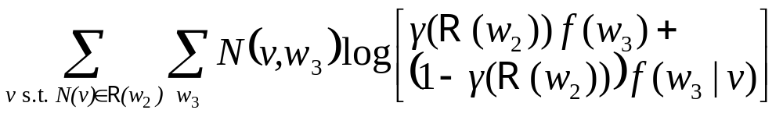
Language Models: Linear Smoothing
Then, we can re-write
using the definition of P*(w₃ | w₂), as follows:
and combining with the definition of γ:
then, because we’re not considering specific w₂, but a range
of counts similar to the count of w₂:

Slide 20
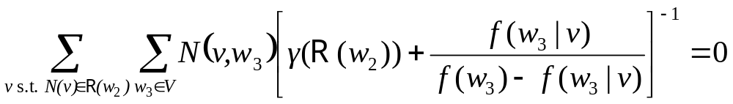
Language Models: Linear Smoothing
So, we’re finding the γ value for each R(w₂) that maximizes the
expected frequency f(w₃ | w₂), thereby yielding better estimates.
To solve the equation, we can find the parameter value γ(R(w₂))
at which the derivative is zero:
This function has only one maximum, and the value of γ(R(w₂)) at which this function is zero can be determined by a gradient search
The parameter θ(R(w₁,w₂)) can be determined by a similar process.
We need to use two partitions of the training data, because if we use only one to compute both the frequencies (f(w₃ | w₁, w₂),
f(w₃ | w₂), f(w₃)) and the parameters γ and θ, the result will end up being λ₃=1, λ₂=0, λ₁=0.
[39]

Slide 21
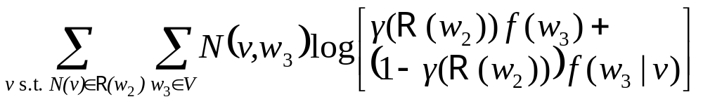
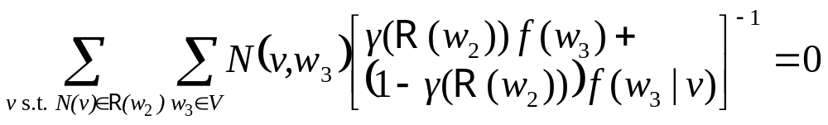

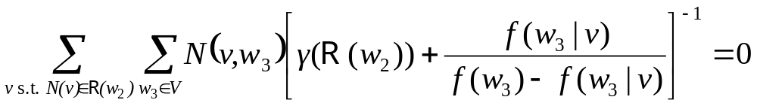
Language Models: Linear Smoothing
To get the derivative of
which we set to zero, remember that log’(x) = 1/x, so
then divide both sides (left and right of eqn) by

Slide 22
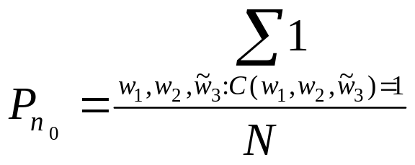
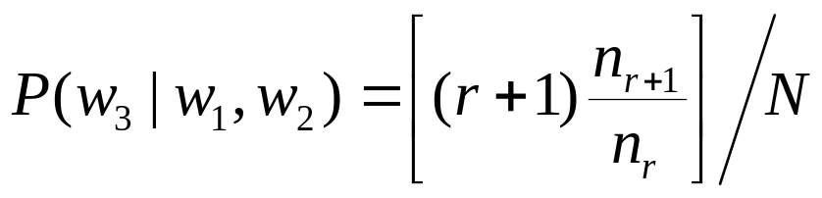
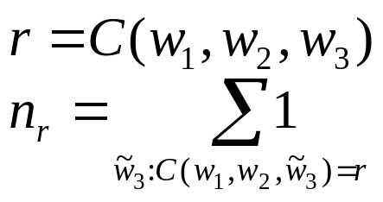
Language Models: Good-Turing Smoothing
Another type of smoothing is Good-Turing (Good, 1953), in which the probability of events with count > 1 is decreased and the probability of events with count = 0 is increased.
Good-Turing states that:
total probability of unseen events (event occurring zero times) is:
the new estimate of the probability of seen events (count > 0) is:
count of the number events (trigrams)
occurring once, given w₁,w₂
[40]
the total number of events (all trigrams)
given w₁,w₂ = C(w₁,w₂)
inside brackets is new expected number
of times that event (triphone) occurs
[41]
N is total number of trigrams given w₁,w₂
= C(w₁,w₂)
[42]
the number of times that trigram
(w₁,w₂,w₃) occurs
[43]
the number (count) of trigrams that
occur exactly r times given w₁,w₂

Slide 23
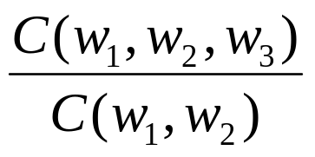
Language Models: Discounting & Back-Off
Good-Turing is an example of discounting, where the probabilities of frequent events are decreased in order to increase the probabilities of unseen events to something greater than zero.
(The frequent events are “discounted” so that we don’t underestimate zero-count events.)
Two issues with applying Good-Turing to language modeling:
  How do we compute a probability for a specific trigram
  (w₁, w₂ , w₃) when C(w₁, w₂ , w₃) = 0?
  Answer: use a back-off model
  For cases in which C(w₁, w₂) is large, Equation [21]
  yields a good estimate of P(w₁, w₂ , w₃) … so we don’t want to use discounting.
  Answer: use a back-off model.

Slide 24
Language Models: Discounting & Back-Off
Back-Off model:
For trigrams that occur more frequently, use a more robust
probability estimate
For trigrams that occur less frequently, “back off” to
a less robust probability estimate (using either lower-order
N-grams or other estimates)
More than one back-off strategy can be contained within one model (see next slide for case of two back-off strategies within
one model)
The same back-off strategy can have different forms of discounting (Good-Turing, absolute, linear, leave-one-out, etc.)

Slide 25
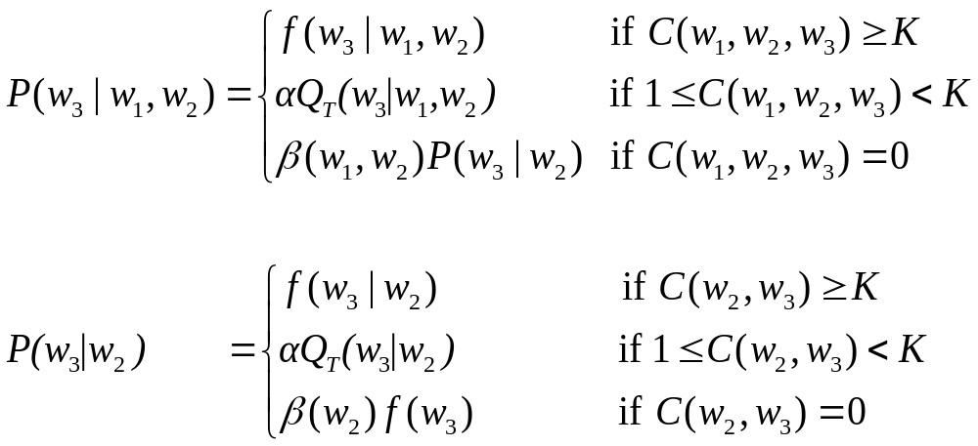
Language Models: Discounting & Back-Off
A Good-Turing back-off model is this (Katz, 1987):
where Q_{T} is a Good-Turing estimate discounting cases in which
the count is between 1 and K, and α and β(·) satisfy both the Good-Turing constraint that the total probability of all unseen events is
n₁/N (Eqn [40]) and the sum of all probabilities of an event is 1.
K is typically 6 or 7
[44]
[45]

Slide 26
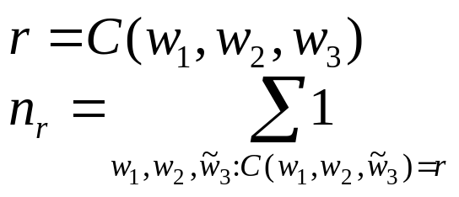
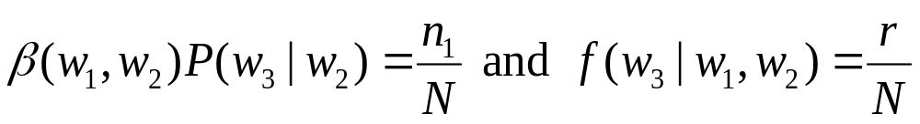
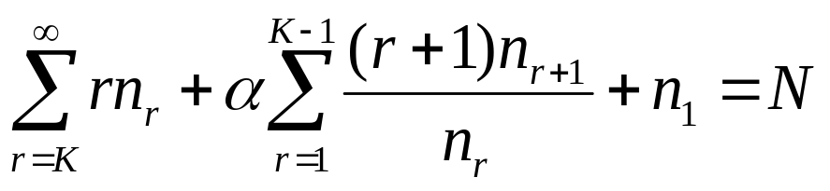
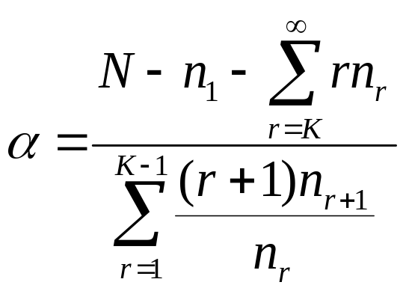
Language Models: Discounting & Back-Off
For [44], Q_{T}(w₃ | w₁, w₂) is the Good-Turing discounting:
Because
and so
[41]
[42]
[43]
total number of trigrams
with count K or greater
Good-Turing estimated
number of trigrams with
count 0 (unseen)
[46]
Good-Turing estimated
number of trigrams with
count 1, 2, … K-1
[47]

Slide 27
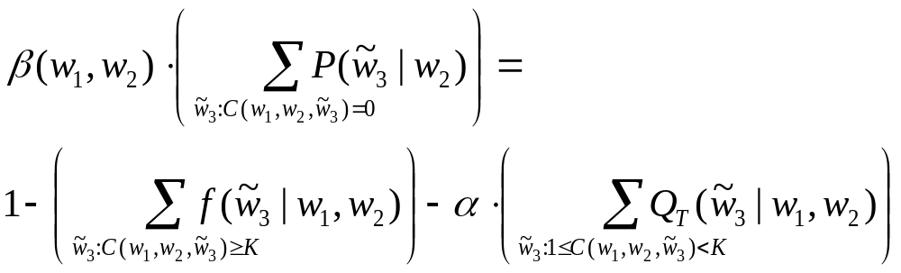
Language Models: Discounting & Back-Off
β(w₁,w₂) is constrained that the sum of all probabilities
P(w₃ | w₁, w₂) must be 1, so
β(w₁,w₂) can therefore be easily computed once P(w₃ | w₂) is known for all w₃.
α and β(w₂) for P(w₃ | w₂) can be determined using the same procedure
[48]

Slide 28
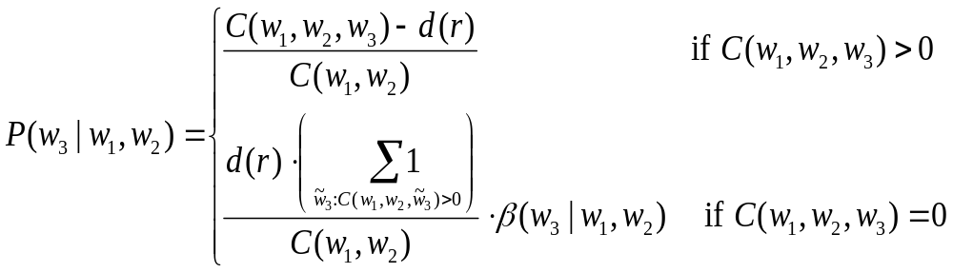
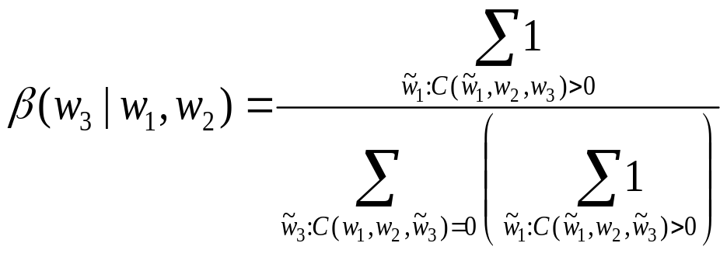
Language Models: Other Discounting/Back-Off Models
Absolute Discounting subtracts a constant from all probabilities with count greater than 0 and distributes it among all probabilities with count equal 0.
A number of forms of absolute discounting. One form
(absolute discounting with Kneser-Ney back-off):
[49]
back-off probability is not
the bigram probability, but
β(w₃|w₁,w₂)
[50]

Slide 29
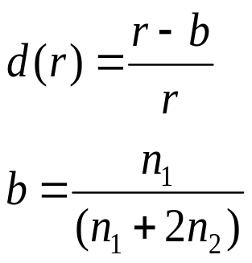
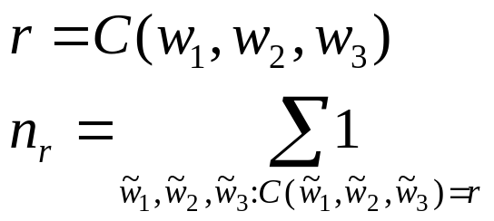
Language Models: Other Discounting/Back-Off Models
The absolute discount d(r) is a constant less than 1 (specific
to each r) that is subtracted from all cases in which
C(w₁, w₂ , w₃) > 0
Many types of discounting and back-off… just a few shown
here
[51]
[52]
[42]
[43]

Slide 30
Language Models: Cache LM
Language models predict text based on (previous) training data.
But text can be specific to one topic, in which case a few words
or word combinations occur frequently.
If our training data consisted of text from computer science but
the document we’re currently recognizing is about language models, P(“model” | “language”) will likely be a back-off probability to unigram P(“model”).
How can we obtain better estimates of P(“model” | “language”)
if this word pair occurs frequently in the current (test) document?
A cache language model interpolates between a static language model based on training data and a dynamic language model based on current words recognized so far.
Assume that size of training data is large, but text is general;
size of words seen so far is small, but text is highly relevant.

Slide 31
Language Models: Cache LM
A cache language model has the form
where P_{static} is the language model (using linear interpolation, Good-Turing back-off, or any other method) with parameters estimated from the large, general training data,
P_{cache} is the language model with parameters estimated from the smaller, specific data seen so far, and
P_{complete} is the final resulting language model that combines both sources of information.
λ is optimized on held-out data using the linear smoothing method
Cache LM has been reported to reduce error rates (e.g. Jelinek, 1991)
[53]

Slide 32
Language Models: Class-Based LM
Category-Based, Class-Based, or Clustering LM improve the number of counts (and therefore the robustness) by grouping words into different classes.
In one case, all relevant words belonging to one category can be clustered into one class. In the language model, the class is treated as a “normal” word.
For example, P(“January” | w₁, w₂) is considered comparable to P(“February” | w₁, w₂) or any other month. Rather than having separate probability estimates for w₁, w₂ followed by each month (some months may not occur at all in the training data), collapse all months into the single class “month_class”, and compute P(“month_class” | w₁, w₂)

Slide 33
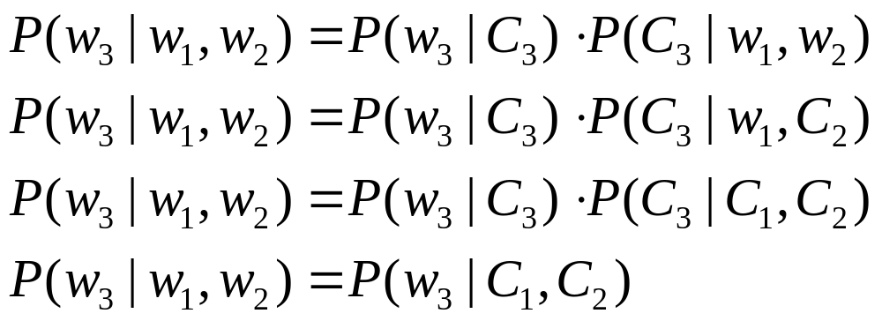
Language Models: Class-Based LM
In another case, all words are assigned to a class (e.g. semantic category or part of speech such as noun, verb, etc.). Then, if C_{i} is the class for word w_{i}, the trigram language model is computed using one of:
Improvement in performance depends on how clustering is done (manually or automatically, semantic categories or part-of-speech categories) and how trigram probabilities are computed (using one of [54] through [57] or some other formula).
[54]
[55]
[56]
[57]

Slide 34

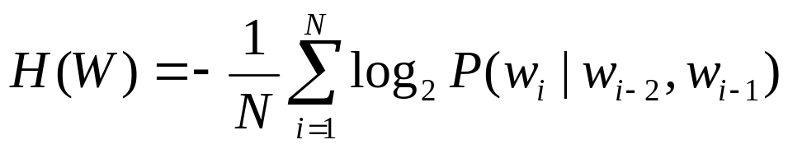
Language Models: Perplexity
How good is a language model? Best way to evaluate is to compare recognizer performance on new data, and measure relative improvement in word error rate.
A simpler method: measure perplexity on a new word sequence W of length N, not seen in training, where perplexity PP is defined as
H(W) can be considered an estimated measure of entropy of the source that is generating the word sequences W.
The perplexity PP can be thought of as the average number of words predicted by the language model.
PP also called “average word branching factor”

Slide 35
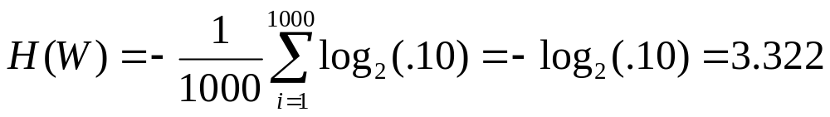

Language Models: Perplexity
For example, a digit recognizer has a vocabulary size of 10 and any digit is equally likely to follow any other digit. Therefore, if we evaluate over a word sequence of length 1000, for each word,
P(w₃ | w₁,w₂)=0.10
If average P(w₃ | w₁,w₂) increases to .20 due to some structure in the sequence of digits, H(W)=2.322 and PP(W)=5
Perplexity measures both the quality of the language model (better language models yield lower PP values on the same data) and the difficulty of the task (harder tasks yield larger PP values).
Reduction in perplexity does not always correspond to reduction in word error rate, but PP is simple and convenient measure.

Slide 36
Language Models: Examples of Language Generation
Example 1 Input: News Item
Microsoft said Tuesday the company would comply with a preliminary ruling by Federal District Court Judge Ronald H. Whyte that Microsoft is no longer able to use the Java Compatibility Logo on its packaging and websites for Internet Explorer and Software Developers Kit for Java.
"We remain confident that once all the facts are presented in the larger case, the court will find Microsoft to be in full compliance with its contract with Sun,” stated Tom Burt, Associate General Counsel for Microsoft Corporation. "We are disappointed with this decision, but we will immediately comply with the Court's order."
Microsoft has been in the forefront of helping developers use the Java programming language to write cutting-edge applications. The company has committed significant resources so that Java developers have the option of taking advantage of Windows features when writing software using the Java language. Providing the best tools and programming options will continue to be Microsoft's goal.
"We will continue to listen to our customers and provide them the tools they need to write great software using the Java language," added Tod Nielsen, General Manager for Microsoft's Developer Relations Group/Platform Marketing.
Example 1 Output: Random News Item, Using as Input a 7th-Order Language Model
Microsoft said Tuesday the court will find Microsoft's goal.
"We will continue to listen to our customers and programming option of taking advantage of Windows features when writing software using the Java Compatibility Logo on its packaging and websites for Internet Explorer and Software using the best tools and programming language. Providing the Java language. Providing the Java programming language to write great software Developers Kit for Java.
"We remain confident that once all the facts are presented in the forefront of helping developers have the option of taking advantage of Windows features when writing software Developers use the Java Compatibility Logo on its packaging and websites for Internet Explorer and Software using the best tools and provide them the tools they need to write cutting-edge applications. The company would comply with this decision, but we will immediately comply with this decision, but we will immediately comply with a preliminary ruling by Federal District Court Judge Ronald H. Whyte that Microsoft is no longer able to use the Java language," added Tod Nielsen, General Manager for Microsoft's goal.
(from http://www.cs.princeton.edu/courses/archive/spring04/cos226/assignments/model.html)

