Slide 1
CSE 552/652
Hidden Markov Models for Speech Recognition
Spring, 2006
Oregon Health & Science University
OGI School of Science & Engineering
John-Paul Hosom
Lecture Notes for May 31, afternoon
Tree-Based Search with Language Models
Grammar-Based Search
Other Approaches to ASR
Final Topics

Slide 2
Tree-Based Search with Language Models
When using a tree-based search, the word identity is not known until a leaf node in the tree is reached.
When using a language model during Viterbi search, δ_{t}(j) is multiplied by P(word_{n} | word_{n-2}, word_{n-1}) when the transition from best previous state i to current state j is a word transition.
We can perform this multiplication at any time while the Viterbi search is within a word. So, in a tree search, we can add in the language model when we reach the leaf node of the tree.
f
t
er (after)
ae
l
ih
s (alice)
d
ae
n (dan)
dh
ih
sh
ih
z (dishes)
k
n
er (dinner)
l
ax (the)
w
aa
r (car)
ah
n
ch (lunch)
aa
sh
t (washed)

Slide 3
Tree-Based Search with Language Models
When using a beam search, we don’t keep track of all paths through the state network, only those paths that have a high likelihood of success.
When using a tree-based search with a language model and beam search, we have conflicting requirements: Beam search wants to prune unlikely paths at time t, language model wants delay until end of word is reached (and word is known).
Solution: use Language-Model Look-Ahead
Examples here will use bigram LM for simplicity, but token-passing can be used to keep track of word history leading to a state.
Basic idea: at each node in the tree, add in as much of the LM information as possible, based on the remaining word possibilities.

Slide 4
Tree-Based Search with Language Models
Example: Given the following lexical tree:
f
t
er (after)
l
ih
s (alice)
ae
ae
n (dan)
d
ih
sh
ih
z (dishes)
n
er (dinner)
dh
ax (the)
w
aa
sh
t (washed)
in practice, only need one null state, but two
is used here for better visualization

Slide 5
Tree-Based Search with Language Models
Example: Given the following subset of LM probabilities:
    p(after | <BEG>) = 0.3
    p(alice | dinner) = 0.4
    p(after | after) = 0.05
    p(alice | after) = 0.2
    p(dan | after ) = 0.2
    p(dishes | after) = 0.05
    p(dinner | after) = 0.4
    p(the | after ) = 0.05
    p(washed | after) = 0.05
    p(dishes | the) = 0.9
    p(dan | dinner) = 0.4
    p(washed | dan) = 0.5
    p(washed | alice) = 0.5
    p(the | washed) = 0.3
In this example, assume that the best state prior to the null node(s) at time t is the /er/ state in the word “after”.
Continue the search starting at the top of the tree, and include the language model information given that the previous word is “after”.
sum is 1.0

Slide 6
Tree-Based Search with Language Models
At each node in the tree, the LM probability at a node is the maximum of the leaf-node LM probabilities for each branch divided by the maximum (numerator) from the previous node. The LM probabilities at each node are then multiplied together.
.05/.20
.05/.05
.05/.05
0.05
f
t
er (after)
.20/.20
.20/.20
.20/.40
0.2
l
ih
s (alice)
ae
.20/.40
.40/.40
0.2
ae
n (dan)
.40/.40
.05/.40
d
.05/.05
0.05
ih
sh
ih
z (dishes)
.40
.40/.40
.40/.40
0.4
n
er (dinner)
.05/.40
.05/.05
0.05
dh
ax (the)
.05/.40
.05/.05
.05/.05
.05/.05
0.05
w
aa
sh
t (washed)

Slide 7
Tree-Based Search with Language Models
At each node in the tree, the LM probability at a node is the maximum of the leaf-node LM probabilities for each branch divided by the maximum (numerator) from the previous node. The LM probabilities at each node are then multiplied together.
.25
1.0
1.0
0.05=.4×.5×.25×1×1
f
t
er (after)
1.0
1.0
.50
0.2=.4×.5×1×1×1
l
ih
s (alice)
ae
.50
1.0
0.2=.4×1×.5×1
ae
n (dan)
1.0
.125
0.05=.4×1×1×.125×1×1
d
1.0
ih
sh
ih
z (dishes)
.40
1.0
1.0
0.4=.4×1×1×1×1
n
er (dinner)
.125
1.0
0.05=.4×.125×1
dh
ax (the)
.125
1.0
1.0
1.0
0.05=.4×.125×1×1×1
w
aa
sh
t (washed)

Slide 8
Tree-Based Search with Language Models
With this method, we add in as much of the LM information as we can, as early as we can. Provides balance for LM and beam-search pruning.
What is the cost? When at the root of a tree at time t, we must find all of the LM probabilities for all words in the vocabulary given the best prior word(s). (If we could wait until word end before applying LM, we would find LM probabilities only for words that survived the pruning.) At each node, we must store the information indicated on slide 7 for each time t.
A number of simplifications can be made in implementation to reduce overhead.
Language-model look-ahead maintains accuracy gained by language model while reducing search time via beam search and lexical tree.

Slide 9
Grammar-Based Search
Aside from the lexical tree with one-pass Viterbi search, the other common framework is a grammar-based Viterbi search when the task belongs to a restricted domain (e.g. finding lost luggage at an airline) or the second pass in a large-vocabulary system.
Three standards have been developed for grammar-based search:
  1. XML (developed by WWW Consortium or W3C, contributions by Bell Labs, Nuance, Comverse, ScanSoft, IBM, Hewlett-Packard, Cisco, Microsoft)
  2. ABNF (Augmented BNF, developed by W3C)
  3. SALT (developed by Microsoft, supported by Cisco Systems, Comverse, Intel, Philips, Scansoft )
The ABNF form will be summarized here, because it’s the simplest to develop from the programmer’s point of view and mappable to/from XML.
Based on documentation “Speech Recognition Grammar Specification Version 1.0”, http://www.w3.org/TR/speech-grammar

Slide 10
Grammar-Based Search
ABNF is composed mostly of context-free grammar rules.
A rule definition begins with a rule name, is delimited by “=” between the rule name and rule expansion, and ends with a “;”
A rule name within a rule expansion may be local (prefixed with ‘$’) or external (specified via uniform resource identifier, or URI).
Rule expansion symbols:
  Dollar sign ('$') and angle brackets ('<' and '>') when needed mark rule references (references to rule names)
  Parentheses ('(' and ')') may enclose any component of a rule expansion
  Vertical bar ('|') delimits alternatives
  Forward slashes ('/' and '/') delimit any weights on alternatives
  Angle brackets ('<' and '>') delimit any repeat operator
  Square brackets ('[' and ']') delimit any optional expansion
  Curly brackets ('{' and '}') delimit any tag
  Exclamation point ('!') prefixes any language identifier

Slide 11
Grammar-Based Search
Rule Examples:
  $date = ([$weekday] $month $day) | $weekday | the $day ;
  $day = first | second | third | … | thirty_first ;
  $time = $hour $minute [$ampm] ;
  $favoriteFoods = /5.5/ ice cream | /3.2/ hot dogs | /0.2/ lima beans ;
  $creditcard = ($digit) <16> ;
  $UStelephone1 = ($digit)<7-10> ;
  $UStelephone2 = ($digit <7>) $digit <0-3 /0.4/> ;
  $international = ($digit)<9-> ;
  $localRule = $<GlobalGrammarURI.gram#rule2> |
  $<GlobalGrammarURI.gram#rule7> ;
  $rule = $word {this is a tag; it does not affect word recognition} ;
  $yes = yes | oui!fr | hai!ja ;
a weight (not necessarily a probability)
40% probability of recurrence
tags may be used to affect subsequent semantic processing after words are identified
language specification determines expected pronunciation of word.

Slide 12
Grammar-Based Search
A set of grammar rules is contained in a grammar document
Example document declarations:
#ABNF 1.0 ISO-8859-1;
language en-US;
mode voice;
root $rootRule;
base <http://www.cslu.ogi.edu/recog/base_path>;
lexicon <C:\users\hosom\recog\generalpurpose.lexicon>;
lexicon <http://www.cslu.ogi.edu/recog/otherwords.lexicon>;
// this is a comment;
/** this is another comment; grammar rules go after this line **/
header identified by #ABNF …
language keyword followed by a
valid language identifier
mode is either ‘voice’ or ‘dtmf’
name of top-level rule
relative URIs are relative to this base
location(s) of one or more
lexicons (pronunciation
dictionaries)

Slide 13
Grammar-Based Search
A rule in one document can reference one or more rules in other documents via URI specification. So, an entire grammar may be composed of numerous files (documents), one file for a specific task (e.g. time or date).
tokens (terminal symbols used in rules) may take a number of forms:
  form example
  single unquoted token yes
  single non-alphabetic unquoted token 3
  single quoted token with white space “New Years Day”
  single quoted token, no white space “yes”
  three tokens separated by white space december thirty first

Slide 14
Other Approaches to ASR: Segment-Based Systems
SUMMIT system
  developed at MIT by Zue, Glass, et al.
  competitive performance at phoneme classification
  segment-based recognition:
  (a) segment the speech at possible phonetic boundaries
  (b) create network of (sub-)phonetic segments
  (c) classify each segment
  (d) search segment probabilities for most likely
  sequence of phonetic segments
  complicated

Slide 15
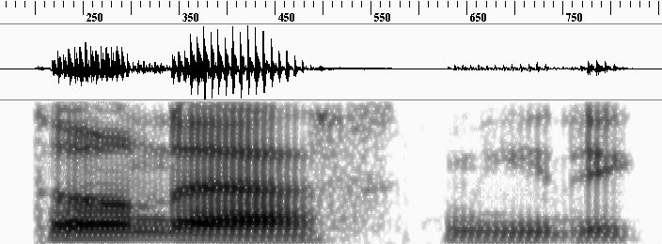
Other Approaches to ASR: Segment-Based Systems
SUMMIT system: dendrogram
ih
.pau
spectral change
ae
.pau
ow
s
kcl
d
n
dx
m
iy
segment network can also be created using
“segmentation by recognition”

Slide 16


Other Approaches to ASR: Segment-Based Systems
segment-based recognition:
(a) segment the speech at possible phonetic boundaries
(b) create network of (sub-)phonetic segments
(c) classify each segment
(d) search segment probabilities for most likely
sequence of phonetic segments
  (a,b) segmentation by recognition (A* search)
m
aa
kc
k
ao
f
pau
n
ah
r
tc
t
ah
f
m
ao
tc
t
ah
v
pau

Slide 17
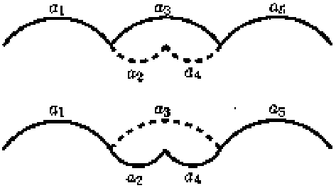
Other Approaches to ASR: Segment-Based Systems
(c) classification
classify each segment (not frame-by-frame) using
information throughout segment:
□ MFCC and energy averages over each segment third,
□ feature derivatives at segment boundaries,
□ segment duration,
□ number of boundaries within segment.
(d) search
Viterbi search through segments to determine best
sequence of segments (phonemes). Search is
complicated by the fact that must consider all possible
segmentations, not just hypothesized segmentation

Slide 18
Other Approaches to ASR: Segment-Based Systems
Feature system
  developed at CMU by Cole, Stern, et al.
  competitive performance at alphabet classification
  segment-based recognition of a single letter:
  (a) extract information about signal, including
  spectral properties, F0, energy in frequency bands
  (b) locate 4 points in utterance:
  beginning of utterance, beginning of vowel,
  offset of vowel, end of utterance
  (c) extract 50 features (from step (a) at the 4 locations)
  (d) use decision tree to determine the probabilities
  of each letter
  fragile: errors in feature extraction & segmentation can not
  be recovered from

Slide 19
Other Approaches to ASR: Segment-Based Systems
  Determine letter/digit boundaries using HMM/ANN
  hybrid (can only recover from substitution errors)
  For each hypothesized letter/digit:
  (a) locate 4 points in word:
  beginning of word, beginning of sonorant,
  offset of sonorant, end of word
  (b) extract information at segment boundaries and
  some points within sonorant region:
  PLP features, zero crossings, peak-to-peak
  amplitude
  (d) use ANN to classify these features into 37 categories
  (26 letters + 11 digits)
  Telephone-band performance of almost 90%; recent HMM
  performance of just over 90%.

Slide 20
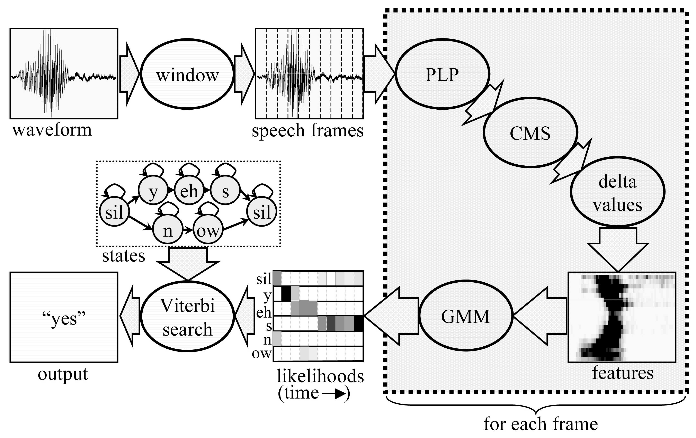
Other Approaches to ASR: Stochastic Approaches
includes HMMs and HMM/ANN hybrids

Slide 21
Other Approaches to ASR: Stochastic Approaches
HMM/ANN hybrids (ICSI, CSLU, Cambridge)
Technique:
Same as “conventional” HMM, except:
(1) Replace GMM with ANN to compute observation
probabilities
(2) Divide by prior probability of each class
Why?
  ANNs compute posterior probabilities, if certain conditions
  are met. (Duda & Hart, Richard & Lippmann, Kanaya & Miyake, several others)
  Criteria are: Sufficient number of hidden nodes, sufficient training data, Mean Square Error criterion, etc.
M.D. Richard and R.P. Lippmann, “Neural Network Classifiers Estimate Bayesian a posteriori Probabilities”, in Neural Computation, vol. 3, no. 4, pp. 461-483, Winter 1991.

Slide 22
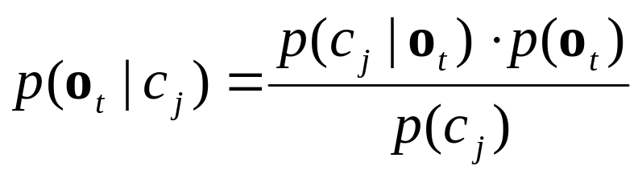
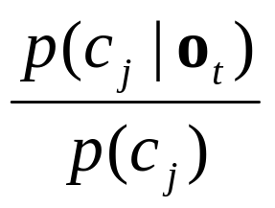
Other Approaches to ASR: Stochastic Approaches
From Duda & Hart, ANNs compute: p(c_{j} | o_{t})
HMMs use observation probabilities: p(o_{t} | c_{j})
From Bayes’ rule:
Because p(o_{t}) is constant for all c_{j},
represents an “unnormalized” probability of p(o_{t} | c_{j})

Slide 23
Other Approaches to ASR: Stochastic Approaches
Training HMM/ANN Hybrids:
Generate file containing feature vectors and an index that indicates
which phonetic class that feature vector belongs to
y = 0 | 1.3683 0.1457 0.5452 2.0481 -0.8259 -0.4031 0.3692
eh = 1 | 3.0426 0.1099 1.2919 2.1857 -0.4413 -1.0909 0.3264
eh = 1 | 5.3509 0.2897 0.5094 1.6424 -0.6084 -2.3583 -0.5751
s = 2 | 0.9681 -0.1542 0.5258 1.2331 -1.0927 0.0814 0.0010
s = 2 | 0.5631 -0.3687 -0.0673 1.2241 -0.8383 0.3568 0.4660
s = 2 | 0.4657 -0.2397 -0.1751 0.6767 -0.3046 -0.3644 -0.1815
n = 3 | 1.2530 0.3205 0.1580 1.1840 0.9955 -0.0059 -0.6327
ow = 4 | 0.9776 -0.4696 1.2784 -0.6718 -0.9155 0.4597 1.1991
ow = 4 | 0.9887 -0.5269 -0.4586 0.0737 -0.1736 -0.0761 0.0152
ow = 4 | 1.2904 -0.2140 -0.9214 -0.5846 -0.6672 0.9754 -0.4610
pau = 5 | -2.6802 -0.5717 -0.0185 -0.4478 0.3059 0.2253 -0.1106
pau = 5 | -2.2165 -0.4182 -0.0946 0.0667 0.2572 0.4710 -0.1685
index
PLP coefficients (or MFCC, with/without delta)

Slide 24
Other Approaches to ASR: Stochastic Approaches
Train a neural network on each of the feature vectors, with the
target value 1.0 for the associated phonetic class and 0.0 for all
other classes. The network may be feed-forward (OGI, ICSI)
or recurrent (Cambridge). Usually fully-connected, trained using
back-propagation.
0.0 0.0 1.0 0.0 0.0 0.0
y eh s n ow pau
PLP0 PLP1 PLP2 PLP3 PLP4 PLP5 PLP6
0.5631 -0.3687 -0.0673 1.2241 -0.8383 0.3568 0.4660

Slide 25
Other Approaches to ASR: Stochastic Approaches
During recognition, present the network with a feature vector,
and use the outputs as a posteriori probabilities of each class:
0.03 0.12 0.01 0.02 0.81 0.00
y eh s n ow pau
PLP0 PLP1 PLP2 PLP3 PLP4 PLP5 PLP6
1.2904 -0.2140 -0.9214 -0.5846 -0.6672 0.9754 -0.4610
Then, divide each output by the a priori probability of that class:
y=0.03/0.08, eh=0.12/0.17, s=0.01/0.25, n=0.02/0.08, ow=0.81/0.25, pau=0.0/0.17
to arrive at the observation probabilities, e.g. p_{ow}(o_{t}) = 3.24
(These values are scaled probabilities; multiplying by p(o_{t}) would
yield p(o_{t} | “ow”))

Slide 26
Other Approaches to ASR: Stochastic Approaches
Instead of dividing by the a priori likelihoods, the training process may be modified to output estimates of p(c_{j} | o_{t}) / p(c_{i}) (Wei and van Vuuren, 1998).
The training process requires that each feature vector be associated with a single phoneme with a target probability of 1.0. Training an ANN takes longer than training a GMM (because one feature vector affects all outputs).
Therefore, training of HMM/ANN hybrids is typically performed on hand-labeled or force-aligned data, not using the forward-backward training procedure. However, there are methods for incorporating forward-backward training into HMM/ANN recognition (e.g. Yan, Fanty, Cole 1997).

Slide 27
Other Approaches to ASR: Stochastic Approaches
Advantages of HMM/ANN hybrids:
  Input features may be correlated
  Discriminant training
  Fast execution time
Disadvantages of HMM/ANN hybrids:
  Long training time
  Inability to “tweak” individual phoneme models
  Relatively small number of output categories possible
  (approx. 500 max.)
Performance:
Comparable with HMM/GMM systems…
Slightly better performance on “smaller” tasks such as phoneme or digit recognition, slightly worse performance on large-vocabulary tasks.

Slide 28
Why Are HMMs Dominant Technique for ASR?
  Well-defined mathematical structure
  Does not require expert knowledge about speech signal
  (more people study statistics than study speech)
  Errors in analysis don’t propagate and accumulate
  Does not require prior segmentation
  Temporal property of speech is accounted for
  Does not require a prohibitively large number of templates
  Results are usually the best or among the best

Slide 29
Large-Vocabulary Continuous Speech Recognition Techniques
Many non-commercial large-vocabulary systems are used solely for research, development, and competition (“bake off”).
As such, some constraints required in commercial systems are relaxed. These non-commercial systems have time requirements on the order of 300 times real-time, do not generate output until the input has been processed completely several times, and have high memory requirements.
A typical structure is a two-pass system. The first pass uses simple acoustic models on a large vocabulary size to generate a “word lattice” of possible N-best word outputs.
The second pass uses more detailed (and time-consuming) acoustic models but restricts the vocabulary size to only the words recognized in the first pass. Speaker adaptation may be performed on the acoustic models.
The second pass may output the 1-best or N-best sentences

Slide 30
Large-Vocabulary Continuous Speech Recognition Techniques
Here, acoustic model #1 units may be context-dependent only within words, whereas acoustic model #2 uses all triphones.
The tree search is on a large vocabulary size (e.g. 64,000 words),
while the grammar search is on only the output from first pass.
acoustic
model #1
acoustic
model #2
input
first-pass N-best
recognition
(tree search)
N-best words
second-pass
recognition
(grammar search)
output

Slide 31

Evaluation of System Performance
Accuracy is measured based on three components:
word substitution, insertion, and deletion errors
accuracy = 100 – (sub% + ins % + del %)
error = (sub % + ins % + del %)
Correctness only measures substitution and deletion errors
correctness = 100 – (sub % + del %)
insertion errors not counted… not a realistic measure
Improvement in a system is commonly measured using relative reduction in error:
where error_{old} is the error of the “old” (or baseline) system,
and error_{new} is the error of the “new” (or proposed) system.

Slide 32
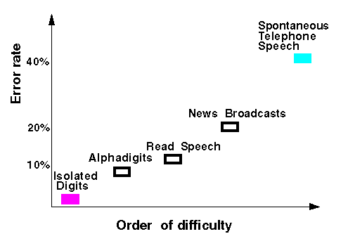
State of the Art
State-of-the-art performance depends on the task…
Broadcast News: ~90%
Phoneme recognition (microphone speech): 74% to 76%
Connected digit recognition (microphone speech): 99%+
Connected digit recognition (telephone speech): 98%+
Speaker-specific continuous-speech recognition systems:
(Naturally Speaking, Via Voice): 95-98%
(from ISIP,1998)

Slide 33
State of the Art
A number of DARPA-sponsored competitions over the years has led to decreasing error rates on increasingly difficult problems
100%
Read
Speech
Conversational
Speech
Structured
Speech
Spontaneous
Speech (2-3k)
20k
Broadcast
Speech
Varied
Microphones
19%
Noisy
Speech
Word Error Rate (log scale)
10%
5k
1k
Noisy
human speech recognition
of Broadcast Speech (0.9%WER)
2.5%
1988 1989 1990 1991 1992 1993 1994 1995 1996 1997 1998 1999 2000 2001 2002 2003
1%

Slide 34
State of the Art
We can compare human performance against machine performance (from 1997, except last two tasks):
Task Machine Error Human Error
Digits 0.72% 0.009% (80)
Letters 9.0% 1.6% (6)
Transactions 3.6% 0.10% (36)
Dictation 7.2% 0.9% (8)
News Transcription 10% 0.9% (11)
Conversational
Telephone Speech 19% 5% (4)
Approximately an order of magnitude difference in performance for systems that have been developed for these particular tasks/environments… performance worse for noisy and mismatched conditions
Lippmann, R., “Speech Recognition by Machines and Humans,” Speech Communication, vol. 22, no. 1, 1997, pp. 1-15.

Slide 35
Summary: Topics Covered
HMMs:
Discrete
Semi-Continuous
Continuous
Hybrid (HMM/ANN)
Semi-Markov Model (and other names)
Search:
Viterbi
Two-Level
Level-Building
Beam Search
A* Search
Tree Search
Grammar Search
On-Line Processing

Slide 36
Summary: Topics Covered
Features:
PLP
MFCC
CMS
Rasta
delta
delta-delta
State Representations:
N States per Word
Monophone
Biphone/Diphone
Triphone
N States per Phoneme
Null States

Slide 37
Summary: Topics Covered
State Connections:
Left-to-Right
Ergodic
T-Model
State Tying
Observation Probability Estimation:
Vector Quantization (VQ)
Gaussian Mixture Models (GMMs)
Artificial Neural Networks (ANNs)
Language Model:
Trigram
Bigram
Unigram
Linear Smoothing
Discounting and Back-Off

Slide 38
Other
Additional Speech-Related Courses:
CSE 550 / 650 Spoken Language Systems (Summer 2006)
Review the state of the art in building spoken language systems; gain hands-on experience using toolkits for building such systems; learn the technologies needed for robust parsing, semantic processing, and dialogue management
CSE 551 / 651 Structure of Spoken Language (Fall 2006)
This course presents some of what is known about speech in terms of phonetics, acoustic-phonetic patterns, and models of speech perception and production. Understand how speech is structured, acoustic cues, and how this information may be relevant to automatic speech recognition or generation.
CSE 553 / 653 Speech Synthesis (Winter 2007)
Introduction to the problem of synthesizing speech from text input. This course considers current approaches to sub-problems such as text analysis, pronunciation, linguistic analysis of prosody, and generation of the speech waveform.
CSE 562 / 662 Natural Language Processing (Winter 2007)
An introduction to artificial intelligence techniques for machine understanding of human language. The course introduces key aspects of natural language, along with the analyses, data structures and algorithms developed for computers to understand it. Computational approaches to phonology, morphology, syntax, semantics and discourse are covered.

