Slide 1
Human Factor Cepstral Coefficients: Biological Inspiration + Engineering = Noise-robust Speech Features
Mark D. Skowronski and John G. Harris
Computational Neuro-Engineering Lab
University of Florida
Gainesville, FL, USA

Slide 2
Outline
Speech Recognition: Man vs Machine
Bottleneck: Noise Robustness
MFCC: Details & Shortcomings
Biologically Inspired Filter Bank
Experiment and Results
Conclusions

Slide 3
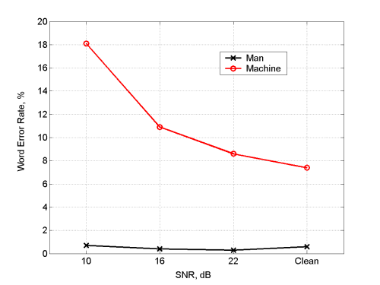
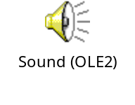
Speech Rec: Man v Machine
Example of Read Speech:
AWGN:
10 dB SNR
Wall Street Journal/Broadcast news readings
Untrained human listeners vs Cambridge HTK LVCSR system

Slide 4
Test/Train Mismatch
Solution approaches:
Add noise to train data
Warp clean models to noisy feature space
Warp noisy features to noise-free models
Extract linguistic information from speech invariant to additive noise.

Slide 5
What Features?
Start with mel frequency cepstral coefficients (mfcc)
Most widely used speech features
  Uncorrelated features: diagonal covariance matrices for each HMM state.
  Distributions modeled by Gaussian mixtures.
  Cepstral Mean Subtraction: removes static convolved noise (channel).
  Superior noise robustness vs Linear Prediction Coefficients.

Slide 6
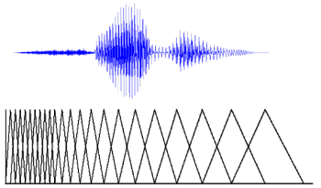
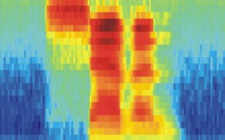
MFCC Algorithm
MFCC--the most widely-used speech feature extractor.
“seven”
x(t)
F
Mel-scaled filter bank
Log energy
DCT
Cepstral domain
Filter #
Time

Slide 7
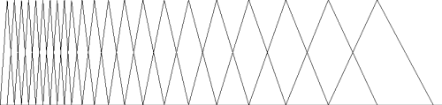
MFCC Shortcomings
Design parameters: FB freq range, number of filters.
Center freqs equally-spaced in mel frequency.
Triangle endpoints set by center freqs of adjacent filters.
Although filter spacing is determined by perceptual mel frequency scale, bandwidth is set more for convenience than by biological motivation.

Slide 8

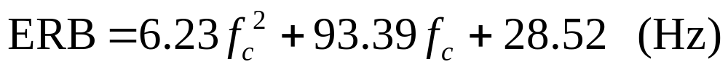
Human Factor Cepstral Coefficients
Decouple filter bandwidth from filter bank design parameters.
Set filter width according to the critical bandwidth of the human auditory system.
Use Moore and Glasberg approximation of critical bandwidth, defined in Equivalent Rectangular Bandwidth (ERB).
f_{c} is critical band center frequency (KHz).

Slide 9
ASR Experiments Review
Isolated English digits “zero” through “nine” from TI-46 corpus, 8 male speakers,
HMM word models, 8 states per model, diagonal covariance matrix,
Control: Davis and Mermelstein (D&M) original algorithm,
Linear ERB scale factor.

Slide 10
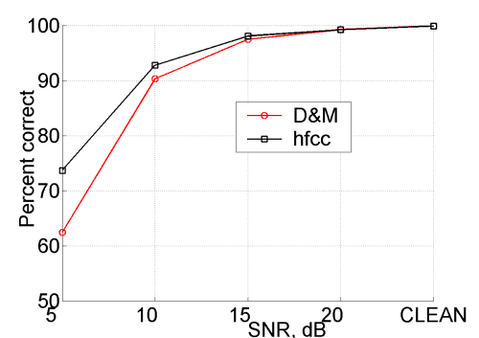
ASR Results
White noise (local SNR), hfcc vs D&M, averaged over 10 trials of random test/train speakers.

Slide 11
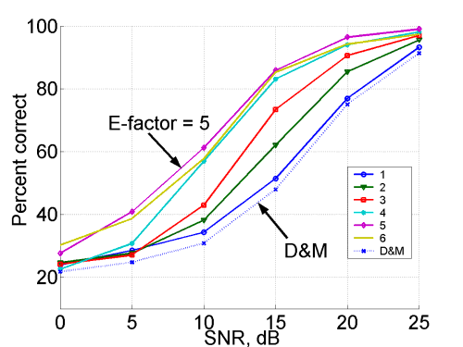
ASR Results
White noise (global SNR), hfcc vs D&M, Linear ERB scale factor (E-factor).

Slide 12
Conclusions
Novel modification to existing successful speech front end.
  Decouples bandwidth from filter bank design parameters.
  Allows for optimization of bandwidth.
Demonstrated 7 dB SNR increase over control in isolated English digit recognition.
Simple modification to filter bank: easy to upgrade existing mfcc algorithms.

