Slide 1
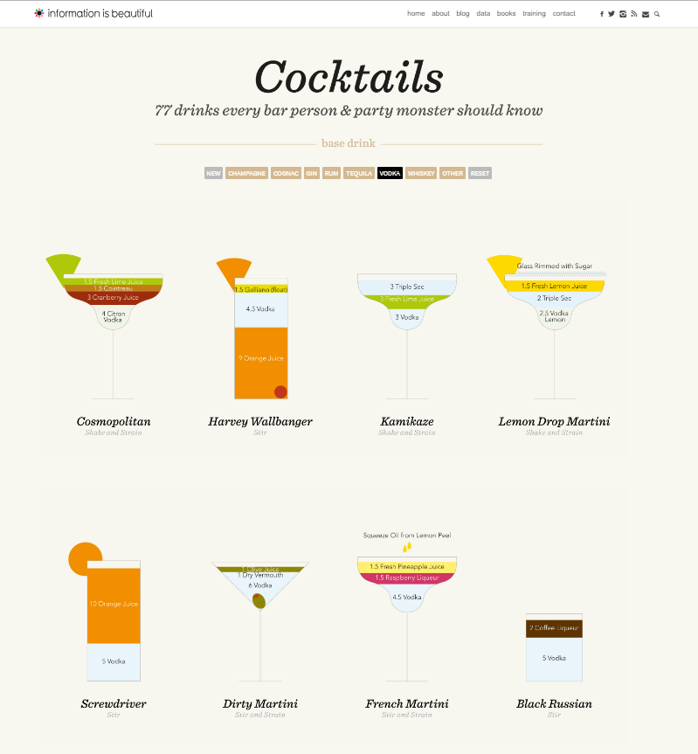
UM02 - Visualization
Title : Cocktails
Headline : 77 drinks every bar person & party monster should know
Ink ratio OK, Duck YES, Lie factor not OK
Component | Variable | O. level | Lenght
Cocktail | X,Y | Selective | 77
Ingredient | Color | Associative | (a lot)
Emphasis | Color | Selective | 2
Glass | Shape | Selective | 4
Quantity ingredient | Size | Quantity | (a lot)

Slide 2
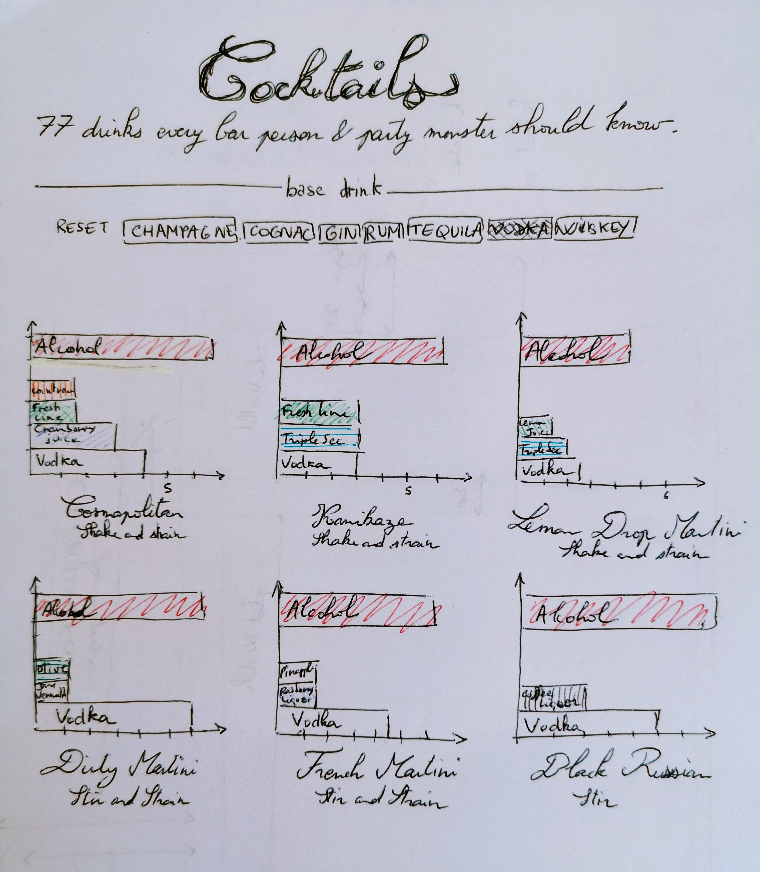
Re-visualization

