Slide 1
UM02 - Visualizations
Fake News of 2017
Senseless - Conflict Death per Hour
Extreme global warming solutions currently on the table
When Sea Levels Attack!
More wildfires than ever

Slide 2
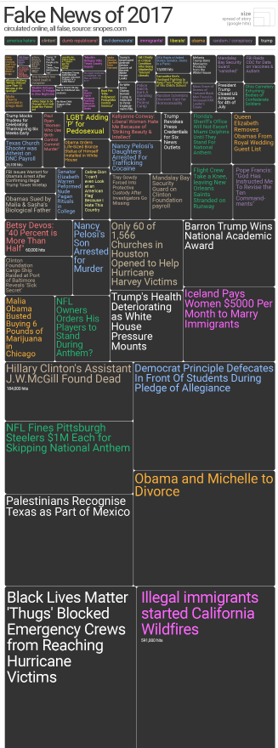
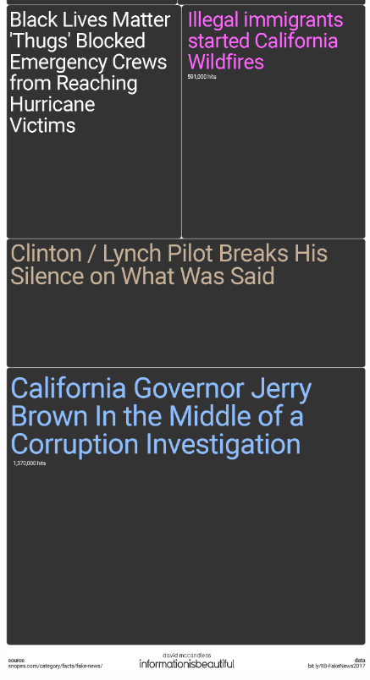
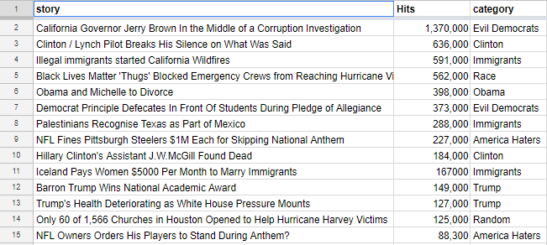
Fake News of 2017
https://informationisbeautiful.net/visualizations/biggest-fake-news-of-2017/
Visualization and
original data
<numéro>

Slide 3
Fake News of 2017
Try to visualize the most important fake news during 2017. More the fake news is important more the square is big. There are different color for the different theme, they are recap at the beginning of the visualization. I think we can understand clearly which fake news is the most important but not which theme.
Pros:
good looking as compared to original data
color for the theme
Cons:
visualization is very big. It’s not possible to see the entirety at once. If you try, it’s not possible to read the smallest fake news
it’s difficult to know which theme is the most important
<numéro>

Slide 4
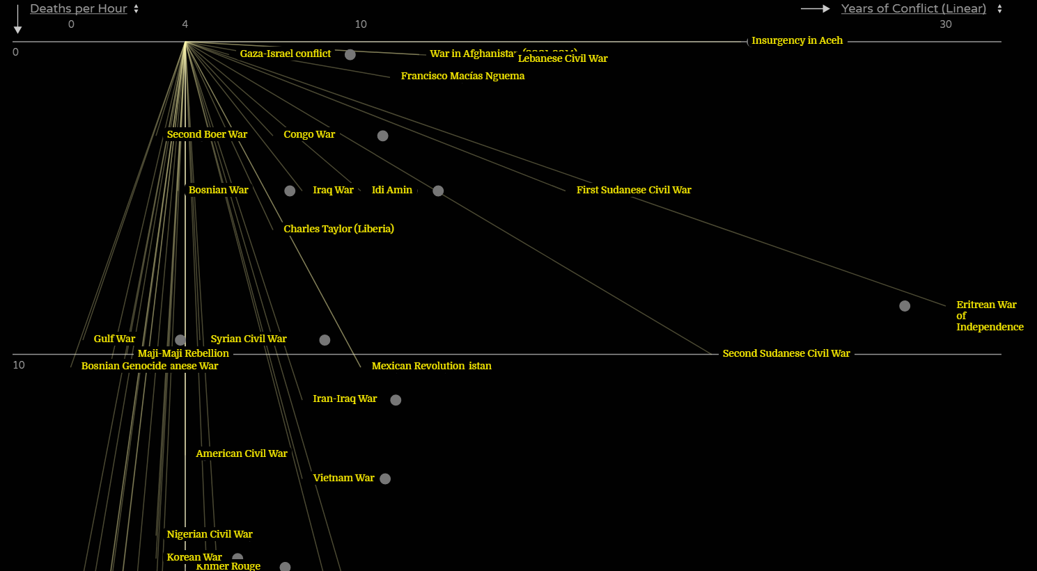
Senseless - Conflict Death per Hour
https://informationisbeautiful.net/visualizations/senseless-conflict-deaths-per-hour/
<numéro>

Slide 5
Senseless - Conflict Death per Hour
Try to visualize the number of death per hour for the most important conflicts on earth. The graph contains another information: the length of the conflict in order to understand if there is a lot of death in a small or big period of time. When you click on the dot, you can see an short explanation and the total of death during the conflict. Therefore, there are many informations (may be to much)
Pros: Nice visualization like constellation and many information
Cons: Difficult to understand at the first look because there are many information and different parameters possible on each axis. For example: if the lines begin at 4 it’s because it’s correspond to the average conflict lenght. But I don’t really understand the purpose and interest to connect all the dot. I think the line aren’t a smart move and add misunderstanding.
<numéro>

Slide 6
Senseless - Conflict Death per Hour : Redesign
Use the same axis (Y: death per hours, X: Years of conflicts)
Remove the lines
Use a system of color scale for the Total death: there are conflict far from each other on the graph (because of different duration) but with the same amount of death. It would be interesting to link them using a same color. (There is no degrade of color in the picture because I only have 4 pens...)
<numéro>

Slide 7
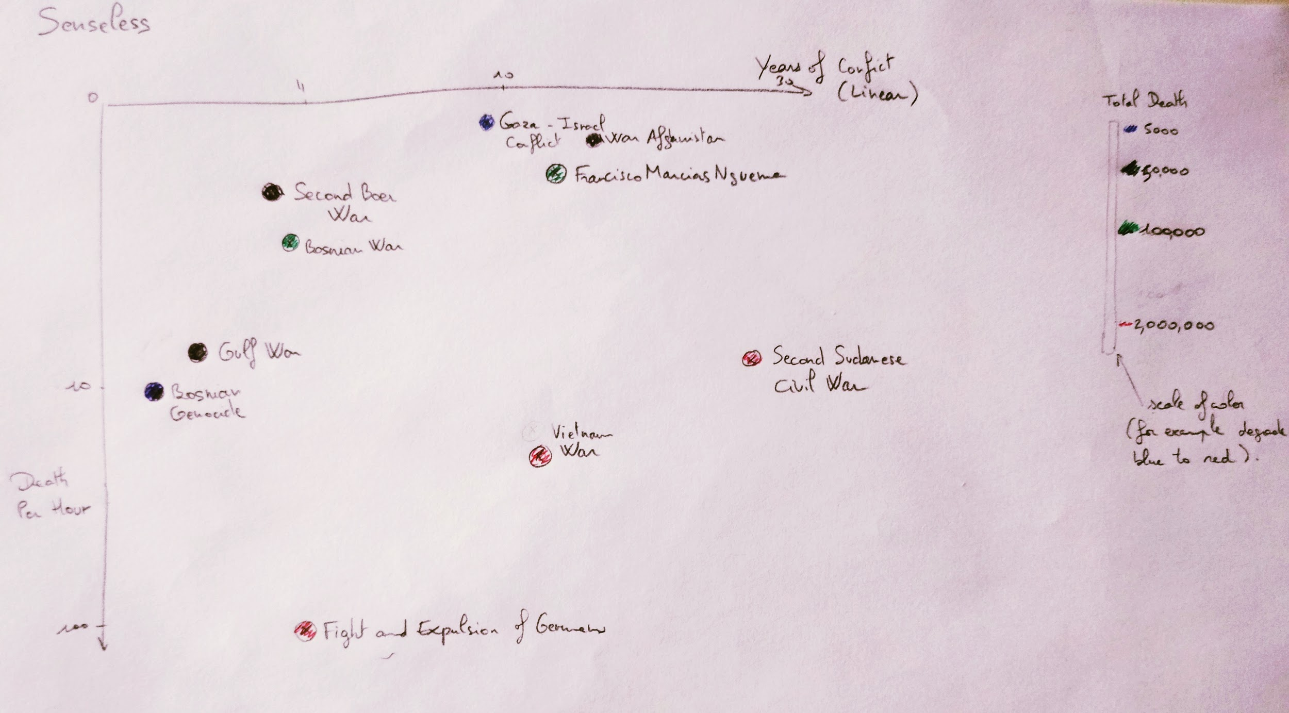
<numéro>

Slide 8
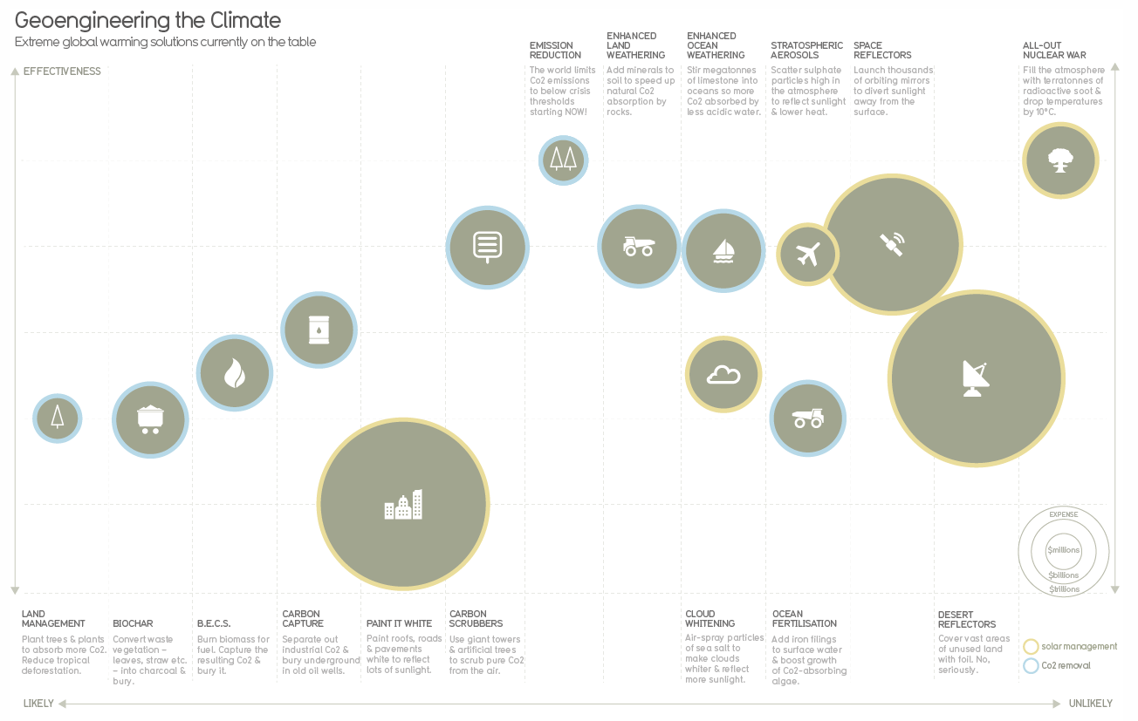
Extreme global warming solutions currently on the table
https://informationisbeautiful.net/visualizations/extreme-global-warming-solutions-currently-on-the-table/
<numéro>

Slide 9
Extreme global warming solutions currently on the table
There are four information about the solution on the graph: Effectiveness, likely or unlikely to happen, the expense and if it’s a solar management or CO2 removal solution (yellow or blue). I think the highlight information is the expense because the first thing we see is the size of the circle. After we take a look at the color and the location of the circle.
Pros:
There are many information but the datavisualization is really readable
Several ways of reading: which kind of solution (CO2 removal or solar) cost the most / are the most likely / are the most effective
Cons:
No quantification for effectiveness and likely/unlikely. We don’t know on what it’s based. But if this information are added may be the graph will be less readable
<numéro>

Slide 10
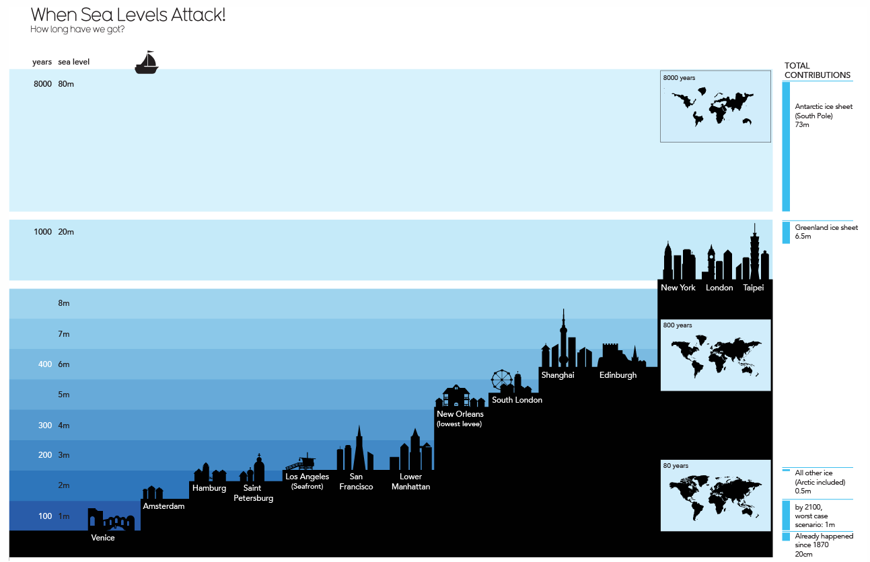
When Sea Levels Attack!
https://informationisbeautiful.net/visualizations/when-sea-levels-attack-2/
<numéro>

Slide 11
When Sea Levels Attack!
The goal of this data visualization is to show the consequences of the sea level rise: if the sea level increases by 1 meters then Venice will be under water. For each increase matches with a amount of years ( 1m -> 100 years). But we don’t really know how the connection is made, if it’s link or not at your current way of life. It will be interesting to have the different years/ sea level according to global warming scenario (+1,5 °C, +2°C, +3°C...).
Pros:
The visualization is very explicit, for each increase we are seeing exactly which town will be underwater
small maps resume the all situation on earth
Cons:
we don’t understand how the total contributions list is organized.
how the connection is made between years and sea level?
<numéro>

Slide 12
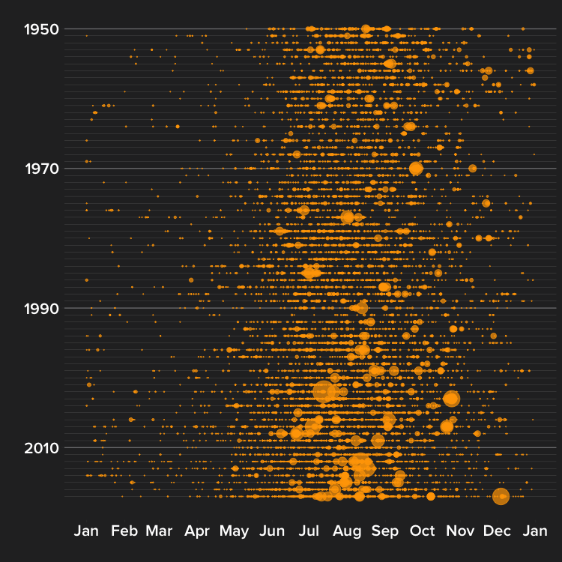
More wildfires than ever
https://flowingdata.com/2018/08/16/more-wildfires-than-ever/
<numéro>

Slide 13
More wildfires than ever
The visualization shows that there is more and more wildfires (in California) over the years and mostly during the summer. There is no scale on the graph so I assume the size of the mark is in connection with the number of fire at this period. Nevertheless the size of the mark could also be link with the size of the fire.
Pros:
Readable
Allow us to know in which period of the years the are most of the fire and not only the augmentation of the fire
Cons:
lack of information, there is no scale and explanation for the size of the dot.
<numéro>

