Slide 1
Model Selection & Evaluation

Slide 2
Model Selection
XGBoost regression model selection,
Model can handle missing values
Model can capture non-linear relationships. (Helps to capture any sales trends, seasonality if required.)
Model can be used for short-term forecasting . (e.g. 7 days)
Supports lagged features.
Tree-based models like XGBoost are less sensitive to outliers compared to linear models such as ARIMA.
Model Parameters :
'n_estimators': [50, 100, 200],
'learning_rate': [0.01, 0.05, 0.1],
'max_depth': [3, 5, 7],
'subsample': [0.8, 1],

Slide 3
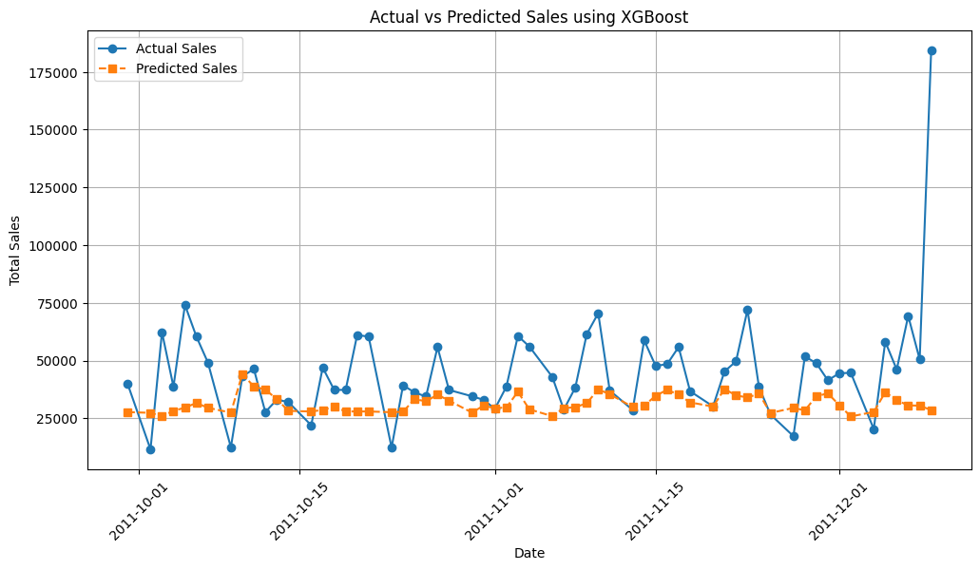
Model Evaluation
Mean Absolute Percentage Error : 0.344
Mean Absolute Error : 16690.45
Root Mean Squared Error : 26954.33

Slide 4
This means that, on average, the model's predictions are off by 16,690.45 in terms of sales , this suggests a relatively high deviation.
RMSE penalizes larger errors more than MAE, and a high RMSE indicates that the model struggles with some large deviations. The large gap between MAE and RMSE suggests the presence of extreme errors (outliers) in the predictions.
This means that, on average, the model's predictions are off by 34% of the actual sales value.
- For time series forecasting:
- A MAPE below 10% is generally considered excellent.
- A MAPE below 20% is considered good.
- 33% suggests the model is not very accurate and may need improvements.

Slide 5
Further Improvements
Handle Outliers
- For extreme sales spikes(e.g., Black Friday), consider applying log transformation or capping outliers.
Tune Hyperparameters Further
- Increase n_estimators, adjust learning_rate, max_depth, and min_child_weight.
Test Other Models
- Try LSTM/GRU (if sequential patterns are strong).
- Can Compare performance with Prophet, ARIMA, or an XGBoost + moving average hybrid approach.
Enhance Feature Engineering
- Add seasonality features (Month, Weekday, Holiday effects).
- Include rolling averages (e.g., past 7-day moving average).

