Slide 1
Aigrant Halfway Progress Report
By Oliver Hennigh

Slide 2
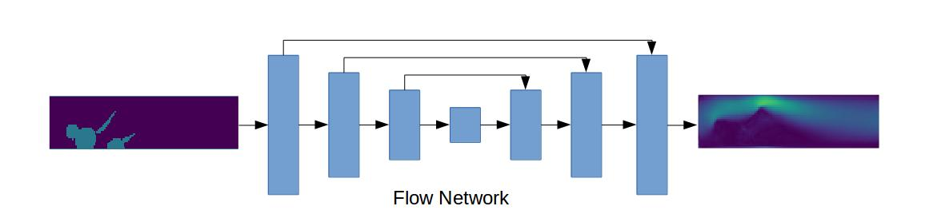
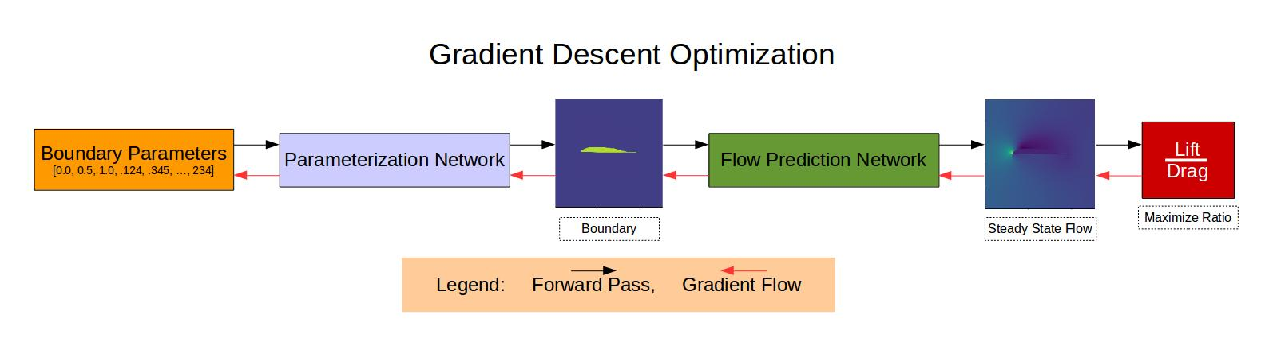
Background Information
Predicting Steady State Fluid Flow with Neural Networks
Automated Design using Gradient Descent and Neural Networks

Slide 3
Work So Far
Unsupervised Loss Function
Multi Resolution Method
Automated Design

Slide 4
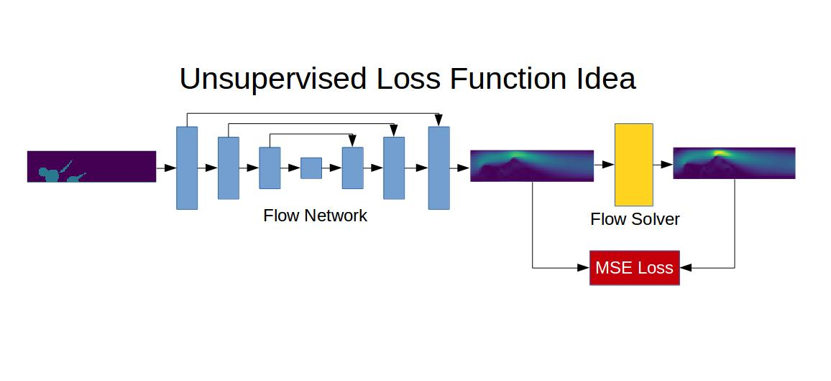

Slide 5
Lattice Boltzmann Solver with Tensorflow
https://github.com/loliverhennigh/Lattice-Boltzmann-fluid-flow-in-Tensorflow

Slide 6
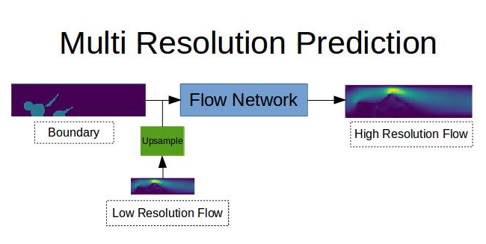

Slide 7
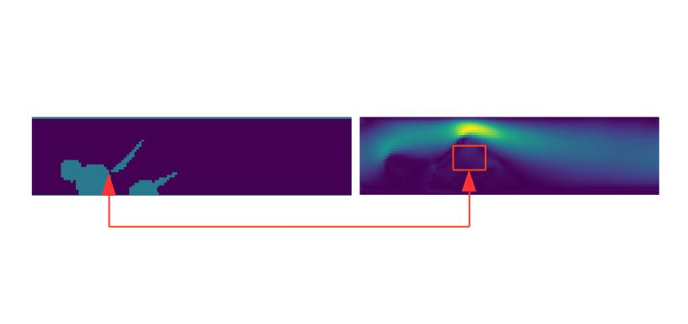

Slide 8
Design Optimization

Slide 9
Heat Sink Optimization

Slide 10
2D Airfoil Optimization

Slide 11
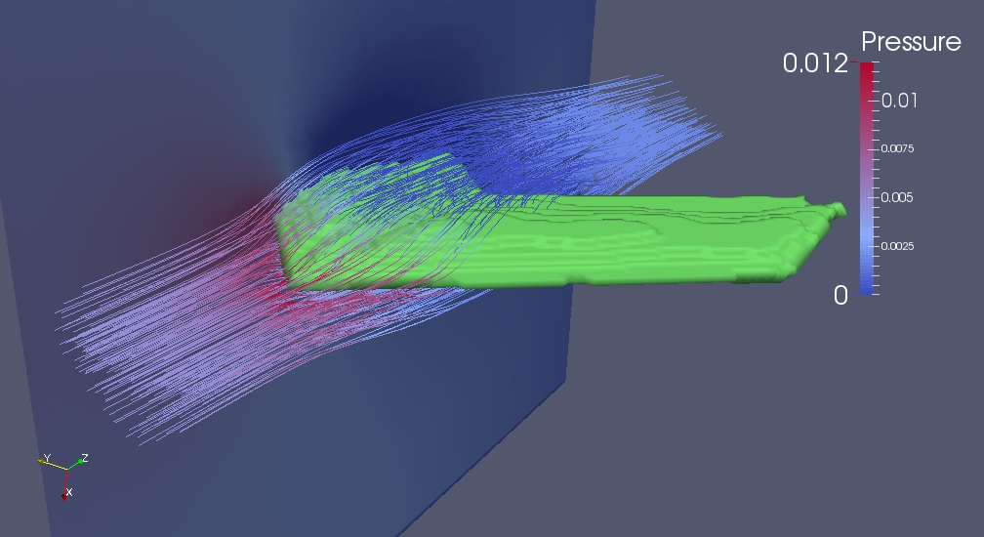
3D Airfoil Optimization
144x144x144 grid size

Slide 12
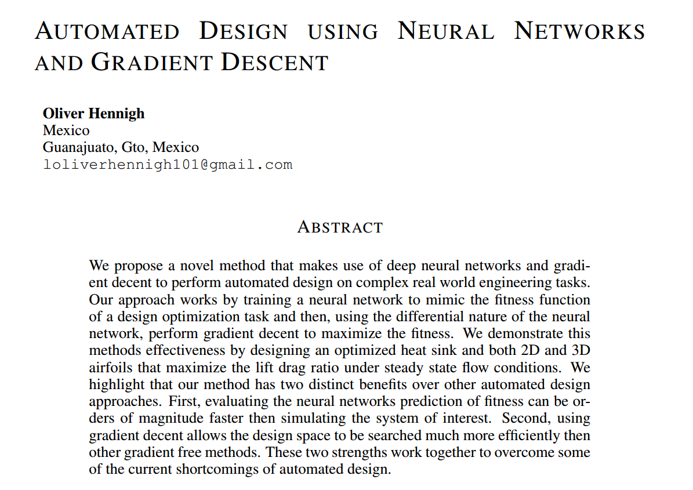
Paper!
Here https://arxiv.org/pdf/1710.10352.pdf

Slide 13
Future Work!
Automated Design Library
Time-dependent Lattice Boltzmann Simulation Library

Slide 14
Automated Design Library
Works on arbitrary simulations
Examples of all problems seen in paper and an electromagnetic problem

Slide 15
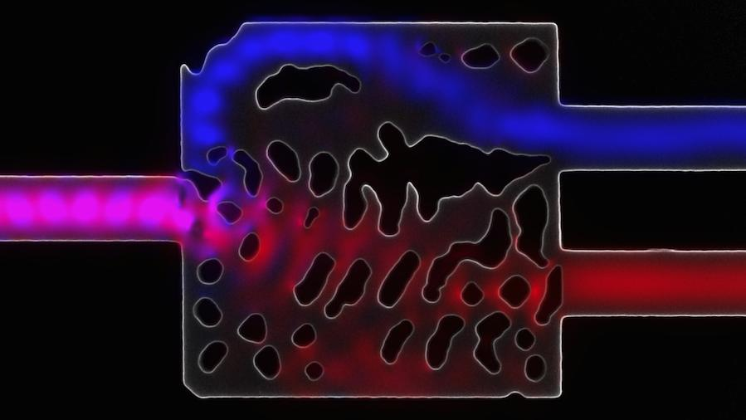
Wavelength Demultiplexer
Designed in 36 hours with 3 Nvidia GTX Titan GPUs
20 minutes on a GTX 1070 GPU
https://arxiv.org/pdf/1504.00095.pdf

Slide 16
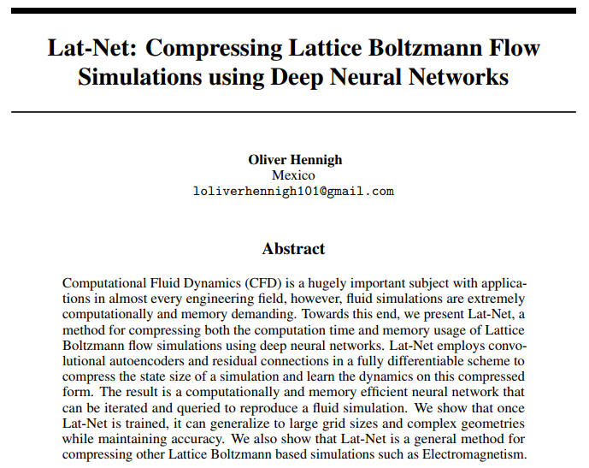
LatNet Library
Compress computation time and memory usage of Lattice Boltzmann based simulations
New methods for generating train data
Better network architectures
https://arxiv.org/abs/1705.09036

Slide 17
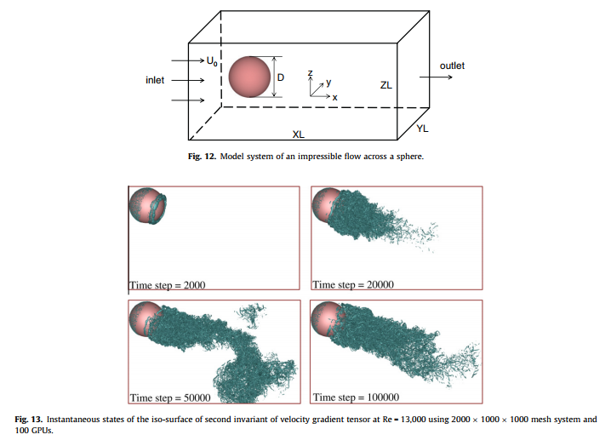
Massive Simulations
Grid Size 1000x1000x2000 100,000 steps
6 hours on GTX 1070 GPU
Lattice Boltzmann Solver would need 240 GB of working GPU memory.
100 GPUs 6 hours to run simulation
http://www.sciencedirect.com/science/article/pii/S0167819111000214

Slide 18
Thanks!

