Slide 1

Programmable Industrial Oven SoC-Arch 2020/2021
Project discussion
Grottesi Lorenzo - Bianco Nicolò
Notes:
Good morning, today we are going to present our System on Chip project, the Programmable Industrial Oven

Slide 2

Outline
Motivation
Introduction
Design and Development
Firmware Solution
Risk Assessment
Results
Summary & Future Works
Notes:
We will start by looking at what drove us to this project. Then we’ll talk about the high level requirements that we found for the project, and how the design and development phase was affected by the current situation. After that we will see the results of our work and how to improve the current system.

Slide 3
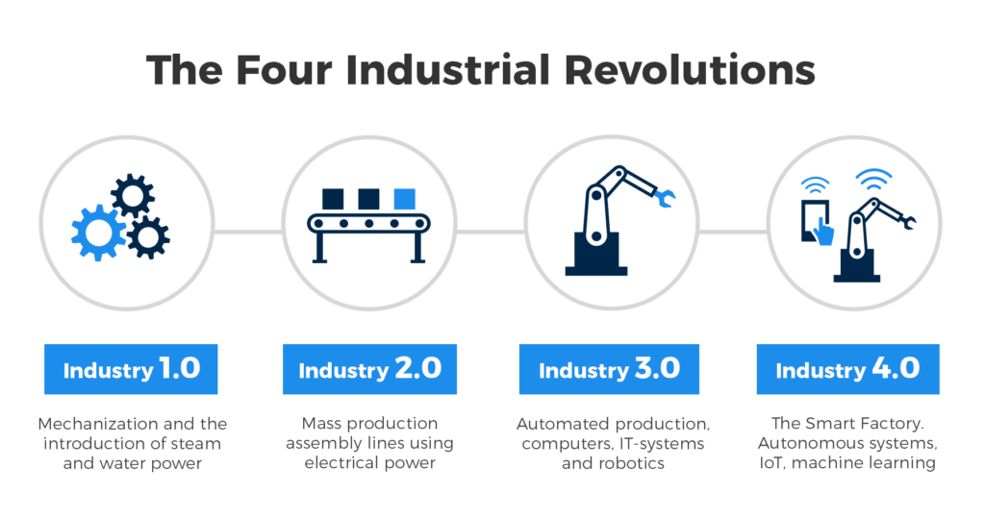

Motivation
Notes:
In the last decades, due to the technology evolution, a lot of new application field were born for the electronic devices.
This concept can be expressed with the term IoT (Internet of Things). The consequences of this evolution impacted a lot of fields, like the industrial one.
The utilization of the IoT in the industrial field took the name of Industry 4.0
// Negli ultimi decenni sono nati a causa del forte sviluppo scientifico/ingegneristico nuove forme di intelligienza associate ai dispositive elettronici.
// Questo concetto è stato riassunto con l’acronimo di IoT, la conseguenza di questa crescita ha impattato diversi settori, tra cui quello industriale. [imagine 2]
// L’uso ti tale tecnologia in ambito industriale ha preso il nome di Industria 4.0.

Slide 4
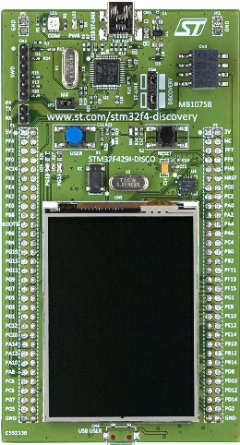
Introduction
Automatic temperature control (Software PID)
Programmable timing
Fan control
Full control through the UART interface
Notes:
For this project we focused on the development of an Oven, that can be used in the industrial fields, and that features some smart functionalities.
The main features are:
Automatic temperature control with a software PID, coupled with a user programmable timer
Full control of the device through the UART interface
Control of the internal ventilation
/* Per questo Progetto ci siamo focalizzati sullo sviluppo di un Industrial Oven il quale vuole essere impiegato in ambienti industriali, dotato di funzionalità smart.
Le principali caratteristiche sono:
- Controllo automatico della temperatura (PID) con timer associato programmabile dall’utente
- Controllabilità via UART
- Controllo della ventilazione interna */

Slide 5








Design and Development
Project management:
Slack
Trello
Overleaf
GitHub
Development tools:
CubeMX
Keil
Renode
PuTTY
Notes:
To keep track of the development of the project we used some tools. For the management we used:
Slack, to organize the calls and to ask questions to the professors
Trello, to have a graphical view of the state of the project
Overleaf, to prepare the final report
GitHub, as a remote repository where to keep the code
While for the development we used:
- CubeMX, <scrivi te lollo>
Keil, to develop the MCU firmware
Renode, to simulate the firmware
PuTTY, to connect to the simulating UART line

Slide 6
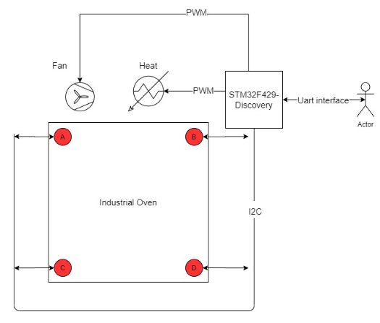
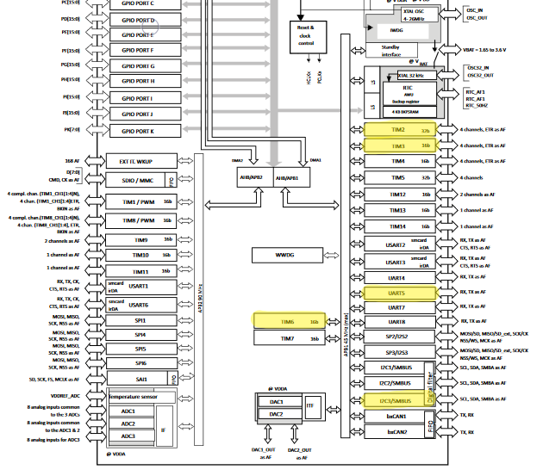
Design and Development

Slide 7
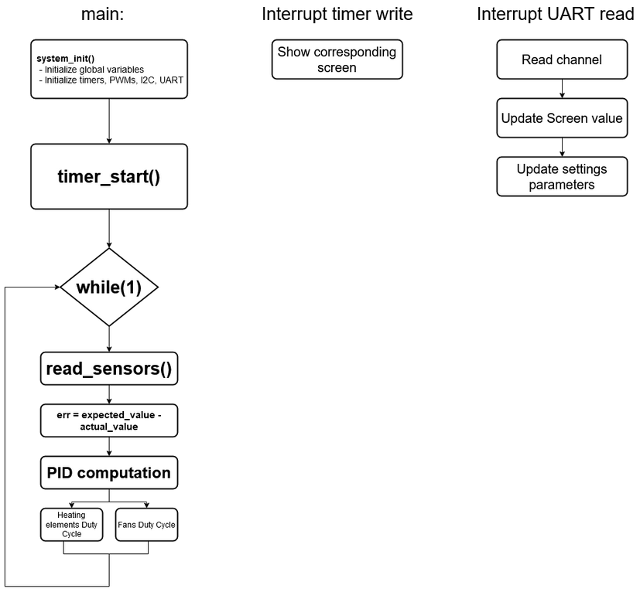
Design and Development

Slide 8
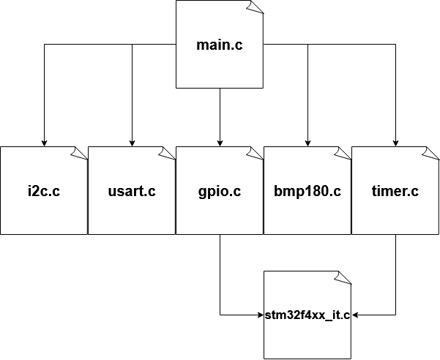
Firmware structure
main.c, contains the main loop
i2c.c, peripheral initializations
bmp180.c, temperature sensor functions
timer.c, peripherals initializations
stm32f4xx_it.c, interrupt callbacks

Slide 9
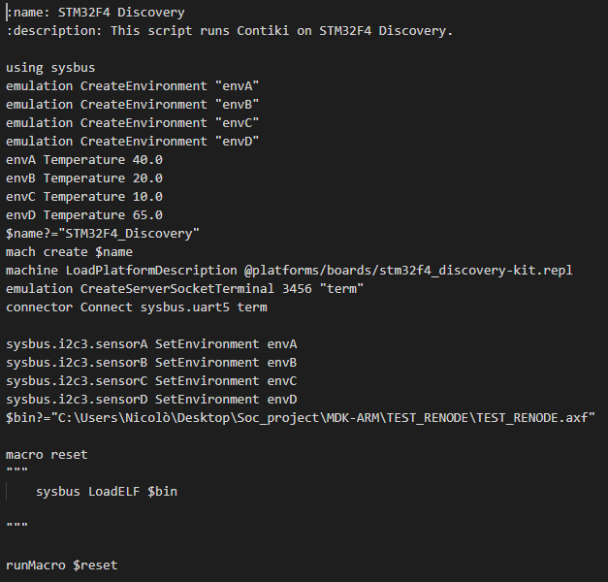
Renode configuration
Enviroments definition
Enviroments initialization
UART configuration
Sensors connection to the enviroments
Absolute path of the .axf file

Slide 10
Risk Assessment
Development tool
PID configuration
PWM testing

Slide 11
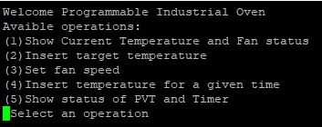
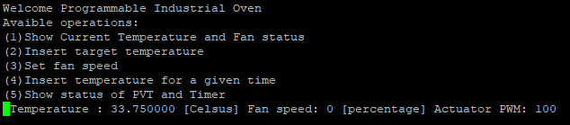
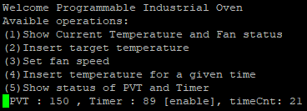
Results
Start-up screen: choose an operation
(1): Show current temperature and fan status
(5): Show status of PVT and Timer

Slide 12
Results
Conditioning noise
Aliasing
Quantization noise

Slide 13
Summary & Future works
The PIO respects the given specifications.
Further works would expand the device with the IoT paradigm:
Simple GUI
Web-app

Slide 14
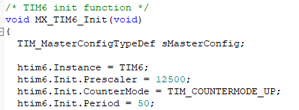

Timer 6
$$f_{APB1}=6.25 MHz$$
$$Prescaler=12500$$
$$Period=50$$
$$T_{TIM6}=\frac{1}{f_{APB1}}∗Prescaler∗Period={1.6∗10}^{−7}s∗12500∗50=100ms$$

Slide 15




Covid-19 emergency
Due to the Covid-19 emergency, we have issues in the organisation face-to-face workgroups for presentations and for projects.
For this motivation, we redesigned the organisation of the projects allowing all the students to implement and simulate their code on virtual platforms by using new-generation development tools.

Slide 16
Rules for Project Presentation
Team should notify to instructor that the project is completed and ready for a request of evaluation (slack channel or email)
Each component of the team should book the exam of the exam session selected for the project discussion
The presentation should be done by all the team members in a single session
You can decide how to split the section to be presented by each team member
The overall presentation should not exceed 20 mins
Main points of the report and the code should be discussed
Notes:
In the note section you can write the main points to be discussed in the slide, that you can use as anchors in case you lose the flow.

Slide 17
Suggested structure for Project Presentation
Project Title/Authors/Affiliation (1 slide)
Intro/Background (or Forecast) (2 slide)
Outline (1 slide)
Motivation and problem statement (1-2 slides)
Project Management system organisation and tool used (2 slides)
In this part the team should discuss
how they organised the work
how they used the tools
how they handled the reporting procedure.
Related work and firmware used as baseline (1 slide)
Introduce the code used as a template for building your firmware components
Notes:
In the note section you can write the main points to be discussed in the slide, that you can use as anchors in case you lose the flow.

Slide 18
Suggested structure for Project Presentation
Methods – Proposed solution (3-4 slides)
Describe the behaviour of the firmware developed (I/O and functions)
Introduce how to run the project and the documentation of the code pushed on GitHub
Results (2-4 slides)
Describe the testing system (emulator and scripts used for running the code and evaluate results)
Describe the main results achieved
Variation with respect to the proposal and Risk management (2 slides)
Report here variations applied to manage issues encountered during the implementation phase.
Report also on changed components or the aim of some modules declared in the original proposal
Summary & Future work (1-2 slides)
Backup (0-3 slides)
Notes:
In the note section you can write the main points to be discussed in the slide, that you can use as anchors in case you lose the flow.

Slide 19
Outline (Example)
Rules for the final mark calculation
Presentation of a paper + Project using a SoC-Arch
Presentation of a paper
Steps to prepare your Presentation
Steps to develop your Project
Timeline
Open discussion

