Slide 1

Programmable Industrial Oven SoC-Arch 2020/2021
Project discussion
Grottesi Lorenzo - Bianco Nicolò
Notes:
Good morning, today we are going to present our System on Chip project, the Programmable Industrial Oven

Slide 2

Outline
Motivation
Introduction
Design and Development
Firmware Solution
Risk Assessment
Results
Summary & Future Works
Notes:
We will start by looking at what drove us to this project. Then we’ll talk about the high level requirements that we found for the project, and how the design and development phase was affected by the current situation. After that we will see the results of our work and how to improve the current system.

Slide 3
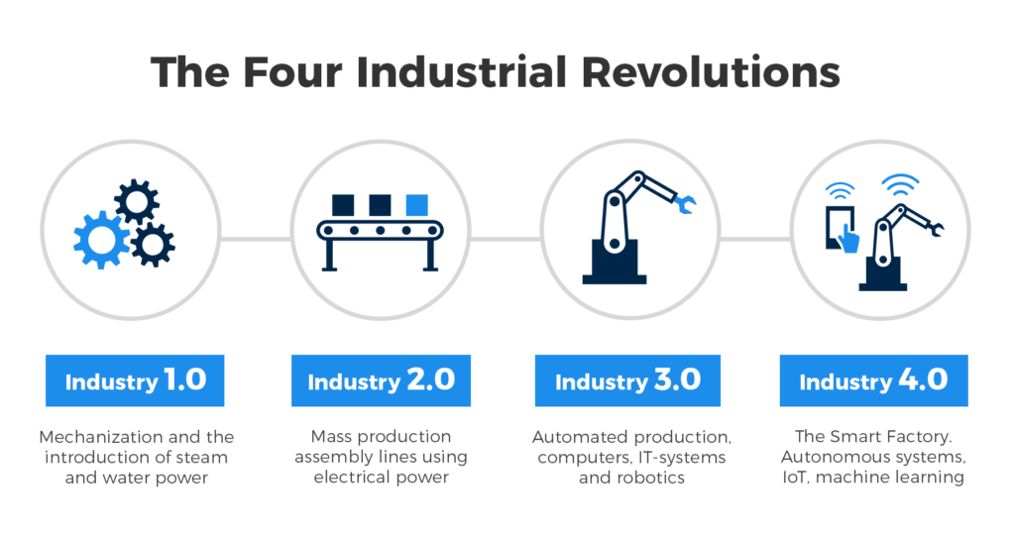

Motivation
Notes:
In the last decades, due to the technology evolution, a lot of new application field were born for the electronic devices.
This concept can be expressed with the term IoT (Internet of Things). The consequences of this evolution impacted a lot of fields, like the industrial one.
The utilization of the IoT in the industrial field took the name of Industry 4.0

Slide 4
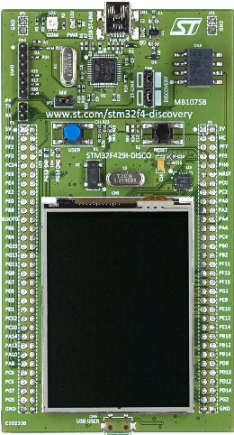
Introduction
Automatic temperature control (Software PID)
Programmable timing
Fan control
Full control through the UART interface
Notes:
For this project we focused on the development of an Oven, that can be used in the industrial fields, and that features some smart functionalities.
The main features are:
Automatic temperature control with a software PID, coupled with a user programmable timer
Full control of the device through the UART interface
Control of the internal ventilation

Slide 5








Design and Development
Project management:
Slack
Trello
Overleaf
GitHub
Development tools:
CubeMX
Keil
Renode
PuTTY
Notes:
To keep track of the development of the project we used some tools. For the management we used:
Slack, to organize the calls and to ask questions to the professors
Trello, to have a graphical view of the state of the project
Overleaf, to prepare the final report
GitHub, as a remote repository where to keep the code
While for the development we used:
- CubeMX, <scrivi te lollo>
Keil, to develop the MCU firmware
Renode, to simulate the firmware
PuTTY, to connect to the simulating UART line

Slide 6
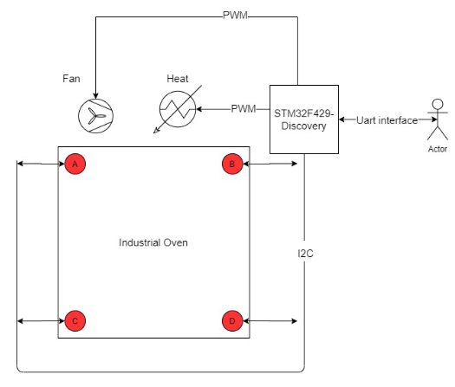
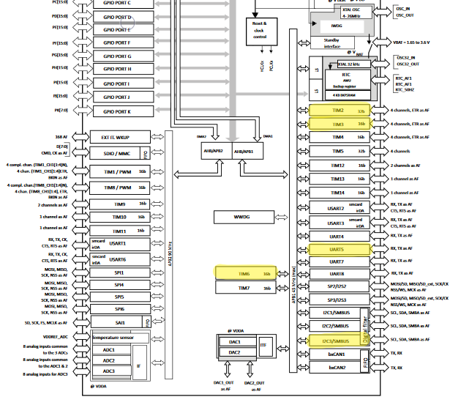
Design and Development
Notes:
Then we sketched the functional level view of the system, underlining the connection and the peripherals that we would have used.
For this reason we choose the STM32F429-Discovery board, that is equipped with an ARM CPU, and has enough peripherals for our needs. In particular the Oven would be composed of
4 temperature sensors scattered across the interior
An heating element to raise the internal temperature
An electric fan for the ventilation
An UART interface to communicate with the Oven
All these elements can be connected with the peripherals of the board, as shown in the solution level architecture,
The UART5 is used for the communication,
the Timer 6 triggers an interrupt routine for the displaying of the informations over the UART,
the I2C3 bus is used for the temperature sensors,
and the Timer1 and 2 for generating the PWM for the Fan and the Heating element

Slide 7
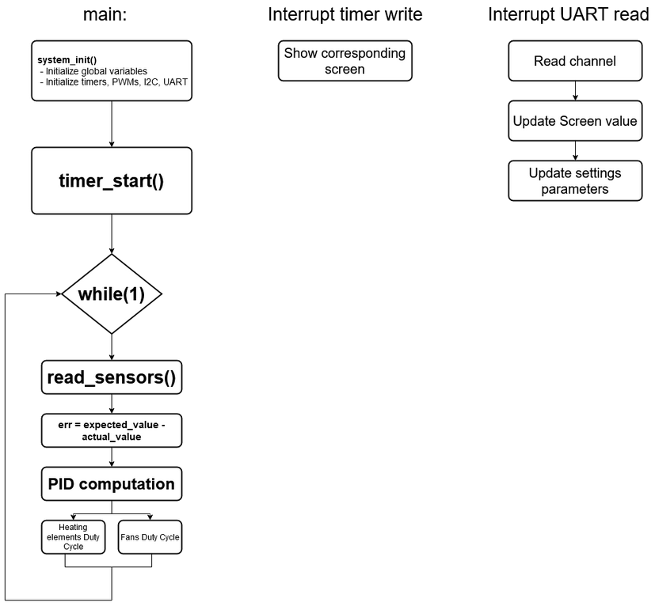
Design and Development
Notes:
The next step was to write the software routines, starting from some flow charts.
The main routine initializes the variables and the peripherals. Then the Timer6 starts, and the program enters in an infinite loop where at each iteration:
Reads the temperature sensors and compute the mean value
Compute the error between the measured value and the expected temperature value
The PID computer the output PWM for the heating element
The Fan and the Heating element duty cycle is updated
Every 100ms the Timer6 interrupt routine is called, and updates the User Interface on the UART5 line.
The UART Read interrupt routine is called every time the user enters an input on the UART line, for example to set a new temperature value.

Slide 8
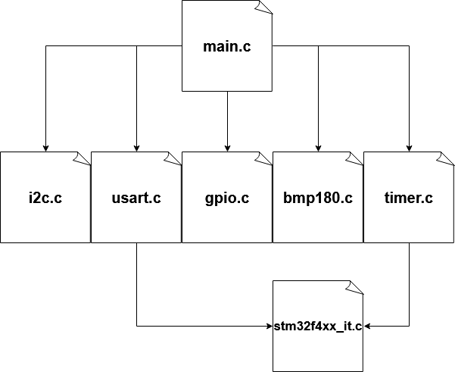
Firmware structure
main.c, contains the main loop
i2c.c, peripheral initializations
bmp180.c, temperature sensor functions
tim.c, peripherals initializations
stm32f4xx_it.c, interrupt callbacks
Notes:
The firmware is composed by the following modules, each one in charge of a particular task.
The main.c contains the main loop, and uses the functions of the other modules
The i2c.c contains the initialization functions for the i2c bus
The usart.c, as the gpio.c and the tim.c contains the initialization functions for these peripherals
The bmp180.c contains the structures and the functions for communication with the bmp180 temperature sensors, that are connected on the i2c line
The stm32f4xx_it.c contains the interrupt routines used for the project.

Slide 9
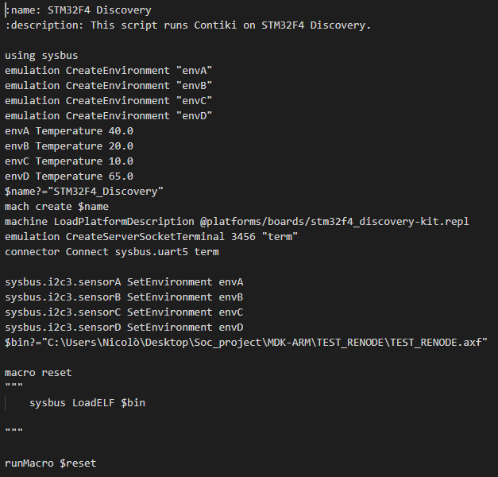
Renode configuration
Enviroments definition
Enviroments initialization
UART configuration
Sensors connection to the enviroments
Absolute path of the .axf file
Notes:
To simulate the board with Renode we had to modify the Resc script by enabling the System Bus and creating 4 environments for the 4 temperature sensors.
For the UART we created a Server Socket at the port 3456 called “term” that is connected to the UART5. In order to access to the UART we simply have to connect with PUTTY at the address localhost:3456,
Then the 4 environments are connected to the i2c3 bus with 4 different sensors.

Slide 10
Risk Assessment
Development tool
PID configuration
PWM testing
Notes:
In the first phase of the project we found some risks that could influence the development. In particular we found that:
Some of the proposed development tools could slow down the project due to the lack of experience with them. For this reason we didn’t used PlatformIO, but rather the combination of CubeMX and Keil.
The intended use of a PID library was stated from the beginning, but we knew that there would not be the possibility to test the component on real hardware. This meant that the parameters for the PID were chosen without a real meaning.
As well as the PID, the testing of the PWM outputs isn’t possible. For this reason we simply print on the User Interface the intended value of the PWM.

Slide 11
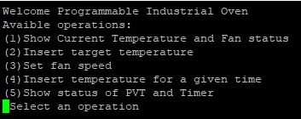
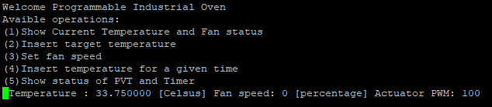
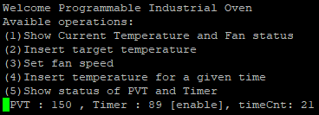
Results
Start-up screen: choose an operation
(1): Show current temperature and fan status
(5): Show status of PVT and Timer

Slide 12
Results
Conditioning noise
Aliasing
Quantization noise

Slide 13
Summary & Future works
The PIO respects the given specifications.
Further works would expand the device with the IoT paradigm:
Simple GUI
Web-app

Slide 14
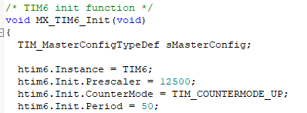

Timer 6
$$f_{APB1}=6.25 MHz$$
$$Prescaler=12500$$
$$Period=50$$
$$T_{TIM6}=\frac{1}{f_{APB1}}∗Prescaler∗Period={1.6∗10}^{−7}s∗12500∗50=100ms$$

Slide 15




Covid-19 emergency
Due to the Covid-19 emergency, we have issues in the organisation face-to-face workgroups for presentations and for projects.
For this motivation, we redesigned the organisation of the projects allowing all the students to implement and simulate their code on virtual platforms by using new-generation development tools.

Slide 16
Rules for Project Presentation
Team should notify to instructor that the project is completed and ready for a request of evaluation (slack channel or email)
Each component of the team should book the exam of the exam session selected for the project discussion
The presentation should be done by all the team members in a single session
You can decide how to split the section to be presented by each team member
The overall presentation should not exceed 20 mins
Main points of the report and the code should be discussed
Notes:
In the note section you can write the main points to be discussed in the slide, that you can use as anchors in case you lose the flow.

Slide 17
Suggested structure for Project Presentation
Project Title/Authors/Affiliation (1 slide)
Intro/Background (or Forecast) (2 slide)
Outline (1 slide)
Motivation and problem statement (1-2 slides)
Project Management system organisation and tool used (2 slides)
In this part the team should discuss
how they organised the work
how they used the tools
how they handled the reporting procedure.
Related work and firmware used as baseline (1 slide)
Introduce the code used as a template for building your firmware components
Notes:
In the note section you can write the main points to be discussed in the slide, that you can use as anchors in case you lose the flow.

Slide 18
Suggested structure for Project Presentation
Methods – Proposed solution (3-4 slides)
Describe the behaviour of the firmware developed (I/O and functions)
Introduce how to run the project and the documentation of the code pushed on GitHub
Results (2-4 slides)
Describe the testing system (emulator and scripts used for running the code and evaluate results)
Describe the main results achieved
Variation with respect to the proposal and Risk management (2 slides)
Report here variations applied to manage issues encountered during the implementation phase.
Report also on changed components or the aim of some modules declared in the original proposal
Summary & Future work (1-2 slides)
Backup (0-3 slides)
Notes:
In the note section you can write the main points to be discussed in the slide, that you can use as anchors in case you lose the flow.

Slide 19
Outline (Example)
Rules for the final mark calculation
Presentation of a paper + Project using a SoC-Arch
Presentation of a paper
Steps to prepare your Presentation
Steps to develop your Project
Timeline
Open discussion

