Slide 1
Kaunas University of Technology (KTU)
HUMAN SIDE OF TECHNOLOGY
Assoc. prof. dr. Dalia Čalnerytė dalia.calneryte@ktu.lt

Slide 2
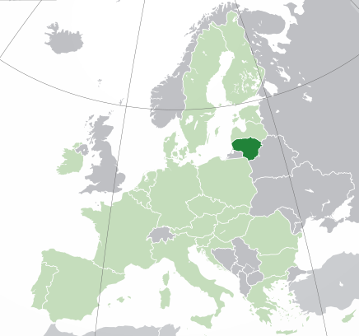
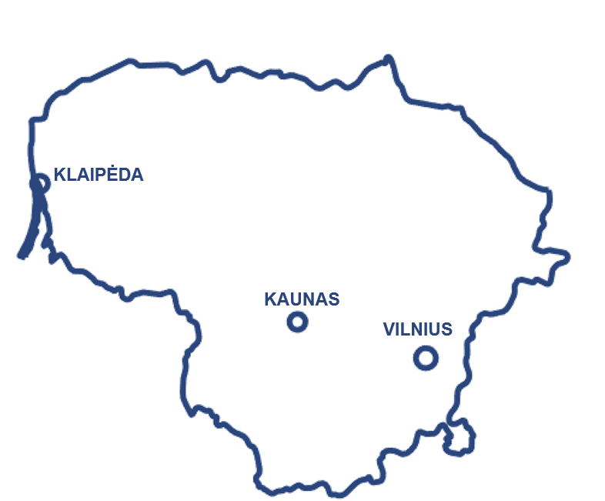




LITHUANIA
Capital: Vilnius
Population: ~2.8 mln.
Area: 65 300 km²
Photo by Misael Silvera on Pexels
KAUNAS
Population: ~300K
2nd largest city in Lithuania

Slide 3

Kaunas University of Technology
KTU is one of the largest technological universities in the Baltic region (>7K students, ~11% foreign students, >100 study programmes (~50/~56/~20), ~1800 employees)
8
9
research
institutes
faculties
Biomedical Engineering Institute
Food Institute
Institute of Architecture and Construction
Institute of Environmental Engineering
Institute of Materials Science
Institute of Mechatronics
Prof. Kazimieras Baršauskas Ultrasound Research Institute
Health Telematics Science Institute
Faculty of Chemical Technology
School of Economics and Business
Faculty of Electrical and Electronics Engineering
Faculty of Informatics
Faculty of Mathematics and Natural Sciences
Faculty of Mechanical Engineering and Design
Faculty of Social Sciences, Arts and Humanities
Faculty of Civil Engineering and Architecture
Panevezys Faculty of Technologies and Business

Slide 4

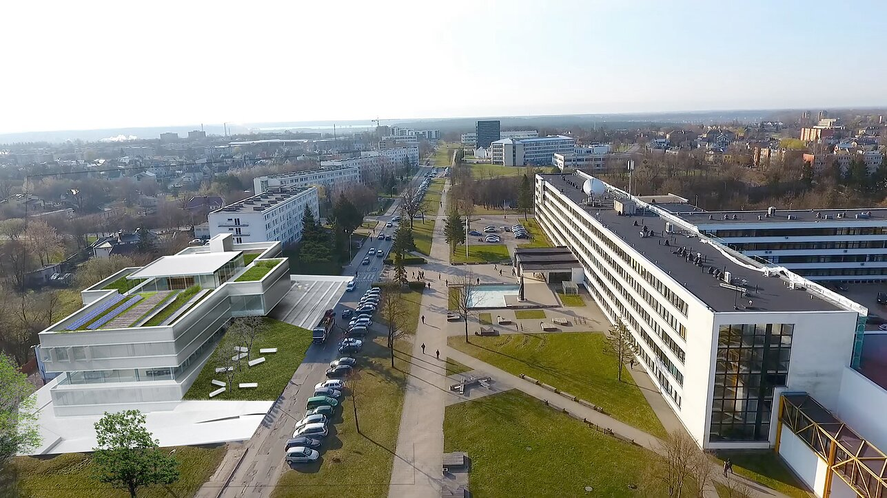
KTU Campus
KTU Santaka Valley
Dormitories
KTU Gymnasium
M-Lab (Interdisciplinary Prototyping Laboratory Centre)
Faculty of Electrical and Electronics Engineering
Faculty of Informatics
Faculty of Mathematics and Natural Sciences

Slide 5

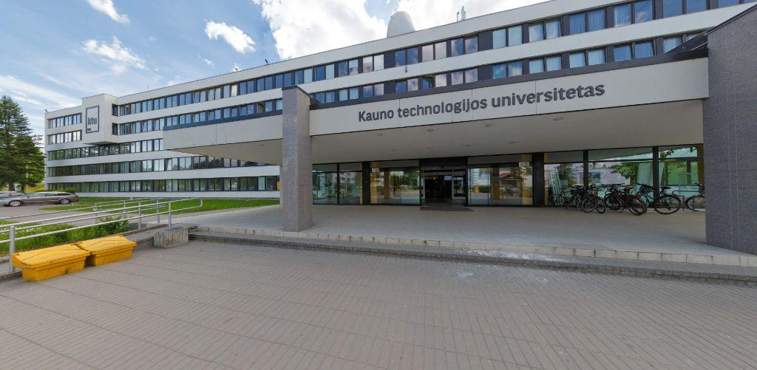
founded in 1977
~2K students
~150 academic staff
5 departments
2 research centres
8 laboratories
8 Research groups
6 1st study cycle programmes
5 2nd study cycle programmes
2 PhD programmes
5
Notes:
1st cycle programmes:
Artificial Intelligence EN
Informatics EN
Informatics Engineering
Information Systems
Multimedia Technologies
Software Systems
2nd cycle programmes:
Artificial Intelligence in Computer Science EN
Information and Information Technologies Security
Digital Transformation and System Architectures
Information Technologies of Distance Education
Software Engineering
Research Groups:
Artificial Intelligence and Image Processing Methods in Multimedia
Cyber Security
Internet-of-Things and Services
Multidisciplinary Models
Multimodal Human-Computer Interactions
Semantics and Knowledge-based Engineering of Information Systems
Smart Educational Technologies and their Application
Systems Design and Testing

Slide 6
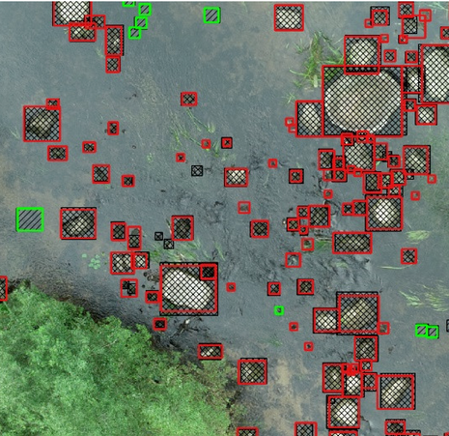
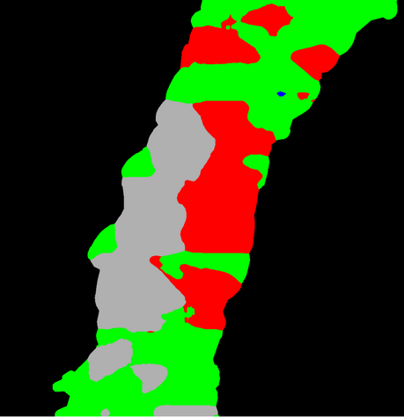
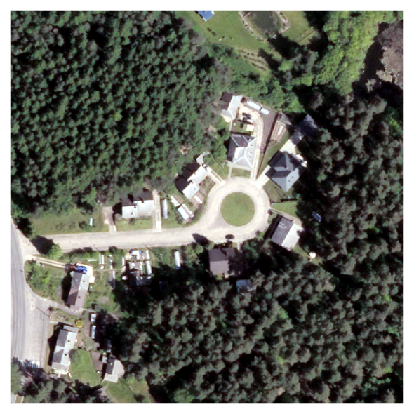
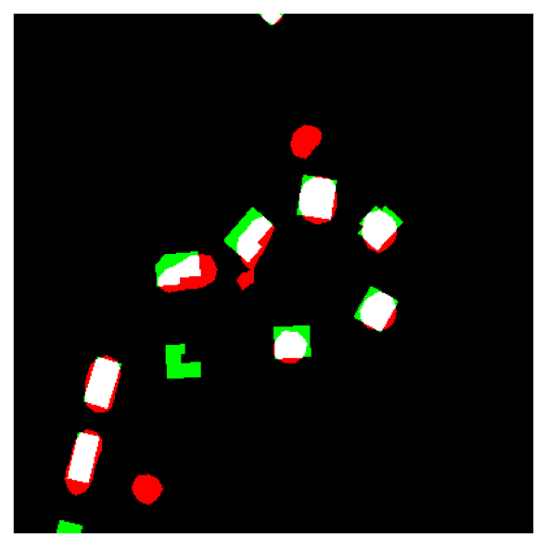
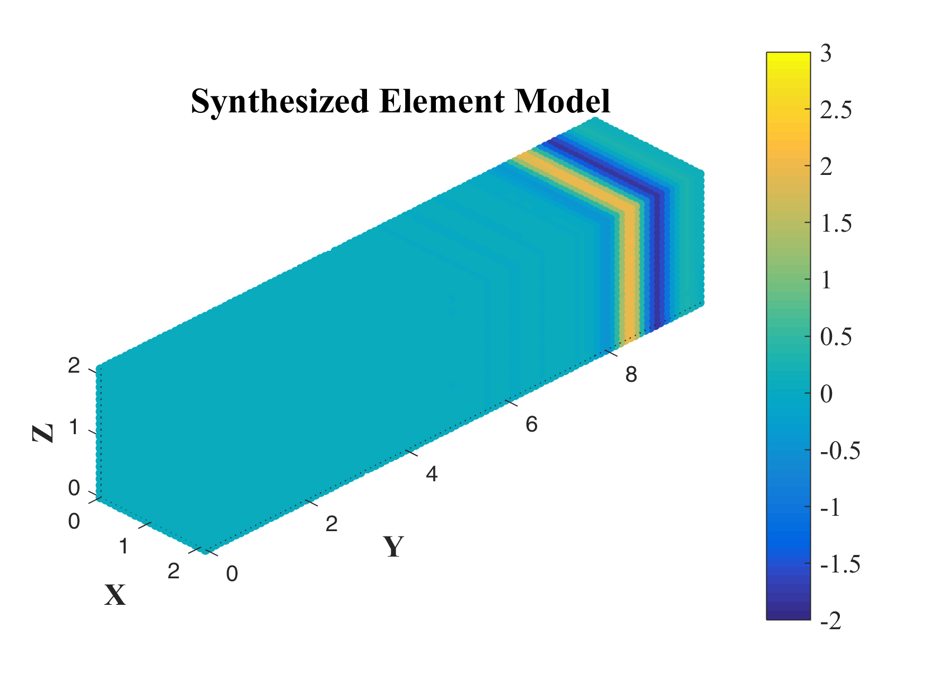
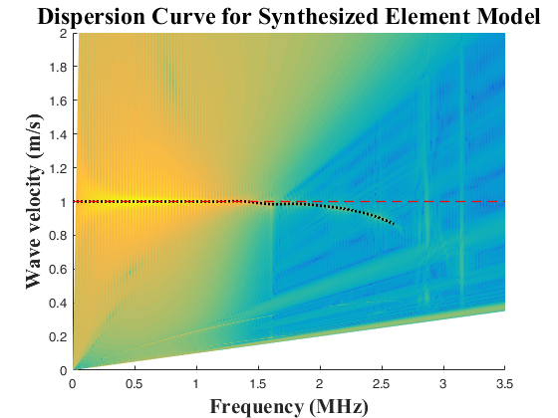
RG Multidisciplinary Models
Determination of River Hydromorphological Features in Low-Land Rivers from Aerial Imagery and Direct Measurements Using Machine Learning Algorithms
Water (2022)
https://doi.org/10.3390/w14244114
Image and signal processing and analysis
Artificial intelligence algorithms
Intelligent decision-making systems
Numerical models of complex systems
Urban change detection from aerial images using convolutional neural networks and transfer learning
ISPRS International Journal of Geo-Information (2022)
https://doi.org/10.3390/ijgi11040246
Synthesis of highly convergent 2D and 3D finite elements for short acoustic wave simulation
Wave Motion (2020)
https://doi.org/10.1016/j.wavemoti.2020.102515

Slide 7
Time Series Analysis
HUMAN SIDE OF TECHNOLOGY
Assoc. prof. dr. Dalia Čalnerytė dalia.calneryte@ktu.lt

Slide 8
Outline
Time series characteristics
Evaluation of time series forecasting
Traditional methods for forecasting time series (ARIMA, exponential smoothing)
Machine learning methods (multilayer perceptron, random forest) in time series analysis
Time series clustering
Anomaly detection in time series

Slide 9
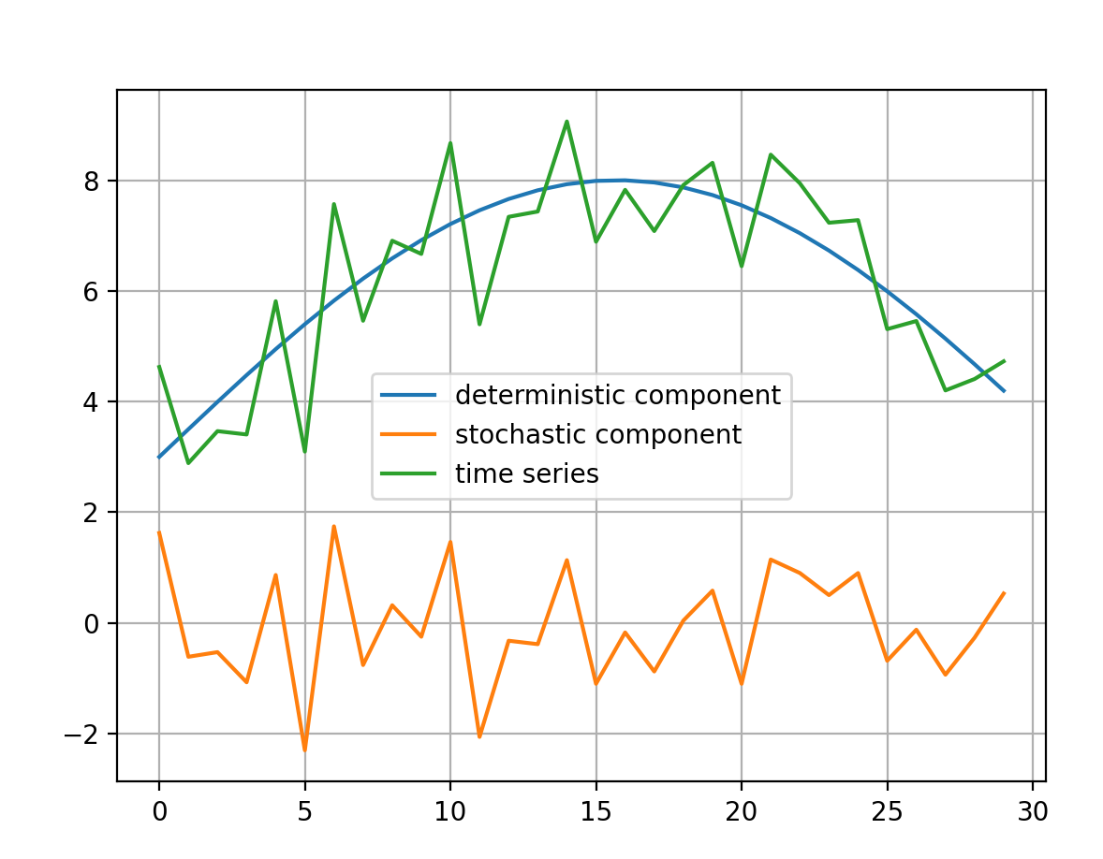
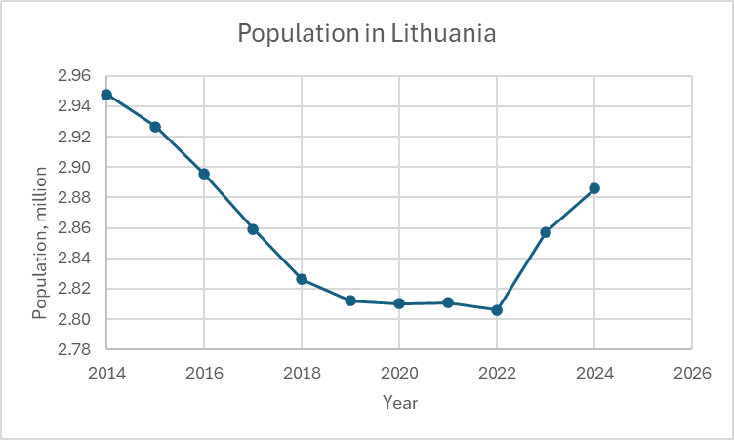
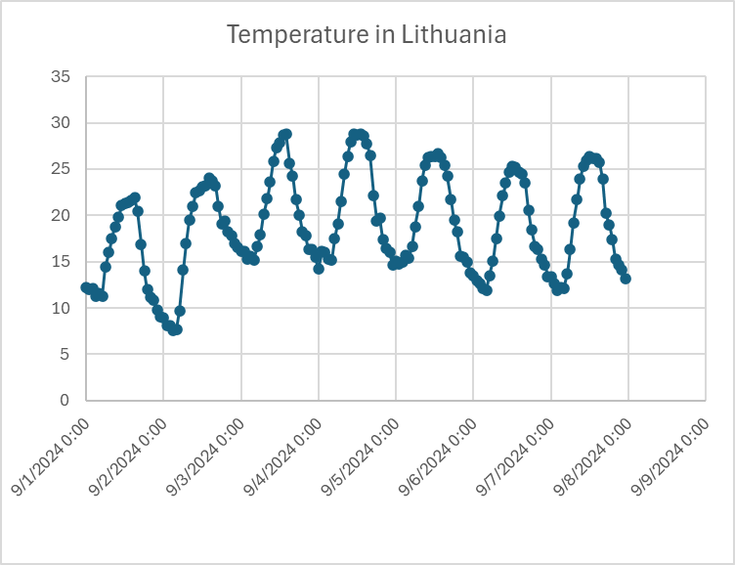
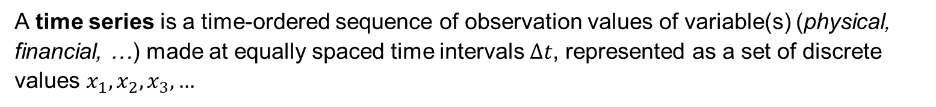
Time Series
A time series is a time-ordered sequence of observation values of variable(s) (physical, financial, …) made at equally spaced time intervals $Δt$, represented as a set of discrete values $x_{1},x_{2}, x_{3},…$

Slide 10
Time Series Related Tasks
Forecasting – for a given forecasting horizon, make a temporal forward prediction of a univariate time series based on patterns found across time points in past data.
Multivariate forecasting – for a given forecasting horizon, make a temporal forward prediction of a multivariate series based on patterns found across individual series and time points in past data.
Panel forecasting – for a given instance and forecasting horizon, make a temporal forward prediction based on patterns found across instances and time points in past data where all instances are observed up to a given point in time (instances are typically observed on a common time scales, e.g. countries).
Supervised forecasting – for a given instance and forecasting horizon, make a temporal forward prediction based on patterns found across instances and time points where some instances are fully observed up to the end of the forecasting horizon (Instances are typically observed on individual time scales, e.g. chemical processes).
Löning, Markus. Machine Learning with Time Series: A Taxonomy of Learning Tasks, Development of a Unified Framework, and Comparative Benchmarking of Algorithms. Diss. UCL (University College London), 2021.

Slide 11
Time Series Related Tasks
Classification – for a given instance, predict the value of the categorical cross-sectional target variable with predefined class labels based on patterns found across instances between the time series on the target variable.
Annotation – annotate time points of a series (e.g., outlier detection, anomaly detection, change point detection, segmentation)
Supervised annotation – for a given instance, annotate time points based on patterns found across instances and time points between values and annotations.
Löning, Markus. Machine Learning with Time Series: A Taxonomy of Learning Tasks, Development of a Unified Framework, and Comparative Benchmarking of Algorithms. Diss. UCL (University College London), 2021.

Slide 12
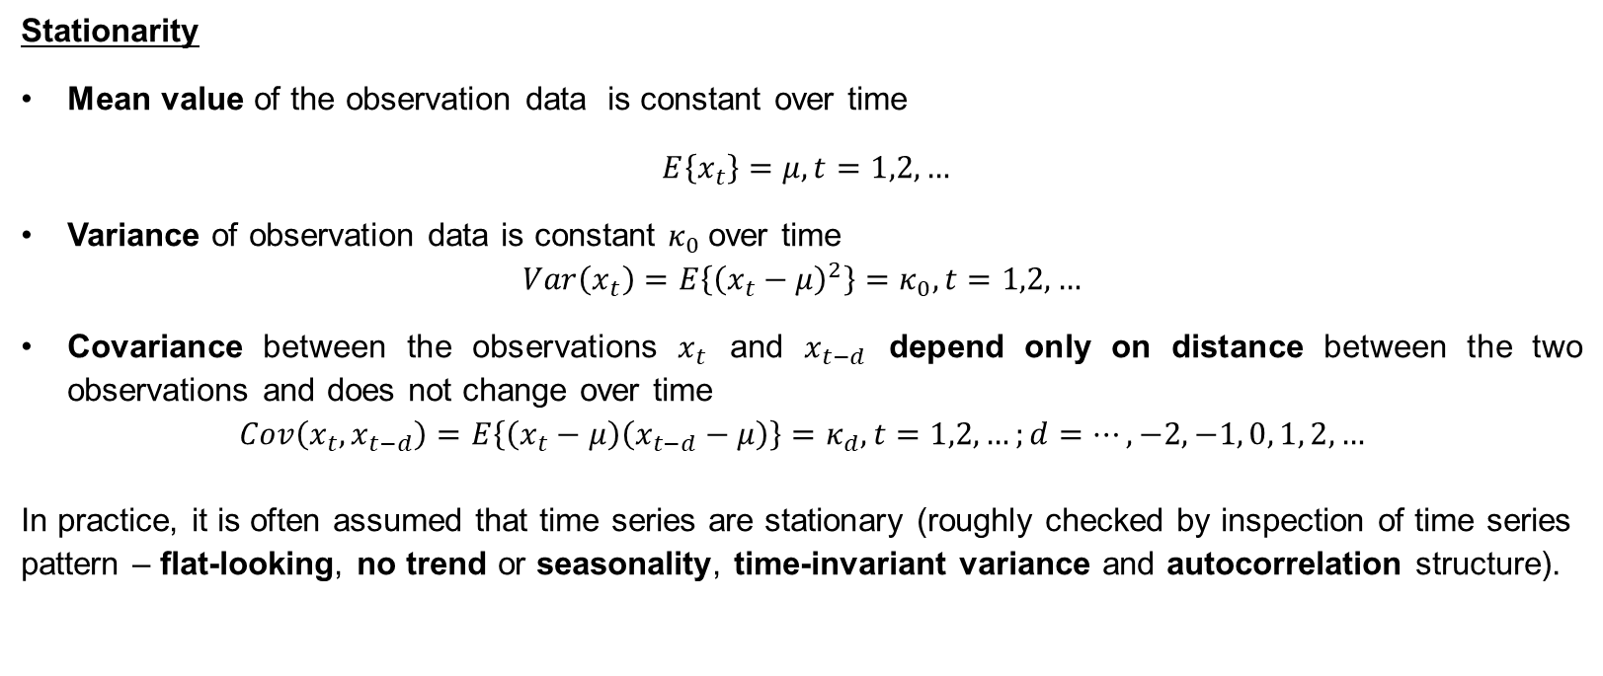
Characteristic Features of Time Series
Stationarity
Mean value of the observation data is constant over time
$E\left\{x_{t}\right\}=μ, t=1,2,…$
Variance of observation data is constant $κ_{0}$over time
$$Var\left(x_{t}\right)=E\left\{{\left(x_{t}−μ\right)}^{2}\right\}=κ_{0}, t=1,2,…$$
Covariance between the observations $x_{t}$ and $x_{t−d}$ depend only on distance between the two observations and does not change over time
$$Cov\left(x_{t}, x_{t−d}\right)=E\left\{\left(x_{t}−μ\right)\left(x_{t−d}−μ\right)\right\}=κ_{d}, t=1,2,…;d=…, −2, −1, 0, 1, 2, …$$
In practice, it is often assumed that time series are stationary (roughly checked by inspection of time series pattern – flat-looking, no trend or seasonality, time-invariant variance and autocorrelation structure).

Slide 13
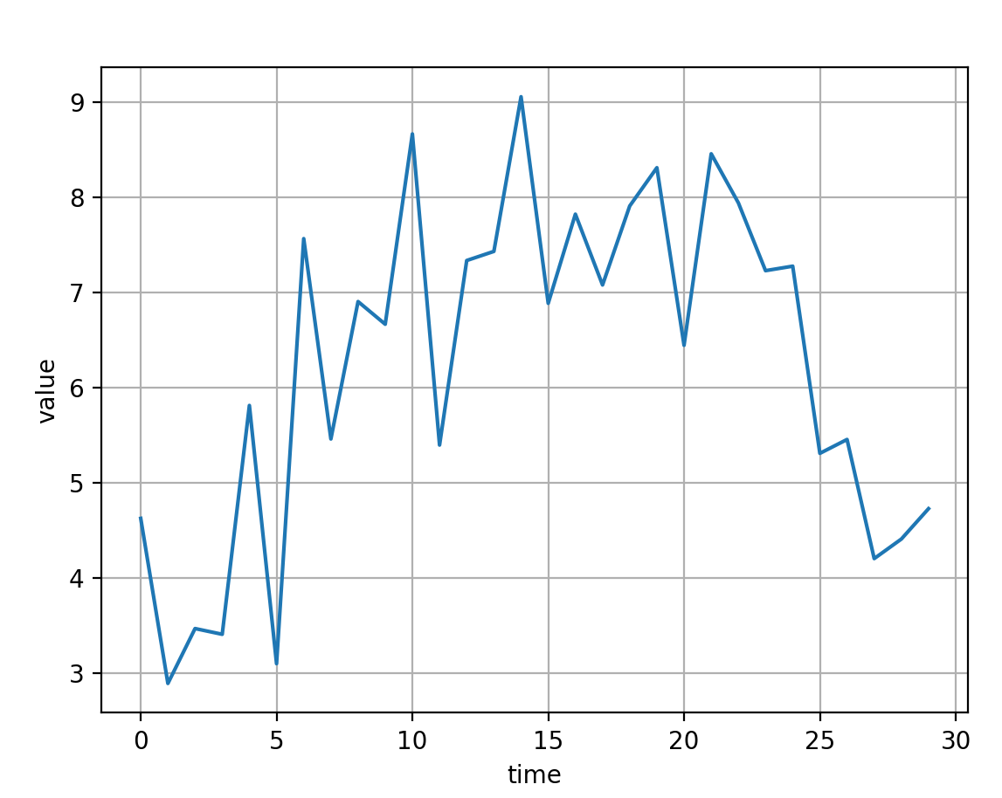
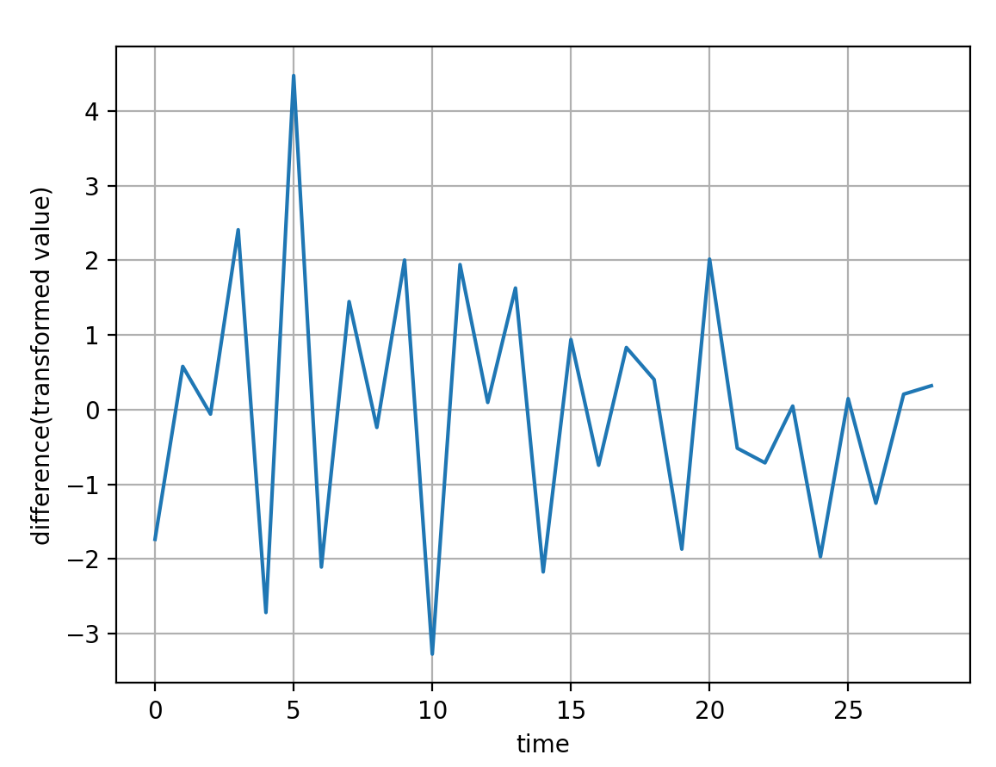
Characteristic Features of Time Series
Many data in engineering, business, economics are better represented by nonstationary time series.
Nonstationary data can be transformed to stationary by taking the differences between the successive data values along the time series pattern.
To resolve stationarity problem experimentally, the time series is partitioned into several segments and their autocorrelation and other properties are compared.

Slide 14
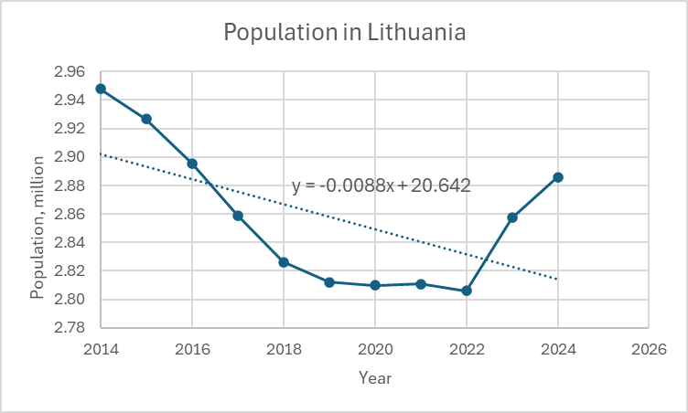
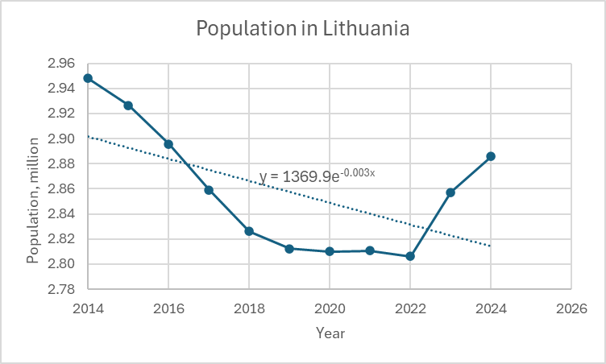
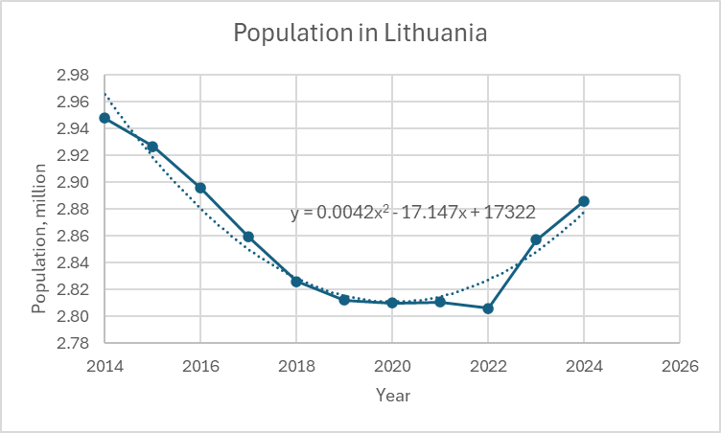
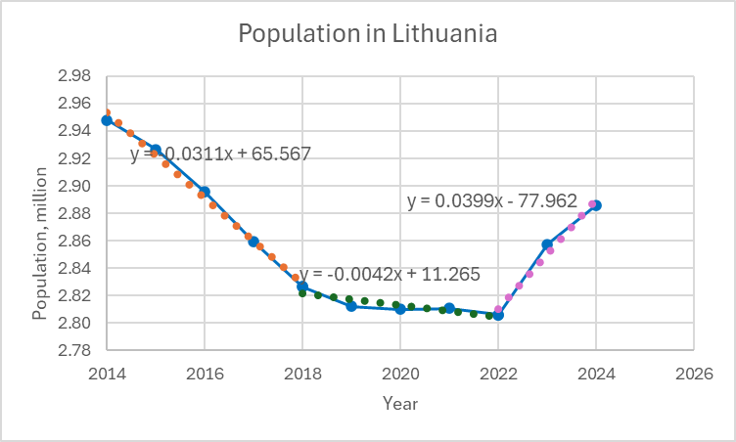
Characteristic Features of Time Series
Trend
A long-term feature that is illustrated by the local or global increase or decrease of data values. It is detected by pursuing the changes in the mean values over the successive time intervals.

Slide 15
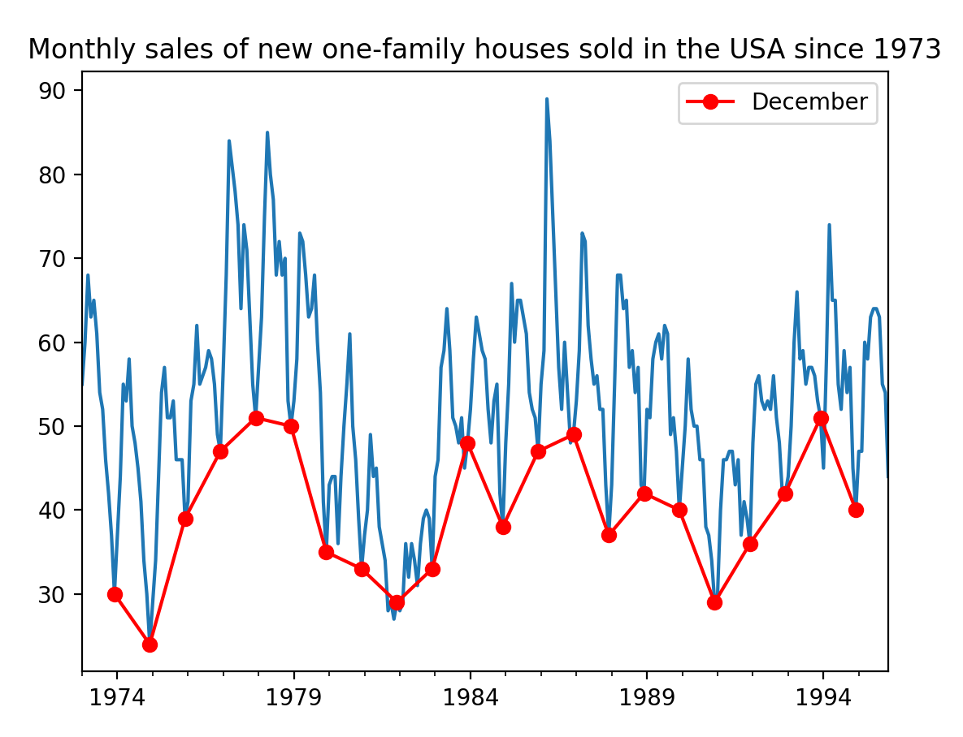
Characteristic Features of Time Series
Seasonality
Periodic fluctuating pattern.
Common in economic time series and in time series where the pattern repeats hourly, daily, weekly, monthly, yearly, e.g., power, gas, water demand systems.

Slide 16


Elimination of Trend and Seasonality
Observed value $X$ at time moment $t$ can be decomposed to:
$$X\left(t\right)=S\left(t\right)+R\left(t\right)+TC(t)$$
additive representation model
Seasonality component
Random component
Trend-cycle component
$$X\left(t\right)=S\left(t\right)∙R\left(t\right)∙TC(t)$$
multiplicative representation model
To eliminate the variability within the seasons, the moving average of the width equal to season length is subtracted for additive and divided by for multiplicative model.

Slide 17
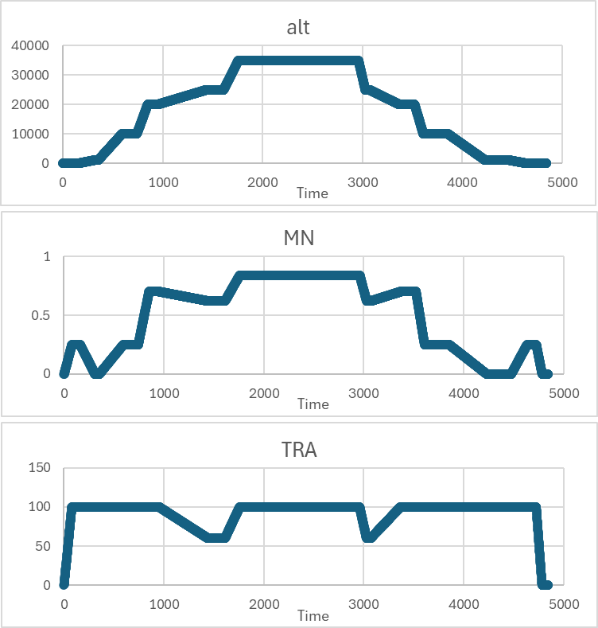
Univariate time series – observing a single process (time can be replaced by index), presented by a single value.
Multivariate time series - observing several processes (two or more) simultaneously, presented by a vector. The values of variable depend not only itself, but also the values of the other component series.
https://data.nasa.gov/dataset/Multivariate-Time-Series-Search/mrcc-b53g

Slide 18
Time Series
Deterministic
Chaotic
Stochastic
Expressed by closed mathematical expression;
Does not exist in reality
Characterized by values that appear to be randomly distributed and non-periodic, but are results of the unknown initial conditions of the deterministic process
(disordered deterministic)
A complete solution cannot be found;
Can only be represented in terms of probability distribution function

Slide 19
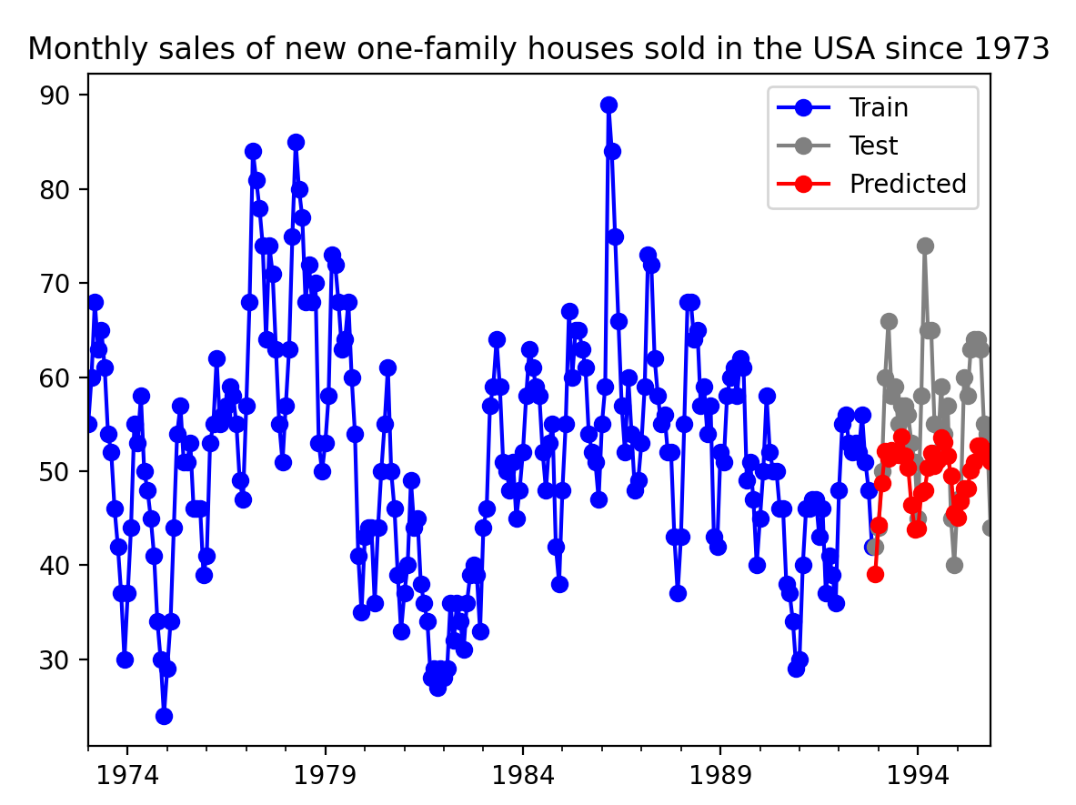
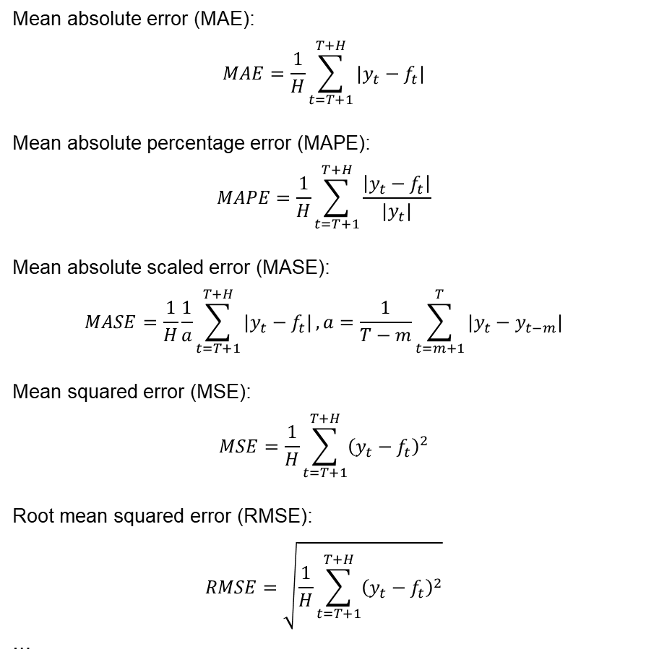
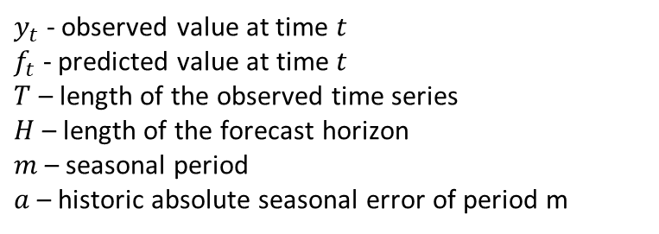
Evaluating Time Series
Mean absolute error (MAE):
$$MAE=\frac{1}{H}\sum_{t=T+1}^{T+H}{|y_{t}−f_{t}|}$$
Mean absolute percentage error (MAPE):
$$MAPE=\frac{1}{H}\sum_{t=T+1}^{T+H}{\frac{\left|y_{t}−f_{t}\right|}{|y_{t}|}}$$
Mean absolute scaled error (MASE):
$$MASE=\frac{1}{H}\frac{1}{a}\sum_{t=T+1}^{T+H}{|y_{t}−f_{t}|},a=\frac{1}{T−m}\sum_{t=m+1}^{T}{|y_{t}−y_{t−m}|}$$
Mean squared error (MSE):
$$MSE=\frac{1}{H}\sum_{t=T+1}^{T+H}{{\left(y_{t}−f_{t}\right)}^{2}}$$
Root mean squared error (RMSE):
$$RMSE=\sqrt{\frac{1}{H}\sum_{t=T+1}^{T+H}{{\left(y_{t}−f_{t}\right)}^{2}}}$$
…
$y_{t}$ - observed value at time $t$
$f_{t}$ - predicted value at time $t$
$T$ – length of the observed time series
$H$ – length of the forecast horizon
$m$ – seasonal period
$a$ – historic absolute seasonal error of period m

Slide 20
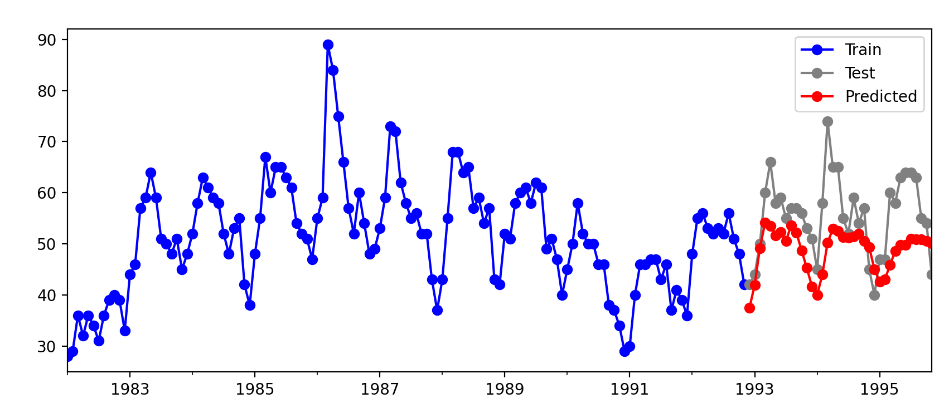
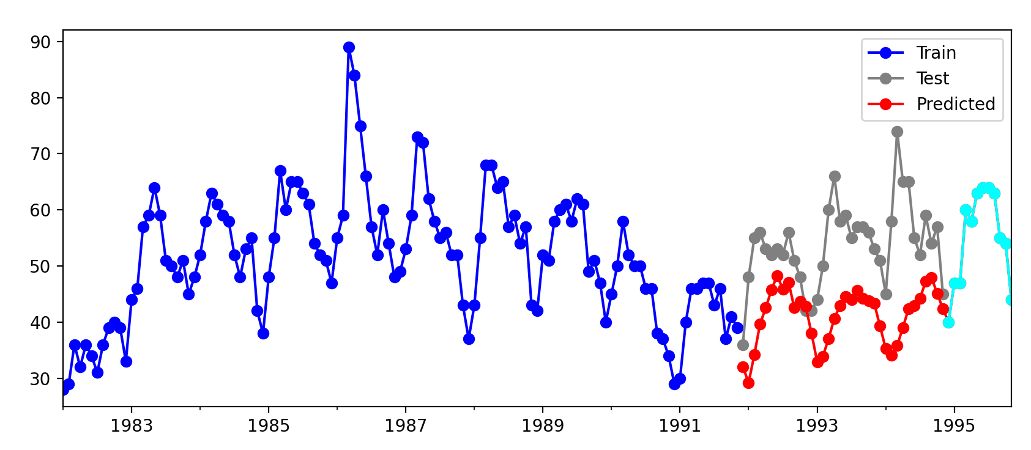
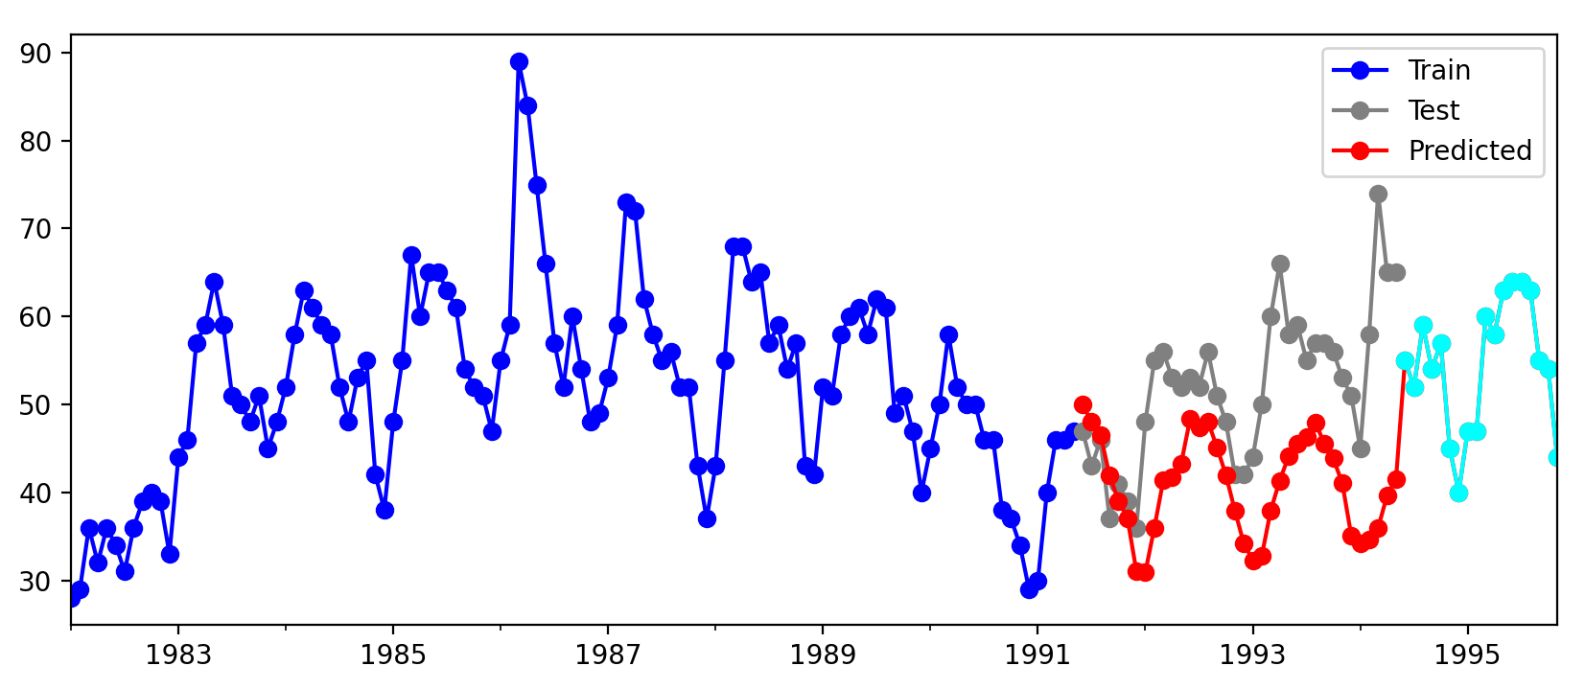
Evaluating Time Series
Hold out method
Training
Test
Repeated hold out method
The dataset is split at random point
Training
Test
Training
Test
Training
Test
…

Slide 21
Evaluating Time Series. Cross Validation
Observations are first used to test the model, and then to train it.
Suits for non-stationary environments where past historical data becomes irrelevant.
The order inside the block is maintained. The blocks are shuffled.

Slide 22
Regressive Models
Autoregressive model (AR)
Moving average model (MA)
ARMA model
ARIMA (autoregressive integrated moving average) model
…

Slide 23
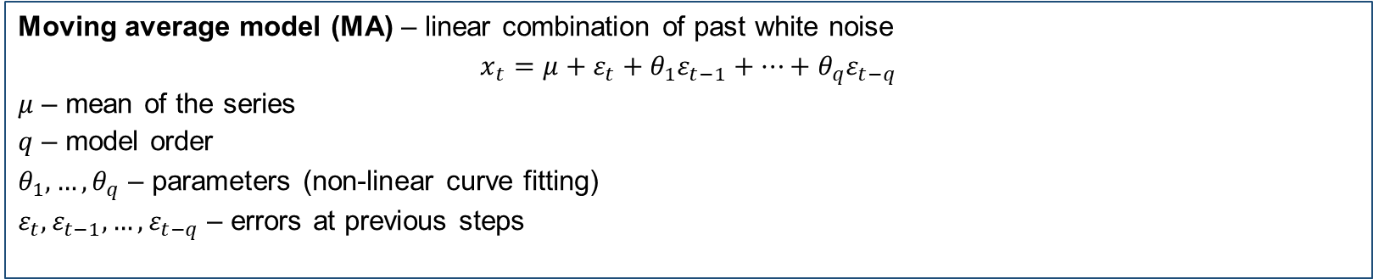
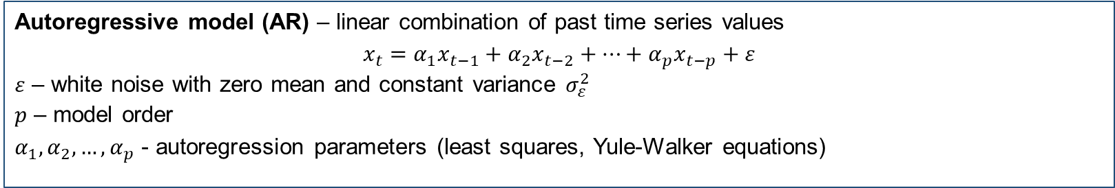
Regressive Models
Autoregressive model (AR) – linear combination of past time series values
$$x_{t}=α_{1}x_{t−1}+α_{2}x_{t−2}+…+α_{p}x_{t−p}+ε$$
$ε$ – white noise with zero mean and constant variance $σ_{ε}^{2}$
$p$ – model order
$α_{1},α_{2},…,α_{p}$ - autoregression parameters (least squares, Yule-Walker equations)
Moving average model (MA) – linear combination of past white noise
$$x_{t}=μ+ε_{t}+θ_{1}ε_{t−1}+…+θ_{q}ε_{t−q}$$
$μ$ – mean of the series
$q$ – model order
$θ_{1}, …,θ_{q}$ – parameters (non-linear curve fitting)
$ε_{t},ε_{t−1},…,ε_{t−q}$ – errors at previous steps

Slide 24
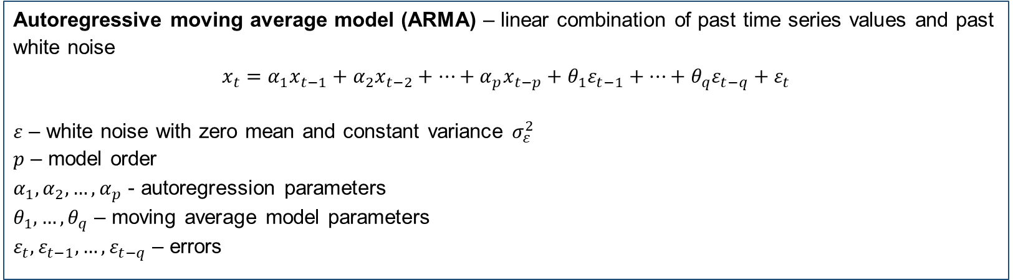
Regressive Models
Autoregressive moving average model (ARMA) – linear combination of past time series values and past white noise
$$x_{t}=α_{1}x_{t−1}+α_{2}x_{t−2}+…+α_{p}x_{t−p}+θ_{1}ε_{t−1}+…+θ_{q}ε_{t−q}+ε_{t}$$
$ε$ – white noise with zero mean and constant variance $σ_{ε}^{2}$
$p$ – model order
$α_{1},α_{2},…,α_{p}$ - autoregression parameters
$θ_{1}, …,θ_{q}$ – moving average model parameters
$ε_{t},ε_{t−1},…,ε_{t−q}$ – errors

Slide 25
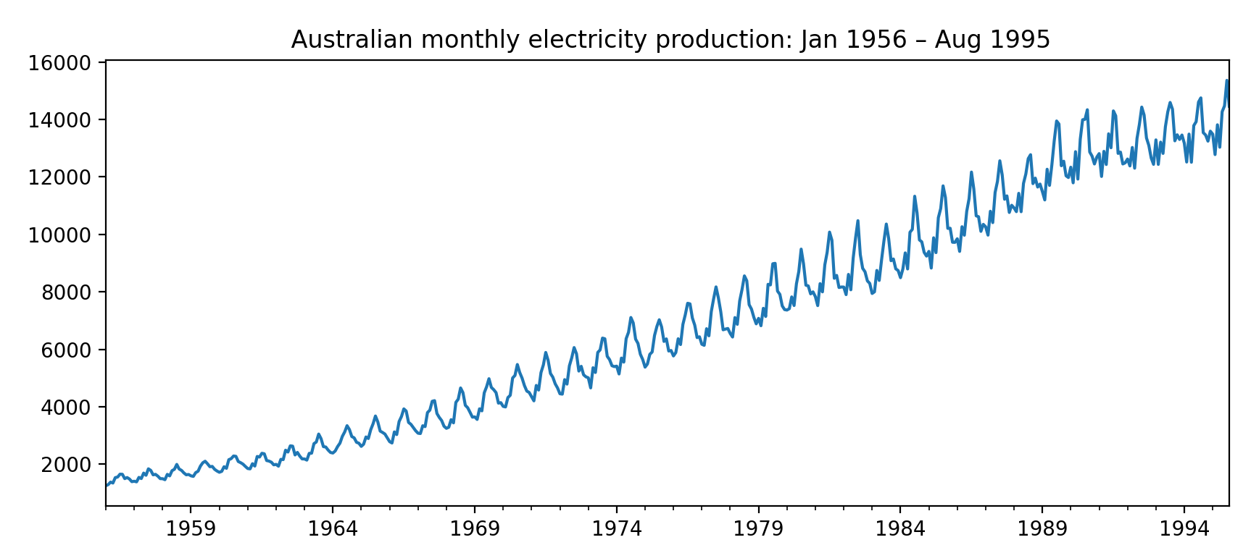
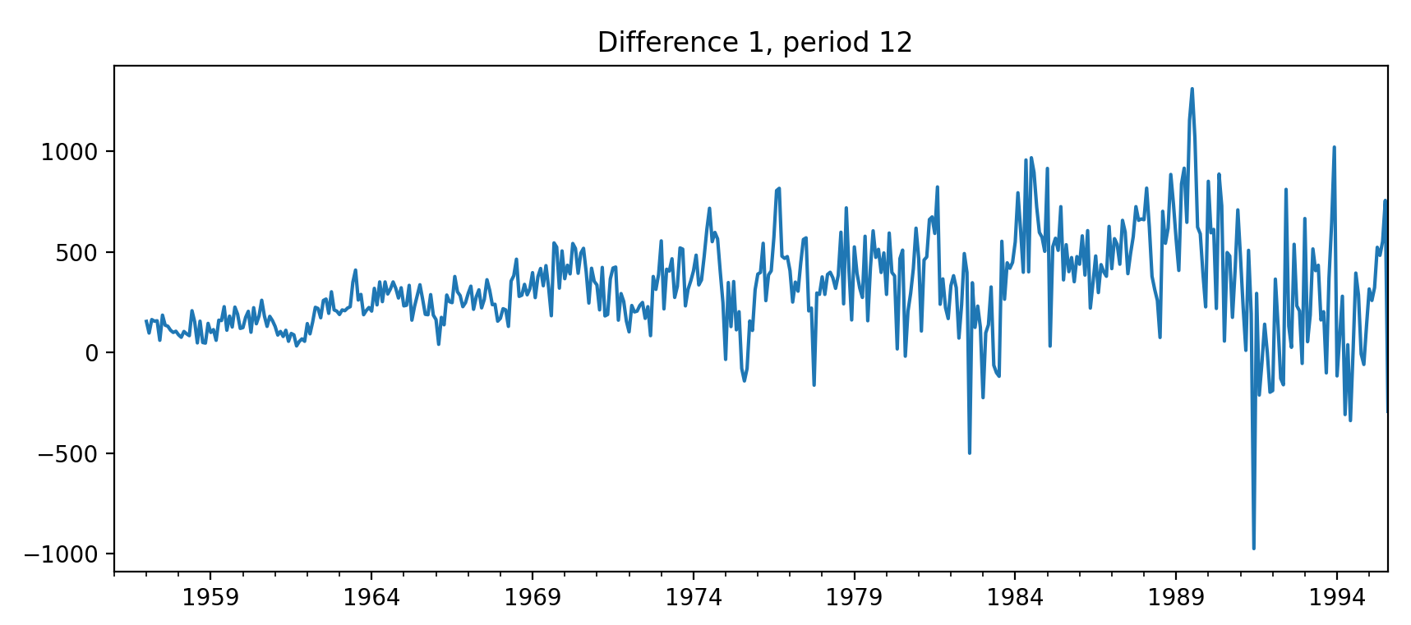
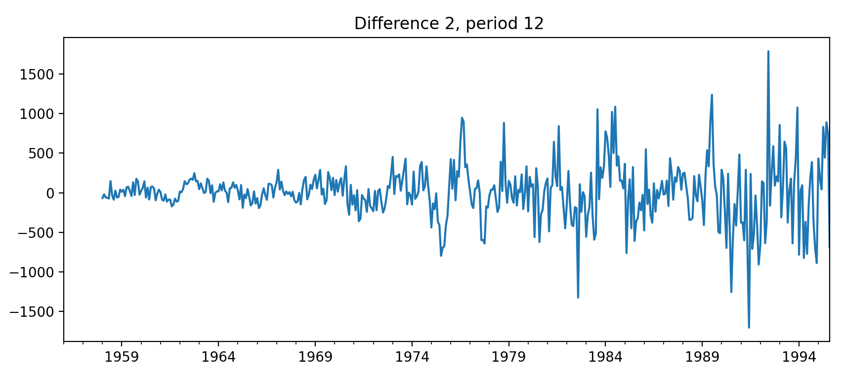
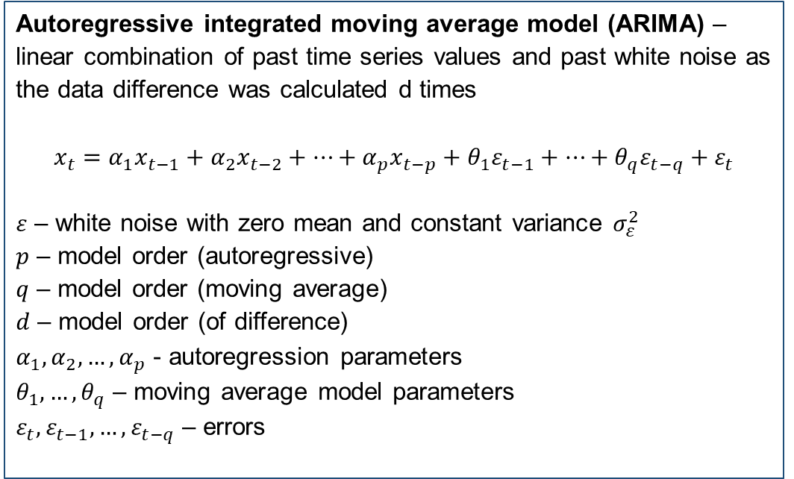
Regressive Models
Autoregressive integrated moving average model (ARIMA) – linear combination of past time series values and past white noise as the data difference was calculated d times
$$x_{t}=α_{1}x_{t−1}+α_{2}x_{t−2}+…+α_{p}x_{t−p}+θ_{1}ε_{t−1}+…+θ_{q}ε_{t−q}+ε_{t}$$
$ε$ – white noise with zero mean and constant variance $σ_{ε}^{2}$
$p$ – model order (autoregressive)
$q$ – model order (moving average)
$d$ – model order (of difference)
$α_{1},α_{2},…,α_{p}$ - autoregression parameters
$θ_{1}, …,θ_{q}$ – moving average model parameters
$ε_{t},ε_{t−1},…,ε_{t−q}$ – errors

Slide 26
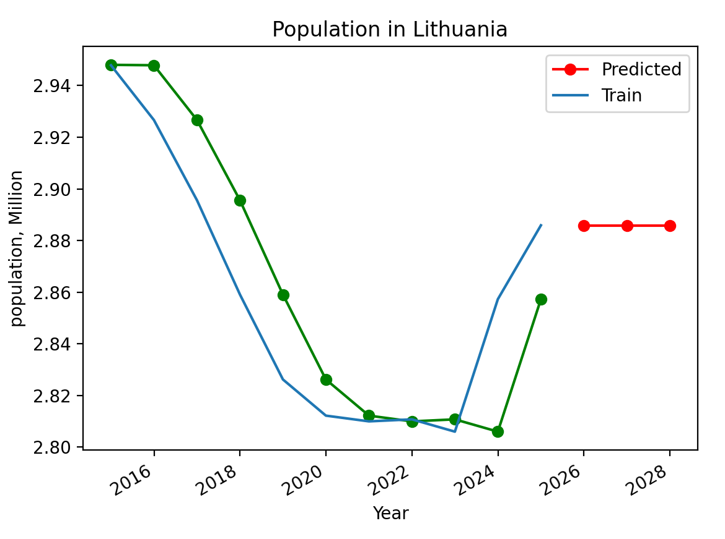
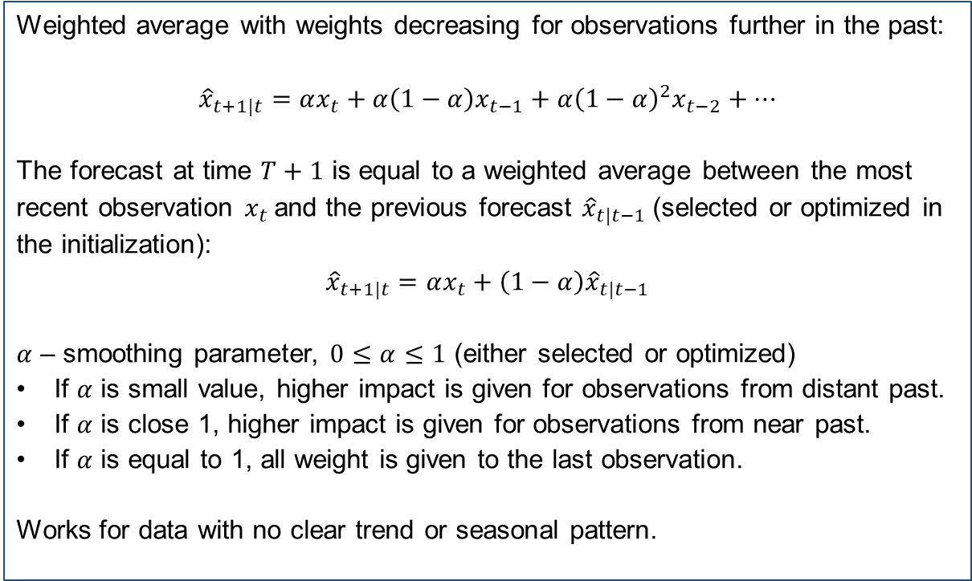
Exponential Smoothing
Weighted average with weights decreasing for observations further in the past:
$${\hat{x}}_{t+1|t}=αx_{t}+α\left(1−α\right)x_{t−1}+α{{\left(1−α\right)}^{2}x}_{t−2}+…$$
The forecast at time $T+1$ is equal to a weighted average between the most recent observation $x_{t}$and the previous forecast ${\hat{x}}_{t|t−1}$(selected or optimized in the initialization):
$${\hat{x}}_{t+1|t}=αx_{t}+\left(1−α\right){\hat{x}}_{t|t−1}$$
$α$ – smoothing parameter, $0≤α≤1$ (either selected or optimized)
If $α$ is small value, higher impact is given for observations from distant past.
If $α$ is close 1, higher impact is given for observations from near past.
If $α$ is equal to 1, all weight is given to the last observation.
Works for data with no clear trend or seasonal pattern.

Slide 27
Data Preprocessing for MLP and Random Forest
Prepare dataset to be used in supervised learning form.
Time | Value
1 | 1.72
2 | 1.25
3 | 1.5
4 | 1.18
5 | 0.95
6 | 0.54
7 | 0.37
8 | 0.09
9 | 0.57
10 | 0.1
11 | 0.49
12 | 0.46
13 | 0.27
14 | 0.75
Feature | Target
NAN | 1.72
1.72 | 1.25
1.25 | 1.5
1.5 | 1.18
1.18 | 0.95
0.95 | 0.54
0.54 | 0.37
0.37 | 0.09
0.09 | 0.57
0.57 | 0.1
0.1 | 0.49
0.49 | 0.46
0.46 | 0.27
0.27 | 0.75
Feature_1 | Feature_2 | Target
NAN | NAN | 1.72
NAN | 1.72 | 1.25
1.72 | 1.25 | 1.5
1.25 | 1.5 | 1.18
1.5 | 1.18 | 0.95
1.18 | 0.95 | 0.54
0.95 | 0.54 | 0.37
0.54 | 0.37 | 0.09
0.37 | 0.09 | 0.57
0.09 | 0.57 | 0.1
0.57 | 0.1 | 0.49
0.1 | 0.49 | 0.46
0.49 | 0.46 | 0.27
0.46 | 0.27 | 0.75
…
Sliding window = 1
Sliding window = 2

Slide 28
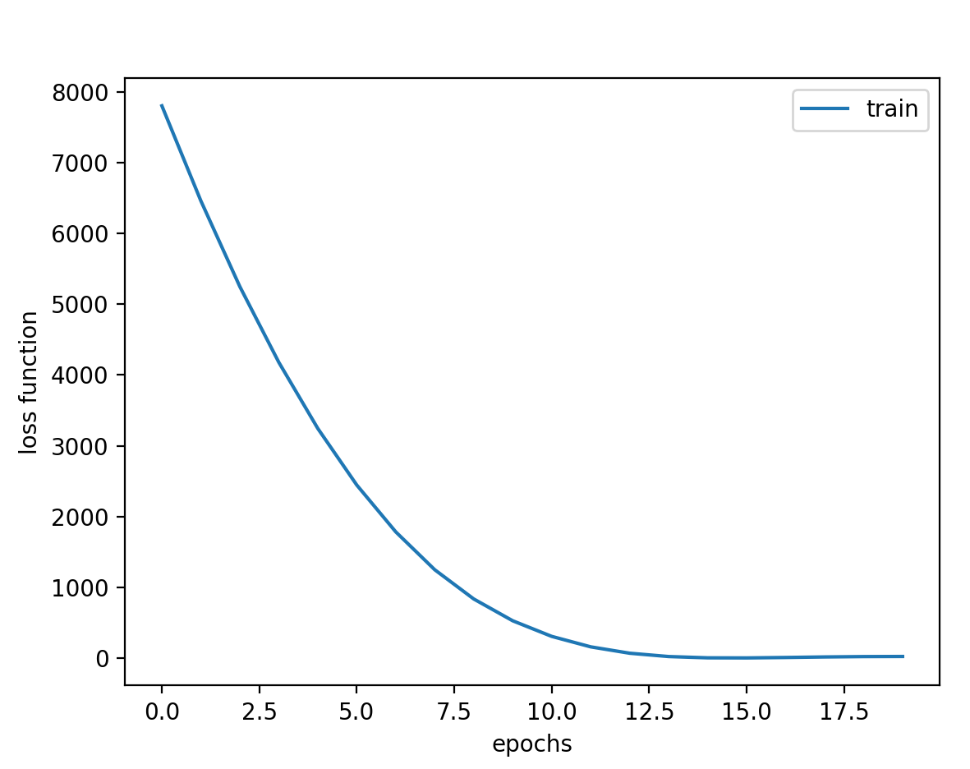
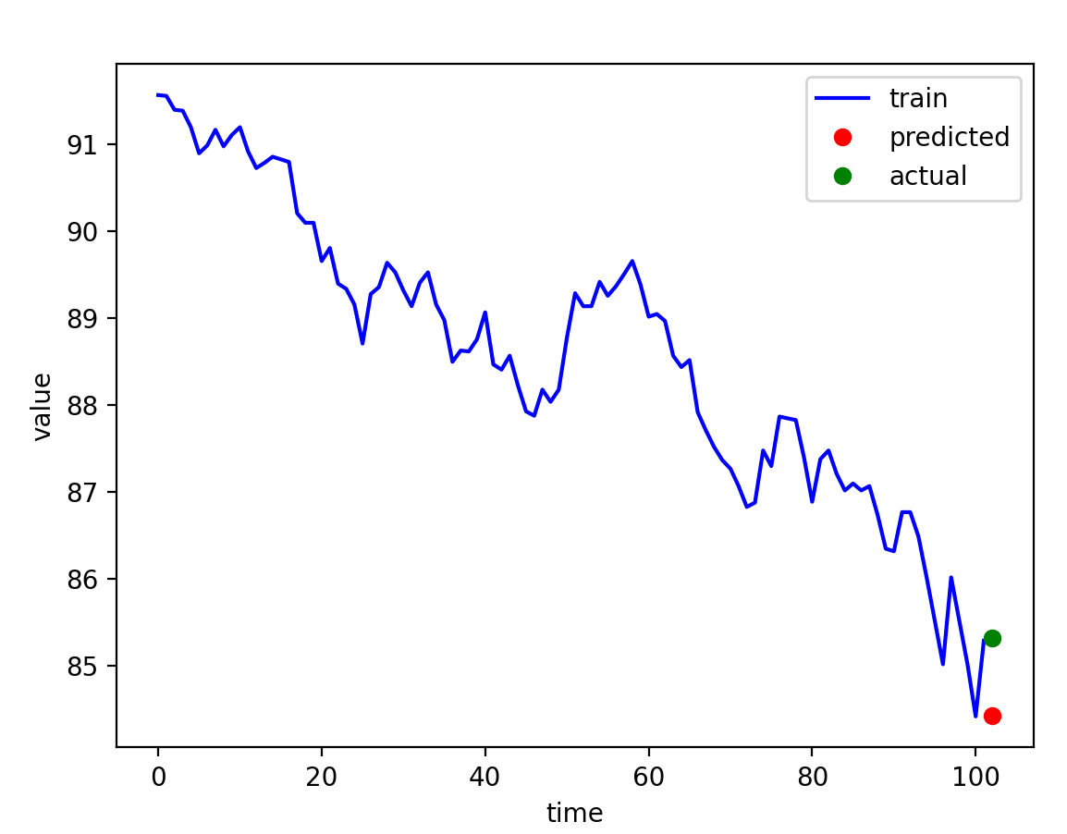





Multi-Layer Perceptron
$$x_{t−1}$$
$$x_{t−2}$$
$${\hat{x}}_{t}$$
$$…$$
$$x_{t−n}$$
n_steps = 3
model = tf.keras.Sequential() model.add(tf.keras.layers.Dense(100, activation='relu', input_dim=n_steps)) model.add(tf.keras.layers.Dense(1)) model.compile(optimizer='adam', loss='mse')
Hidden layers

Slide 29
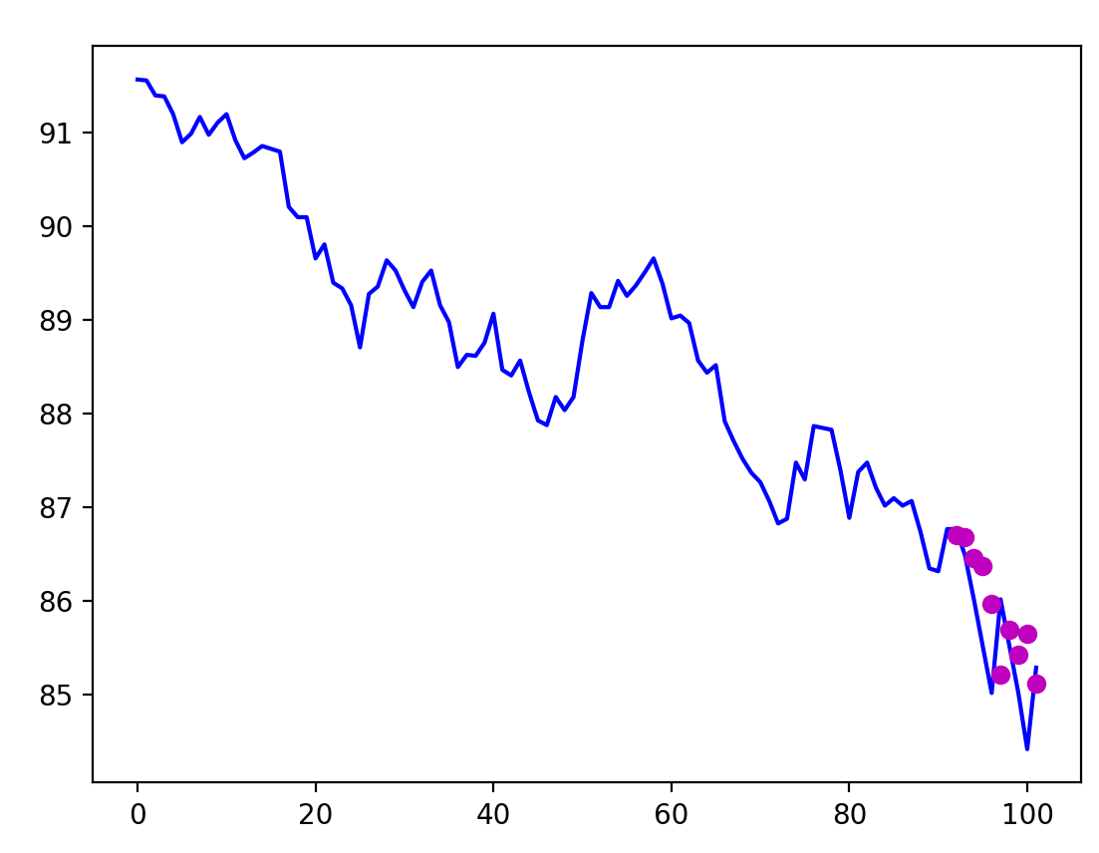
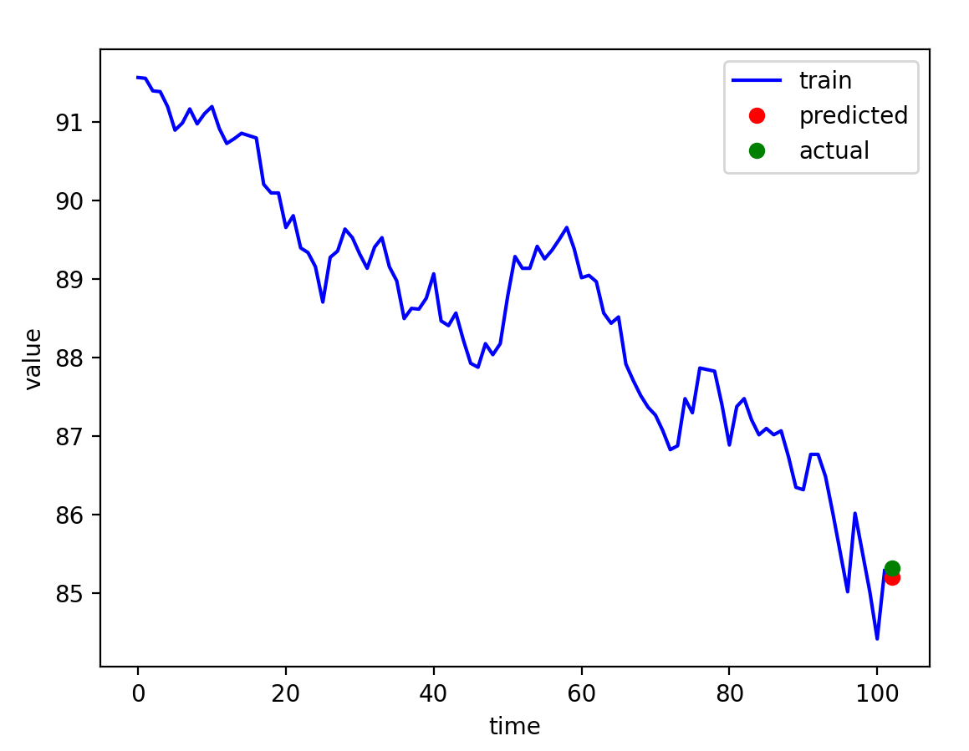
Random Forest
One-step forward validation
Multiple decision trees created using subset of data and subset of features
…
One-step forward prediction
model = RandomForestRegressor(n_estimators=50)

Slide 30
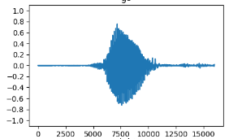
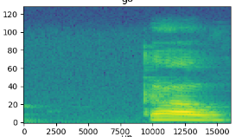
Other Machine Learning Methods
Recurrent Neural Networks
LSTM – long-short term memory
GRU – gated rectified unit
Convolutional neural networks
CNN 1D
CNN 2D (for spectral representation)
Transformers
Combinations
1D CNN+LSTM
…

Slide 31
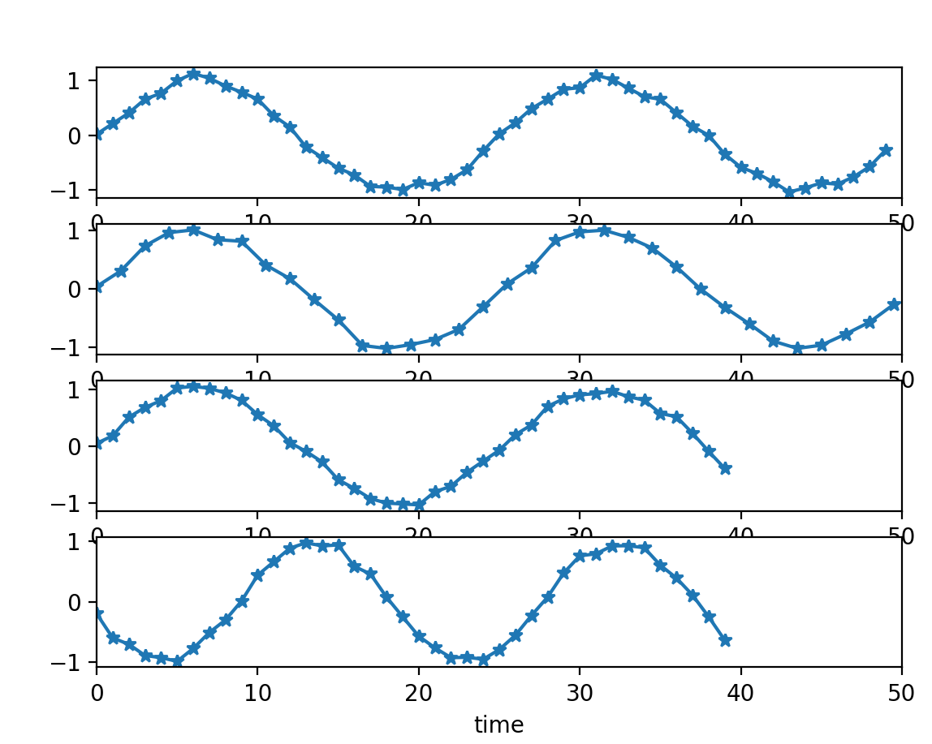
Clustering
Given multiple time series. The task is to group the similar ones (patterns in stock prices; patients with similar medical history; climate data; equipment performance, etc.).
Straightforward approach – Kmeans with Euclidean distance.
What if the sequences are of different length or start with different phase?
Dynamic Time Warping (DTW) can be used as a metric to measure similarity between temporal sequences that do not align in time, speed or length.
Extract relevant features (trend, seasonality, frequency components, and others) using statistics, Fourier transforms, wavelets, singular value decomposition.

Slide 32
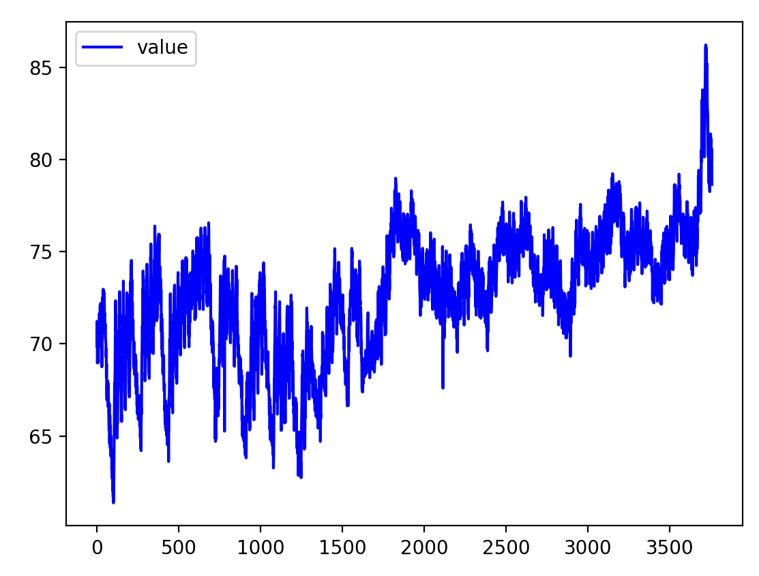
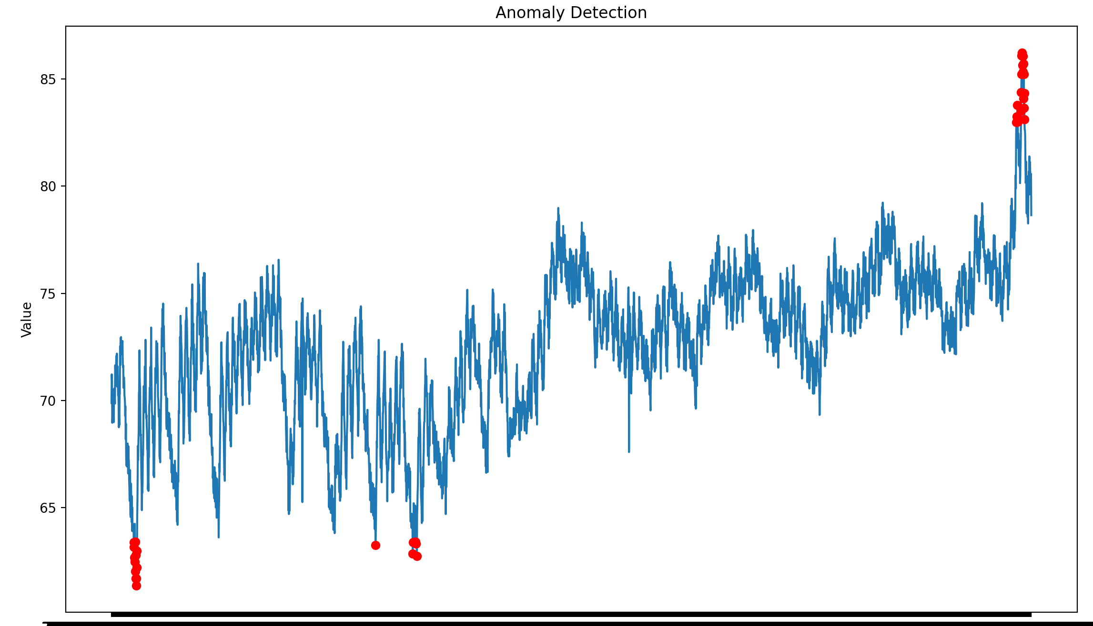
Anomaly Detection
Anomaly detection is the process of identifying data points or patterns in a dataset that deviate significantly from the norm (fraud detection, intrusion detection, failure detection, etc.).
AI model training to reconstruct regular patterns
Calculate reconstruction error between the original and reconstructed data
Values with high reconstruction error are anomalies

Slide 33
To Sum Up
Time series data has temporal dependencies, meaning that past values can influence future values. Recognizing these dependencies is crucial for accurate modeling and forecasting.
Time series data often exhibits seasonality (repeating patterns) and trends (long-term increase or decrease). Machine learning models should account for these features to improve forecasting accuracy.
Many time series models assume stationarity, so techniques like differencing or transformation may be necessary to make the data stationary, which helps improve the reliability of forecasts.
Common machine learning models for time series analysis include decision trees, Random Forest, Gradient Boosting, recurrent neural networks (RNNs) and Long Short-Term Memory (LSTM) networks.

Slide 34
For Further Reading
Gharehbaghi, Arash. Deep learning in time series analysis. CRC Press, 2023.
Palit, Ajoy K., and Dobrivoje Popovic. Computational intelligence in time series forecasting: theory and engineering applications. Springer Science & Business Media, 2006.
Peixeiro, Marco. Time series forecasting in python. Simon and Schuster, 2022.
Cerqueira, Vitor, Luis Torgo, and Igor Mozetič. "Evaluating time series forecasting models: An empirical study on performance estimation methods." Machine Learning 109.11 (2020): 1997-2028.
Benidis, Konstantinos, et al. "Deep learning for time series forecasting: Tutorial and literature survey." ACM Computing Surveys 55.6 (2022): 1-36.
Wen, Qingsong, et al. "Transformers in time series: A survey." arXiv preprint arXiv:2202.07125 (2022).
Choi, Kukjin, et al. "Deep learning for anomaly detection in time-series data: Review, analysis, and guidelines." IEEE access 9 (2021): 120043-120065.

Slide 35
Q&A
dalia.calneryte@ktu.lt

