Slide 1
Big Data and Text Mining: Project (+ proj. work)
ARASAAC Agent for
Pictogram Retrieval
Architecture & Evaluation Results
Lorenzo Pellegrino - lorenzo.pellegrino2@studio.unibo.it

Slide 2
PROJECT MAP
Three Pillars
1
2
3
app/
annotation/
eval/
The Agent
The Dataset
The Evaluation
It takes in the natural language inputs and, by using prompts, returns the window of suggested pictograms.
How the final evaluation dataset was built, starting from the provided datasets.
We simulate multiple user-like turns thanks to the dataset.
We perform multiple experiments under different models and hyperparameters and then measure retrieval and ranking quality.
2

Slide 3
APP/
The Agent: Six Phases
1
2
3
4
5
6
→
→
→
→
→
Decision
Context
Planning
Retrieval
Synset
Expansion
Ranking
Resolve: fallback chain (runs inside Phase 4)
exact → lemma → hyphen → lemma_alt → token → embedding → None
Embedding is cosine similarity against precomputed embeddings of keywords, threshold 0.75.
Ranking: two strategies compared
sequential_blocks: fills one concept at a time, following the model output order. (risk: the first concept saturates the window)
round_robin_weighted: weighted deficit round-robin shares the window instead of letting one concept monopolize it.
3
Notes:
Every message goes through 6 phases:
Decision (does it need time/schedule context?) ⇒ small LLM call only on first turn
Context (calls get_time/get_schedule)
Planning (LLM emits 5-10 concepts)
Retrieval (each concept becomes an ARASAAC keyword)
Synset expansion (WordNet synonyms)
Ranking (final window).
For resolve:
hyphen = space and separators, couple of generated keywords
lemma_alt = lemma on hyphen

Slide 4
ANNOTATION/
Where the Ground Truth Comes From
1
2
3
→
→
Three vocabularies, one merge
Merge & Filter
GPU Annotation
Manual QA
df_local: 13,800 pictograms
Production catalog, clean.
df_hf: 12,474 pictogramss
HF mirror: 20 duplicate IDs, 1,817 rows with null metadata.
df_eval: 2,461 sentences
Caregiver sentences, gold IDs point at df_hf.
arasaac_vs_hf_vs_eval.ipynb
cluster_work / SLURM
annotation_quality_evaluation.ipynb
Three sources reconciled into en_eval/: keep only sentences whose gold pictogram exists in the merged catalog.
Qwen2.5-7B-Instruct (4-bit) labels clear/vague phrasing, time of day and a plausible schedule with distractors events, based on the sentence.
1,760 rows checked.
The annotation seems realistic and only few corrections seemed necessary:
2 manual non-ASCII fixes, 30 time-of-day conflicts caught and corrected.
It produces eval_final.parquet.
Result: the merge makes sure every gold pictogram the eval sentences cite actually exists in the catalog the agent queries.
4

Slide 5
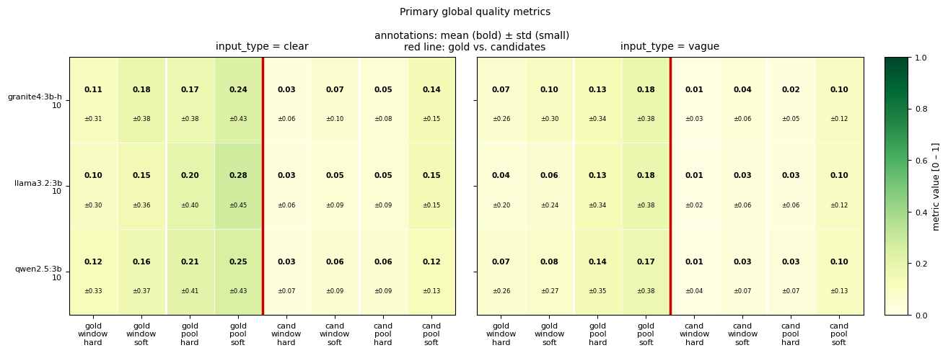
EVAL/: METHODOLOGY + FIRST RESULTS
Does Retrieval Work?
30–73×
–40 / –74%
35–45%
pool hit-rate vs. a random baseline
relative drop: the golds lost from pool to window (clear / vague)
gold-in-pool cases buried below the window cut
Absolute numbers are low partly by design: the agent's context is only time and schedule, and most real communications aren't really plannable.
Quality heatmap: all model, window, and input-type configs.
5
Notes:
hard = exact ID match
soft = weighted Jaccard over synset/category/keyword/tag (0.40/0.25/0.25/0.10, threshold 0.3)
pool = everything retrieval+synset expansion find
window = what's finally shown.
The retriever beats random by 30-73x: it isn't guessing, it's actually finding the right pictogram before ranking even gets involved.
Between "gold is in the pool" and "gold survives into the shown window," we lose a lot: 40-48% on clear inputs, 56-74% on vague, worse on vague because vaguer input makes the planner emit less precise concepts, so pools are bigger and noisier to rank.
Even when the gold pictogram IS in the pool, ranking buries it below the window cut 35-45% of the time on clear inputs, worse on vague.

Slide 6
EVAL/: ALSO WORTH CHECKING
A Few More Signals
It calls tools well.
High recall on knowing when a context tool is needed. Precision is lower and more variable: a safe, over-triggering bias.
NOTE: llama3.2:3b is the exception
Resolve is mostly deterministic.
It leans almost entirely on exact keyword and embedding matches, not on fuzzier fallbacks.
It’s fast once warm.
5–15 seconds per turn after the first call. qwen2.5:3b is consistently the fastest model.
The frist call is slower as it has to load the model in memory
NOTE: same model, same strategy, same notebook: the local run is about 4× faster than Colab.
6

Slide 7
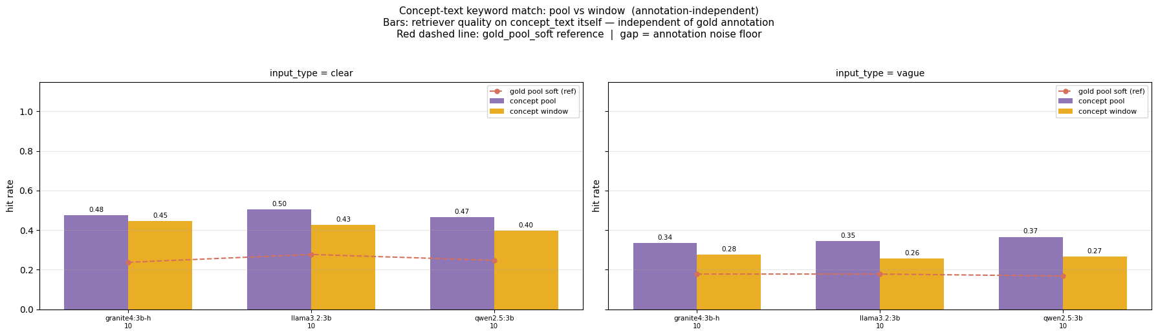
EVAL/: SECTION 5, DATASET AUDIT
What Actually Explains the Low Numbers
2–3×
~90%
7.3% vs. 13.6%
52.8%
of gold annotations are “indirect,” not literal keyword matches
gold reachable by exact keyword
vs
gold reachable by the full resolve pipeline
of annotators’ non-gold candidates share nothing with the gold
perfect vs. indirect annotations, every row, every model, no exceptions
Concept-text match (ignoring the gold label entirely) vs. gold-based match
7
Notes:
perfect = concept text is literally a gold-pictogram keyword
indirect = it isn't, though the pictogram still makes sense
Independent proof: measuring ‘did the retriever find ANYTHING relevant to the concept’ instead of the gold specifically nearly doubles the hit rate.
And 52.8% of the annotators' own non-gold candidates are completely unrelated to the gold by these same features: the dataset itself is noisy.

Slide 8
SUMMARY
Bottom Line
Retrieval works. The bottleneck is ground-truth quality.
Two independent pieces of evidence: retrieval clears random baseline by 30-73x, and hit-rate nearly doubles when measuring "found anything relevant" instead of the gold specifically.
It’s not the model.
qwen2.5:3b, llama3.2:3b, and granite4:3b-h behave almost identically: the sentence and its annotation drive the score, not the model choice.
Final pick: qwen2.5:3b + round_robin_weighted.
The fastest model, and the ranking strategy with the edge, though no single strategy dominates everywhere.
Side note: 11 of 30 sentences never score a hit ⇒ roughly half retrieval misses, half ranking misses.
8

