Slide 1

Quarterly review
Phase one
Figures in EUR millions
https://example.invalid/reports/2021/regional-performance-and-outlook/full-text
Source: report 2021

Slide 2
Market data
Key: EU, US, APAC
Figures in EUR millions
Source: report 2022

Slide 3
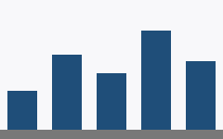
Regional detail
المبيعات حسب المنطقة
Growth in the region held through the second half, and the pipeline for the first quarter of next year is larger than it was at the same point last year, which is why the outlook has not been reduced.
Region | Change
EU | +4%
APAC | +9%
地域別の売上高
Key: EU, US, APAC
Figures in EUR millions
Source: report 2023

