Slide 1
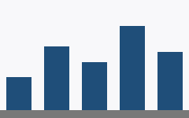
Revenue by region

Slide 2
The same chart, one bar graded

Slide 3
Too many parts, and a metafile

