Slide 1
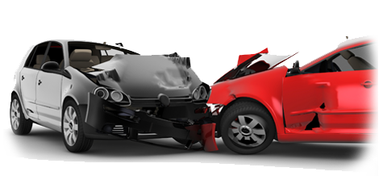


Distribution of Car Accidents in US by city
Risk Management (2020-2021)
First assignment
Lirida Papallazi
rank | city | cum_sum_percentage
1 | Houston | 2,714799455
2 | Los Angeles | 4,904996786
3 | Charlotte | 7,005082762
4 | Dallas | 8,831479719
5 | Austin | 10,49804361
6 | Miami | 11,99033866
7 | Raleigh | 13,23961185
8 | Atlanta | 14,33417892
9 | Baton Rouge | 15,34572258
10 | Nashville | 16,33449032
11 | Orlando | 17,26917707
12 | Oklahoma City | 18,20204459
13 | Sacramento | 19,10129164
14 | Phoenix | 19,87635796
15 | Minneapolis | 20,62723078
16 | San Diego | 21,322227
17 | Seattle | 21,98386265
18 | Richmond | 22,64320653
19 | San Antonio | 23,29331246
20 | Jacksonville | 23,86056036
The Dataset
The dataset reports the information on more than 420.000 car accidents across the US.
It is possible to observe that the first 20 Cities account for 23% of the accidents, and circa the 0.017% of the cities account instead for the 80% of the cases..

Slide 2
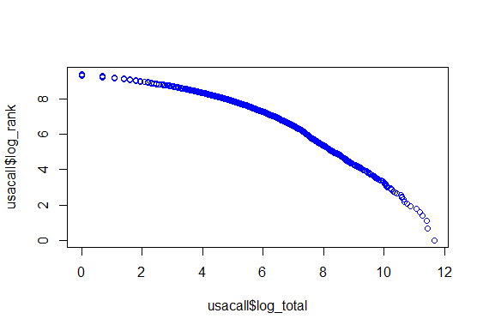
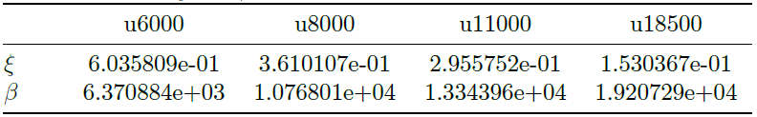
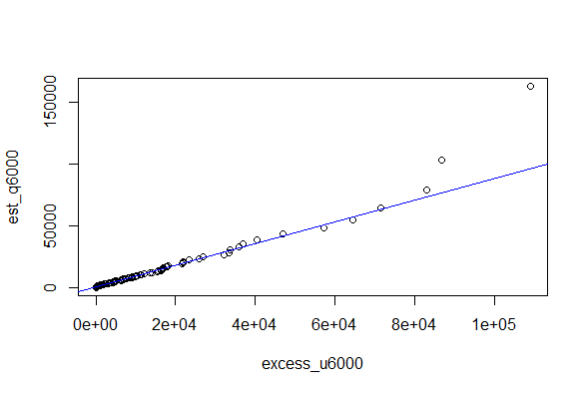
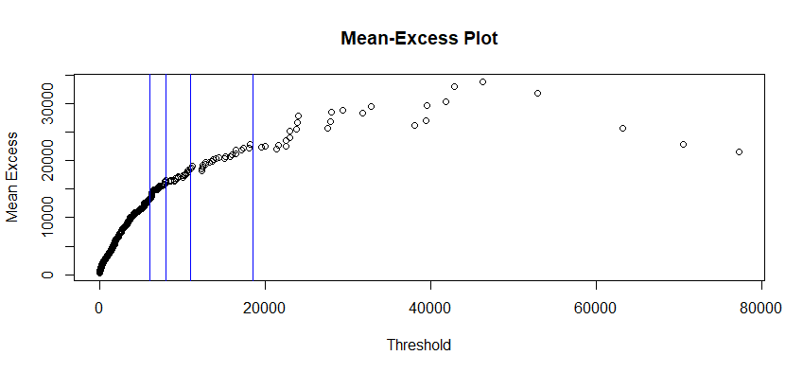
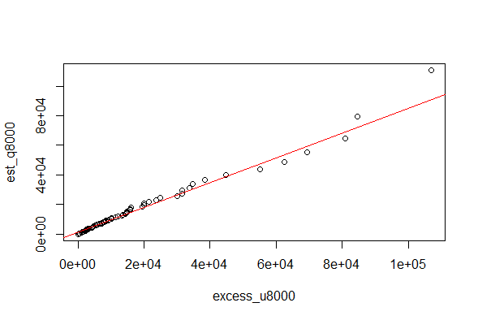
Xis and Betas estimation via Maximum likelihood estimation for the four selected thresholds.
Log-Log Scale
From the plot of the log-log scale, the distribution seems to behave like a power-law.
Mean-Excess
Through the Mean-excess function is possible to validate the model and the choice of the thresholds.
The vertical lines represent the threshold in the points where the slope of the curve changed, namely at 6.000, 8.000, 11.000 and 18.500.
The decision for thresholds equal to 6.000 and 8.000 is because they are respectively the first and second kink of our Mean Excess Function.

