Slide 1
Diagramm Aussetzung Fahrerlaubnis bestimmen
BD0020_001
Aussetzung Fahrerlaubnis bestimmen
BD0020
RF0055_001
Aussetzung Fahrerlaubnis
Test Physis
Test Psyche
RF0054_001
Test Psyche
Bewertung Fahrverhalten
RF0052_001
Test Physis
Alter Sehtest in Monaten
Alter Reaktionstest in Monaten
RF0053_001
Bewertung Fahrverhalten
Anzahl Verkehrsverstösse letzte 12 Monaten
Inkl. schwere Verkehrsverstösse
RF0051_001
Sehtest
Alter Sehtest in Monaten
RF0050_001
Reaktionstest
Alter Reaktionstest in Monaten

Slide 2
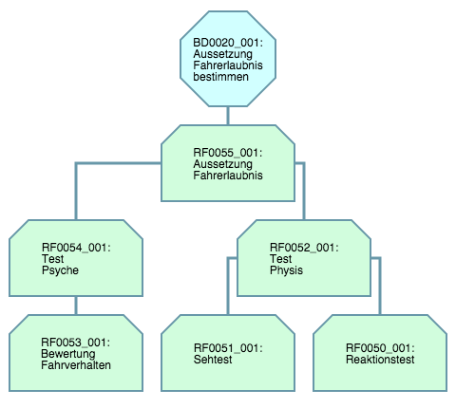

Slide 3
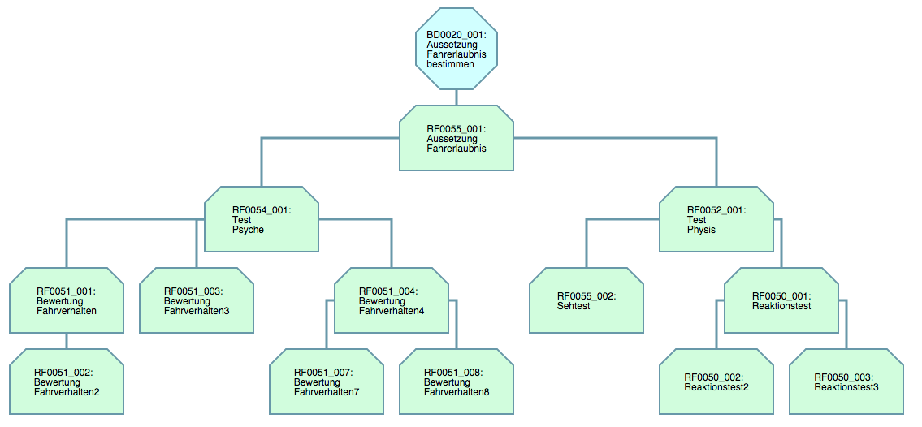

Slide 4
<id>
<name>
<id>
<name>
<id>
<conclusion>
<list of conditions in family>
<id>
<conclusion>
<list of conditions in family>
<id>
<conclusion>
<list of conditions in family>
<id>
<name>
<id>
<conclusion>
<list of conditions in family>
<id>
<conclusion>
<list of conditions in family>
<id>
<conclusion>
<list of conditions in family>

Slide 5
<id>
<name>
<id>
<name>
<id>
<conclusion>
<list of conditions in family>
<id>
<conclusion>
<list of conditions in family>
<id>
<conclusion>
<list of conditions in family>
<id>
<conclusion>
<list of conditions in family>
<id>
<conclusion>
<list of conditions in family>

Slide 6
<id>
<name>
<id>
<conclusion>
<list of conditions in family>
<id>
<conclusion>
<list of conditions in family>
<id>
<conclusion>
<list of conditions in family>
<id>
<conclusion>
<list of conditions in family>

Slide 7
<id>
<name>
<id>
<conclusion>
<list of conditions in family>
<id>
<conclusion>
<list of conditions in family>
<id>
<conclusion>
<list of conditions in family>
<id>
<conclusion>
<list of conditions in family>
<id>
<conclusion>
<list of conditions in family>

Slide 8
<id>
<name>
<id>
<conclusion>
<list of conditions in family>
<id>
<conclusion>
<list of conditions in family>
<id>
<conclusion>
<list of conditions in family>
<id>
<conclusion>
<list of conditions in family>
<id>
<conclusion>
<list of conditions in family>
<id>
<conclusion>
<list of conditions in family>
<id>
<conclusion>
<list of conditions in family>

Slide 9
<id>
<name>
<id>
<conclusion>
<list of conditions in family>
<id>
<conclusion>
<list of conditions in family>
<id>
<conclusion>
<list of conditions in family>
<id>
<conclusion>
<list of conditions in family>
<id>
<conclusion>
<list of conditions in family>
<id>
<conclusion>
<list of conditions in family>
<id>
<conclusion>
<list of conditions in family>
<id>
<conclusion>
<list of conditions in family>

Slide 10
<id>
<name>
<id>
<conclusion>
<list of conditions in family>
<id>
<conclusion>
<list of conditions in family>
<id>
<conclusion>
<list of conditions in family>
<id>
<conclusion>
<list of conditions in family>
<id>
<conclusion>
<list of conditions in family>
<id>
<conclusion>
<list of conditions in family>
<id>
<conclusion>
<list of conditions in family>

Slide 11
<id>
<name>
<id>
<conclusion>
<list of conditions>
<id>
<conclusion>
<list of conditions>
<id>
<conclusion>
<list of conditions>
<id>
<conclusion>
<list of conditions>
<id>
<conclusion>
<list of conditions>

Slide 12
group-rule-family
group-element
<id>
<conclusion>
<list of conditions>
rule-family
group-children

