Slide 1


Team Phosphorus HQC TeamWork
Team members:
Mariela Kassovska
Spas Kyuchukov
Dobromir Kralev Pirin Karabenchev
Project URL: https://github.com/lolotobg/hangman

Slide 2
Team Phosphorus HQC TeamWork
Hangman
Project URL: https://github.com/lolotobg/hangman

Slide 3
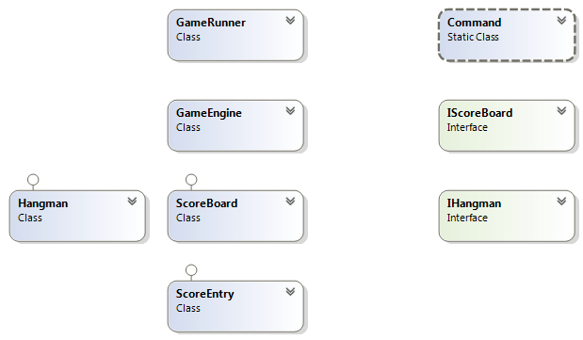
Team Phosphorus HQC TeamWork
Class diagram:
Project URL: https://github.com/lolotobg/hangman

Slide 4
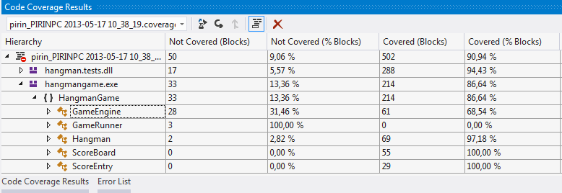
Team Phosphorus HQC TeamWork
Project URL: https://github.com/lolotobg/hangman

Slide 5
Team Phosphorus HQC TeamWork
Some statistics:
More than 65 commits
40 tests introduced
More than 20 post in the facebook group
More than 100 comments
Project URL: https://github.com/lolotobg/hangman

Slide 6
Team Phosphorus HQC TeamWork
Questions?
Project URL: https://github.com/lolotobg/hangman

Slide 7
Team Phosphorus HQC TeamWork
Thank you!
Project URL: https://github.com/lolotobg/hangman

