Slide 1



Art by GAN
Name: Lathika D
NM ID: au211521104078
CLG Name: Panimalar Institute of Technology

Slide 2

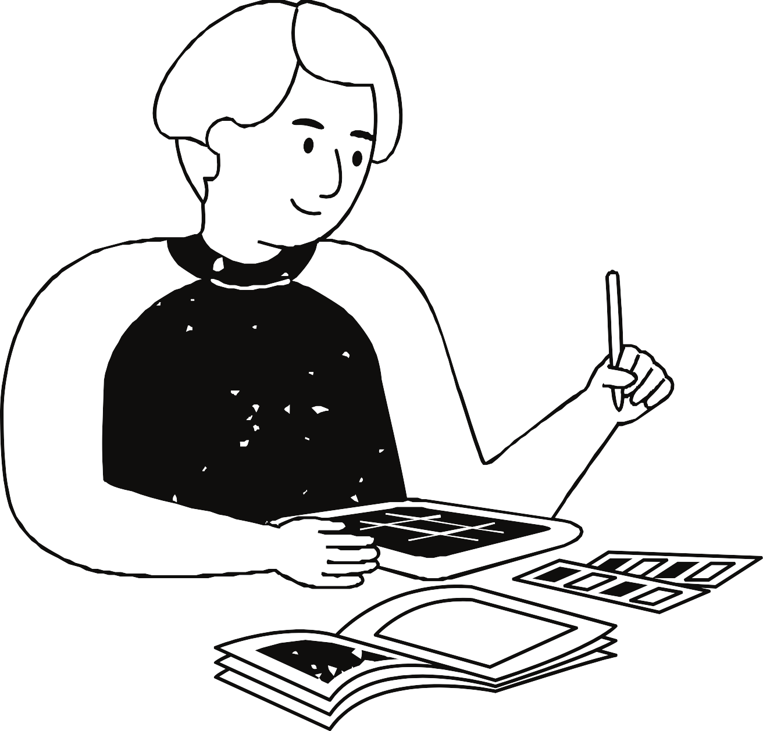
Art by GAN
Our project aims to employ Generative Adversarial Networks (GANs) for the generation of portrait images, a task that lies at the intersection of artificial intelligence and computer vision. GANs, comprising a generator and a discriminator in a competitive setting, have demonstrated remarkable capabilities in producing realistic synthetic data
In our endeavor, we train a GAN model on a dataset of portrait images,
wherein the generator learns to synthesize new portraits by capturing the underlying patterns and features of human faces. The discriminator, on the other hand, strives to distinguish between real and generated portraits, thereby honing the generator's ability to produce increasingly convincing images
Through iterative training, the GAN refines its ability to
portraits with intricate details, diverse expressions, and
generate realistic training
characteristics. Our project explores the architecture,
methodology, and outcomes of this GAN-based portrait generation process, shedding light on the advancements and challenges in AI- driven image synthesis.

Slide 3
AGENDA
Introduction to Generative Adversarial Networks (GANs):
Overview of GANs and their architecture.
Explanation of how GANs are used for image generation tasks.
Dataset Acquisition and Preprocessing:
Description of the portrait image dataset used in our project.
Preprocessing steps such as resizing, normalization, and augmentation.
Architecture and Training of GAN Model:
Detailed insight into the architecture of the generator and discriminator networks.
Explanation of the training process, including loss functions, optimizers, and training
iterations.
Assessment of the generated portrait images for realism, diversity, and quality.
Comparison of generated portraits with real images and discussion on the challenges faced.
Evaluation and Results:
Future Directions and Conclusion:
Exploration of potential enhancements to the GAN model.
Reflection on the project outcomes and implications for future research in AI-driven image synthesis.

Slide 4
PROBLEM
STATEMENT
The task of generating high-quality portrait images using Generative Adversarial Networks (GANs) poses several challenges, including capturing the subtle nuances and intricate details of human faces, ensuring diversity and realism in the generated images, and overcoming the potential for mode collapse or lack of convergence during training. This project aims to address these challenges by developing and training a GAN model capable of producing realistic and diverse portrait images. The project seeks to explore effective architectural choices, training methodologies, and evaluation metrics to enhance the quality and diversity of generated portraits, thus advancing the state-of-the-art in AI-driven portrait generation.

Slide 5



Project Overview
Introduction: Generating realistic portrait images is challenging due to facial complexity. GANs offer promise by training a generator to produce convincing images, while a discriminator distinguishes real from fake.
Dataset and Preprocessing: Acquire diverse portrait datasets and preprocess for uniformity. Data split into training, validation, and test sets.
Model Architecture: GAN consists of a generator and discriminator. Experiment with architectural choices to optimize performance.
Training and Optimization: Adversarial training: Generator produces realistic images, discriminator improves discernment. Optimization techniques such as SGD and Adam are employed.
Evaluation and Results: Metrics assess image quality, diversity, and similarity to
real portraits. Qualitative and quantitative comparisons with real images are conducted.
Conclusion and Future Directions: Demonstrates GAN efficacy in portrait
generation. Future work includes conditional GANs and novel loss functions to enhance performance.

Slide 6
Who are the end users?
Artists & Creatives: Utilize generated exploring diverse styles and compositions.
Photographers: Incorporate generated
portraits as references for artwork,
composites,
images for digital
experimenting with lighting and poses.
Content Creators: Enhance visual storytelling in films, games, and advertisements with diverse characters and scenes.
Researchers & Developers: Employ the system for experimentation, benchmarking, and integration into AI systems.

Slide 7
Solution & Value
Proposition
Solution:
Our system employs advanced Generative Adversarial Networks (GANs) to generate lifelike portrait images.
Value Proposition:
High-Quality Portraits: Produce realistic and diverse portrait images suitable for various applications.
Creative Inspiration: Artists and designers can use generated portraits as references for artwork, sparking creativity.
Efficiency: Save time and resources by generating portraits digitally, eliminating the need for extensive photoshoots.
Versatility: Serve diverse end users including artists, photographers, content creators, and researchers.
Innovation: Harness cutting-edge AI technology for image synthesis, staying ahead in the digital era.

Slide 8
Wow in your solution
Wow Factor: Revolutionizing Portrait Generation
Cutting-Edge Technology: Our system utilizes state-of-the-art Generative Adversarial Networks (GANs) to produce stunning portrait images.
Realism & Diversity: Witness the incredible realism and diversity in the generated portraits, showcasing the capabilities of our advanced AI algorithms.
Creative Inspiration: Experience the creative possibilities unlocked by our system, providing artists and designers with an endless wellspring of inspiration.
Efficiency & Innovation: By digitally generating portraits, we revolutionize traditional workflows, saving time, resources, and unlocking new avenues for innovation.
Cross-Industry Impact: From art and photography to media and research, our solution transcends boundaries, catering to diverse end users and industries.

Slide 9
Modelling
Architectural Innovation: Our portrait generation system is meticulously designed, employing a sophisticated architecture based on Generative Adversarial Networks (GANs).
Generator Network: The heart of our system, the generator network, transforms random noise into intricate and lifelike portrait images through a series of convolutional and upsampling layers.
Discriminator Network: The discriminator network acts as a discerning critic, meticulously evaluating the authenticity of generated portraits, thereby guiding the generator towards producing increasingly realistic results.
Optimization Strategies: Through advanced optimization techniques such as stochastic gradient descent (SGD) and Adam, our model continuously refines its parameters to achieve optimal performance and convergence.
Iterative Training: The training process involves iterative optimization of both the generator and discriminator networks, fostering a competitive dynamic that drives the system towards generating high-quality and diverse portrait images.

Slide 10
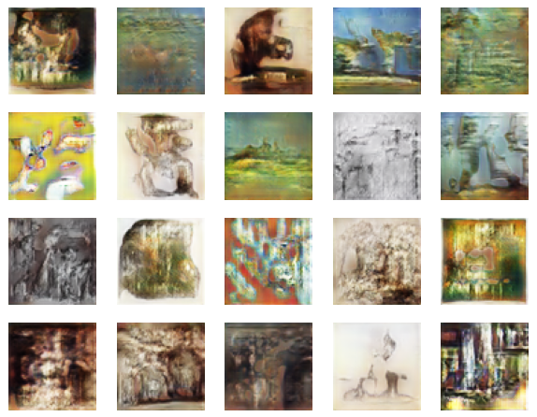
Result

Slide 11
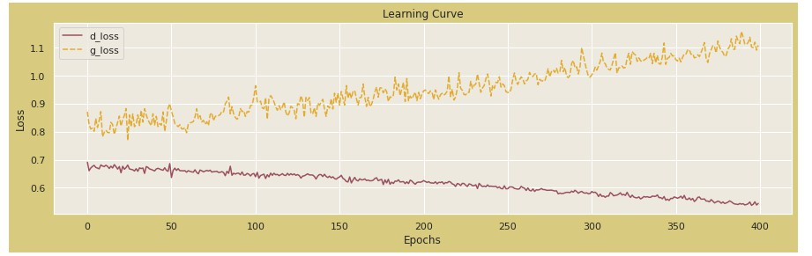
Result
Demo Link

