Slide 1
INTRODUCTION
Binary Addition
Half & Full Adders
Parallel Adders

Slide 2
Binary Addition
Conceptually similar to decimal addition
Example: Add the binary numbers 1010 and 11
(carry)
1
1 0 1 0
+ 1 1
1
1
0
1

Slide 3
QUIZ
Add the Binary numbers 11010 and 1100
(carry)
1
(carry)
1
1 1 0 1 0
+ 1 1 0 0
1
0
0
1
1
0

Slide 4
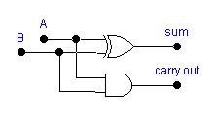
Half Adder
Logic device that adds two binary numbers
Only adds Least Significant Digit (LSD) column (1s column) in binary addition
Input Output
Logic Symbol:
A
Half
Adder
Σ (sum)
B
C₀ (carry out)
Logic Diagram:

Slide 5
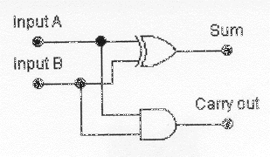
QUIZ
Q#1- This circuit is called a ___.
Q#2- What are the sum and carry out outputs
from the half adder circuit?
Q#3- What are the sum and carry out outputs
from the half adder circuit?
Q#4- What are the sum and carry out outputs
from the half adder circuit?
Q#5- What are the sum and carry out outputs
from the half adder circuit?
ANS: Half-adder
ANS: Sum=0, Carry out=0
ANS: Sum=1, Carry out=0
ANS: Sum=0, Carry out=1
ANS: Sum=1, Carry out=0
A = 0
B = 0
A = 0
B = 1
A = 1
B = 1
A = 1
B = 0
?
?

Slide 6
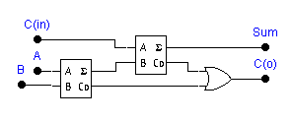
Full Adder
Used for adding binary place values other than the 1s place
Input Output
Logic Symbol:
C_{in}
Full
Adder
Σ (sum)
A
B
C₀ (carry out)
Logic Diagram:

Slide 7
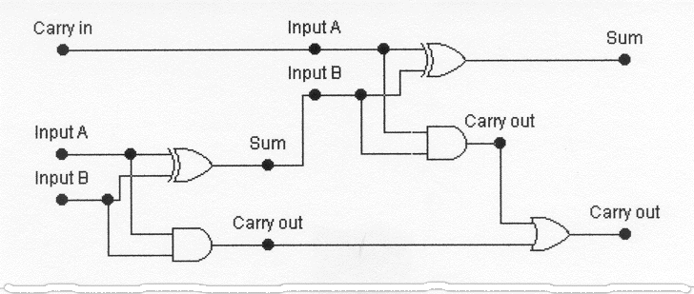
QUIZ
Q#1- This combinational logic circuit is described as a(n) ___.
Q#2- What are the sum and carry out outputs of this
full-adder circuit?
Q#3- What are the sum and carry out outputs of this
full-adder circuit?
Q#4- What are the sum and carry out outputs of this
full-adder circuit?
Q#5- What are the sum and carry out outputs of this
full-adder circuit?
Q#6- What are the sum and carry out outputs of this
full-adder circuit?
ANS: full-adder
ANS: Sum=0, Carry out=0
ANS: Sum=1, Carry out=0
ANS: Sum=0, Carry out=1
ANS: Sum=1, Carry out=1
ANS: Sum=0, Carry out=1
Cin = 0
A = 0
B = 0
Cin = 0
A = 0
B = 1
Cin = 1
A = 0
B = 1
Cin = 1
A = 1
B = 1
Cin = 0
A = 1
B = 1
?
?

Slide 8
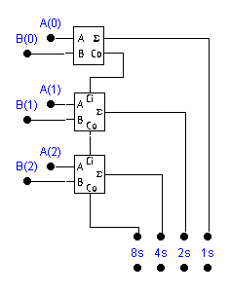
Parallel Adding
Use half adder for LSD
Use full adder for other digits
A₂ A₁ A₀
+ B₂ B₁ B₀

Slide 9
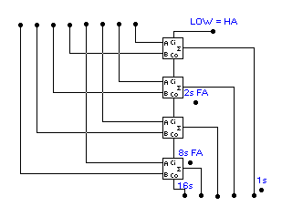
Parallel Adder
Enter binary numbers
to be added here
1 1 1 0 + 0 1 1 0
1 1 0 0 + 1 1 1 1
0 0 1 1 + 1 0 0 0
1 0 1 0 0
1 1 0 1 1
0 1 0 1 1
SUM appears here
1s place uses half-adder
2s, 4s, 8s places use full adders
Parallel adders are available in IC form.
©2008 The McGraw-Hill Companies, Inc. All rights reserved.

Slide 10
QUIZ
Q#1- With the top full adder’s Cin input LOW, this operates
as a half-adder while the bottom three are full adders. (T or F)
Q#2- When the 4-bit parallel adder adds binary 1100 and 0011
the sum appearing at the lower right will be ___.
Q#3- When the 4-bit parallel adder adds binary 0111 and 1001
the sum appearing at the lower right will be ___.
Q#4- When the 4-bit parallel adder adds binary 1101 and 1001
the sum appearing at the lower right will be ___.
Q#5- When the 4-bit parallel adder adds binary 0011 and 0110
the sum appearing at the lower right will be ___.
Q#6- When the 4-bit parallel adder adds binary 1111 and 1111
the sum appearing at the lower right will be ___.
Q#7- When the 4-bit parallel adder adds binary 1010 and 1001
the sum appearing at the lower right will be ___.
4-bit number
4-bit number
ANS: True
ANS: 01111
ANS: 10000
ANS: 10110
ANS: 01001
ANS: 11110
ANS: 10011

