Slide 1
Digital Electronics
Principles & Applications
Seventh Edition
Roger L. Tokheim
Chapter 3
Logic Gates
©2008 The McGraw-Hill Companies, Inc. All rights reserved.

Slide 2
INTRODUCTION
The AND Gate
The OR Gate
The Inverter
The NAND Gate
The NOR Gate
The XOR Gate
The XNOR Gate
NAND as Universal Gate
Gates with More Than Two Inputs
Using Inverters to Convert Gates
TTL & CMOS Gates
Troubleshooting Gating Circuits
IEEE Logic Symbols
Logic Functions using Software

Slide 3
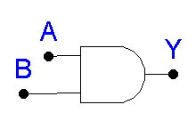
“All or Nothing Gate”
Boolean Expression: A · B = Y
Truth Table (See next slide)
The AND Gate

Slide 4
Truth Table - AND Gate

Slide 5

What is the output of the AND gate?
QUIZ
L
L
H
H
Low
High
?
?
L
H
H
L
Low
Low
?
?
Unique Output: Output HIGH only when all inputs are HIGH.

Slide 6
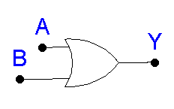
“Any or All Gate”
Boolean Expression: A + B = Y
Truth Table (See next slide)
The OR Gate

Slide 7
Truth Table - OR Gate

Slide 8

What is the output of the OR gate?
QUIZ
H
H
H
L
High
High
?
?
L
L
Low
L
H
?
High
?
Unique Output: Output LOW only when all inputs are LOW.

Slide 9
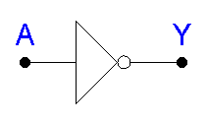
NOT Circuit
Gives output that is not the same as the input.
Boolean Expression: Y = A or Y = A‘
Double inverting: A = A
NOT gate inverts, or complements, or negates
The Inverter

Slide 10
QUIZ
If the input to an inverter is LOW, the output will be __________.
HIGH
2. If the input to an inverter is HIGH, the output will be __________.
LOW
3. A NOT gate is said to invert, to negate or to complement the input. (True or False)
True
4. A NOT gate is also called commonly called a(n) __________ (AND gate, inverter).
inverter

Slide 11
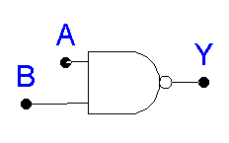
NOT AND or inverted AND function.
Boolean Expression: A · B = Y
or (A · B)' = Y
Truth Table (See next slide)
The NAND Gate

Slide 12
Truth Table - NAND Gate

Slide 13

What is the output of the NAND gate?
QUIZ
L
L
L
H
High
High
?
?
H
H
H
L
Low
High
?
?
Unique Output: Output LOW only when all inputs are HIGH.

Slide 14
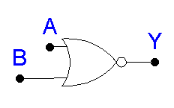
NOT OR or Inverted OR
Boolean Expression: A + B = Y
or (A + B)' = Y
Truth Table (See next slide)
The NOR Gate

Slide 15
Truth Table - NOR Gate

Slide 16
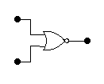
QUIZ
What is the output of the NOR gate?
L
L
L
H
High
Low
?
?
H
L
H
H
Low
Low
?
?
Unique Output: Output HIGH when all inputs are LOW.

Slide 17
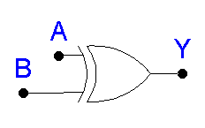
Known as “Exclusive OR” Gate
“Anything but not all” Gate
Boolean Expression: A ⊕ B = Y
Truth Table (See next slide)
The XOR Gate

Slide 18
Truth Table - XOR Gate

Slide 19

What is the output from the XOR gate?
QUIZ
L
L
L
L
L
H
High
?
?
?
Low
H
H
H
High
H
H
L
?
?
?
Low
XOR output is HIGH only when odd number of inputs are HIGH

Slide 20
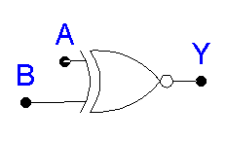
Known as the Exclusive NOR Gate
The Inverted XOR
Boolean Expression: A ⊕ B = Y
or (A ⊕ B)' = Y
Truth Table (See next slide)
The XNOR Gate

Slide 21
Truth Table - XNOR Gate

Slide 22

QUIZ
What is the output from this XNOR gate?
L
L
L
High
L
H
L
?
Low
?
H
H
L
H
H
H
High
Low
?
?
XNOR output is HIGH only when odd number of inputs are LOW

Slide 23
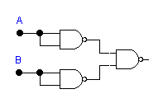
The NAND as a Universal Gate
“Universal gate” can be used in combination to create any other logic function.
Example:
Shorting NAND inputs
Yields the NOT logic function
Equal to the
OR logic function
A + B

Slide 24
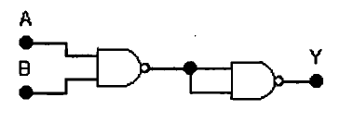
QUIZ
1. NAND gates can be wired together to convert to other logic functions (True or False).
True
2. These two NAND gates wired together will produce the ______ (AND, XOR) logic function.
AND

Slide 25
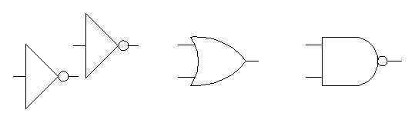
Using Inverters to Convert Gates
For example:

Slide 26
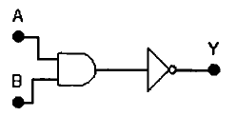
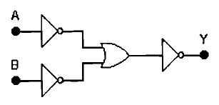
QUIZ
1. This combination of gates will generate the ______ (NAND, OR) logic function.
NAND
2. This combination of gates will generate the ______ (AND, OR) logic function.
AND

Slide 27
Practical Logic Gates
ICs - Integrated Circuit Form
TTL Family of ICs
CMOS Family of ICs
TTL = Transistor-Transistor Logic
CMOS = Complementary Metal Oxide Semiconductor

Slide 28
QUIZ
1. Practical logic gates (AND-, OR-, NAND-, NOT-gates) are packaged in __________ form.
IC
2. Two popular families of ICs used to manufacture logic gate ICs are __________.
TTL and CMOS
3. In digital electronics, TTL commonly refers to a family of ICs. TTL stands for __________.
transistor-transistor logic
4. In digital electronics, logic gates are manufactured using either TTL or __________ technology.
CMOS

Slide 29
Troubleshooting Simple Gate Circuits
Logic probe - equipment used to test circuits
Feel top of IC to determine if it is hot
Look for broken connections, signs of excessive heat
Smell for overheating
Check power source
Trace path of logic through circuit

Slide 30
QUIZ
1. A simple hand-held instrument called a __________ (logic probe, oscilloscope) can be used for troubleshooting simple logic gate circuits.
logic probe
2. The first three steps in troubleshooting are to use your senses to (1) feel the top of the ICs for overheating, (2) look for broken connections, and (3) __________ for signs of overheating.
smell
3. The fourth step in troubleshooting is to use a logic probe to check the power sources. (True or False)
True

