Slide 1
Computer Systems Organization
CHAPTER 2

Slide 2
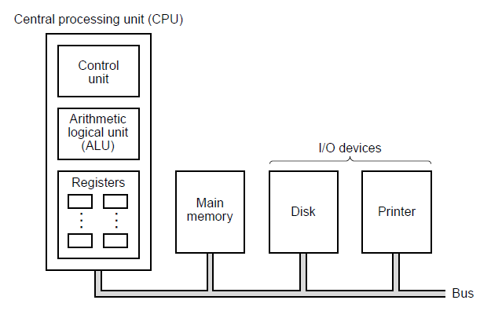
Processors

Slide 3
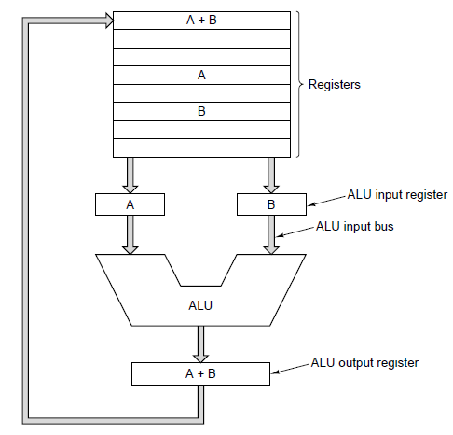
CPU Organization

Slide 4
Instruction Execution (1)
Fetch next instruction from memory
Change program counter to point to next instruction
Determine type of instruction just fetched
If instruction uses a word in memory, locate it
Fetch word, if needed, into a CPU register.
Execute instruction.
Go to step 1 to begin executing following instruction

Slide 5
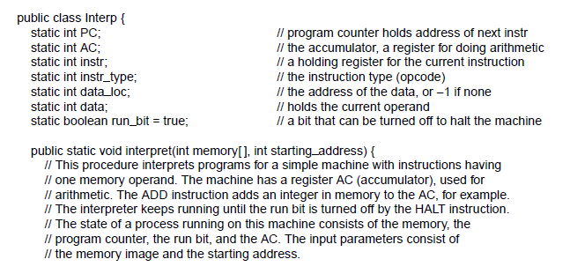
Instruction Execution (3)
Figure 2-3. An interpreter for a simple computer (written in Java).
. . .

Slide 6
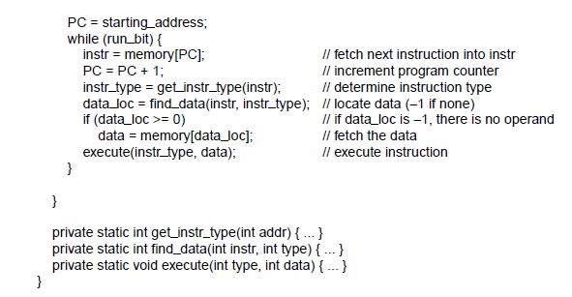
Instruction Execution (4)
. . .

Slide 7
Instruction Execution (5)
Benefits of machines with interpreted instructions
Ability to fix incorrectly implemented instructions in field,
even make up for design deficiencies in basic hardware
Opportunity to add new instructions at minimal cost,
even after delivery of machine
Structured design that permitted efficient development,
testing, documenting of complex instructions

Slide 8
Design Principles for Modern Computers
All instructions directly executed by hardware
Maximize rate at which instructions are issued
Instructions should be easy to decode
Only loads and stores should reference memory
Provide plenty of registers

Slide 9
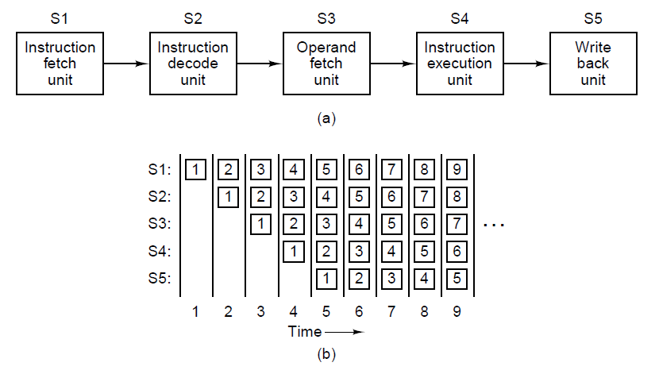
Pipelining
Figure 2-4. (a) A five-stage pipeline. (b) The state of each stage as a function of time. Nine clock cycles are illustrated

Slide 10
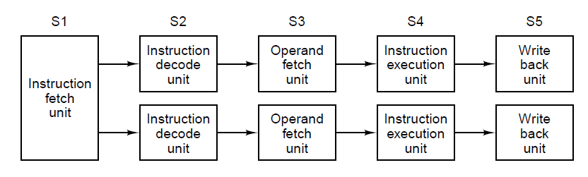
Superscalar Architectures (1)

Slide 11
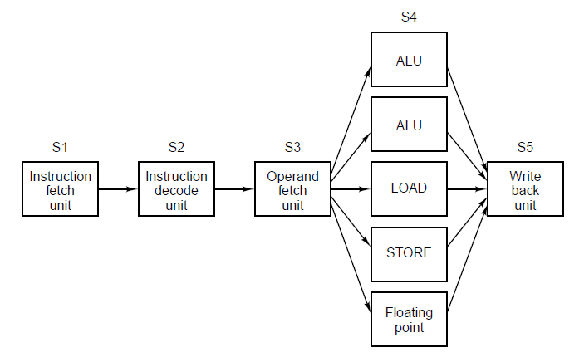
Superscalar Architectures (2)

Slide 12
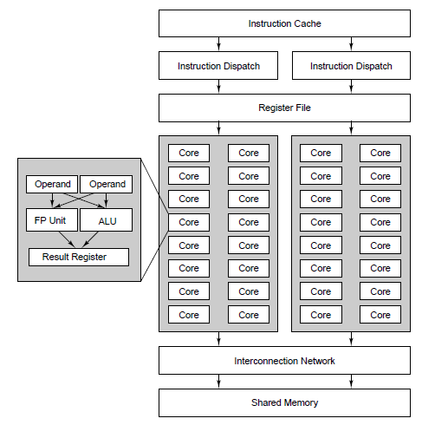
Data Parallel Computers

Slide 13
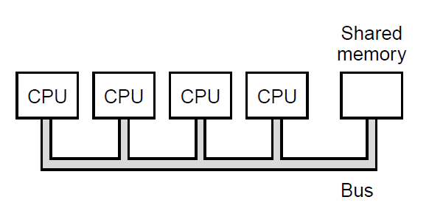
Multiprocessors (1)

Slide 14
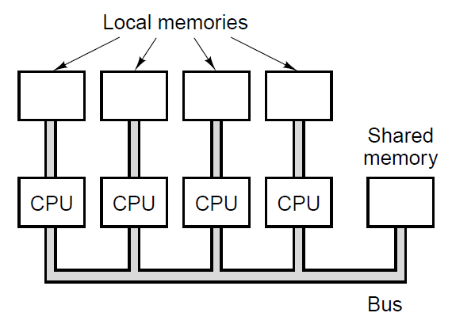
Multiprocessors (1)

Slide 15
Primary Memory (1)
The part of computer where programs and data are stored
Bit: binary digit
Memory address: location in memory of a cell containing data

Slide 16
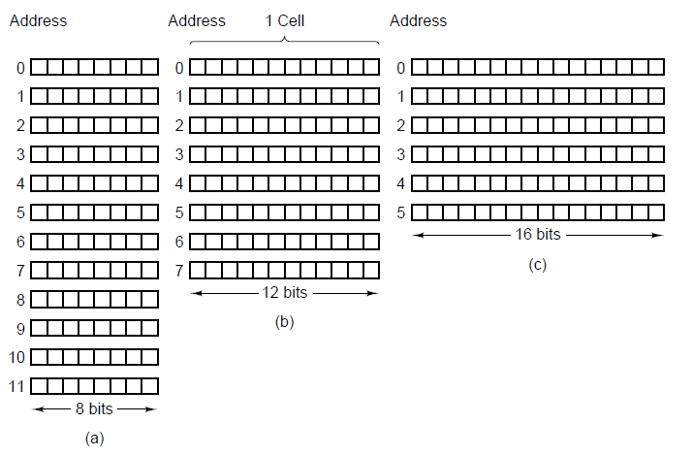
Primary Memory (2)

Slide 17
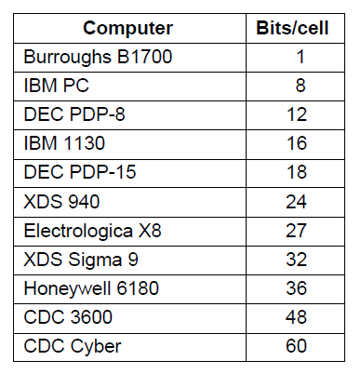
Primary Memory (3)

Slide 18
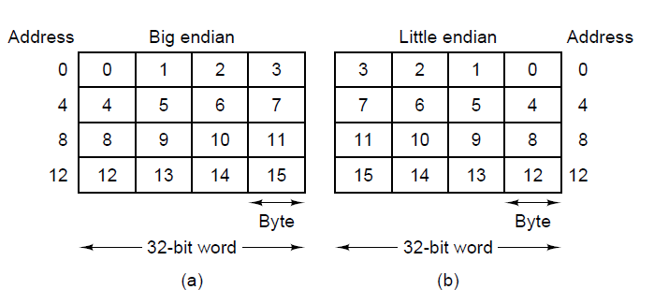
Byte Ordering (1)

Slide 19
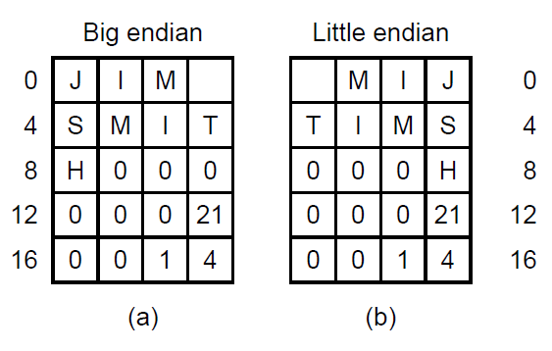
Byte Ordering (2)

Slide 20
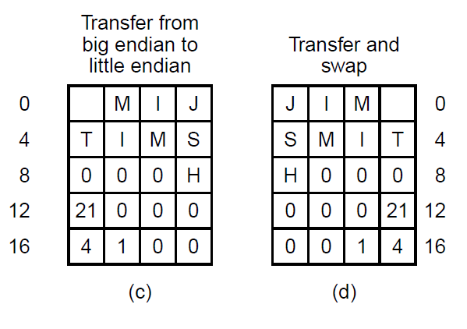
Byte Ordering (3)

Slide 21
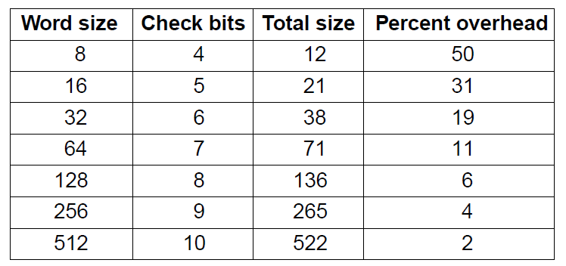
Error-Correcting Codes (1)

Slide 22
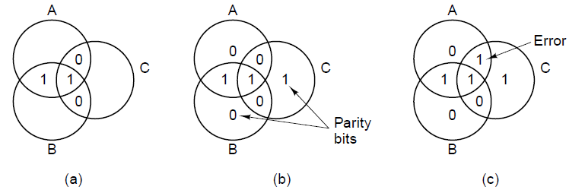
Error-Correcting Codes (2)

Slide 23
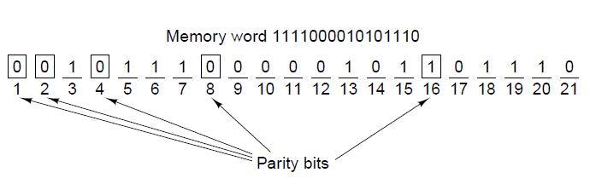
Error-Correcting Codes (3)

Slide 24
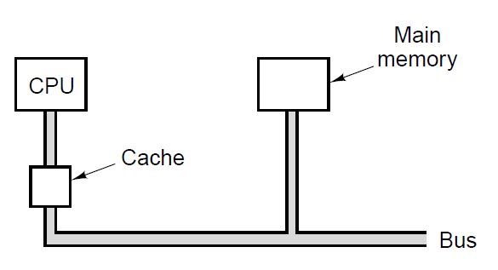
Cache Memory

Slide 25
Cache Memory
What it is: A small, fast memory close to the CPU.
Why it helps: Keeps recently and nearby used data so the CPU waits less.
Data unit: Moves data in cache lines (32K or 64K).
Hit vs miss: Hit = data found in cache (fast). Miss = fetch from RAM (slow).
Levels: L1 (smallest, fastest, split), L2, L3 (bigger, slower, unified).
Evict & replace: When full, old lines get evicted to make room for new ones.

Slide 26
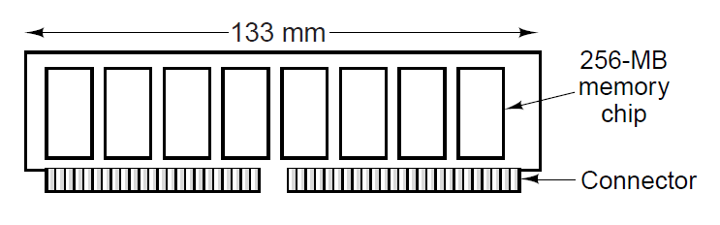
Memory Packaging and Types

Slide 27
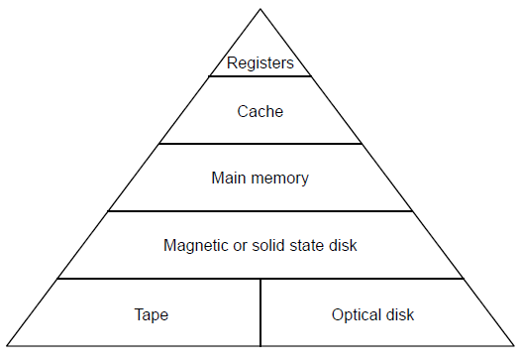
Secondary Memory
Memory Hierarchies

Slide 28
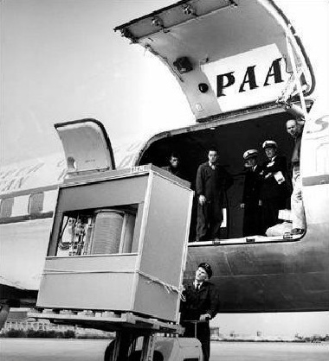
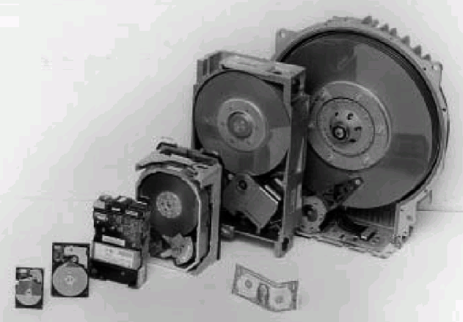
Magnetic Disks (1)
From 14 inch to 1.8 inch
5 MB in 1956

Slide 29
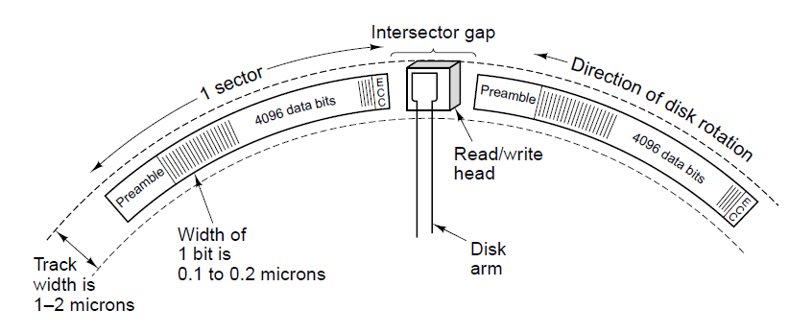
Magnetic Disks (2)
Figure 2-19. A portion of a disk track. Two sectors are illustrated.

Slide 30
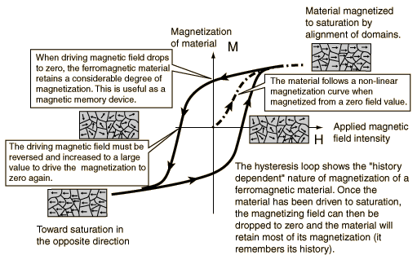
Magnetic Disks (3)

Slide 31
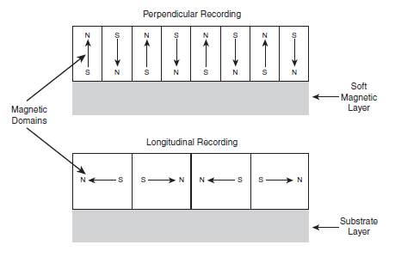
Magnetic Disks (4)

Slide 32
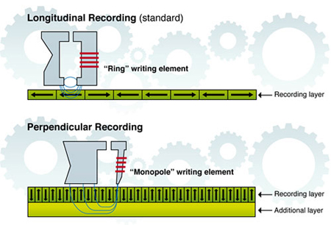
Magnetic Disks (5)

Slide 33
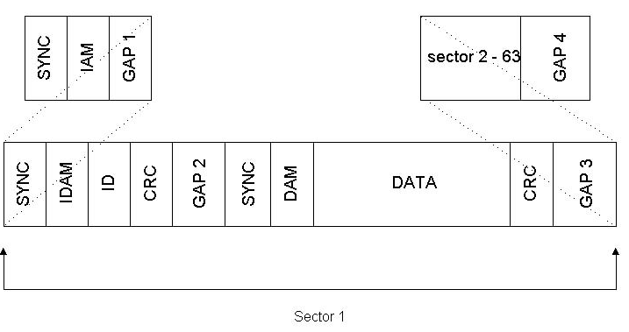
Magnetic Disks (6)

Slide 34
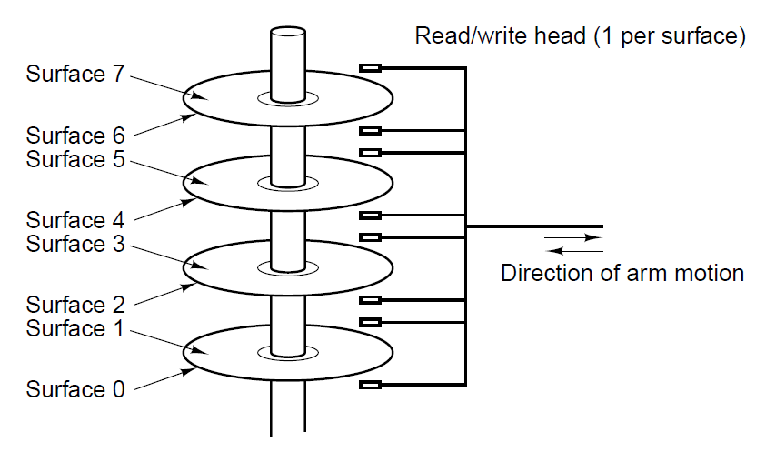
Magnetic Disks (7)

Slide 35
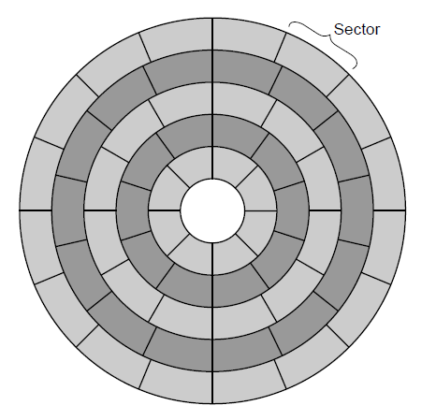
Magnetic Disks (8)

Slide 36
IDE disks
 | BIOS | ATA
Heads | 255 | 16 | 16
Cylinders | 1024 | 65536 | 1024
Sectors | 63 | 255 | 63
Max. Capacity | 7,8GB | 127,5GB | 504MB

Slide 37
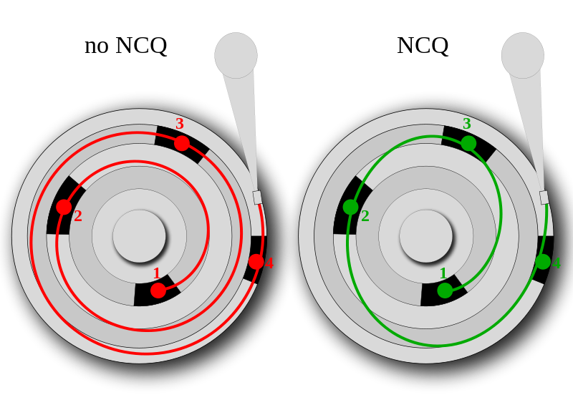
Serial ATA (Native Command queuing)

Slide 38
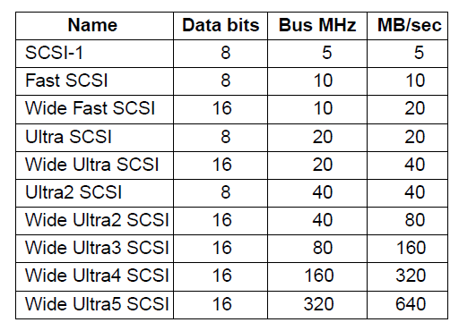
SCSI Disks

Slide 39
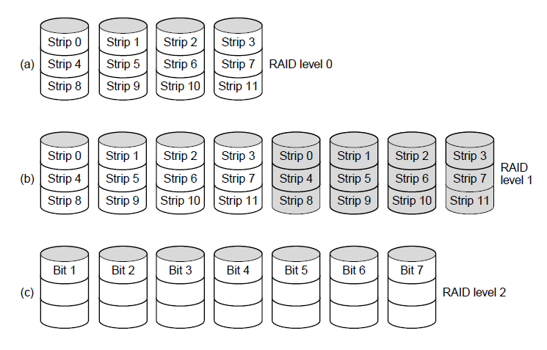
RAID (1)

Slide 40
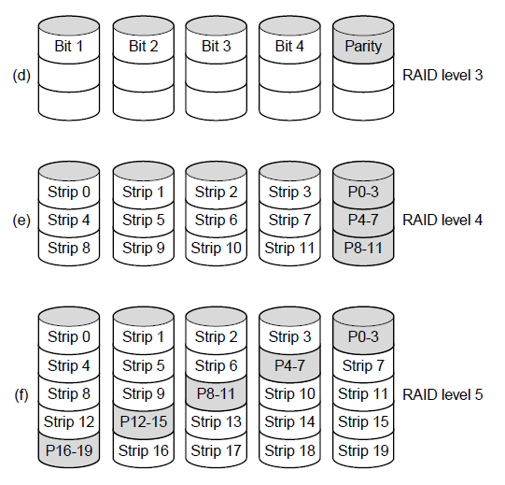
RAID (2)

Slide 41
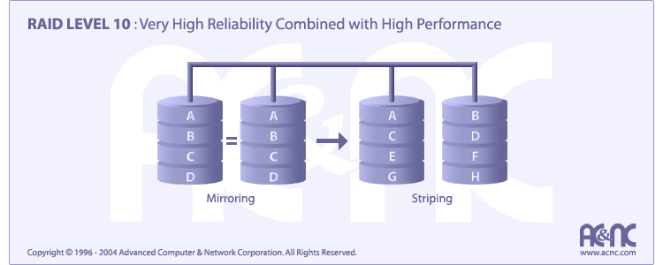
RAID (3)

Slide 42
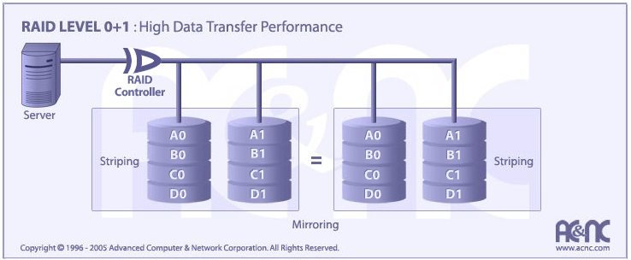
RAID (4)

Slide 43
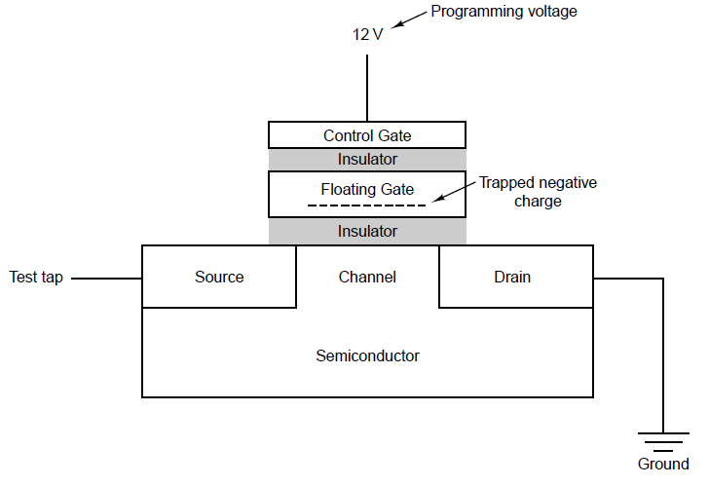
Solid-State Disks

Slide 44
Solid state disks
NVMe over PCIe as default interface (no more SATA)
More expensive, less reliable, faster
Wear levelling
Bit rot

Slide 45
Solid state disks
Reads: The controller reads data at the page level; no erase needed to read. Page size approx. 4-16KB
Writes (“programs”): NAND can only write to an empty (erased) page—no in-place overwrite.
Erase happens at the block level (many pages at once) and is relatively slow. (128-1024 pages per block)
Modify/update: To change data, the SSD writes a new copy to a fresh page and marks the old page invalid; it then updates the logical-to-physical map.
Cleanup: Later, garbage collection moves valid pages together and erases whole blocks to free space—this extra housekeeping is why write amplification exists.

Slide 46
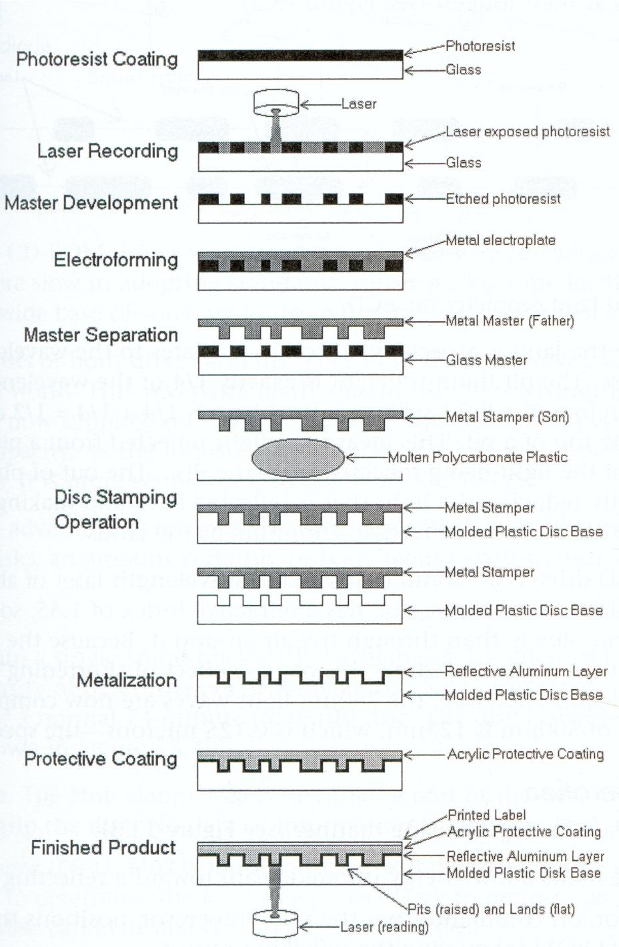

Slide 47
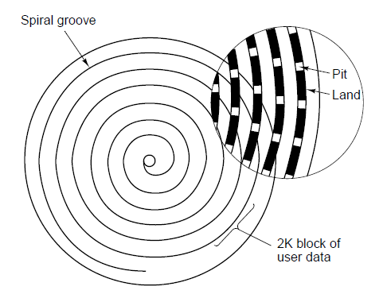
CD-ROMs (1)

Slide 48
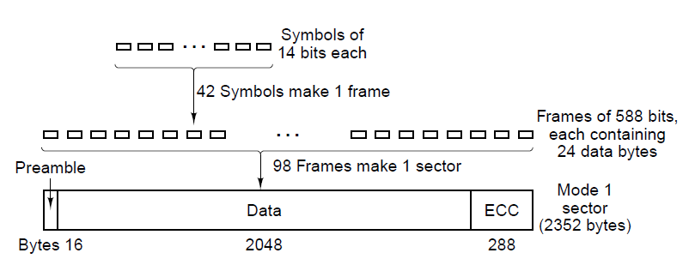
CD-ROMs (2)
Figure 2-26. Logical data layout on a CD-ROM.

Slide 49
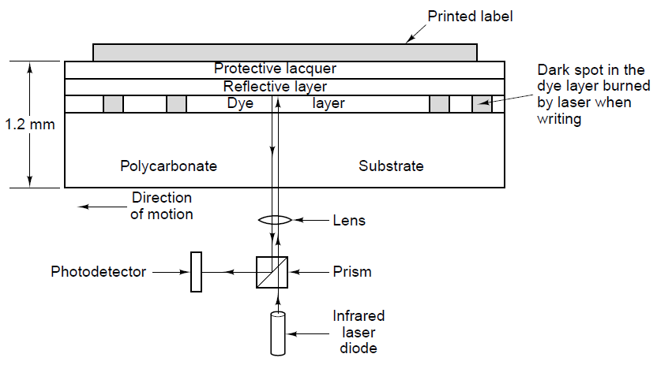
CD-Recordables

Slide 50
DVD (1)
Was Digital Video Disk
Now Digital Versatile Disk
New features
  Smaller pits
  A tighter spiral
  A red laser

Slide 51
DVD (2)
Formats:
Single-sided, single-layer (4.7 GB)
Single-sided, dual-layer (8.5 GB)
Double-sided, single-layer (9.4 GB)
Double-sided, dual-layer (17 GB)

Slide 52
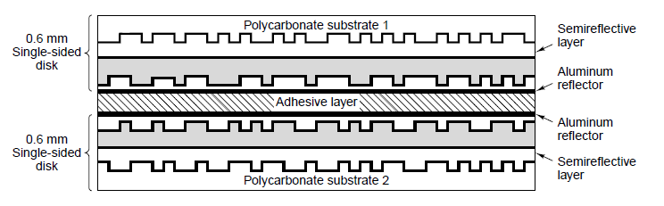
DVD (3)

Slide 53
DVD (4) Copy protection
RPC ( region playback control )
CSS ( content scramble system )
APC ( analog protection system )

Slide 54
DVD (5) RPC
Movies in the US are sooner available then in the rest of the world
Protect content by adding a region code which is embedded in the hardware of DVD players.

Slide 55
DVD (6) regiocodes
1 | USA and Canada
2 | Europe, middle East, Japan and South Africa
3 | South east Asia en east asia
4 | Australia, NZ, south America, Mexico and Central America
5 | Poland, Africa and North Korea
6 | China and Tibet

Slide 56
DVD (7) CSS
MPAA
Developed by Matsushita (Panasonic)
Digital scrambling of images and speech(encryption)
Descrambling requires three keys. The player key, disc key and title key

Slide 57
DVD (8) CSS (continued)
Keys are stored onto the medium during the the production process (glass master)
Every DVD player (computer, TV) contains 400 player keys (409?)
With the player key you can get the disc key
Every DVD has all disc keys encrypted with every possible player key. Also the disc key is encryped with itself and is also stored on the DVD medium
With the disc key you can retrieve the title key.

Slide 58

DVD (9) CSS (continued)
Safe until 1999 when the code was cracked by Jon Lech Johansen using reverse engineering

Slide 59
DVD (10) APS
Analog Protection System aka Copyguard
Developed by Macrovision (1985)
Prevent copying of DVD content onto VHS tape

Slide 60
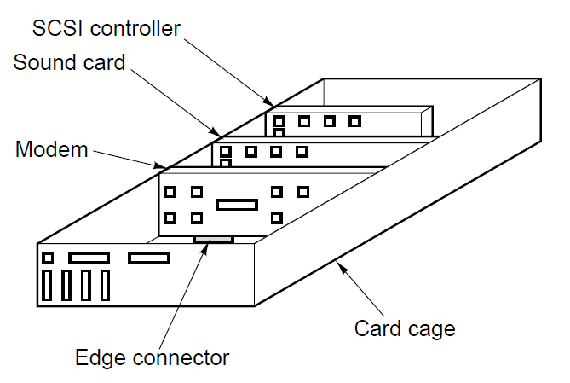
Input/Output Buses (1)

Slide 61
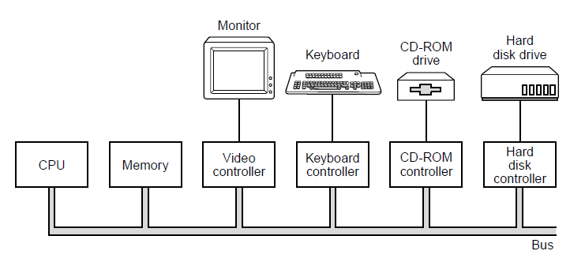
Buses (2)

Slide 62
Device vs. controller: Device = the peripheral; controller = the logic that speaks the device’s protocol and presents a uniform bus/CPU interface.
Abstraction: controller exposes simple registers (cmd/data/status) via MMIO/PIO, hiding timing/protocol quirks
Control flow: OS driver → writes controller registers → controller translates/executes → device acts.
Data path: controller buffers and can use DMA for memory transfers; completion signaled by interrupts (or polling).
Throughput: controllers queue & reorder requests (e.g., disk NCQ) to cut latency and raise IOPS.
Integration: often embedded (NVMe SSDs, SoC I/O); logical separation remains; controller handles retries/status/errors.
Examples: GPU/video, HDD/SSD ↔ SATA/NVMe, keyboard ↔ USB/HID.

Slide 63
Driver prepares the command: OS driver sets parameters (address, length, opcode).
Fill controller registers: CPU writes via MMIO/PIO to controller registers: command, data/address, length, start/doorbell.
Controller to device: controller translates the command into the device’s protocol (SATA/NVMe/USB/HID/…) and kicks the operation.
Data path (PIO): for reads, device places data in the controller buffer and the CPU reads it; for writes, CPU stores data into the controller buffer.
Completion: controller updates status/flags; CPU either polls the status register or gets an interrupt (legacy INTx or MSI/MSI-X) and reads status/error codes.
Driver finalizes: driver clears status, copies data if needed, wakes waiting threads, and returns the result to the caller.

Slide 64
DMA and cache memory!!!
Inconsistent view of data: with write-back caches, the CPU may hold recent updates in L1/L2 while the DMA device reads from RAM, so the device sees stale data; conversely, the device can write to RAM while the CPU still reads a stale cached line.

Slide 65
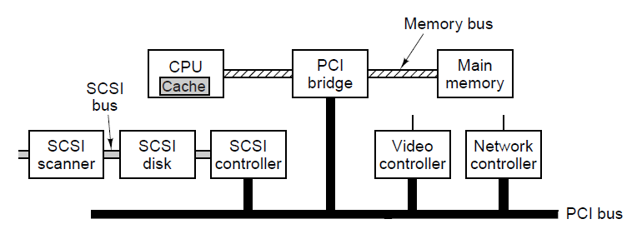
PCI and PCIe Buses (1)

Slide 66
What PCI is: a legacy parallel, shared I/O bus standard (PCI Local Bus) for attaching controllers (NIC, GPU, SCSI) to the CPU/memory via a PCI bridge.
Topology: multiple devices share one bus; central arbiter grants bus access; bridges connect segments and the memory bus.
Transactions: memory-mapped or I/O-mapped reads/writes; devices support bus mastering DMA to move data without CPU copies.
Config space: each device has standardized Configuration Space with Vendor/Device IDs and BARs (Base Address Registers) that map device registers into system address space; OS enumerates at boot (Plug-and-Play).
Interrupts: legacy INTx# (shared, level-triggered); optional MSI/MSI-X on later PCI/PCI-X.
Speeds (theoretical): 32-bit @ 33 MHz ≈ 133 MB/s; 64-bit @ 66 MHz ≈ 533 MB/s; PCI-X up to 1.06 GB/s. Real throughput is lower due to arbitration/turnaround.

Slide 67
Why the shift (parallel → serial): As speeds rose, parallel buses hit limits: inter-wire skew, crosstalk, reflections, tight timing margins, and exploding pin/trace counts. Serial links (differential pairs + SERDES) deliver far higher bit rate per pin, cleaner signal integrity, simpler routing/connectors, and better EMI behavior.
What “skew” means: Skew is the difference in arrival time of signals that were launched simultaneously on different wires. Even small length or impedance mismatches shift edges; when edges no longer line up with the sampling window, receivers misread bits.
Why serial mitigates skew: One differential data path per direction means no inter-lane skew to align; the clock is recovered from the data stream (Clock and Data Recovery), and link training/equalization compensates channel loss and dispersion. Line codes (e.g., 8b/10b, 128b/130b) ensure transition density and bounded wander.

Slide 68
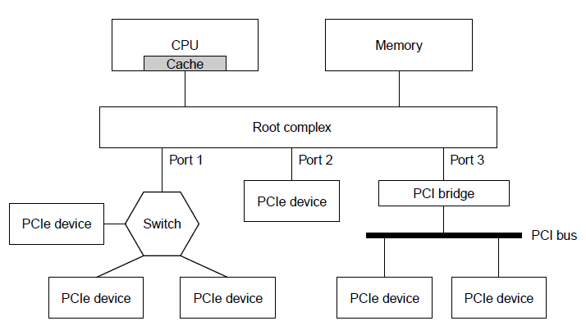
PCI and PCIe Buses (2)

Slide 69
What PCIe is: high-speed serial, point-to-point interconnect; each link = 1+ lanes (x1/x4/x8/x16), full-duplex.
Topology: RC (Root Complex) → ports → EPs (endpoints) and switches; each hop is isolated (no shared bus).
Speeds per lane (≈ payload each way): Gen1 2.5 GT/s ≈ 250 MB/s, Gen2 5.0 ≈ 500 MB/s, Gen3 8.0 ≈ 985 MB/s, Gen4 16 ≈ 1.97 GB/s, Gen5 32 ≈ 3.94 GB/s, Gen6 64 GT/s (PAM4+FEC) ≈ 7.88 GB/s.
Protocol layers: PHY, DLL (DLLPs, CRC, replay), TL (TLPs for Mem/IO/Cfg/Msg). Credit-based flow control.
Addressing & config: PCI model retained—Config Space, Vendor/Device IDs, BARs (MMIO); OS enumeration at boot/plug.
Interrupts & DMA: MSI/MSI-X standard.
Features: Hot-plug, AER (Advanced Error Reporting), …
Why it wins over PCI: dedicated bandwidth per device, scalable lanes, fewer contention/turnaround penalties, better power/error handling.

Slide 70
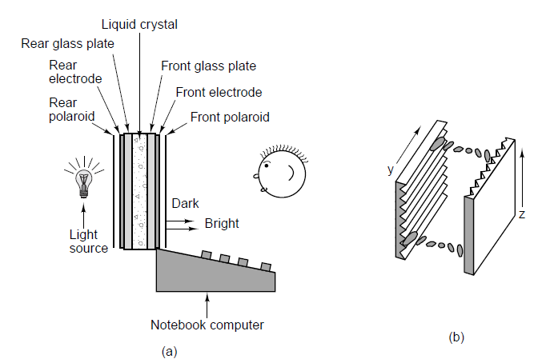
Terminals

Slide 71
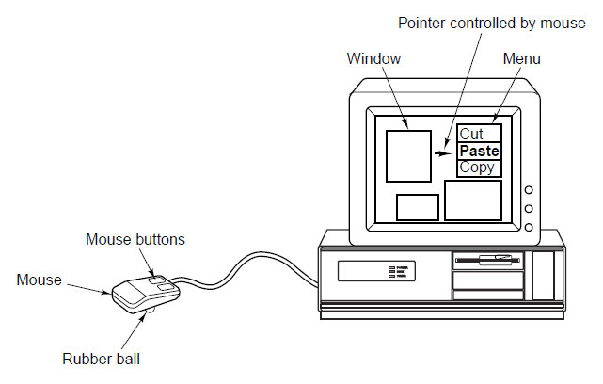
Mice

Slide 72
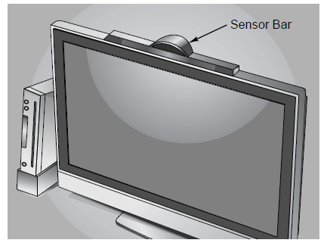
Game Controllers (1)

Slide 73
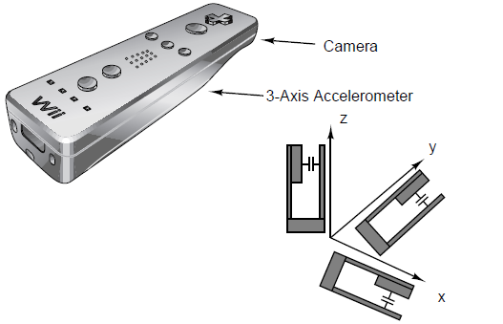
Game Controllers (2)

Slide 74

Laser Printers (1)

Slide 75

Laser Printers (2)

Slide 76
Color Printing
Color monitors use transmitted light;
  Color printers use reflected light.
Monitors have 256 intensities per color;
  Color printers must halftone.
Monitors have a dark background;
  Paper has a light background.
The RGB gamut of a monitor and the CMYK gamut of a printer are different.

Slide 77

Modems

Slide 78

Digital Subscriber Lines (1)

Slide 79

Digital Subscriber Lines (2)

Slide 80
Internet over Cable (1)
Problems to overcome:
How to add Internet access without interfering with TV programs.
How to have two-way traffic when amplifiers are inherently one way.

Slide 81

Internet over Cable (2)

Slide 82

Internet over Cable (3)

Slide 83

Digital Cameras

Slide 84
ASCII = American Standard Code for Information Interchange: a 7-bit character set with 128 codes (0–127).
Structure: codes 0–31 + 127 are control (e.g., NUL, BEL, ESC, CR, LF); 32–126 are printable (space, digits, letters, punctuation).
Examples: 'A' = 65 (0x41), 'a' = 97 (0x61), '0' = 48 (0x30), space = 32.
Line endings history: text used CR (13) and/or LF (10); Windows keeps CR+LF, Unix/Linux/macOS use LF.“
8-bit ASCII”: colloquial for ASCII + parity or various code pages; strictly, ASCII is 7-bit only.
Limits: no accented letters or non-Latin scripts; solved by Unicode/UTF-8, where ASCII’s first 128 codes map identically.
Why it endures: stable, interoperable baseline for protocols, file formats, and programming literals.

Slide 85

Character Codes (1)

Slide 86

Character Codes (2)

Slide 87
Terminology check: “Extended ASCII” is vague. The usual Latin extension means the ISO/IEC 8859 family—especially ISO-8859-1 (Latin-1)—which expands 7-bit ASCII (0–127) to 8 bits (0–255).
Latin-1 (ISO-8859-1): keeps ASCII identical in 0–127; adds Western-European letters with diacritics (á, ä, ç, ñ, ø, ß), punctuation, and symbols in 160–255. Bytes 128–159 remain control codes (not printable).
Windows-1252: looks like Latin-1 but uses 128–159 for printable glyphs (smart quotes, € later via updates). Many “Latin-1” web pages were actually Windows-1252, causing mojibake (文字化け) (moji=character, bakeru=to change, changed characters or “rommeltekst” in Dutch)
.Other Latin sets: Latin-2 (Central/Eastern Europe), Latin-3/4/5, etc., trade different accented letters; ISO-8859-15 (Latin-9) replaces a few Latin-1 symbols to add € and Š/š/Ž/ž/Œ/œ/Ÿ.

Slide 88
Unicode = universal character repertoire: assigns every character a stable code point (U+0000…U+10FFFF), independent of font or platform.
Planes & blocks: 17 planes (Plane 0 BMP; Planes 1–16 supplementary) organizing scripts, symbols, and control ranges.
Character properties: each code point has normative data (category, case, numeric value, combining class, line-break, bidi class, etc.) driving search, sort, case-fold, and rendering.

Slide 89
What it is: byte-based, variable-length Unicode encoding; 1–4 bytes per code point.ASCII-compatible: codes 0–127 are identical to ASCII; any ASCII file is valid UTF-8.
Byte patterns (self-sync):1 byte: 0xxxxxxx · 2 bytes: 110xxxxx 10xxxxxx · 3 bytes: 1110xxxx 10xxxxxx 10xxxxxx · 4 bytes: 11110xxx 10xxxxxx 10xxxxxx 10xxxxxx.
Endian-free & streaming-friendly: no byte-order issues; self-synchronizing—you can recover boundaries after errors.

Slide 90

Character Codes (3)

Slide 91
End
CHAPTER 2

