Slide 1
Week 12: Mastering MLA & Launching the Research Paper
CST1100 - Introduction to Computing
Notes:
Hi everyone, welcome to Week 12. Today we are laser-focused on mastering MLA style and getting the first research paper off the ground for CST1100.

Slide 2
Today's Roadmap
Why MLA format is required for Formal Writing Assignment #1
Document setup standards from Purdue OWL
How to cite sources in-text and on a Works Cited page
Hands-on MLA practice activity
Choosing a focused topic and gathering credible sources
Notes:
Here is today's roadmap: we will clarify why MLA matters for our formal assignment, review document setup, practice citations, work through an MLA lab, and finish by choosing research-friendly topics.

Slide 3
Learning Goals
Explain what MLA style is and when to use it
Configure a blank document that meets MLA layout rules
Create accurate in-text citations and Works Cited entries
Apply MLA conventions to a short paragraph that integrates sources
Begin selecting and justifying a topic for the first research paper
Notes:
By the end of class you should know when MLA is required, how to format a blank document correctly, how to cite sources inside the text and on a Works Cited page, and how to start shaping your research topic.

Slide 4
What is MLA Style?
Modern Language Association style is the humanities standard (English, communications, many liberal arts courses)
Emphasizes author and page number for in-text citations
Provides shared expectations so instructors can assess work consistently
Our guide: Purdue OWL's MLA Formatting and Style Guide (owl.purdue.edu)
Notes:
MLA stands for the Modern Language Association style. It is the humanities default, it highlights author and page numbers, and we will lean on Purdue OWL as our authoritative reference point.

Slide 5
When & Where You'll Use MLA
Formal Writing Assignment sequence (see '4 Required Formal Writing Assignments scaffolding 10_20.pdf')
Any essay or report that analyzes readings, media, or cultural topics
Discussion posts or reflections that reference literary sources
Scholarship applications or transfer essays that specify MLA
Notes:
You will use MLA in every formal writing assignment from the scaffolding packet, in essays about media or culture, and anytime a scholarship or transfer school specifically requests MLA.

Slide 6
Document Setup Checklist
1" margins on all sides; Times New Roman 12 pt (or Arial/Calibri 11 pt)
Double-spacing everywhere, including Works Cited; no extra blank lines
Left-align text; do not justify
Insert running header with your last name and page number in the upper-right corner
Use the "Paragraph" settings to add a 0.5" first-line indent for each paragraph
Notes:
When you open a document, set one inch margins, choose Times New Roman twelve point or an approved alternative, double-space everything, left-align the text, add your last name with the page number in the header, and turn on a half-inch first-line indent.

Slide 7
First Page Formatting
No cover page unless specifically requested
Heading (double-spaced, left-aligned): Your Name, Instructor, Course, Due Date (day month year)
Center the paper title on the next line; use Title Case; do not bold, italicize, or underline
Begin the introduction immediately after the title with a 0.5" first-line indent
Notes:
The first page does not need a cover sheet. Use the standard heading with your name, my name, the course, and the date, center a clear title, and then start your introduction with that automatic first-line indent.

Slide 8
In-Text Citations Basics
Core formula: (Author Last Name page#) or Author signal phrase + (page#)
Example: According to Lopez, technology shapes literacy "at every level" (58).
Paraphrase example: Social media can fragment attention spans (Nguyen 112).
No commas between name and page number; omit p. unless the source lacks pagination
If no author, use the first few words of the Works Cited entry
Notes:
In-text citations follow a simple pattern: author last name plus page number in parentheses, or weave the author into the sentence and keep the page number in parentheses. No commas, no abbreviation p., and use a shortened title only if no author exists.

Slide 9
Signal Phrases & Paraphrasing
Signal phrases introduce the author and provide context before a quote or paraphrase
Blend your voice with source material to show analysis, not just copying
Use present tense verbs (argues, explains, notes) when discussing authors
Always cite paraphrases even when you rewrite the wording
Notes:
Signal phrases do the heavy lifting: they introduce the source, keep your voice in control, and remind readers who is speaking. Even paraphrases need citations, and we stick to present tense verbs like argues or explains when referring to authors.

Slide 10
Short vs. Block Quotations
Short quotes (fewer than four typed lines of prose) stay within the paragraph and inside double quotation marks
Place the period after the parenthetical citation
Block quotes (four+ lines) start on a new line, are indented 0.5", and stay double-spaced
Block quotes omit quotation marks and place the citation after the final punctuation
Notes:
Short quotes stay inside the paragraph with quotation marks. Longer passages turn into block quotes that start on a new line, get indented half an inch, stay double-spaced, drop the quotation marks, and place the citation after the final punctuation.

Slide 11
Works Cited Fundamentals
Start on a new page titled "Works Cited" (centered)
Entries are double-spaced with hanging indents (first line flush left, others indented 0.5")
Alphabetize by the first item in each entry (usually the author's last name)
Only include sources that appear in the body of your paper
Notes:
The Works Cited page always begins on a fresh page, uses the heading Works Cited, keeps double-spacing, applies hanging indents, and lists sources alphabetically by the first element of each entry.

Slide 12
Common Source Templates
Book: Last, First. *Title of Book*. Publisher, Year.
Journal Article: Last, First. "Article Title." *Journal Name*, vol. #, no. #, Year, pp. #-#.
Web Article: Last, First (or Org). "Page Title." *Website Name*, Day Month Year, URL.
Online Video: Creator Username. "Video Title." *Platform*, uploaded by Name, Day Month Year, URL.
Always end entries with a period
Notes:
Here are the core templates: books use the author, title, publisher, and year; journal articles need the article title, journal title, volume, issue, year, and page range; web pages require the author or organization, page title, site name, date, and URL; videos credit the creator, video title, platform, uploader, date, and URL. End every entry with a period.

Slide 13
Matching In-Text and Works Cited
Every in-text citation must have a Works Cited entry
Use shortened titles in parentheses only when no author is available
Page numbers belong in the parentheses even if mentioned in the sentence
For multiple works by the same author, add a shortened title in the citation
Double-check capitalization and italics so readers can locate sources
Notes:
Every parenthetical citation must have a matching Works Cited entry. If you cite multiple works by the same author add a shortened title, always keep page numbers in the parentheses, and double-check italics plus capitalization so readers can find the source.

Slide 14
Common MLA Pitfalls
Mixing citation styles (APA, Chicago) within one paper
Forgetting to update the Works Cited when you remove or add sources
Including URLs without access dates when the site is likely to change
Leaving hyperlinks blue or underlined - remove hyperlink formatting in MLA papers
Using citation generators without verifying punctuation and italics
Notes:
Avoid the common pitfalls: do not mix citation styles, keep the Works Cited updated, add access dates for sources that can change, remove blue hyperlinks, and never trust a citation generator without proofreading punctuation and italics.

Slide 15
In-Class MLA Practice
Work individually or in pairs on the MLA exercise (Word or Google Docs)
Use built-in styles to confirm spacing, heading, and header settings
Locate three source types: book or ebook, scholarly article, reputable website
Write a short paragraph that integrates at least two of the sources with proper in-text citations
Create and double-check a Works Cited list, then download or export your document
Notes:
During the MLA practice you will work solo or with a partner to set up the document, locate a book, a scholarly article, and a reputable website, draft a paragraph with two citations, and build a polished Works Cited list before you download the file.

Slide 16
Choosing a Research Topic
Review the formal assignment prompt and rubric in the scaffolding PDF
Brainstorm issues connected to technology, literacy, or your major
Narrow broad themes into arguable, researchable questions
Check that credible sources exist before committing
Aim for a topic that connects personal curiosity with course goals
Notes:
When choosing a research topic, revisit the assignment prompt, brainstorm issues tied to technology, literacy, or your major, narrow the idea into an arguable question, confirm that credible sources exist, and pick something that motivates you.

Slide 17
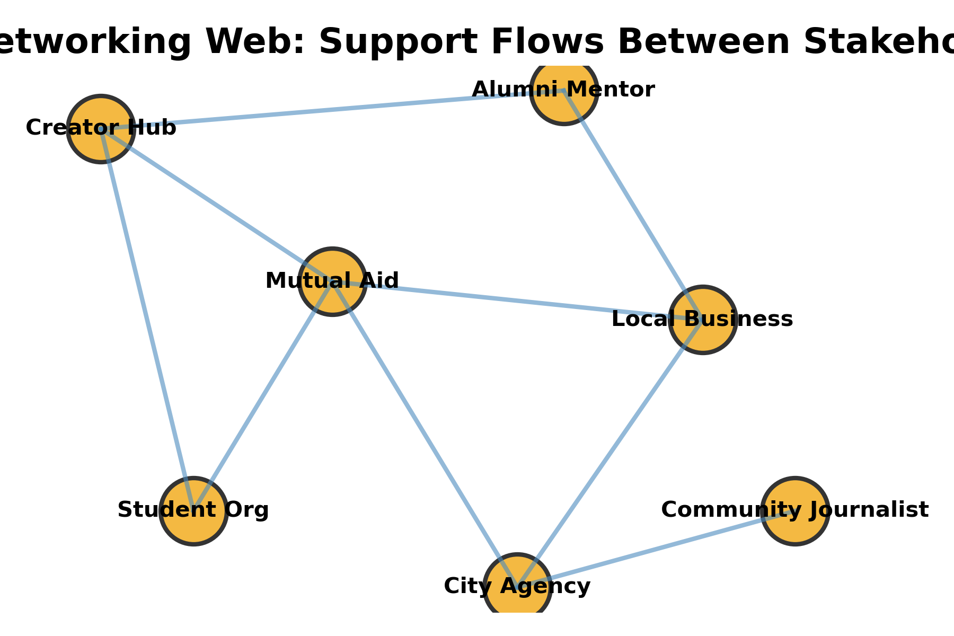
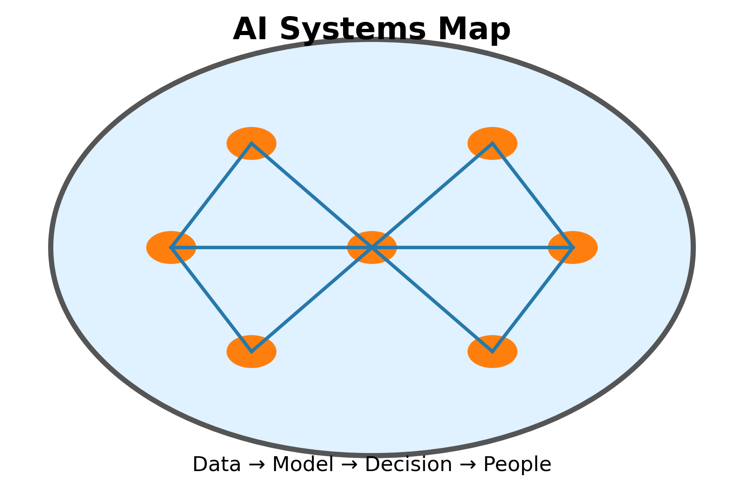
Research Paper Choice: Social Networking or AI?
Social Networking Focus
When do platforms help communities organize, learn, or launch careers?
Which harms—privacy loss, data commodification, persuasion—demand attention?
Artificial Intelligence Focus
Where is AI amplifying human expertise (medicine, accessibility, climate)?
Which risks—bias, opacity, accountability—should your paper interrogate?
Illustrations created for CST1100 discussion prompts.

Slide 18
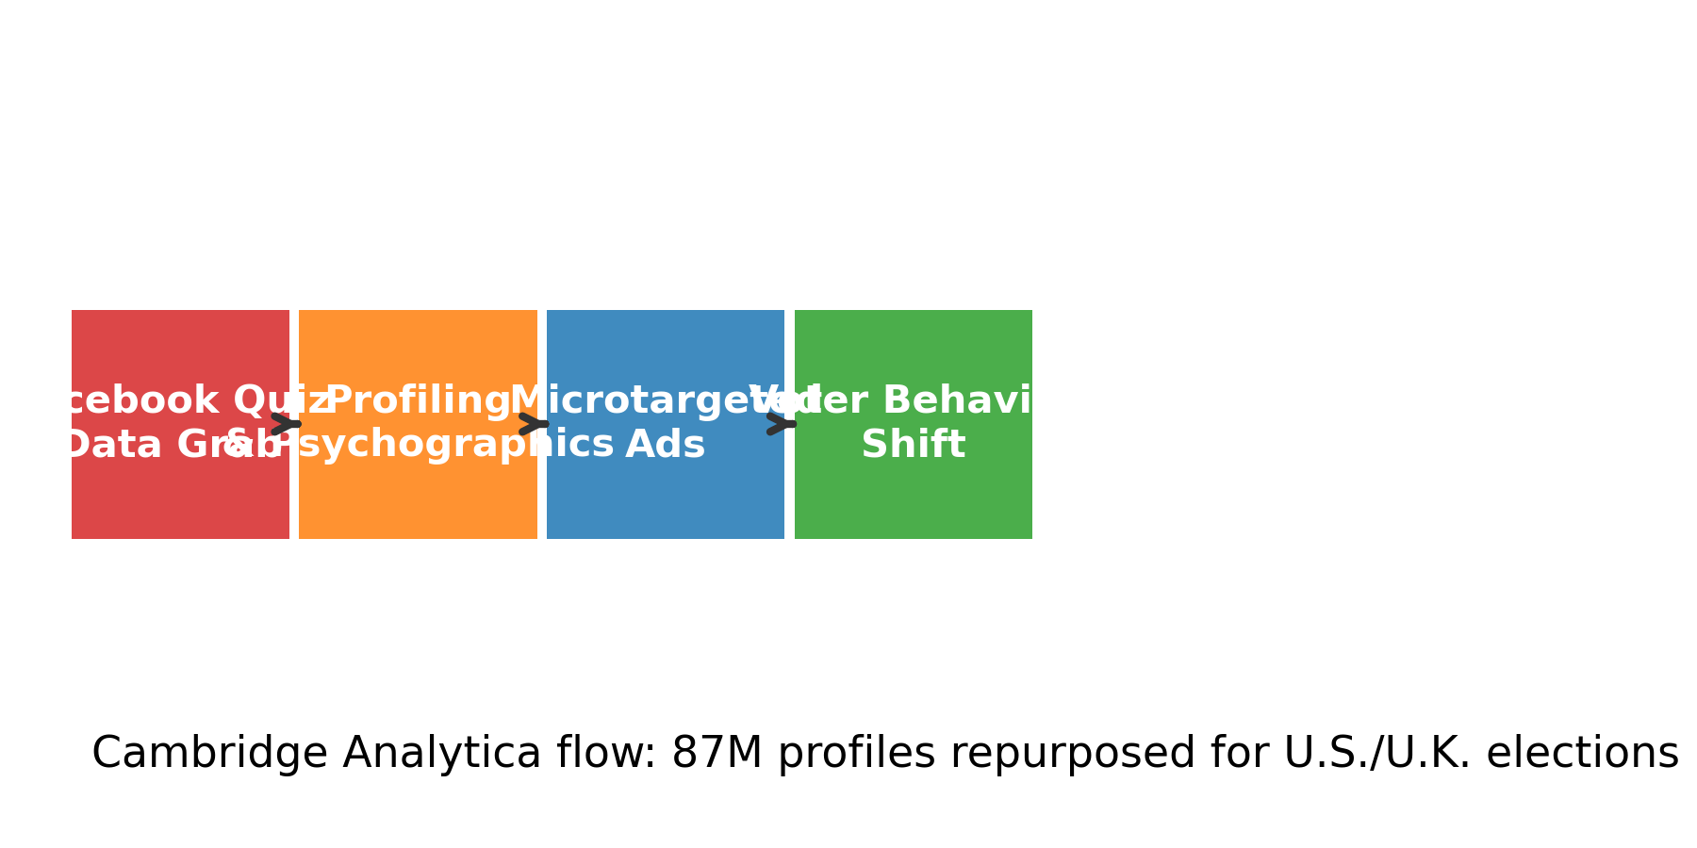
Social Networking Case Studies
Good Example — Mutual Aid & Career Building
Students spin up Instagram/TikTok Live mutual-aid hubs to route groceries, charging stations, and translation help after storms.
LinkedIn Student Voices playlists connect alumni mentors with first-gen interns and track job leads in real time.
Research angles: What community design or data tells this success story? How do you document impact?
Bad Example — Cambridge Analytica
Harvested 87M Facebook profiles via quiz apps, merged them with voter files, and micro-targeted dark ads in U.S./U.K. elections.
Illustrates how opaque data brokerage, lax API rules, and persuasive tech can distort civic participation.
Discussion prompts: Consent, platform accountability, researcher ethics, policy fixes.
Flow created from public testimony & ICO investigations.

Slide 19
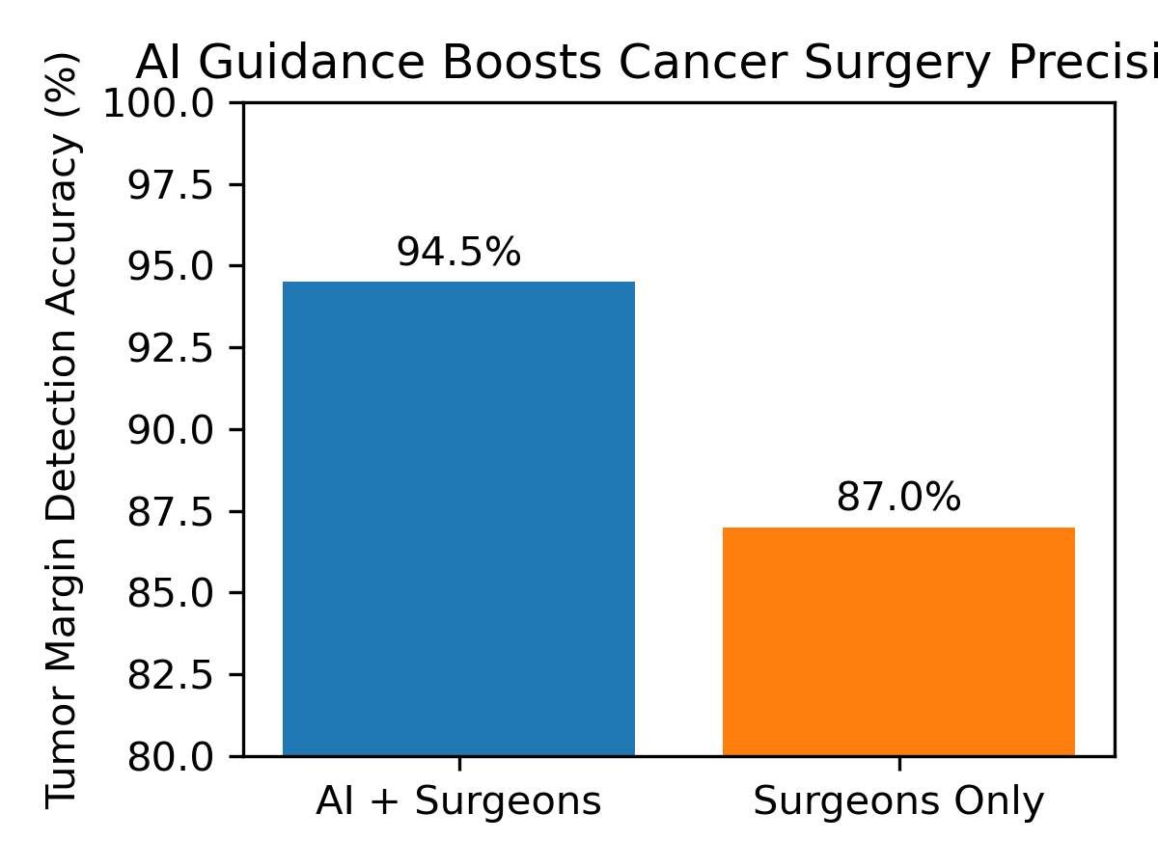
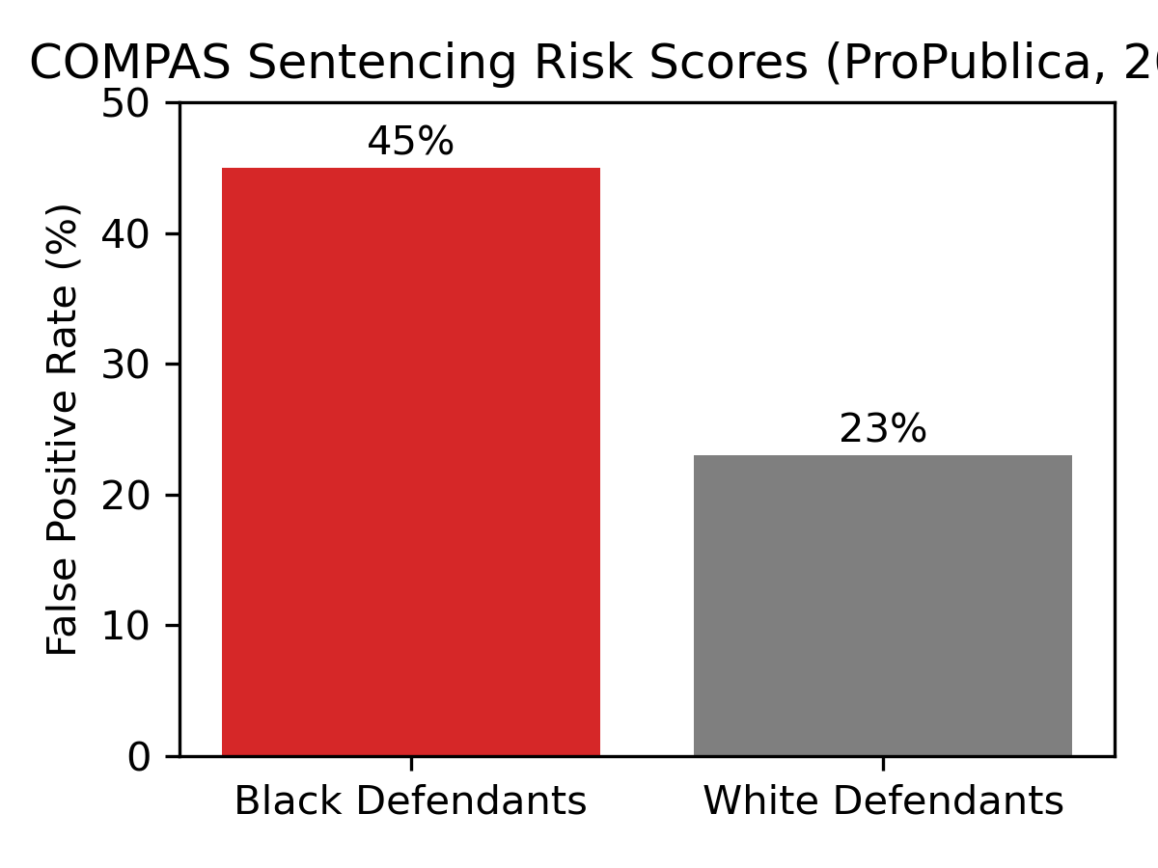
Artificial Intelligence Case Studies
Good Example — ML-Guided Cancer Surgery
Nature Medicine (2019): convolutional neural nets detected brain tumor margins with 94.5% accuracy vs. 87% for surgeons alone.
Hospitals pair surgeons with ML dashboards for in-operation calls, reducing repeat surgeries and costs.
Consider data governance, IRB approvals, and interdisciplinary teams in your outline.
Bad Example — Racist Sentencing & Policing
COMPAS risk scores flagged Black defendants “high risk” at twice the false-positive rate of white defendants (ProPublica, 2016).
Predictive policing tools (PredPol, LASER) flood patrols into already over-surveilled neighborhoods, reinforcing bias loops.
Discuss algorithmic transparency, audit rights, and abolitionist tech frameworks.
Charts created from Nature Medicine (2019) and ProPublica (2016) reporting.

Slide 20
Finding Starting Sources
Library databases (Academic Search Complete, JSTOR, Gale) for peer-reviewed work
Google Scholar for quick discovery - verify with library access
Professional organizations, government reports, reputable news outlets
Use the CRAAP test (Currency, Relevance, Authority, Accuracy, Purpose) to vet each source
Capture citation info as you go to save time later
Notes:
For starting sources, lean on library databases like Academic Search Complete or JSTOR, double-check quick finds in Google Scholar, bring in professional organizations or government data, apply the CRAAP test to everything, and capture citation details immediately.

Slide 21
Next Steps
Finish the MLA practice document and upload or download a copy for feedback
Submit 2-3 tentative research topics with one-sentence rationales
Gather at least two credible sources per topic for next week's source review
Keep using Purdue OWL as your reference whenever you cite
Notes:
Next steps: finish and submit the MLA practice doc, turn in two or three tentative research topics with a one-sentence rationale, gather at least two credible sources per topic for next week, and keep Purdue OWL bookmarked for every citation.

