Slide 1
Week 12 Research Paper Journey
From brainstorming through MLA submission
Notes:
Set expectations for a full walkthrough of the first formal research paper. Tie to MLA skills from earlier in class.

Slide 2
Why This Paper Matters
Demonstrates you can analyze tech impacts with credible evidence
Connects course themes (computing, ethics, literacy) to real communities
Builds MLA formatting muscles ahead of upper-level writing
Leads directly into group work + in-class reflection today
Notes:
Emphasize authentic reasons: professional communication, critical thinking, alignment with program outcomes.

Slide 3
Today's Roadmap
Review prompts, requirements, and supports
Walk step-by-step through the scaffolded process
Surface model cases (good/bad) for both topic options
Plan group investigations + individual reflection deliverable
Notes:
Let students know approximately how long each block lasts; mention exit ticket at end.

Slide 4
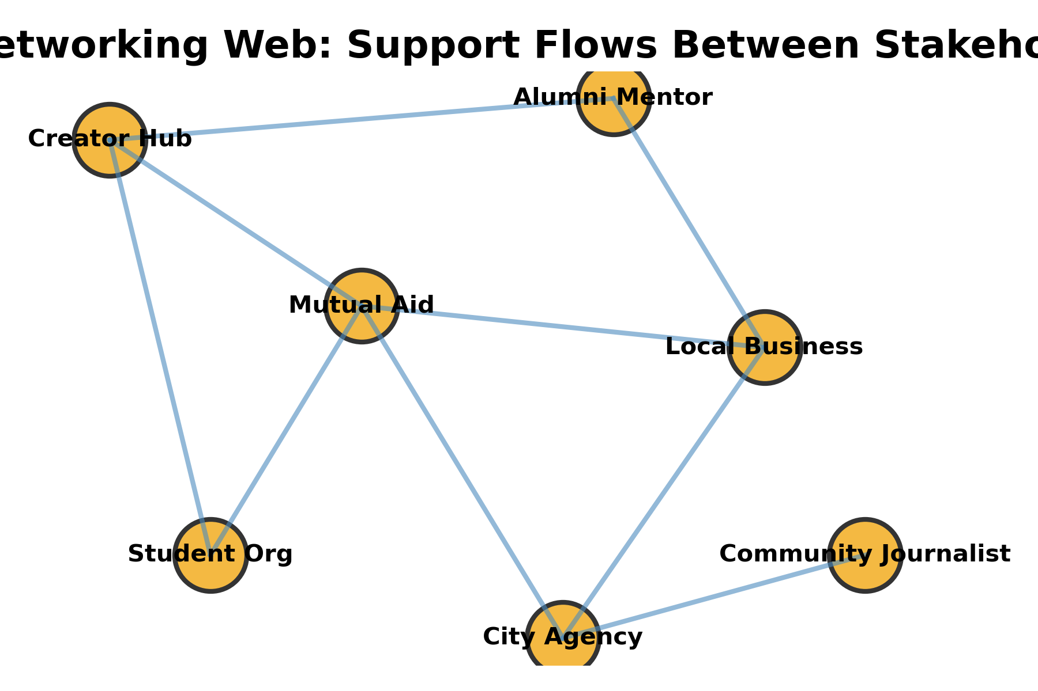
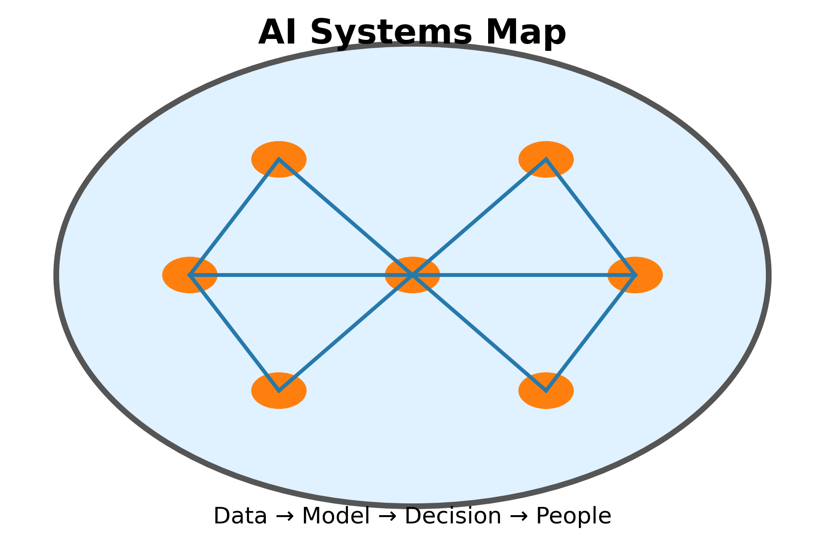
Two Prompt Options
Pros & Cons of Social Networking: 5-paragraph argumentative essay on platforms like Instagram, TikTok, Facebook, X
Exploring Artificial Intelligence: analyze AI impact in one industry with benefits, risks, ethics, and human roles
Class can choose one prompt together or pursue individual choice per PDF instructions
Notes:
Briefly narrate each prompt; invite initial votes or impressions but save decisions for later slide.

Slide 5
Paper Requirements at a Glance
Length: 3 full pages in Word (not counting Works Cited)
Spacing & Layout: 1.5 spacing, default margins, Times New Roman 12 pt, MLA heading + header
Sources: 6–8 credible sources (≥3 pro, ≥3 con) no Wikipedia; cite using MLA 9
Format: submit DOCX or PDF + final reflection paragraph on learning
Notes:
Remind them Purdue OWL and CUNY Library are key resources; cite the PDF expectations explicitly.

Slide 6
MLA & Research Supports
Reuse the MLA checklist from today’s exercise for margins, headers, in-text citations, Works Cited
Purdue OWL + sample papers stay open while you draft
CUNY databases, Google Scholar, news outlets, professional orgs = approved evidence pools
Capture metadata immediately to avoid citation scramble later
Notes:
Connect to Week 12 MLA practice document; reassure them the same doc is the template for final paper.

Slide 7
Topic Choice Snapshot
Social Networking Lens
Community organizing, career building, or civic harms
Case study idea: Cambridge Analytica data misuse
Evidence sources: communication studies, sociology, policy reports
Artificial Intelligence Lens
Industry focus (healthcare, education, business, etc.)
Case ideas: ML-guided cancer surgery vs. biased sentencing/policing
Evidence sources: CS research, ethics, law, economics
Notes:
Point students back to their interests/majors; remind them they can connect to lived experiences.

Slide 8
Scaffolded Timeline Overview
Step 1: Brainstorm & discussion (9/30)
Step 2: Organize thoughts + pro/con or job tables (10/7)
Step 3: Thesis + topic sentences (10/9)
Step 4: Evidence gathering (10/14)
Step 5: Outline (10/16)
Step 6: Drafting (10/21)
Step 7: Peer review (10/23)
Step 8: Revision + reflection paragraph (10/28)
Step 9: Final submission (10/30)
Notes:
Make clear these dates can shift for your section but order must remain.

Slide 9
Step 1: Brainstorm — Social Networking
Guiding Questions
How do platforms help people connect across distance?
Which drawbacks hit your community (privacy, mental health, misinformation)?
What personal or local stories could anchor your stance?
Notes:
Encourage quick list-building in small groups; remind them to keep both pros and cons visible.

Slide 10
Step 1: Brainstorm — Artificial Intelligence
Guiding Questions
Will AI replace jobs or create new ones in your field?
What ethical concerns (bias, surveillance, regulation) stand out?
How should students prepare for an AI-heavy workplace?
Notes:
Prompt them to pick industries relevant to CIS, business, or liberal arts majors.

Slide 11
Step 2: Organize Your Thoughts (Due 10/7)
Social Networking: build a pro/con table to see argument strength
AI: compare “jobs replaced” vs. “jobs created” + note evidence needed
Circle the column that feels richer; that becomes your stance
Share a screenshot or upload your table to the LMS for accountability
Notes:
Reference planning template; tie to group station work happening today.

Slide 12
Step 3: Thesis & Topic Sentences (Due 10/9)
Draft a precise thesis that states stance + 2-3 supporting points
Write topic sentences for each body paragraph to keep outline on track
Check: does each topic sentence link back to thesis + include a debatable idea?
Bring draft thesis to office hours or discussion board for feedback
Notes:
Encourage them to recycle content from in-class reflection to jumpstart thesis writing.

Slide 13
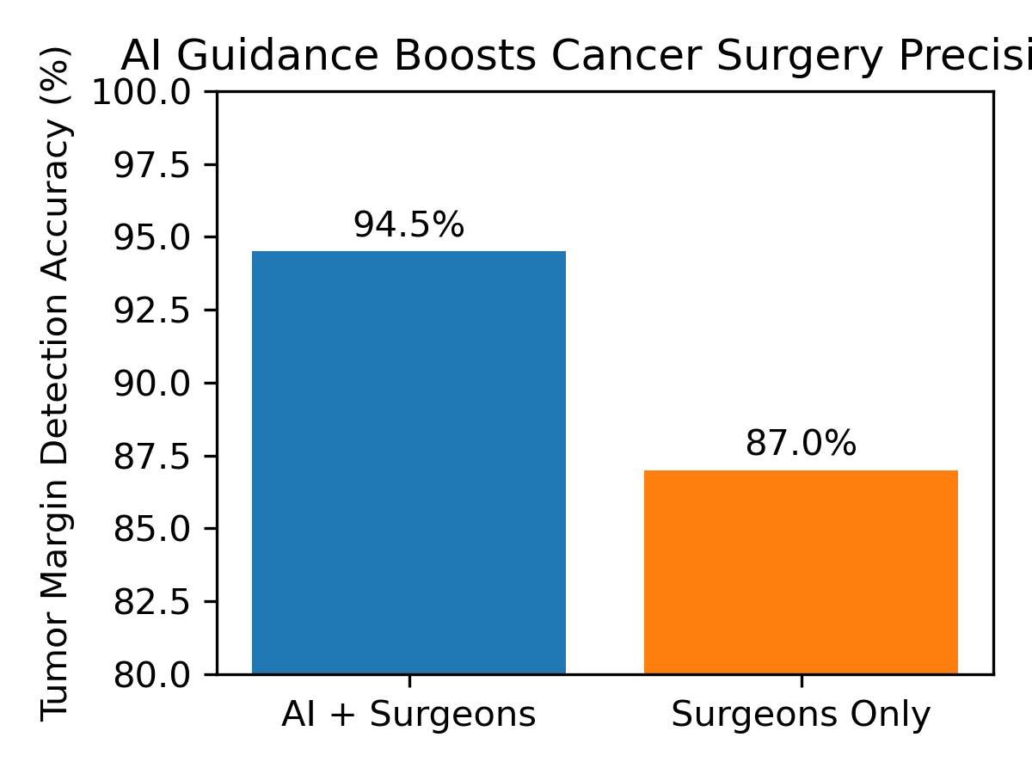
Step 4: Evidence Gathering (Due 10/14)
Locate at least 5 sources (mix of articles, videos, studies) before drafting
Record quotes or paraphrases with MLA citations in an evidence log
Tag each source as pro, con, or background to maintain balance
Capture media type + reliability notes (CRAAP test) for later Works Cited
Notes:
Highlight example of data visualization to show what “evidence” can look like.

Slide 14
Step 5: Outline (Due 10/16)
Intro: hook + context + thesis
Body: Social prompt = at least 2 body paragraphs (pro + con or both); AI prompt = 3 body paragraphs (definition, benefits, risks)
Each section lists main evidence + transition idea
Conclusion: revisit stakes + call to action or future research question
Notes:
Offer optional template or remind them to upload outline for quick feedback.

Slide 15
Step 6: Drafting (Due 10/21)
Turn outline paragraphs into complete sentences; focus on clarity over polish
Integrate quotations + paraphrases with MLA in-text citations
Flag sections needing more research so you can revisit evidence log
Submit draft to instructor for quick diagnostic feedback
Notes:
Connect to MLA exercise—they already practiced formatting headings and citations.

Slide 16
Step 7: Peer Review (Due 10/23)
Exchange drafts + use the Peer Review Rubric 10_19.docx
Focus on argument clarity, organization, grammar, and evidence strength
Ask reviewers to highlight thesis, topic sentences, and MLA errors
Summarize feedback + next steps in your journal or planning template
Notes:
Remind students to give/receive actionable comments (“add statistic here...”).

Slide 17
Step 8: Revision & Reflection (Due 10/28)
Revise based on peer + instructor notes: reorganize sections, deepen analysis
Check MLA formatting end-to-end (header, spacing, Works Cited alignment)
Write reflection paragraph: What changed? What did you learn researching tech impacts?
Schedule mini-conference if you feel stuck before final submission
Notes:
Connect to metacognitive goals; reflection paragraph is required per PDF.

Slide 18
Step 9: Final Submission (Due 10/30)
Export polished DOCX + PDF with MLA formatting intact
Submit to LMS along with reflection paragraph + evidence log (if requested)
Double-check every in-text citation has a matching Works Cited entry
Celebrate! You have a portfolio-ready research paper
Notes:
Encourage them to keep final version for ePortfolio or job applications.

Slide 19
Week 12 Launch Studio (Today)
Station work: compare social networking vs. AI sub-questions in groups
Evidence & course map: list sources + disciplines (psych, business, CS, ethics)
Gallery walk + coaching: capture photos/notes for planning template
Notes:
This slide mirrors the Week 12 Research Paper Launch Studio doc you created.

Slide 20
Planning Template Check-In
Topic & assignment choice
Working thesis + three talking points
Evidence leads + courses/disciplines to cite
Timeline check + support needed (librarian, instructor, peer)
Notes:
Remind students to complete template digitally or on paper before leaving.

Slide 21
In-Class Writing Submission
Document title: Week12_Research_Plan_LastName
Include MLA heading + 1.5 spacing in Word/Docs
Minimum 250 words: topic, why it matters, which courses inform research, lingering question
Save as DOCX/PDF and upload before class ends
Notes:
Exit ticket ensures accountability; matches instructions in Week 12 doc.

Slide 22
After Today
Lock in topic choice + share with instructor via LMS post
Schedule evidence-gathering time and library visit this week
Bring thesis + topic sentences to next class for quick feedback
Stay on top of due dates—set phone reminders for each scaffold milestone
Notes:
Close with encouragement; remind them resources (tutoring, writing center) are available.

