Slide 1
Week 12 Research Paper Launch
Choosing between Social Networking and Artificial Intelligence
Notes:
Welcome students, set 60-minute expectation, remind them this ties into MLA practice and the scaffolded assignment.

Slide 2
Today's Goals
Connect the formal assignment to real tech controversies
Compare strong vs. weak cases for both social networking and AI
Plan group investigations and an individual reflection submission
Notes:
Emphasize students will brainstorm, analyze, and leave with a documented commitment.

Slide 3
Assignment Snapshot
3-page MLA paper due 10/30 (not counting Works Cited)
Two prompts: Pros/Cons of Social Networking OR Exploring Artificial Intelligence
Cite 6–8 credible sources (mix of pro & con evidence)
Follow scaffold: brainstorming → thesis → evidence log → draft → peer review → revision
Notes:
Reference the PDF, highlight flexibility to choose or vote as a class.

Slide 4
Scaffolded Timeline (Suggested)
Week 12: Topic selection, initial sources, reflection submission
Week 13: Thesis + topic sentences, evidence log (5 sources)
Week 14: Outline + first full draft
Week 15: Peer review + revision plan
Week 16: Final submission + reflective paragraph
Notes:
Adjust dates to your calendar; underline that tonight covers the first checkpoint.

Slide 5
Discussion Norms & Roles
Assume good intent, cite evidence, and invite quieter voices
Timekeeper: keeps each mini-debate to 4 minutes
Skeptic: asks “what evidence proves this?” for every claim
Synthesizer: writes takeaways for gallery walk
Notes:
Assign roles quickly or let groups choose; remind them to capture quotes for later MLA citations.

Slide 6
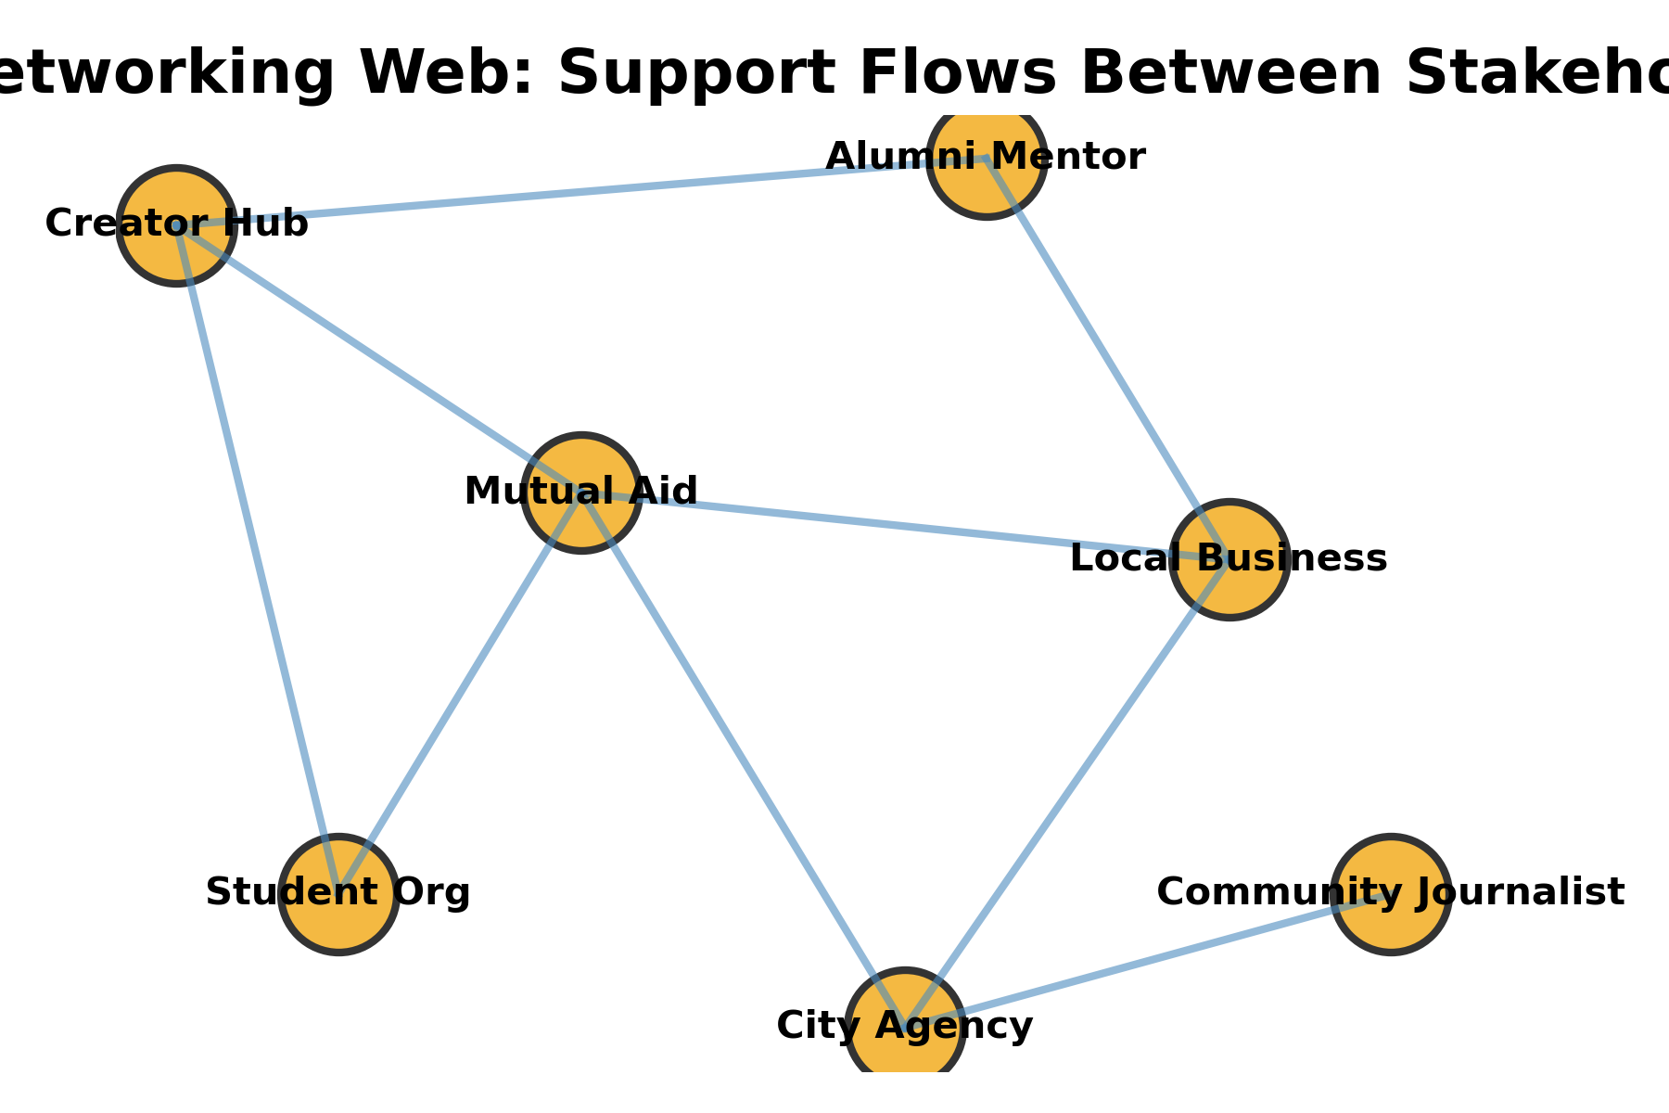
Social Networking Warm-Up
Prompt
Where has a social platform made your community stronger?
Where has it felt extractive or risky?
Notes:
Let students pair share for 2 minutes before whole-class popcorn responses.

Slide 7
Case: Mutual Aid & Career Building
Highlights
Student-led Instagram Live mutual-aid hubs route resources after storms
LinkedIn Student Voices pairs first-gen students with alumni mentors
Evidence ideas: follower analytics, donation totals, mentee outcomes
Notes:
Ask: what makes this a “pro” argument? What data would strengthen it?

Slide 8
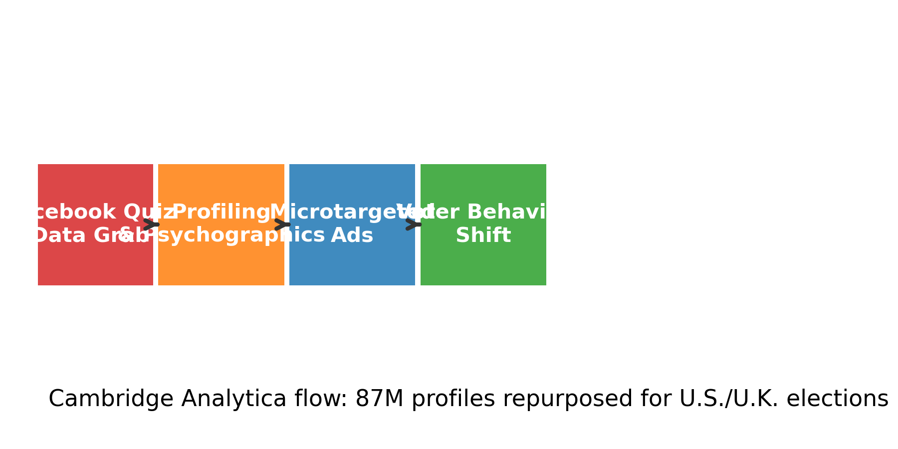
Case: Cambridge Analytica Harms
Key Facts
Harvested ~87M Facebook profiles via quiz app (2013-2015)
Psychographic modeling → dark political ads in US/UK elections
Questions: consent? platform rules? laws preventing repetition?
Notes:
Connect to privacy, data brokerage, and persuasive tech ethics.

Slide 9
Group Task #1: Social Networking Investigations
Choose one positive and one negative social networking story to outline
List stakeholders helped/harmed + kinds of evidence you would cite
Draft one research question per story (arguable, researchable)
Prepare a 1-minute share-out for the gallery walk
Notes:
Give groups 8 minutes; remind them to capture URLs/keywords in their notes.

Slide 10
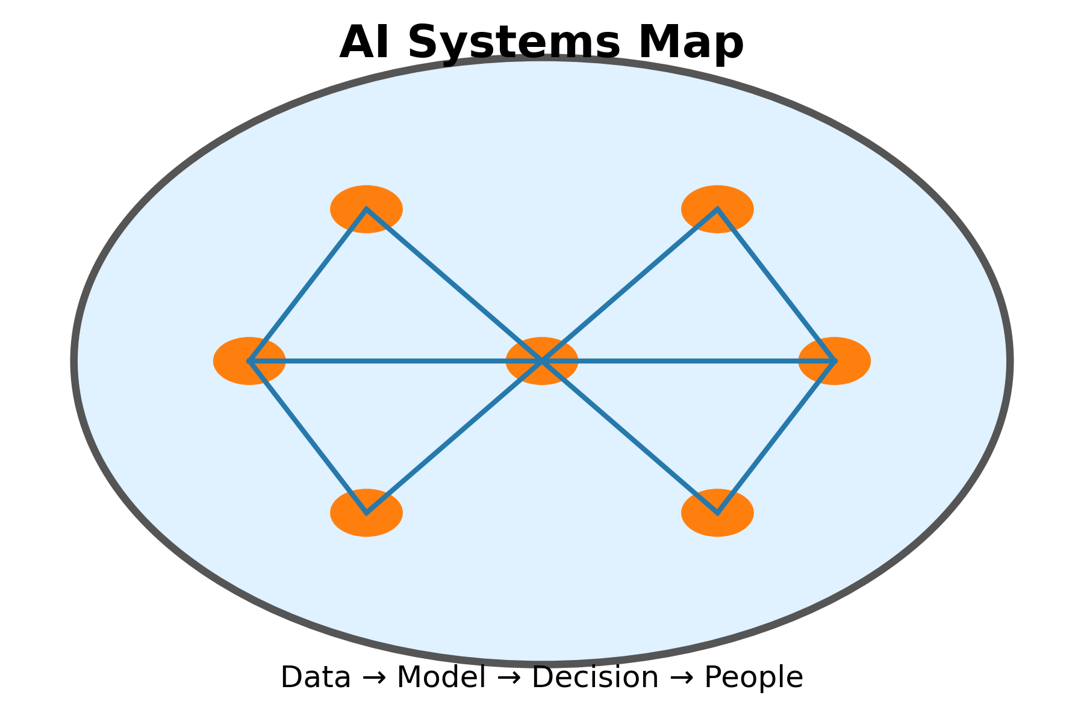
Artificial Intelligence Warm-Up
Prompt
Where is AI already touching your life (recommendations, chatbots, grading)?
Where would you refuse AI involvement?
Notes:
Encourage a spectrum from curiosity to skepticism; jot ideas on board.

Slide 11
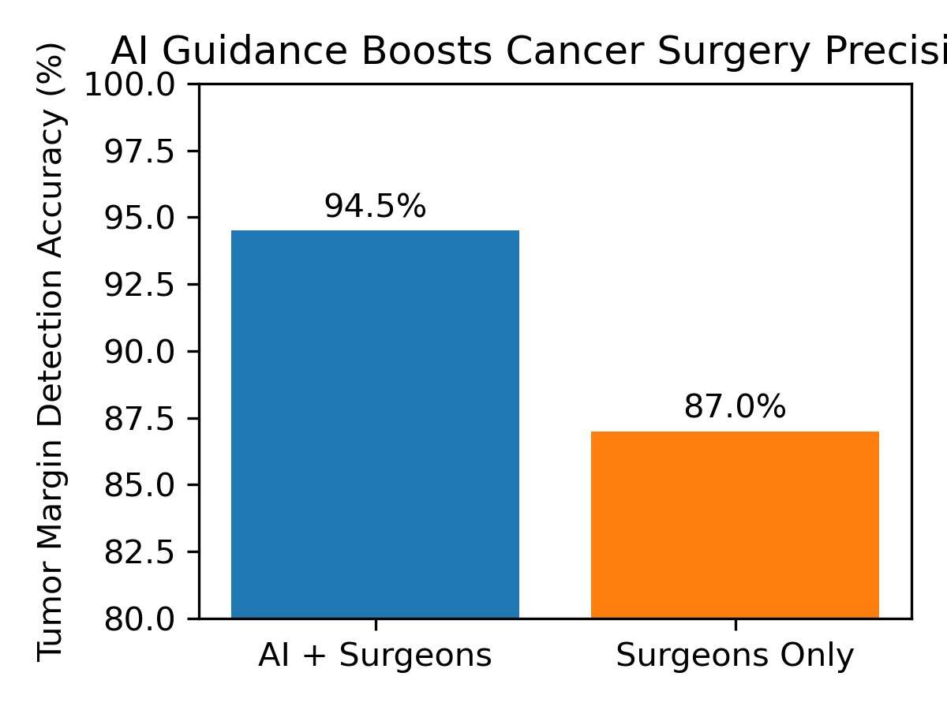
Case: ML-Guided Cancer Surgery
Key Takeaways
Nature Medicine (2019): CNN detects brain tumor margins at 94.5% accuracy
Surgeons + ML dashboards reduce repeat operations and speed lab analysis
Consider data governance, IRB approval, and interdisciplinary teams
Notes:
Prompt: what makes this “good”? what counterarguments exist (cost, access)?

Slide 12
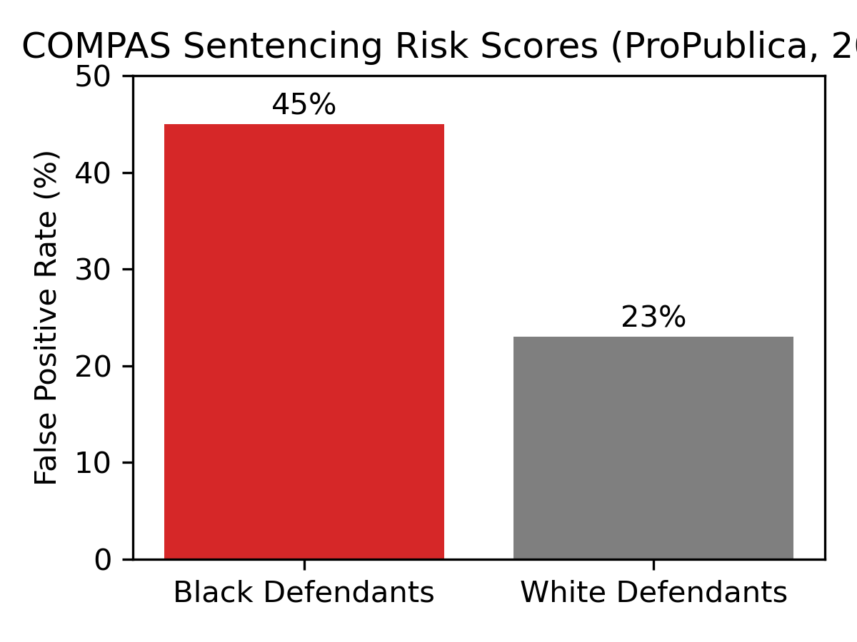
Case: Racist Sentencing & Policing
Key Facts
ProPublica (2016): COMPAS high-risk false positives 45% for Black vs. 23% for white defendants
Predictive policing loops send more patrols to already over-surveilled neighborhoods
Policy ideas: algorithmic audits, transparency mandates, community consent
Notes:
Push students to consider justice system reform, abolitionist tech critiques, etc.

Slide 13
Group Task #2: AI Impact Briefs
Pick one AI success AND one AI harm relevant to your interests
Map benefits/risks + list courses/disciplines you need to cite (CS, ethics, sociology, medicine)
Draft a thesis claim for each scenario (pro vs. con)
Identify missing voices or data you must research before drafting
Notes:
Give another 8 minutes; circulate to coach on specificity.

Slide 14
Decide & Plan
Individually choose: Social Networking or AI (or propose a class-wide vote)
Complete the planning template: thesis idea, 3 talking points, 2 sources, 1 question
Conference with instructor for approval before leaving this slide
Notes:
Hand out or link the template; verify each student logs their choice.

Slide 15
In-Class Writing Submission
Open Word/Docs → title file Week12_Research_Plan_LastName
250+ words: What will you write about? Why? Which courses/disciplines guide your research?
Save as PDF or DOCX and upload before leaving
Add 1 lingering question for instructor or librarian
Notes:
Set timer for final 10 minutes. Collect uploads via LMS or shared folder.

