Slide 1

CST 2412: Data Security, Privacy & Ethics
Week 1: Introduction
Data Science BS Program,
New York City College of Technology
Spring 2026
[1]
Notes:
Welcome to the first lecture of CST 2412, Data Security, Privacy & Ethics.
In this session we will set the stage for the rest of the semester. We'll look at why data security and privacy are foundational to your success as data scientists, and how ethical considerations play into everything you'll do. Our aim today is threefold: first, to give you an overview of the course structure and expectations; second, to introduce core concepts such as the CIA triad, threat landscapes, authentication and privacy; and third, to explain how the course aligns with your degree program and future career.
As you follow along, please note that the text on the slides is kept intentionally brief. The detailed explanations are in these notes. You can use these notes as a script when presenting or for review. Throughout the lecture we'll refer to our official syllabus and textbook, and every key fact is tied back to a source. Be prepared to engage with the material and ask questions. This introduction will last roughly two hours, setting the pace for a thoughtful and comprehensive course.

Slide 2

Agenda
• Course overview & objectives
• Importance of security & ethics
• Historical perspective
• Fundamentals: CIA Triad
• Threat landscape
• Authentication & access control
• Privacy & legal frameworks
• Course requirements & evaluation
• Expectations & academic integrity
• Q&A & next steps
[2]
Notes:
This slide outlines the ten sections of today's lecture. We'll begin with an overview of the course, its goals and how it fits into your degree. We'll then examine why security and ethics are important, including current events that demonstrate the consequences of poor practices.
A brief historical tour will show how computer security evolved from early computing to today's complex cyber landscape. We'll introduce the CIA triad—Confidentiality, Integrity and Availability—as the fundamental model for understanding security. We'll survey common threats and vulnerabilities, from malware to social engineering, to frame the challenges you'll encounter.
We'll discuss mechanisms for authentication, authorization and access control, followed by a segment on privacy and legal frameworks such as HIPAA and GDPR. We'll then review our course syllabus, assignments and evaluation criteria. Finally, we'll cover classroom expectations, academic integrity, and end with time for your questions and a preview of next week's topics.
As we move through the agenda, I'll refer back to these bullet points so you always know where we are in our journey.

Slide 3

Course Overview & Objectives
Goal: Build security-conscious data scientists
• Understand core security principles and ethical issues
• Learn practical skills in authentication, access control, cryptography and risk assessment
• Explore privacy laws, policies and the implications of data misuse
• Prepare for real-world challenges in data-driven organisations
[3] [4]
Notes:
Our first objective is to develop security-conscious data scientists. Data science isn't just about extracting insights from data. It's about doing so responsibly. That means thinking about how the data was collected, how it's stored, who can access it and how it could be misused.
Throughout the semester you'll learn core principles such as confidentiality, integrity and availability; practical skills including authentication mechanisms, access control models and basic cryptography; and methods for risk assessment and mitigation. We'll also delve into privacy laws like HIPAA and GDPR, as well as corporate privacy policies, and discuss how decisions around data can harm or benefit individuals and societies.
This course is designed with your future career in mind. Whether you go into analytics, engineering or research, you'll need to design and operate systems that respect user privacy and resist attacks. The assignments and project will give you hands-on experience that you can talk about in internships and job interviews.

Slide 4
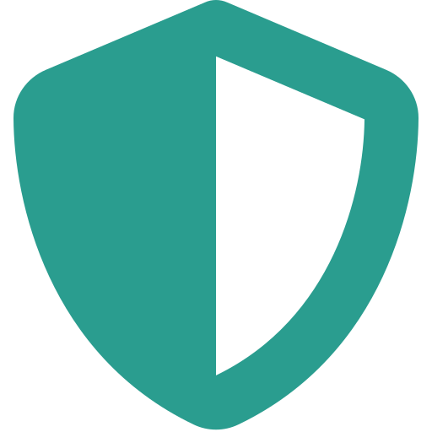
Why Data Security & Ethics Matter
• Data breaches and cybercrime are rising
• Public trust depends on privacy protections
• Ethical missteps can harm users and reputations
• Security is a competitive differentiator
[5] [6]
Notes:
Why does this course matter? Because we live in an era where data is currency. News stories about major breaches—think Equifax, Target or the Colonial Pipeline ransomware attack—demonstrate that security failures can impact millions of people, cost billions of dollars and erode trust. Small companies and startups suffer too: roughly 60% of small businesses fold within six months of a significant cyber incident.
Public trust in data science and AI also depends on our ability to respect privacy. If we build systems that can be exploited or that misuse personal information, people will refuse to participate or push for stringent regulation. In extreme cases, unethical data use has led to discriminatory algorithms and violations of civil liberties.
Ethics go hand-in-hand with security. Even if your systems are technically secure, you need to think about how you're using data: Are you collecting only what you need? Are you transparent about data use? Do you respect user consent? Ethical missteps can damage careers and reputations. Conversely, good security and privacy practices can be a competitive advantage—companies that protect user data often gain loyal customers.

Slide 5
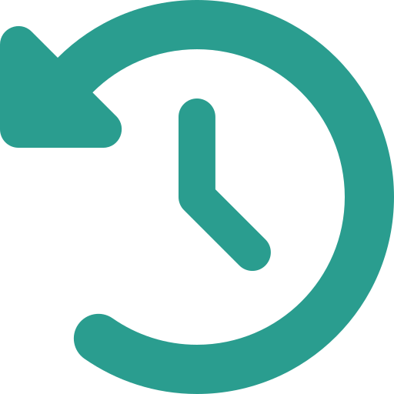
A Brief History of Computer Security
• Early computing and isolated mainframes
• The ARPANET and the first worms
• The evolution of viruses, trojans and ransomware
• Growing complexity and connectedness of networks
[7]
Notes:
Security didn't become a major field overnight. In the 1960s and 1970s, computers were largely isolated mainframes protected by physical security. With the birth of the ARPANET in 1969, researchers began to connect machines, inadvertently creating the first opportunities for remote compromise. By 1988, the Morris Worm—one of the first internet worms—exploited vulnerabilities in Unix systems and shut down thousands of computers, demonstrating how quickly malicious code could spread.
Through the 1990s and early 2000s, viruses and trojan horses proliferated. Early malware like Michelangelo and the Love Letter worm spread via floppy disks and email attachments, while later ransomware such as CryptoLocker and WannaCry encrypted victims' files for ransom. Meanwhile, the growth of the world wide web and mobile computing greatly expanded the attack surface.
Today, cloud computing, mobile apps and the Internet of Things mean that virtually everything is interconnected. New categories of attack appear each year: supply chain compromises, side-channel attacks, zero-day exploits and advanced persistent threats. Understanding this history helps us appreciate why modern security requires layered defenses and why ethical considerations—like responsible disclosure—are vital.

Slide 6

Fundamentals: The CIA Triad
ConfidentialityOnly authorized users and processes can access data
IntegrityData and systems are protected from unauthorized modification
AvailabilitySystems and data are accessible to authorized users when needed
[8] [9]
Notes:
The CIA Triad—Confidentiality, Integrity and Availability—is a simple but powerful model for thinking about security.
Confidentiality means that only those with proper authorization can see data. This involves controlling access through authentication and encryption. For example, health records must be confidential so that only patients and authorized medical staff can view them.
Integrity ensures that data and systems are accurate and complete. Without integrity, attackers could modify data or software to produce false results or hide malicious activity. Techniques like cryptographic hashes, digital signatures and audit trails help detect and prevent unauthorized changes.
Availability guarantees that systems and data remain accessible to authorized users when needed. Denial-of-service attacks or system failures threaten availability. Strategies like redundancy, load balancing and incident response planning help ensure that services stay online.
Throughout this course, you'll see how confidentiality, integrity and availability are balanced. A design that maximizes confidentiality might hinder availability, or strong integrity controls might complicate usability. Recognizing these trade-offs is key to good security engineering.

Slide 7

Understanding Threats & Vulnerabilities
• Malware: viruses, worms, trojans, ransomware
• Social engineering & phishing
• Insider threats & human error
• Web, network and cloud vulnerabilities
[10]
Notes:
A threat is any potential danger to your system and data. A vulnerability is a weakness that could be exploited by a threat. Threats come in many forms and can be intentional or accidental.
Malware includes viruses that attach to programs, worms that propagate across networks and ransomware that encrypts your files. The SolarWinds supply chain attack is a recent example where malicious code was inserted into trusted software updates.
Social engineering exploits human behavior. Phishing emails trick users into revealing passwords or installing malware. Pretexting and tailgating are techniques to gain physical access. Studies show that more than 90% of breaches begin with a phishing attack.
Insider threats arise when employees or contractors misuse their access, either maliciously or through negligence. For instance, mishandling of S3 bucket permissions has exposed millions of records.
Finally, vulnerabilities exist in web applications (like SQL injection or cross-site scripting), networks (such as misconfigured firewalls or unpatched devices) and cloud services (improperly secured APIs or shared responsibility misunderstandings). We'll explore these categories in depth in later lectures. Today, remember that threat awareness and vulnerability management are ongoing processes.

Slide 8
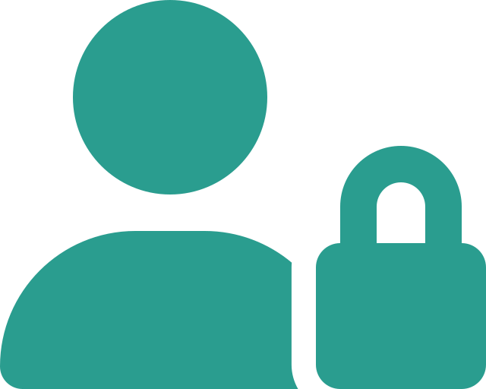
Authentication & Access Control
• Authentication verifies identity
• Authorization defines what you can do
• Access control models: DAC, MAC, RBAC
• Multi-factor authentication & password hygiene
[11]
Notes:
Authentication answers the question: who are you? It involves verifying that a user or process is who they claim to be. Common methods include something you know (a password), something you have (a token or smartphone) and something you are (biometrics). Multi-factor authentication combines two or more of these to reduce risk.
Authorization is what you're allowed to do after you've proven your identity. Access control lists and policies restrict operations based on user roles.
There are several models for designing access control systems. Discretionary Access Control (DAC) allows data owners to set permissions; Mandatory Access Control (MAC) relies on classification labels and central policies, commonly found in military contexts; Role-Based Access Control (RBAC) assigns permissions to roles rather than individuals, simplifying administration. We'll study these models later in the course.
For now, remember that strong authentication and well-designed authorization are primary defenses against unauthorized access. Encourage the use of password managers, unique credentials per service and enable multi-factor authentication wherever possible.
In assignments, you'll implement simple access control mechanisms and analyze their strengths and weaknesses.

Slide 9

Privacy & Legal Frameworks
• Privacy principles: notice, consent, purpose limitation
• Key regulations: HIPAA, GDPR, state laws
• Corporate policies and terms of service
• Balancing analytics with user rights
[12]
Notes:
Privacy means different things to different people, but several core principles recur in legislation and best practices. Notice means informing individuals about data collection. Consent requires obtaining permission before collecting or using personal data. Purpose limitation specifies that data collected for one reason shouldn't be repurposed without additional consent.
In the United States, HIPAA protects health information; FERPA covers student records; Gramm-Leach-Bliley governs financial data. The European General Data Protection Regulation (GDPR) has global reach, requiring explicit consent, data minimization and allowing users to request erasure of their data. Many U.S. states, such as California with the CCPA and CPRA, are crafting their own data privacy laws.
Corporate policies and terms of service often fill gaps left by regulation. However, these documents can be opaque, and companies may change them unilaterally. As data professionals, it's your responsibility to design systems that follow the law and respect user expectations.
The hardest part is balancing the desire to extract value from data against the obligation to protect individual rights. We'll study frameworks like Privacy by Design and discuss current debates around de-identification, re-identification risks and algorithmic fairness.
An upcoming assignment asks you to analyze the privacy policy of a popular app and evaluate its alignment with these principles.

Slide 10
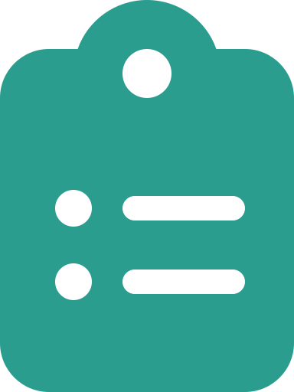
Course Syllabus & Evaluation
• Textbook: Computer Security: Principles & Practice
• Grading: assignments, labs, project & exams
• Participation & attendance expectations
• Policies: late work, academic integrity
[13]
Notes:
The official syllabus is your roadmap. Our primary text is *Computer Security: Principles and Practice* by Stallings and Brown. Each week you'll be assigned readings from this book. The lectures will supplement, not replace, the text, so it's crucial that you keep up.
Your grade will be based on several components. Short assignments and lab exercises will reinforce topics like authentication, cryptography and access control. A midterm and final exam test your conceptual understanding. A substantial group project will allow you to explore a security or privacy problem in depth. Participation is also graded; engage in class discussions and complete in-class activities.
We expect you to attend every class session. If you must miss class, notify me in advance and make up the material. Late work is generally penalized unless arrangements are made ahead of time. Academic integrity is non-negotiable: plagiarism or cheating on assignments or exams will be reported.
Please read the full syllabus posted on Blackboard; it contains detailed rubrics, due dates and my office hours. Understanding these requirements early helps avoid surprises later in the semester.

Slide 11
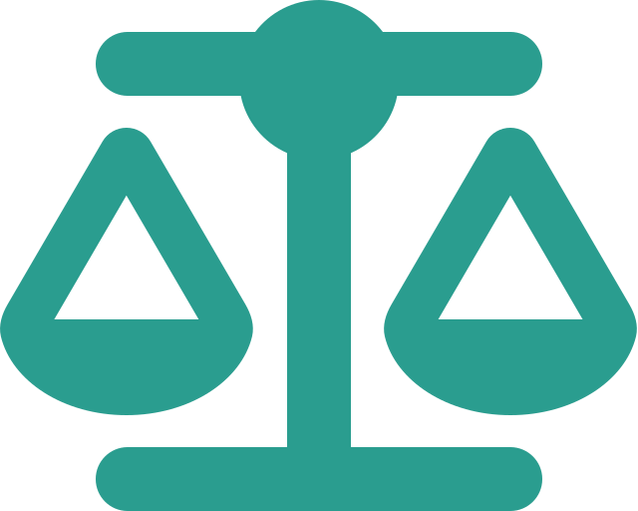
Expectations & Academic Integrity
• Collaborative learning vs. academic misconduct
• Respectful discussion & inclusive participation
• Proper citation of sources
• Professional communication and conduct
[14]
Notes:
To get the most out of this course, you must be an active participant. Collaboration is encouraged: discussing lecture concepts with classmates, forming study groups and debugging code together are all healthy academic behaviors. But there's a line between collaboration and misconduct. When you submit work, it must be your own. You should never copy someone else's code or text without attribution. If you're unsure about how much collaboration is permitted on an assignment, ask.
Engage respectfully with your peers. Data security and ethics can involve sensitive topics—surveillance, discrimination, government policies. Our classroom should be a space where everyone feels comfortable sharing perspectives. Be aware of your tone in discussions and online posts.
Proper citation isn't just for papers. When you borrow ideas, definitions or code snippets, cite the source. This helps others verify information and reinforces the ethical norms we want to practice.
Finally, treat this class like a professional environment. Arrive on time, meet deadlines and communicate proactively when issues arise. These habits will serve you well in your career. With these expectations in mind, we can foster a collaborative, honest and productive learning environment.

Slide 12

Summary & Next Steps
• Reviewed course structure and importance of security
• Introduced foundational concepts and threat awareness
• Outlined assignments, policies and expectations
• Next week: Cryptography basics and access control models
[15]
Notes:
Let's recap what we've covered today. We started by exploring the course objectives and why data security, privacy and ethics are vital components of a data science curriculum. We introduced the CIA triad and discussed common threats and vulnerabilities. We touched on authentication, access control, privacy frameworks and the legal landscape. We went through the syllabus, assignments and evaluation criteria, and we set expectations for participation and academic integrity.
Between now and our next class, please do the following: read Chapter 1 of the textbook, which covers basic definitions and the threat environment; review the syllabus on Blackboard and note all due dates; sign up for the class forum if you haven't already; and skim the privacy policy of an app or service you use frequently so we can discuss it next week.
Next week's lecture will delve into the basics of cryptography—how we use mathematics to protect data—and into formal models of access control. You'll learn about symmetric vs. asymmetric algorithms, hashing, and the principles behind certificates and secure channels. We'll also expand on the access control models introduced today.
Please come prepared with your questions. Remember that security is a rapidly evolving field; staying curious and engaged is the best way to succeed. See you next time!

