Slide 1
Week 3: Postgres Admin + DevOps in Supabase
CST4714 Database Administration | Detailed lecture script in speaker notes
Notes:
Good session everyone. Today is Week 3, and our topic is PostgreSQL administration and DevOps operations in Supabase.
In Week 2, we built operational confidence by running Postgres locally with Docker, connecting through tools, loading datasets, and practicing dump and restore.
Today we move from setup mechanics into production-style operating behavior.
Our focus is simple: we will manage database change safely, verify database state with evidence, secure data with role and policy controls, and prepare recovery paths before incidents happen.
As we go, we will treat Supabase as managed Postgres, not as a black box.
That means the database fundamentals still apply exactly: schema quality, transaction behavior, indexing, locking, permissions, and backups.
By the end of this lecture, everyone in this room can explain what we own operationally, what the platform owns, and what shared boundary decisions still require judgment.
Everything in this deck is designed to be reused during the midterm project.

Slide 2
Learning Outcomes
Explain shared DBA responsibilities in managed Postgres (Supabase).
Navigate Supabase admin surfaces used for day-to-day operations.
Design schema/index changes with migration-first discipline.
Diagnose performance and locking issues with concrete workflows.
Apply role/privilege/RLS controls using least-privilege principles.
Execute restore-first backup and incident response runbooks.
Notes:
These are the outcomes we are targeting today.
First, you will explain the DBA responsibilities that remain in managed Postgres.
Second, you will navigate Supabase admin surfaces as an operator, not just as a beginner user.
Third, you will apply a migration-first workflow so schema changes remain traceable and reversible.
Fourth, you will triage performance and locking symptoms with a repeatable method.
Fifth, you will apply least-privilege security using roles, grants, and row-level security.
Finally, you will practice restore-first operations so backup claims are verified by evidence.
As you listen, map each outcome to one artifact you can produce.
In operations work, proof matters more than intent.
If you can show the migration, the query plan, the policy test, and the restore check, you are operating like a real database administrator.

Slide 3
Agenda and Time Budget (90 minutes)
0-10 min: Week 2 recap and managed Postgres responsibility model.
10-35 min: Guided Supabase admin console walkthrough (screenshots).
35-60 min: Core Postgres admin workflows in Supabase.
60-80 min: DevOps pipeline, migrations, and recovery drills.
80-90 min: In-class lab launch, deliverables, and troubleshooting.
Notes:
Here is our ninety-minute plan.
We begin with a short recap and responsibility model.
Then we spend focused time inside Supabase admin surfaces, because interface literacy is part of operational literacy.
After that, we move into core Postgres workflows: schema control, indexing, query plan triage, maintenance, and security.
Then we cover the DevOps layer: migrations, environment promotion, CI checks, and incident response.
We close by launching the Week 3 lab with clear deliverables.
While we move through this agenda, keep a running operations log.
Write down what action happened, why it happened, and how you verified success.
That habit will improve your debugging speed, and it will make your midterm report much stronger.

Slide 4
From Week 2 to Week 3
Week 2 baseline: local Docker Postgres, pgAdmin, pg_dump/restore, Supabase import.
Week 3 expansion: platform operations, observability, and controlled change.
Same data discipline, higher operational rigor.
Every change must include validation and rollback planning.
Notes:
Let’s connect this directly to last week.
Week 2 gave us infrastructure fluency: stand up Postgres, connect, import data, export data, and restore data.
Week 3 raises the bar.
Now we care about change control, policy correctness, performance evidence, and recovery readiness.
The technical tools are similar, but the mindset is different.
Instead of asking, “Can I make this query run,” we ask, “Can I make this change safely, prove it worked, and recover if it fails?”
That shift is the difference between classroom SQL practice and real operational responsibility.
From this point forward in the course, we assume every change includes validation steps and rollback awareness.

Slide 5
DBA + DevOps in Supabase: What Changes
Supabase manages infrastructure layers, but you own schema/data/access quality.
You still tune queries, indexes, and privileges.
You still design backup verification and restore drills.
You still own migration sequencing, release safety, and incident response.
Managed platform means fewer server chores, not fewer accountability points.
Notes:
Managed Postgres changes the operating surface, but it does not remove ownership.
Supabase manages infrastructure layers such as base hosting and many platform services.
You still own schema correctness, query efficiency, permissions, policy logic, migration quality, and data integrity.
If a bad migration drops needed data, the platform did not cause that.
If a weak policy leaks rows, the platform did not cause that.
If a missing index turns a fast endpoint into a slow one, the platform did not cause that.
Managed service means fewer server chores, not less accountability.
The most reliable way to work in this model is to treat every database change as an engineering release with explicit checks before and after.

Slide 6
Shared Responsibility Model
Platform side: host uptime, managed backups, core patching, base networking.
Team side: schema design, SQL quality, roles/grants/RLS, migration safety.
Joint side: observability interpretation and capacity planning decisions.
Class rule: always document who owns each operational task.
Notes:
This responsibility split is important.
Platform ownership usually includes base availability, patching layers, and core managed backup mechanisms.
Your team ownership includes schema evolution, SQL quality, role design, policy enforcement, and operational verification.
There is also a shared zone: interpreting metrics, planning capacity, and timing high-impact changes.
Whenever an incident happens, begin by classifying the owner for each failure point.
That classification removes confusion and speeds escalation.
In team settings, vague ownership causes delays and repeated mistakes.
Clear ownership lets us act fast while still learning from the event.
Keep this model in mind for every task in today’s lab.

Slide 7
Supabase Architecture for Postgres Ops
Core Postgres database remains the system of record.
Supabase services add Auth, Storage, APIs, and realtime integrations.
Operationally relevant surfaces: SQL Editor, Logs, Reports, Backups, Settings.
Treat platform services as operational dependencies around your SQL core.
Notes:
Operationally, Supabase is still centered on PostgreSQL.
Around that core, Supabase adds useful services such as authentication, storage, API layers, and realtime features.
For us, the key admin surfaces are SQL execution, settings, logs, reports, and backup/recovery controls.
When something breaks, we diagnose through those surfaces and map symptoms back to Postgres behavior.
For example, an API timeout may still be a slow SQL plan.
An auth complaint may still be a policy issue on data access.
A deployment incident may still be migration ordering.
So keep this mental model: services around the database are important, but Postgres remains the center of correctness.

Slide 8
Textbook Integration Map
Molina/Ullman/Widom: logging, recovery, serializability, locking, deadlocks.
Obe/Hsu (Up and Running): config, roles, privileges, backup/restore, tuning.
PostgreSQL 16 Cookbook: WAL, autovacuum, HA patterns, backup automation.
Week 3 applies these ideas directly inside Supabase operational workflows.
Notes:
We are grounding today’s workflows in three textbook streams.
From Molina, Ullman, and Widom, we take the deep foundations of transactions, locking, logging, and recovery.
From Obe and Hsu’s PostgreSQL text, we take practical administration mechanics: roles, privileges, configuration habits, backup and restore, and performance tuning workflow.
From PostgreSQL 16 Cookbook, we take modern operational patterns such as WAL awareness, autovacuum behavior, replication context, backup strategy, and recovery operations.
The point is not to memorize isolated facts from each source.
The point is to integrate theory and operations into decisions you can execute with confidence.
Today’s lab asks you to do exactly that.

Slide 9
Part A
Supabase Admin Console Walkthrough (capture these screenshots)
Notes:
We are now entering Part A: the Supabase console walkthrough.
I want us to view each screen as an operational control point.
For every screen, we ask three questions.
What state can I change here?
What state can I verify here?
What evidence can I capture here after a change or incident?
If you can answer those three questions on each surface, you can operate the platform with discipline.
If you cannot answer them, you are relying on luck.
Let’s go screen by screen and make this practical.

Slide 10
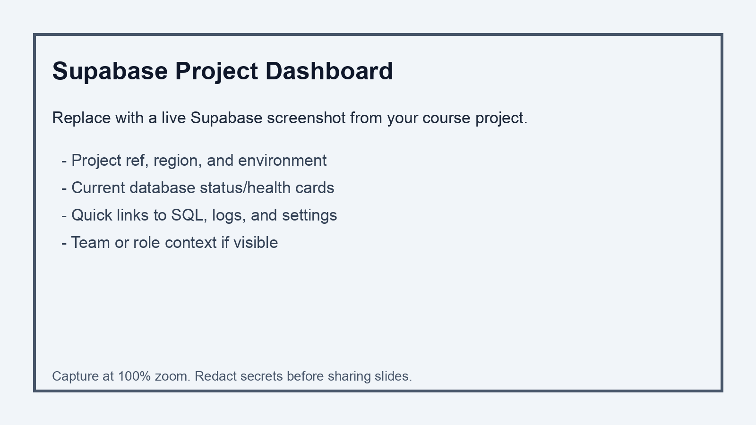
Screenshot 1: Project Dashboard Overview
Capture checklist
- Show project name/ref and region
- Capture health/status indicators
- Include quick navigation to SQL/logs/settings
- Hide sensitive tokens or secrets
Notes:
On this dashboard view, start with environment certainty.
Confirm project identity, project reference, and region before any action.
Wrong-environment mistakes are common and expensive.
Next, read status signals and recent activity indicators.
These clues often reveal trouble before users report issues.
From here, identify fast paths to SQL, logs, and settings.
In live operations, time to navigation matters.
When pressure rises, we go directly to the right surface for diagnosis and mitigation.
Capture this screen in lab evidence so the report proves the correct project was used.

Slide 11
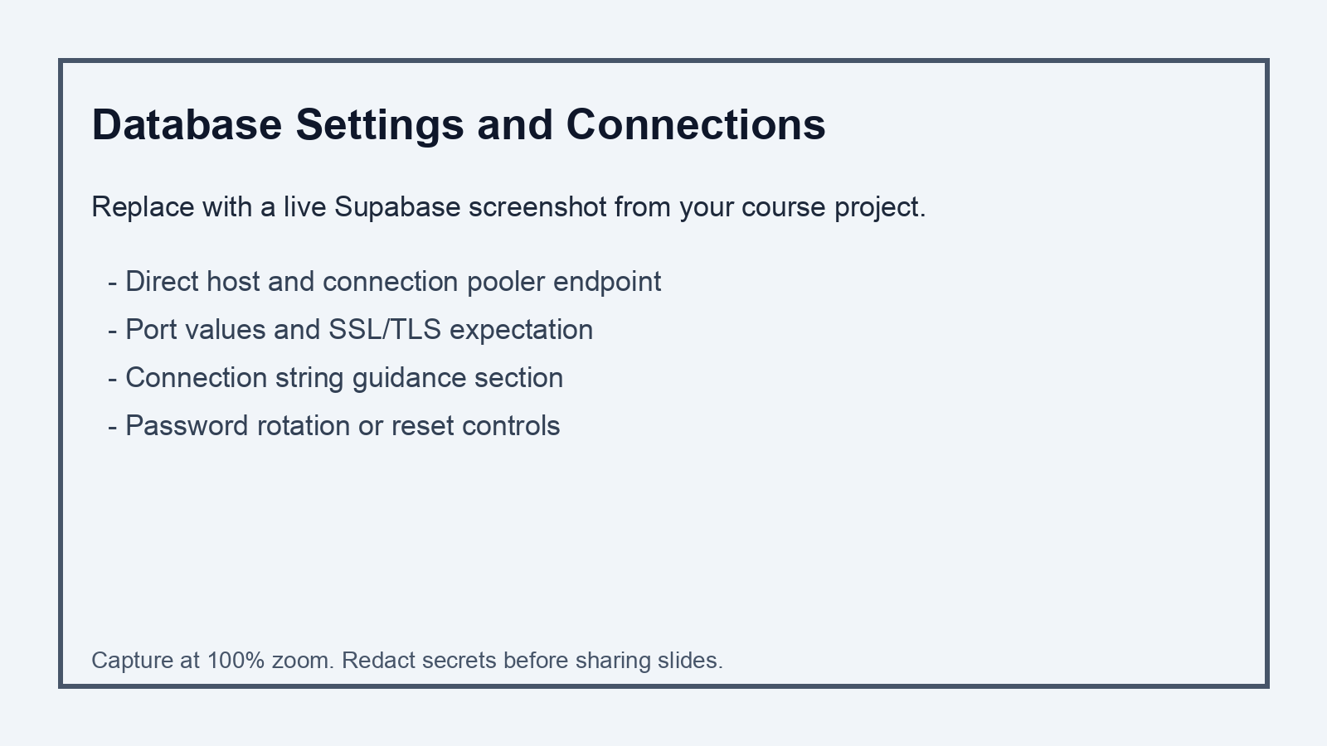
Screenshot 2: Database Settings and Connections
Capture checklist
- Show direct + pooler connection options
- Show SSL requirement and ports
- Highlight password rotation controls
- Record where connection strings are obtained
Notes:
This settings screen is where connection discipline starts.
Review direct connection details and pooler endpoint details.
Identify which client type uses which endpoint.
Check port and SSL expectations.
Most avoidable connection failures come from stale credentials, SSL mismatch, or wrong endpoint selection.
Also note where password rotation is performed.
Credential rotation is not just a click; it is an operational event coordinated with deployment.
If credentials change but application secrets do not, an outage follows.
In your notes, record the connection source of truth for this project.

Slide 12
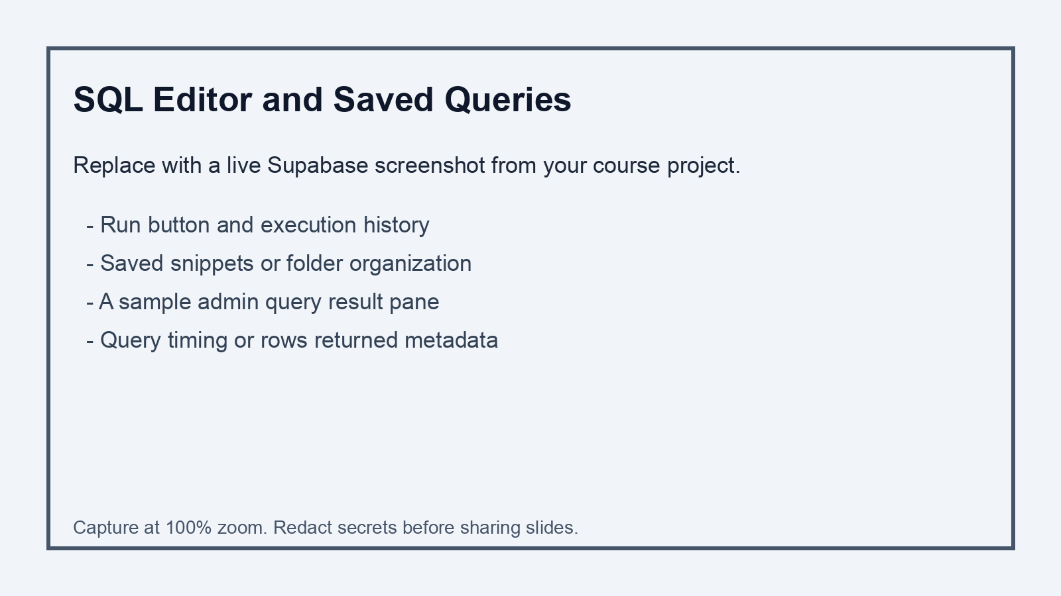
Screenshot 3: SQL Editor Workflow
Capture checklist
- Show a saved admin query
- Run a verification SELECT
- Include execution result metadata
- Capture execution history if visible
Notes:
This SQL editor is your controlled execution surface for diagnostics and small operational tasks.
Use saved queries for repeatability.
If a query is important enough to run during incidents, it is important enough to save with a clear name.
Always read result metadata: row counts, execution timing, and errors.
Those details are operational evidence.
For risky statements, prepare checks before execution and verification queries after execution.
Never rely on memory alone.
In your lab deliverable, include at least one query output that proves state before change and state after change.
That is how we demonstrate reliable operations.

Slide 13
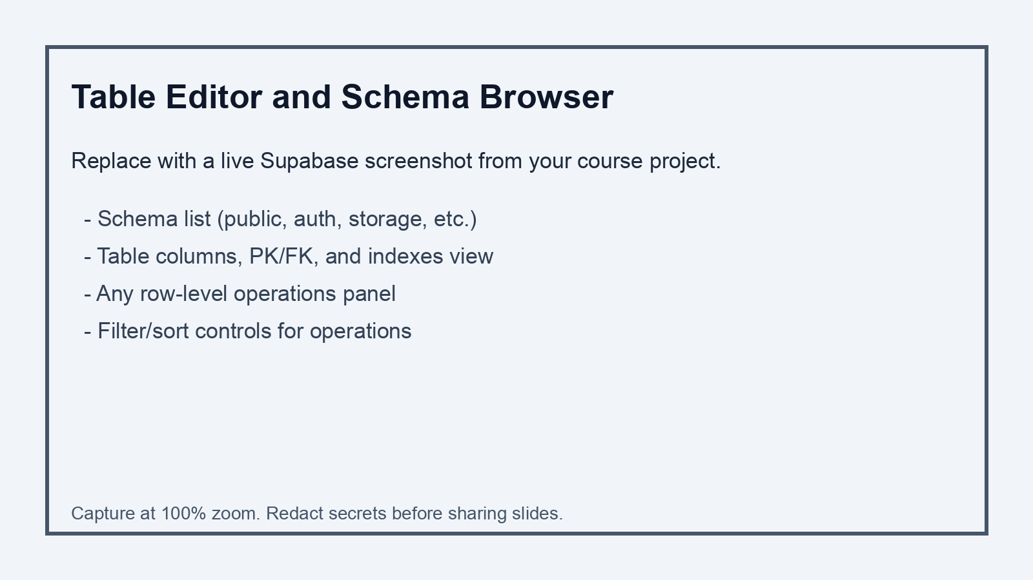
Screenshot 4: Table Editor and Schema Browser
Capture checklist
- Show schema list and table inventory
- Capture one table with constraints
- Show index visibility if available
- Note where DDL should still come from migrations
Notes:
The table and schema browser is excellent for inspection and fast orientation.
Use it to understand object layout, constraints, and table structure.
However, do not treat UI edits as the primary change mechanism.
Structural changes go into migration files so they are reviewable, replayable, and auditable.
If environments drift because of ad hoc UI edits, debugging becomes painful and releases become risky.
Use this interface for visibility and verification.
Use migration files for durable change history.
That split gives speed and control at the same time.

Slide 14
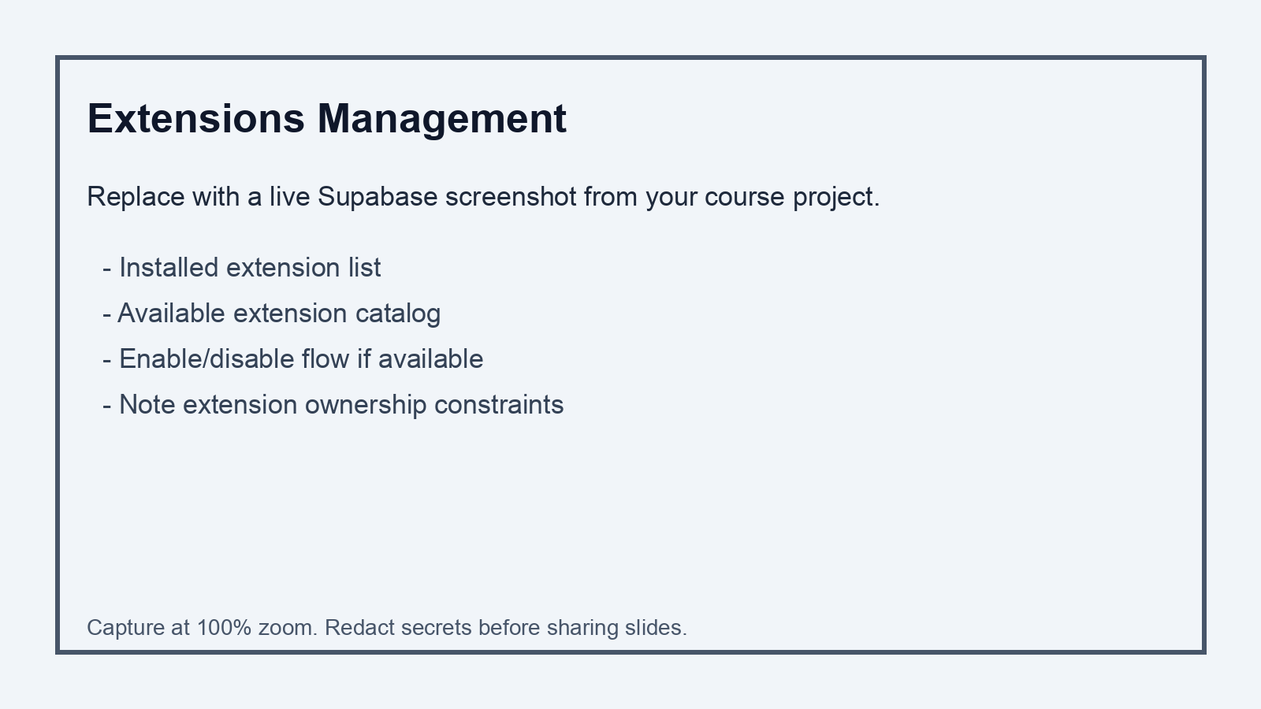
Screenshot 5: Extensions Management
Capture checklist
- Show installed extension list
- Show searchable extension catalog
- Capture enable flow for one extension
- Document extension rationale in notes
Notes:
Extensions are operational dependencies and must be introduced deliberately.
Before enabling an extension, define the problem it solves.
Then confirm compatibility, privilege requirements, and expected maintenance impact.
In managed environments, extension availability and permissions can differ from local self-managed installs.
So validate first, then enable.
Record extension decisions in the runbook, including why the extension exists and which feature depends on it.
That documentation helps future teammates and protects the team during incident review.
If no clear use case exists, leave extension surface area unchanged.

Slide 15
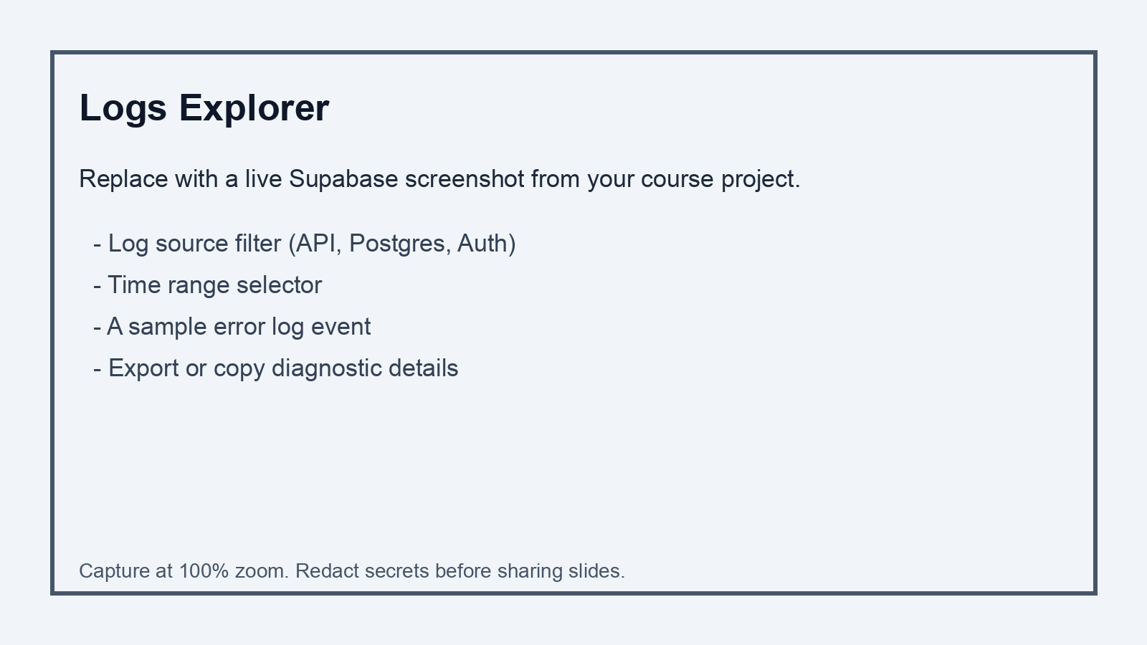
Screenshot 6: Logs Explorer
Capture checklist
- Filter by source (Postgres/Auth/API)
- Set a narrow incident time window
- Capture one real error event
- Show how to copy event details
Notes:
Logs Explorer is one of the highest-value operational tools in this entire platform.
When diagnosing an issue, narrow by time range first.
Then filter by signal source so you avoid noise.
From there, inspect concrete events and correlate with change history.
Did errors begin right after a migration?
Did auth failures rise after policy changes?
Did API timeouts align with slow query events?
Use logs to build a timeline, not guesses.
The faster you can produce a clean timeline, the faster you can decide mitigation safely.
Include at least one log event in your lab evidence with a short interpretation.

Slide 16
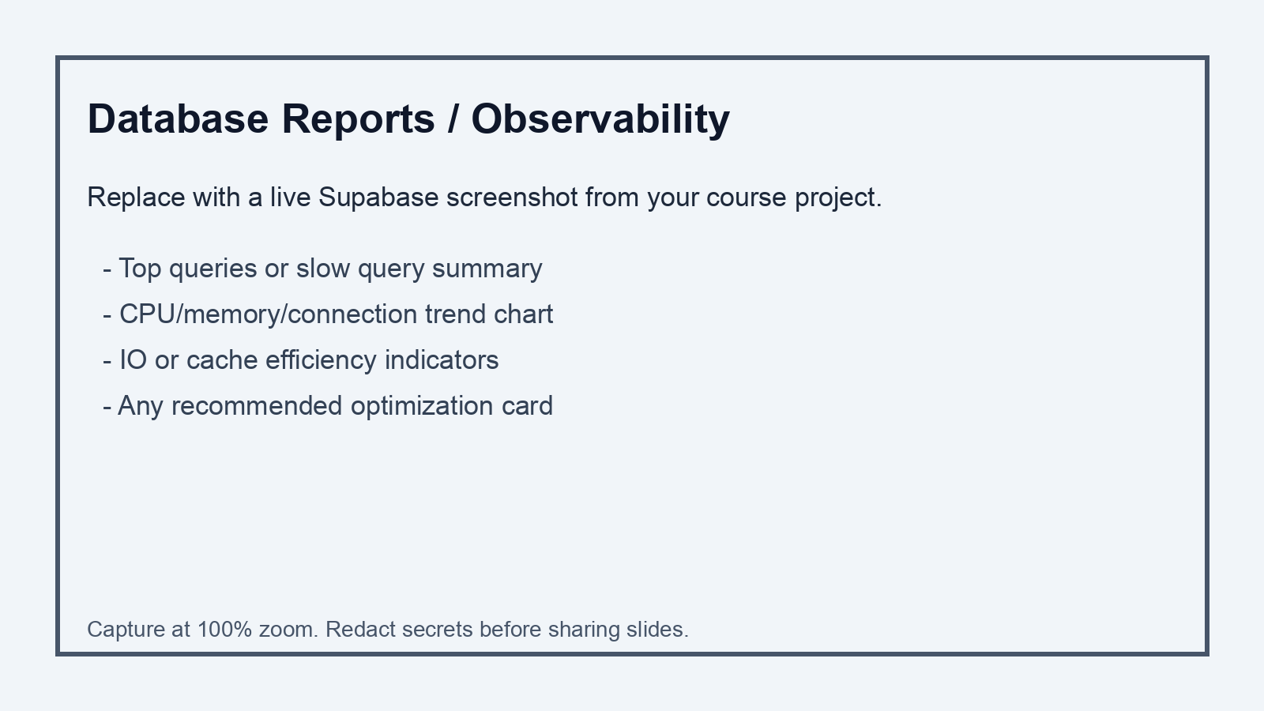
Screenshot 7: Database Reports / Observability
Capture checklist
- Capture load and connection trends
- Show top query or resource-heavy query insight
- Include any alert/recommendation card
- Record one optimization candidate
Notes:
Reports and observability views convert raw activity into patterns.
Use these screens to identify heavy queries, unusual connection behavior, and resource spikes.
A chart alone is not the outcome.
The outcome is an operational decision.
For example, you might add an index, rewrite a query, or reduce connection churn.
Always attach a proposed action to the metric you highlight.
When you submit lab work, do not just paste graphs.
State what the graph indicates and what change you would test next.
That practice demonstrates engineering judgment.

Slide 17
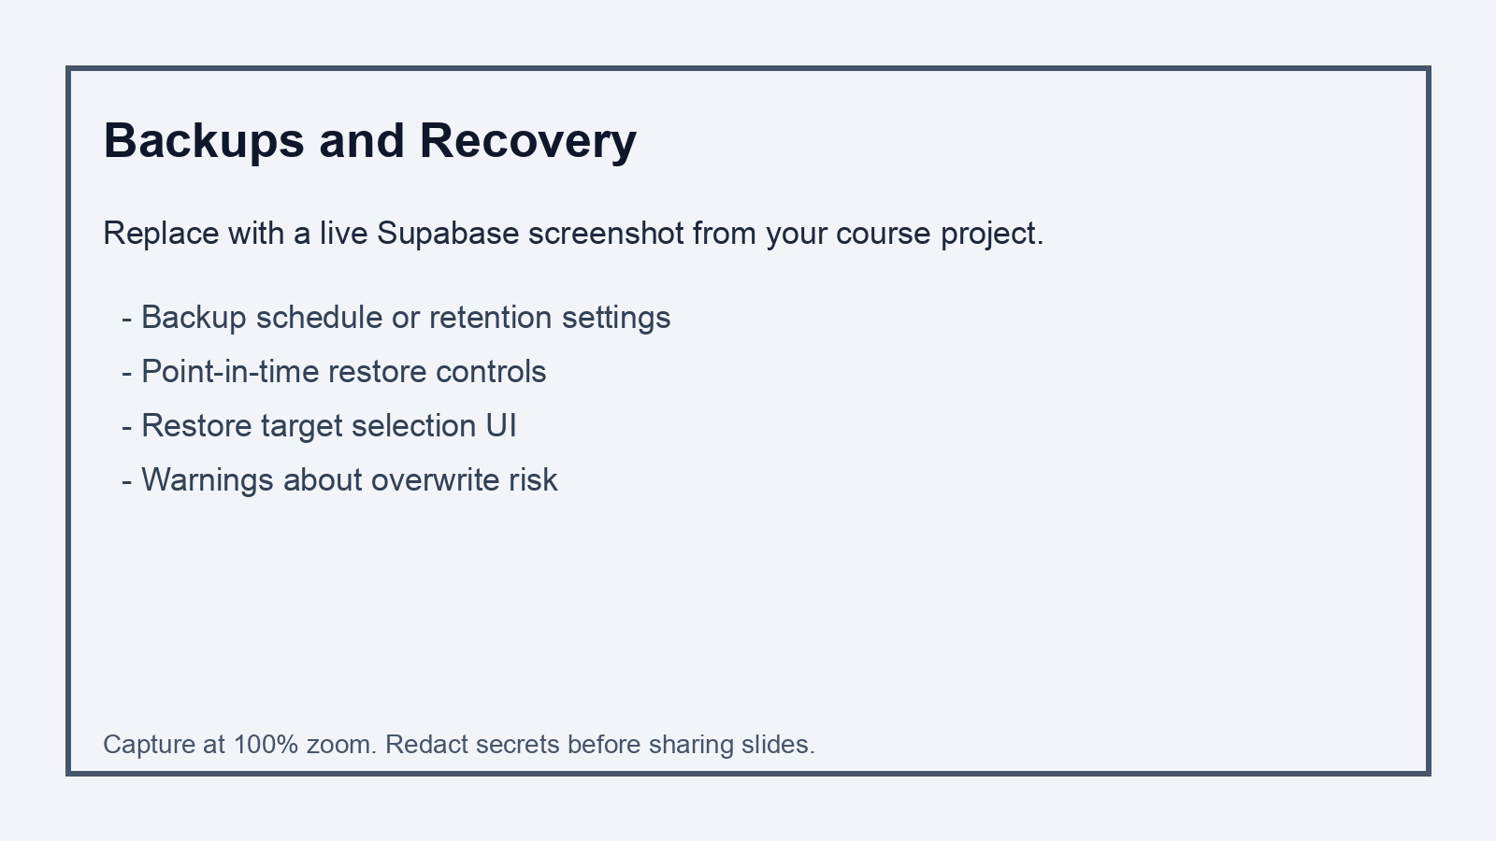
Screenshot 8: Backups and Point-in-Time Recovery
Capture checklist
- Show retention configuration
- Show restore target selection controls
- Capture warnings/confirmation flow
- Document expected recovery objective
Notes:
Now we are on backups and point-in-time recovery controls.
Treat this screen as a reliability contract.
A backup setting is a promise about what recovery may be possible.
You need to know retention windows, restore options, and practical limitations.
Then you need to verify that recovery works in a controlled drill.
In real incidents, untested recovery paths fail when you need them most.
So we operate with a restore-first mindset.
If we cannot restore and validate, we are not actually safe.
Your lab must include recovery verification evidence, not only backup configuration screenshots.

Slide 18
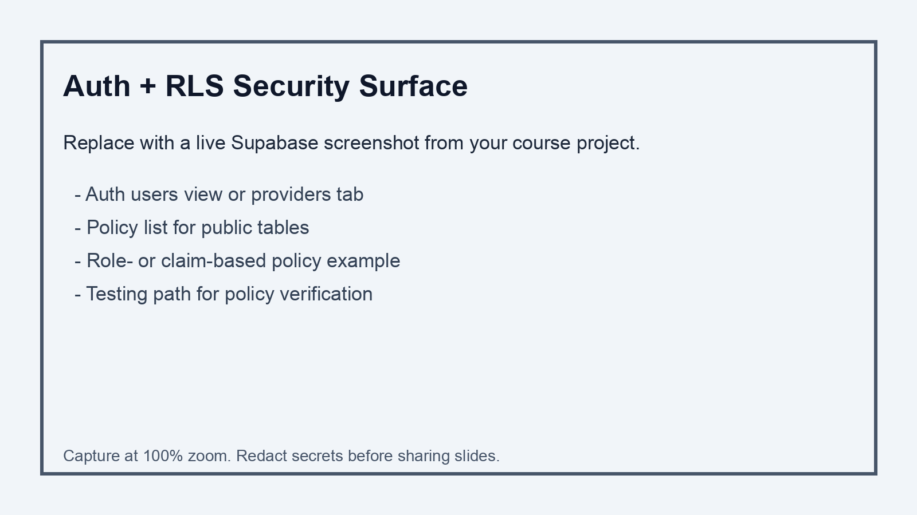
Screenshot 9: Auth + RLS Operational Surface
Capture checklist
- Show Auth users/providers screen
- Show policies for one table
- Capture policy expression example
- Demonstrate policy test query
Notes:
This auth and policy surface is where data access control becomes real.
Enabling RLS is the start, not the finish.
Policy logic must be tested with both allowed and denied scenarios.
A policy that looks correct can still leak data when claim assumptions are wrong.
So validate with concrete principals and clear expected outcomes.
Also review role boundaries and make sure privileges are minimal.
Security failures usually come from excessive permission or weak policy conditions.
In your lab, include one policy test that proves correct denial behavior.
That is critical evidence for secure operations.

Slide 19
Part B
Postgres Administration Workflows in Supabase
Notes:
We are now entering Part B: core PostgreSQL administration workflows in Supabase.
This is where we shift from interface walkthrough to daily operating mechanics.
The pattern is always the same.
Plan the change.
Apply the change in a controlled way.
Verify the result with evidence.
Observe system behavior for regression.
If needed, recover using a prepared path.
That cycle is the heartbeat of database operations.

Slide 20
Schema Governance Standards
Use explicit schema naming and ownership conventions.
Separate operational tables from application domain tables where useful.
Name constraints/indexes consistently for debugging clarity.
Document every DDL change in a migration and changelog entry.
Notes:
Schema governance keeps systems understandable as they grow.
Use consistent naming for tables, constraints, indexes, and related objects.
Organize schemas intentionally so purpose is clear.
When object names are predictable, troubleshooting is faster and less error-prone.
Every DDL change includes a migration entry and a short changelog note.
That history matters during audits, rollbacks, and post-incident analysis.
The goal is not bureaucracy.
The goal is lower debugging cost and better collaboration.
Good governance now prevents confusion later.

Slide 21
Index Strategy for Operational Workloads
Start with workload evidence, not guesswork.
Prefer B-tree for equality/range filters; use GIN/GiST where data type demands.
Use partial indexes when predicate selectivity is stable.
Re-check plan changes after every schema or query revision.
Notes:
Index strategy begins with observed workload, not assumptions.
Identify high-frequency filters, joins, and sorts that drive latency.
Choose index types based on access patterns and data characteristics.
Remember that indexes improve reads and add write and maintenance cost.
So each index justifies its existence with evidence.
After creating an index, compare plan behavior before and after.
If the plan does not improve materially, reconsider the change.
In operations, every performance change is evidence-driven and reversible.

Slide 22
Query Plan Triage
Capture baseline with EXPLAIN (ANALYZE, BUFFERS) for slow statements.
Check scan type, row estimate errors, and join strategy.
Inspect pg_stat_statements-style views via SQL/Inspect workflows.
Apply one optimization at a time and compare before/after evidence.
Notes:
Query plan triage follows a repeatable sequence.
First, capture baseline execution details.
Second, inspect scan choices, cardinality estimates, and join methods.
Third, identify the highest-probability bottleneck.
Fourth, apply one targeted change.
Fifth, re-measure and compare.
Avoid making multiple changes at once because causality becomes unclear.
This discipline saves time and reduces risk.
In performance write-ups, show baseline, intervention, and measured outcome.

Slide 23
VACUUM, ANALYZE, and Storage Hygiene
Understand MVCC bloat and why vacuuming matters.
Monitor autovacuum behavior and blocked maintenance events.
Use ANALYZE to refresh planner statistics after major data shifts.
Treat maintenance windows as operational design, not afterthought.
Notes:
Vacuum and analyze are central to long-term PostgreSQL health.
Because of MVCC, dead tuples accumulate and statistics become stale over time.
Autovacuum helps, but you still need to monitor behavior and identify gaps.
After significant data shifts, planner statistics may need refresh through analyze.
If maintenance is ignored, query quality declines and storage bloat grows.
So treat maintenance as normal operations, not emergency cleanup.
A healthy system is maintained continuously.
A neglected system eventually forces reactive firefighting.

Slide 24
Locking and Blocking Diagnosis
Symptom: rising latency with low CPU can indicate lock contention.
Use lock/active-session queries to identify blocker and wait chain.
Kill only as last resort; prefer safe transaction design fixes.
Capture incident timeline for root-cause review.
Notes:
Locking issues often appear as high latency even when CPU looks moderate.
When this pattern appears, inspect active sessions and lock wait chains.
Identify blocker transactions and understand which object they are holding.
Then decide the least risky corrective action.
Terminating a session may restore service quickly, but it is not the first habit.
The better long-term fix is transaction design: shorter transactions, safer sequencing, and reduced contention.
Capture a timeline whenever locking incidents occur.
That timeline helps fix root cause instead of repeating emergency actions.

Slide 25
Roles, Grants, and Least Privilege
Create role tiers: owner/admin, app writer, read-only analyst.
Grant explicit privileges; avoid broad grants to PUBLIC.
Set default privileges to prevent future drift.
Audit privilege map regularly and during releases.
Notes:
Role design is one of the strongest safety controls you have.
Define clear role tiers for ownership, application writes, and read-only analytics.
Grant only needed privileges, and avoid broad default access.
Set default privilege behavior intentionally so future objects do not drift into unsafe exposure.
Then periodically audit grants to confirm policy still matches architecture.
Least privilege reduces blast radius and prevents accidental damage.
It also makes incident investigation cleaner because rights are explicit.
Strong privilege structure is not optional in production-minded systems.

Slide 26
Row Level Security Pattern
Enable RLS on exposed tables before shipping client-facing features.
Write separate SELECT/INSERT/UPDATE/DELETE policies where needed.
Bind policies to verified user identity/claims, not assumptions.
Add policy tests to migration verification checklist.
Notes:
Row Level Security controls which rows each principal can access.
That makes it critical for multi-user applications and shared datasets.
Write policies explicitly for each relevant action path: select, insert, update, and delete.
Validate policy behavior with realistic identity claims.
Never assume policy logic is correct until tested for both allow and deny cases.
A single weak condition can expose sensitive data silently.
Include policy tests in migration verification.
Security that is not tested is security that is not trusted.

Slide 27
Part C
DevOps Workflow for Supabase Postgres
Notes:
Now we enter Part C: DevOps workflow for Supabase Postgres.
In this section we connect database administration to release engineering.
Our objective is predictable deployment with low regression risk and fast recovery options.
The core rule is simple.
If a change cannot be versioned, reviewed, tested, and rolled back, it is not ready for production-style environments.
Let’s walk through that release discipline step by step.

Slide 28
Migration-First Workflow (Supabase CLI)
Initialize/link: supabase init, supabase link --project-ref <ref>
Sync baseline: supabase db pull
Create change file: supabase migration new <name>
Apply safely: supabase db push
Verify with SQL checks and policy tests after push.
Notes:
This migration-first workflow keeps schema history durable and auditable.
Initialize and link your project context.
Pull baseline state when needed.
Create migration files for each structural change.
Push changes through controlled commands, then run verification SQL immediately.
Never treat migration execution as complete without validation queries.
In team workflows, migration files are reviewable contracts.
They carry intent, order, and rollback context.
That is exactly what ad hoc manual changes fail to provide.

Slide 29
Environment Promotion Model
Local development for rapid iteration and destructive tests.
Staging environment for integration and migration rehearsal.
Production environment for approved, reviewed migrations only.
Promotion gate requires: tests pass, metrics stable, rollback ready.
Notes:
Use environment promotion intentionally.
Local is for fast experimentation and destructive learning.
Staging is for realistic rehearsal and integration checks.
Production is for approved, traceable changes only.
Promotion requires gates: passing checks, stable metrics, and a recovery path.
This discipline prevents accidental rollout of untested behavior.
It also reduces pressure because the team knows what qualifies a change for promotion.
Structured promotion is one of the highest-value habits we build early.

Slide 30
CI/CD Pipeline Example (GitHub + Supabase)
On pull request: lint SQL, run schema drift checks, run test queries.
On merge to main: apply migrations to staging automatically.
Manual approval gate before production migration push.
Post-deploy: run smoke tests + monitor logs/reports for regressions.
Notes:
A practical CI/CD pipeline makes database releases safer.
On pull requests, run static checks, migration checks, and essential SQL tests.
On merge, deploy to staging and run smoke verification.
Use explicit approval before production migration steps.
After deployment, monitor logs and performance indicators for regression signals.
Automation does not remove judgment; it removes skipped steps.
That is the real benefit.
Consistent automation plus clear gates produces reliable releases over time.

Slide 31
Backup and Restore Runbook
Use platform-managed backups plus periodic logical exports (pg_dump).
Perform restore drills into an isolated target before incidents happen.
Document RPO/RTO assumptions for each environment.
After restore: verify row counts, constraints, and critical queries.
Notes:
This runbook mindset is essential.
Use platform-managed backups, but also maintain logical exports when portability is needed.
Schedule restore drills in isolated targets.
Define recovery objectives clearly, then verify that your process can meet them.
After restore, run structural and data checks: tables, counts, constraints, and critical query behavior.
Without post-restore verification, recovery is incomplete.
The goal is confidence backed by evidence, not confidence based on assumptions.

Slide 32
Incident Response Flow for Database Events
1) Declare incident and freeze nonessential changes.
2) Identify symptom scope (latency, errors, data correctness).
3) Correlate with recent migrations/deployments and logs.
4) Apply minimal corrective action, then verify service health.
5) Write post-incident notes with root cause and prevention actions.
Notes:
When incidents occur, follow a calm sequence.
Declare the incident and pause nonessential change.
Scope the impact clearly.
Correlate symptoms with recent releases, migrations, and logs.
Apply the smallest safe mitigation first.
Then verify service restoration with concrete checks.
After stabilization, document root cause and prevention actions.
This process shortens outages and improves future reliability.
Incident response is a skill built through consistent structure.

Slide 33
Part D
Week 3 In-Class Lab
Notes:
We are now in Part D, the Week 3 lab launch.
This lab is designed to force complete operational loops, not partial activity.
You will capture operational surfaces, execute controlled changes, validate outcomes, and produce evidence.
The goal is to demonstrate that you can operate a managed Postgres environment with discipline.
Process quality matters as much as query correctness.

Slide 34
Lab Tasks
Capture the nine Supabase admin screenshots listed in this deck.
Create one migration that adds at least one useful index.
Run EXPLAIN ANALYZE before and after the index change.
Implement one new role and one RLS policy test case.
Produce a short backup/restore verification report.
Notes:
Here are your core lab tasks.
Capture the required Supabase admin screenshots.
Create and apply a migration that introduces a meaningful index.
Measure performance before and after with explain analyze evidence.
Implement at least one role and one RLS policy test.
Produce a short backup and restore verification record.
For each task, include what you changed, why you changed it, and how you confirmed the result.
That structure is how operations work is evaluated professionally.

Slide 35
Deliverables and Evaluation
One PPTX/PDF evidence packet with screenshots and short annotations.
Migration SQL file plus verification SQL script.
Performance comparison note (before/after plan summary).
Security note describing role/policy intent and outcome.
Reflection paragraph: what failed first and how it was fixed.
Notes:
Your submission needs to be evidence-rich and clear.
Include screenshots with short annotations, migration SQL, verification SQL, performance comparison notes, and security outcome notes.
Add a short reflection that explains the first failure you encountered and how you fixed it.
I care about the debugging process, not just polished final output.
If you encountered no issues, explain what checks you ran to establish confidence.
Operational maturity means proving reliability, not claiming reliability.

Slide 36
Troubleshooting Matrix (Most Common Failures)
Auth errors: recheck role credentials, provider state, and policy logic.
Migration errors: inspect dependency order and object existence.
Slow queries: inspect plan drift, missing indexes, stale statistics.
Connection spikes: verify pool usage and client connection lifecycle.
Restore mismatch: validate target DB and backup artifact selected.
Notes:
Use this troubleshooting matrix as your first-pass triage guide.
For auth issues, inspect credentials, provider status, and policy logic.
For migration issues, inspect order dependencies and object existence.
For slow queries, inspect execution plans and statistics quality.
For connection spikes, inspect pooling usage and client behavior.
For restore mismatches, verify target selection and backup source integrity.
Categorizing by failure layer reduces random trial-and-error and speeds resolution.

Slide 37
Wrap-Up and Week 4 Preview
Week 3 outcome: operate Supabase Postgres with admin + DevOps discipline.
Next focus (Week 4): deeper schema management, constraints, and introspection.
Carry forward: migration-first thinking and restore-first safety mindset.
Do not proceed to next project milestone without a working runbook.
Notes:
To close, Week 3 is about operational discipline in managed Postgres.
You now have a framework for secure change, performance triage, policy enforcement, and recovery verification.
In Week 4 we deepen schema management and introspection, but the operating cycle stays the same: plan, change, verify, observe, and recover.
Carry this mindset into every assignment.
Reliable systems are built by consistent, evidence-based habits.
That is the professional standard we are practicing in this course.

