Slide 1
WEEK 12
MongoDB Reliability and Recovery
Turn replication, read and write settings, and restore work into explicit operating promises.
12
OPERATING CLOUD DATABASES
Notes:
This week asks a reliability question that sounds simple but is not: what does a database promise when a node, network path, client, or human action fails? We will answer by naming the operation, failure, mechanism, observed behavior, and limitation instead of using broad phrases such as highly available or safe.
We will study MongoDB replica sets, elections, write concern, read preference, read concern, and partition behavior. Then we will separate replication from backup by creating and verifying a collection-level logical recovery artifact. The same reasoning applies beyond MongoDB: a replicated service and a recoverable history solve different failure classes.
[Sources]
- CST4714 course textbook, Chapter 12.
- https://www.mongodb.com/docs/manual/replication/

Slide 2
WEEK 12 / CST4714
A reliability promise needs five visible parts
Name the operation and failure before choosing the mechanism.
1
2
3
4
5
Operation
Failure
Behavior
Mechanism
Observed result
Which read, write, query, connection, or restore matters?
Node loss, partition, timeout, deletion, or bad change?
Continue, wait, reject, retry, read stale, or recover later?
Replica, concern, routing, export, restore, or application rule?
What observation supports the claim, and what remains untested?
2
Notes:
A useful reliability promise begins with one operation. A ticket write and an analytics read can deserve different behavior. Next, name the failure. Loss of one member is different from a network partition, and both are different from an authorized deletion that every replica accepts.
Then state acceptable behavior. Should the operation continue, wait, reject, retry, return older data, or recover later? Only after those choices should we select a mechanism. Finally, define the check and its limitation. A successful read after reconnection may support client recovery, but it does not confirm that an accidental deletion can be restored. This framework prevents a product feature from becoming a promise larger than the test supports.
[Sources]
- CST4714 course textbook, Chapter 12.
- https://www.mongodb.com/docs/manual/replication/

Slide 3
WEEK 12 / CST4714
Replication and backup protect against different failures
Replication
Backup or logical recovery artifact
Maintains active copies from an ordered change history
Preserves recoverable history outside active state
Supports continuity after some member failures
Supports restoration after deletion, bad change, or loss
Also reproduces valid but destructive writes and deletes
Still requires a target, procedure, credentials, and verification
3
Notes:
Replication maintains current service state across members. If one member is unavailable, another member may continue or become primary when the election requirements are met. That is valuable for continuity, but the replicas are participating in the same active history.
When an authorized user deletes a collection, replication can faithfully copy that deletion. A backup or logical export preserves an earlier recoverable artifact outside the active state. It solves a different problem. The artifact alone is not recovery: we still need a compatible tool, a separate target, permission, time, and verification. Three replicas are not three independent backups.
[Sources]
- CST4714 course textbook, Chapter 12.
- https://www.mongodb.com/docs/manual/replication/

Slide 4
WEEK 12 / CST4714
A replica set copies one ordered stream of changes
Secondary A
Primary
accepts writes
oplog
Client write
fetches and applies
oplog
ticket_id 1099
records operation in oplog
Secondary B
may temporarily lag
Members converge on the replica-set history; replication is asynchronous and failover takes time.
4
Notes:
Under normal operation, the primary accepts writes. It records data changes in the oplog, a bounded ordered log used for replication. Secondaries fetch and apply those operations. Because that work is asynchronous, a secondary can temporarily be behind the primary.
If the primary becomes unavailable, eligible voting members may elect a new primary when a majority can agree. Election, topology discovery, and client reconnection take time. A driver can retry only according to supported settings and operation semantics. This architecture can hide some member failures, but it cannot promise that every request is uninterrupted or that every secondary read sees the newest acknowledged value.
[Sources]
- CST4714 course textbook, Chapter 12.
- https://www.mongodb.com/docs/manual/replication/

Slide 5
WEEK 12 / CST4714
Write concern defines the acknowledgment a client waits for
A timeout can leave the application uncertain about whether the write exists.
REQUEST
COST
AMBIGUITY
The client asks for a required level of acknowledgment, such as majority.
More acknowledgment can add latency or make success unavailable during failures.
A timeout means the condition was not confirmed in time, not necessarily that nothing wrote.
5
Notes:
Write concern tells the server what acknowledgment the client requires. A majority acknowledgment asks for confirmation from the calculated majority of voting data-bearing members under the deployment's documented rules. Waiting for more acknowledgment can improve resilience to rollback, but it can increase latency and reduce successful writes when enough members are unavailable.
A write-concern timeout creates an important application problem. It means the requested acknowledgment was not received before the deadline. The write may still exist on one or more members. Blindly repeating a non-idempotent request can create a duplicate. Applications need stable operation identifiers, safe retry rules, and a read-back strategy that can determine the outcome without assuming timeout means absence.
[Sources]
- CST4714 course textbook, Chapter 12.
- https://www.mongodb.com/docs/manual/replication/

Slide 6
WEEK 12 / CST4714
Read preference selects a member; concern limits visibility
Read preference
Read concern
Selects eligible members such as primary or secondary-preferred
Defines consistency and isolation properties of returned data
Can serve locality or read-distribution goals
Interacts with sessions, topology, and write concern
A secondary may be behind the primary
Does not choose which member receives the read
6
Notes:
Read preference is a routing choice. Primary directs normal reads to the primary. Secondary or secondary-preferred can route eligible reads to secondaries, which may help certain locality or workload goals. Because replication is asynchronous, those reads may observe older state.
Read concern is a visibility choice. It defines which data is eligible to be returned under the product's consistency and isolation semantics. The two settings solve different questions and interact with sessions, write concern, and topology. A read-your-own-write workflow should not casually route the confirmation read to a lagging secondary simply because secondary reads sound scalable.
[Sources]
- CST4714 course textbook, Chapter 12.
- https://www.mongodb.com/docs/manual/replication/

Slide 7
WEEK 12 / CST4714
A partition forces an operation-specific choice
Network partition
Majority side
2 voting members
Isolated side
1 voting member
can agree on one primary
cannot form a voting majority
messages are lost or delayed between sides
Preserving one current write history can require rejecting or delaying operations on one side.
7
Notes:
During this partition, two voting members can still communicate with each other while the third member is isolated. The two-member side retains a voting majority and can agree on a primary. The isolated member cannot independently become a primary while preserving one authoritative current history.
This is the practical CAP question. During a communication partition, which operations remain available, and what consistency behavior do they preserve or sacrifice? CAP consistency is a single-copy style property, not the generic C in ACID. CAP availability means every request to a non-failing node receives a response, not that the service is usually online. We describe specific operation behavior instead of labeling the whole product with two permanent letters.
[Sources]
- CST4714 course textbook, Chapter 12.
- https://www.mongodb.com/docs/manual/replication/

Slide 8
WEEK 12 / CST4714
Reliability settings should follow user expectations
Workload expectation
Candidate decision
Mechanism
Cost or limit
Confirmed ticket survives minority member loss
majority acknowledgment
replica-set acknowledgment
latency and timeout ambiguity
Resident immediately sees submitted ticket
primary-oriented confirmation read
routing plus suitable visibility
primary load and reconnect delay
Hourly dashboard may be slightly stale
secondary-preferred where justified
read routing
replication lag
Accidental collection delete is recoverable
separate logical artifact
export, restore, verification
recovery point and recovery time
8
Notes:
The settings on this table are candidates tied to four different expectations. A confirmed ticket may justify majority acknowledgment because silent loss after a minority member failure would harm the user. The immediate confirmation read should avoid a route that can return a stale view of the just-completed action.
An hourly dashboard may tolerate slight lag and could justify a secondary-oriented route if measurement supports it. Accidental deletion needs a separate recovery artifact because replication can copy the deletion. None of these choices is universally strongest. Each has latency, availability, staleness, storage, scheduling, or operational cost. The decision is credible only when its mechanism and limitation are stated.
[Sources]
- CST4714 course textbook, Chapter 12.
- https://www.mongodb.com/docs/manual/replication/

Slide 9
WEEK 12 / CST4714
Lab 1: Match expectations to reliability decisions
Build one decision matrix, analyze one partition, and connect one workload to the final-project plan.
For each Metro Support expectation, name the setting or mechanism, failure behavior, results, and limitation.
Analyze the two-member majority side and one-member isolated side without assigning a permanent CAP label.
Add one short workload checkpoint that links to, but does not redefine, the canonical final project.
SUBMIT ONE THING / one week_12_reliability_decision.md file
9
Notes:
Complete this lab individually. Use the four Metro Support expectations to build one decision matrix. For each row, name the operation, user impact, relevant setting or mechanism, expected failure or timeout behavior, verification method, and limitation. Confirm current Atlas Free constraints with the linked official page and record the date checked.
Then analyze the stated partition in precise terms. Finish the same file with one short final-project workload checkpoint naming two reads, one write, and one failure or recovery concern. The canonical final-project page remains the only source of final requirements. Submit one file and keep every credential, project identifier, and network detail out of it.
[Sources]
- CST4714 course textbook, Chapter 12.
- https://www.mongodb.com/docs/manual/replication/

Slide 10
DAY 2
Recovery is a procedure, not a file
Export elsewhere, restore to a separate target, verify behavior, and state what the artifact omits.
10
Notes:
Day two turns the reliability distinction into recovery practice. We will create a transparent collection-level logical export, restore it to a different database and collection, and verify that the recovered data still answers meaningful questions.
This educational JSON artifact is deliberately inspectable, but it is narrower than a complete database backup. We will compare it with `mongodump` and `mongorestore`, which can preserve additional database metadata within documented behavior. The point is not to call every copied file a backup. The point is to name scope accurately and check the parts that were restored.
[Sources]
- CST4714 course textbook, Chapter 12.
- https://www.mongodb.com/docs/manual/replication/

Slide 11
WEEK 12 / CST4714
Extended JSON preserves BSON meaning that JSON cannot
The representation must protect types before it can protect values.
ORDINARY JSON
BSON
EXTENDED JSON
Has strings, numbers, booleans, null, arrays, and objects.
Adds database types such as ObjectId, date, decimal, binary, and integer variants.
Encodes BSON type meaning in a JSON-compatible representation.
11
Notes:
Ordinary JSON has a small set of value types. MongoDB stores BSON, which can distinguish values such as ObjectId, date, decimal, binary, and several numeric forms. If an export turns every special value into a plain string or generic number, the restored document may look similar while behaving differently in comparisons, sorting, validation, or application code.
MongoDB Extended JSON provides representations that carry BSON type meaning through JSON-compatible text. The recovery notebook uses canonical Extended JSON so the serialized artifact is transparent while preserving those meanings. Verification must still inspect restored types rather than assuming that valid JSON implies faithful BSON recovery.
[Sources]
- CST4714 course textbook, Chapter 12.
- https://www.mongodb.com/docs/manual/replication/

Slide 12
WEEK 12 / CST4714
A recovery drill closes the loop from source to restored state
Never overwrite the source while learning whether the artifact works.
1
2
3
4
5
Scope
Export
Restore
Verify
Limit
Name source database, collection, and artifact boundary
Write artifact, size, hash, and tool result
Use a different database or collection target
Check counts, IDs, types, query, and one rule
State omitted metadata, history, identity, and configuration
12
Notes:
A recovery drill begins by naming scope. Which database and collection are represented, and which parts of the system are outside the artifact? Export the data and record whether the operation completed, the file size, and a hash that can identify the exact bytes later.
Restore into a separate target so the source remains available for comparison. Verify more than row count: trace stable identifiers, inspect restored BSON types, run a meaningful query, and test one expected validation behavior where the scope supports it. End with omissions. A collection export does not automatically preserve all indexes, validators, users, network settings, multi-collection consistency, or point-in-time history.
[Sources]
- CST4714 course textbook, Chapter 12.
- https://www.mongodb.com/docs/manual/replication/

Slide 13
WEEK 12 / CST4714
JSON recovery and mongodump cover different scopes
Canonical Extended JSON exercise
mongodump and mongorestore
Readable collection-level interchange artifact
Database Tools logical dump and restore workflow
Can preserve represented BSON value types
Includes collection data and supported metadata such as options and indexes
Does not automatically recreate indexes, validators, users, or project settings
Still does not recreate every Atlas project, network, or identity control
13
Notes:
The notebook's Extended JSON path is useful because every step is visible. Students can inspect serialization, hash the artifact, restore to a new target, and compare identifiers and types. Its narrowness must be stated: it is not a complete database backup simply because it can recover documents.
`mongodump` and `mongorestore` are the documented database-tools path for logical backups and restores, including supported collection metadata and index definitions. Their compatibility, namespace mapping, credentials, and tool versions still matter. Neither path recreates every Atlas project setting, database user, network rule, or external secret. A recovery plan must account for both data artifacts and environment configuration.
[Sources]
- CST4714 course textbook, Chapter 12.
- https://www.mongodb.com/docs/manual/replication/

Slide 14
WEEK 12 / CST4714
Lab 2: Restore MongoDB data and verify the claim
Run the recovery notebook through an Atlas connection or the complete offline path.
Export canonical Extended JSON, record size and SHA-256, and restore into a different target.
Verify counts, identifiers, BSON types, one meaningful query, and one expected rule failure.
Compare the artifact with mongodump and confirm that no URI or private account detail appears in output.
SUBMIT ONE THING / one completed 05_mongodb_logical_recovery.ipynb notebook
14
Notes:
Complete this lab individually in the provided notebook. The default offline path executes the full export, restore, and verification sequence with an in-memory fixture. If you use Atlas, enter the URI only at runtime through the hidden prompt, use uniquely named temporary targets, and remove temporary network access after class.
Record artifact size and SHA-256, then verify counts, stable identifiers, BSON types, one query, and one expected validation failure. Complete the comparison with `mongodump` and state the artifact's limitations. Before submission, search the notebook source and outputs to confirm that no connection string, password, project identifier, or IP address was stored.
[Sources]
- CST4714 course textbook, Chapter 12.
- https://www.mongodb.com/docs/manual/replication/

Slide 15
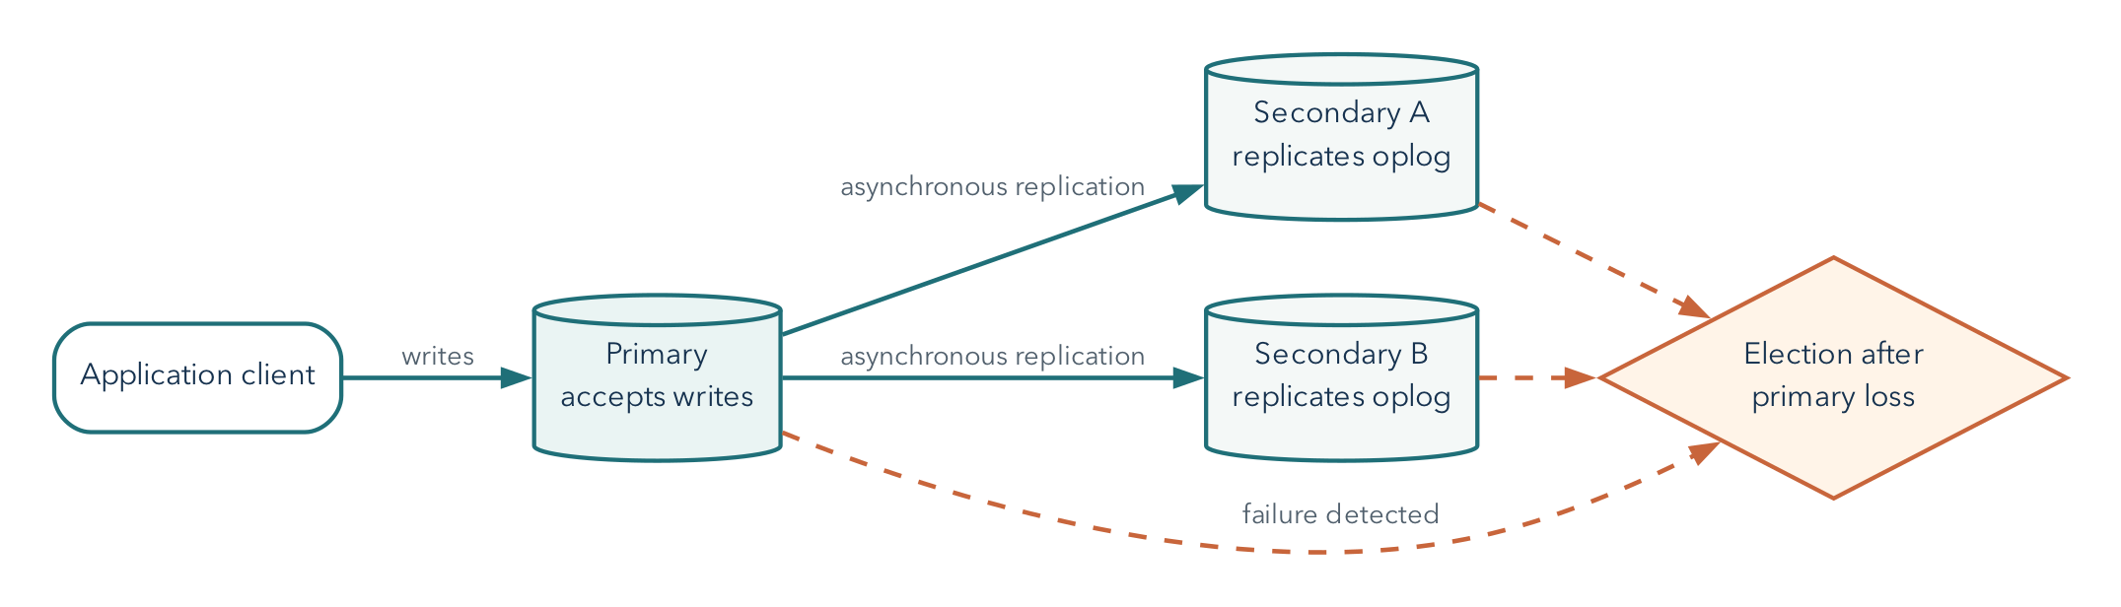
REPLICA SET
Replication maintains service state across members
replication supports continuity; it also copies authorized deletion
WEEK 12
Notes:
A MongoDB replica set has one primary that accepts ordinary writes and secondary members that replicate the oplog. If the primary becomes unavailable, eligible members can elect a new primary. This mechanism supports continuity through some member failures, but it does not preserve every previous state. An authorized delete can enter the oplog and replicate correctly to every member. Write concern controls which acknowledgment the client waits for; read preference and read concern control different aspects of reading. None of those settings replaces a separate recovery history and a tested restore procedure.
[Sources]
- CST4714 course textbook, Chapter 12.
- CST4714 OER figure: textbook/figures/replica_set.png.

Slide 16
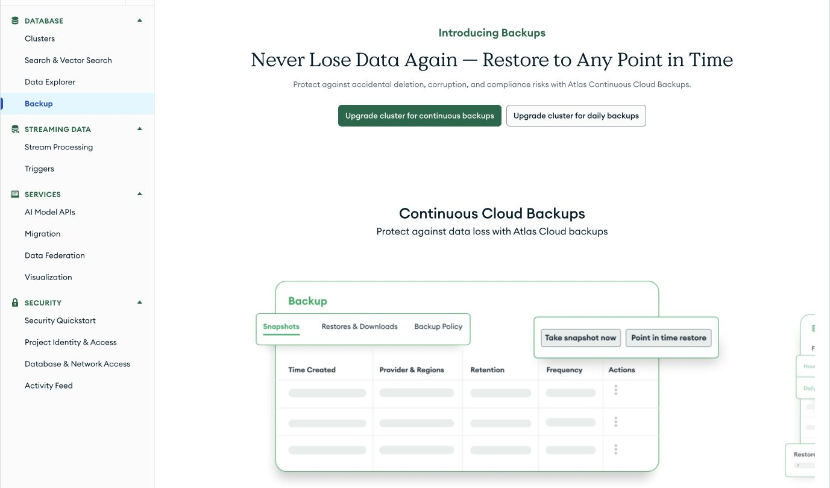
PLAN BOUNDARY
Atlas Free does not include managed continuous backups
1
A free classroom cluster needs a separate logical export path
2
Plan features can change; verify the current Atlas documentation
3
A copied file still requires a restore target and checks
WEEK 12
Notes:
This Atlas project is on a free tier, and the Backup page offers an upgrade for managed continuous or daily backups. That product boundary matters when choosing a classroom recovery method. A course lab can use a scoped logical export, canonical Extended JSON, or MongoDB Database Tools, then restore into a separate collection or database and compare counts, identifiers, types, and behavior. The free-tier limitation does not change the difference between replication and backup. It changes which recovery mechanism is available in this environment. Product plans can change, so the current official documentation remains the authority.
[Sources]
- CST4714 course textbook, Chapter 12.
- CST4714 redacted course screenshot: textbook/figures/cloud_interfaces/atlas_free_tier_backup.png, captured August 25, 2026.
- https://www.mongodb.com/docs/atlas/backup/cloud-backup/overview/

Slide 17
Reliable systems make failure behavior and recovery procedures explicit
Replicas preserve service history; separate artifacts preserve recoverable history.
Which operation and failure does the promise address?
Which setting changes acknowledgment, routing, or visibility?
Which restore checks confirm scope, and which omissions remain?
15
Notes:
This week separated several ideas that are often collapsed. Write concern changes required acknowledgment. Read preference changes eligible routing. Read concern changes visibility semantics. Replica-set elections can restore a writable primary when a voting majority can agree, but failover is not instantaneous and partitions force operation-specific tradeoffs.
Replication protects continuity against some member failures while also copying destructive changes. Recovery needs a separate artifact, target, procedure, credentials, and verification. A strong reliability statement names operation, failure, acceptable behavior, mechanism, verification, and limitation. Next week we will use the same discipline for scale, capacity, sharding, and safe data integration.
[Sources]
- CST4714 course textbook, Chapter 12.
- https://www.mongodb.com/docs/manual/replication/

