Slide 1

Predicting Heart Disease
A machine learning analysis on predicting heart disease
Timothy Lau

Slide 2

Intent
Model, analyze medical data to predict presence of heart disease
Doctors can be subjective
Patients often find 2nd opinions
Prescribing treatment difficult
Treatment expensive, risks
Machine learning models often are black boxes
Use models to support medical staff – supplement the diagnosis
Decision making process by doctors less subjective
Faster, more precise treatment

Slide 3
Data
Reduced dataset taken from UC Irving/Cleveland database
Target variable – heart disease or not
Main predictor – chest pain experienced
https://archive.ics.uci.edu/ml/datasets/Heart+Disease

Slide 4
Definitions
Heart disease
“what happens when heart’s blood supply is blocked or interrupted in coronary arteries”
Major risk factors
High cholesterol
High blood pressure
Diabetes
Weight
Family history
Smoking
Other risk factors
Stress
Alcohol
Poor nutrition in diet

Slide 5
Other KPI/measures
Age – higher age should have higher chance of heart disease
Blood pressure
Normal < 120
Elevated 120 – 129
High, stage 1 130 – 139
High, stage 2 > 140
Hypertensive > 180
Cholesterol in mg/dl (healthy levels)
Total 125 - 200
Non-HDL < 130
LDL (bad chol) < 100
HDL (good chol) > 45
Fasting blood sugar (mg/dl)
Normal >100
Pre-diabetes 100-125
Diabetes > 125
Maximum heart rate
Number of major blood vessels
More major vessels should be a good thing since heart disease = heart blood supply is blocked
Thalassemia
Blood disorder – lower hemoglobin count
red blood cells carry less oxygen
Hereditary
Notes:
The ST segment on an electrocardiogram (ECG) normally represents an electrically neutral area of the complex between ventricular depolarization (QRS complex) and repolarization (T wave). However, it can take on various waveform morphologies that may indicate benign or clinically significant injury or insult to the myocardium.

Slide 6

Data Summary
 | age | sex | cp | trestbps | chol | fbs | restecg | thalach | exang | oldpeak | slope | ca | thal | target
count | 303 | 303 | 303 | 303 | 303 | 303 | 303 | 303 | 303 | 303 | 303 | 303 | 303 | 303
mean | 54.36634 | 0.683168 | 0.966997 | 131.6238 | 246.264 | 0.148515 | 0.528053 | 149.6469 | 0.326733 | 1.039604 | 1.39934 | 0.729373 | 2.313531 | 0.544554
std | 9.082101 | 0.466011 | 1.032052 | 17.53814 | 51.83075 | 0.356198 | 0.52586 | 22.90516 | 0.469794 | 1.161075 | 0.616226 | 1.022606 | 0.612277 | 0.498835
min | 29 | 0 | 0 | 94 | 126 | 0 | 0 | 71 | 0 | 0 | 0 | 0 | 0 | 0
25% | 47.5 | 0 | 0 | 120 | 211 | 0 | 0 | 133.5 | 0 | 0 | 1 | 0 | 2 | 0
50% | 55 | 1 | 1 | 130 | 240 | 0 | 1 | 153 | 0 | 0.8 | 1 | 0 | 2 | 1
75% | 61 | 1 | 2 | 140 | 274.5 | 0 | 1 | 166 | 1 | 1.6 | 2 | 1 | 3 | 1
max | 77 | 1 | 3 | 200 | 564 | 1 | 2 | 202 | 1 | 6.2 | 2 | 4 | 3 | 1

Slide 7
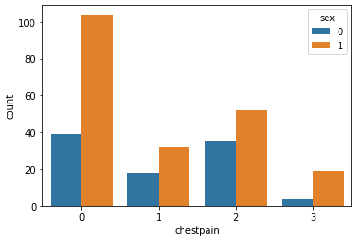
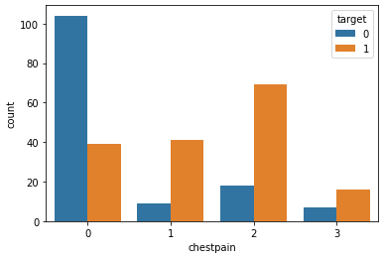
Figure 1. Chest pain types categorized by sex. Pain: 0 = typical, 1 = atypical, 2 = non-anginal pain, 3 = asymptomatic; Sex: 0 = female, 1 = male
Figure 2. Chest pain types categorized by heart disease presence. Target: 0 = not present, 1 = present
Notes:
Males do experience chest pain more often in all categories; typical pain does not seem to be an indicator of heart disease though others do.

Slide 8
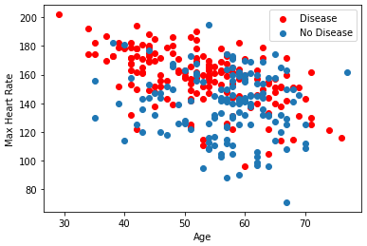
Figure 3. Age plotted against max heart rate categorized by presence of heart disease
Seems like clustering or utilizing K-means for heart rate isn’t very helpful
Graphically, looks like heart disease causes higher maximum heart rate

Slide 9
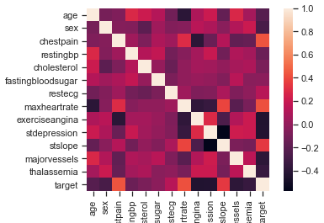
Figure 4. Correlation heat map of data variables.

Slide 10
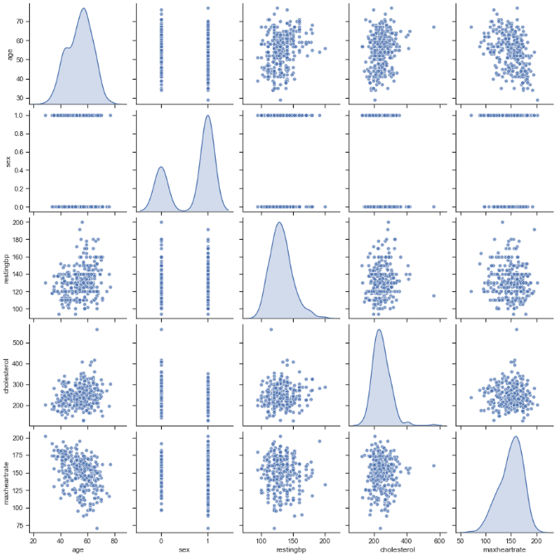
Figure 5. Pairplot of major variables.

Slide 11
Base models
Random Forest
Naïve Bayes
Support Vector Machine
K-Nearest Neighbors

Slide 12
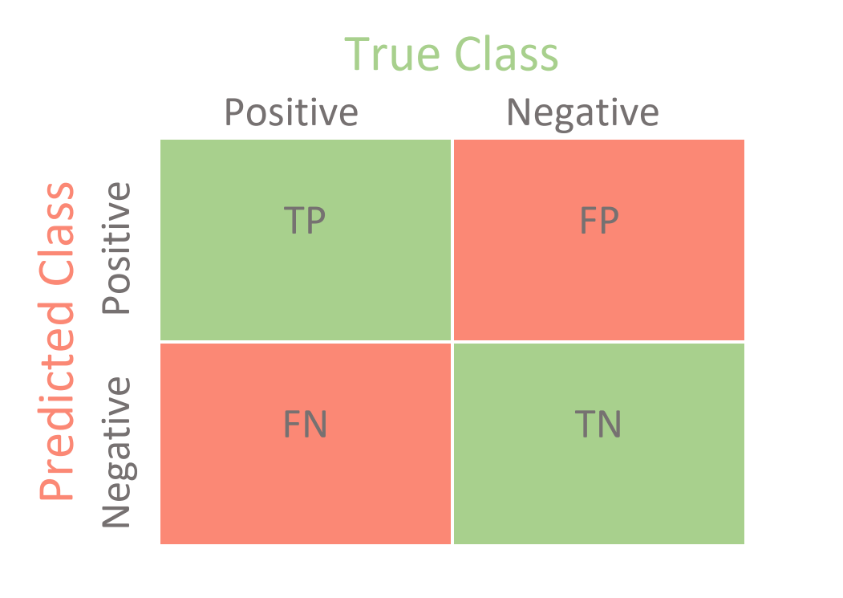
Model Measures
Accuracy: the higher the better
Average absolute error: the lower the better
Confusion matrices: the more green/less red, the better

Slide 13
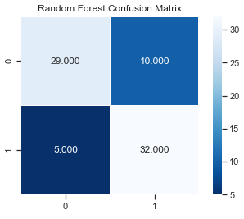
Base RF performance
Accuracy: 0.8026
Avg Abs Error: 0.2
Figure 6. RF Confusion Matrix.

Slide 14
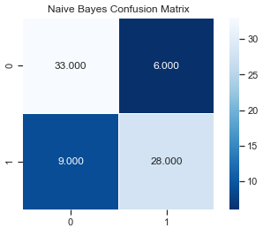
Base NB performance
Accuracy: 0.8026
Figure 7. NB Confusion Matrix.

Slide 15
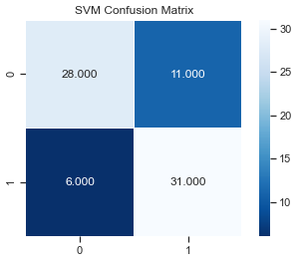
Base SVM performance
Accuracy: 0.7763
Figure 8. SVM Confusion Matrix.

Slide 16
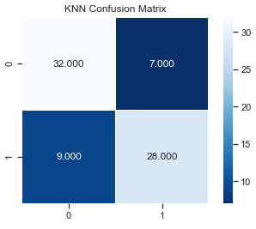
Base KNN performance
Base accuracy (2NN): 0.7632
Max KNN (tuned by cross val) – k = 3,7: 0.7895
Figure 9. 3NN Confusion Matrix.

Slide 17
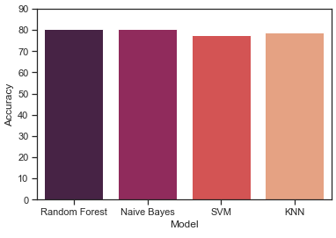
Figure 10. Comparing model accuracy
RF and NB have the best accuracies of the four
RF seems to predict true negatives better
Better for medical since treatments for false negatives have serious ramifications

Slide 18
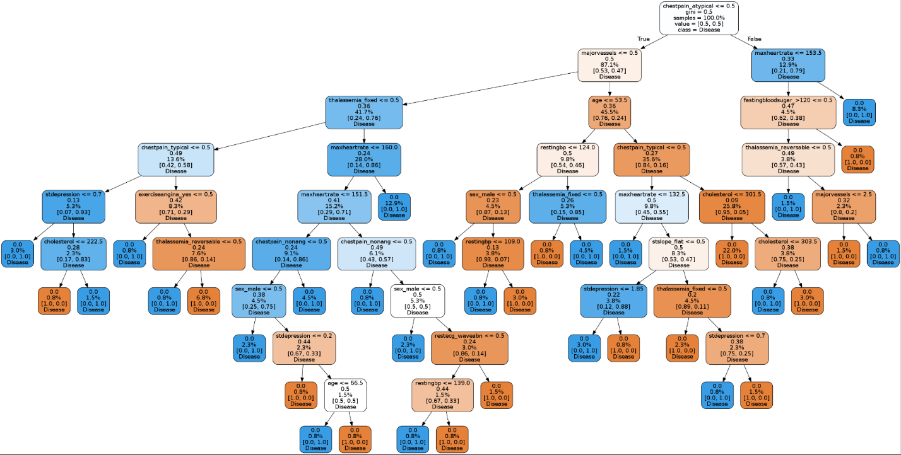
Figure 11. Base Tree.

Slide 19


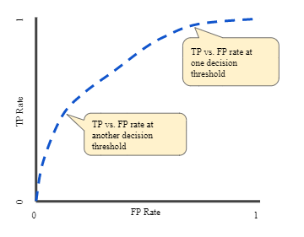
Area Under ROC Curve
One value method to capture performance of model
AUC = Area Under ROC Curve
Provides aggregate measure of performance across all classification thresholds
Likelihood of model predicting true value over false value
AUC of our model: 0.804227
Notes:
https://developers.google.com/machine-learning/crash-course/classification/roc-and-auc
Measures how well predictions are ranked
Measures quality of model’s prediction regardless of given classification threshold

Slide 20
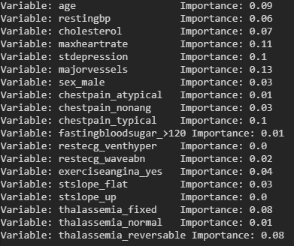
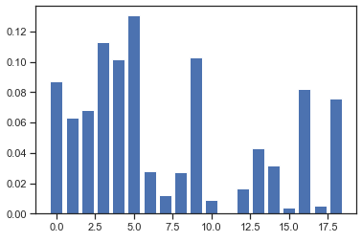
Feature Importance
Figures 11, 12. Feature importance from random forest model.

Slide 21
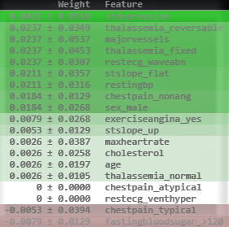
Figure 13. Feature Importance using ELI5 Package
ELI5 does feature importance by measuring how the score responds when a feature is unavailable; also known as permutation importance or MDA.
Retraining model for each removed feature is too computationally expensive so features are replaced with white noise one by one.
Notes:
https://eli5.readthedocs.io/en/latest/blackbox/permutation_importance.html#eli5-permutation-importance

Slide 22
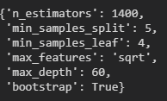
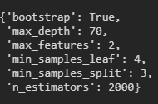
Tuning RF Hyperparameters
RF has 19 different hyperparameters
Chose 6 hyperparameters to tune
N estimators – number of trees in forest
Min samples split – minimum number of samples required to split into a node
Max depth – maximum depth of a tree; defines maximum growth of a tree
Max features – number of features to consider when looking for the best split
Min samples leaf – minimum number of samples required to be at a node. Defines if a node splits
Bootstrap – whether samples are used when building trees; false = whole dataset used to build each tree
Figure 14. Results of using RandomizedSearchCV
Figure 15. Results of using GridSearchCV
Final Accuracy Score: 0.81578

Slide 23
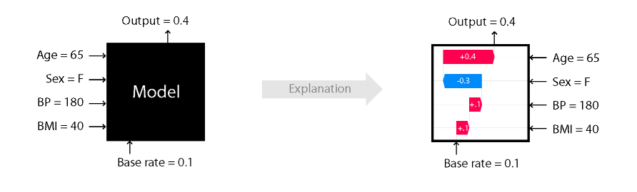
SHAP Package
Utilized Shap package on final trained model
Shapley values are a solution concept in game theory – fairly distributes gains and costs to players working in coalition
Shap package – game theoretic approach to explain output of machine learning models
“connects optimal credit allocation with local explanations using the classic Shapley values from game theory and their related extensions”
Notes:
https://github.com/slundberg/shap

Slide 24

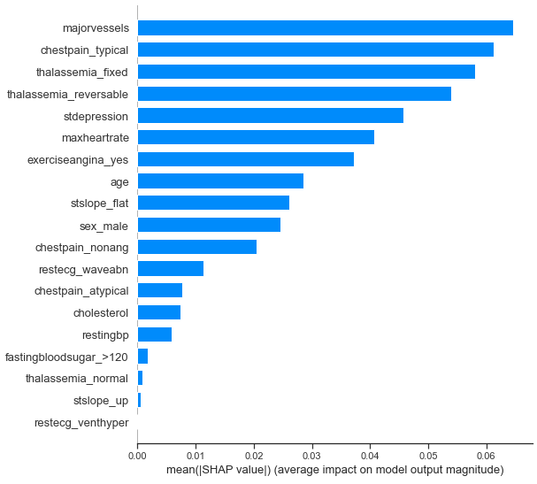
Figure 14. Feature Importance with Shap

Slide 25
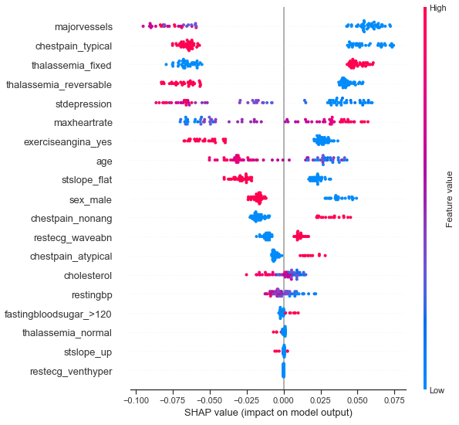
Figure 15. Shap values portray how each variable impact model output

Slide 26
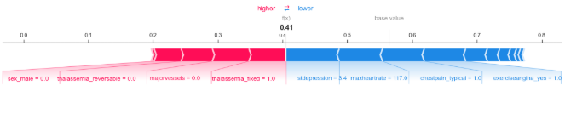
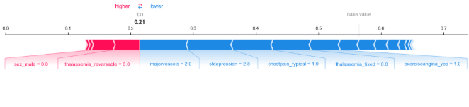
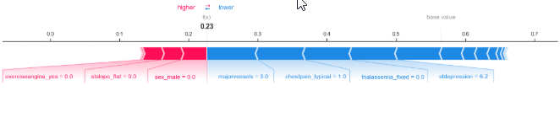
Using Shap Values to predict chance of heart disease
Figures 16, 17, 18. Using patients 42, 1, 15 respectively
Patient 42 predicted 41%
Things working in favor of lower % prediction
ST depression low
Max heart rate low
Chest pain is typical
Things working against lower % prediction
Unreversable thalassemia
Low major blood vessels

Slide 27
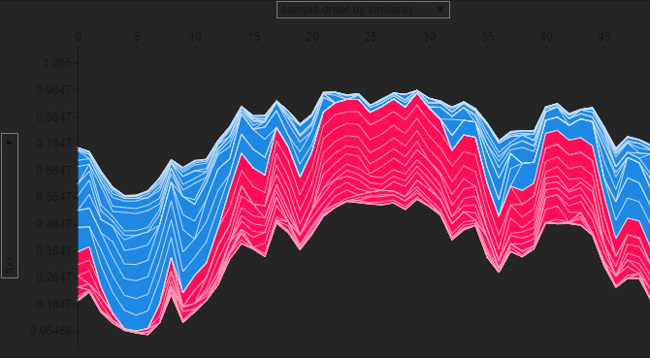
Figure 19. Interactive Shap Forceplot

Slide 28
Conclusion
Using machine learning models, we have shown that it is possible to predict heart disease within a patient to a certain degree of confidence
Model has a 82% accuracy score; AUC of 0.8
Not above 90% accurate; still require a doctor’s judgement on patients’ illness and treatment
Have outlined important features pertaining to heart disease
Hereditary issues, major heart vessels > age or sex
SHAP and ELI5 are good packages for determining patterns within models, providing insights on how features impact outcomes, and predicting probability of model outcome
Model can be further trained with external data with more features
Solution can then be used by doctors; input values and SHAP will provide doctors with insight on how each feature impacts outcome as well as probability of disease presence
COVID?

