Slide 1
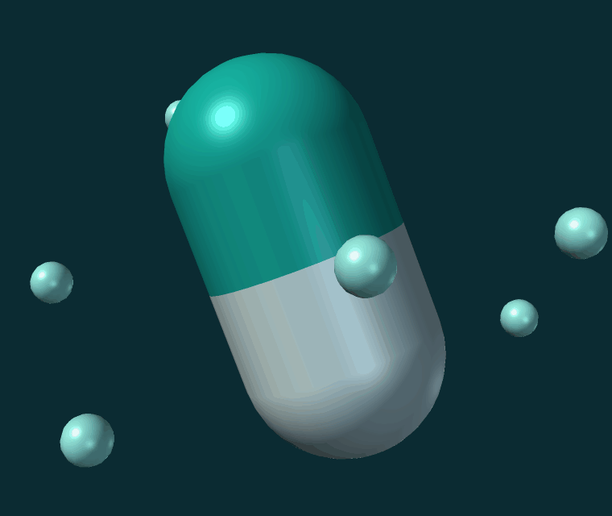
Role of Gastrointestinal pH and Secretions in Drug Absorption
BIOPHARMACEUTICS · DRUG ABSORPTION
Presented by: ______________________
Department of Pharmacy
University: ______________________
Notes:
Title slide. Fill in the presenter name and the university before the session.

Slide 2






What this presentation covers
01
02
Drug absorption
Gastrointestinal pH
Definition and where it happens
pH of the stomach, duodenum and intestine
03
04
Ionization and permeability
Gastrointestinal secretions
Unionized vs. ionized drug, Henderson–Hasselbalch
HCl, bicarbonate, bile salts, intestinal fluid
05
06
Clinical examples
Food, antacids and applications
Omeprazole, ketoconazole, aspirin, tetracyclines
Interactions and formulation strategies
Notes:
Roadmap of the talk: physiology first, then the mechanism, then the clinical consequences.

Slide 3
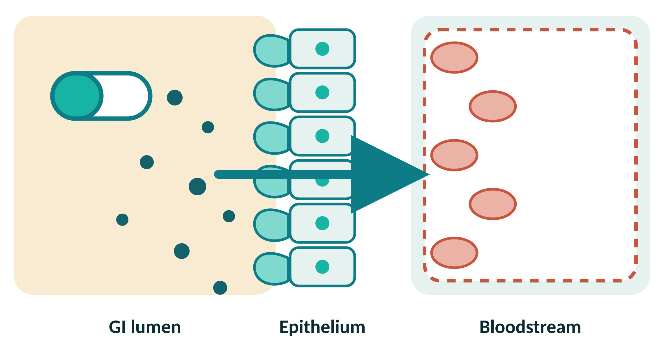

What is drug absorption
Drug absorption is the movement of a drug from the gastrointestinal tract into the bloodstream.
Most orally administered drugs are absorbed mainly from the small intestine.
Gastrointestinal pH and secretions can affect drug absorption.
Key idea
GI conditions can change how much and how quickly a drug is absorbed.
From the lumen, across the intestinal epithelium, into the blood
Notes:
Absorption = movement from the GI tract into the systemic circulation. The small intestine dominates because of its very large surface area.

Slide 4



Gastrointestinal conditions influence four things
Drug solubility
Drug ionization
Drug stability
Drug dissolution
How much drug can dissolve in the GI fluids
The balance between ionized and unionized drug
Whether the drug survives the gastric environment
How fast the dosage form releases dissolved drug
Together these determine the extent and the rate of oral drug absorption.
Notes:
These four properties are the link between gut physiology and plasma concentration.

Slide 5

Gastrointestinal pH and Drug Absorption
SECTION 01
The gastrointestinal tract has different pH environments

Slide 6
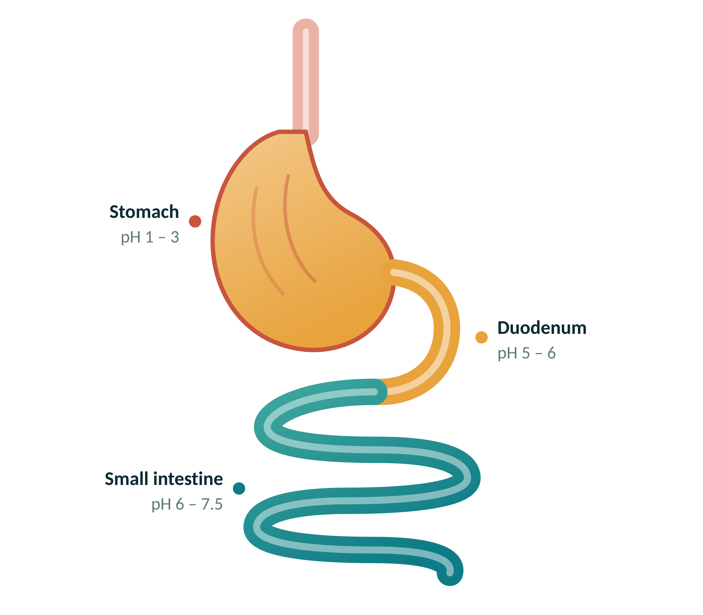


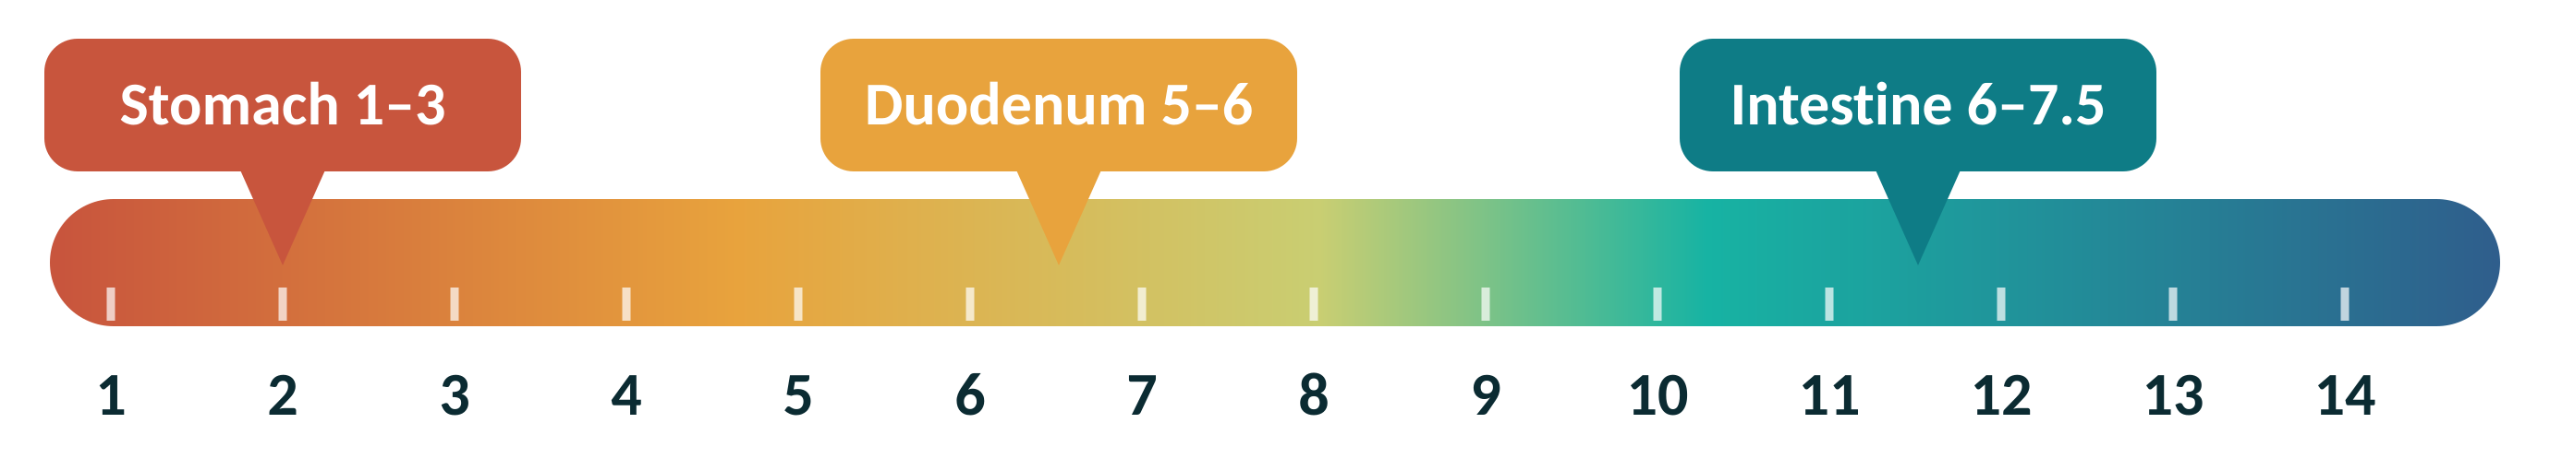
pH changes along the gastrointestinal tract
SITE
APPROXIMATE pH
Stomach
1 – 3
Duodenum
5 – 6
Small intestine
6 – 7.5
Notes:
Approximate values; they vary with fasting or fed state, age and disease.

Slide 7

How does pH affect drugs
pH can change drug solubility.
pH affects the ionization of weak acids and bases.
It can affect the stability of acid-sensitive drugs.
It can influence drug dissolution and availability for absorption.
Important. Absorption is not determined by pH alone. Surface area, permeability, formulation, and other physiological factors are also important.
Notes:
Guard against the exam-style oversimplification that pH alone predicts absorption.

Slide 8
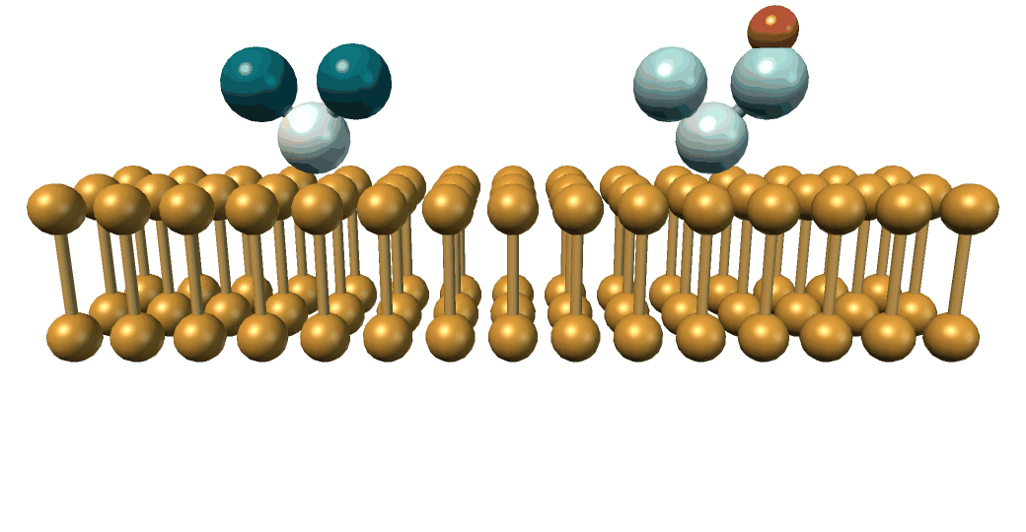
Ionized vs. unionized drug
Unionized form
Generally crosses lipid membranes more easily.
Ionized form
Generally has lower membrane permeability but may have higher water solubility.
Only the unionized fraction moves freely through the lipid bilayer
Notes:
Lipid membranes favour the neutral species; charge keeps a molecule in the aqueous phase.

Slide 9
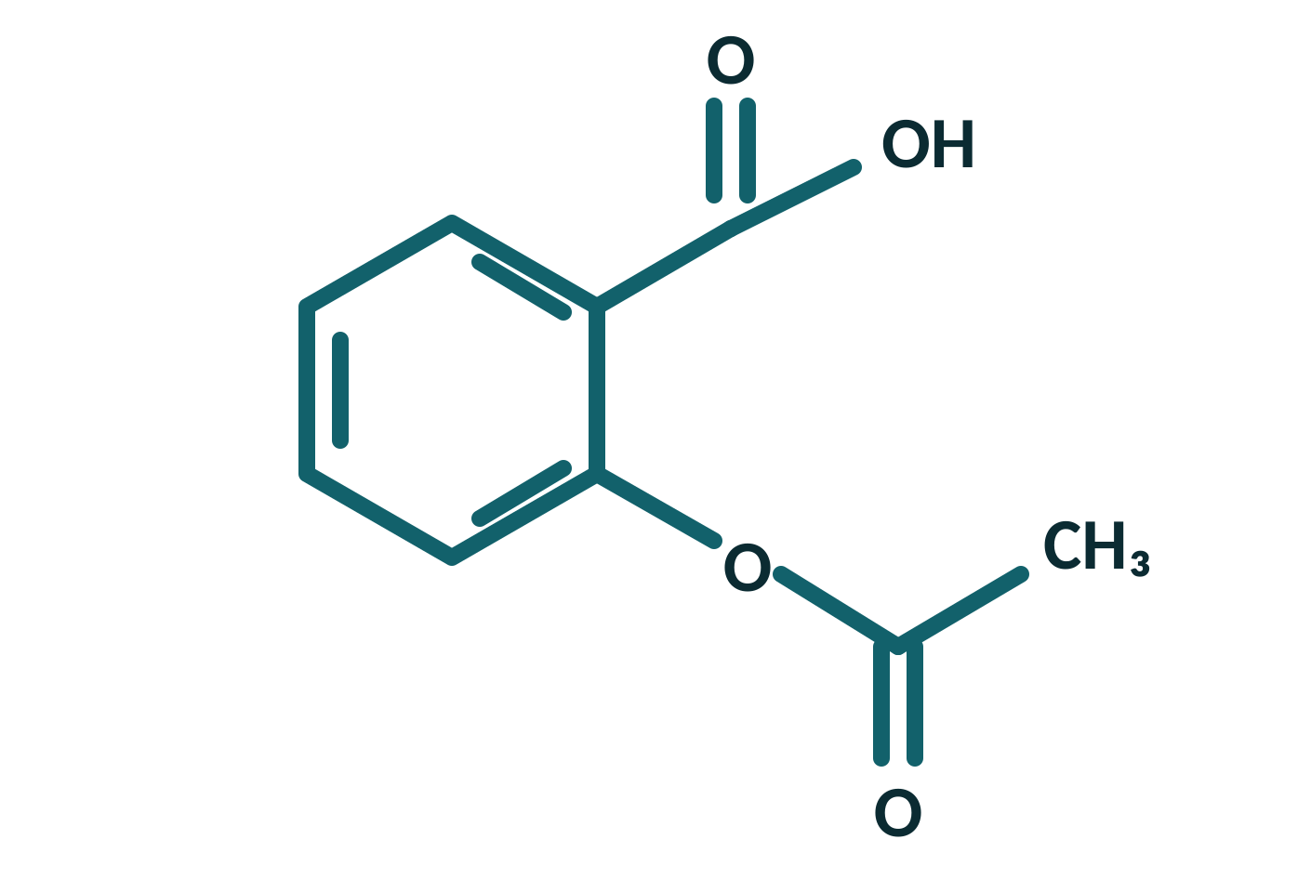
Weak acids and weak bases
Weak acids
Weak bases
Low pH → more unionized form
Higher pH → more unionized form
Example: Aspirin
The opposite pattern to weak acids
Gastric pH 1 – 3
Intestinal pH 6 – 7.5
more unionized base → better permeability
Notes:
Aspirin is the classic weak acid; most antihistamines and opioids are weak bases.

Slide 10
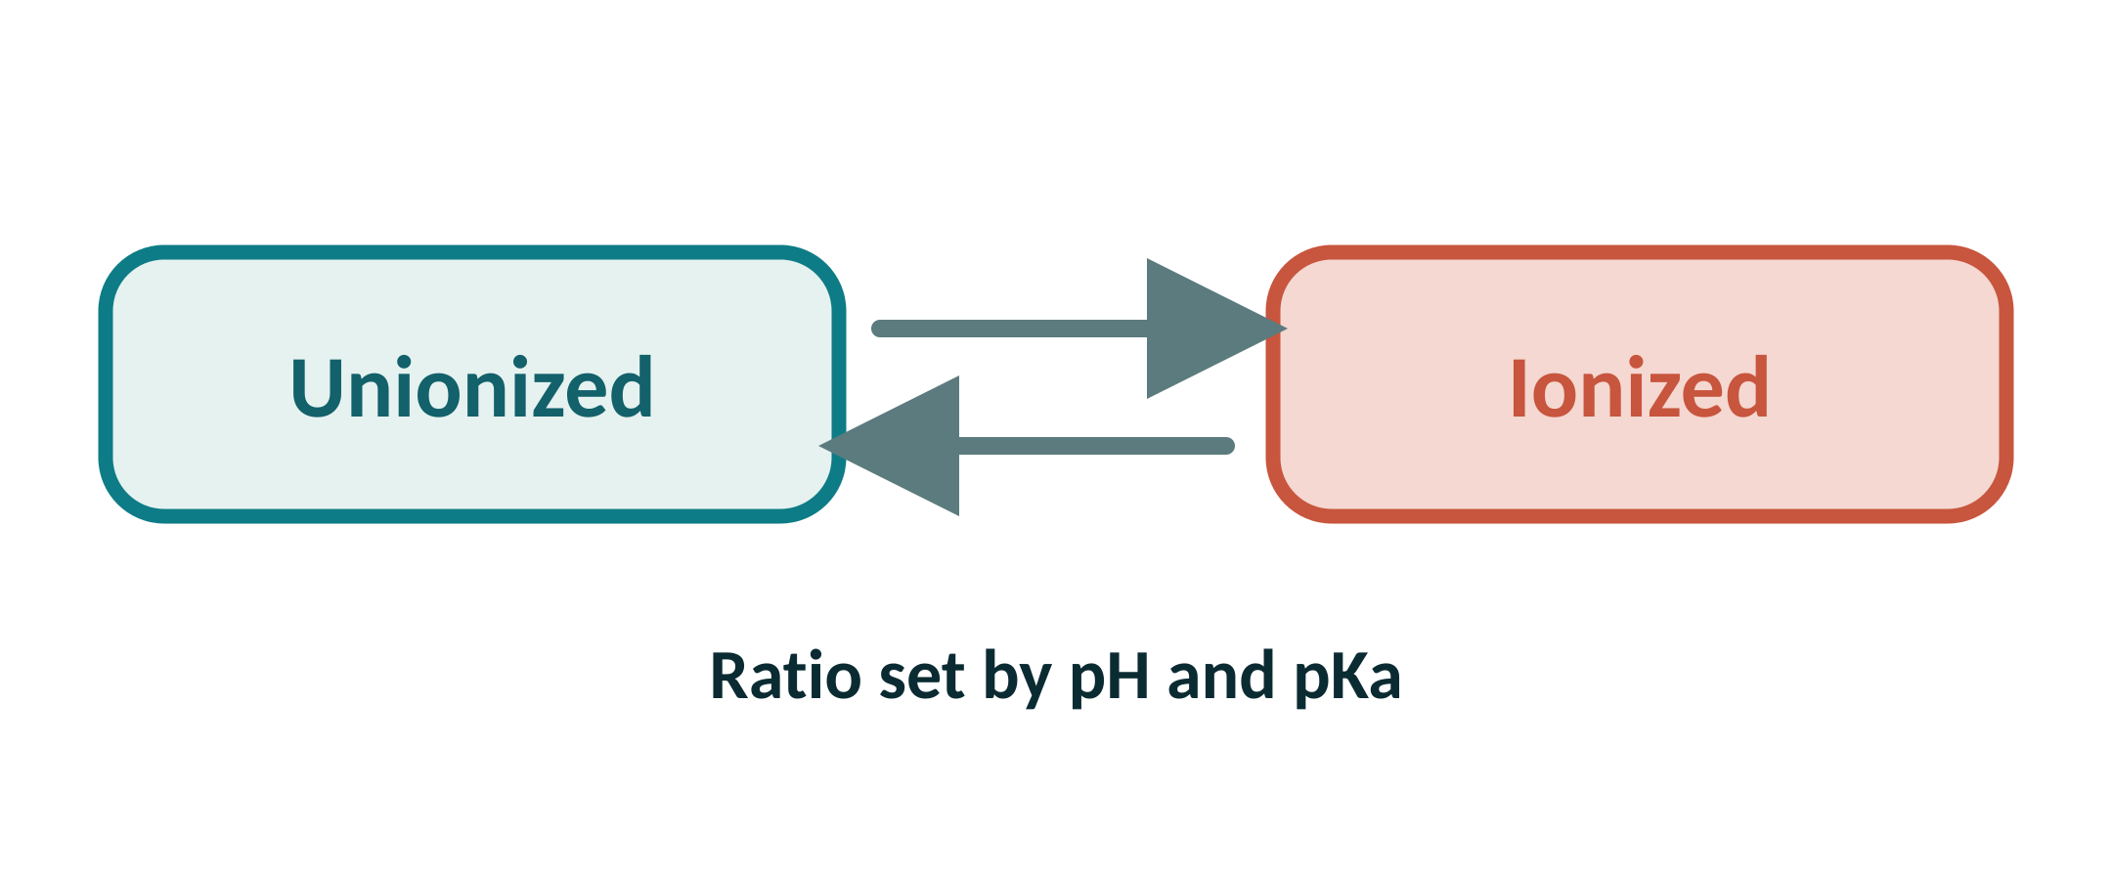
Henderson–Hasselbalch equation
For weak acids
For weak bases
pH = pKa + log ( [A⁻] / [HA] )
pH = pKa + log ( [B] / [BH⁺] )
Key point. pH determines the ratio of ionized to unionized drug.
Notes:
At pH = pKa the drug is 50% ionized. One pH unit away from the pKa shifts the ratio tenfold.

Slide 11
Gastrointestinal Secretions
SECTION 02
Acid, bicarbonate, bile salts and intestinal fluid

Slide 12
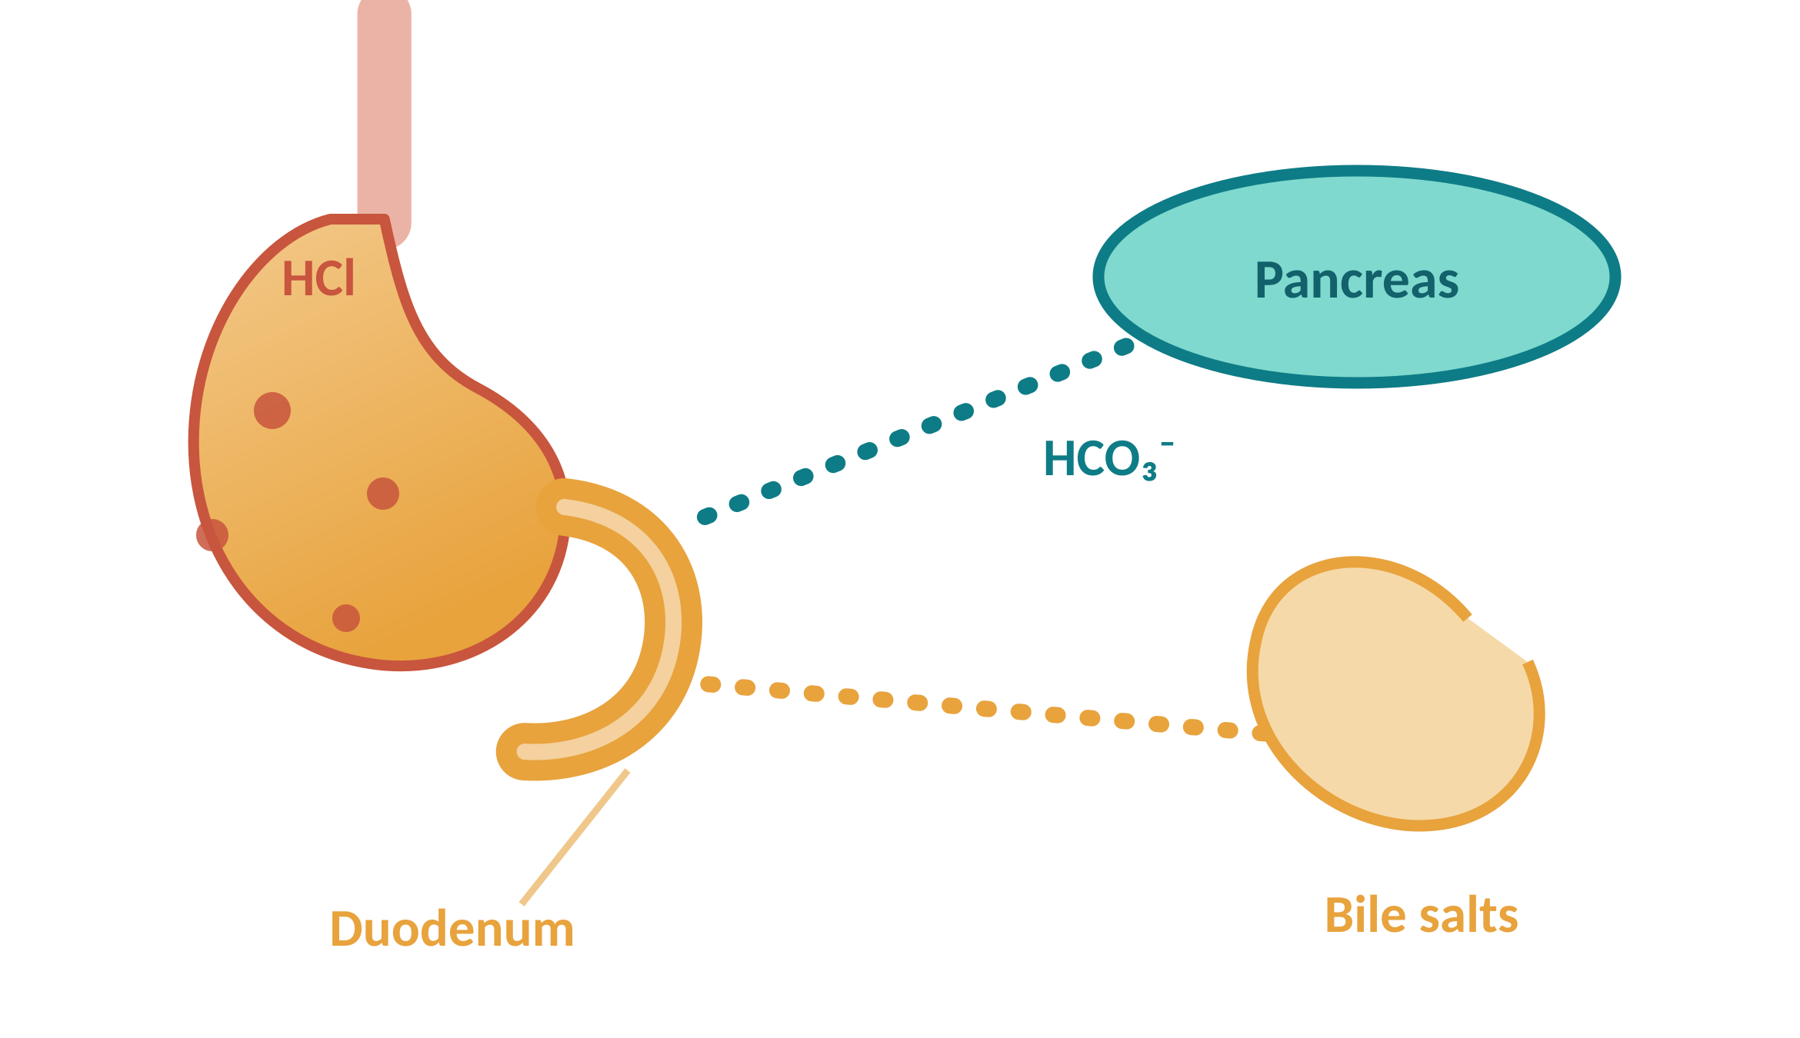
Gastric acid and bicarbonate
Gastric acid (HCl)
Produced by parietal cells.
Creates the acidic gastric environment.
Can affect drug solubility, ionization, and stability.
Bicarbonate (HCO₃⁻)
Mainly supplied to the duodenum by pancreatic secretions.
Helps neutralize gastric acid.
Raises intestinal pH.
Acid from the stomach is neutralized by pancreatic bicarbonate in the duodenum
Notes:
The acid–bicarbonate pair sets the pH gradient that the rest of the lecture depends on.

Slide 13
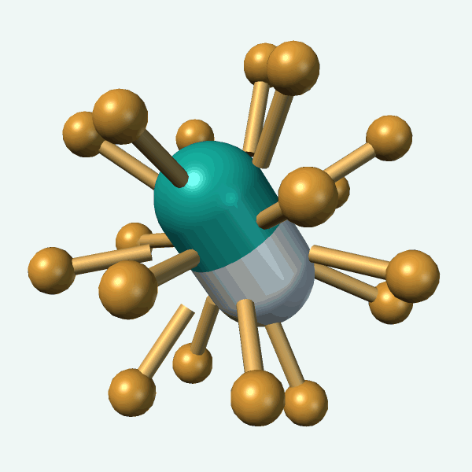


Bile salts and intestinal secretions
Bile salts
Secreted into the small intestine.
Form micelles and improve the solubilization of some poorly water-soluble drugs.
Intestinal secretions
Provide water, electrolytes, mucus, and enzymes.
Support drug dissolution and movement toward the intestinal surface.
Notes:
Bile salts matter most for lipophilic, poorly soluble (BCS class II) drugs.

Slide 14
Clinical Examples
SECTION 03
Four drugs whose absorption depends on GI pH and secretions

Slide 15
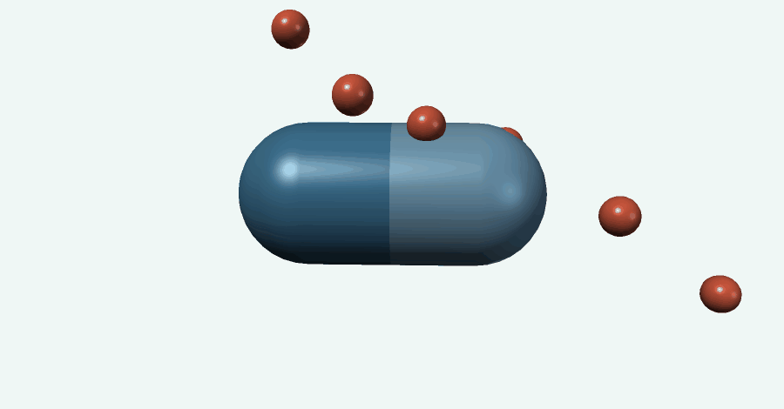


Omeprazole and ketoconazole
Omeprazole
Ketoconazole
Acid-sensitive drug.
Formulated as a delayed-release, enteric-coated dosage form.
Protects the drug from gastric acid.
Oral absorption depends on an acidic environment.
Increased gastric pH may reduce its dissolution and absorption.
Gastric pH rises
Dissolution falls
Absorption falls
Notes:
Omeprazole is protected from acid; ketoconazole needs acid. Opposite formulation problems.

Slide 16
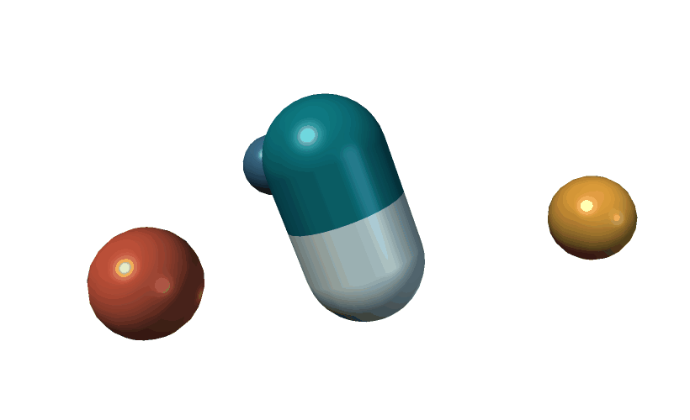
Aspirin and tetracyclines
Aspirin
Tetracyclines
A weak acid.
Its ionization changes with GI pH.
However, most drug absorption occurs in the small intestine because of its large surface area.
Can form complexes with calcium, iron, and magnesium.
This can reduce drug absorption.
Surface area wins
Site of absorption is not decided by pH alone.
Notes:
Counsel patients: separate tetracyclines from dairy products, antacids and iron tablets.

Slide 17

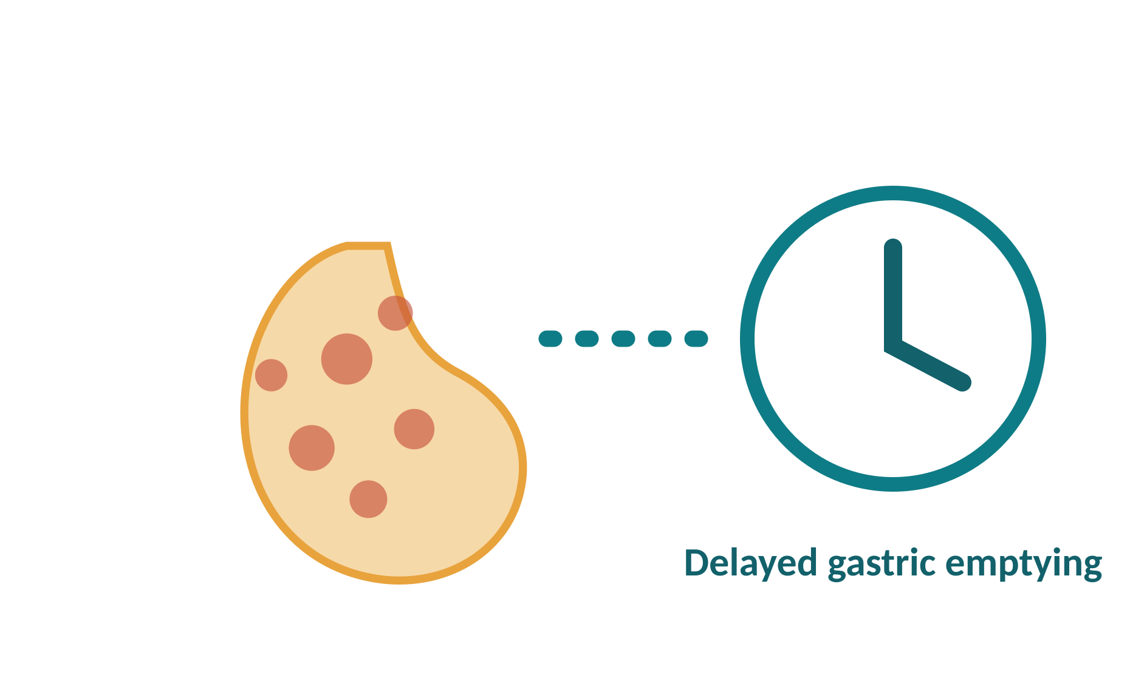
Food, antacids and proton pump inhibitors
Food
Antacids & PPIs
Food may:
Increase gastric pH.
May reduce the absorption of drugs that require an acidic environment for dissolution.
Change gastric pH.
Delay gastric emptying.
Increase bile secretion.
Bind to some drugs.
Increase or decrease drug absorption.
Normal gastric pH 1 – 3
With an antacid or PPI → higher pH
Example: ketoconazole taken with an antacid
Notes:
Separating doses in time is the usual practical answer to an antacid interaction.

Slide 18

Pharmaceutical applications
Enteric-coated tablets
pH-dependent drug delivery
Delayed-release formulations
Improving bioavailability
Managing drug–drug and drug–food interactions
Notes:
These are the formulation and counselling levers that follow from the physiology.

Slide 19
Key takeaways
pH varies along the gut
Stomach 1–3, duodenum 5–6, small intestine 6–7.5.
pH sets the ionization ratio
And with it solubility, stability and permeability.
Secretions shape dissolution
HCl, bicarbonate, bile salts and intestinal fluid.
Formulation answers the problem
Enteric coats, delayed release, dose separation.
Notes:
Close on the mechanism, not the drug list: pH and secretions act through four properties.

Slide 20
Questions are welcome
THANK YOU
Name: ______________________
Department of Pharmacy
University: ______________________
Notes:
Thank the audience and invite questions.

