Slide 1
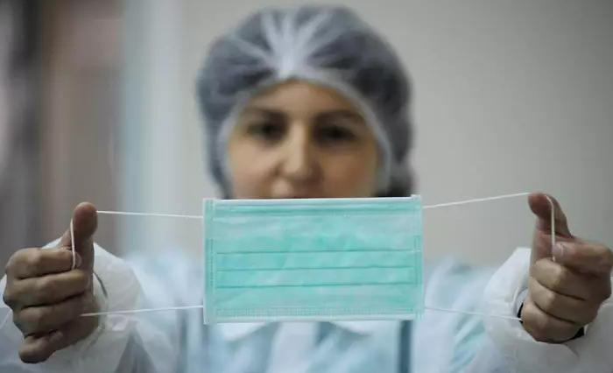
Facemask Detector
Face mask detection using convolutional neural networks (CNN)
Notes:
My Name is Phillip and i am working on an exiting project of developing a machine learnig algorithm for face mask detection using cnn

Slide 2
Background
Importance of automated face mask detection in preventing the spread of viruses.
Notes:
Given the current emphasis on wearing face masks for prevention,
there is a growing need for automated systems that can accurately detect the presence of face masks.

Slide 3
Aims and Objective
Develop a face mask detection algorithm to curb the spread of both current and future viruses
Notes:
This project is aimed at curbing the spread of both current and future viruses by automating the identification of individuals wearing face masks
For this project, I collected a dataset from Kaggle. which consists of 7553 images of people with and without facemask.

Slide 4
Methodology
Model Selecion and Trainning: I will be using CNN architecture to train my model
Evaluation Metrics: I will be using metrics such as accuracy, precision and f1 score
Notes:
my model will be trained using cnn architecture
and the metrics i will be using for evaluation are accuracy, precision and f1 score

Slide 5
Pre-Trained Models for Face Mask Detection
MobileNetV2
ResNet
VGG16
Notes:
after building my model, i will be evaluating the performance of my model by comparing it with pretrained model such as MobileNetv2, ResNet, VGG16

Slide 6
Application
Workplace Monitoring: workplaces, personal office factories, and construction sites to monitor employees and visitors
Public Safety: Hospitals and clinics, to monitor patients, visitors, and staff for proper mask usage
Public Transportation: Deploying the algorithm in transportation systems, such as buses, trains, and subways, can help identify individuals not wearing face masks
Notes:
In summary, This technology can be applied in various settings such as personal offices public tranportation and hospitals to create safer environments and reduce the spread of viruses

Slide 7
Thank you :)

