Slide 1
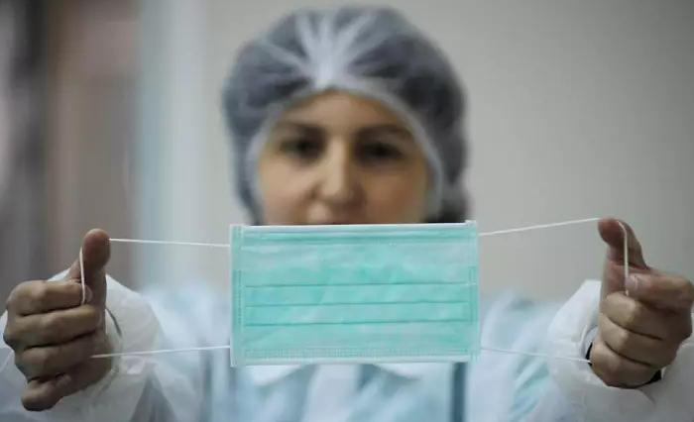
Facemask Detector

Slide 2
Face mask detection using convolutional neural networks (CNN)
Introduction
Notes:
(CNN) is an innovative solution that combines deep learning and computer vision to ensure public safety and prevent the spread of viruses. using CNNs, we can accurately identify individuals wearing face masks and those who are not. This technology plays a crucial role in enforcing mask-wearing policies, creating a safer environment, and minimizing the risk of virus transmission.

Slide 3
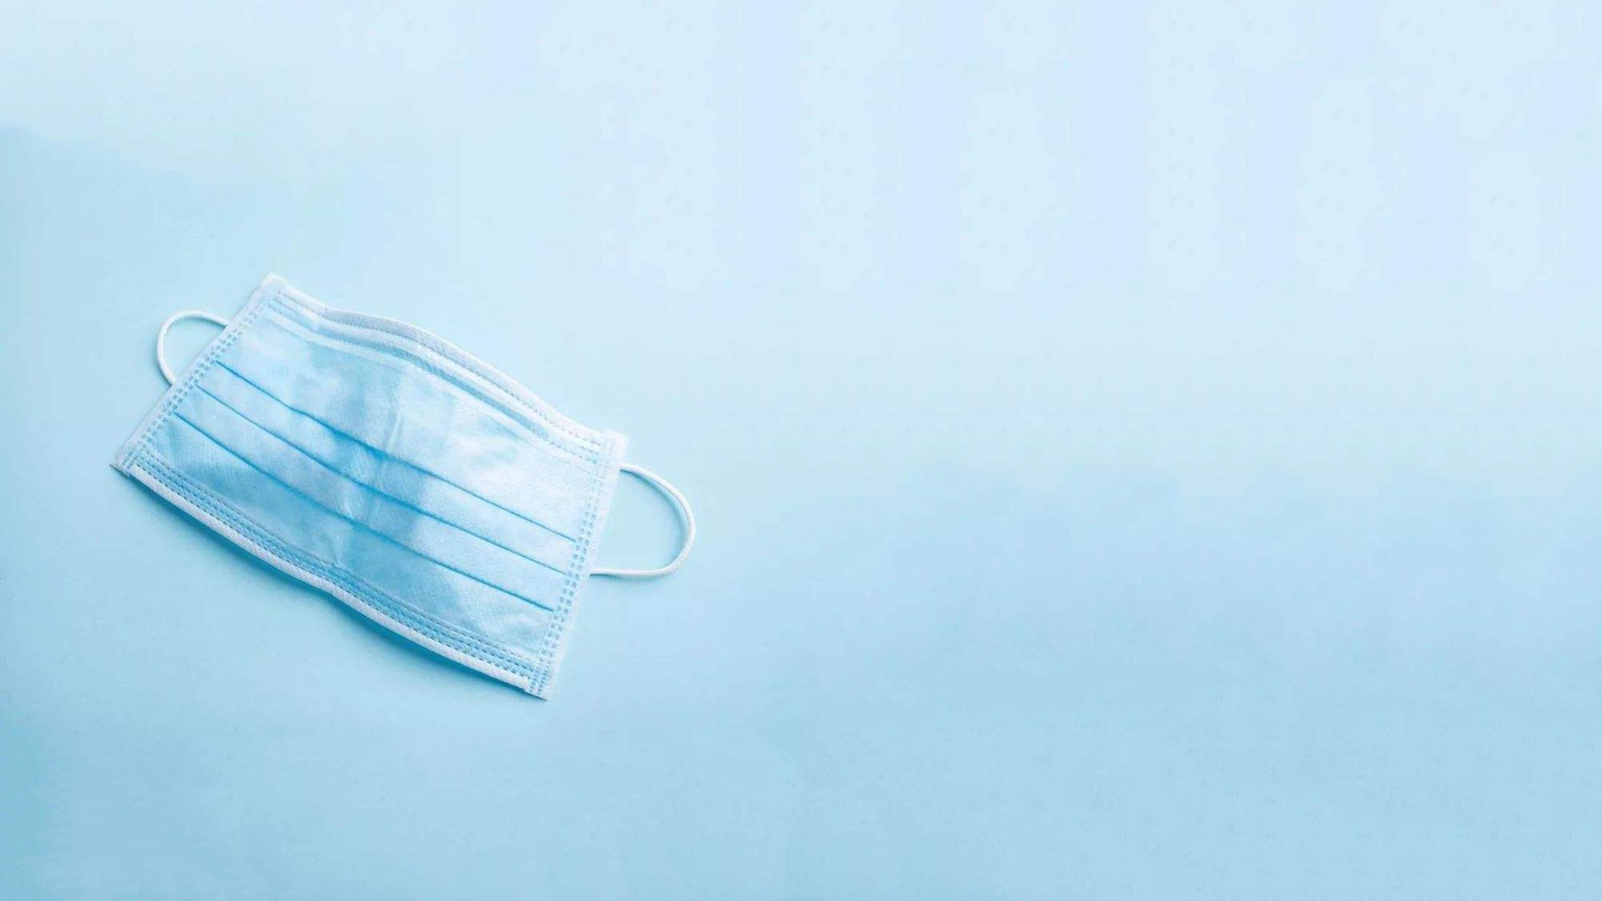
The objective is to develop a machine learning algorithm using (CNN) that accurately classifies individuals wearing face masks from those not wearing face masks.
Objectives
Notes:
The algorithm will contribute to the overall goal of enhancing public safety by automating face mask detection, ensuring compliance with mask-wearing policies, and minimizing the risk of virus transmission.

Slide 4
Methodology
Data Colection: I will be using Dataset from Kaggle that consists the faces of people wearing face mask and people not wearing face mask
Model Selecion and Trainning: i will be using CNN architecture to train my model
Evaluation Metrics: I will be using metrics such as accuracy, precision and f1 score

Slide 5
Application
Workplace Monitoring: workplaces, personal office factories, and construction sites to monitor employees and visitors
Public Safety: Hospitals and clinics, to monitor patients, visitors, and staff for proper mask usage
Public Transportation: I will be using metrics such as accuracy, precision and f1 score

