Slide 1
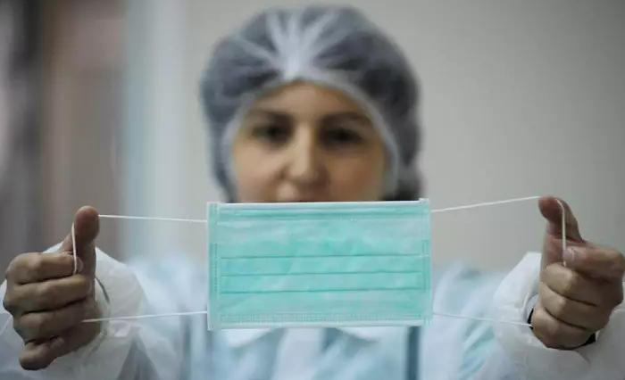
Facemask Detector
Face mask detection using convolutional neural networks (CNN)
Notes:
My Name is Phillip and i am working on an exiting project of developing a machine learnig algorithm for face mask detection using cnn
This project is aimed at curbing the spread of both current and future viruses by automating the identification of individuals wearing face masks
For this project, I collected a dataset from Kaggle. which consists of 7553 images of people with and without facemask.

Slide 2
Methodology
Data Colection: Dataset from Kaggle that consists the faces of people wearing face mask and people not wearing face mask
Model Selecion and Trainning: I will be using CNN architecture to train my model
Evaluation Metrics: I will be using metrics such as accuracy, precision and f1 score
Notes:
my model will be trained using cnn architecture
and the metrics i will be using for evaluation are accuracy, precision and f1 score

Slide 3
Pre-Trained Models for Face Mask Detection
MobileNetV2
ResNet
VGG16
Notes:
after building my model, i will be evaluating the performance of my model by comparing it with pretrained model such as MobileNetv2, ResNet, VGG16

Slide 4
Application
Workplace Monitoring: workplaces, personal office factories, and construction sites to monitor employees and visitors
Public Safety: Hospitals and clinics, to monitor patients, visitors, and staff for proper mask usage
Public Transportation: Deploying the algorithm in transportation systems, such as buses, trains, and subways, can help identify individuals not wearing face masks
Notes:
In summary, This technology can be applied in various settings such as personal offices public tranportation and hospitals to create safer environments and reduce the spread of viruses

Slide 5
Thank you :)

