Slide 1
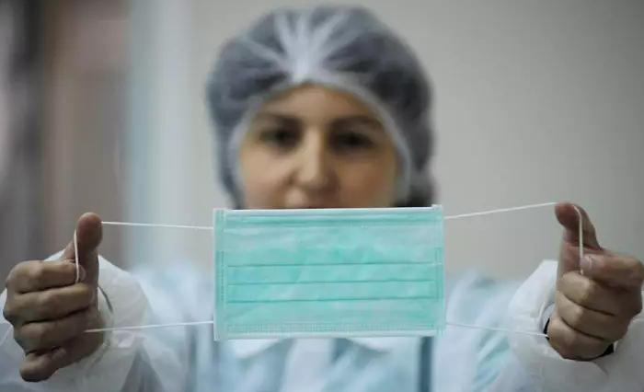
Facemask Detector
Face mask detection using convolutional neural networks (CNN)

Slide 2
Background
With the increasing focus on wearing face masks for preventive measures, there is a rising demand for automated systems capable of accurately identifying the presence of face masks.

Slide 3
Aims and Objective
Develop a face mask detection algorithm to curb the spread of both current and future viruses

Slide 4
Methodology
Model Selecion and Trainning: I will be using CNN architecture to train my model
Evaluation Metrics: I will be using metrics such as accuracy, precision and f1 score

Slide 5
Pre-Trained Models for Face Mask Detection
MobileNetV2
ResNet
VGG16

Slide 6
Application
Workplace Monitoring: workplaces, personal office factories, and construction sites to monitor employees and visitors
Public Safety: Hospitals and clinics, to monitor patients, visitors, and staff for proper mask usage
Public Transportation: Deploying the algorithm in transportation systems, such as buses, trains, and subways, can help identify individuals not wearing face masks

Slide 7
Thank you :)

