Slide 1

Social and Psychological Factors Affecting Fertility. An Agent-based Model
Student: Lomatskiy Andrey
Supervisor: Professor, Daniel A. Alexandrov

Slide 2
01
Theory and Relevance

Slide 3



Research Relevance
birth control
abortion policies
child allowances
complex decision-making algorithms
social and institutional context
almost no way to explore what would happen if the policy had not been introduced
simulate the society in a computational model and manipulate the model inputs

Slide 4
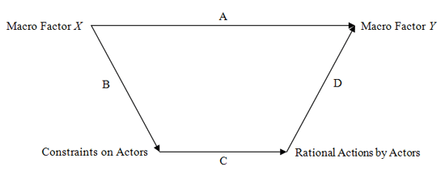
How pronatalist policies affect fertility outcomes through influencing the individual decision-making in its social and psychological complexity
Child Allowances
Fertility Rate
Personal Attitudes
Fertility Decision
Figure 1. Coleman’s Boat. Macro-Micro Effects

Slide 5
Theoretical Framework
Household as a unitary model
- individuals are motivated by altruism, simultaneously with self-interest, and such intentions as cooperation, help, and support (Alderman et al., 1995).
Education and career intentions versus fertility intentions
- people with higher education are more responsible and aware of costs the child brings to the family (Li et al., 2019).
Context and wealth influence
- increase in housing wealth is positively associated with birthrates (Iwata & Naoi, 2017).
Rational approach in fertility decisions
- increasing benefits from children should be associated with higher fertility (Friedman et al., 1994).

Slide 6
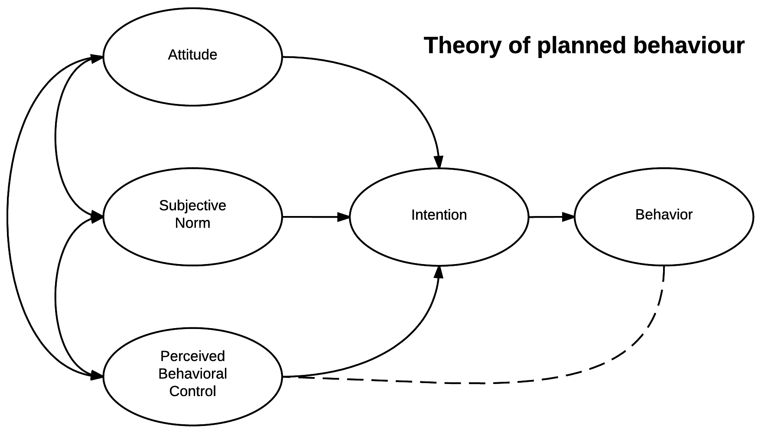
Decision-making Mechanism
Figure 2. Theory of planned behavior
Source: researchgate.net/figure/Theory-of-Planned-Behaviour-Ajzen-1991_fig1_5407720

Slide 7
Decision-making Mechanism
personal values, thoughts, and attitude towards having a child
referent group’s opinion about having a child
planning to have a child
childbearing
financial resources, opportunities, state support, and environment
Figure 3. Theory of planned behavior. Fertility behavior case

Slide 8


Hypotheses
Introducing child allowances lowers the age at first birth
The association between family economic background and the average number of children per family is moderated by child allowances
Environmental specifics moderate the outcome of the experiment

Slide 9
02
Methodology

Slide 10

Factor List
Age
Age of parents when they had a first child
Education
Education of parents
Median income among regions
The size of child allowance
Attitudes, subjective norm, perceived behavioral control
Housing price among regions

Slide 11




Model Building
Operationalization
Face validation
Validation
Calibration

Slide 12
Data for Calibration
Variable | Value
Age | 5 categories: 0-15; 15-29; 30-49; 50-79; 80+
Education | 6 initial categories: No Primary Education - Higher 3 constructed categories: Lower, Middle, Higher
Income | Median salary in regions: Moscow, Leningrad region, Perm, Kostroma
Housing prices | Price for square metre: Moscow, Leningrad region, Perm, Kostroma
Table 1. Initial parameters for model calibration (2019)

Slide 13
Methodology for Data Analysis
Experiments were conducted in NetLogo software. Each experiment was done by 100 simulation runs. Each experiment included four Russian regions for the comparison.
First Experiment
investigating the relationship between child allowance and the age of a person at first birth
Second Experiment
investigating the relationship between family economic background and the effect of child allowance on the number of children in the household

Slide 14
03
Data Analysis

Slide 15
Decision-making process. Scenario 1
Factor | Behavior
Age | Childbearing
Table 3. Decision-making. Scenario 1

Slide 16
Decision-making process. Scenario 2
Factor | Scale | Behavior
Age | - | Childbearing
Attitude | Two scales: -The degree to which an agent wants a child (0-100) -The degree to which an agent does not want a child (0-100) | Childbearing
Subjective Norms | Closeness of an agent to the average age of first birth in chosen region (0-100)
Perceived Behavioral Control | The agent’s perceived control over his/her ability to pay for child basic needs based on average costs for a child (0-100)
Table 4. Decision-making. Scenario 2

Slide 17
Decision-making process. Scenario 2
0-100
0-1
0-1
0-100
0-100
0-1
0-100
Figure 4. Theory of planned behavior. Factor Weights

Slide 18
Decision-making process. Scenario 3
If an agent does not have housing:
increase
Child Allowance
Attitude
If an agent has housing:
increase
Perceived Behavioral Control
Child Allowance

Slide 19
Experiments
The first experiment was aimed on investigating the relationship between the presence of child allowance (baby bonus) and age at first birth.
The second experiment was aimed on investigating the relationship between family economic background and average number of children in each income group, moderated by the presence of child allowance (baby bonus).
Note: All experiments were conducted for 100 simulation runs, with the following factor weights: attitude (0.3), subjective norms (0.3), and perceived behavioral control (0.4). The intention threshold was 50%.

Slide 20
Experiments
The results of the first experiment:
the median age at first birth slightly decreases (~0.5 years) with the introduction of child allowance in more developed regions (Moscow, Leningrad region)
the median age at first birth sharply decreases (~8 years) with the introduction of child allowance in less developed regions (Perm, Kostroma)
The results of the second experiment:
higher family economic background increases the average number of children per family in any region
introduced child allowance motivates families to have more children in any income group and any region
In less developed regions the presence of child allowance is the determining factor of fertility decisions

Slide 21
04
Results and Discussion

Slide 22
Hypotheses Testing
Hypothesis 1: Approved
In those regions where child allowances are not comparatively high to salary and prices, child allowance will have much less influence on the age at first birth.
Hypothesis 2: Approved
In less developed regions the influence of child allowance on the relationship between the number of children and family economic background is much higher than in more developed regions.

Slide 23
Comparison to Previous Research
Previous research
“Pronatalist measures in 2007 mainly caused lowering the age of the first birth and shortening the intervals between parities” (Frejka & Zakharov, 2013)
“Slonimczyk and Yurko (2013) reported that the maternity capital in Russia resulted in an increase of fertility of about 0.15 children per woman”
Agent-based model
“Introducing child allowances lowers the age at first birth in less developed regions”
“Introducing maternity capital (child allowance) increased fertility by 0.25 children per family in Moscow and Leningrad region, and by ~2 children per family in Perm and Kostroma ”

Slide 24
Discussion
Further Research
finding the difference between planning first and second child
exploring change in time between parities
adding more hidden factors to the model
Limitations
weights of TPB factor are distributed equally
intention threshold is not calibrated
the link between perceived behavioral control and behavior is absent

Slide 25
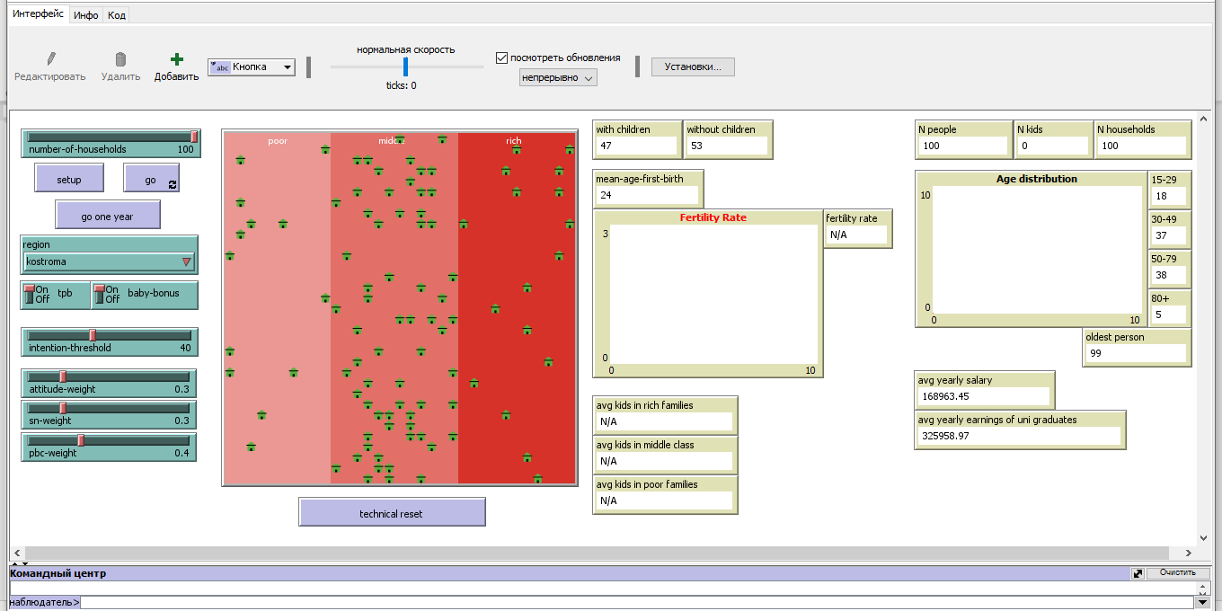

Slide 26
Thank you for your attention

Slide 27
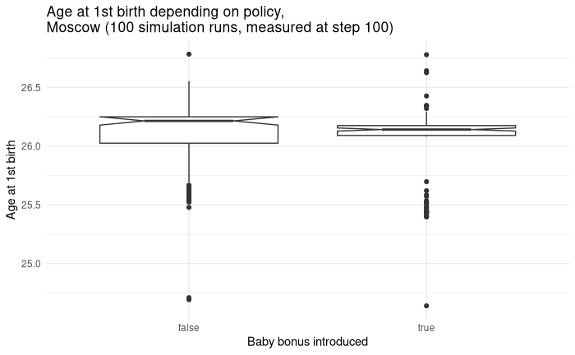
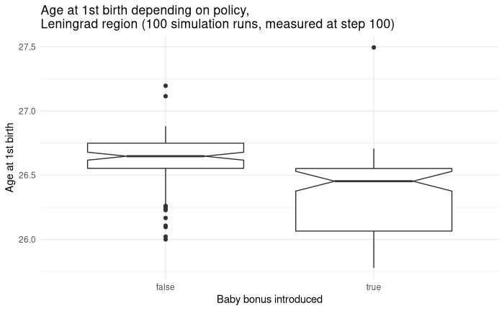
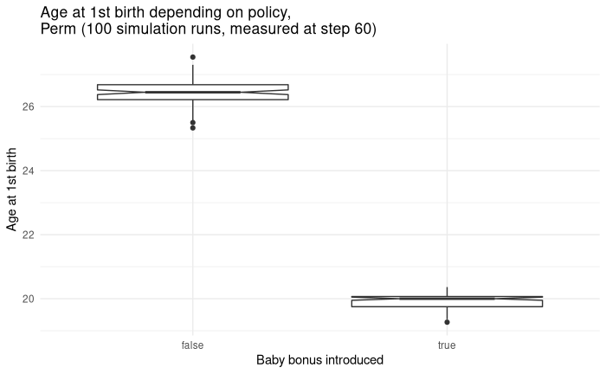
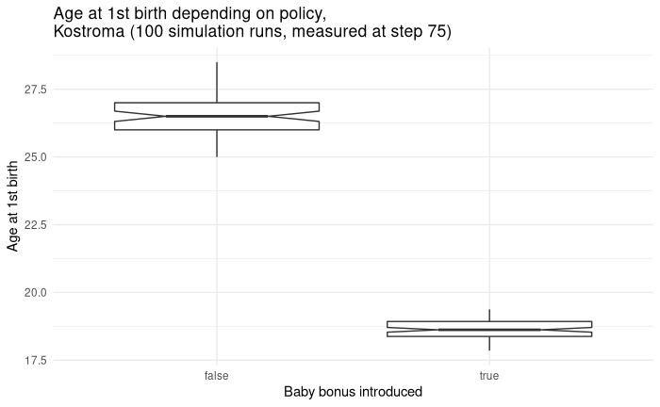

Slide 28
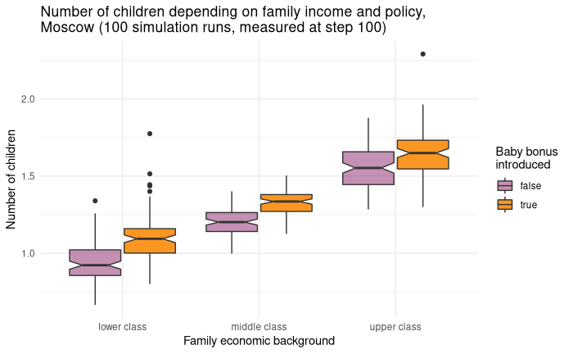
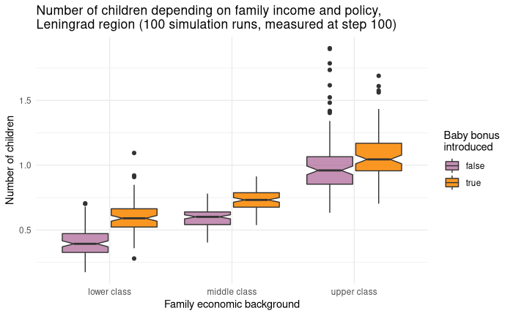
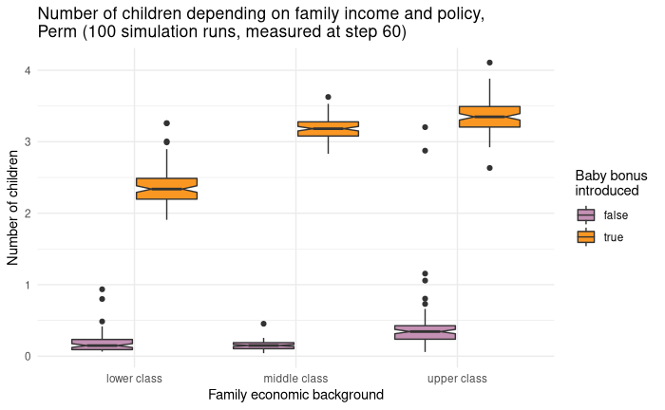
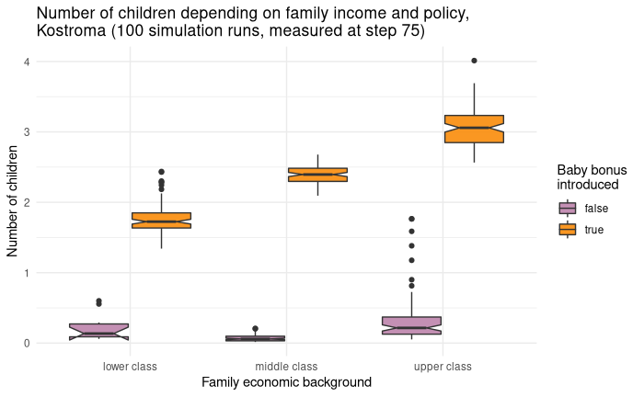

Slide 29
References
Alderman, H., Chiappori, P.-A., Haddad, L., Hoddinott, J., & Kanbur, R. (1995). Unitary Versus Collective Models of the Household: Is It Time to Shift The Burden of Proof? The World Bank Research Observer, 10(1), 1–19. https://doi.org/10.1093/wbro/10.1.1
Frejka, T., & Zakharov, S. (2013). The Apparent Failure of Russia’s Pronatalist Family Policies. Population and Development Review, 39(4), 635–647. https://doi.org/10.1111/j.1728-4457.2013.00631.x
Friedman, D., Hechter, M., & Kanazawa, S. (1994). A theory of the value of children. Demography, 31(3), 375–401. https://doi.org/10.2307/2061749
Iwata, S., & Naoi, M. (2017). The asymmetric housing wealth effect on childbirth. Review of Economics of the Household, 15(4), 1373–1397. https://doi.org/10.1007/s11150-016-9355-8
Li, X., Fan, Y., Assanangkornchai, S., & McNeil, E. B. (2019). Application of the Theory of Planned Behavior to couples’ fertility decision-making in Inner Mongolia, China. PLOS ONE, 14(8), e0221526. https://doi.org/10.1371/journal.pone.0221526
Slonimczyk, Fabian and Anna V. Yurko. 2013. “Assessing the impact of the maternity capital policy in Russia using a dynamic model of fertility and employment,” IZA Discussion Paper No. 7705.

