Slide 1
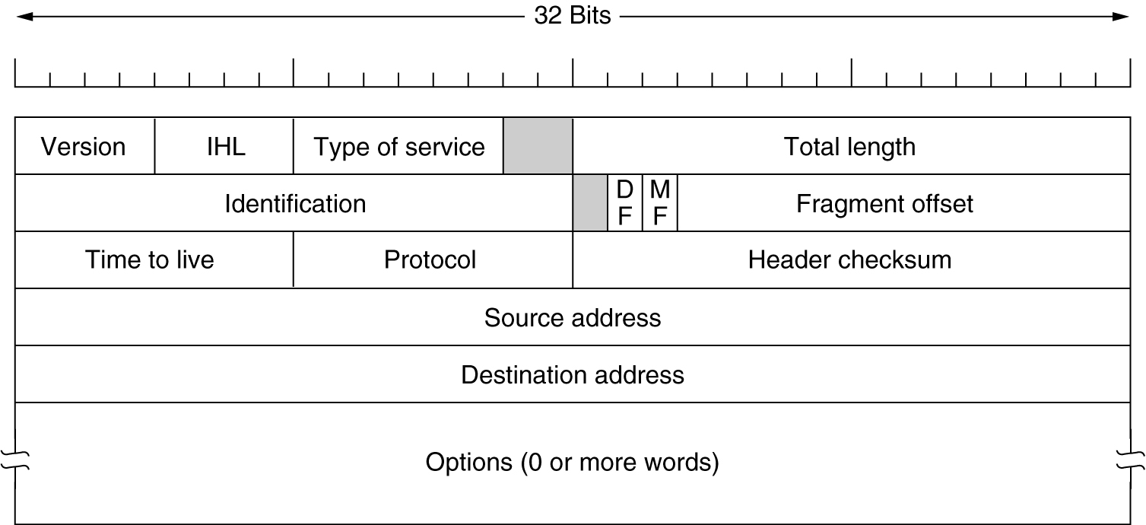
The IP Protocol
The IPv4 (Internet Protocol) header.

Slide 2
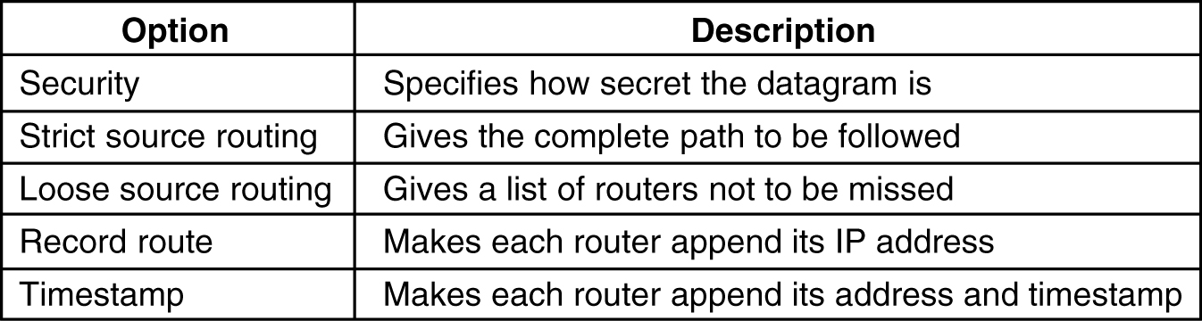
The IP Protocol (2)
5-54
Some of the IP options.

Slide 3
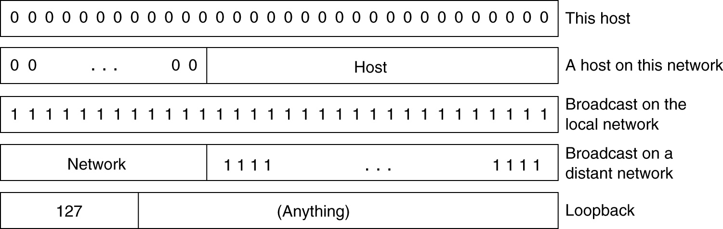
IP Addresses (2)
Special IP addresses.

Slide 4
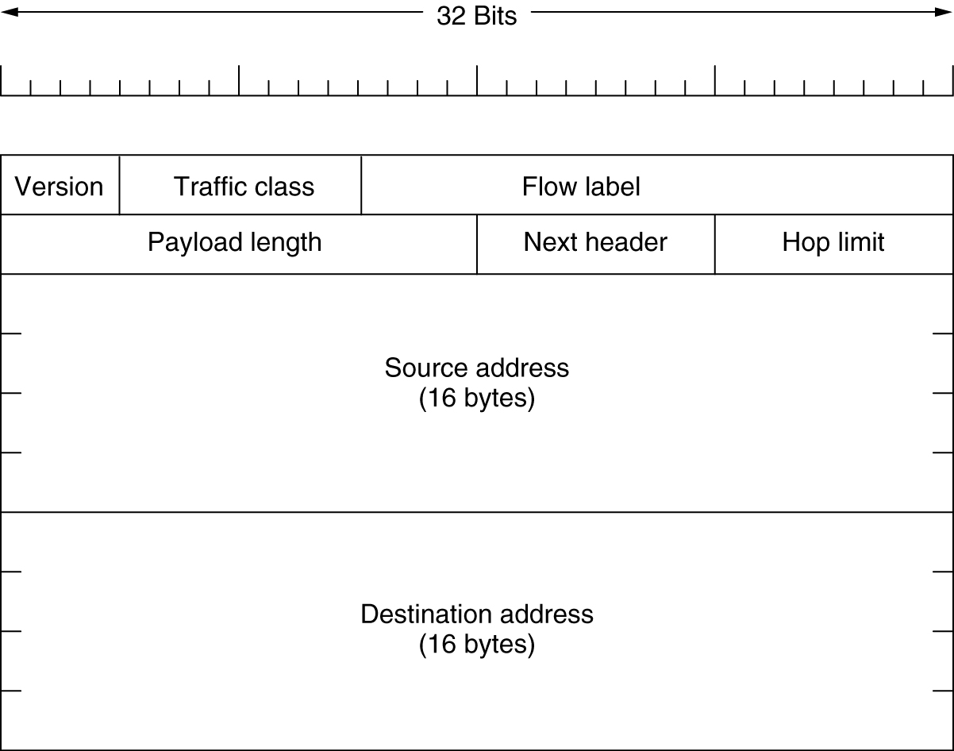
The Main IPv6 Header
The IPv6 fixed header (required).

Slide 5
IP V6 Header
Version (4 bits)
Traffic Class (8 bits) (as in IPv4 now)
  The 6 most-significant bits are used for differentiated services, which is used to classify packets.
  The remaining two bits are used for ECN.
Flow Label (20 bits) (new in IPv4)
  Originally created for giving real-time applications special service. The flow label when set to a non-zero value now serves as a hint to routers and switches with multiple outbound paths that these packets should stay on the same path so that they will not be reordered.
Payload Length (16 bits) (instead of Total length in IPv4)
  The size of the payload in octets, including any extension headers. The length is set to zero when a Hop-by-Hop extension header carries a Jumbo Payload option.
Next Header (8 bits)
  This field usually specifies the transport layer protocol used by a packet's payload. When extension headers are present in the packet this field indicates which extension header follows.
Hop Limit (8 bits)
  Replaces the time to live field of IPv4. This value is decremented by one at each intermediate node visited by the packet. When the counter reaches 0 the packet is discarded.
Source Address (16B) & Destination Address (16B): much larger than in IPv4!
In order to increase performance, the header has no checksum to protect it.
Fragmentation is now an option and it can be carried out only by the source.

Slide 6
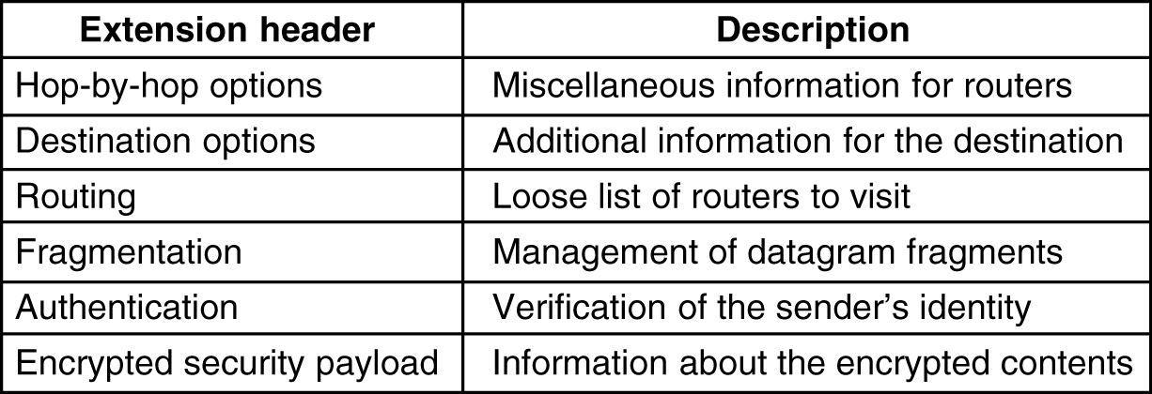
Extension Headers
5-69
IPv6 extension headers.

Slide 7
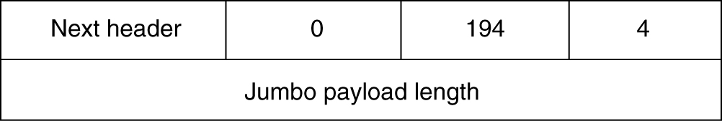
Extension Headers (2)
The hop-by-hop extension header for large datagrams (jumbograms).
An optional feature of IPv6, the jumbo payload option in a Hop-By-Hop Options extension header, allows the exchange of packets with payloads of up to 4 GB.
Since both TCP and UDP include fields limited to 16 bits (length, urgent data pointer), support for IPv6 jumbograms requires modifications to the Transport Layer protocol implementation.
Jumbograms are only relevant for links that have a MTU larger than 65583 octets

