Slide 1
IEEE 802.3 (Ethernet)

Slide 2
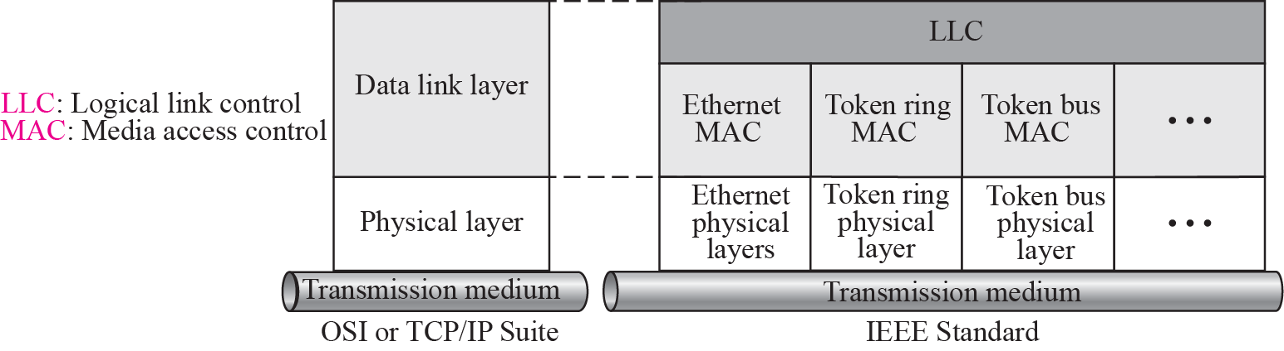
Ethernet (and other old IEEE standard) layers
Ethernet includes the physical and Data Link layer
The Data Link layer is in turn divided into the MAC and the LLC sub-layers

Slide 3
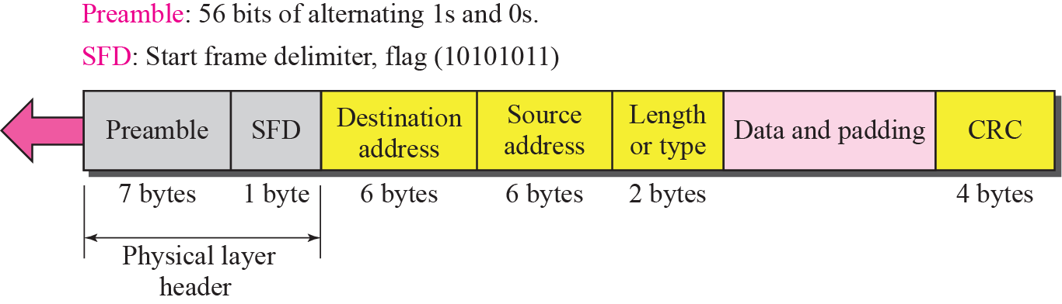
Ethernet Frame

Slide 4
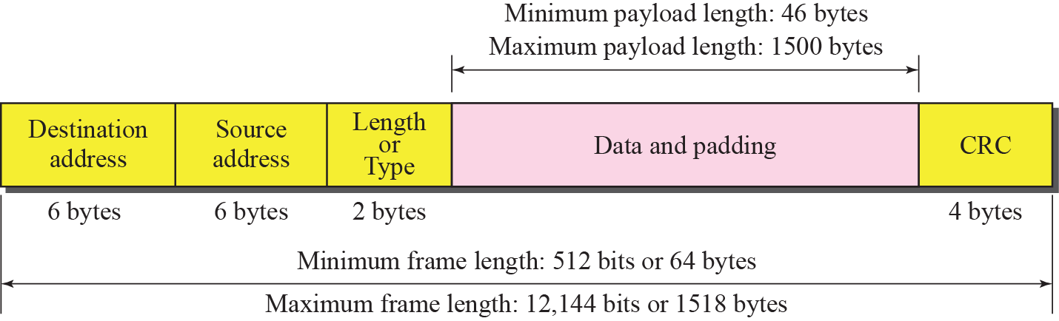
Maximum and minimum lengths

Slide 5
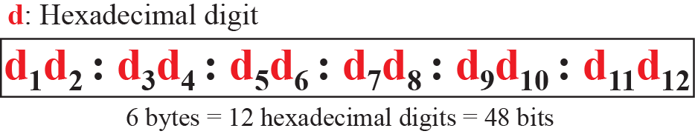
Address format and types
There are 3 address types:
Unicast (d2 even)
Multicast (d2 odd)
Broadcast (all “1”, or FF:FF:FF:FF:FF:FF)

Slide 6
Address type examples
Define the type of the following destination addresses:
a. 4A:30:10:21:10:1A
b. 47:20:1B:2E:08:EE
c. FF:FF:FF:FF:FF:FF
Solution
a. This is a unicast address because A in binary is 1010 (d2 even).
The first 3 bytes identify the NIC manufacturer, the latter are a sort of serial number
b. This is a multicast address because 7 in binary is 0111 (d2 odd).
c. This is a broadcast address because all digits are, F’s.

Slide 7
Address serialization
Address
47:20:1B:2E:08:EE
The address is sent left-to-right, byte by byte; for each byte, it is sent right-to-left, bit by bit:
← 11100010 00000100 11011000 01110100 00010000 01110111

Slide 8
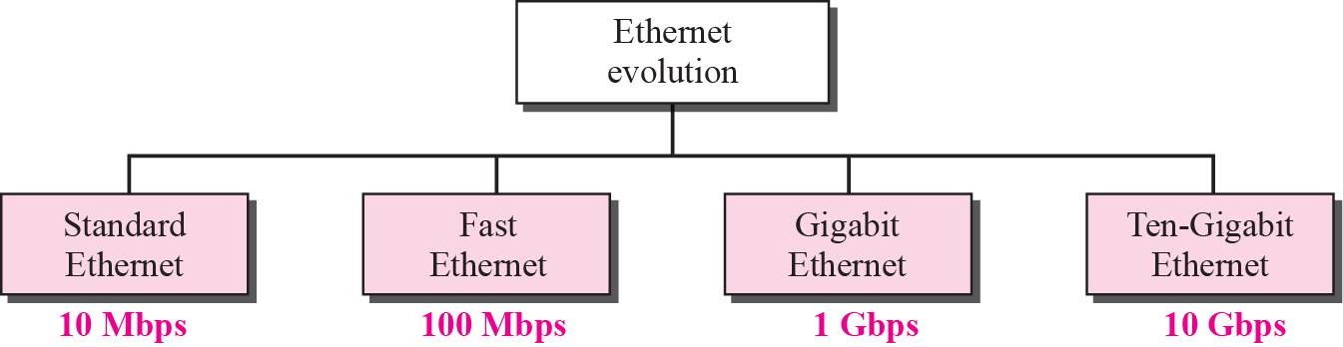
Ethernet evolution
Standardized as one of 3 incompatible schemes of IEEE 802.3 in 1983
Designed in early 70’s (Bob Metcalfe at Xerox)
Digital/Intel/Xerox (DIX standard) in 1980
Metcalfe’s 3COM became one of the largest producer of NICs (Network Interface Card)
Enhanced many times to follow the technological advancements; “evolutionary path”
easy deployment, investments preserved
old inefficient schemes supported to maintain compatibility with obsolescent hardware
We will start with 10 Mbit/s, bus topology (“standard Ethernet”).
Figure from TCP/IP Protocol Suite

Slide 9
Space time model of a collision in CSMA
A
B
C
D
T
i
m
e
T
i
m
e

Slide 10
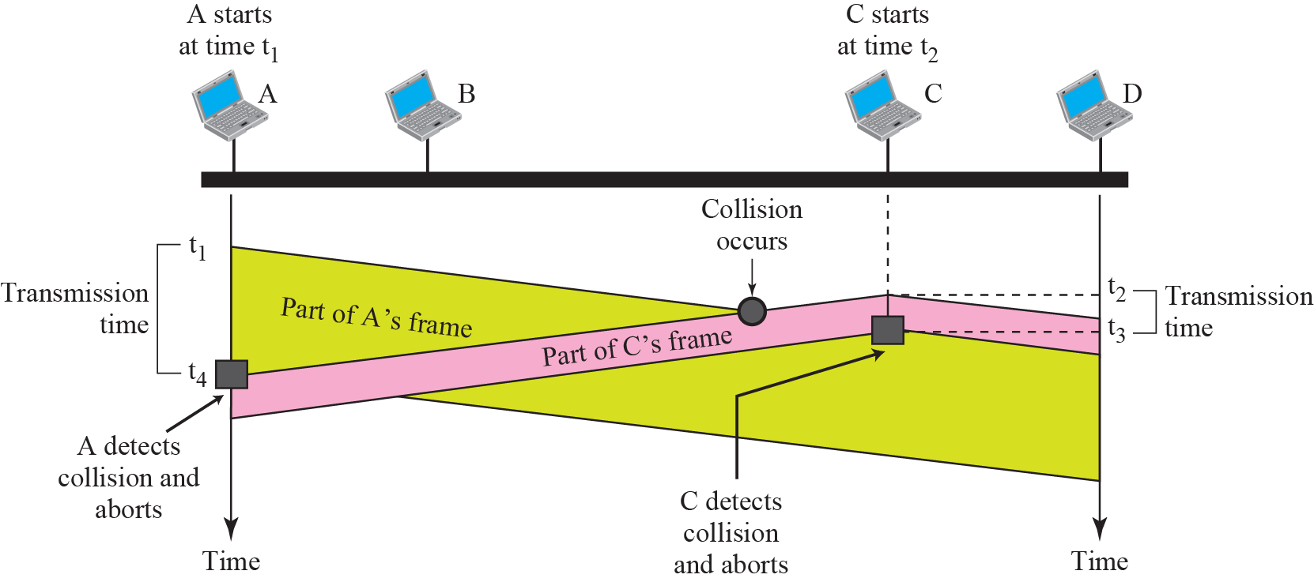
Figure 3.8 Collision of the first bit in CSMA/CD

Slide 11
Minimum frame size
In the “classic” Ethernet the maximum propagation time Tp is 25.6 μs
The design of CSMA-CD requires that a collision be detected by the transmitter before the ending of transmission
This implies that the frame transmission time must be twice Tp
Tfr = 2 × Tp = 51.2 μs.
The minimum size of the frame is thus 10 Mbps × 51.2 μs = 512 bits or 64 bytes

Slide 12
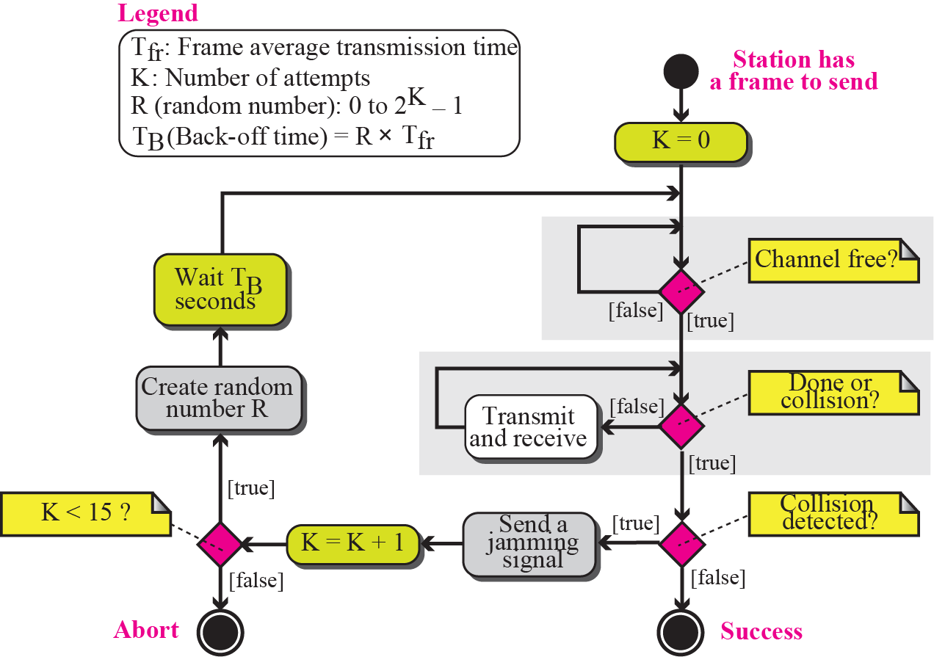
CSMA-CD (Carrier Sensing Multiple Access-Collision Detection)

Slide 13
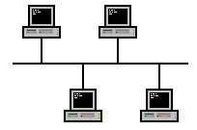
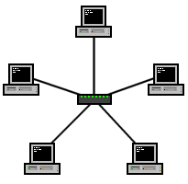
Ethernet Topology evolution
Bus
Thick coaxial cable with “vampires”
Thin coaxial cable with T junction and BNC connectors
Segments could be connected by max 4 repeaters.
One collision domain, CSMA/CD (half-duplex) necessary
Reliability problems
Physical star
Nodes are connected to a hub (physical repeater), which is the centre of the star; twisted pair cables and RJ45 connectors used
The layout is star, but it is logically equivalent to a bus, because all the cables are electrically connected (although we have separate Tx and Rx channels).
One collision domain, CSMA/CD (half-duplex) still necessary because in case of collision the hub send the jamming signal on the NIC Rx channel
Better reliability.
Hub

Slide 14
Ethernet Topology evolution 2
Logical star
The centre of the star is a switch; the inputs are buffered and frames are moved from the input to the output socket by means of a high speed internal bus.
Only one node connected to each socket; each node has its collision domain, i.e. no collisions possible.
CSMA/CD no more necessary; full-duplex possible.
Better throughput.
Importance of flow control to “pause” transmitting nodes before congestion occurs.
Switch

Slide 15
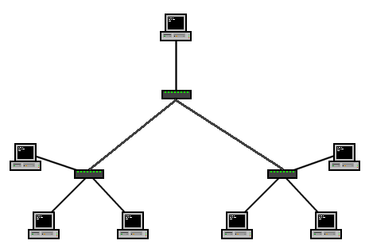
Ethernet Topology evolution 3
Hierarchical structures
One central switch to serve three buildings
One building switch to serve three floors
One floor switch to serve three areas
Each standard variant has its own constraints on max cable lengths and max “radius”.

Slide 16
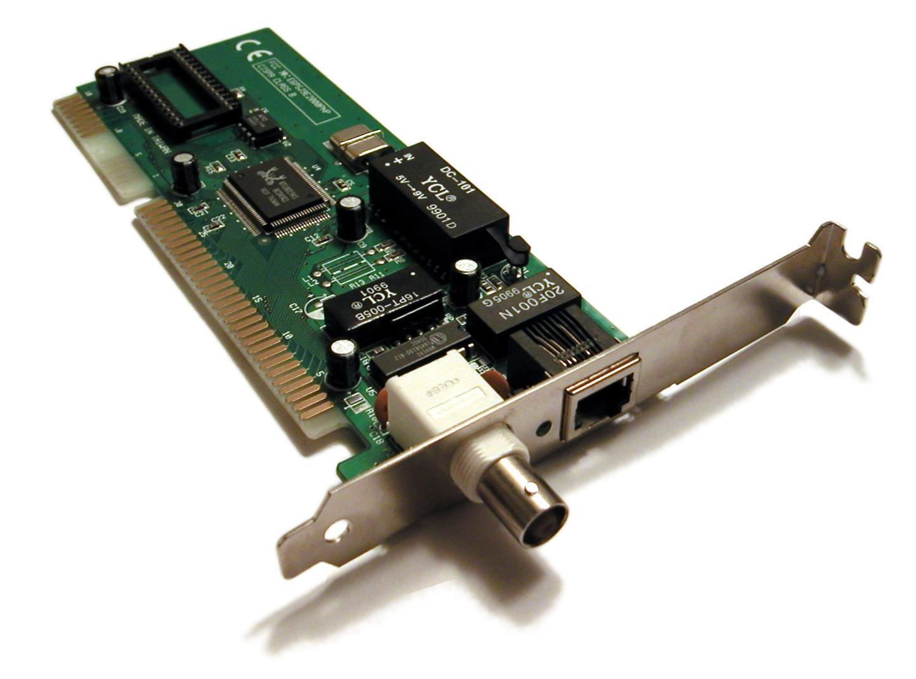
Combo NIC (90s)
A “combo” 1990s Ethernet network interface controller card.
BNC connector (left) for use in (now obsolete) 10BASE2
CC BY-SA 3.0, https://commons.wikimedia.org/w/index.php?curid=122201

Slide 17
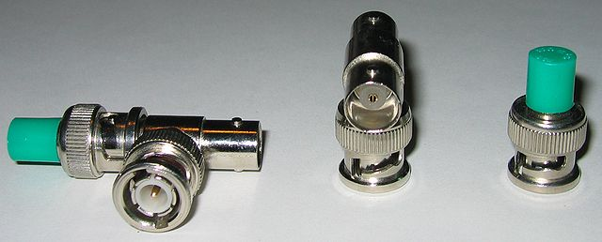
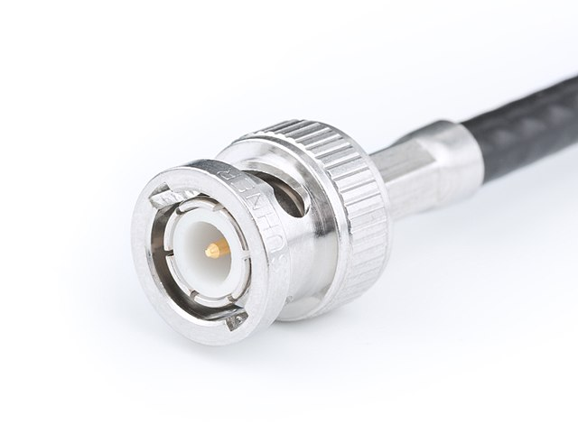
BNC cables and T connectors
By Romantiker - Own work, CC BY-SA 3.0, https://commons.wikimedia.org/w/index.php?curid=96414
By Swift.Hg - Own work, CC BY-SA 3.0, https://commons.wikimedia.org/w/index.php?curid=25681746

Slide 18
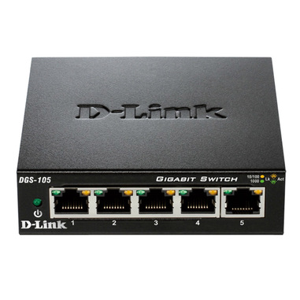
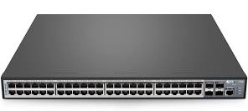
Switches
48 port10 Gb/s switch+4 40Gb/s fiber
(4000 euro)
5 port switch unmanaged (plug & Play)
(20 euro)

Slide 19
Ethernet 10 Mbit/s (or Classic)
Several variants depending on the physical medium
Coaxial cable («thick» or «thin») or
2 pairs of UTP Cat. 3 (used for telephone lines)
Fiber
10Base-T
Signal
10 Msymbol/s, Manchester encoding (about 20 MHz BW)
 | 10Base5 | 10Base2 | 10Base-T | 10Base-F
Medium | Thick coax | Thin coax | 2 UTP | 2 fibers
Max hop length | 500m | 185m | 100m | 2000m

Slide 20
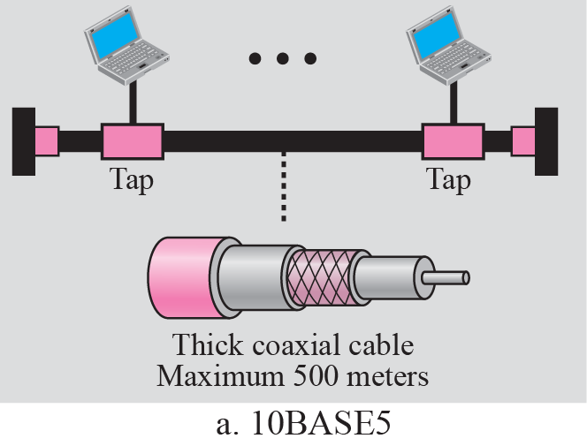
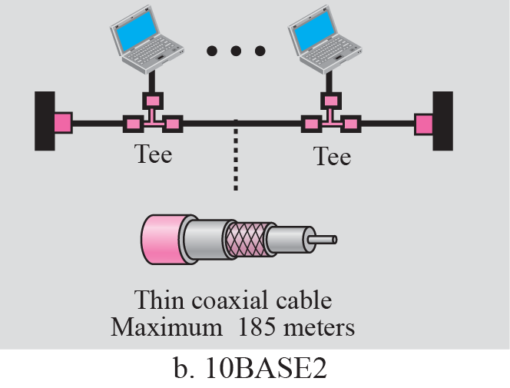
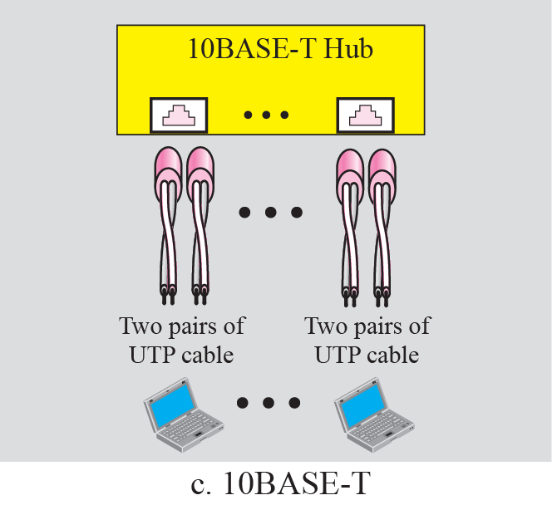
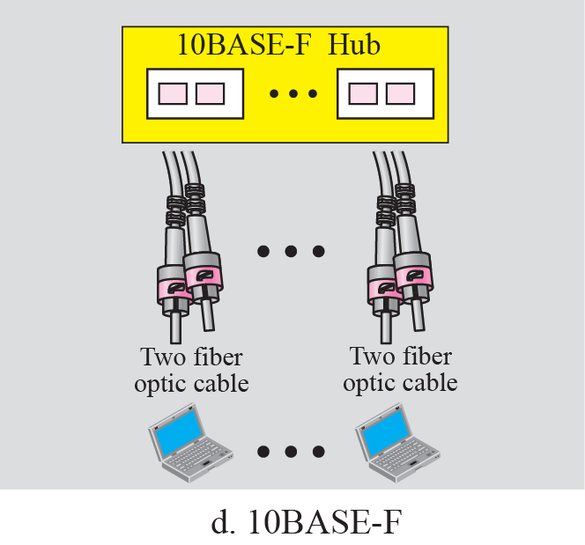
Ethernet 10 Mbit/s variants

Slide 21
Ethernet 100 Mbit/s, or Fast Ethernet
Different variants depending on the medium characteristics. Bus topologies not permitted.
100Base-TX differences with 10Base-T
Use of two twisted pairs as in 10Base-T, but the cable is of better quality (cat 5 UTP instead of 3 UTP).
no Manchester encoding to halve BW per symbol (=bit here)
4/5B encoding (4 source to 5 channel bits). The 5 bit words chosen to help symbol synchronization at receiver (no more helped by Manchester).
Tx at 125 Msymbol/s on each pair=100 Mbit/s (125*4/5)
Flow control possible
Fast Ethernet NIC compatible with 10 Mbit/s NICs
Half-duplex (with hubs) and full-duplex (with switches) modes.
In full duplex one pair for each direction
Auto negotiation possible (like faxes and modems) to choose the best common mode.
10 Mbit/s half-duplex mandatory on all NICs, minimum common mode
In case of auto negotiation failure, 10 Mbit/s half-duplex selected

Slide 22
Ethernet 1Gbit/s objectives
The following are the objectives of 1000BASE-T (from the IEEE 802.3 ab standard):
a) Support the CSMA/CD MAC
d) Provide line transmission that supports full and half duplex operation
f) Support operation over 100 meters of Category 5 balanced cabling as defined in 40.7
g) Bit Error Rate of less than or equal to 10⁻¹⁰
h) Support Auto-Negotiation (Clause 28)

Slide 23
Ethernet 1Gbit/s description
Different variants depending on the medium characteristics, as usual. Bus not permitted.
1000Base-T (IEEE 802.3ab) differences with 100 Base-TX
Use of 4 twisted pairs of a Cat.5-UTP cable in a bidirectional way (through “hybrids”) instead of two pairs unidirectional.
125 Msymbols/s per pair as before; aggregate 500 Msymbols/s (125x4)
5 PAM levels plus TCM (Trellis Coded Modulation)= 2 bits per symbol;
1000 Mbit/s (=500x2); P_{error}=10⁻¹⁰
Half-duplex mode possible, but requires frames of min 512 bytes (to keep the max length of the cable acceptable).
1 Gbit/s compatible with 10 and 100 Mbit/s NICs half and full duplex modes.
But much longer Tx and Rx buffers may cause long delays when lower speed selected
Interrupt moderation mechanisms usually added to preserve CPU from a flood of interrupts.
Auto negotiation possible (like faxes and modems) to choose the best common mode.
In case of failure, 10 Mbit/s half-duplex selected

Slide 24
Ethernet 1 Gbit/s variants
Name | Medium | Specified distance
1000BASE‑CX | Twinaxial cabling | 25 meters
1000BASE‑SX | Multi-mode fiber | 220 to 550 meters dependent on fiber diameter and bandwidth
1000BASE‑LX | Multi-mode fiber | 550 meters
1000BASE‑LX | Single-mode fiber | 5 km[4]
1000BASE‑LX10 | Single-mode fiber using 1,310 nm wavelength | 10 km
1000BASE‑ZX | Single-mode fiber at 1,550 nm wavelength | ~ 70 km
1000BASE‑BX10 | Single-mode fiber, over single-strand fiber: 1,490 nm downstream 1,310 nm upstream | 10 km
1000BASE‑T | Twisted-pair cabling (Cat‑5, Cat‑5e, Cat‑6, or Cat‑7) | 100 meters
1000BASE‑TX | Twisted-pair cabling (Cat‑6, Cat‑7) | 100 meters
http://en.wikipedia.org/wiki/Gigabit_Ethernet

Slide 25
Ethernet 10 Gbit/s
The 10 gigabit Ethernet (10GE or 10GbE or 10 GigE) was first published in 2002.
Only full duplex point-to-point links
Half duplex operation, hubs and CSMA/CD (carrier sense multiple access with collision detection) do not exist in 10GbE.
Most variants use fiber as a medium, but also twisted pair (Cat.6 and above) is allowed.
10GBASE-T (802.3an) standard defines the wire-level modulation for as a Tomlinson-Harashima precoded (THP) version of pulse-amplitude modulation with 16 discrete levels (PAM-16), encoded in a two-dimensional checkerboard pattern known as DSQ128.
http://en.wikipedia.org/wiki/10_Gigabit_Ethernet

Slide 26
Ethernet 40/100 Gbit/s
100 Gigabit Ethernet (or 100GbE) and 40 Gigabit Ethernet (or 40GbE) support sending Ethernet frames at 40 and 100 Gbit/s over multiple 10 Gbit/s or 25 Gbit/s lanes. They were ratified in June 2010.
The standard supports only full-duplex operation. Other electrical objectives include:
Preserve the 802.3 / Ethernet frame format utilizing the 802.3 MAC
Preserve minimum and maximum FrameSize of current 802.3 standard
Support a bit error ratio (BER) better than or equal to 10⁻¹² at the MAC/PLS service interface
Provide appropriate support for OTN
Support MAC data rates of 40 and 100 Gbit/s
Provide Physical Layer specifications (PHY) for operation over single-mode optical fiber (SMF), laser optimized multi-mode optical fiber (MMF) OM3 and OM4, copper cable assembly, and backplane.
New variants
2014 P802.3bj 100 Gbit/s Backplane and Copper Cable
2015 P802.3bm 40 Gbit/s and 100 Gbit/s on Fiber Optic
http://en.wikipedia.org/wiki/100_Gigabit_Ethernet

