Slide 1
Network Devices

Slide 2
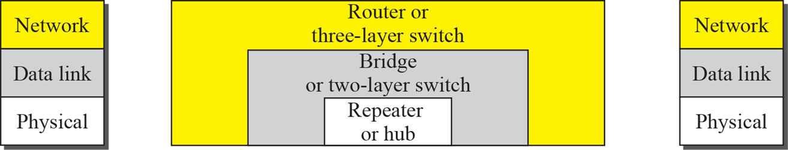
Classification
Connecting devices can be classified by considering the layer at which they operate
Layer 1 Physical
Repeaters
Hubs
Layer 2 Data Link
Switches
Bridges
Layer 3 Network
Routers

Slide 3
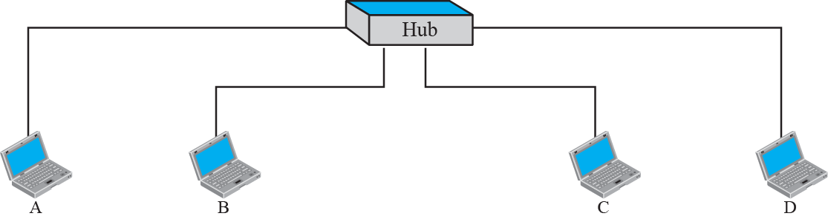
Hub
A hub (or repeater), being at layer 1, has no knowledge of frames or packets; it only knows bits.
It forwards every bit to all ports, i.e. it has not any filtering capability.
Obsoleted by switches.

Slide 4
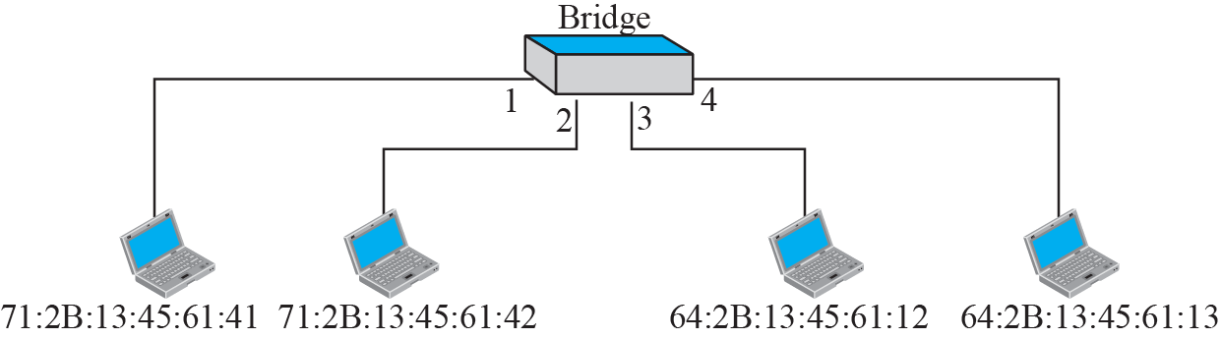
Switch (bridge)
A switch, being a 2-layer device, “knows” frames, but not packets.
It has a switching table and uses MAC addresses to find the port to which forward the input frame, i.e. it has filtering capabilities at layer 2
The table is normally built automatically (learning switch)
It is used to interconnect devices belonging to the same LAN

Slide 5
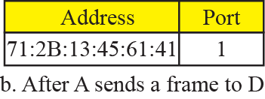
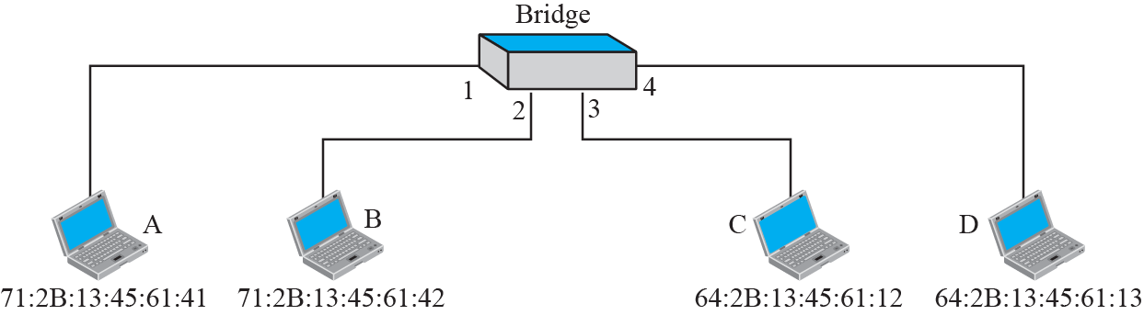
Learning switch (bridge)
M
M
M
M

Slide 6
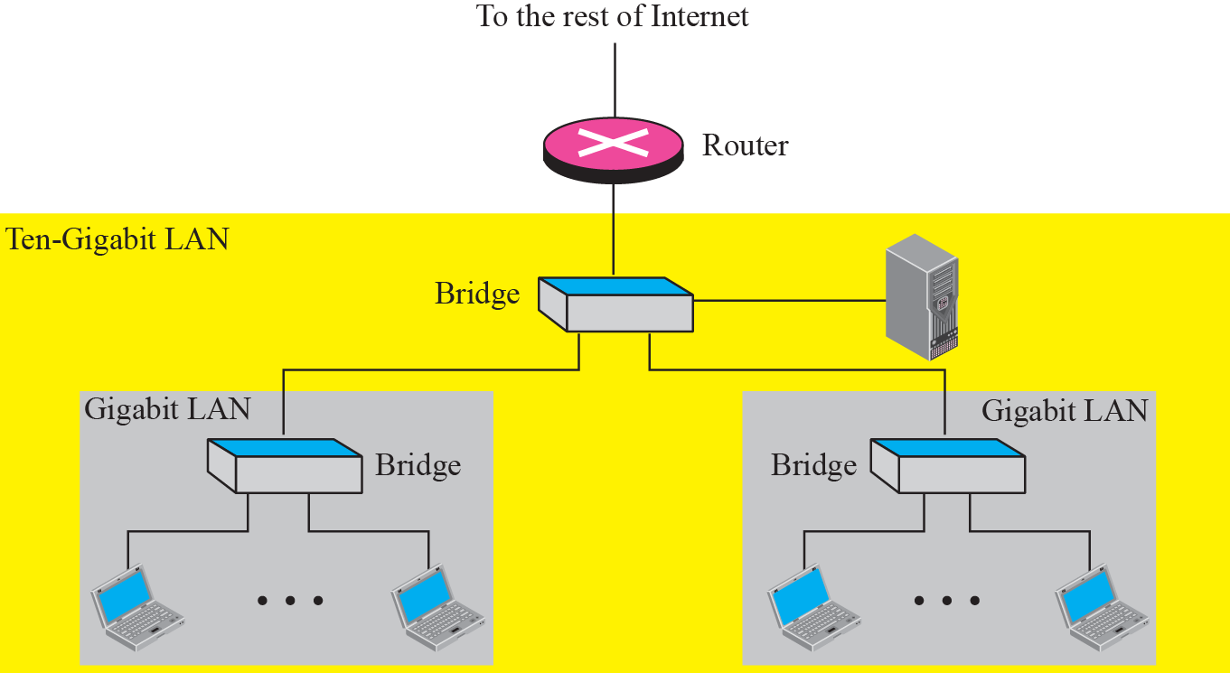
Router
A router, being a 3 layer device, knows packets.
It has a routing table with network addresses
The routing table can be manually set (static rules) or dynamically built
It is used to connect one LAN to Internet (as in ADSL “routers”), or multiple independent LANs (building an inter-net), or different Internet parts
It operates on network addresses. It changes destination MAC addresses of packets that traverse the router.

