Slide 1

Chapter 7
Internet Protocol Version4
(IPv4)
TCP/IP Protocol Suite
Copyright © The McGraw-Hill Companies, Inc. Permission required for reproduction or display.

Slide 2
7-1 INTRODUCTION
The Internet Protocol (IP) is the transmission mechanism used by the TCP/IP protocols at the network layer.
TCP/IP Protocol Suite

Slide 3
Topics Discussed in the Section
Relationship of IP to the rest of the TCP/IP Suite
TCP/IP Protocol Suite

Slide 4
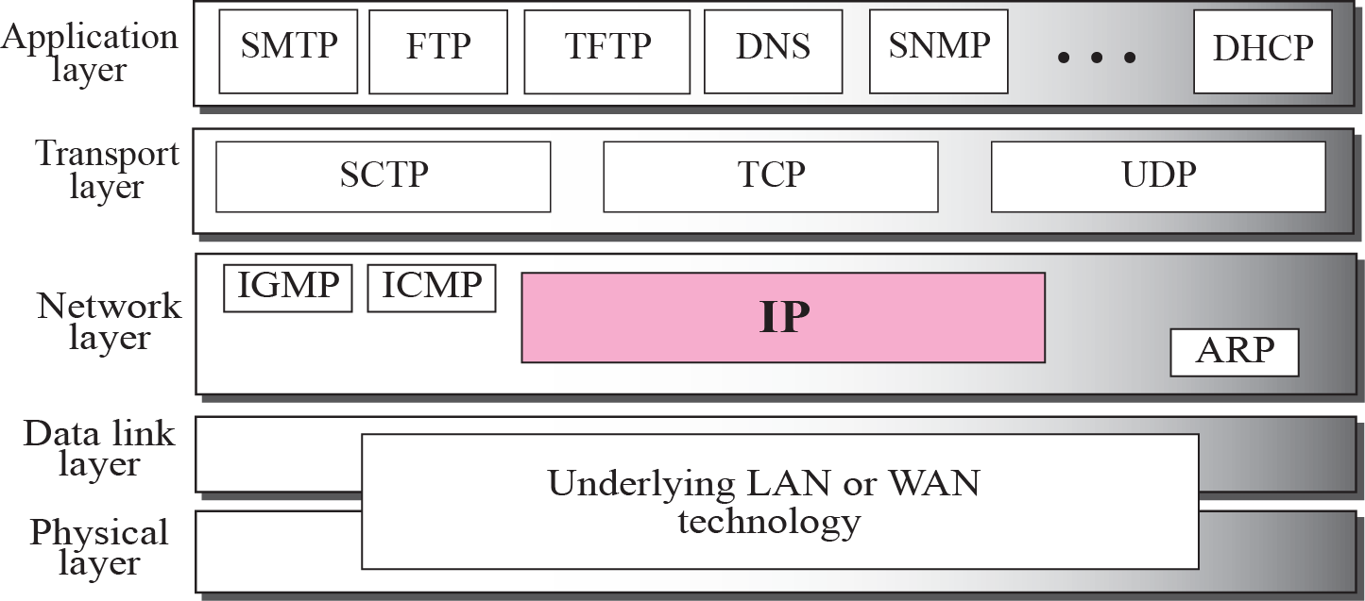
Figure 7.1 Position of IP in TCP/IP protocol suite
TCP/IP Protocol Suite

Slide 5
7-2 DATAGRAMS
Packets in the network (internet) layer are called
datagrams. A datagram is a variable-length packet consisting of two parts: header and data. The header is 20 to 60 bytes in length
(because only 4 bit for HLEN, so max 15 words of 4B=60B max) and contains information essential to routing and delivery. It is customary in TCP/IP to show the header in 4-byte sections. A brief description of each field is in order.
TCP/IP Protocol Suite

Slide 6
Topics Discussed in the Section
Format of the datagram packet
Some examples
TCP/IP Protocol Suite

Slide 7
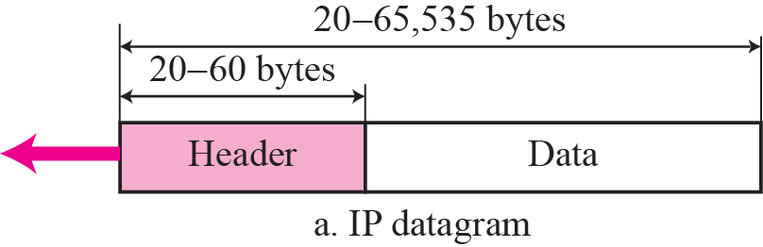
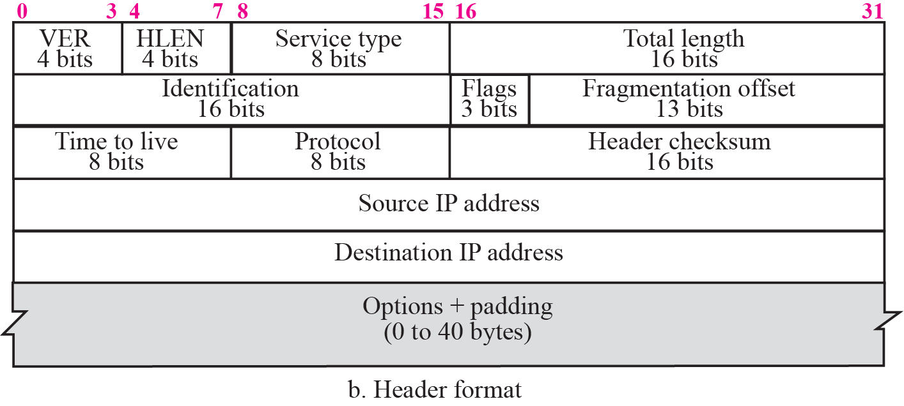
Figure 7.2 IP datagram
TCP/IP Protocol Suite

Slide 8
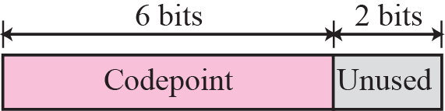
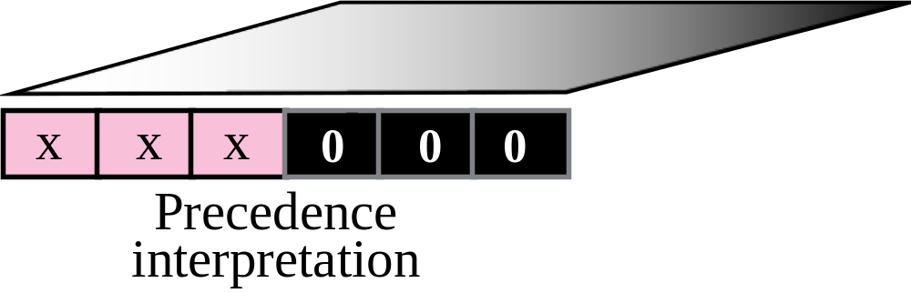
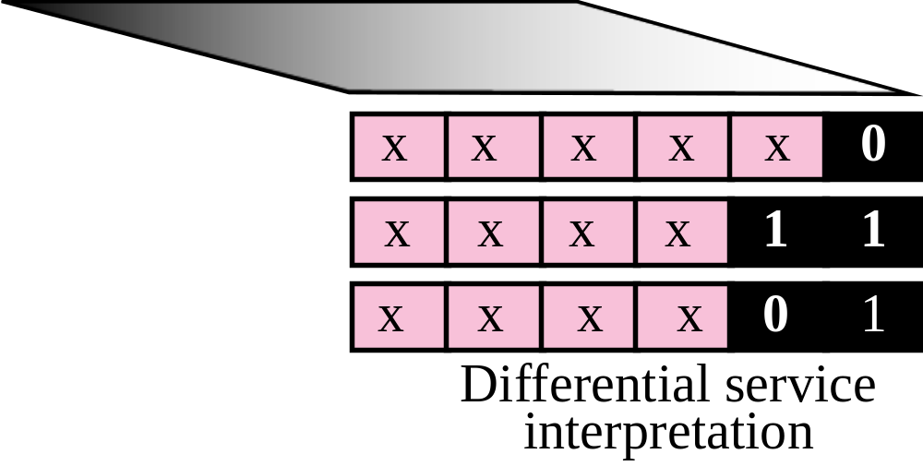
Figure 7.3 Service type
«Unused» are now assigned to ECN (Early Congestion Notification)
Diffserv interpretation is in use now
Codepoints ending in 0 are standard, in 11 experimental or local use, 01 exp/LU to become standard
TCP/IP Protocol Suite

Slide 9
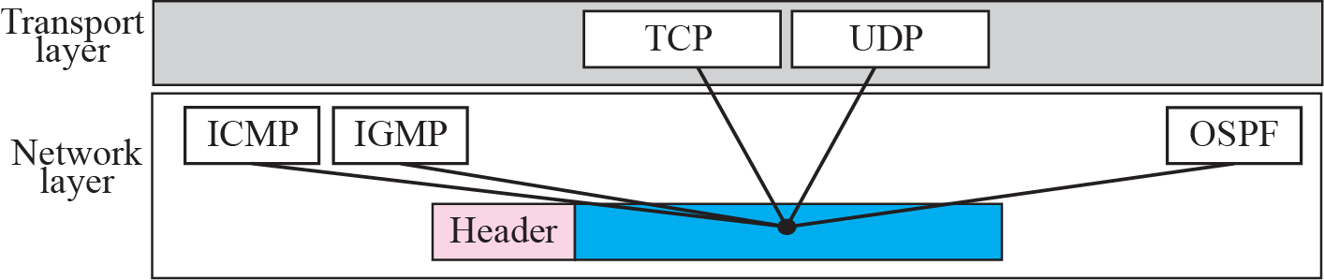
Figure 7.5 Multiplexing
TCP/IP Protocol Suite

Slide 10
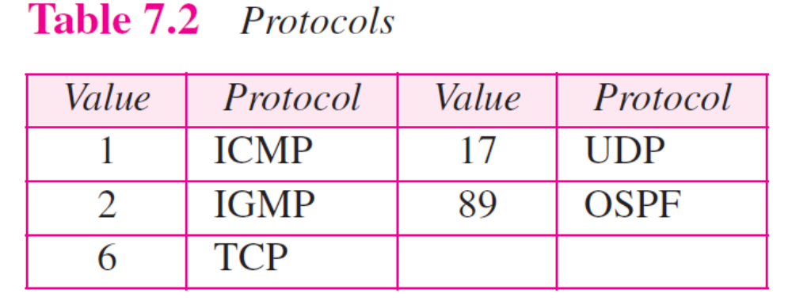
TCP/IP Protocol Suite

Slide 11
7-3 FRAGMENTATION
A datagram can travel through different networks. Each router decapsulates the IP datagram from the frame it receives, processes it, and then encapsulates it in another frame. The format and size of the received frame depend on the protocol used by the physical network through which the frame has just traveled. The format and size of the sent frame depend on the protocol used by the physical network through which the frame is going to travel.
TCP/IP Protocol Suite

Slide 12
Topics Discussed in the Section
Maximum Transfer Unit (MTU)
Fields Related to Fragmentation
TCP/IP Protocol Suite

Slide 13

Figure 7.6 MTU
TCP/IP Protocol Suite

Slide 14

Note
Only data in a datagram is fragmented.
TCP/IP Protocol Suite

Slide 15

Figure 7.7 Flags field
TCP/IP Protocol Suite

Slide 16
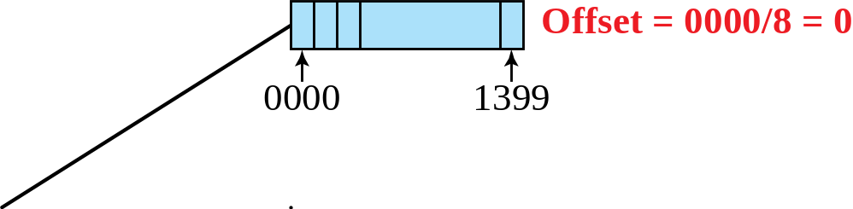
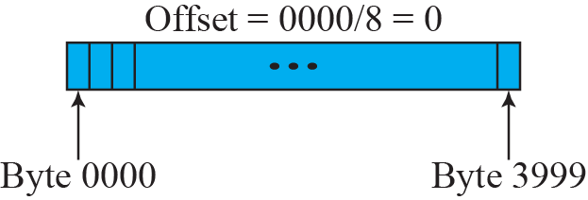
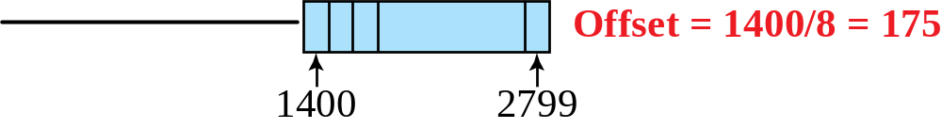
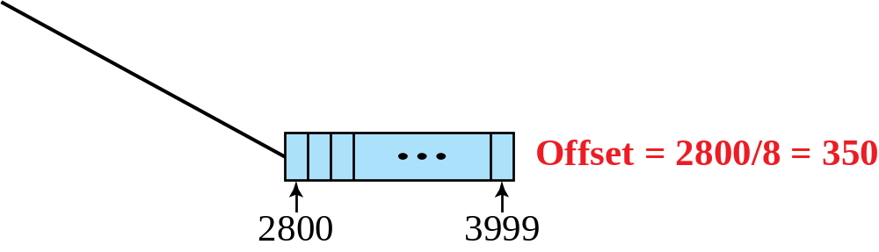
Figure 7.8 Fragmentation example
TCP/IP Protocol Suite

Slide 17
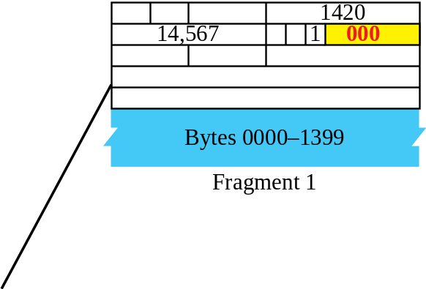
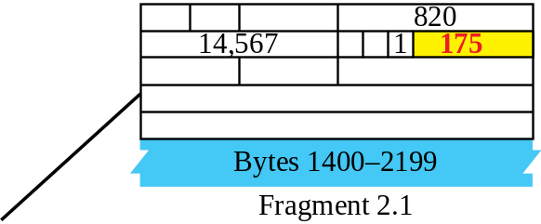
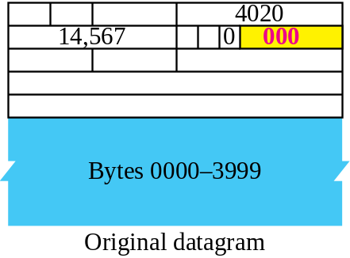
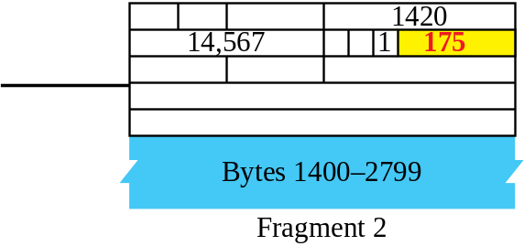
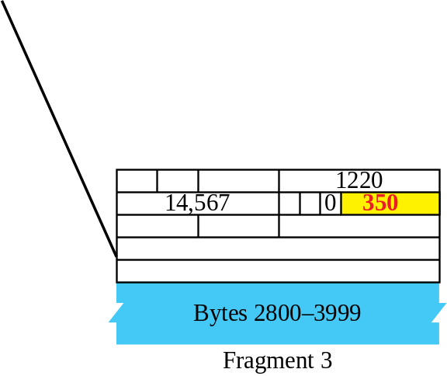
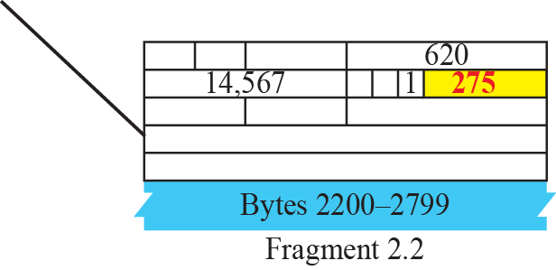
Figure 7.9 Detailed fragmentation example
TCP/IP Protocol Suite

Slide 18
Example 7.5
A packet has arrived with an M bit value of 0. Is this the first fragment, the last fragment, or a middle fragment? Do we know if the packet was fragmented?
Solution
If the M bit is 0, it means that there are no more fragments; the fragment is the last one. However, we cannot say if the original packet was fragmented or not. A nonfragmented packet is considered the last fragment.
TCP/IP Protocol Suite

Slide 19
Example 7.6
A packet has arrived with an M bit value of 1. Is this the first fragment, the last fragment, or a middle fragment? Do we know if the packet was fragmented?
Solution
If the M bit is 1, it means that there is at least one more fragment. This fragment can be the first one or a middle one, but not the last one. We don’t know if it is the first one or a middle one; we need more information (the value of the fragmentation offset). See also the next example.
TCP/IP Protocol Suite

Slide 20
Example 7.7
A packet has arrived with an M bit value of 1 and a fragmentation offset value of zero. Is this the first fragment, the last fragment, or a middle fragment?
Solution
Because the M bit is 1, it is either the first fragment or a middle one. Because the offset value is 0, it is the first fragment.
TCP/IP Protocol Suite

Slide 21
Example 7.8
A packet has arrived in which the offset value is 100. What is the number of the first byte? Do we know the number of the last byte?
Solution
To find the number of the first byte, we multiply the offset value by 8. This means that the first byte number is 800. We cannot determine the number of the last byte unless we know the length of the data.
TCP/IP Protocol Suite

Slide 22
Example 7.9
A packet has arrived in which the offset value is 100, the value of HLEN is 5 and the value of the total length field is 100. What is the number of the first byte and the last byte?
Solution
The first byte number is 100 × 8 = 800. The total length is 100 bytes and the header length is 20 bytes (5 × 4), which means that there are 80 bytes in this datagram. If the first byte number is 800, the last byte number must be 879.
TCP/IP Protocol Suite

Slide 23
7-4 OPTIONS
The header of the IP datagram is made of two parts: a fixed part and a variable part. The fixed part is 20 bytes long and was discussed in the previous section. The variable part comprises the options, which can be a maximum of 40 bytes (because HLEN has only 4 bits, resulting in 60B max and 20B are fixed). This is a severe limitation.
Options, as the name implies, are not required for a datagram. They can be used for network testing and debugging. Although options are not a required part of the IP header, option processing is required of the IP software.
TCP/IP Protocol Suite

Slide 24
Topics Discussed in the Section
Format
Option Types
TCP/IP Protocol Suite

Slide 25
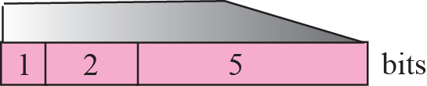
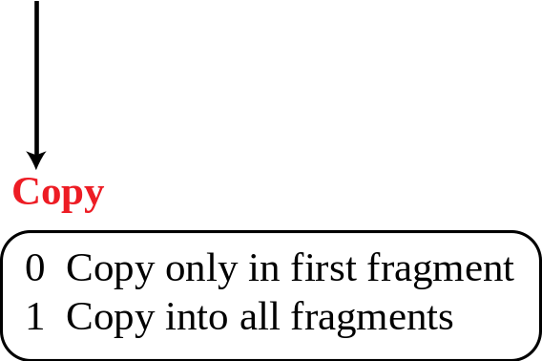
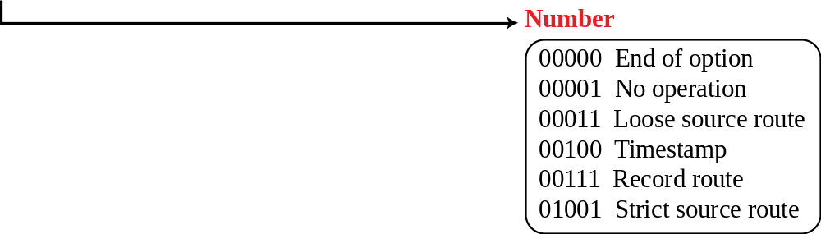
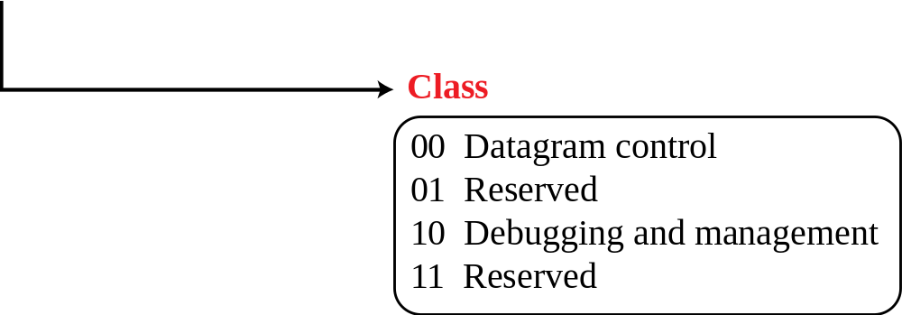
Figure 7.10 Option format
TCP/IP Protocol Suite

Slide 26
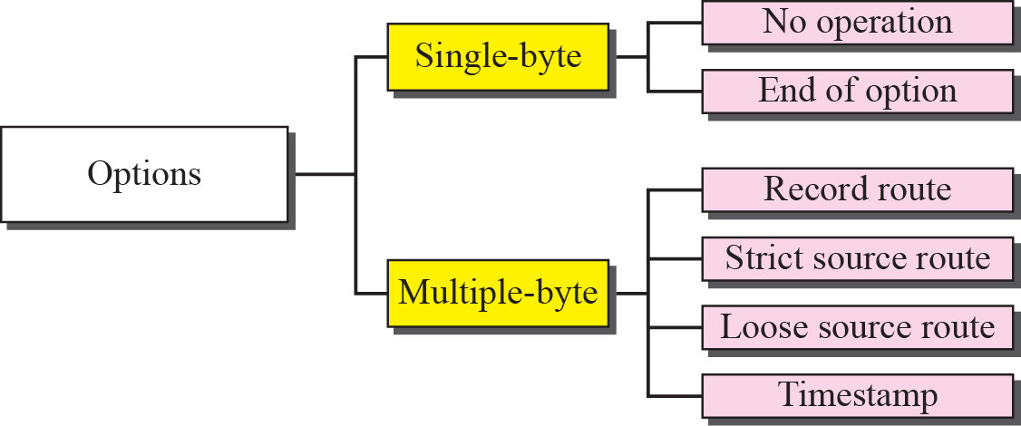
Figure 7.11 Categories of options
TCP/IP Protocol Suite

Slide 27
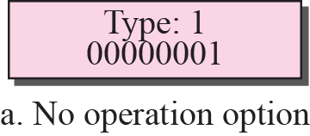
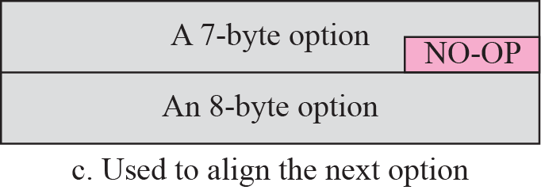
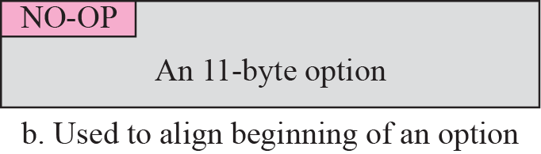
Figure 7.12 No operation option
TCP/IP Protocol Suite

Slide 28
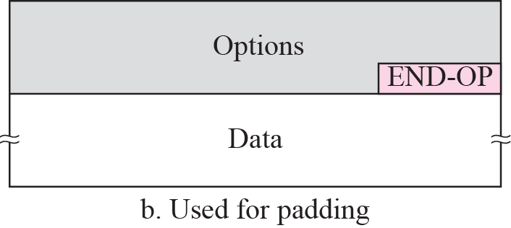
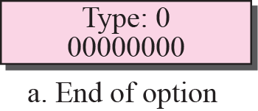
Figure 7.13 Endo-of-option option
TCP/IP Protocol Suite

Slide 29
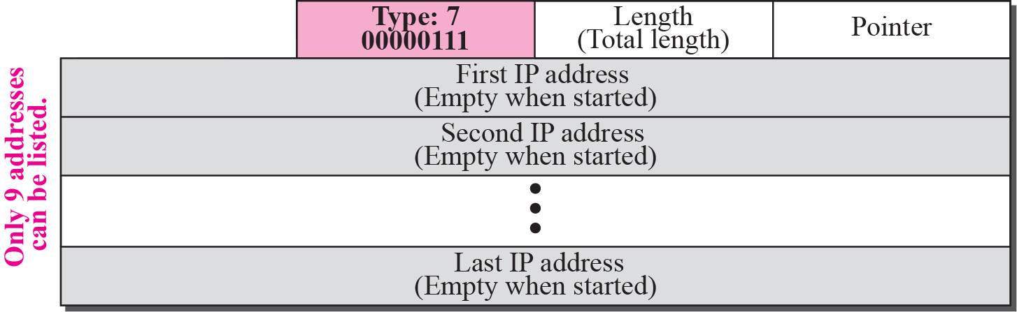
Figure 7.14 Record-route option
TCP/IP Protocol Suite

Slide 30
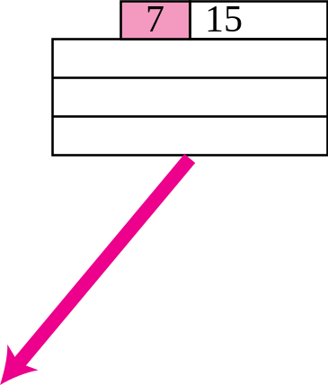
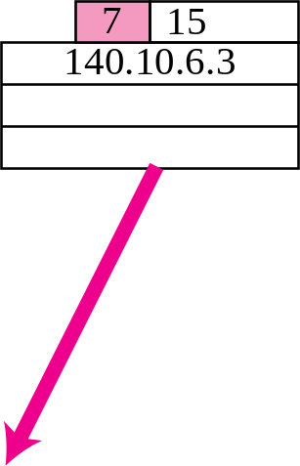
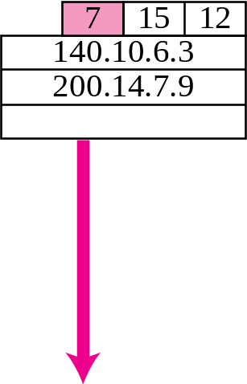
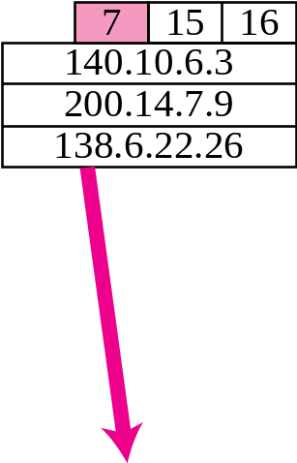
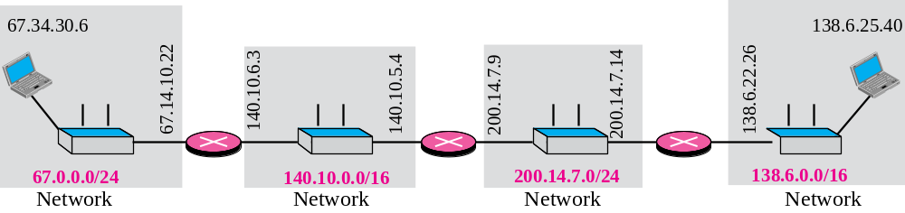
Figure 7.15 Record-route concept
TCP/IP Protocol Suite

Slide 31
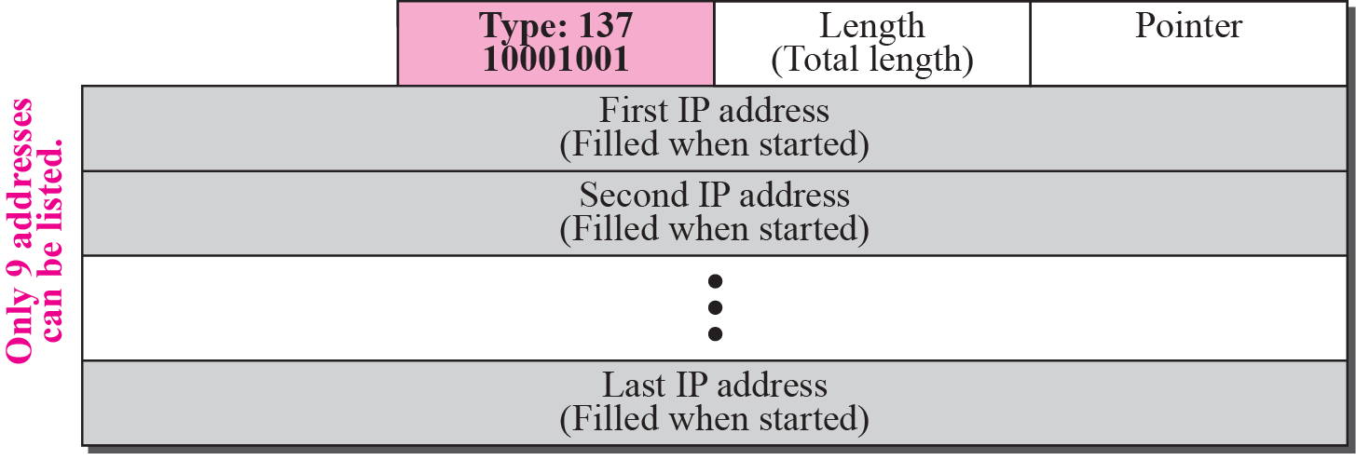
Figure 7.16 Strict-source-route option
TCP/IP Protocol Suite

Slide 32
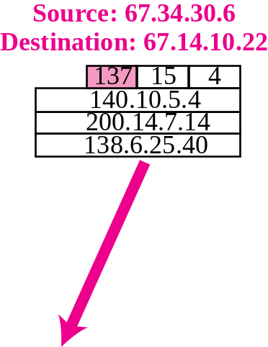
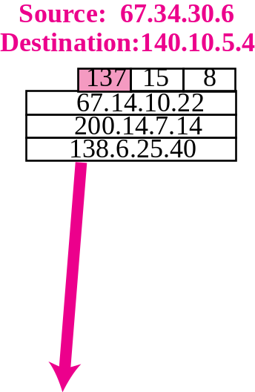
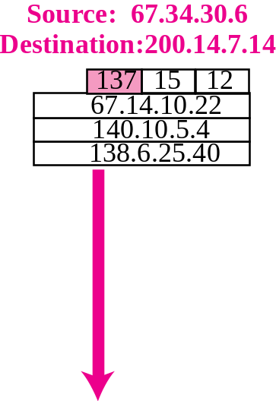
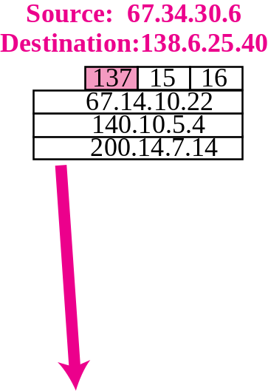
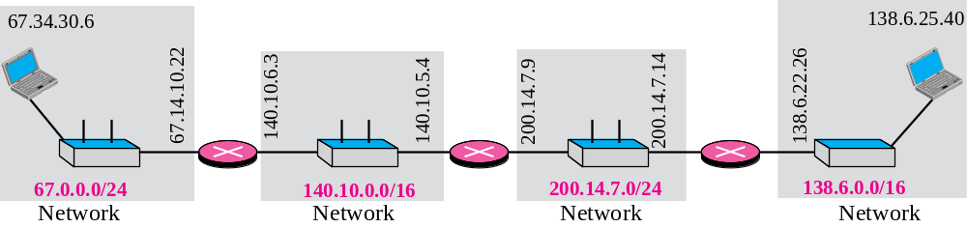
Figure 7.17 Strict-source-route option
TCP/IP Protocol Suite

Slide 33
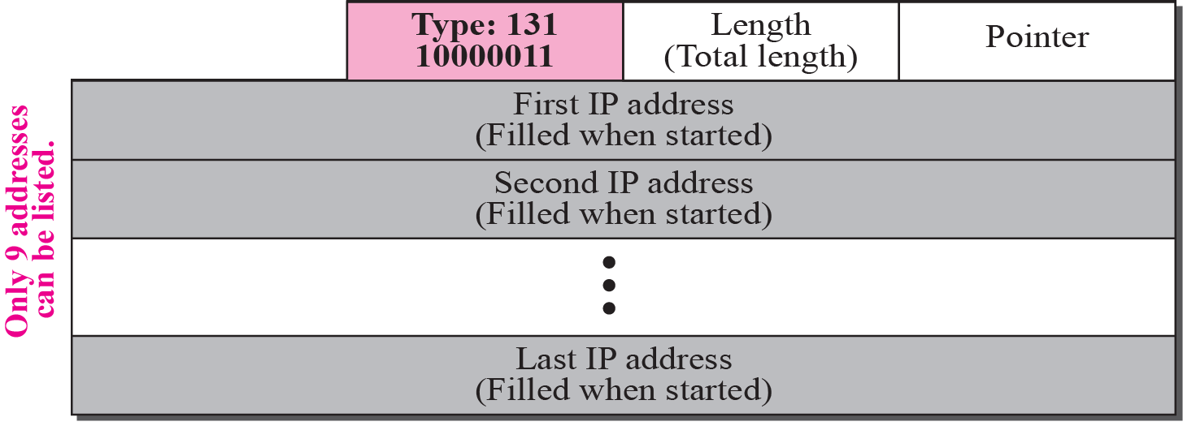
Figure 7.18 Loose-source-route option
TCP/IP Protocol Suite

Slide 34
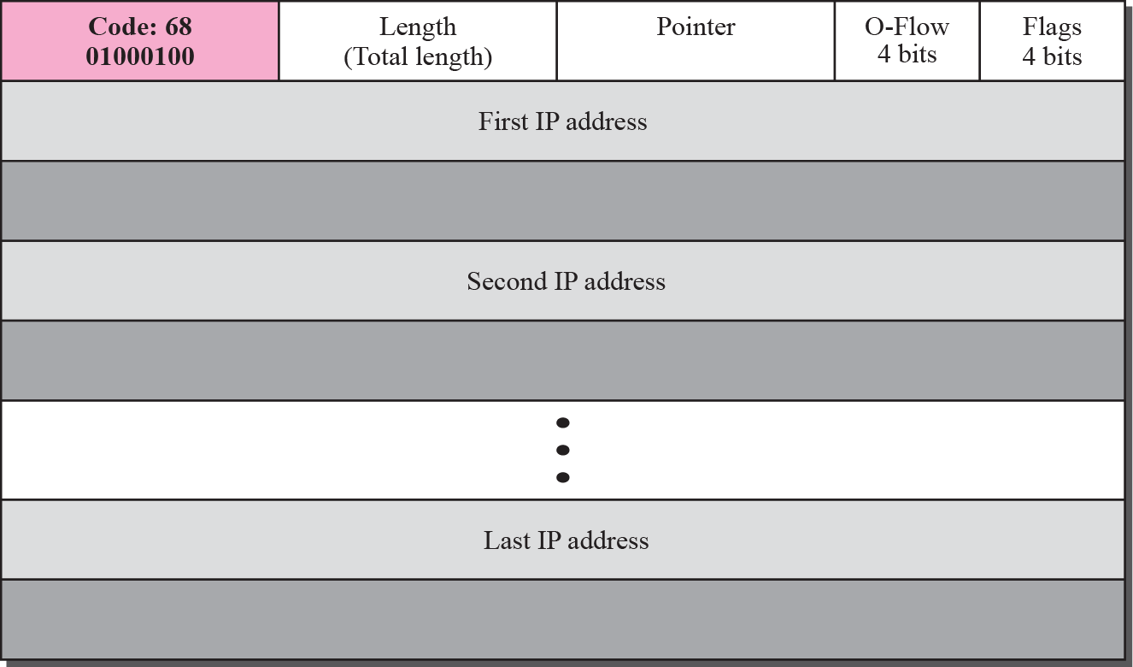
Figure 7.19 Time-stamp option
TCP/IP Protocol Suite

Slide 35
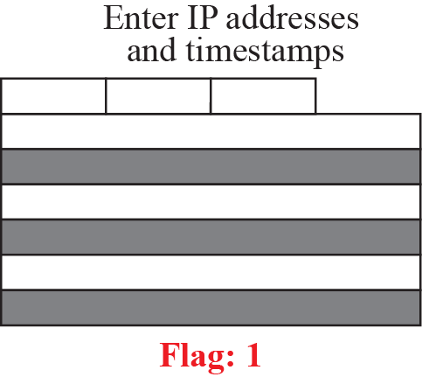
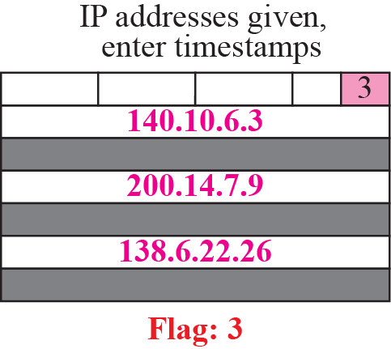
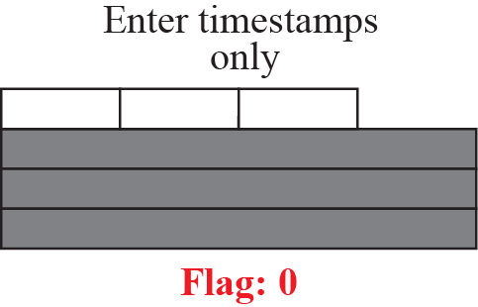
Figure 7.20 Use of flags in timestamp
TCP/IP Protocol Suite

Slide 36
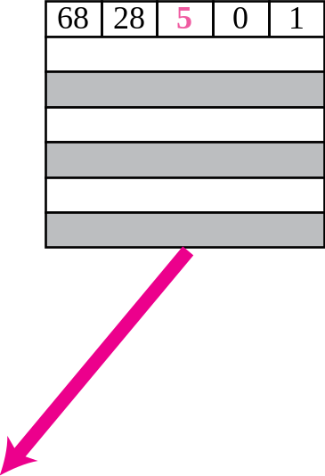
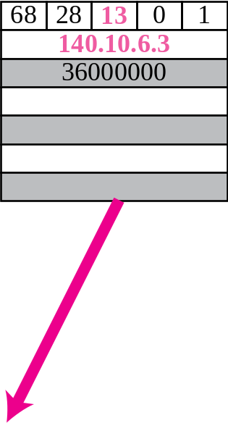
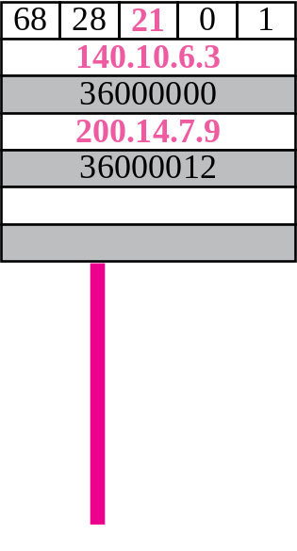
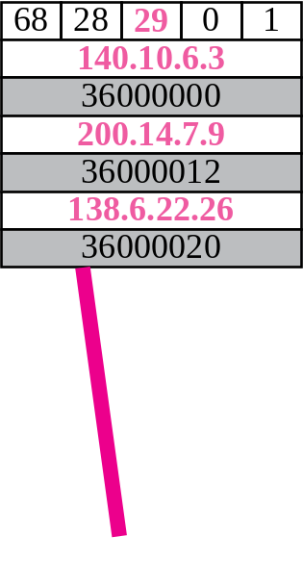
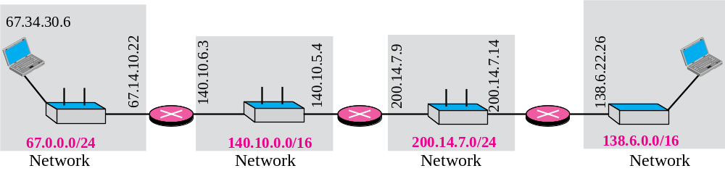
Figure 7.21 Timestamp concept
TCP/IP Protocol Suite

