Slide 1
STUN, TURN and ICE
Advanced, not for the exam

Slide 2
STUN (Session Traversal Utilities for NAT)
STUN (RFC 8489) is a client server protocol used by a client to know the external IP address and port allocated to it by a NAT.
It can also be used to check connectivity between two endpoints (as in ICE RFC 8445)
and as a keep-alive protocol to maintain NAT entries
Used by Teams and others…

Slide 3
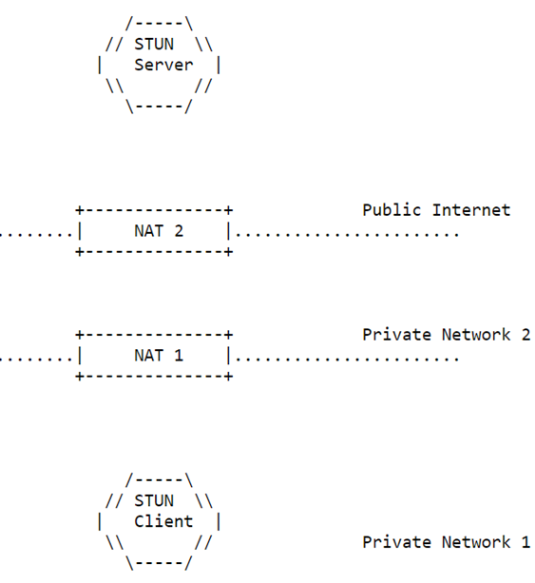
STUN basics
Binding request
The STUN client (behind one or more NATs) sends a «binding» request to the STUN server (on Internet).
When the request arrives at server the original IP and port of the source (this pair is said «local address») have been replaced by IP and port inserted by the (last) NAT (said «reflexive address»). The IP will be necessarily public
response
The STUN server copy the «reflexive address» in the “XOR-MAPPED-ADDRESS” attribute of the STUN response sent to the client al client.
This address is obscured to NAT by an XOR function, so that NATs do not see it and are prevented form altering it (some NATs do alter IPs even if the are in the IP payload)
In the return path, NATs replace the IP destination address and port, so that the STUN response arrives at the original (private) IP and port (“local address”.
The reflexive address in the attribute XOR-MAPPED-ADDRESS in the STUN response is left unaltered
This way the client can know the reflexive address allocated by the most external NAT, i.e. the closest to the STUN server.

Slide 4
TURN (Traversal Using Relays around NAT)
TURN [RFC 8656] is an extension of STUN
Motivation (STUN may fails on some NATs)
Some NATs do register also destination addresses when a NAT rule is inserted; then they do not allow incoming packets on the reflexive address unless sent back by the address registered on the NAT rule.
This is OK for a browser, but makes useless the knowledge of the reflexive address declared by the STUN response, as only the STUN server could use it!
The client uses the TURN server as a “relay” (intermediate sending/receiving agent) to communicate with peers.
This way NATs always see on incoming IP packets the TURN server address, not that of the peer.

Slide 5
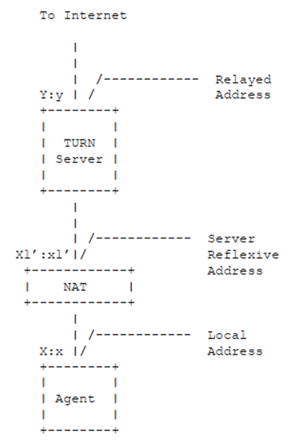
TURN basics
TURN allocates one «relayed address» Y:y (on Internet) to the client «reflexive address» X’:x’. The peers can use the relayed address to communicate with the client.
The packets sent on the relayed address will be redirected on the «reflexive address».
From client (X:x) to peer (on Internet)
The client sends data to the TURN server in a TURN message containing the peer address, the server extract the content and send it to the peer in a UDP segment with the relayed address Y:y as source.
From peer (on Internet) to client (X:x)
The peer sends a UDP datagram to the «relayed» address” Y:y. The server encapsulates the data inside a TURN message sent to the «reflexive address» X1’:x1’ of the client.
As TURN messages contain the peer address, the client can use one allocation, i.e. one relayed address, to communicate with multiple peers.

Slide 6
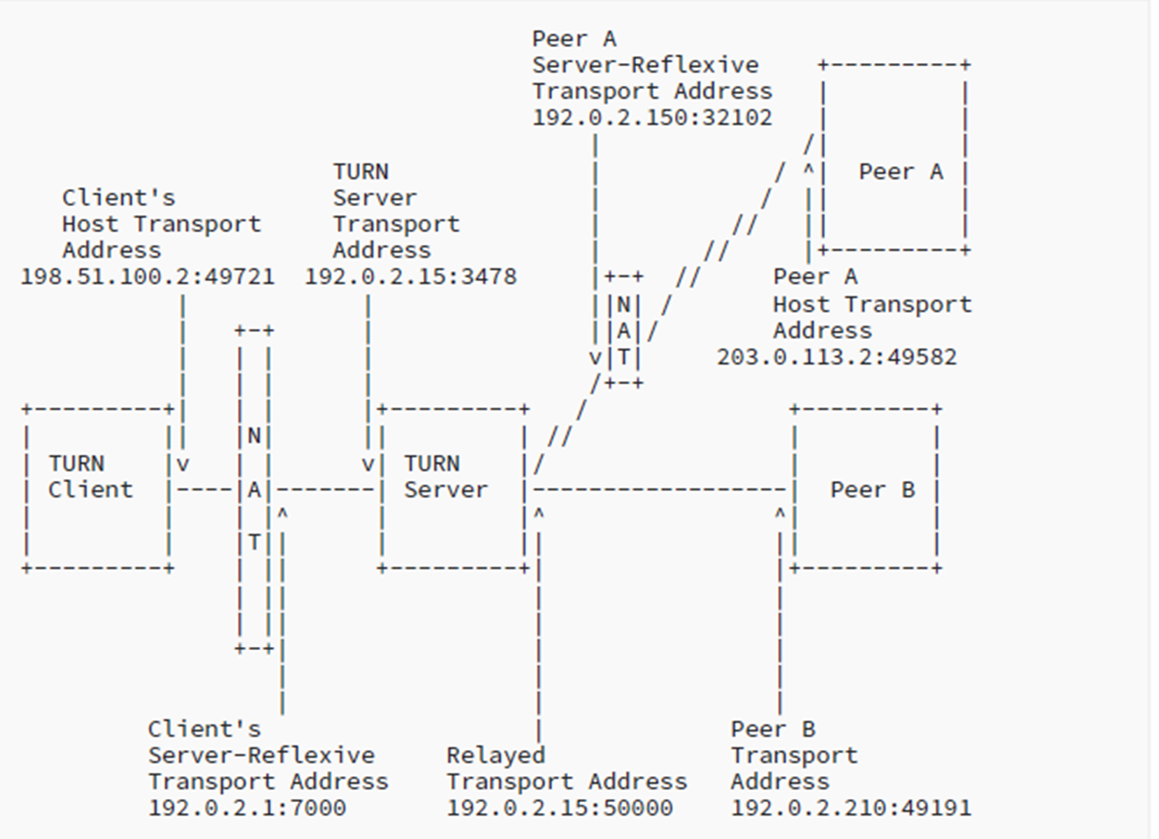
TURN
More generally, the peer can be on Internet (Peer B) or behind a NAT (Peer A)
Communication
between client and server via UDP or TCP
Between server and peer via UDP

Slide 7
ICE (basics)
ICE (Interactive Connectivity Establishment) [RFC8445] defines a series of rules to find the best couple of “candidate addresses” that can be used to communicate between two nodes, generally behind NATs.
To this end each ICE node uses external servers, both STUN and TURN to find all its candidate addresses:
local (X:x) (from internal routing table)
reflexive (X’:x’) (from STUN server)
relayed (y:y) (form TURN server)
each categories can include multiple addresses, e.g. if there are multiple TURN servers

Slide 8
ICE (basics)
ICE agent on node A sends its list of candidate addresses to ICE agent on node B.
Each ICE agent forms a list of ordinate pairs (one A’s and one B’s candidate address).
Priority is given to local address, then reflexive and last relayed.
One ICE agent acts as a controlling agent, the other as controlled. ICE checks connectivity (if a candidate pair works) by means of STUN binding requests to the other node. The selected pair is selected by the ICE controlling agent after examining all pairs (regular nomination) or after having found the first (aggressive nomination). Then it is communicated to the other node.
If the two hosts are on the same private network, a couple of local addresses should be selected
By contrast in the worst case, a couple of relayed.
The algorithm is complex, see RFC.

