Slide 1
Delay/Disruption Tolerant Networking
Carlo Caini
carlo.caini@unibo.it
DEI/ARCES University of Bologna, Italy
Notes:
1

Slide 2
Introduction
Some assumptions at the basis of TCP/IP
End-to-end connectivity
Communication is possible if exists at least a continuous path between source and destination
Short RTT
Loss recovery from the source, based on ARQ (Automatic Repeat request), is efficient
Few Losses
Most due to congestion
“Challenged networks”
Environments where one or more of the previous assumptions do not hold
DTN (Delay/Disruption Tolerant Networking)
A novel networking architecture to cope with challenged networks
DTN-DINET w/ Vint Cerf You Tube (3 min)
Notes:
2

Slide 3
Background
1973 –Cerf’s and Kahn’s work on TCP
Early ‘90 –Researchers at NASA Jet Propulsion Laboratory (JPL) try to adapt Internet protocols to space missions
1998 –Cerf at alii promote the Interplanetary Internet (IPN)
May 2001 –“Interplanetary Internet: Architectural Definition” Internet draft 00
Necessity of a new architecture
Whereas the Earth’s Internet was basically conceived as a “network of connected networks,” the IPN was thought of as a “network of disconnected Internets” connected through a system of gateways forming a stable backbone across interplanetary space.
August 2002-updated version of the draft as “Delay-Tolerant Network Architecture: The Evolving Interplanetary Internet” internet draft 01
The new architecture can be applied to other environments (“challenged networks”)
October 2002
IRTF DTNRG start
“It is an open research group, meaning that anyone interested can contribute simply by joining the mailing list and getting involved in the work”.
Notes:
3

Slide 4
From IRTF-DTNRG to IETF-DTNWG
Members of DTNRG first, and now of IETF DTNWG, are concerned with how to address the architectural and protocol design principles arising from the need to provide interoperable communications in performance-challenged environments, such as:
spacecraft
military/tactical
some forms of disaster response
underwater
some forms of ad-hoc sensor/actuator networks
Internet connectivity in places where performance may suffer such as developing parts of the world.
2015-from IRTF to IETF (from Research to Engineering)
IETF DTN WG start: https://datatracker.ietf.org/wg/dtn/charter/
4
Notes:
4

Slide 5
The DTN architecture
It is based on the introduction of the Bundle layer between Application and Transport
“Bundles” are (large) data packet at this layer
Store and forward architecture
A bundle is first received, stored, and then transmitted (when possible)

Slide 6
Bundle Layer
Bundle Layer
Application
Application
Transport
Transport
Transport
Network
Network
Network
Datalink
Datalink
Datalink
Physical
Physical
Physical

Slide 7
Bundle Layer
Regione A
Regione B
Application
Application
Bundle Layer
Transport A
Transport A
Transport B
Transport B
Network A
Network A
Network B
Network B
Datalink A
Datalink A
Datalink B
Datalink B
Physical A
Physical A
Physical B
Physical B

Slide 8
First basic concept: overlay network
End-to-end path in a heterogeneous network divided into multiple DTN hops
Transport end-to-end semantics confined inside each DTN hop
Possibility to use different protocol stacks in different DTN hops
TCP or transport protocols optimized to channel characteristics of each DTN hop
Note: the Bundle protocol is not end-to-end, but just hop-by-hop

Slide 9
Second basic concept: bundle stored inside the network
Why necessary
To cope with the possible lack of a continuous end-to-end path
“data mule” applications random intermittent connectivity (disruptions) on earth
scheduled intermittent connectivity (space)
More efficient loss recovery with long RTTs
Custody transfer option
The task of successful bundle delivery to destination is moved forward to the next DTN custodian
Bundles are deleted only when a following custodian has accepted the custody (or the bundle expires)
Bundles are retransmitted after a given interval, unless a custody acceptance signal has been received.

Slide 10
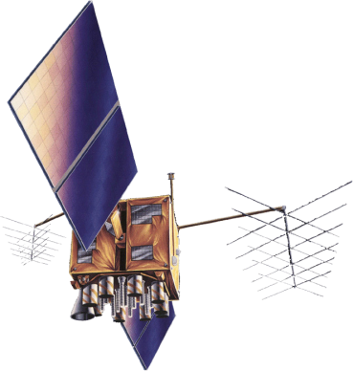



Bundle Transfer
Bundle Layer

Slide 11
The TCP/IP architecture

Slide 12
The DTN architecture
Note: between two DTN nodes, we can have many intermediate Layer 3 routers (not reported in the figure)

Slide 13
DTN evolution
2007
RFC 4838: V. Cerf et al., Delay-Tolerant Networking Architecture, IETF RFC 4838, Apr. 2007
RFC 5050: K. Scott and S. Burleigh, Bundle Protocol Specification, IETF RFC 5050, Nov. 2007
2008
The Saratoga project at the University of Surrey: first to test the bundle protocol in space (LEO satellite)
First NASA experiments
2011
Many RFCs on DTN security, routing, and various other BP extensions.
CGR routing introduced
2012
DTN2 Bundle Layer Reference Implementation 2.9 released (and no more updated…) https://sourceforge.net/projects/dtn/
2015
Start of IETF (“Engineering”) standardization
CCSDS tests on BP interoperability (DTN2&ION) successful
2019
Experiments with International Space Station
CCSDS SABR (CGR) https://public.ccsds.org/Pubs/734x3b1.pdf
2022
RFC 9171: S. Burleigh, K. Fall, E. Birrane “Bundle Protocol Version 7”, IETF RFC 9171, Jan. 2022
Inter regional routing introduced
2023
ION 4.1.2, DTN protocol Implementation released by NASA-JPL https://sourceforge.net/projects/ion-dtn/
DTNME 1.2.0 beta (DTN2 fork, by NASA-MSFC) https://github.com/nasa/DTNME/tree/v1.2.0_Beta
Unibo-BP https://gitlab.com/unibo-dtn/unibo-bp

Slide 14
Research prospects
Scientific challenge
Open issues: LTP (transport protocol for space links), routing, security, congestion control.
Future prospects
Interplanetary Internet and Space Communications
Aeronautical communications?
Smartphones?
Internet of Things?
Others?

Slide 15
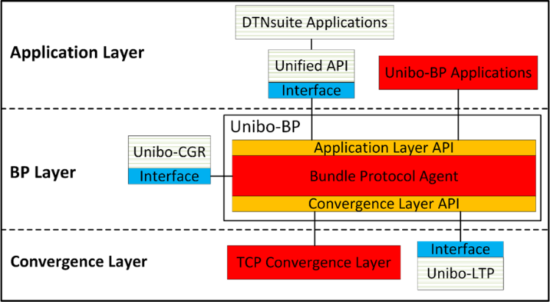
Unibo research activity
Research topics
DTN protocols
Unibo-BP
Unibo-LTP
DTN Routing
Unibo-CGR
Inter-regional routing
DTN applications (DTNsuite)
Unified API
DTNperf etc.
15

Slide 16



DTNperf_3: client, server & monitor
Bundle
Bundle
ACK
ACK
Client
Server
Status Report
Status Report
Status Report
Monitor
.csv file

Slide 17
DTNperf_3 & CGR research: images from the far side of the Moon…
Dotted lines=space intermittent links (windows of visibility)
Continuous lines=terrestrial continuous links
Two routes possible (via GW or direct); the choice is dynamic (as for trains or flights)
Lunar Satellite (Sat)
Lander
Route via GW
Direct route
Non- institutional user
Internet
Gateway (GW)
Mission Control Centre (MCC)

Slide 18
DTNperf & CGR:images from the far side of the Moon…
The 8 bundles generated on Lander have to be delivered to User
First 6 transferred to Sat during the 1st Lander-Sat window; then routed via GW;
Last 2 transferred during the 2nd Lander-Sat window, then routed directly to MCC

Slide 19
Mars-Earth scenario: logical topology
9 DTN nodes:
Lander on Mars
2 Martian Orbiters
3 Ground Stations
1 GEO sat system (EDRS)
2 destination nodes on Earth

Slide 20
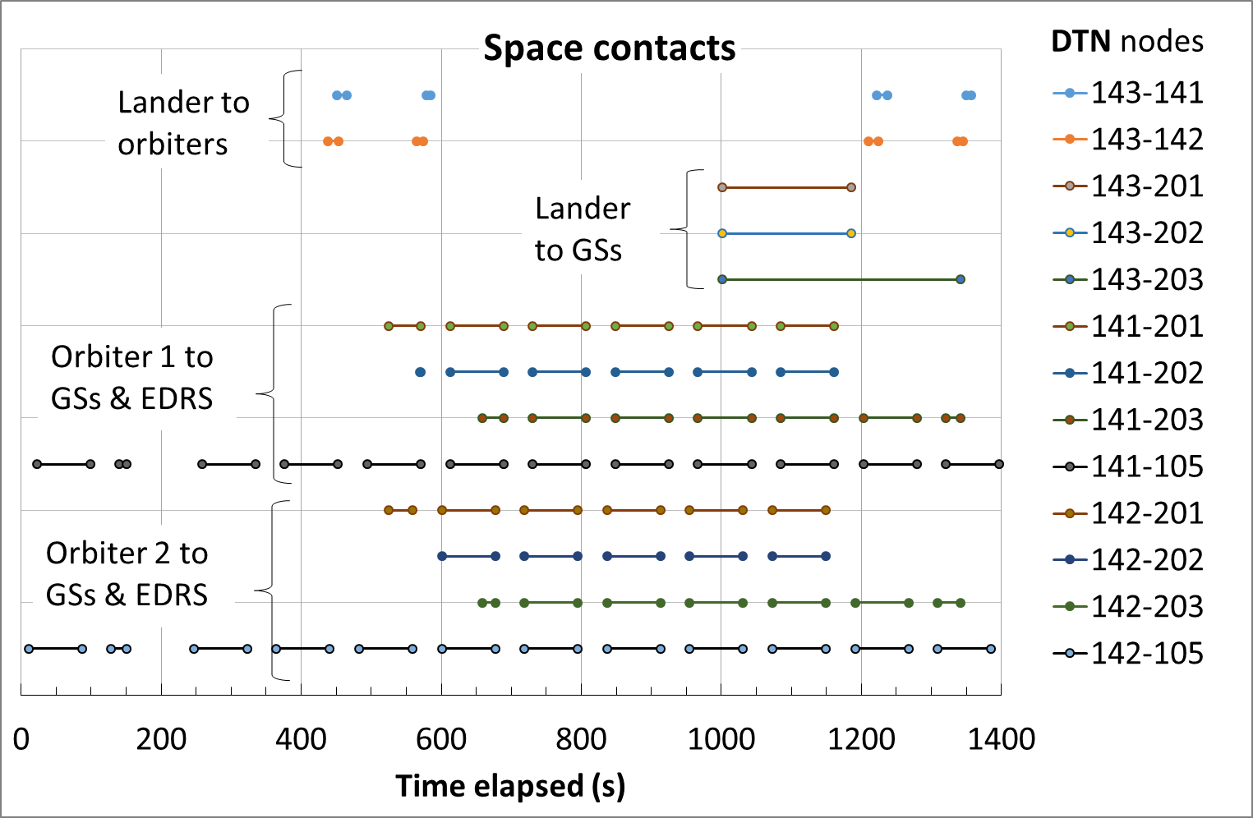
Mars-Earth scenario: Contacts

Slide 21
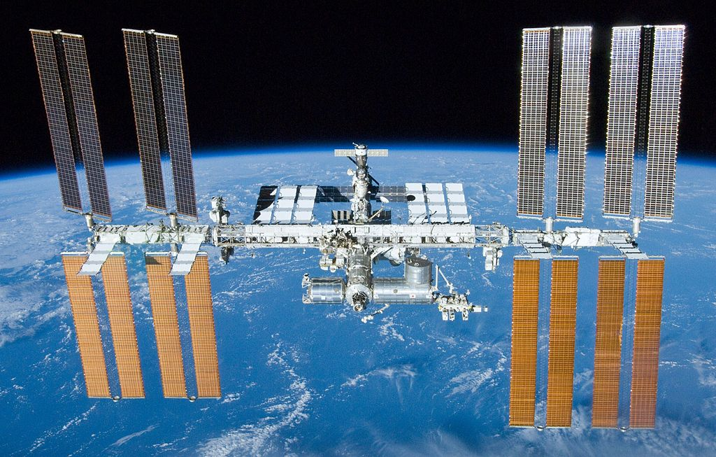
1998-present: cooperation in space, the International Space Station
The ISS is the result of a wide international cooperation, NASA, Roscosmos, JAXA, ESA, CSA
After the American Space Shuttle program ended in 2011, Russian Soyuz rockets until 2020 were the only means of transport to ISS for all astronauts.
DTN nodes are on board!
It should be operational until 2030

Slide 22
Link su ISS e dintorni
Vita a bordo ISS
ISS astronauti italiani
SpaceX_Dragon_27_maggio_2020
il-giorno-di-crew-dragon-lancio-storico
Artemis (Moon)
Bollettino 15 maggio 2023

