Slide 1
TCP

Slide 2
TCP (Transmission Control Protocol)
Much more complex than UDP, as it must offer a connection oriented and reliable service at Transport layer, starting from the datagram service offered by IP.
Data are seen as a flow of bytes, although organized by TCP in packets called “segments”
Services offered
Multiplexing (by TCP ports)
Error detection (checksum)
Ordered data delivery
Loss recovery (ARQ, automatic Repeat Request)
Flow control
Not to overload the receiver
Congestion control
Not to congest the network
Decentralized, feedback based
To know more:
RFC 5681 (NewReno)
http://en.wikipedia.org/wiki/Transmission_Control_Protocol
http://condor.depaul.edu/~jkristof/technotes/tcp.html (ottimo e molto conciso tutorial)

Slide 3
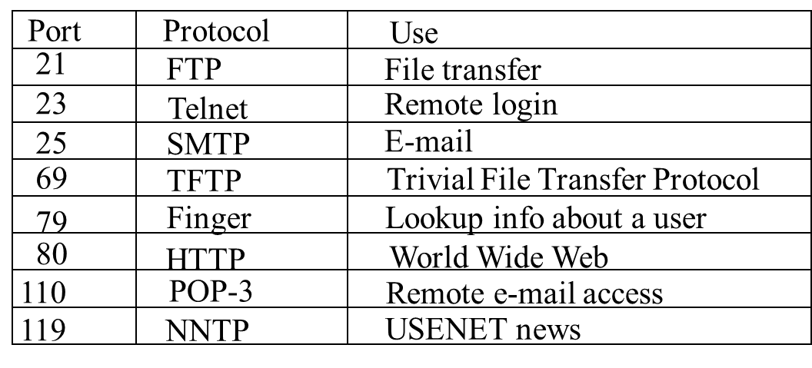
The TCP Service Model
Some assigned (“well known”) ports.

Slide 4
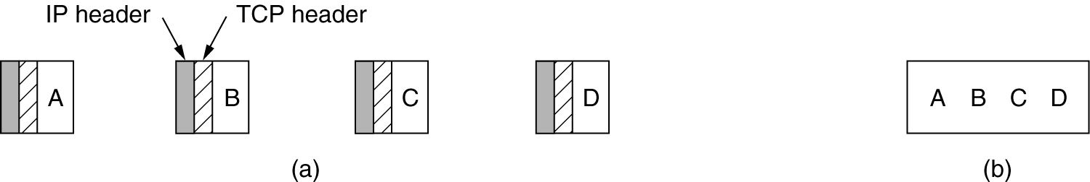
The TCP Service Model (2)
Application “write” and “read” are decoupled from TCP segmentation, which is performed by TCP itself
(a) Four 512-byte segments sent as separate IP datagrams.
(b) The 2048 bytes of data delivered to the application in a single READ CALL.

Slide 5
Preliminary remarks on ACKs
Data sent by TCP (byte flow), organized in segments, must be confirmed by one ACK
TCP is bidirectional
ACKs can be piggybacked on data segments traveling in the opposite direction
Details
Every segment is characterized by a sequence number (first byte of the payload)
Every ACK reports the first byte expected by the receiver and it implicitly confirms all previous bytes (ACKs are cumulative, a protection against ACK losses)
At the arrival of each segment different from that expected a duplicate ACK is sent (DupACK)
Each received segment causes the sending of an ACK (excluding “delayed ACKs” for which one ACK is sent every two received segments (to save bandwidth in the opposite direction)
The time elapsed from the sending of a segment and the reception of the corresponding ACK is called RTT (Round Trip Time). It is the feedback time.
The longer, the worse for TCP.

Slide 6
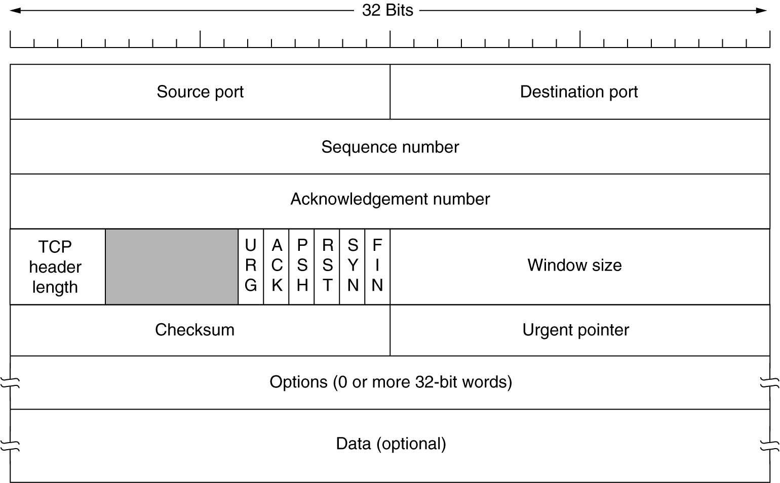
The TCP Segment Header

Slide 7
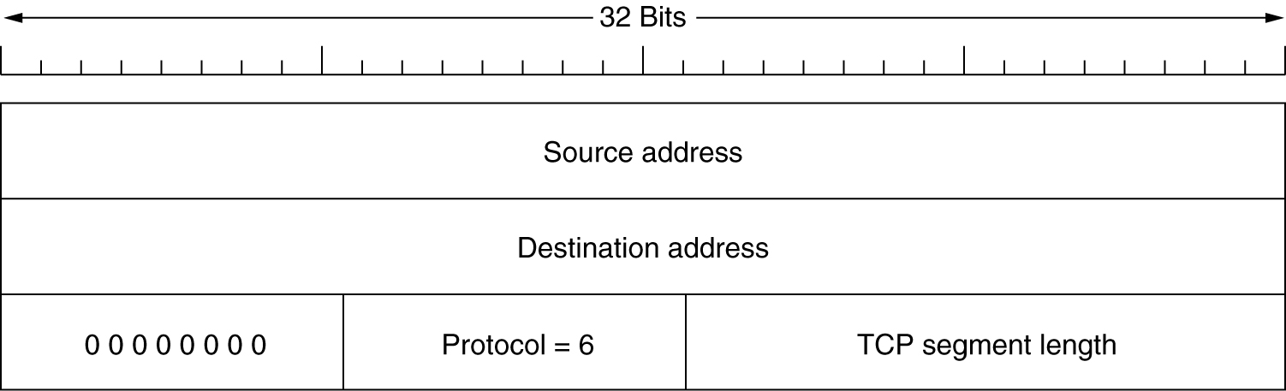
The TCP Segment Header (2)
The pseudoheader included in the TCP checksum.
Layering violation

Slide 8
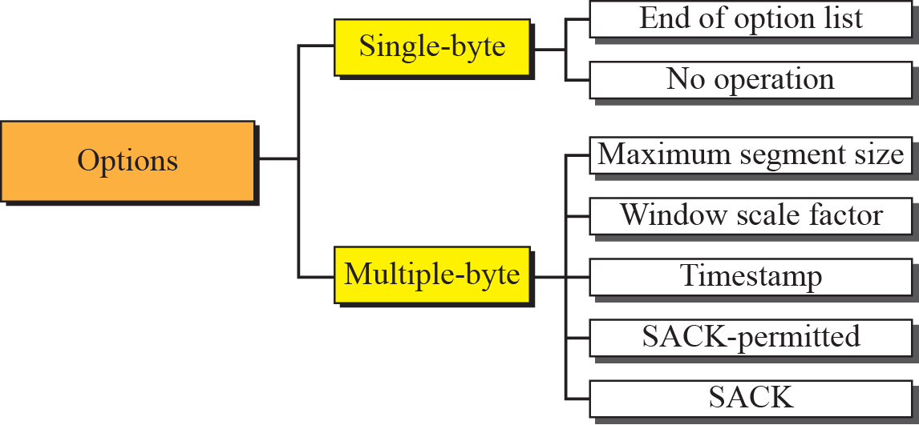
Options
Figure from Forouzan TCP/IP Protocol Suite, McGraw Hill
Notes:
8

Slide 9
Connection establishment and closing

Slide 10
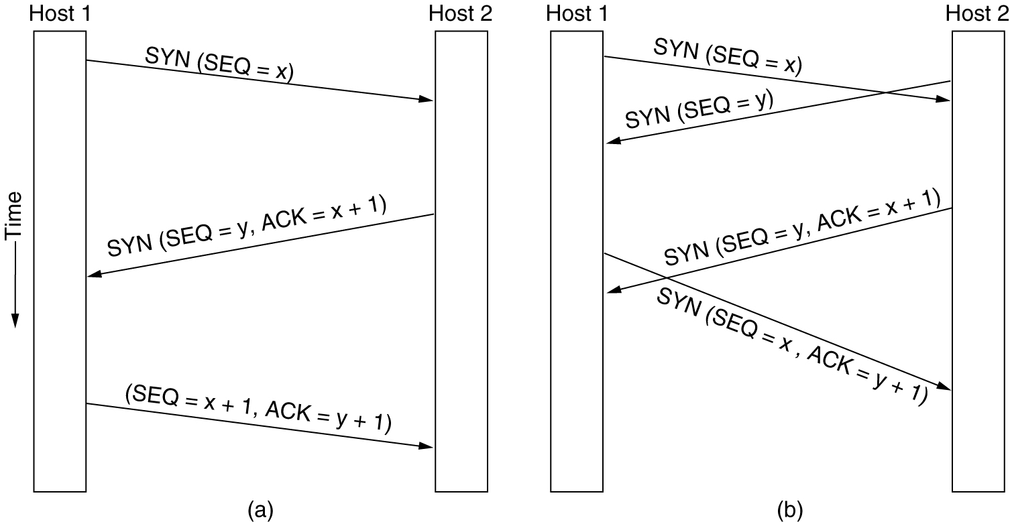
TCP Connection Establishment
(a) TCP connection establishment in the normal case.
(b) Call collision.
6-31

Slide 11
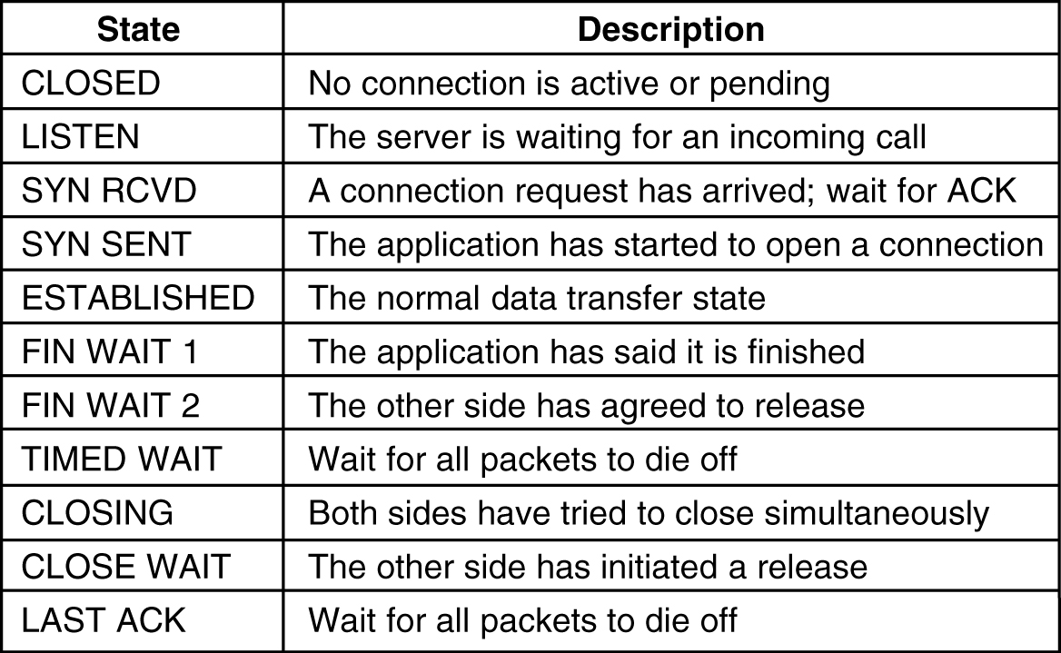
TCP Connection Management Modeling
The states used in the TCP connection management finite state machine.

Slide 12
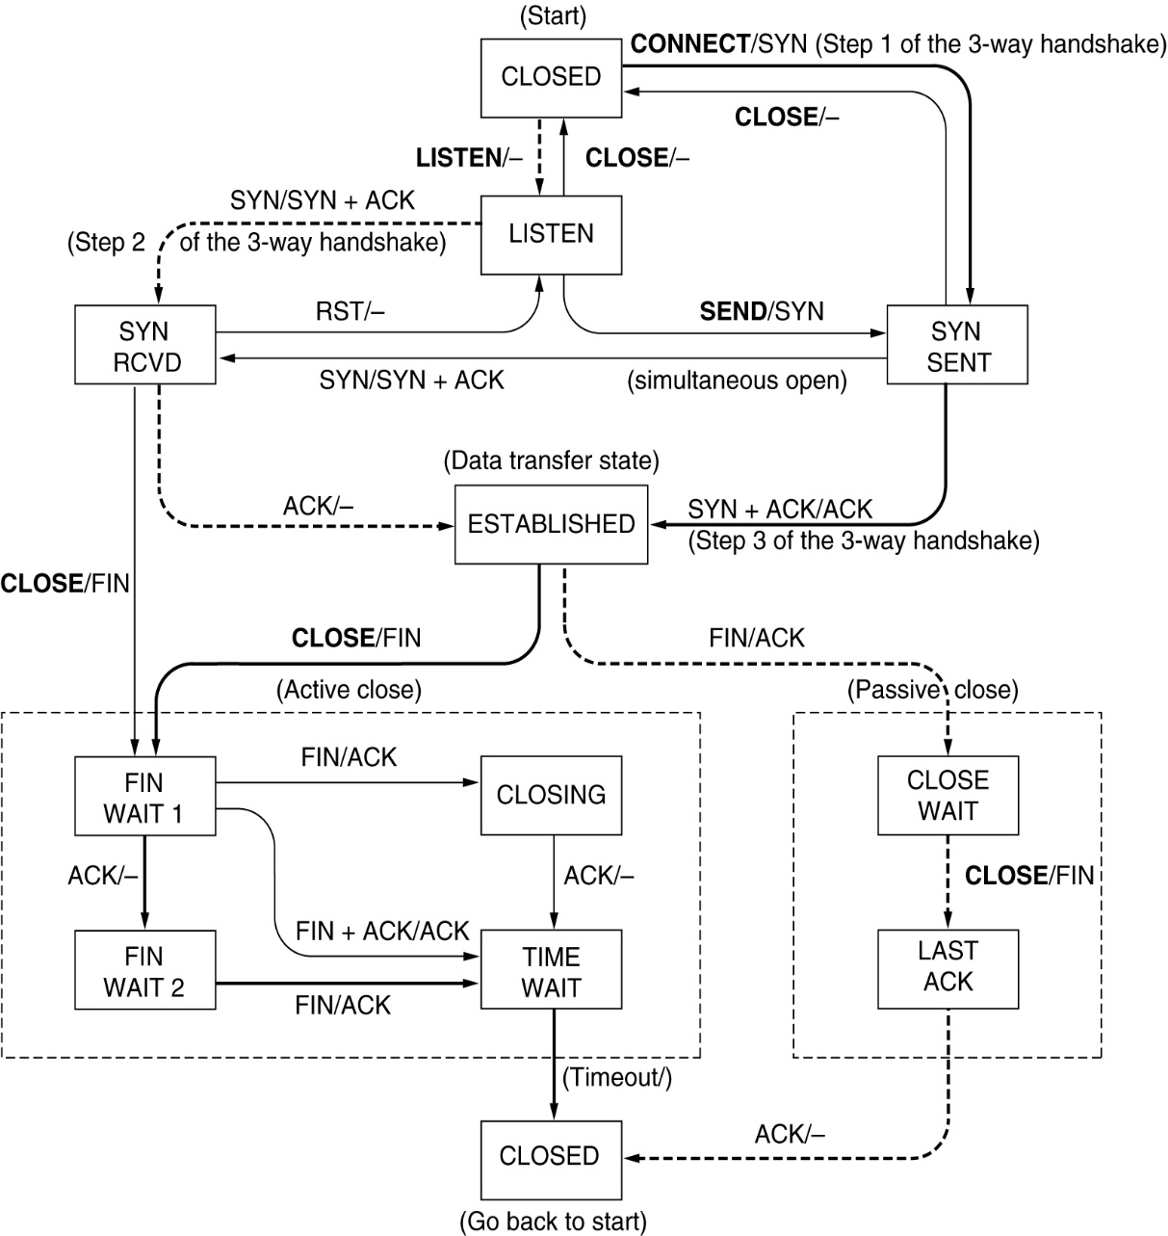
TCP Connection Management Modeling (2)
TCP connection management finite state machine.
The heavy solid line is the normal path for a client.
The heavy dashed line is the normal path for a server.
The light lines are unusual events.
Each transition is labeled by the event causing it and the action resulting from it, separated by a slash.

Slide 13


Slide 14
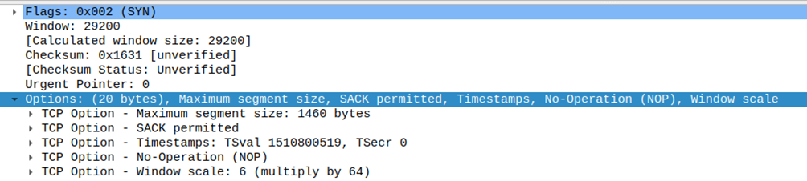
Options in the 3-way handshake: SYN
This syn has 20B of options: MSS, SACK, Timestamp, Window Scale
MSS is the Max Segment Size the client is willing to accept (it is calculated by the machine on the basis of its link MTU or of its path MTU)
SACK permitted means that the client is able to decode SACK information
Window scale 6 means that the client is willing to use the window scale option, if agreed by the server it will scale down the declared RCWND by 2^6 (64) in next segments
Tsval is the timestamp value declared by the client in this SYN; Tsecr is the TimeStamp Echo Reply (0 has the syn is the first segment of the connection)

Slide 15
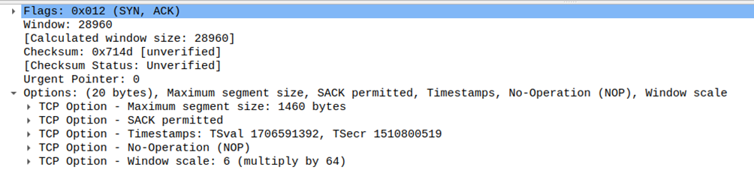
Options in the 3-way handshake: SYN+ACK
This SYN+ACK has 20B of options: MSS, SACK, Timestamp, Window Scale
MSS is the Max Segment Size the server is willing to accept (it is calculated by the machine on the basis of its link MTU or of its path MTU)
Note that it could be different from that declared by the client
SACK permitted means that the server is able to decode SACK information
Both sides can now use SACK
Window scale 6 means that the server will use the window scale option, scaling down its RCWND by 2^6 (64) in next segments
This options aknowledge the client request of using the window scale option an it also declares its scale factor
Tsval is the timestamp value declared by the client in this SYN; Tsecr is the TimeStamp Echo Reply (0 has the syn is the first segment of the connection)
Note that Tsecr is the copy of the SYN Tval

Slide 16
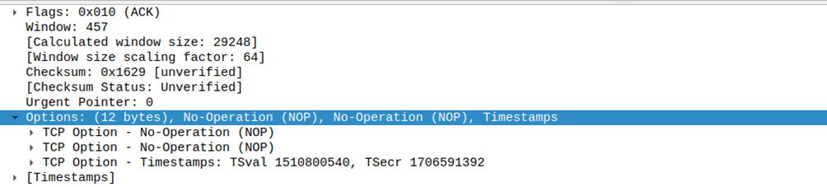
Options in the 3-way handshake: ACK
This ACK has only 12B of options: Timestamp
MSS, SACK, and window scale have already been negotiated; no need to add these options here and in next packets unless necessary for updates (MSS, window scale) or to report SACK blocks
Vice versa, timestamp must be always declared in order to have a sample of RTT for each segment sent
Note that the calculated rwnd is the same as before, but the value declared has been scaled down by 64.

Slide 17
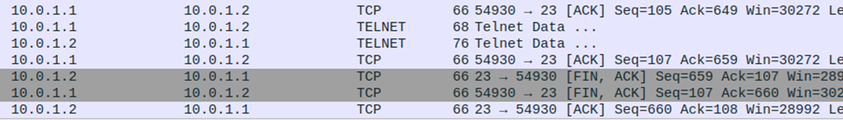
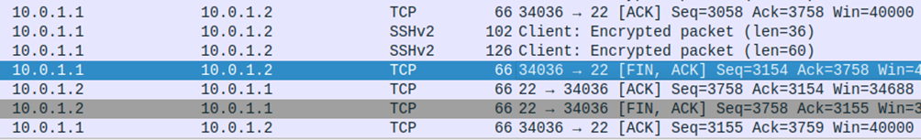
FIN handshakes: SSH and Telnet
In the example below, Telnet performs a 3-way handsake
The first FIN is labelled FIN ACK by wireshark as it (redundantly) acknowledges the last segment sent in the opposite direction
The second FIN also labelled as FIN ACK, acknowledges the previous FIN
In the example below, SSH performs two separate 2-way handshakes
Each FIN is acked by a simple (not FIN) ACK

Slide 18
Connection established

Slide 19
Connection established
TCP is complex. It is often preferable to read the «source» documents, i.e. RFCs:
RFC 7414 - A Roadmap for Transmission Control Protocol (TCP) Specification Documents
RFC 6582 - TCP NewReno Congestion Control
RFC 6298 - Computing TCP's Retransmission Timer
RFC 5681 - TCP Congestion Control
RFC 2018 - TCP Selective Acknowledgment Options
RFC 793 - TCP
Implementations are rarely strictly compliant
See for Linux
http://www.cs.helsinki.fi/research/iwtcp/papers/linuxtcp.pdf

Slide 20
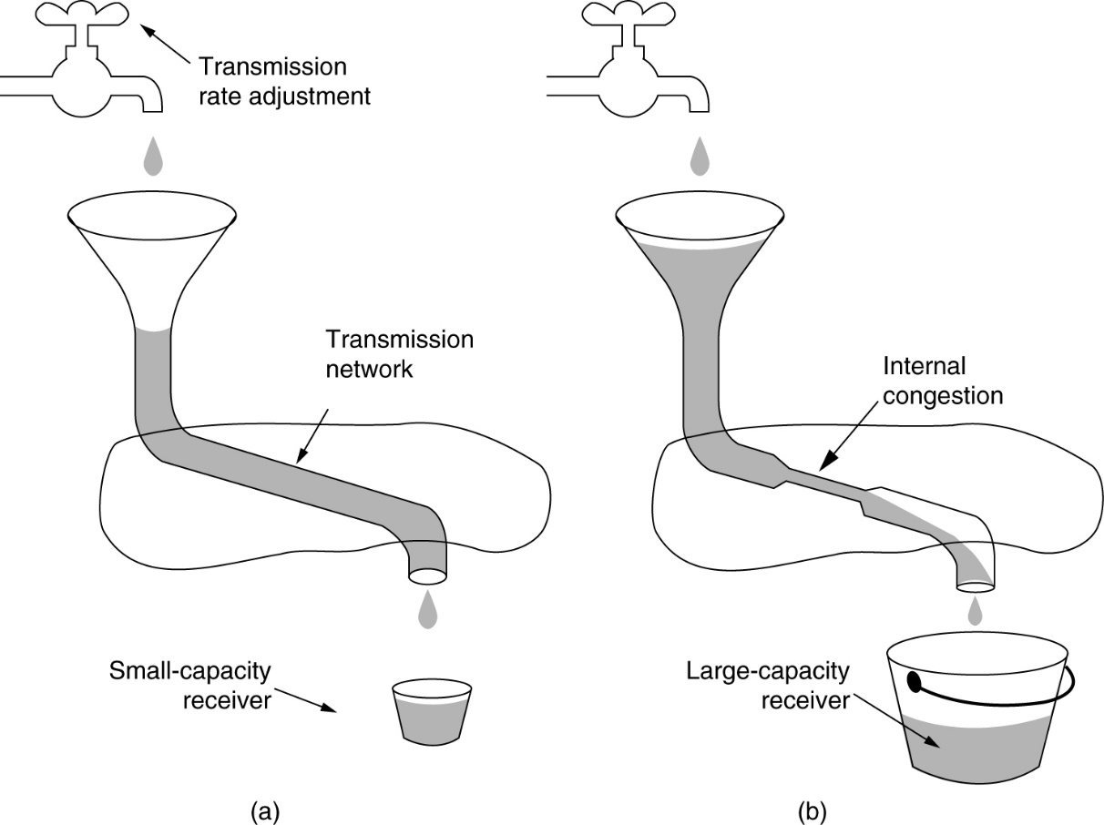
TCP Flow & Congestion Control
(a) A fast network feeding a low capacity receiver. (need of a flow control, rwnd window))
(b) A slow network feeding a high-capacity receiver. (need of a congestion control, cwnd window)

Slide 21
Windows & Tx-rate
W (in segments) is the max number of segments that can be sent after the last confirmed.
It represents the max number of segments “in flight” (sent but not ACKed yet)
W=1
One segment is sent, the next is blocked until the ACK arrives, and so on (sliding window of dimension 1). The Tx-rate is equal to 1 segment per RTT, usually to low.
W>1
W segments are sent; at the arrival of the first ACK the next is sent, and so on, (sliding window of dimension W).
Tx(bit/s)=W(in bit)/RTT(s)
To have Tx = bandwidth_available, the window must be equal to the bandwidth delay product (BDP)
W=B*RTT

Slide 22
Windows & Tx-rate
W=min(cwnd,rwnd)
Thus
Tx=min(cwnd/RTT,rwnd/RTT)
cwnd/RTT is the max Tx-rate allowed by the congestion control
rwnd/RTT is the max Rx-rate allowed by the flow control
The Tx-rate can be limited either by the congestion or the flow control
Both cwnd and rwnd change with time

Slide 23
Flow control
Receiver window (rwnd; alias «advertised window», or «window»)
It represents the amount of new data (i.e. not acked yet) that can be sent to the destination
It is sent back by the destination to the sender
=0 means that the sender must stop transmission
It is by default given in bytes, and as in there are only 2 B devoted to it in the TCP header, the maximum is 64kiB, which is too low if the BDP is high.
By means of the TCP window scale option it may be given in multiple of bytes.
Essential with long RTT and/or large bandwidth
This option is enabled by default in Linux

Slide 24
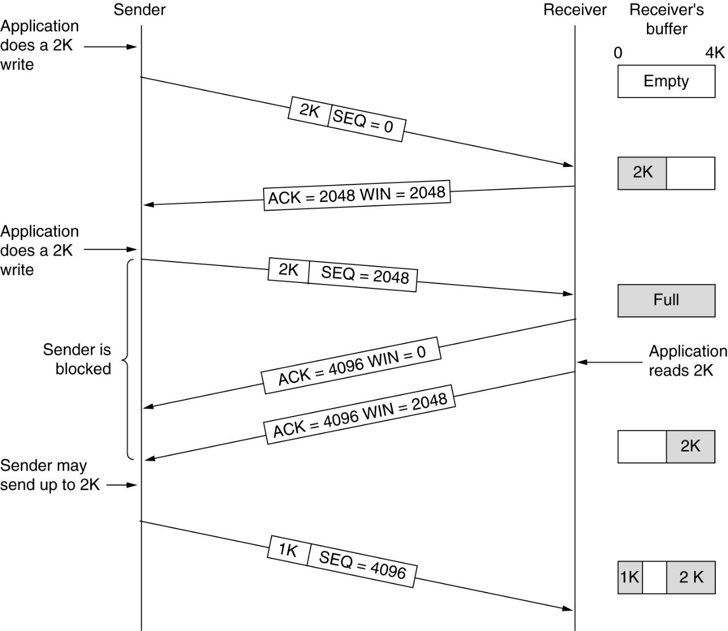
TCP Transmission Policy
Advertised window (o rwnd) management in TCP.

Slide 25
Segment losses
The first not-acked segment is assumed lost if:
the RTO (Retransmission Time Out) has fired
Fresh (not duplicated) ACK have not arrived for a period longer than RTO (calculated dynamically on the basis of RTT estimates)
It was the only condition in the first versions of TCP
3 dupACKs have arrived (Fast retransmit)
Dupacks are generated by the reception of segments following a missing segment
Added from TCP “Tahoe”, to improve the responsiveness of TCP to losses
In both cases, the “recovery phase” is entered and the first not-acked segment is retransmitted.

Slide 26
Congestion Control (& error recovery) from RFC 5681
Congestion Control Algorithms, quoting from RFC 5681 (Reno)
“This section defines the four congestion control algorithms:
slow start
congestion avoidance
fast retransmit (CC: 3 dupacks to enter recovery phase)
fast recovery (CC: including cwnd=ssthresh after entering recovery phase)
In some situations it may be beneficial for a TCP sender to be more conservative than the algorithms allow, however a TCP MUST NOT be more aggressive than the following algorithms”
CC: Too conservative for long RTTs or large bandwidths!

Slide 27
Congestion Control (& error recovery) from RFC 5681 (cont.)
The slow start and congestion avoidance algorithms MUST be used by a TCP sender to control the amount of outstanding data being injected into the network. To implement these algorithms, two variables are added to the TCP per-connection state.
The congestion window (cwnd) is a sender-side limit on the amount of data the sender can transmit into the network before receiving an acknowledgment (ACK),
while the receiver's advertised window (rwnd) is a receiver-side limit on the amount of outstanding data.
The minimum of cwnd and rwnd governs data transmission.
Another state variable, the slow start threshold (ssthresh), is used to determine whether the slow start or congestion avoidance algorithm is used to control data transmission, as discussed below.

Slide 28
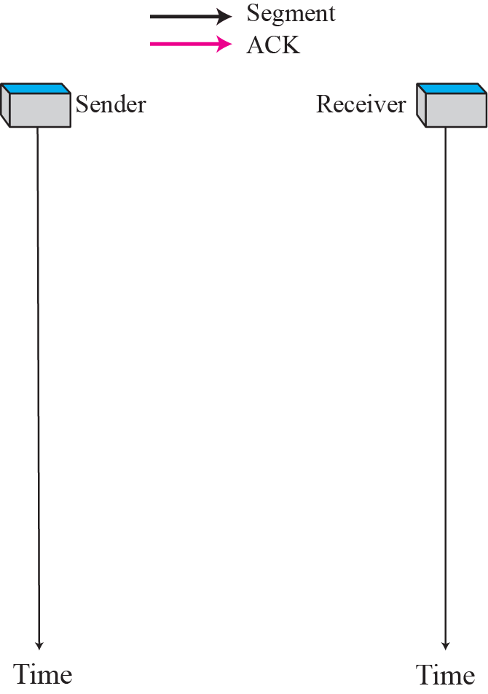
Slow start
At the reception of a new ACK, cwnd=cwnd+1
In ideal conditions the overall result is that the cwnd is doubled at every RTT (exponential increase with time). Actual CWND increments are by one and made ACK by ACK!
TCP/IP Protocol Suite
Notes:
28

Slide 29
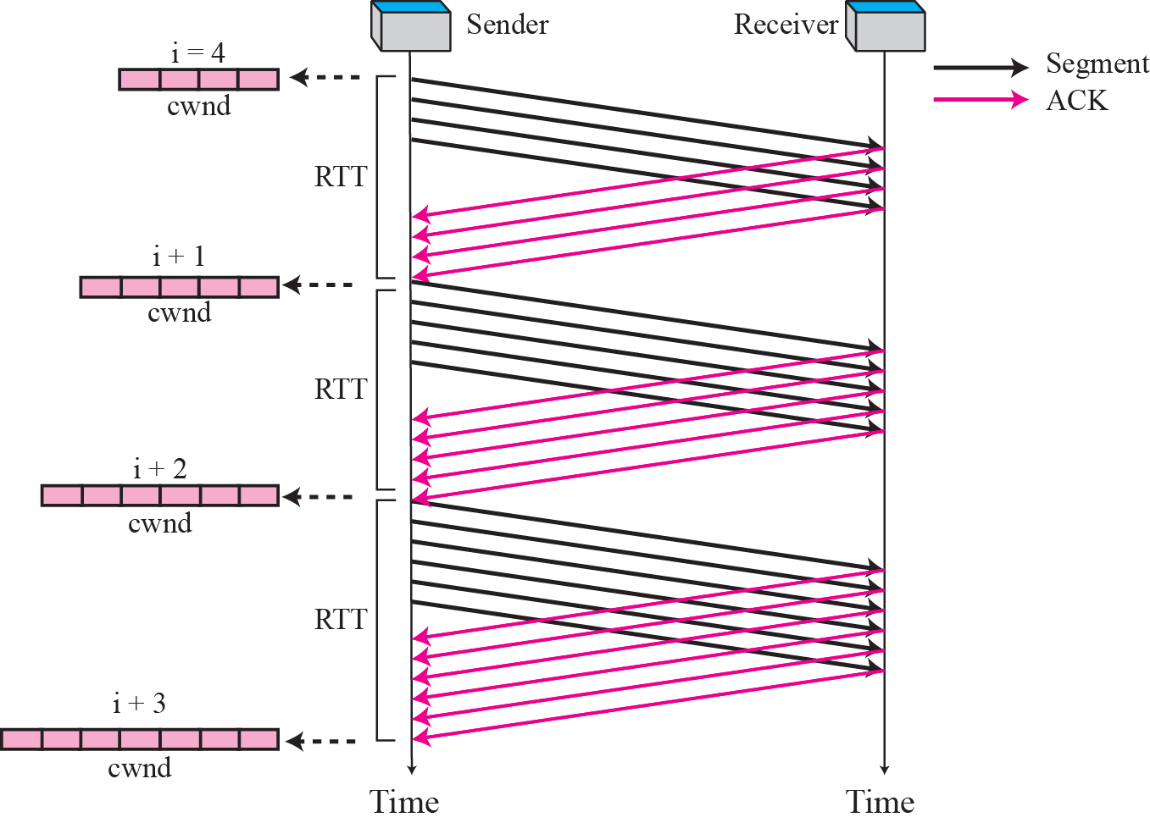
Congestion avoidance
At the reception of cwnd ACKs, cwnd=cwnd+1
Or, alternatively, at the reception of one ACK, cwnd=cwnd+1/cwnd
In ideal conditions the cwnd increases by one every RTT (linear increase with time)
Figure from Forouzan TCP/IP Protocol Suite, McGraw Hill
Notes:
29

Slide 30
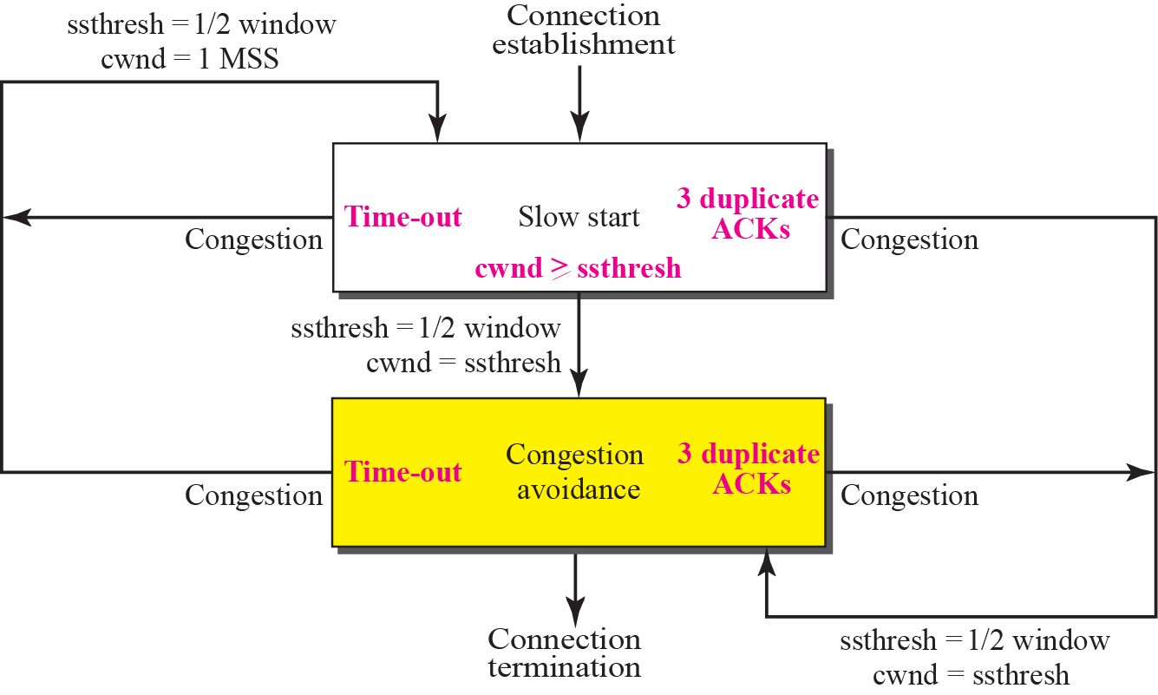
Congestion control TCP Reno and NewReno
Figure from Forouzan TCP/IP Protocol Suite, McGraw Hill
Notes:
30

Slide 31
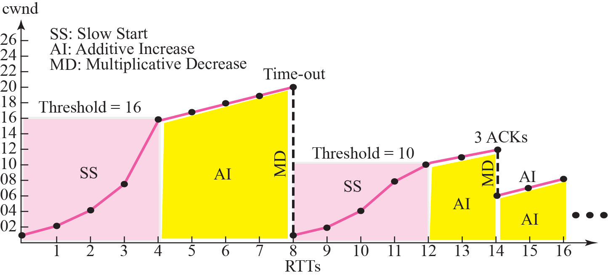
Congestion control example (TCP Reno and NewReno)
Figure from Forouzan TCP/IP Protocol Suite, McGraw Hill
Notes:
31

Slide 32
TCP Congestion Control evolution (ADVANCED)
First versions
No fast retransmit (3 dupacks), only RTO timeouts.
Tahoe
Fast Retransmit (3 dupacks), new cwnd=1
Reno (RFC 5681)
Fast Retransmit/Recovery, new cwnd=ssthresh
Recovery terminates at reception of the ACK confirming the first retransmitted segment
NewReno (RFC 6582)
Recovery termination is delayed until reception of the «full» ACK, confirming the last segment sent before entering recovery (e.g. all outstanding data at recovery entrance)
It avoids multiple halving of the cwnd in the presence of burst of losses (multiple losses among the outstanding segments), frequent in radio channels
Cubic (RFC 8312)
Used by Linux. It has a congestion control policy quite different from that based on Reno
Recovery with SACK (RFC 6675)
Selective ACK option confirms blocks of data that follows the first missing segment
It makes possible to recover multiple losses in one RTT
At least 10 «experimental» variants in Linux, included Cubic (and Hybla)
PRR Proportional Rate Reduction (RFC 6937)
It is patterned after Rate-Halving (1 packet sent every 2 dupacks in recovery), but using the fraction that is appropriate for the target window chosen by the congestion control algorithm (not 50% in Cubic).
32

Slide 33
TCP Tuning
Some TCP parameters can be configured to improve performance in specific environments, e.g. on satellite communications (actually, >50 in Linux!)
To see all: sysctl -a|grep ipv4.tcp|more
advanced-tuning-for-linux by NASA
33

Slide 34
Other topics

Slide 35
TCP timers
Retransmission (RTO)
Max elapsed time before considering a segment lost (all segments are subjected to retransmission, but ACKs)
Implemented as max time without receiving fresh ACKs
Persistence
Max silence time after receiving rwnd=0; after this time a “probe segment” with only 1B is sent, to trigger the reception of a new rwnd
To prevent a stall at sender side, should an rwnd different from zero be lost
Keep-alive (optional)
Max silence time before probing the peer node; if the peer does not answer the keep-alive segment (for N times), it is considered unreachable, thus the connection is unilaterally closed.
To distinguish between a silent node from a node that has “disgracefully” gone (e.g. brutally disconnected or switched off).
Time-wait
Time to wait in the TCP “time-wait” state, before definitively closing a half-closed TCP connection after receiving the final FIN
To allow for the acknowledgement of duplicated final FIN, should the previous FIN-ACK be lost

Slide 36
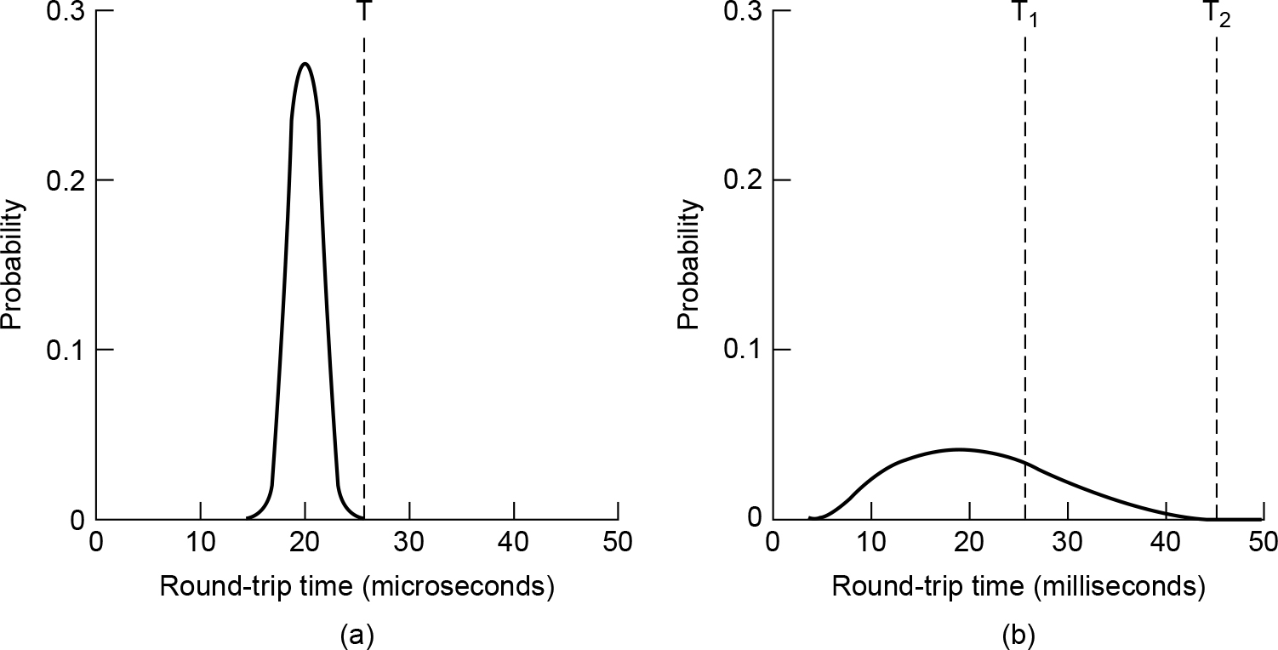
TCP Timer Management
(a) Probability density of acknowledgement arrival times in the data link layer. (b) Probability density of acknowledgement arrival times for TCP.

Slide 37
RTO
Syn, Fin and data segments are retransmitted unless acked before an RTO expires
The RTO starts with an initial value, then it is continuously updated by means of RTT sample (one for each segment, if the timestamp option is on). The RTO must be moderately larger than the RTT.
If too short we have spurious re-Transmissions
If too large it is not reactive enough
RTO calculation takes into account average and variance of RTT. See RFCs for the actual formulae used.
If the re-Tx segment is lost, RTO is doubled (exponential backoff, like that used by 802.3 and 802.11), until a max value (ceiling) is reached
The difference is that here the actual RTO is doubled, not the range from which to pick up the random number
Ceiling=90s default in Linux
After N consecutive failures (or after a given time elapsed) the connection is aborted
N=5 Linux default for SYN
N=15 Linux default for data

Slide 38
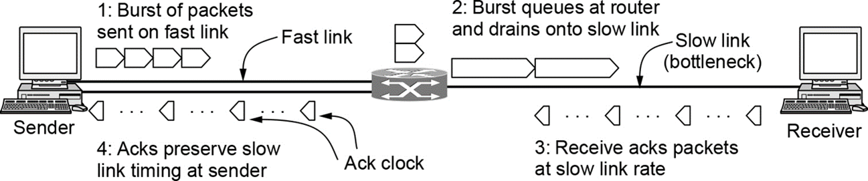
ACK pacing
Segments sent in a burst are received at larger intervals due the reduced Tx speed on the second hop
ACK intervals (when sent by the receiver) reflect the arrival times
New segments (in CA usually just one) are allowed only when an ACK arrives, thus we can say that the Tx of new segments is ack-paced
CC’s comment: there is a lot of not said (it must be taken with a grain of salt)
Interrupt moderation is required not to kill the OS at high speed; packets are passed to/from the NIC in bursts no more one-by-one
Wireless channel may introduce variable delays (channel contention , TDMA physical links, BW allocated on request in some satellite links, etc.)

