Slide 1
Transport

Slide 2
UDP vs TCP
UDP
Connection less (non orientato alla connessione)
datagram
Unreliable (non affidabile)
TCP (Transmission Control Protocol)
Connection oriented (orientato alla connessione), thus 3 phases:
Establishment (Apertura)
Data transfer (Trasferimento dati)
Closing (Chiusura)
Reliable (affidabile)

Slide 3
UDP
It implements a datagram service at Transport layer
(one UDP segment in one IP packet)
Services offered
Multiplexing (by UDP ports)
Error detection (checksum, optional)
Unicast, multicast, broadcast
Services not offered
Segment reordering
Segment retransmission
Flow control
Congestion control
To know more
RFC 768
http://en.wikipedia.org/wiki/User_Datagram_Protocol

Slide 4
UDP
Pro
Very simple, fast data delivery
Con
Unreliable
Uses
Voice over IP, videoconferencing, or streaming; in general whenever delay is an issue and segment loss, or disordered delivery are tolerable
RTP (Real time Transport Protocol)
Proprietary protocols for voice and video in Teams, etc.
Many signaling Internet protocols use UDP, e.g.:
Domain Name System (DNS)
Dynamic Host Configuration Protocol (DHCP)
Simple Network Management Protocol (SNMP)
Routing Information Protocol (RIP)
Not used by routing protocols OSPF (IP) e BGP (TCP)

Slide 5
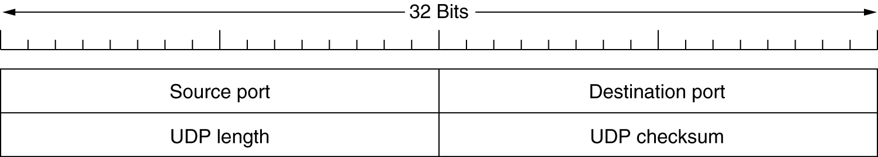
Introduction to UDP
The UDP header.
The UDP (as the TCP) checksum is computed including an IP pseudo-header (with IP addresses), which represents a layering violation)
One UDP segment is inserted into one IP packet
The max length is little less than 2^16 as an UDP packet must fit in an IP packet payload
Large UDP segment may result into IP packets requiring fragmentation
One application “write” instruction generates one UDP segment; one “read” get one segment.
The first 1024 (0-1023) are the “well-known” ports, i.e. they are associated to server applications https://en.wikipedia.org/wiki/List_of_TCP_and_UDP_port_numbers#Well-known_ports

Slide 6
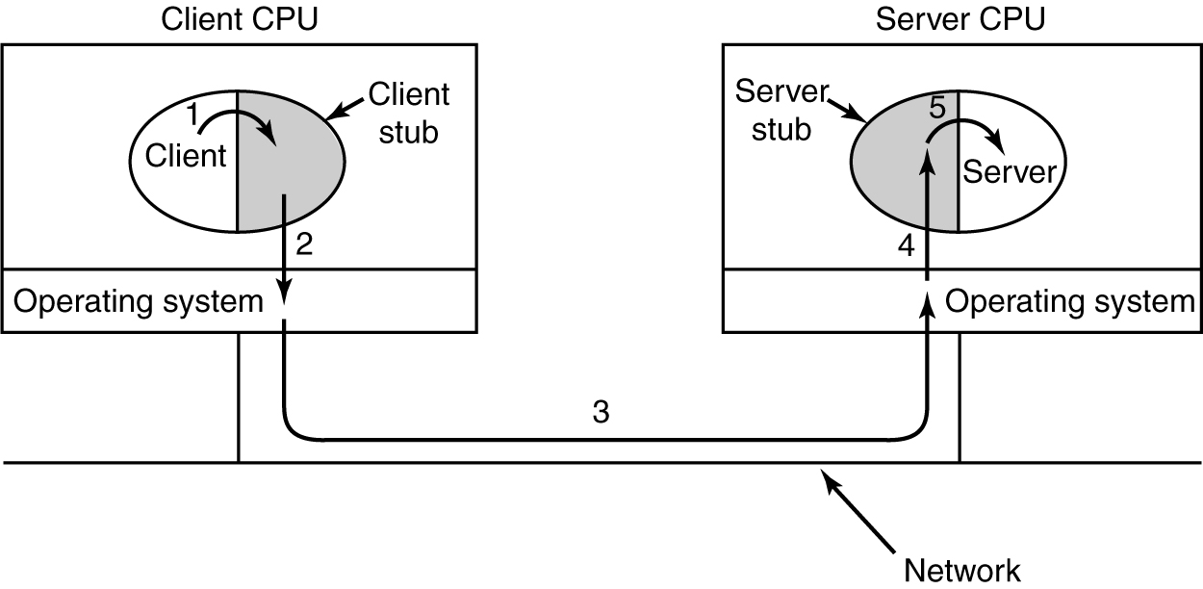
Remote Procedure Call
Steps in making a remote procedure call. The stubs are shaded.

Slide 7
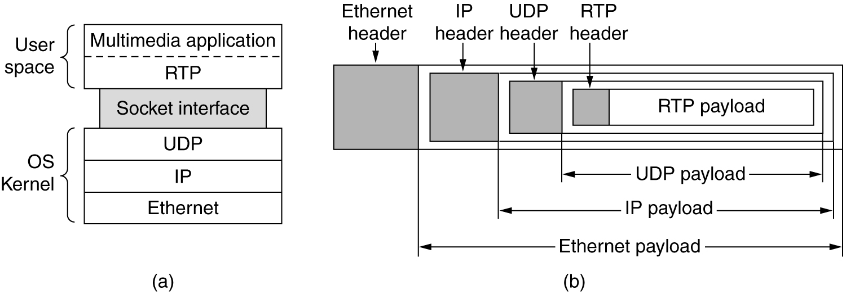
The Real-Time Transport Protocol
Used to send voice and video content in VoIP and teleconferencing
The data transport is augmented by a control protocol (RTCP) to allow monitoring of the data delivery
RTP does not address resource reservation and does not guarantee quality-of-service for real-time services.
RFC 3550 https://datatracker.ietf.org/doc/html/rfc3550

Slide 8
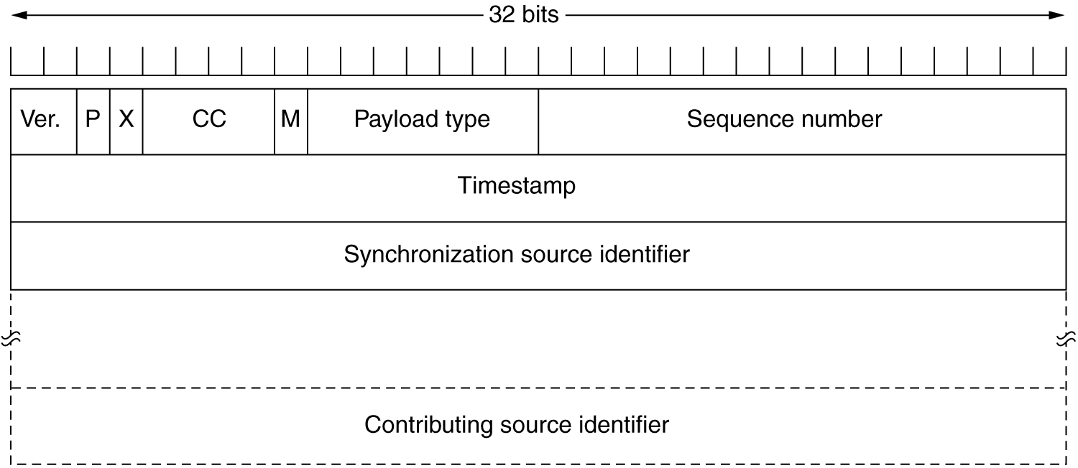
The Real-Time Transport Protocol (2)
The RTP header.

Slide 9
The Real-Time Transport Protocol (3)
X is set if there is an extension
CC (contributing sources counter)
M is a marker intended for applications (e.g. the beginning of a “talkspurt” (non silence period)
Payload type
defines the encoding algorithm
Sequence number
RTP packet Counter (to detect lost packets and to reorder the others)
Timestamp
Time offset of the first sample in the RTP packet. It decouples playback from packet arrival time.
Synchronization source (if multiple sources are mixed, it is the mixer)
Contributing sources (the sources that are mixed, if any)

Slide 10
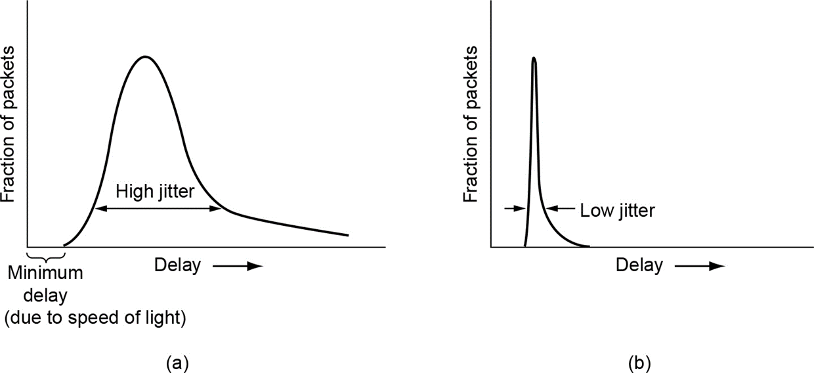
Jitter
The delivery delay is not constant but varies around an average value
The average value is of concern in real time applications (voice over IP, teleconferences, gaming, etc.) , but not in streaming
In streaming jitter can be counteracted by mans of buffering
In real time applications by QoS

Slide 11
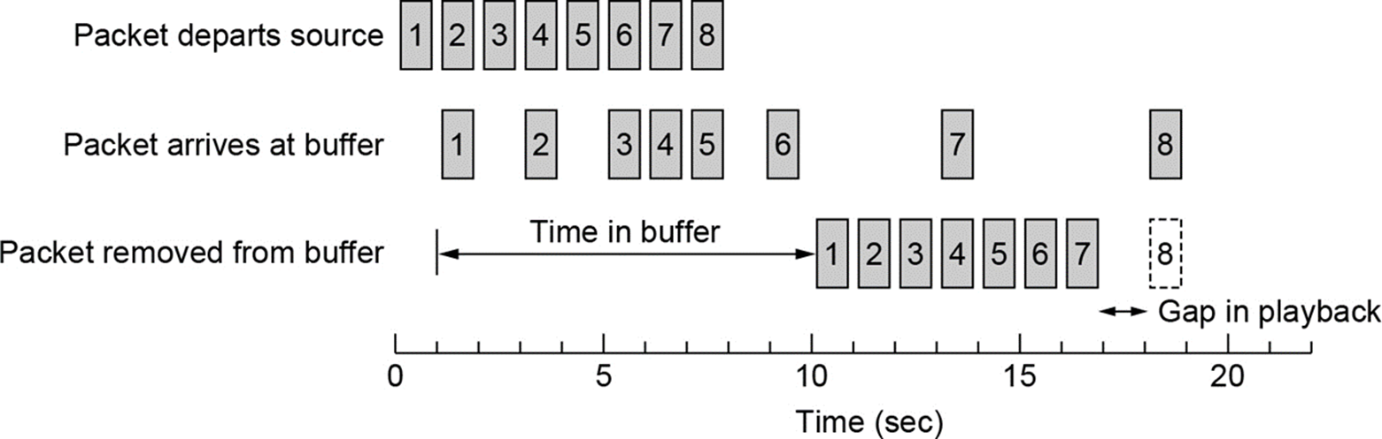
Buffering
Buffering is used to counteract variations in delivery time
The larger the buffer, the longer the delay added. In streaming it is usually not a problem.

Slide 12
Real-Time Transport Control Protocol
It is used in conjunction with RTP to exchange control messages about RTP
It does not transmit data
Continuous feedback to the source
Delay, jitter, bandwidth, congestion
Used by the source to change encoding parameters
E.g. a bandwidth increase can allow the use of a higher quality encoding, and vice versa.
The encoding is specified in the “payload type” field, thus it can change dynamically to match the available bandwidth

