Slide 1
IEEE 802.11 (WiFi)

Slide 2
Introduction
Wireless LANs are ubiquitous nowadays. We concentrate on the most important standard, IEEE 802.11, also known as WiFi.
The standard is issued by IEEE
Certification, which is essential for interoperability, is promoted by an independent manufacturer “alliance”, under the brand “WiFi” (Wireless Fidelity, which means nothing but sounds fairly well).
The standard has been continuously updated
Very complex (more than 1000 pages!)
It is common to find descriptions/figures that do not fully match in the literature
They do not report to which of the many versions they refer
Exhaustive explanation impossible. See:
Tanenbaum (introductory, until 802.11 n in 5th edition or ax in 6th)
K. Fall, Stevenson, “TCP/IP Illustrated”, 2nd Edition, Addison Wesley (in depth, until 802.11 ac)

Slide 3
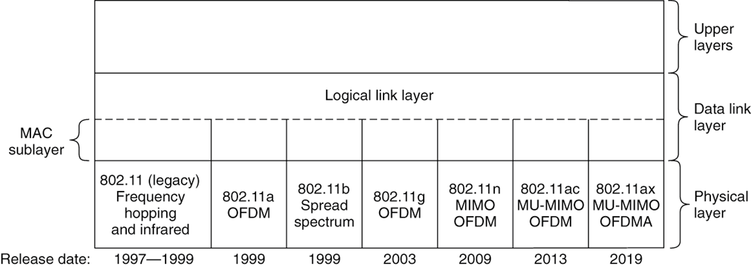
The 802.11 Protocol Stack
The LLC sublayer and the format of MAC addresses are the same as other 802 standards (e.g. 802.3 Ethernet)
MAC sublayer is different

Slide 4
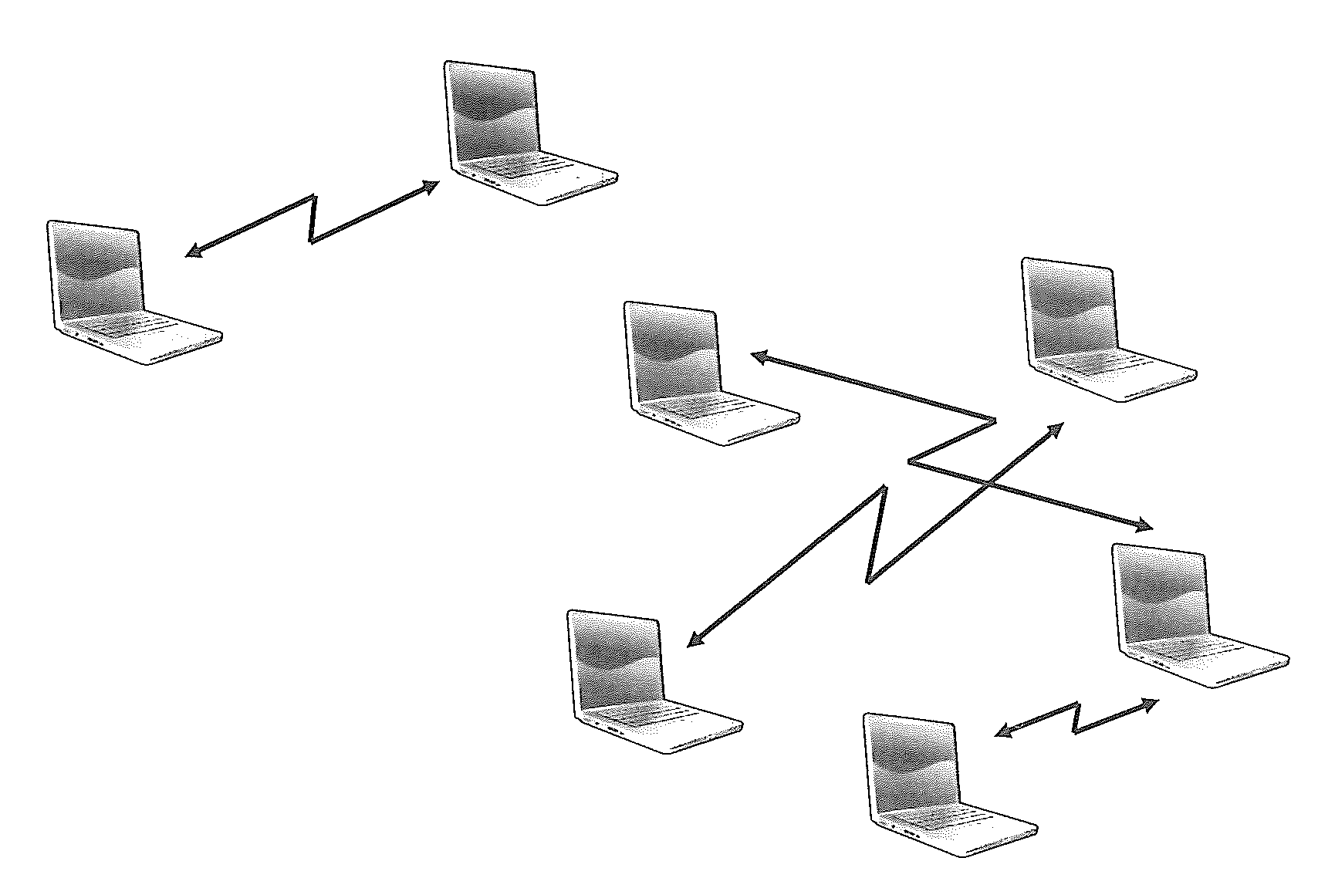
Basic Service Set
“Independent BSS” or “Ad hoc” (i.e. no access point)
“Infrastructure BSS” (i.e. with AP)

Slide 5
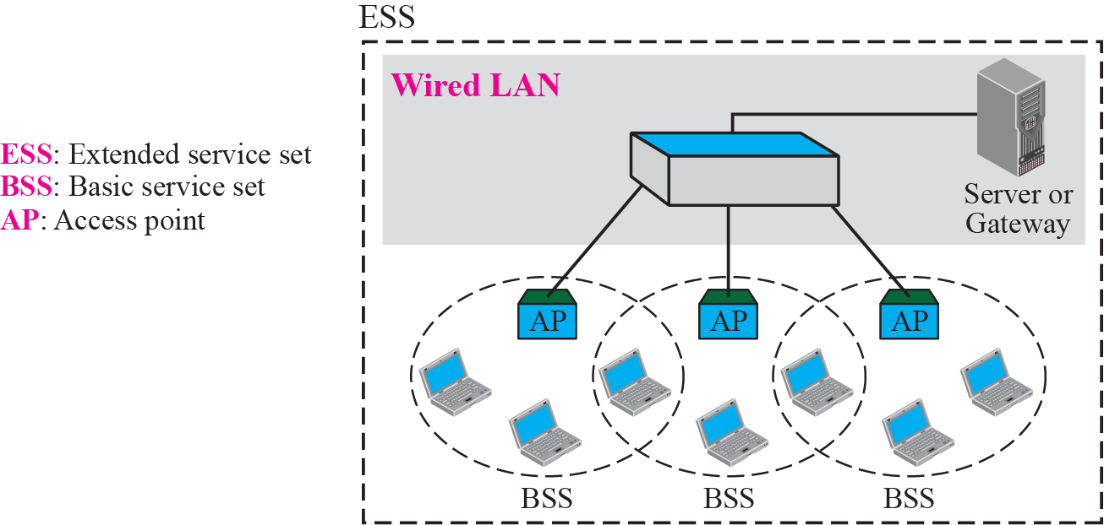
Extended Service Set (ESS)

Slide 6
Typical ESS

Slide 7
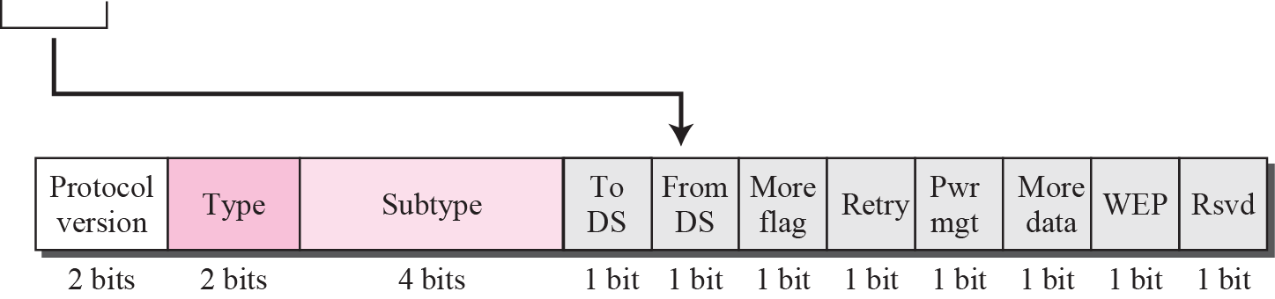
Frame format (early versions)
FC (Frame Control)
D (Duration) contains the NAV (channel booking duration)
Types: data (as in figure), control (CTS, RTS, ACK, etc.), management (beacon, association, authentication, etc.)
There are at most four MAC addresses (same format as 802.3).
In “ad hoc”, or before association, only two (for the 2 STAs)
In “Infrastructure”, usually three (2 for STAs, 1 for the intermediate AP).
Four only in special cases (not well specified by the standard), e.g. when a data packet go through one AP and one repeater; in this case both “To DS” and “From DS” flags are set to 1 .
Note that even one AP isolated is considered as a Distribution System.
The format has been augmented in more recent versions

Slide 8
Additional notes on addresses
We must distinguish between 4 logical entities:
Source Address (SA, the node that generates the frame)
Destination Address (DA, the node to which the frame is intended)
Transmitter Address (TA, the node that transmits the frame)
Receiver Address (RA, the node that receives the frame)
When the communication is direct STA1-STA2 (ad hoc), or between STA-AP with the AP not acting as a relay (e.g. many management & control frames) we have 1 hop and SA=TA and DA=RA, i.e. only 2 addresses are used (in few cases just one)
When the communication is relayed by the AP, e.g. STA1-AP-STA2, or STA1-AP-external_node, we have 2 hops and thus 3 addresses are necessary.
In special cases (not standardized, e.g. range extender) the communication can include an additional leg (“From DS”=1 and “To DS”=1) and the data frame can contain and use 4 addresses.
Frame headers must be read by all nodes (NAV is in the duration field); payload can be enciphered

Slide 9
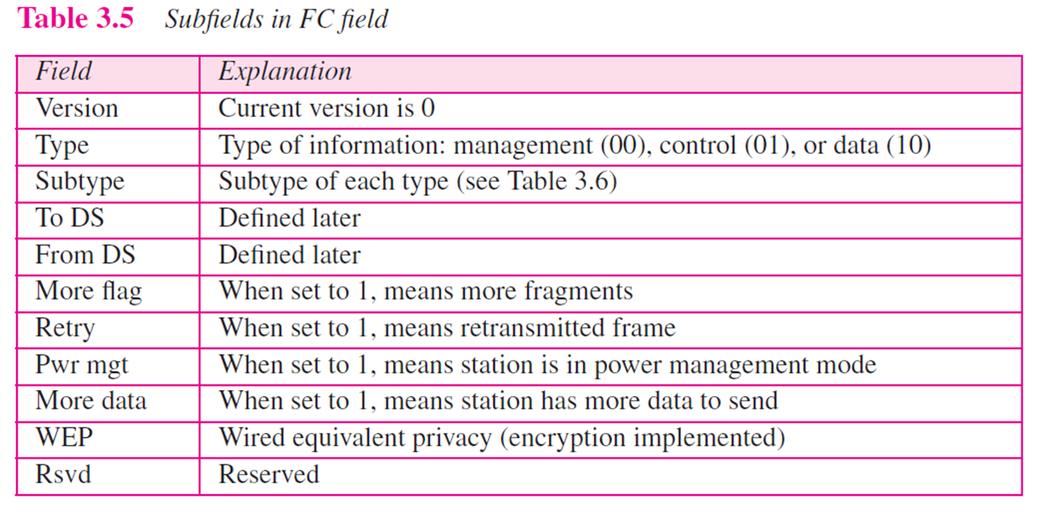
FC field
More Data used by AP to tell a STA in pwr mgt that there are other frames buffered to it.
WEP(old)=Protected It means that the payload is ciphered

Slide 10
Management frames (type 00)
Beacons to advertise the ESS (ESSID, type of security, rates, etc.) sent at about every 100ms
https://mrncciew.com/2014/10/08/802-11-mgmt-beacon-frame/?wref=tp
Probe requests (active scanning)
https://mrncciew.com/2014/10/27/cwap-802-11-probe-requestresponse/?wref=tp
Association, re-association, de-association, etc.
Authentication, de-authentication, etc.
https://mrncciew.com/2014/10/11/802-11-mgmt-deauth-disassociation-frames

Slide 11
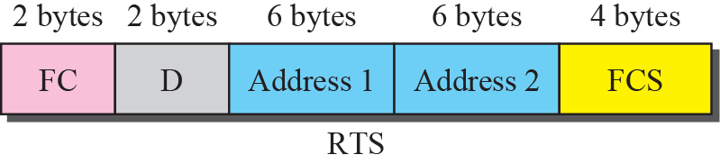
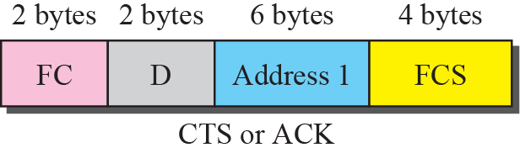
Control frames (type 01)
By contrast to data and management frames, they do not have a “frame body” (payload)
D contains the NAV
They are read by all STAs (NAV must be known by all)
https://mrncciew.com/2014/10/02/cwap-802-11-control-frame-types/

Slide 12
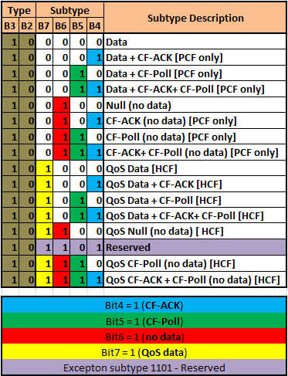
Data frames (type 10)
They have a lot of subtypes.
The most common frame is a data frame (10) of subtype 0.0.0.0
The meaning of other sub-types will be clear later after reading all slides
https://mrncciew.com/2014/10/13/cwap-802-11-data-frame-types/

Slide 13
Shared channels
When a channel is shared, two approaches are possible (both present in IEEE 802.11).
Polling (centralized)
The AP ask (polls) the stations if they have frames to send
Contention (distributed)
Stations have to compete to use the medium
CSMA-CA (CSMA Collision Avoidance) used
Polling (PCF) and contention (DCF) can work simultaneously in 802.11 “Infrastructure BSS”.
Only DCF in “ad hoc” (“Independent BSS”)
The scheme has been refined in recent QoS aware versions (802.11e)
Hybrid Coordination Function (HCF).
Enhanced Distributed Channel Access (EDCA, evolution of DCF)
HCF Controlled Channel Access (HCCA, evolution of PCF).

Slide 14
Hidden station problem

Slide 15
CSMA-CA motivation
The contention algorithm in 802.11 is different from that of Ethernet because
hidden station problem impairs channel sensing
“near/far” problem prevents Tx stations from “hearing” collisions
to detect a collision, the Tx station must be able to transmit and listen at the same time, but its Tx signal is much stronger than the Rx one
Remedies:
Collisions during data transfers are avoided by means of a sort of reservation mechanism (optional)
NAV unavailability periods “announced” by RTS (Request To Send) and CTS (Clear To Send).
Frames must be ACKed
When the RTS/CTS mechanism is applied, contention is limited to the reservation phase, as RTS can still collide
RTS are shorter than data frames
In Ethernet a collision is always detected after the first 64 bytes, thus collisions are less harmful.

Slide 16
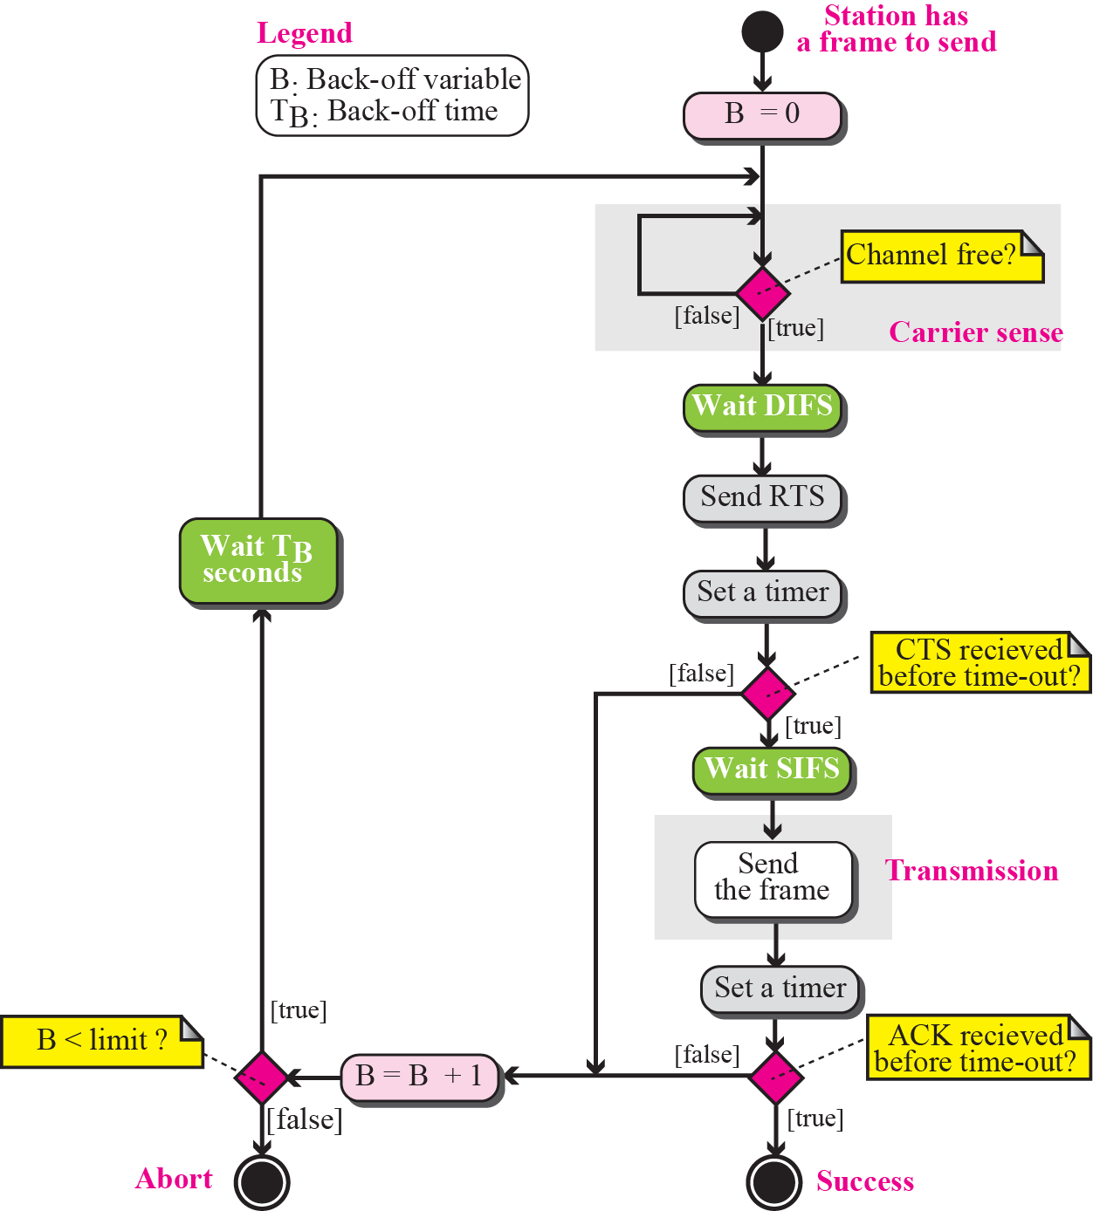
CSMA-CA

Slide 17
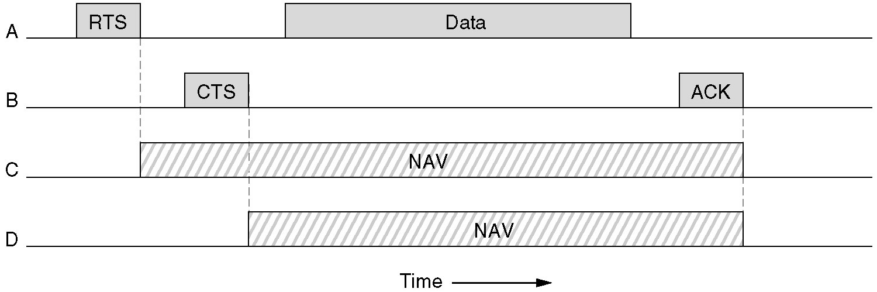
The use of virtual channel sensing using CSMA/CA

Slide 18
The same but with animation…
Notes:
2CTS

Slide 19
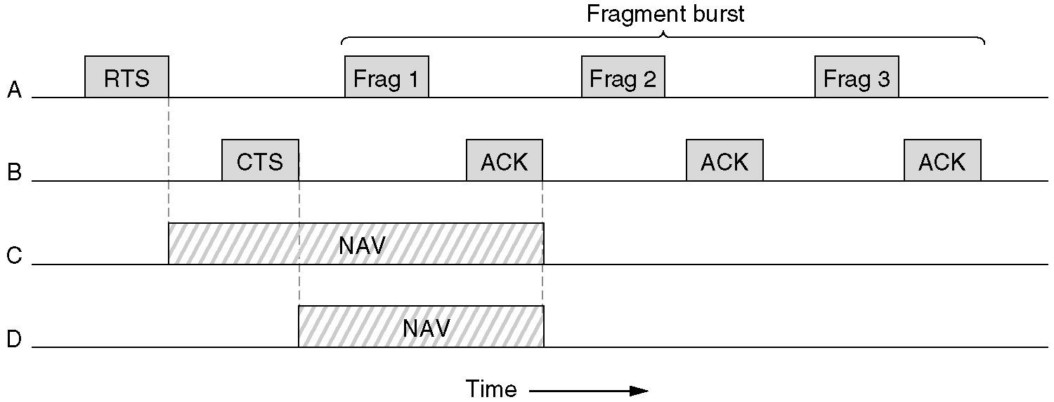
A fragment burst
Due to relatively high bit error rate, it may be useful to fragment one long data packet into many short fragments.
Only A can use the channel after a SIFS (Short Inter Frame Space) from ACK reception, thus A has the highest priority after ACK of the previous frame, although its NAV has expired.
Every fragment has its own NAV (not shown for Frag.2 and 3)

Slide 20
Why short frames can be preferable on noisy radio networks?
The larger the payload, the better the efficiency (pro)
efficiency=payload/(payload + overhead)
The larger the packet (block) the higher the probability to have at least one bit wrong in the packet (con)
n=#bits of a block P_{e,bit}=bit error probability
If the P_{e,bit} is high, long packets have few chances of being received correctly!
The fact that retransmission of shorter packets is more efficient is negligible!

Slide 21
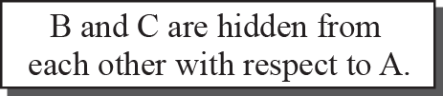
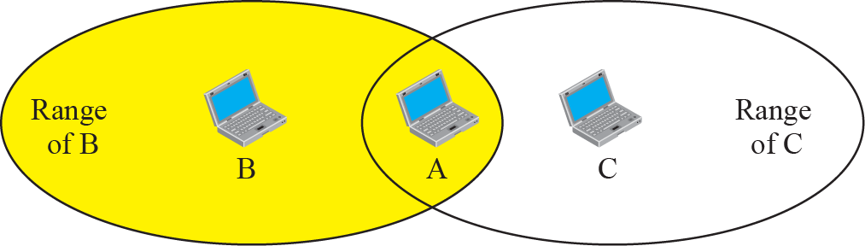
Hidden station problem
A is in Tx range with both B and C, but B and C are out of each other’s range.
If B transmits to A, C cannot hear
C could erroneously deduce that the channel is free

Slide 22
Use of handshaking to prevent hidden station problem

Slide 23

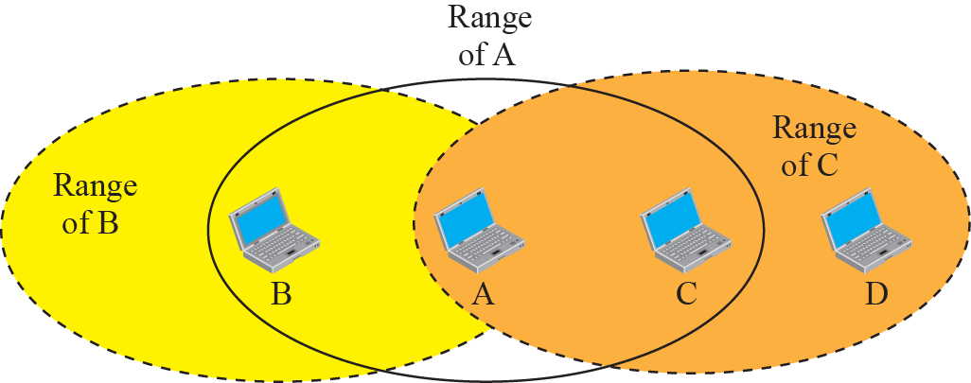
Exposed station problem
A transmits to B and C can hear; C will not transmit to D, as C perceive that the channel is busy
C could theoretically have, as its Tx signal would have not arrived to B (the receiver of the other transmission)
No countermeasure in 802.11, but also not a great problem.

Slide 24
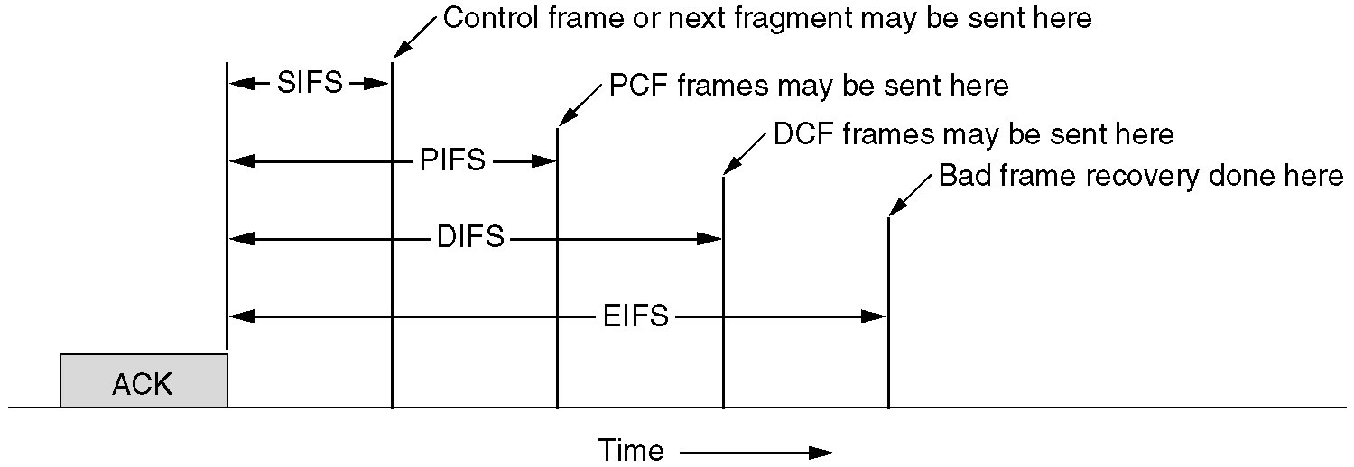
DCF and PCF compatibility
The shorter the time, the higher the priority
After a SIFS only the pair that already use the channel can send (i.e. an ACK after data, or a new frame)
After a PIFS of silence the AP can take the channel and start a PCF period
After a DIFS of silence one station can send an RTS and start a DCF period
After an EIFS of silence bad frames can be retransmitted

Slide 25
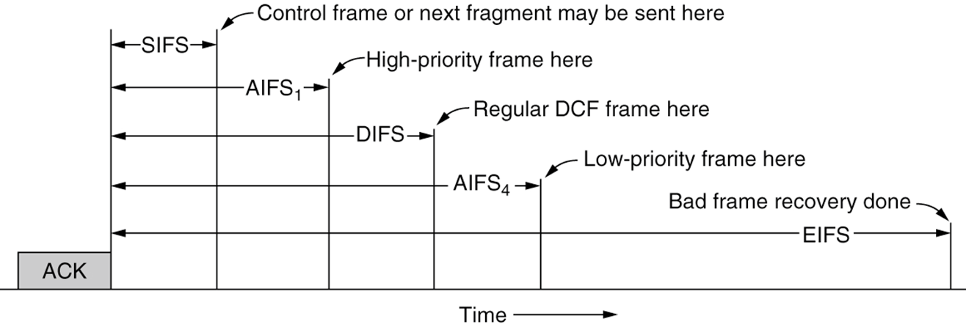
Priorities
The shorter the time, the higher the priority
High priority frames can be sent after AIFS1<DIFS
Low priority frames after AIFS2>DIFS

Slide 26
Data frame times

Slide 27
RTS-CTS Data Frame times

Slide 28
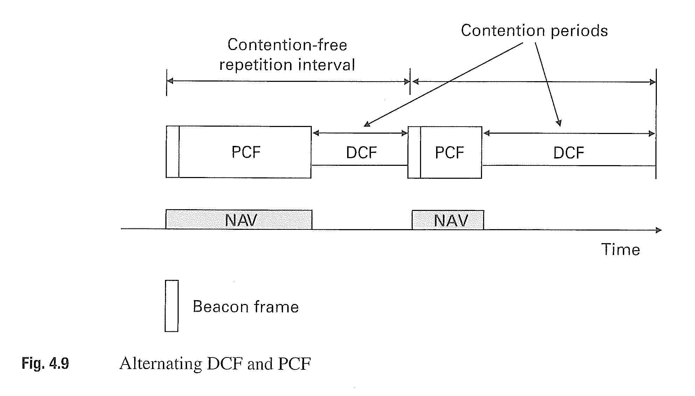
Alternating DCF-PCF

Slide 29
CFP transmission times
After a PIFS of silence the access point can start a CF Period.
D₁ are data sent by the AP to User1; U₁ data sent by User1 to AP with ACK of D₁, D₂ data sent by AP to User2 with (piggybacked) ACK of U₁, and so on.
Note that the special data frame D₂+ACK has D₂ for User2 and ACK for User1!

Slide 30
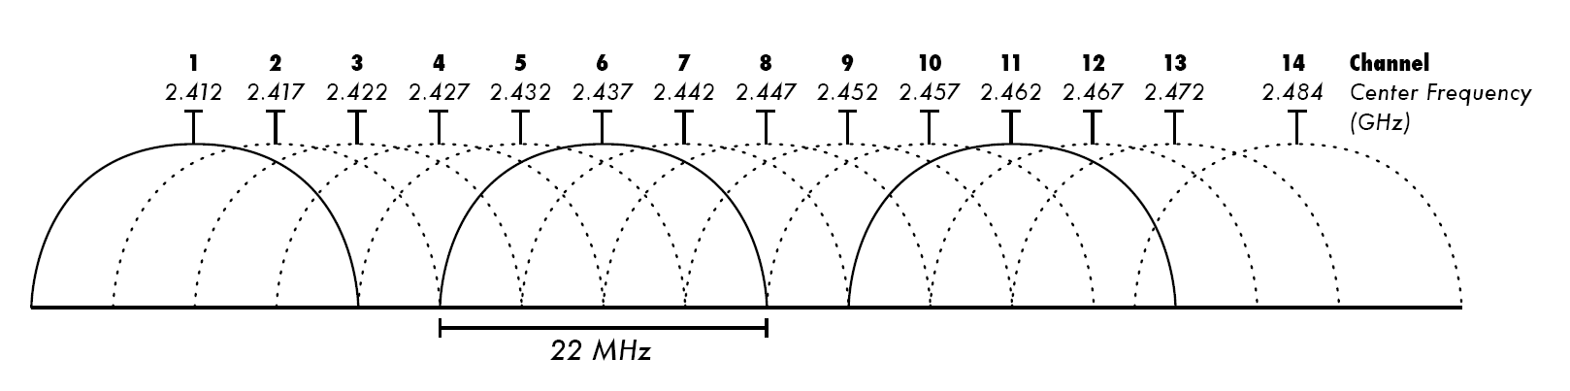
Channels (2.4 GHz band, «b» version)
14 channels (max) of 22 MHz each (old «b» versions)
Large overlapping
Adjacent channel interference
1, 6 and 11 do not overlap (often used)
The channels really usable vary with country
In a, g ,n, ac versions the minimum BW is 20 MHz instead of 22

Slide 31
OFDM principle
From https://en.wikipedia.org/wiki/Orthogonal_frequency-division_multiplexing#Orthogonality
OFDM is a frequency-division multiplexing (FDM) scheme used as a digital multi-carrier modulation method. Numerous closely spaced orthogonal sub-carrier signals with overlapping spectra are emitted to carry data
Each sub-carrier (signal) is modulated with a conventional modulation scheme at a low symbol rate.
One key principle of OFDM is that since low symbol rate modulation schemes (i.e., where the symbols are relatively long compared to the channel time characteristics) suffer less from intersymbol interference caused by multipath propagation, it is advantageous to transmit a number of low-rate streams in parallel instead of a single high-rate stream.
Since the duration of each symbol is long, it is feasible to insert a guard interval between the OFDM symbols, thus eliminating the intersymbol interference.

Slide 32
OFDM principle (example)
If one sends a million symbols per second using conventional single-carrier modulation over a wireless channel, then the duration of each symbol would be one microsecond or less.
This imposes severe constraints on synchronization and necessitates the removal of multipath interference.
If the same million symbols per second are spread among one thousand sub-channels, the duration of each symbol can be longer by a factor of a thousand (i.e., one millisecond).
Assume that a guard interval of 1/8 of the symbol length is inserted between consecutive symbols.
Intersymbol interference can be avoided if the multipath time-spreading (the time between the reception of the first and the last echo) is shorter than the guard interval (i.e., 125 microseconds). This corresponds to a maximum difference of 37.5 kilometers between the lengths of the paths.

Slide 33
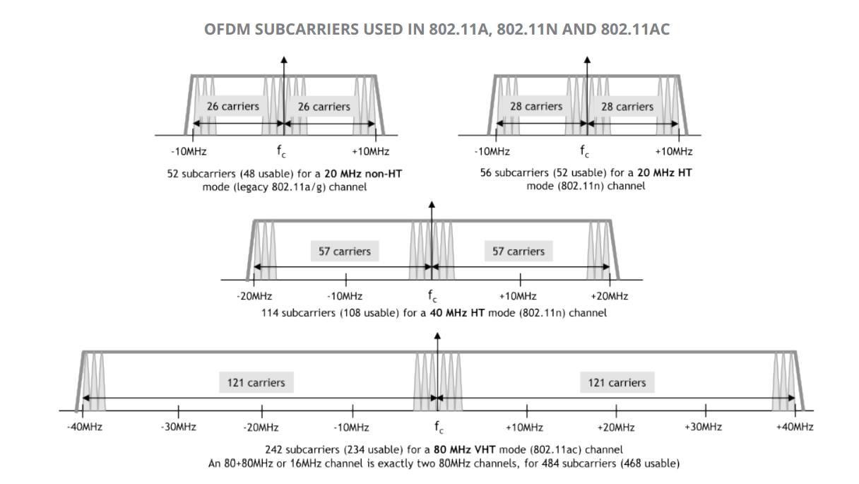
OFDM subcarriers in one channel

Slide 34
Summary of recent evolution
802.11 g (2003)
2.4 GHz, OFDM, 20 MHz, 1 spatial flow
Max 54 Mbit/s
802.11 n (2009)
2.4 & 5GHz (optional), OFDM, max 64 QAM (6 bit/symbol), 20 or 40 MHz channels, short GI (400ns), MIMO, up to 4 spatial flows, frame aggregation
HT (High Throughput) MCS indexes 0-31 (equal flows), plus 32 non-equal, Max 600Mbit/s (theoretical)
802.11 ac (2013; the most common now)
As “n”, plus in 5GHz only: max 256 QAM (8 bit/symbol), 80 or 160 MHz channels, MU-MIMO (in downlink only), up to 8 spatial flows
VHT (Very HT) MCS indexes, 0-9 for each spatial flow. Max 6.93 Gbits/s
Further information in
“MCS Index, Modulation and Coding Index 11n and 11ac.html”
802.11 Data Rates & SNR Requirements.xls

Slide 35
802.11ax (2021)
The main goal of this standard is enhancing throughput-per-area in high-density scenarios
corporate offices, shopping malls and dense residential apartments.
It is designed to operate in license-exempt bands between 1 and 7.125 GHz
including the 2.4 and 5 GHz bands and the much wider 6 GHz band
4 times finer subdivision in frequency Δf_{ax}=Δf_{g,n,ac} /4
T_{u,ax}=4 x T_{u, g,n,ac}=4 x 3.2 μs =12.8 μs
3 guard intervals (800 ns, 1.6 μs, 3.2 μs); better outdoor resistance
Added (optional) MU-MIMO (also in uplink) and OFDMA modes
https://en.wikipedia.org/wiki/IEEE_802.11ax-2021

Slide 36
802.11 ax MCS
Modulation and coding schemes for single spatial stream
MCS index^{[i]} | Modulation type | Coding rate | Data rate (in Mbit/s)^{[ii]}
 |  |  | 20 MHz channels |  | 40 MHz channels |  | 80 (from ac) MHz channels |  | 160(ax) MHz channels
 |  |  | 1600 ns GI^{[iii]} | 800 ns GI | 1600 ns GI | 800 ns GI | 1600 ns GI | 800 ns GI | 1600 ns GI | 800 ns GI
0 | BPSK | 1/2 | 8 | 8.6 | 16 | 17.2 | 34 | 36.0 | 68 | 72
1 | QPSK | 1/2 | 16 | 17.2 | 33 | 34.4 | 68 | 72.1 | 136 | 144
2 | QPSK | 3/4 | 24 | 25.8 | 49 | 51.6 | 102 | 108.1 | 204 | 216
3 | 16-QAM | 1/2 | 33 | 34.4 | 65 | 68.8 | 136 | 144.1 | 272 | 282
4 | 16-QAM | 3/4 | 49 | 51.6 | 98 | 103.2 | 204 | 216.2 | 408 | 432
5 | 64-QAM | 2/3 | 65 | 68.8 | 130 | 137.6 | 272 | 288.2 | 544 | 576
6 | 64-QAM | 3/4 | 73 | 77.4 | 146 | 154.9 | 306 | 324.4 | 613 | 649
7 | 64-QAM | 5/6 | 81 | 86.0 | 163 | 172.1 | 340 | 360.3 | 681 | 721
8 (from ac) | 256-QAM | 3/4 | 98 | 103.2 | 195 | 206.5 | 408 | 432.4 | 817 | 865
9 (from ac) | 256-QAM | 5/6 | 108 | 114.7 | 217 | 229.4 | 453 | 480.4 | 907 | 961
10 (ax) | 1024-QAM | 3/4 | 122 | 129.0 | 244 | 258.1 | 510 | 540.4 | 1021 | 1081
11 (ax) | 1024-QAM | 5/6 | 135 | 143.4 | 271 | 286.8 | 567 | 600.5 | 1134 | 1201

Slide 37
802.11 ax Multi-User Operation (MU-MIMO and OFDMA)
The 802.11ax standard has two operation modes:
Single User: STAs send and receive data one at a time, once they secure access to the medium, as usual.
Multi-User: simultaneous operation of multiple non-AP STAs.
Downlink multi-user refers to data that the AP serves to multiple associated wireless STAs at the same time. The existing 802.11ac standard already specifies this feature.
Uplink multi-user involves simultaneous transmission of data from multiple STAs to the AP. This is new functionality of the 802.11ax standard, which did not exist in any of the previous versions of the Wi-Fi standard.
Under the Multi-User mode of operation, the standard also specifies two different ways of multiplexing:
Multi-User MIMO
Orthogonal Frequency Division Multiple Access (OFDMA).
For both of these methods, the AP acts as the central controller, similar to an LTE cellular base station.
An 802.11ax AP can also combine MU-MIMO with OFDMA operation.
https://www.ni.com/it-it/innovations/white-papers/16/introduction-to-802-11ax-high-efficiency-wireless.html

Slide 38
Useful Linux commands
Old
iwconfig
Basic info
iwlist scan
Basic info on associated AP
New
iw dev wlp2s0 info
Basic info on wlp2s0 WiFi card
iw dev wlp2s0 link
Info on link quality
iw dev wlp2s0 scan dump
Full info on associated AP
iw dev wlp2s0 scan
Full info on all Aps in range (huge output)
iw list
Full info on WiFi card(s)
See WiFiCommands.txt file for examples of output

