Slide 1

Chapter 4
Introduction to
Network Layer
TCP/IP Protocol Suite
Copyright © The McGraw-Hill Companies, Inc. Permission required for reproduction or display.

Slide 2
OBJECTIVES:
To introduce switching and in particular packet switching as the mechanism of data delivery in the network layer.
To discuss two distinct types of services a packet-switch network can provide: connectionless service and connection-oriented service.
To discuss how routers forward packets in a connectionless packet-switch network using the destination address of the packet and a routing table.
To discuss how routers forward packets in a connection-oriented packet-switch network using the label on the packet and a routing table.
To discuss services already provided in the network layer such as logical addressing and delivery at the source, at each router, and at the destination.
To discuss issues or services that are not directly provided in the network layer protocol, but are sometimes provided by some auxiliary protocols or some protocols added later to the Internet.
TCP/IP Protocol Suite

Slide 3
Chapter
Outline
4.1 Introduction
4.2 Switching
4.3 Packet Switching
4.4 Network Layer Services
4.5 Other Network Layer Issues
TCP/IP Protocol Suite

Slide 4
4-1 INTRODUCTION
At the conceptual level, we can think of the global Internet as a black box network that connects millions (if not billions) of computers in the world together. At this level, we are only concerned that a message from the application layer in one computer reaches the application layer in another computer.
TCP/IP Protocol Suite

Slide 5
Topics Discussed in the Section
General Introduction
TCP/IP Protocol Suite

Slide 6
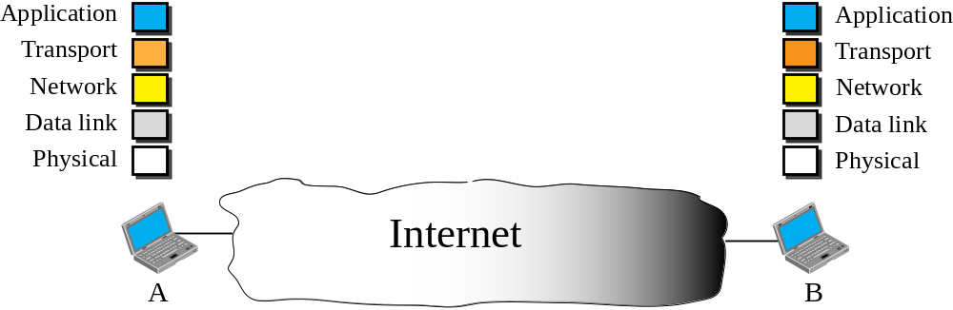


Figure 4.1 Internet as a block box
TCP/IP Protocol Suite

Slide 7
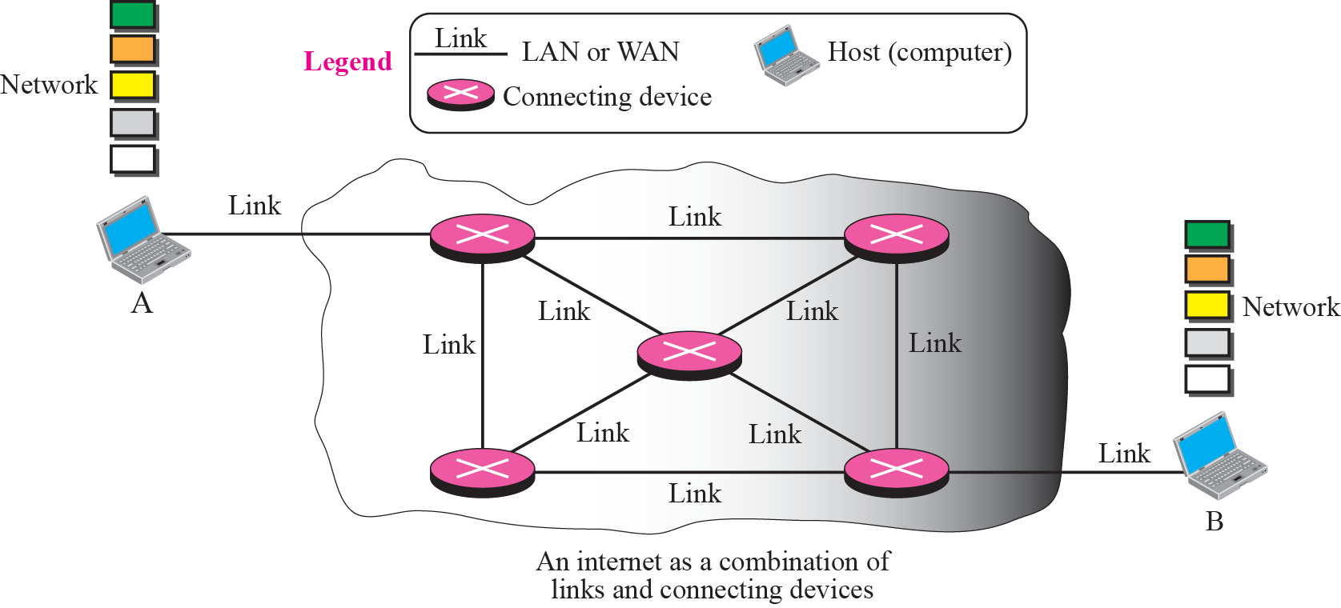
Figure 4.2 Internet as a combination of LANs and WANs connected together
TCP/IP Protocol Suite

Slide 8
4-2 SWITCHING
From the previous discussion, it is clear that the passage of a message from a source to a destination involves many decisions. When a message reaches a connecting device, a decision needs to be made to select one of the output ports through which the packet needs to be send out. In other words, the connecting device acts as a switch that connects one port to another port.
TCP/IP Protocol Suite

Slide 9
Topics Discussed in the Section
Circuit Switching
Packet Switching
TCP/IP Protocol Suite

Slide 10

Note
In circuit switching, the whole message is sent from the source to the destination without being
divided into packets.
TCP/IP Protocol Suite

Slide 11
Example 4.1
A good example of a circuit-switched network is the early telephone systems in which the path was established between a caller and a callee when the telephone number of the callee was dialed by the caller. When the callee responded to the call, the circuit was established. The voice message could now flow between the two parties, in both directions, while all of the connecting devices maintained the circuit. When the caller or callee hung up, the circuit was disconnected. The telephone network is not totally a circuit-switched network today.
TCP/IP Protocol Suite

Slide 12
Note
In packet switching, the message is first divided into manageable packets at the source before being transmitted.
The packets are assembled at the destination.
TCP/IP Protocol Suite

Slide 13
4-3 PACKET SWITCHING
The network layer is designed as a packet-switched network. This means that the packet at the source is divided into manageable packets, normally called datagrams. Individual datagrams are then transferred from the source to the destination. The received datagrams are assembled at the destination before recreating the original message. The packet-switched network layer of the Internet was originally designed as a connectionless service, but recently there is a tendency to change this
to a connection-oriented service.
TCP/IP Protocol Suite

Slide 14
Topics Discussed in the Section
Connectionless Service
Connection-Oriented Service
TCP/IP Protocol Suite

Slide 15
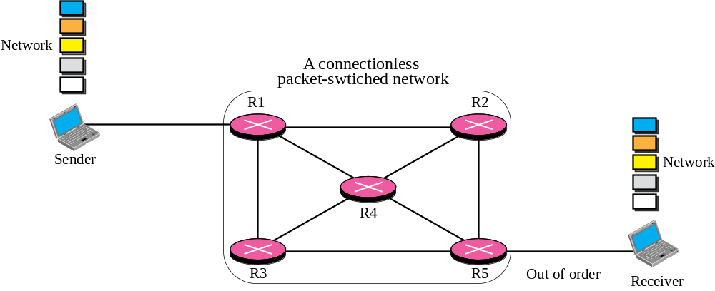







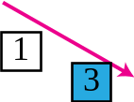



Figure 4.3 A connectionless packet-switched network
TCP/IP Protocol Suite

Slide 16
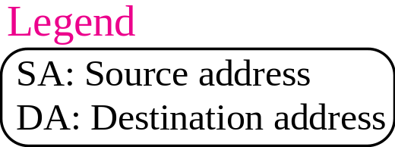
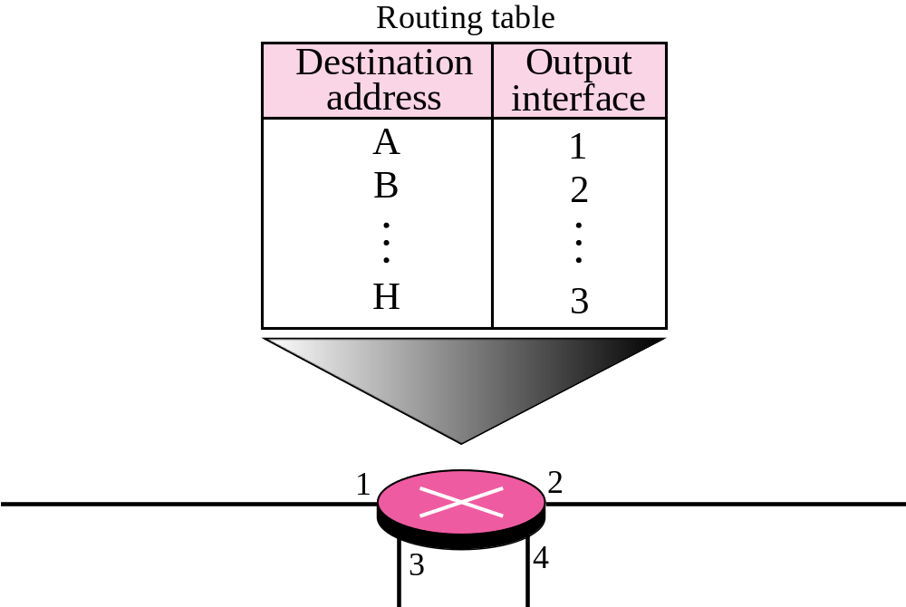
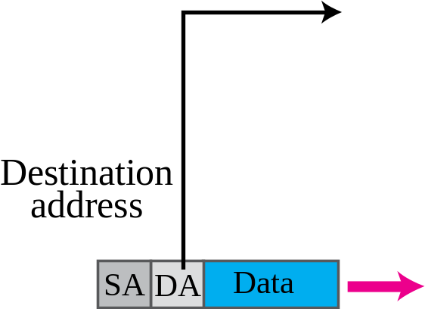
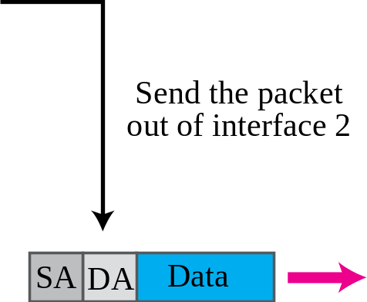
Figure 4.4 Forwarding process in a connectionless network
TCP/IP Protocol Suite

Slide 17
Note
In a connectionless packet-switched network, the forwarding decision
is based on the destination address of the packet.
TCP/IP Protocol Suite

Slide 18
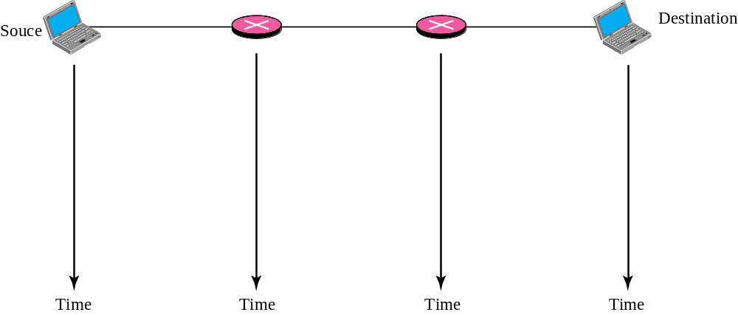






Figure 4.5 Delay in a connectionless network
TCP/IP Protocol Suite
Notes:
Waiting
time

Slide 19
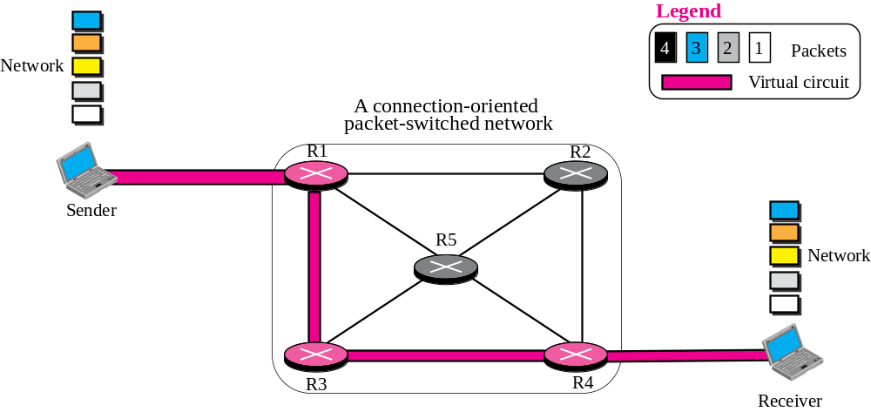
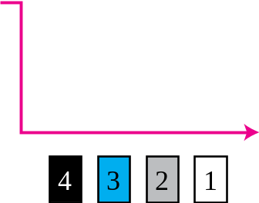




Figure 4.6 A connection-oriented packet switched network
TCP/IP Protocol Suite

Slide 20
Note
In a connection-oriented packet switched network, the forwarding decision is based on the
label of the packet.
TCP/IP Protocol Suite

Slide 21
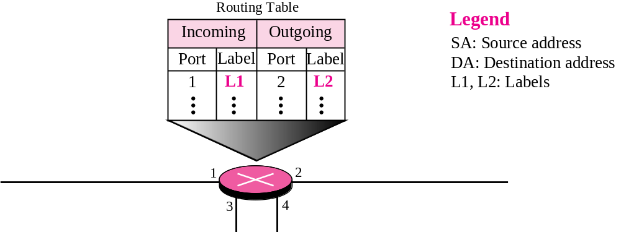
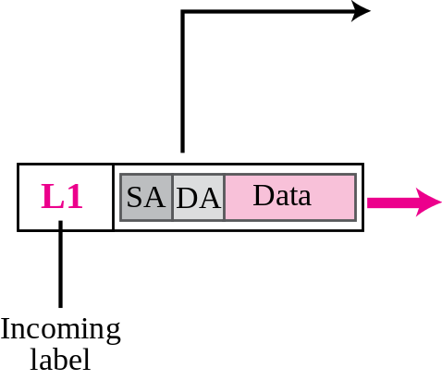
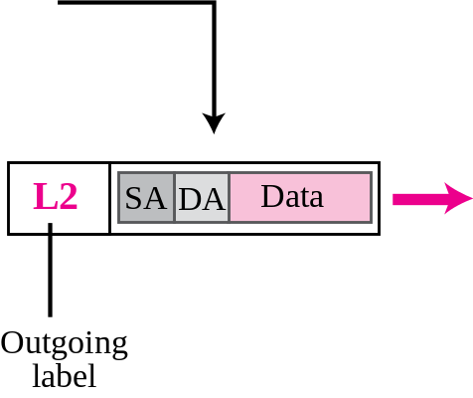
Figure 4.7 Forwarding process in a connection-oriented network
TCP/IP Protocol Suite

Slide 22
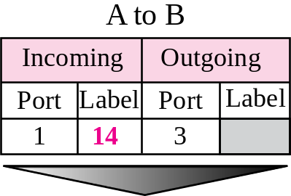
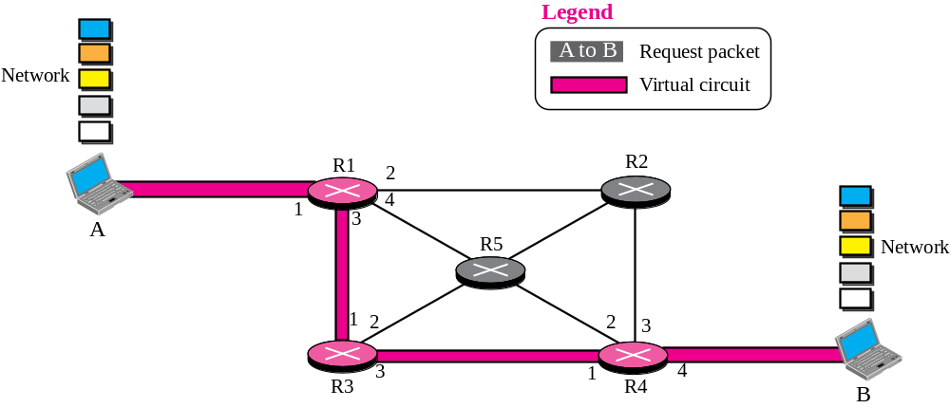
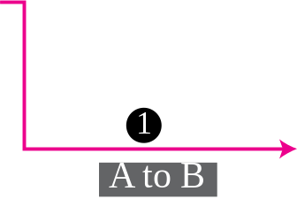
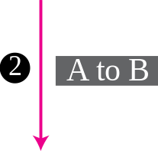
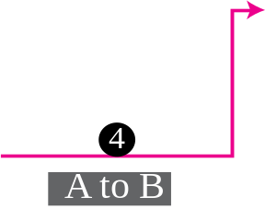
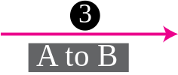
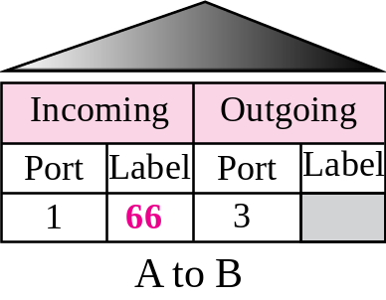

Figure 4.8 Sending request packet in a virtual-circuit network
TCP/IP Protocol Suite

Slide 23
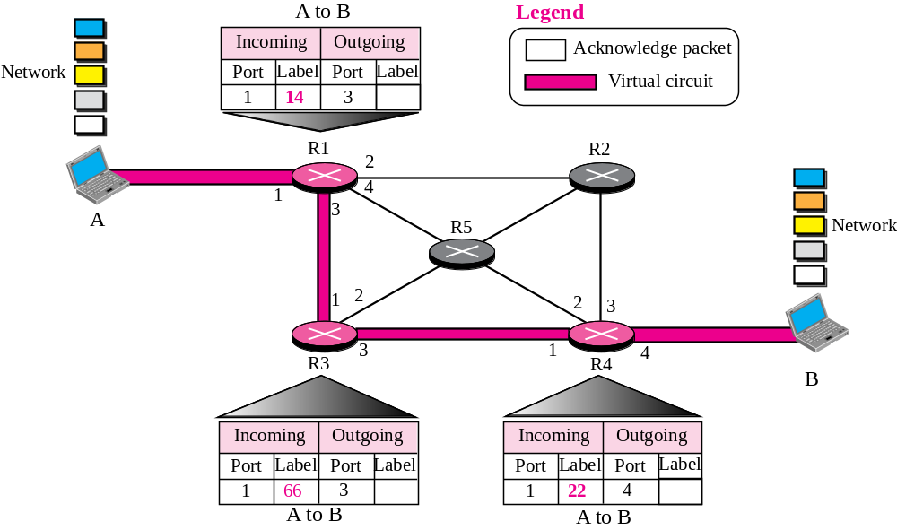
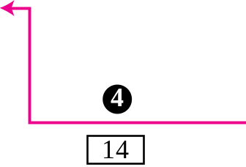
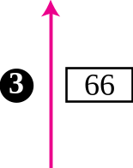
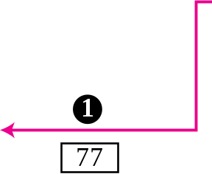

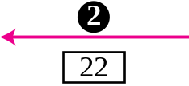


Figure 4.9 Setup acknowledgement in a virtual-circuit network
TCP/IP Protocol Suite

Slide 24
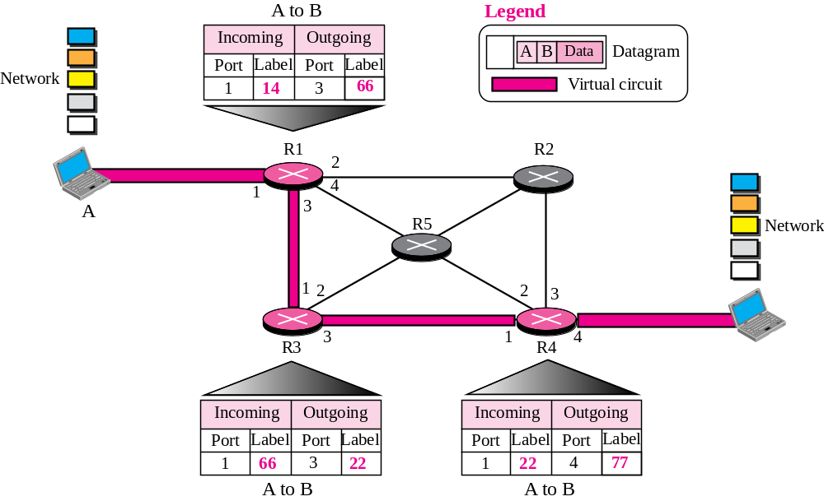
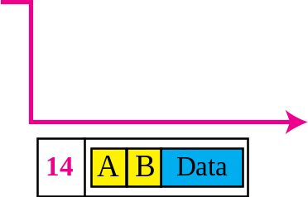
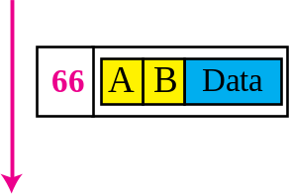
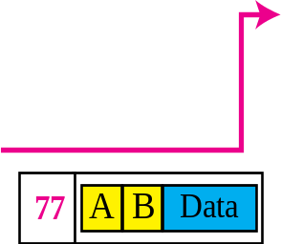
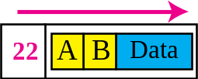
Figure 4.10 Flow of one packet in an established virtual circuit
TCP/IP Protocol Suite
Notes:
14ABData

Slide 25
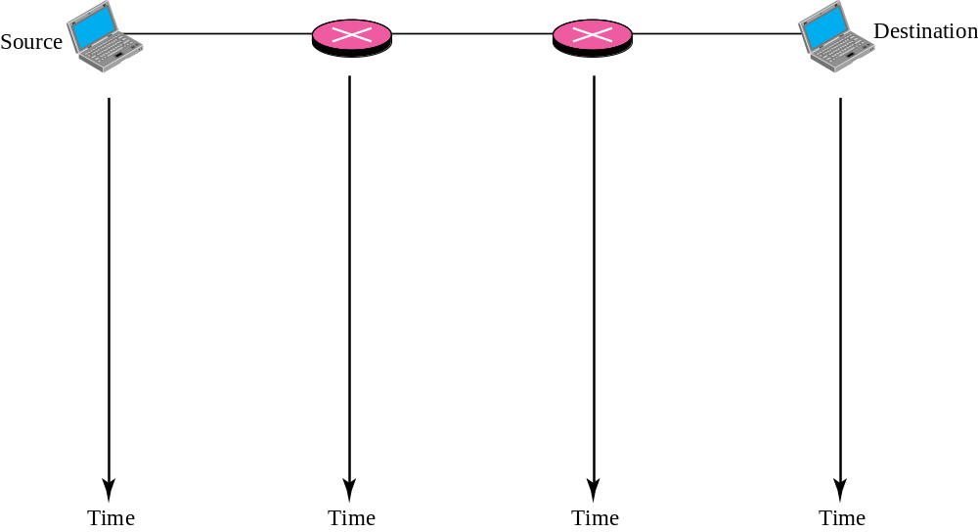


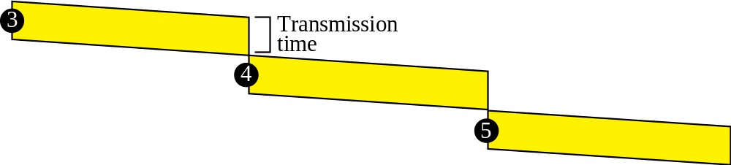

Figure 4.11 Delay in a connection-oriented network
TCP/IP Protocol Suite

Slide 26
4-4 NETWORK LAYER SERVICES
In this section, we briefly discuss services provided by the network layer. Our discussion is mostly based on the connectionless service, the dominant service in today’s Internet.
TCP/IP Protocol Suite

Slide 27
Topics Discussed in the Section
Logical Addressing
Services Provided at the Source Computer
Services Provides at the Each Router
Services Provided at the Destination Computer
TCP/IP Protocol Suite

Slide 28
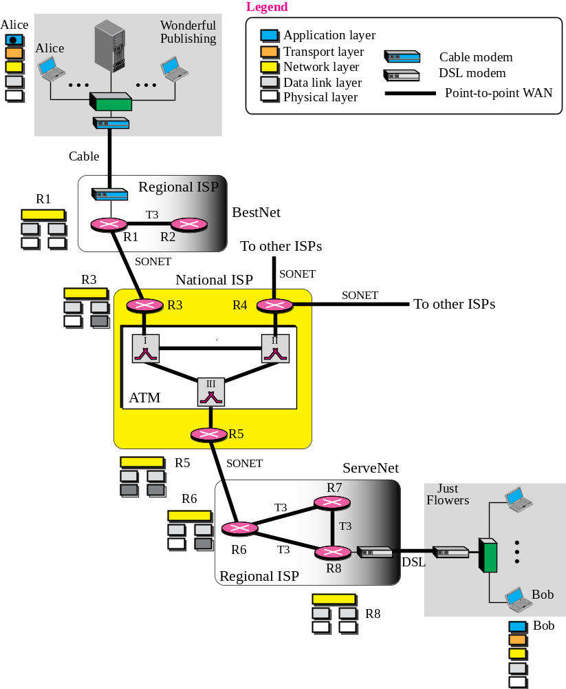
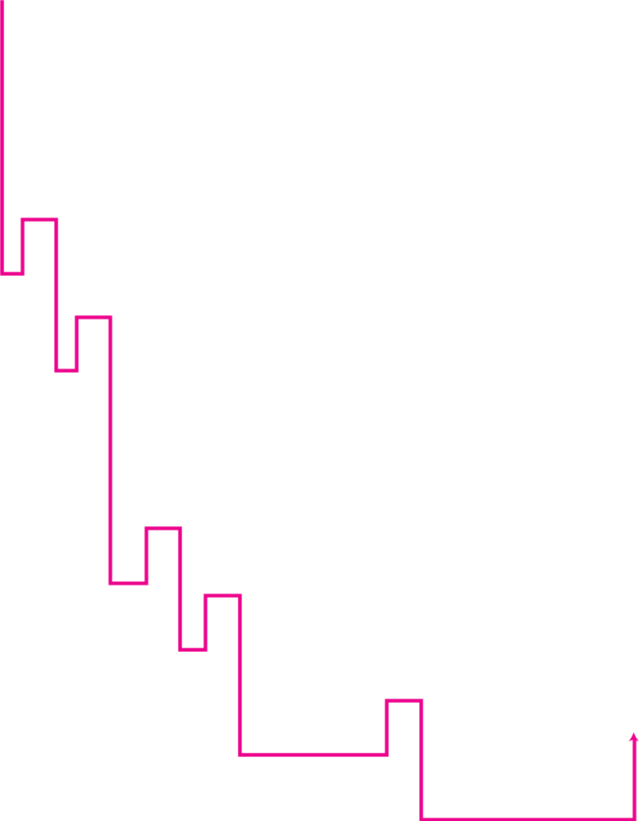
Figure 4.12 An imaginary part of the Internet
TCP/IP Protocol Suite

Slide 29
Network Layer
Aim: to route packets from source to destination
A third layer, on top of link, is necessary:
  to interconnect networks with different technologies (data link and physical)
  to provide for a more efficient and scalable switching (MAC addresses are “flat”, e.g. as serial numbers)
    “switching” at 3d layer is called “routing”
Addresses at 3d layer are called “logical”
  137.204.59.12 (an IPv4 example)
Addresses at data link layer are called MAC, “physical” (although they are at layer 2!).
  6c:3b:e5:20:e4:bc (an 802.3 MAC example)
The network layer provides interoperability across a large variety of physical network types (it is the “glue” of the internet)
  In theory, only one protocol allowed (all nodes of the internet must interpret all addresses) and the same (logical) internet
  In Internet we have only IP, but in two versions (IPv4 and IPv6); in fact, the interoperability is an issue
It is necessary a mechanism to automatically associate network-layer and underlying link-layer addresses
TCP/IP Protocol Suite

Slide 30
Logical and MAC association: the ARP table
Each NIC has a MAC address
  802.3 and 802.11 NICs have a 6B MAC, inserted by manufacturer and stored in permanent memory, as a sort of SN
Each NIC (not each node!) must be given a logical address
  4B in IPv4, either obtained by DHCP at start up, or manually set by the network manager.
  If “public”, it is associated to a specific network, as a result it has also a topology meaning. IP addresses have been assigned in blocks of contiguous elements to different institutions (e.g. to the University of Bologna) and ISPs (Internet Service Providers).
  If a notebook is moved from the University of Bologna to another institution or ISP it must change its logical address, (i.e. it must use an address assigned to the hosting University, or to the local ISP).
The correspondence is maintained on each host by the ARP (Address Resolution Protocol) table, populated and updated by the ARP protocol.
  “resolution is the process of finding the MAC corresponding to a logical address
ARP provides a dynamic mapping from a network-layer address (including but not necessarily IP) to a corresponding hardware address.
  dynamic because it is set automatically and changes over time without requiring reconfiguration by a system administrator

Slide 31
Routing tables
Routing tables have entries that are like the arrow road signs at road intersections (to Rimini go straight ahead, to Ferrara turn left, to Firenze turn right)
They are inserted either
  Automatically when a local NIC address is set
    They allow to know which IP addresses are “local”, i.e. belonging to a local network
  Statically
    by the network manager (common in testbeds, isolated networks)
  Dynamically
    By routing protocols, such as OSPF (Open Shortest Path First) and BGP (Border Gateway Protocol) in Internet
If the address of the packet processed matches more conditions, the most stringent is chosen
  Analogously, a car choose the direction suggested by the arrow sign that best matches the destination (e.g. San Lazzaro instead of Bologna)
If the destination address
  is local the entry gives only the OS name of the NIC (e.g. eth0)
  is external the entry gives also the logical address (or name) of the next router (sometimes called “gateway”) to destination (next router address).

Slide 32
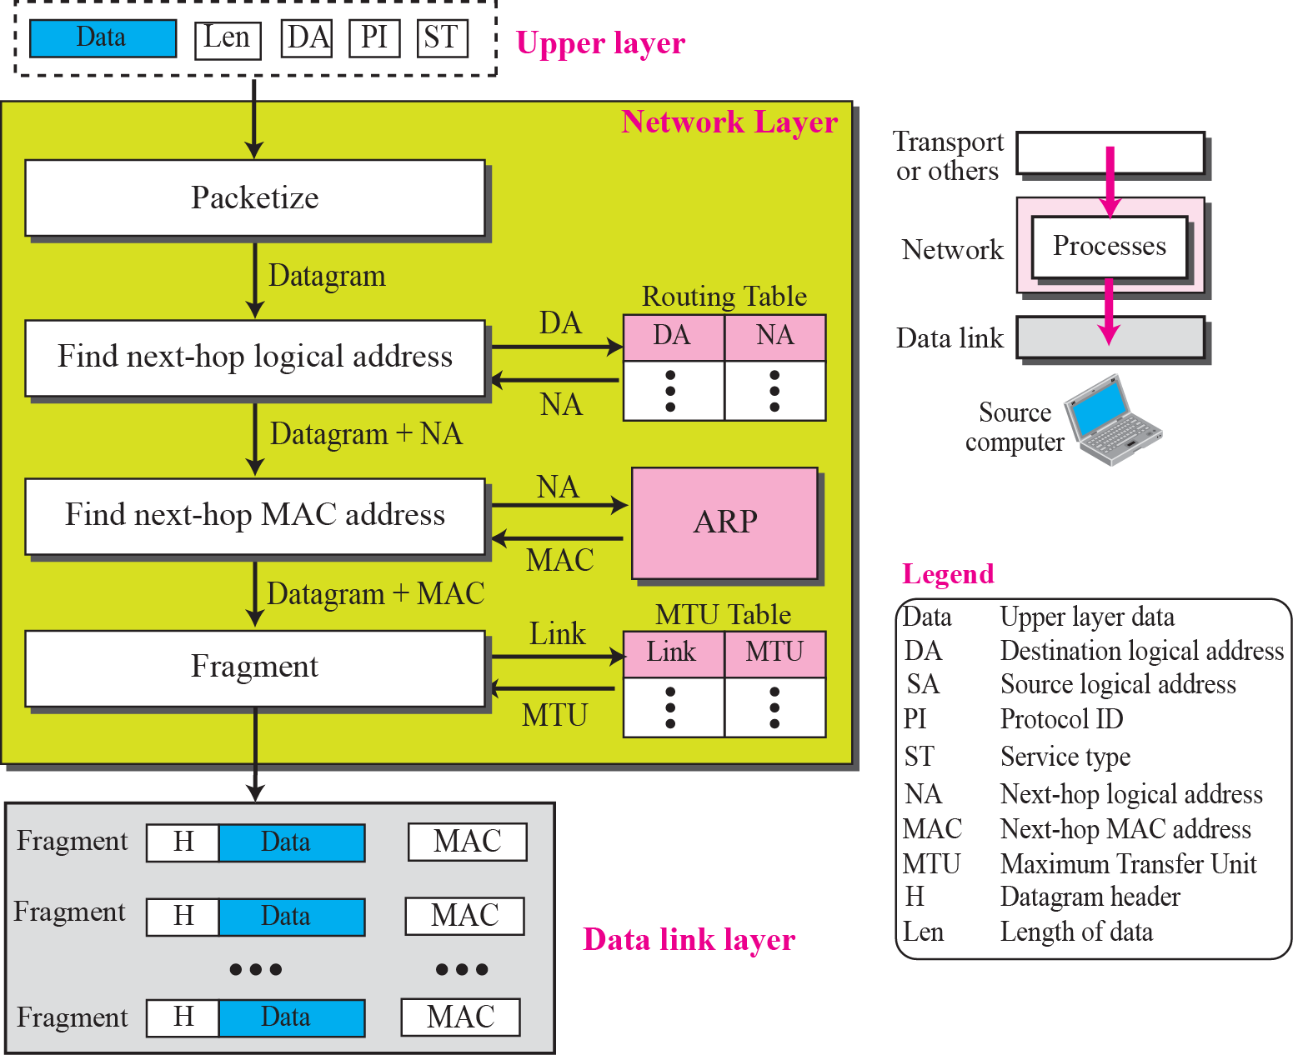
Figure 4.13 Services provided at the source computer
TCP/IP Protocol Suite

Slide 33
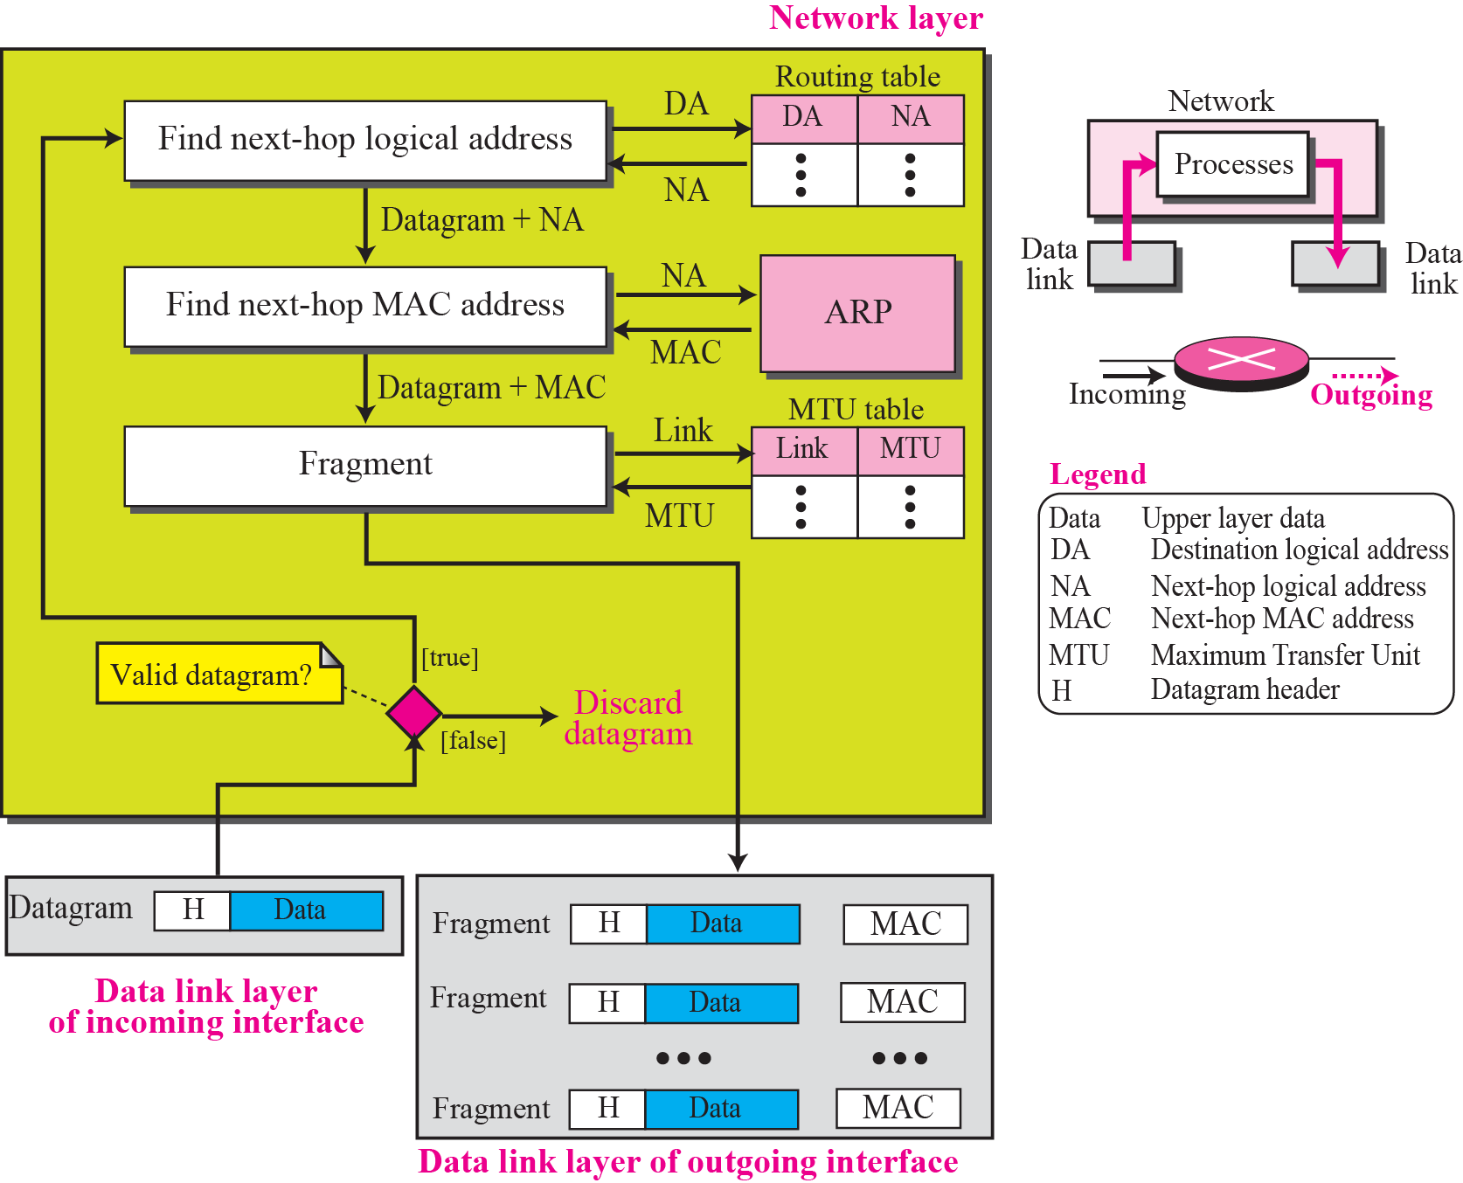
Figure 4.14 Processing at each router
TCP/IP Protocol Suite

Slide 34
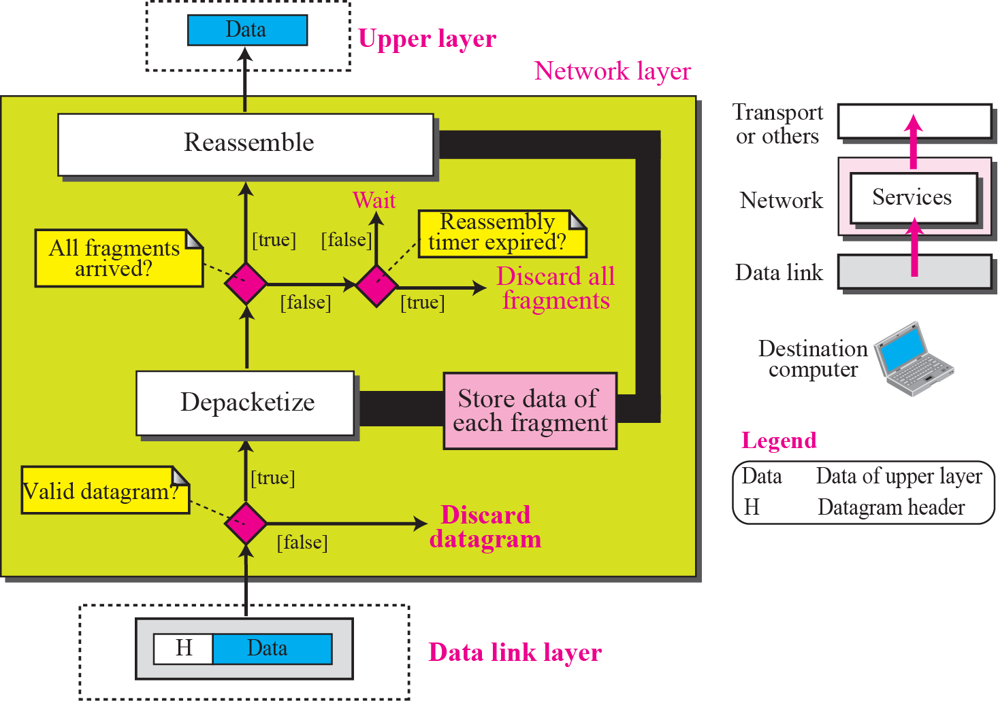
Figure 4.15 Processing at the destination computer
TCP/IP Protocol Suite

Slide 35
4-5 OTHER SERVICES
In this section we introduce some issues related to the network layer. These issues actually represent services that are normally discussed for the network layer, but they are either partially implemented at the network layer or not implemented at all. Some services are provided by some auxiliary protocols or by protocols added to the Internet later. Most of these issues resurface in future chapters.
TCP/IP Protocol Suite

Slide 36
Topics Discussed in the Section
Error Control
Flow Control
Congestion Control
Routing
Security
TCP/IP Protocol Suite

Slide 37
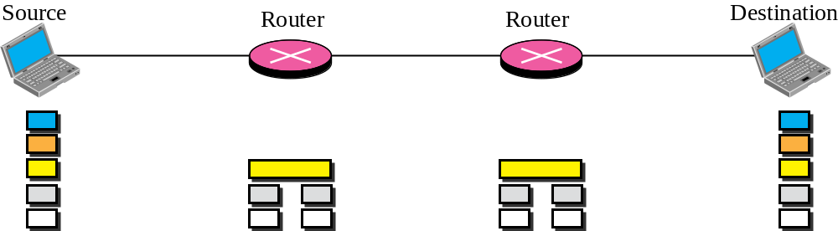

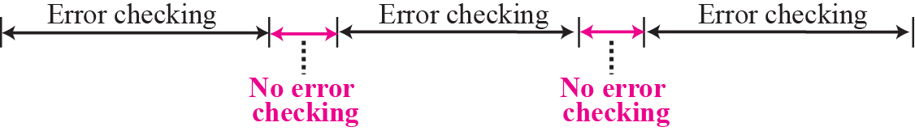
Figure 4.16 Error checking at the data link layer
TCP/IP Protocol Suite

Slide 38
Note
No flow control is provided for the current version of Internet network layer.
TCP/IP Protocol Suite

