Slide 1

Chapter 5
IPv4 Addresses
TCP/IP Protocol Suite
Copyright © The McGraw-Hill Companies, Inc. Permission required for reproduction or display.

Slide 2
5-1 INTRODUCTION
The identifier used in the IP layer of the TCP/IP protocol suite to identify each device connected to the Internet is called the Internet address or IP address. An IPv4 address is a 32-bit address that uniquely and universally defines the connection of a host or a router to the Internet; an IP address is the address of the interface.
TCP/IP Protocol Suite

Slide 3
5-3 CLASSLESS ADDRESSING
Subnetting and supernetting in classful addressing did not really solve the address depletion problem. With the growth of the Internet, it was clear that a larger address space was needed as a long-term solution. Although the long-range solution has already been devised and is called IPv6, a short-term solution was also devised to use the same address space but to change the distribution of addresses to provide a fair share to each organization. The short-term solution still uses IPv4 addresses, but it is called classless addressing.
TCP/IP Protocol Suite

Slide 4
Topics Discussed in the Section
Variable –Length Blocks
Two-Level Addressing
Block Allocation
Subnetting
TCP/IP Protocol Suite

Slide 5
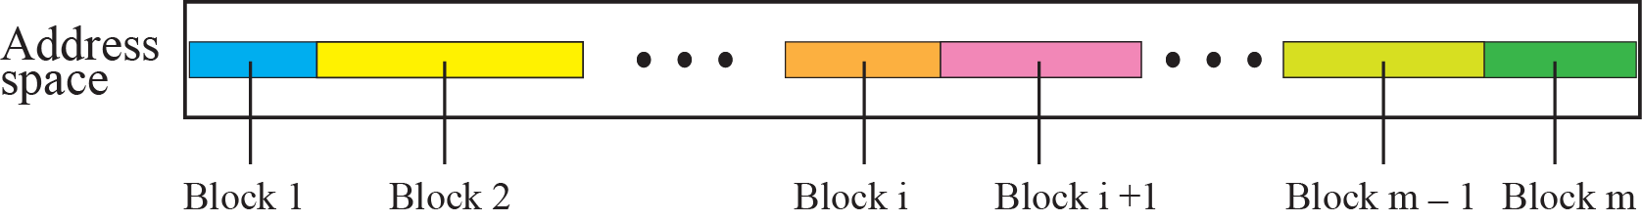
Figure 5.27 Variable-length blocks in classless addressing
TCP/IP Protocol Suite

Slide 6

Note
In classless addressing, the prefix defines the network and the suffix
defines the host.
TCP/IP Protocol Suite

Slide 7
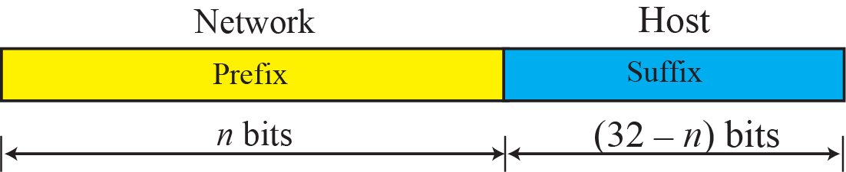
Figure 5.28 Prefix and suffix
TCP/IP Protocol Suite

Slide 8
Note
The prefix length in classless addressing can be 1 to 32.
TCP/IP Protocol Suite

Slide 9
Example 5.22
What is the prefix length and suffix length if the whole Internet is considered as one single block with 4,294,967,296 addresses?
Solution
In this case, the prefix length is 0 and the suffix length is 32. All 32 bits vary to define 2³² = 4,294,967,296 hosts in this single block.
TCP/IP Protocol Suite

Slide 10
Example 5.23
What is the prefix length and suffix length if the Internet is divided into 4,294,967,296 blocks and each block has one single address?
Solution
In this case, the prefix length for each block is 32 and the suffix length is 0. All 32 bits are needed to define 2³² = 4,294,967,296 blocks. The only address in each block is defined by the block itself.
TCP/IP Protocol Suite

Slide 11
Example 5.24
The number of addresses in a block is inversely related to the value of the prefix length, n. A small n means a larger block; a large n means a small block.
TCP/IP Protocol Suite

Slide 12
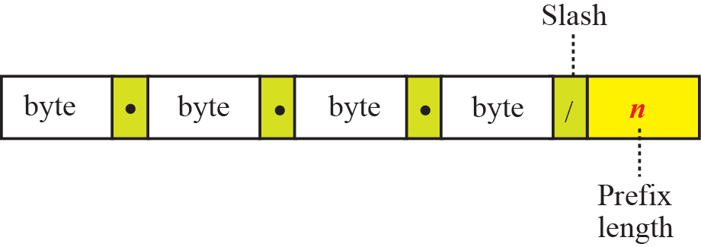
Figure 5.29 Slash notation
TCP/IP Protocol Suite

Slide 13
Note
In classless addressing, we need to know one of the addresses in the block
and the prefix length to define the block.
TCP/IP Protocol Suite

Slide 14
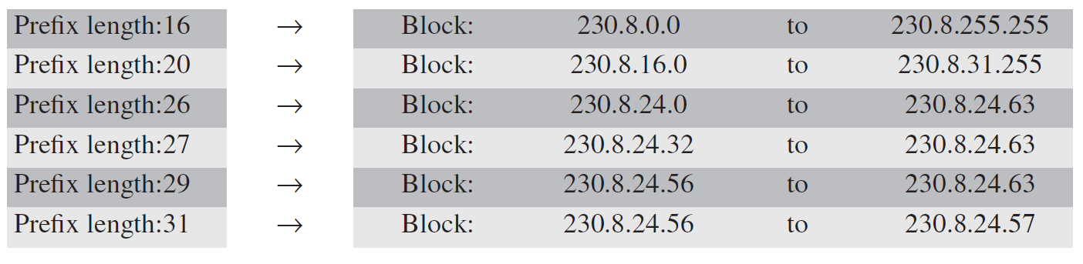
Example 5.25
In classless addressing, an address cannot per se define the block the address belongs to. For example, the address 230.8.24.56 can belong to many blocks some of them are shown below with the value of the prefix associated with that block:
TCP/IP Protocol Suite

Slide 15
Example 5.26
The following addresses are defined using slash notations.
a. In the address 12.23.24.78/8, the network mask is 255.0.0.0. The mask has eight 1s and twenty-four 0s. The prefix length is 8; the suffix length is 24.
b. In the address 130.11.232.156/16, the network mask is 255.255.0.0. The mask has sixteen 1s and sixteen 0s.The prefix length is 16; the suffix length is 16.
c. In the address 167.199.170.82/27, the network mask is 255.255.255.224. The mask has twenty-seven 1s and five 0s. The prefix length is 27; the suffix length is 5.
TCP/IP Protocol Suite

Slide 16
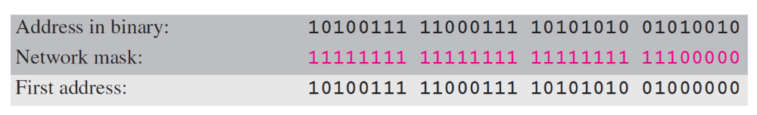
Example 5.27
One of the addresses in a block is 167.199.170.82/27. Find the number of addresses in the network, the first address, and the last address.
Solution
The value of n is 27. The network mask has twenty-seven 1s and five 0s. It is 255.255.255.204.
a. The number of addresses in the network is 2^{32 − n} = 2⁵ =32.
b. We use the AND operation to find the first address (network address). The first address is 167.199.170.64/27.
TCP/IP Protocol Suite

Slide 17
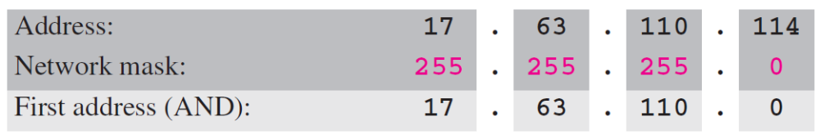
Example 5.28
One of the addresses in a block is 17.63.110.114/24. Find the number of addresses, the first address, and the last address in the block.
Solution
The network mask is 255.255.255.0.
a. The number of addresses in the network is 2³² ⁻ ²⁴ = 256.
b. To find the first address, we use the short cut methods
discussed early in the chapter. The first address is
17.63.110.0/24.
TCP/IP Protocol Suite

Slide 18
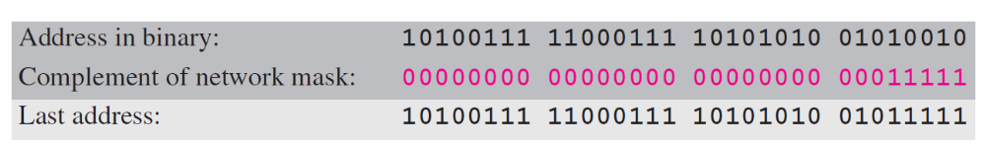
Example 5.28 Continued
c. To find the last address, we use the complement of the network mask and the first short cut method we discussed before. The last address is 17.63.110.255/24.
TCP/IP Protocol Suite

Slide 19
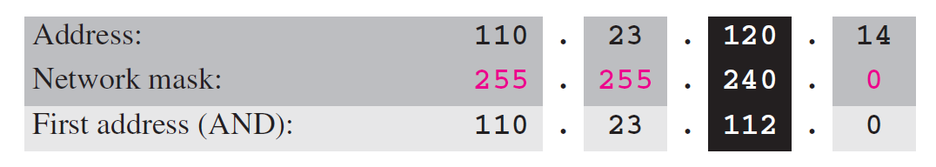
Example 5.29
One of the addresses in a block is 110.23.120.14/20. Find the number of addresses, the first address, and the last address in the block.
Solution
The network mask is 255.255.240.0.
a. The number of addresses in the network is 2³² ⁻ ²⁰ = 4096.
b. To find the first address, we apply the first short cut to bytes 1, 2, and 4 and the second short cut to byte 3. The first address is 110.23.112.0/20.
TCP/IP Protocol Suite

Slide 20
5-4 SPECIAL ADDRESSES
In classful addressing some addresses were reserved for special purposes. The classless addressing scheme inherits some of these special addresses from classful addressing.
TCP/IP Protocol Suite

Slide 21
Topics Discussed in the Section
Special Blocks
Special Addresses in each Block
TCP/IP Protocol Suite

Slide 22
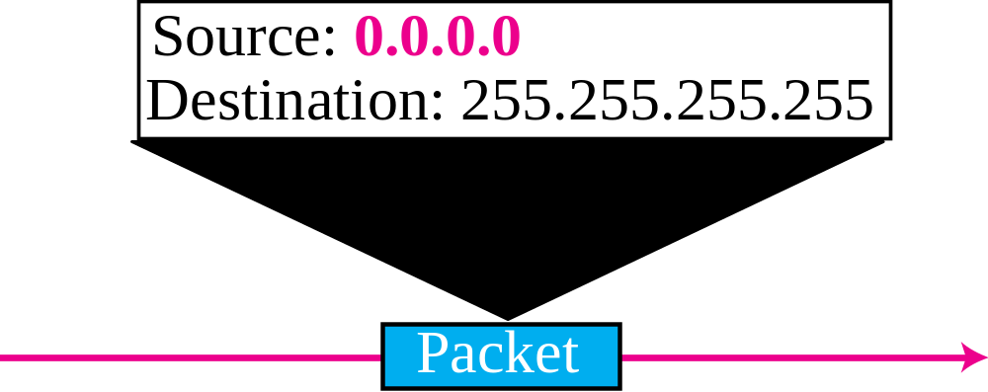
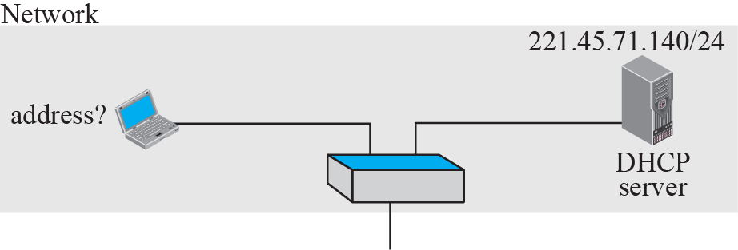
Figure 5.35 Example of using the all-zero address
TCP/IP Protocol Suite

Slide 23
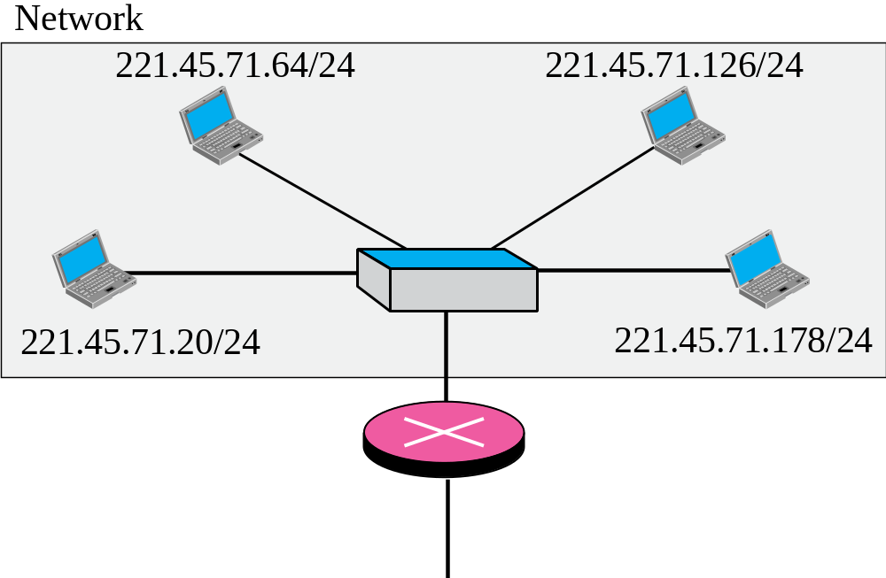
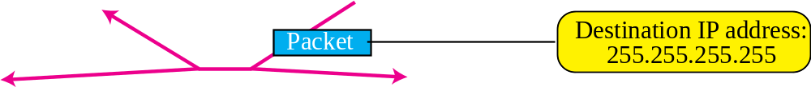
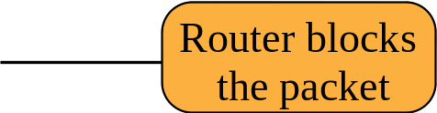
Figure 5.36 Example of limited broadcast address
TCP/IP Protocol Suite

Slide 24
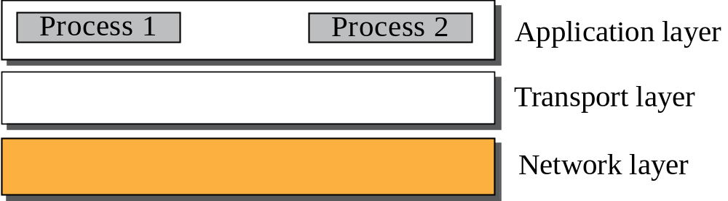
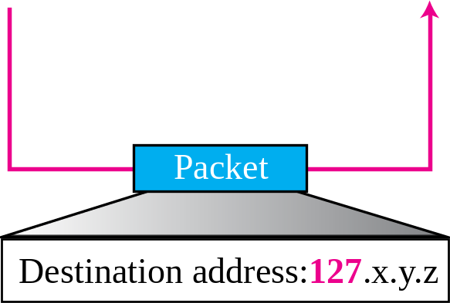
Figure 5.37 Example of loopback address
TCP/IP Protocol Suite

Slide 25
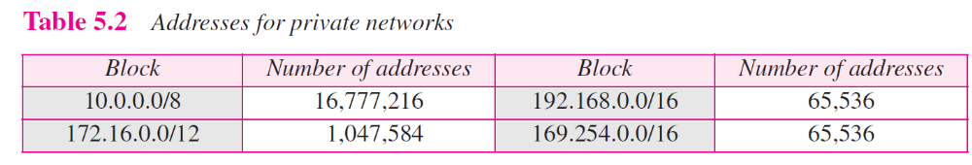
TCP/IP Protocol Suite

Slide 26
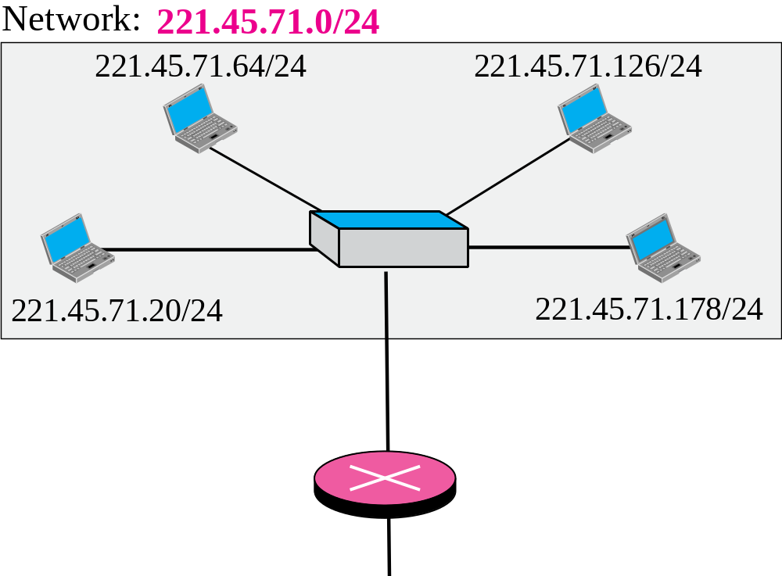
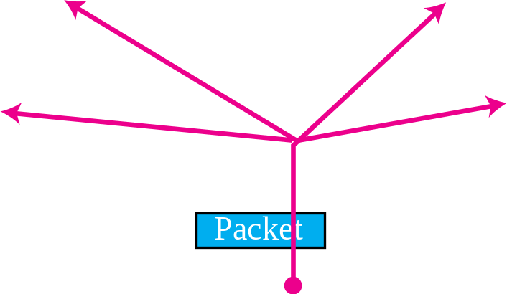
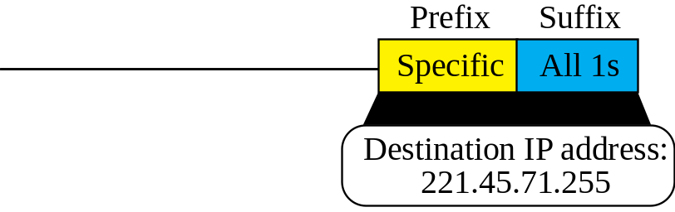
Figure 5.38 Example of a directed broadcast address
TCP/IP Protocol Suite

Slide 27
5-5 NAT
The distribution of addresses through ISPs has created a new problem. If the business grows or the household needs a larger range, the ISP may not be able to grant the demand because the addresses before and after the range may have already been allocated to other networks. In most situations, however, only a portion of computers in a small network need access to the Internet simultaneously. A technology that can help in this cases is network address translation (NAT).
TCP/IP Protocol Suite

Slide 28
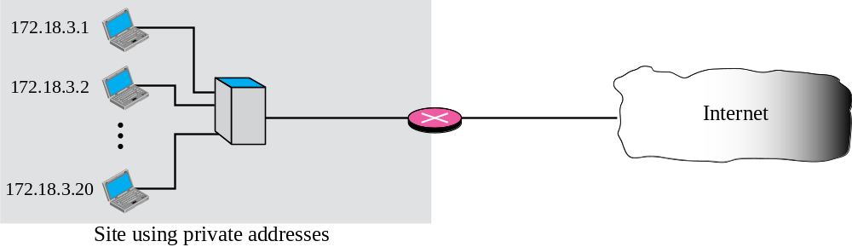
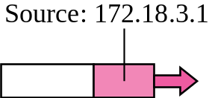
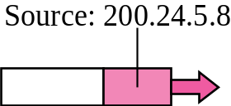
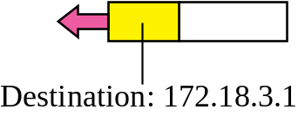
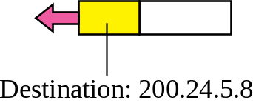
Figure 5.40 NAT
NAT
TCP/IP Protocol Suite

Slide 29
NAT (Network Address Translation)
Network Address Translation (NAT) is the process of modifying IP address information in IPv4 headers while in transit across a traffic routing device.
From RFC2663
  “Basic” (or “one-to-one”) NAT changes only IP addresses.
  NAPT (Network Address Port Translation) changes IP addresses and “transport identifiers” (i.e. TCP and UDP ports)
In practice, the term NAT is used for NAPT

Slide 30
NAPT (or just “NAT”) by CC
NAPT=NAT+PAT
NAT
  When a computer on the private (internal) network sends an IPv4 packet to the external network, the NAT device replaces the internal IP address in the source field of the packet header (sender's address) with the external IP address of the NAT device.
PAT (Port Address Translation)
  PAT may then assign the connection a port number from a pool of available ports, inserting this port number in the source port field (much like the post office box number), and forwards the packet to the external network. The NAT device then makes an entry in a translation table containing the internal IP address, original source port, and the translated source port. Subsequent packets from the same connection are translated to the same port number.
The process is transparent to the destination node, which answers to the IP&port provided in the source fields
A packet coming from the external network is mapped to a corresponding internal IP address and port number from the translation table, replacing the external IP address and port number in the incoming packet header

Slide 31
NAT table (example)
Original Source | Original Port | Translated Source | Translated Source Port | Destination | Destination Port
 |  | IP of NAT device | It works as a label to identify the original pair (IP, port) | Unaltered | Unaltered
192.168.0.1 | 1400 | 137.204.57.12 | 2405 | 173.194.40.81 | 80
192.168.0.2 | 1653 | 137.204.57.12 | 2406 | 173.194.40.81 | 80
192.168.0.5 | 1653 | 137.204.57.12 | 2407 | 173.194.40.81 | 80

Slide 32
NAT entries
TCP (connection oriented)
  The NAT inspects TCP headers to understand when a TCP connection is open or closed
    Layering violation!
    A new entry in the TCP table of NAT is inserted when a new connection is established
    It is removed when “gracefully” closed
  It is also removed after a long period of inactivity to cope with “hard” closing (reboot of a node)
UDP (connectionless)
  A new entry in the UDP table of NAT is inserted when a new “session” is seen by the NAT
  As it is impossible to know when it terminates, it is deleted after a short period of inactivity

