Slide 1
2-2 THE OSI MODEL
Established in 1947, the International Standards Organization (ISO) is a multinational body dedicated to worldwide agreement on international standards. Almost three-fourths of countries in the world are represented in the ISO. An ISO standard that covers all aspects of network communications is the Open Systems Interconnection (OSI) model. It was first introduced in the late 1970s.
TCP/IP Protocol Suite

Slide 2
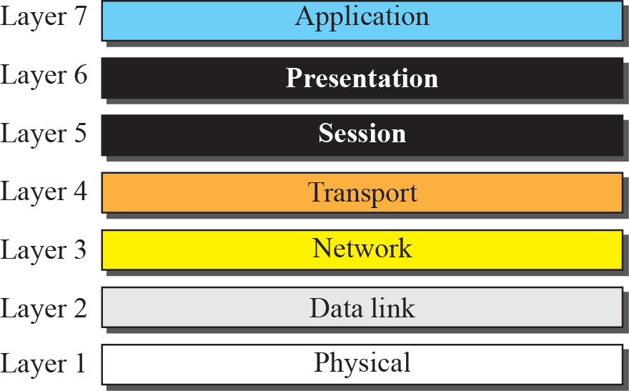
Figure 2.3 The OSI model
TCP/IP Protocol Suite

Slide 3

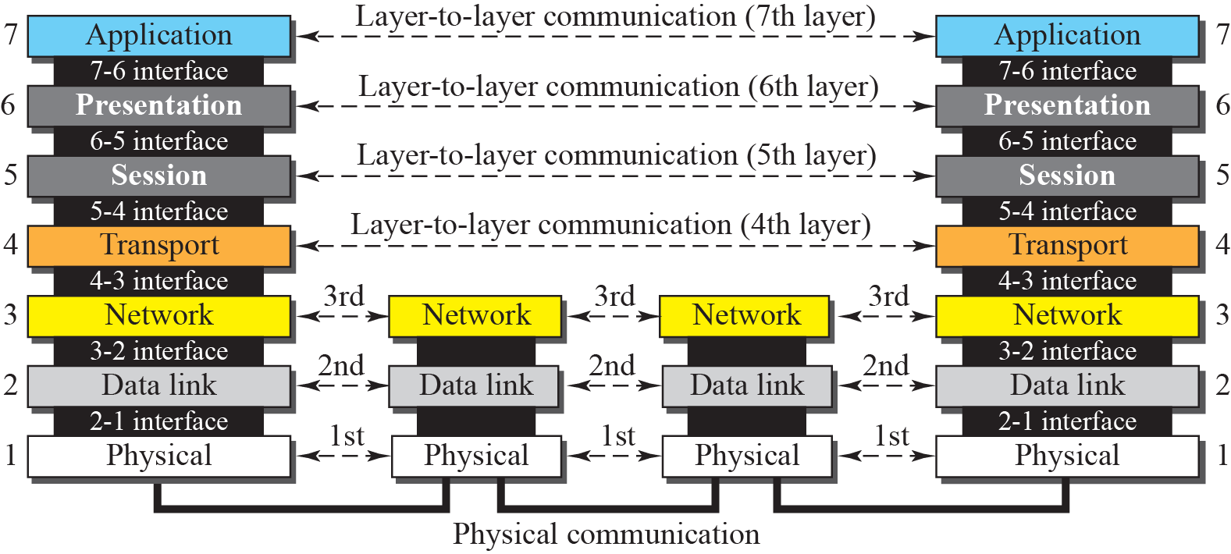
Figure 2.4 OSI layers
TCP/IP Protocol Suite

Slide 4
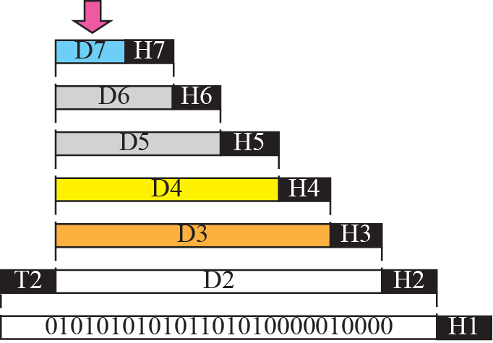


Figure 2.5 An exchange using the OSI model
TCP/IP Protocol Suite

Slide 5

Note
The physical layer is responsible for moving individual bits from one
(node) to the next.
TCP/IP Protocol Suite

Slide 6
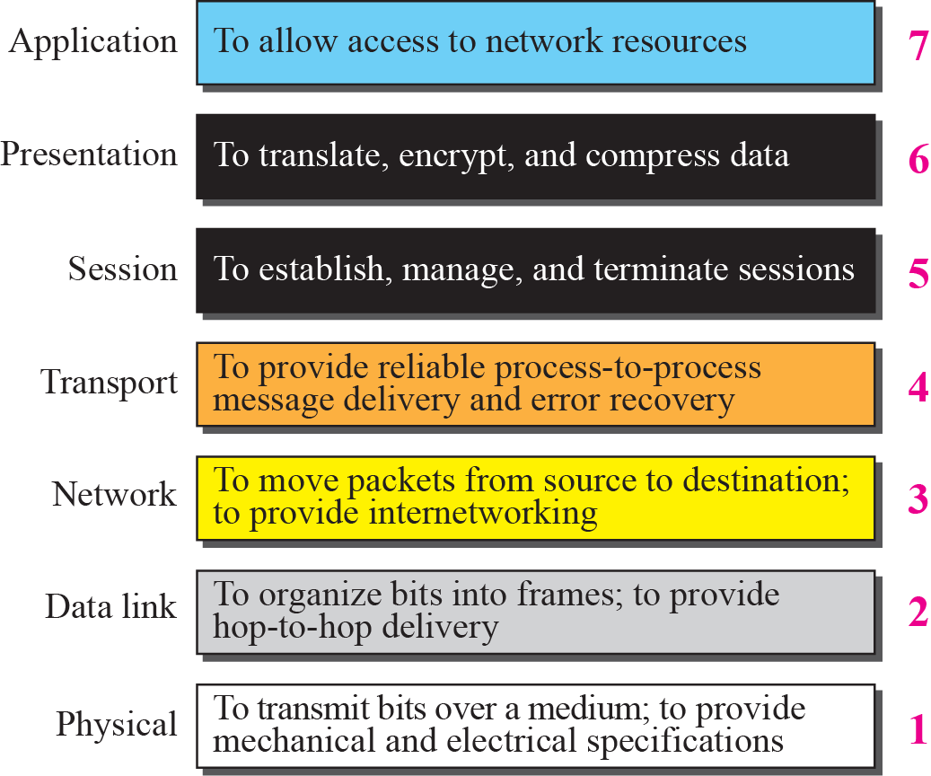
Figure 2.6 Summary of OSI Layers
CC: Task descriptions below are often questionable
TCP/IP Protocol Suite

Slide 7
2-3 TCP/IP PROTOCOL SUITE
The TCP/IP protocol suite was developed prior to the OSI model. Therefore, the layers in the TCP/IP protocol suite do not match exactly with those in the OSI model. The original TCP/IP protocol suite was defined as four software layers built upon the hardware. Today, however, TCP/IP is thought of as a five-layer model with the layers named similarly to the ones in the OSI model. Figure 2.7 shows both configurations.
TCP/IP Protocol Suite

Slide 8
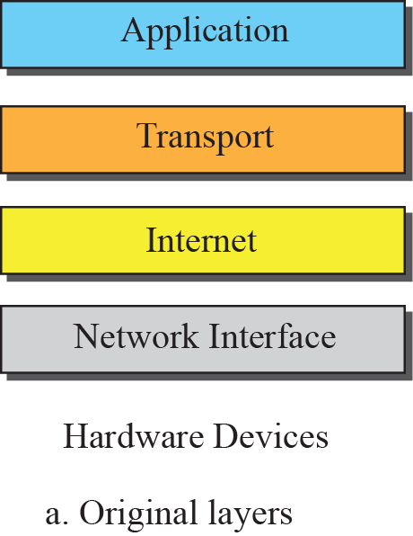
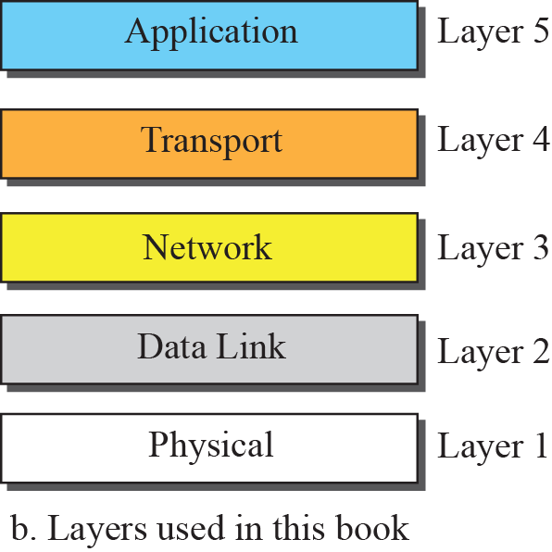

Figure 2.7 Layers in the TCP/IP Protocol Suite
TCP/IP Protocol Suite

Slide 9
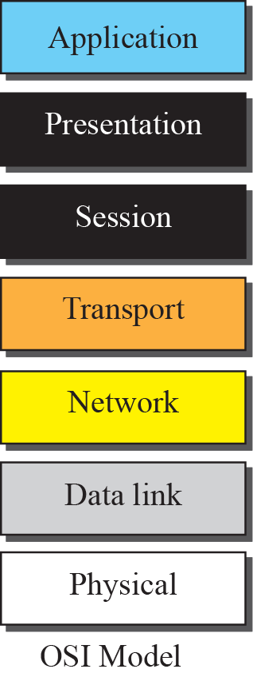
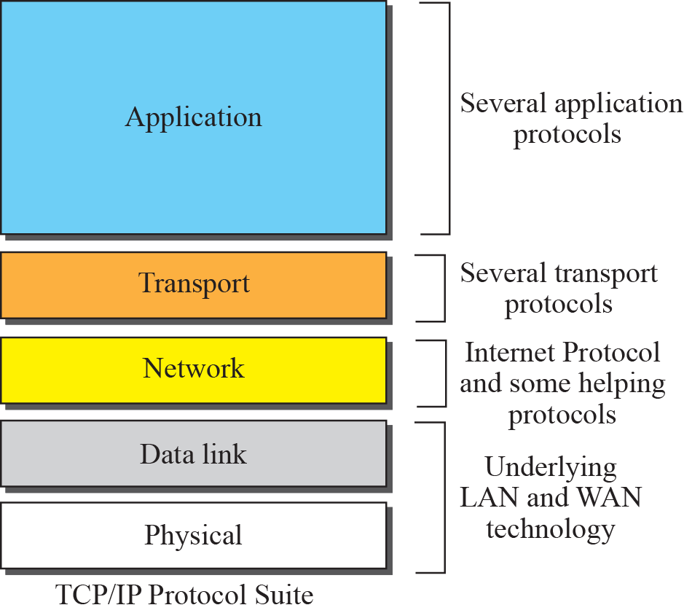
Figure 2.8 TCP/IP and OSI model
TCP/IP Protocol Suite

Slide 10
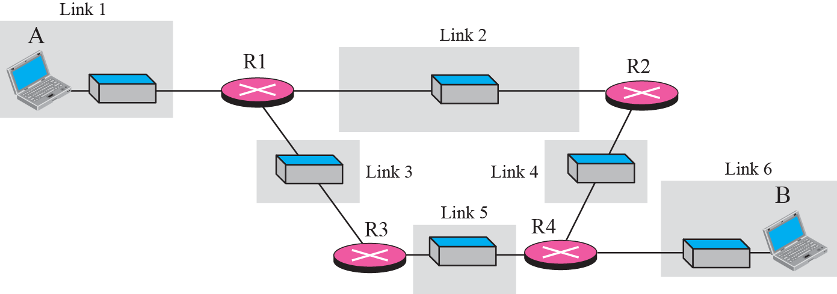
Figure 2.9 A private internet
TCP/IP Protocol Suite

Slide 11
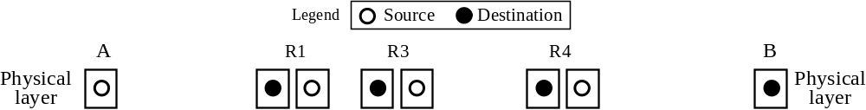





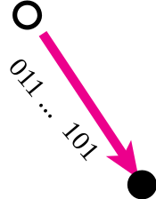


Figure 2.10 Communication at the physical layer
TCP/IP Protocol Suite

Slide 12
Note
The unit of communication at the physical layer is a bit.
TCP/IP Protocol Suite

Slide 13
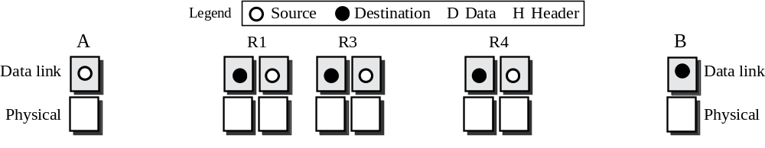
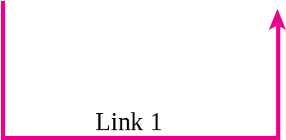
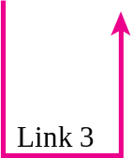


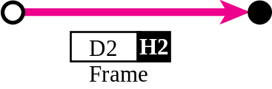
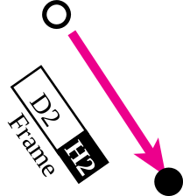
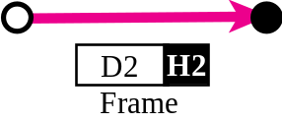

Figure 2.11 Communication at the data link layer
TCP/IP Protocol Suite

Slide 14
Note
The unit of communication at the data link layer is a frame.
TCP/IP Protocol Suite

Slide 15
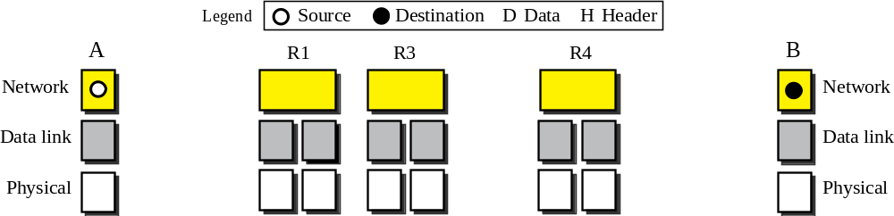

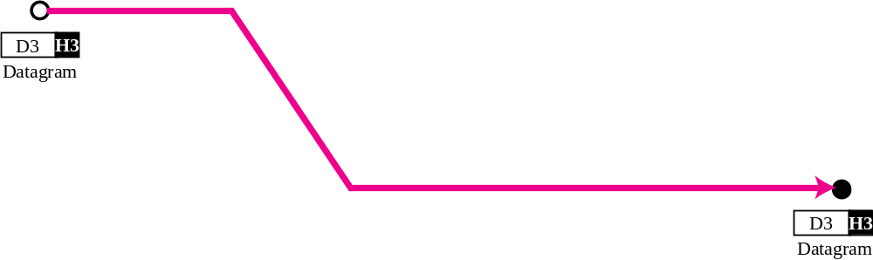
Figure 2.12 Communication at the network layer
TCP/IP Protocol Suite

Slide 16
Note
The unit of communication at the network layer is a datagram.
TCP/IP Protocol Suite

Slide 17
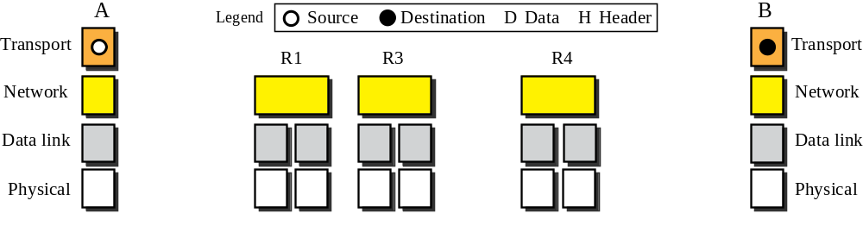

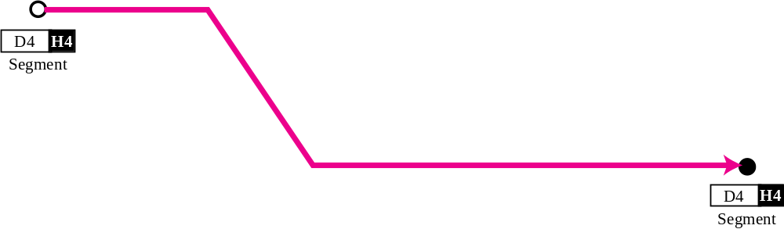
Figure 2.13 Communication at transport layer
TCP/IP Protocol Suite

Slide 18
Note
The unit of communication at the transport layer is a segment, user datagram, or a packet, depending on the specific protocol used in this layer.
TCP/IP Protocol Suite

Slide 19
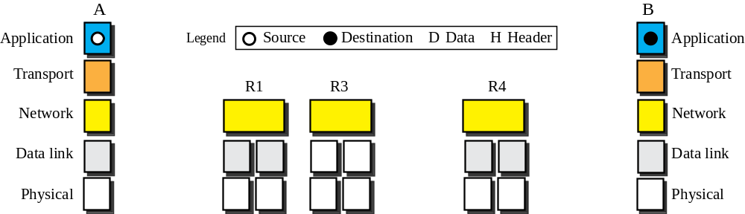

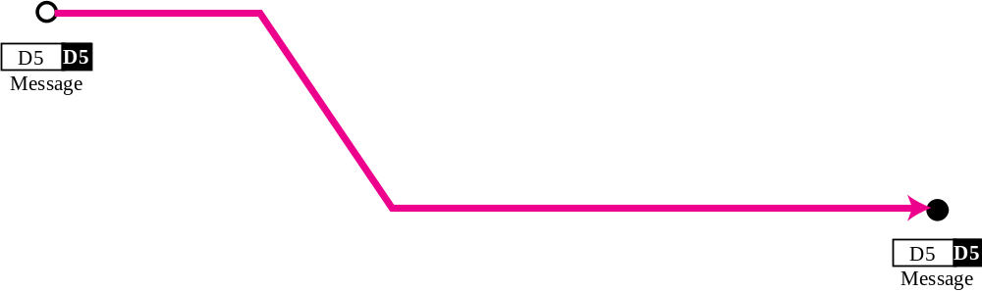
Figure 2.14 Communication at application layer
TCP/IP Protocol Suite

Slide 20
Note
The unit of communication at the application layer is a message.
TCP/IP Protocol Suite

Slide 21
2-4 ADDRESSING
Four levels of addresses are used in an internet employing the TCP/IP protocols: physical address, logical address, port address, and application-specific address. Each address is related to a one layer in the TCP/IP architecture, as shown in Figure 2.15.
TCP/IP Protocol Suite

Slide 22
Topics Discussed in the Section
Physical Addresses
Logical Addresses
Port Addresses
Application-Specific Addresses
TCP/IP Protocol Suite

Slide 23
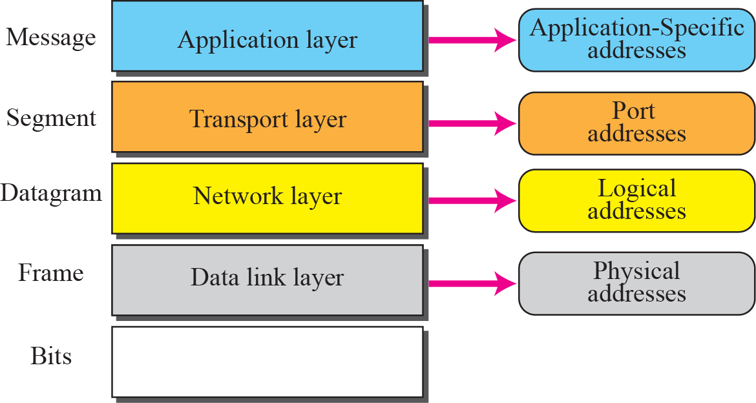
Figure 2.15 Addresses in the TCP/IP protocol suite
TCP/IP Protocol Suite

Slide 24
Example 2.3
In Figure 2.16 a node with physical address 10 sends a frame to a node with physical address 87. The two nodes are connected by a link (a LAN). At the data link layer, this frame contains physical (link) addresses in the header. These are the only addresses needed. The rest of the header contains other information needed at this level. As the figure shows, the computer with physical address 10 is the sender, and the computer with physical address 87 is the receiver. The data link layer at the sender receives data from an upper layer. It encapsulates the data in a frame. The frame is propagated through the LAN. Each station with a physical address other than 87 drops the frame because the destination address in the frame does not match its own physical address. The intended destination computer, however, finds a match between the destination address in the frame and its own physical address.
TCP/IP Protocol Suite

Slide 25
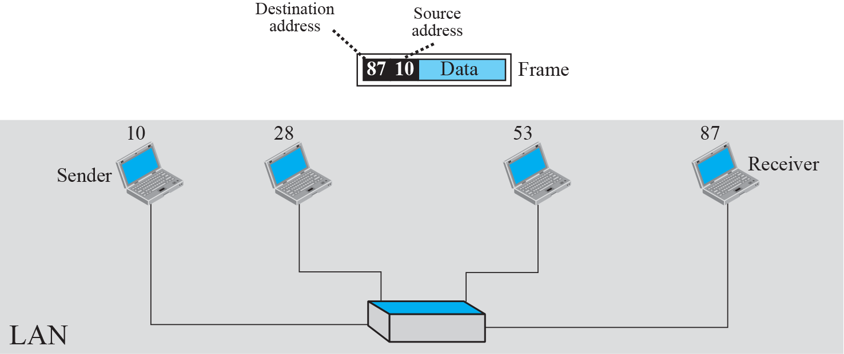
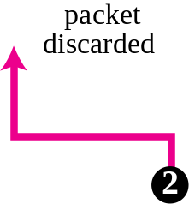
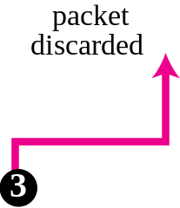
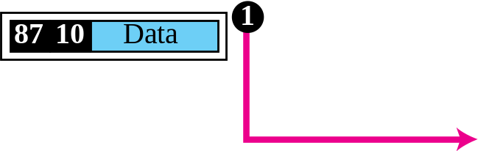
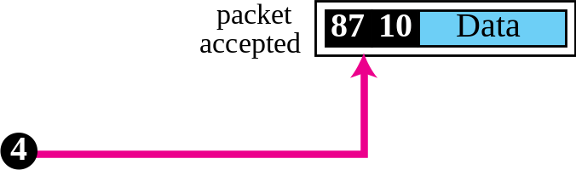
Figure 2.16 Example 2.3: physical addresses
TCP/IP Protocol Suite

Slide 26
Example 2.4
As we will see in Chapter 3, most local area networks use a 48-bit (6-byte) physical address written as 12 hexadecimal digits; every byte (2 hexadecimal digits) is separated by a colon, as shown below:
07:01:02:01:2C:4B
A 6-byte (12 hexadecimal digits) physical address
TCP/IP Protocol Suite

Slide 27
Example 2.5
Figure 2.17 shows a part of an internet with two routers connecting three LANs. Each device (computer or router) has a pair of addresses (logical and physical) for each connection. In this case, each computer is connected to only one link and therefore has only one pair of addresses. Each router, however, is connected to three networks. So each router has three pairs of addresses, one for each connection. Although it may be obvious that each router must have a separate physical address for each connection, it may not be obvious why it needs a logical address for each connection. We discuss these issues in Chapters 11 and 12 when we discuss routing. The computer with logical address A and physical address 10 needs to send a packet to the computer with logical address P and physical address 95. We use letters to show the logical addresses and numbers for physical addresses, but note that both are actually numbers, as we will see in later chapters.
TCP/IP Protocol Suite

Slide 28
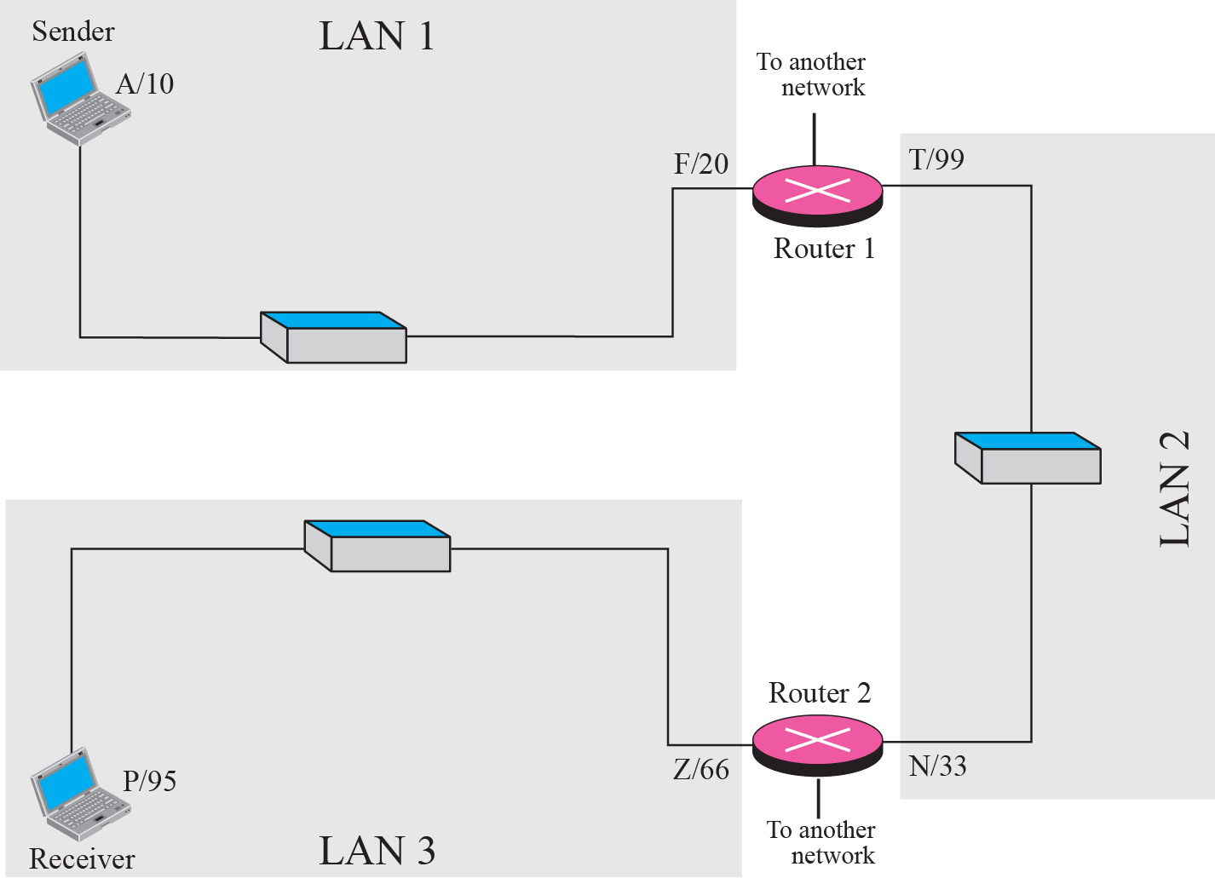
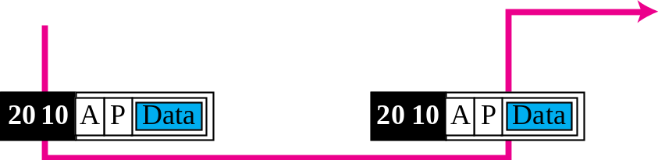
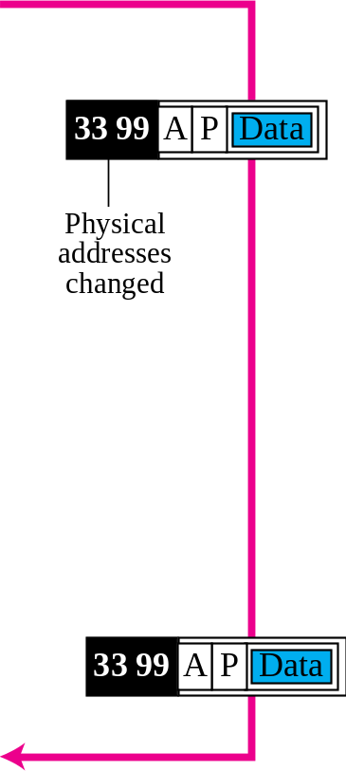
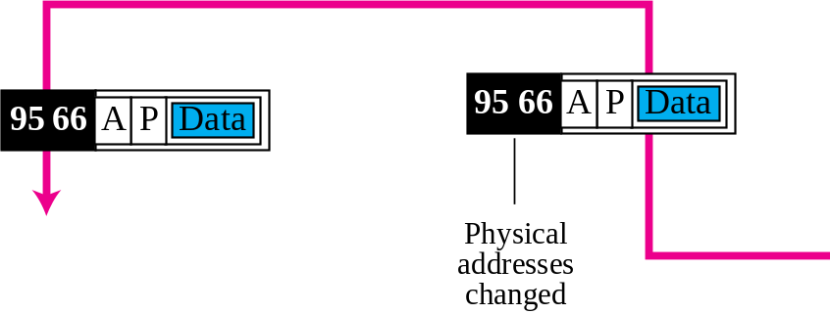
Figure 2.17 Example 2.5: logical addresses
TCP/IP Protocol Suite

Slide 29
Note
The physical addresses will change from hop to hop, but the logical addresses remain the same.
TCP/IP Protocol Suite

Slide 30
Example 2.6
Figure 2.18 shows two computers communicating via the Internet. The sending computer is running three processes at this time with port addresses a, b, and c. The receiving computer is running two processes at this time with port addresses j and k. Process a in the sending computer needs to communicate with process j in the receiving computer. Note that although both computers are using the same application, FTP, for example, the port addresses are different because one is a client program and the other is a server program, as we will see in Chapter 17.
TCP/IP Protocol Suite

Slide 31
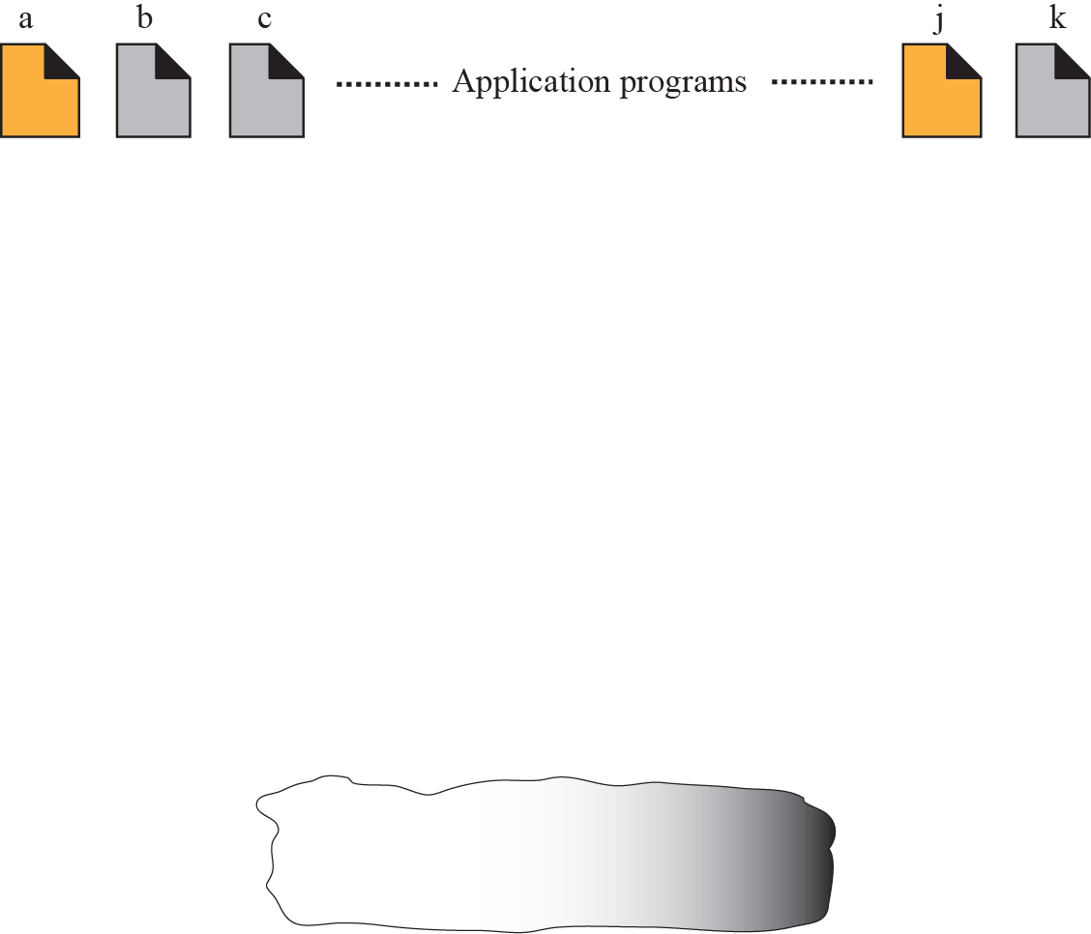
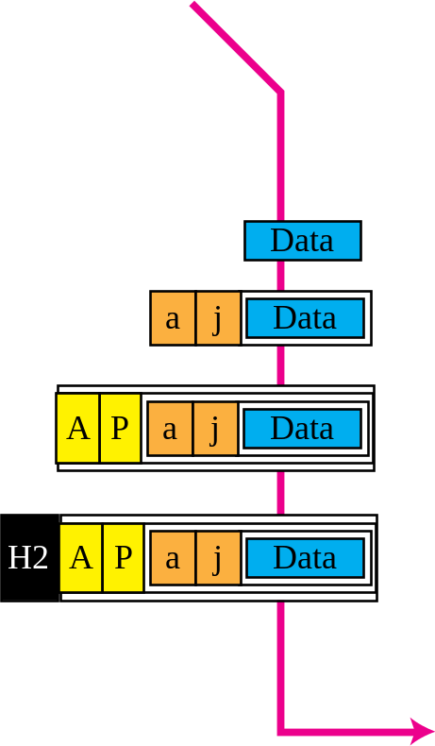
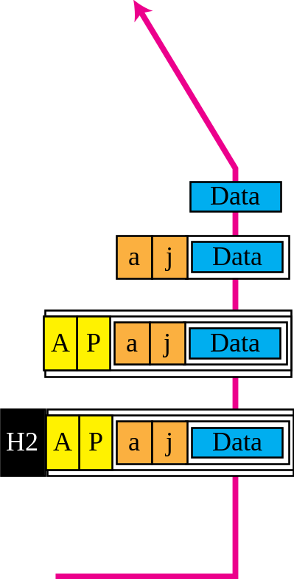


Figure 2.18 Example 2.6: port numbers
TCP/IP Protocol Suite

Slide 32
Note
The physical addresses change from hop to hop, but the logical and port addresses usually remain the same.
TCP/IP Protocol Suite

Slide 33
Example 2.7
As we will see in future chapters, a port address is a 16-bit address represented by one decimal number as shown.
753
A 16-bit port address represented as one single number
TCP/IP Protocol Suite

