Slide 1

智能体搭建信息输入
①Boundary输入
②correlation输入
③Tube&Fin选型
④期望输出表单

Slide 2
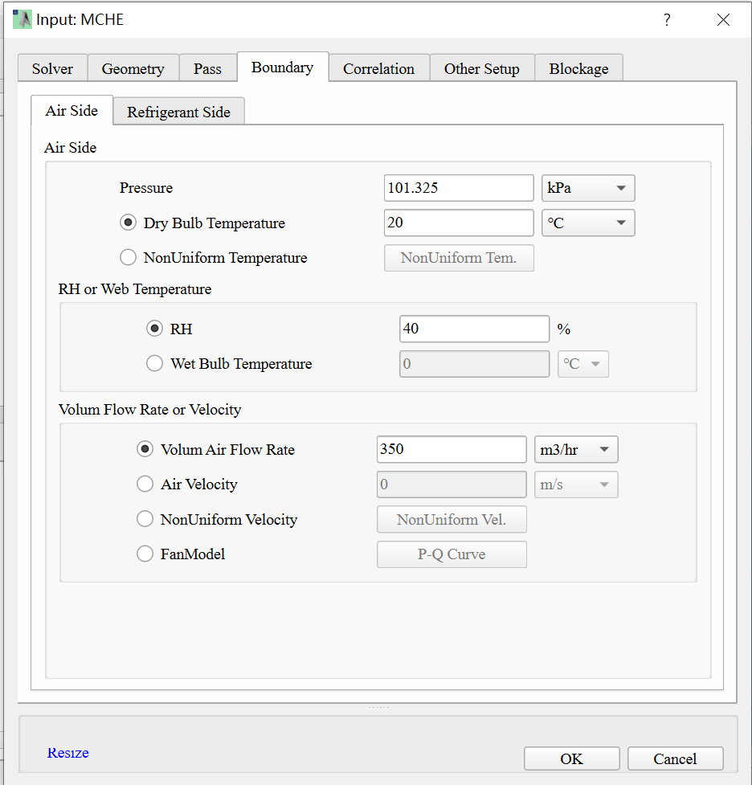
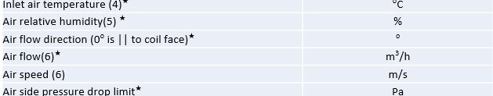
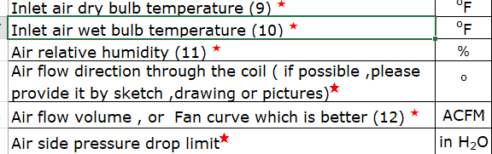
空气侧Boundary，蒸发器冷凝器通用
Inlet air temperature (4)★
Air relative humidity(5) ★
Air flow(6)★
右图为空气侧工况输入，蒸发器冷凝器通用

Slide 3
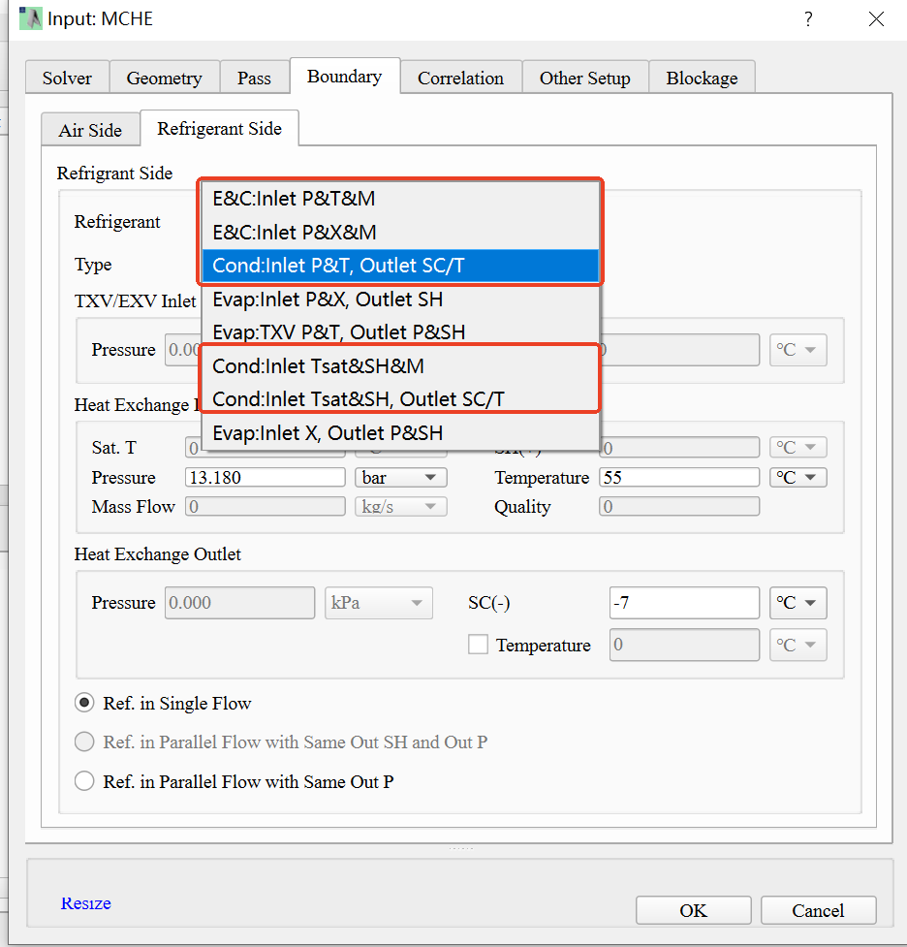
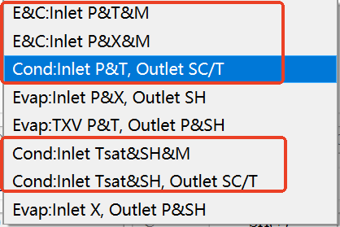
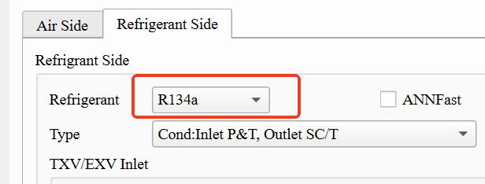
冷媒侧Boundary(冷凝器)
如图：蒸发器冷凝器冷媒侧可各选五种工况条件（E&C代表蒸发器冷凝器都适用），
根据客户输入工况信息进行条件和冷媒的选择

Slide 4
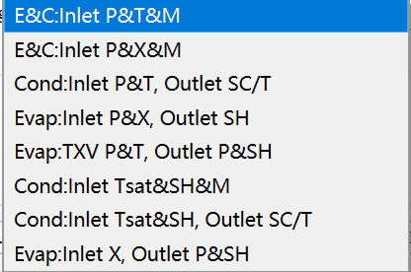
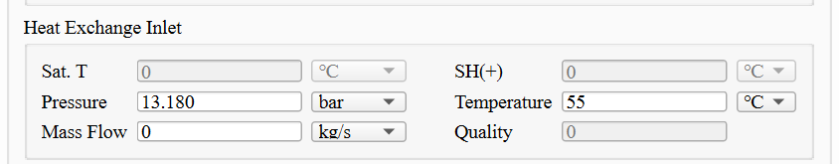
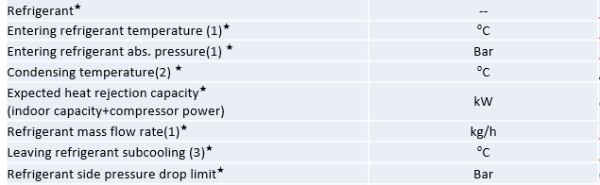
冷媒侧Boundary(冷凝器)
Entering refrigerant temperature (1)★
Entering refrigerant abs. pressure(1) ★
Refrigerant mass flow rate(1)★
模拟软件对应
客户输入冷媒侧工况信息

Slide 5
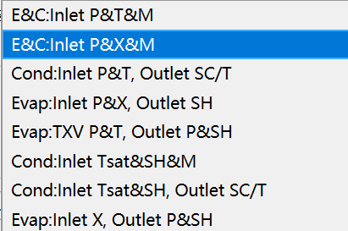
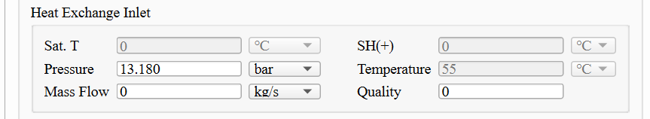
冷媒侧Boundary(冷凝器)
Entering refrigerant abs. pressure(1) ★
Refrigerant mass flow rate(1)★
Quality
模拟软件对应
客户输入冷媒侧工况信息

Slide 6
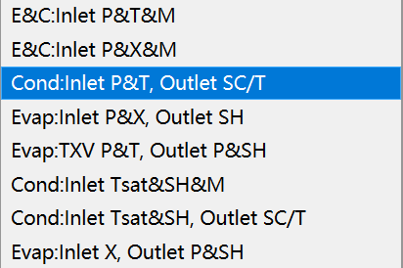
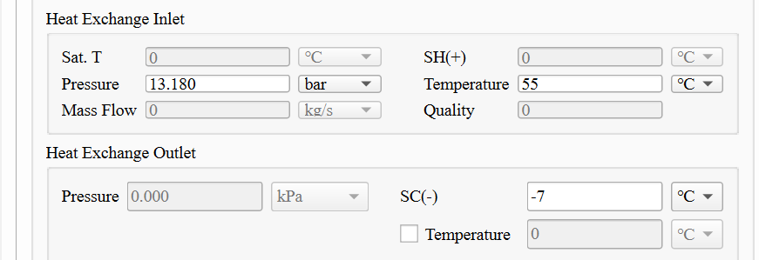
冷媒侧Boundary(冷凝器)
Entering refrigerant abs. pressure(1) ★
Entering refrigerant temperature (1)★
Leaving refrigerant subcooling (3)★
模拟软件对应
客户输入冷媒侧工况信息

Slide 7
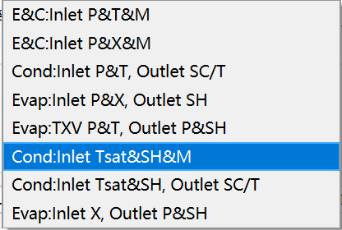
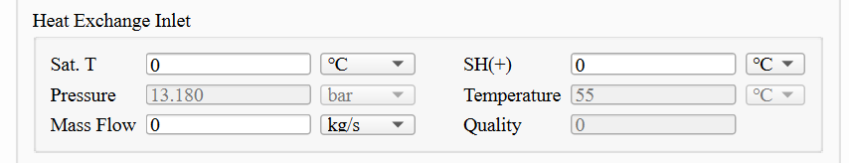
冷媒侧Boundary(冷凝器)
Condensing temperature(2) ★
SH=InletT-CondT
Refrigerant mass flow rate(1)★
模拟软件对应
客户输入冷媒侧工况信息

Slide 8
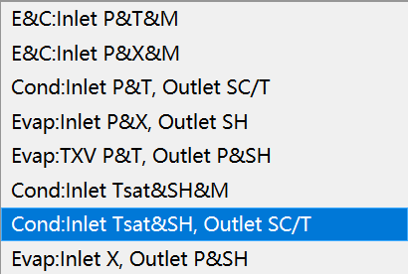
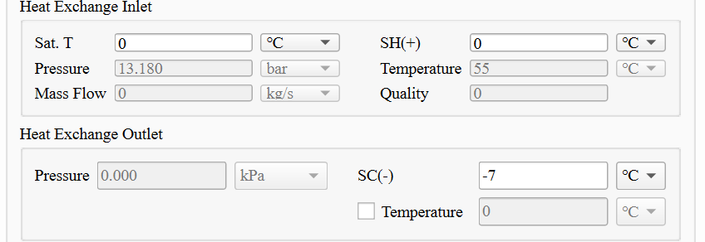
冷媒侧Boundary(冷凝器)
Condensing temperature(2) ★
SH=InletT-CondT
Leaving refrigerant subcooling (3)★
模拟软件对应
客户输入冷媒侧工况信息

Slide 9
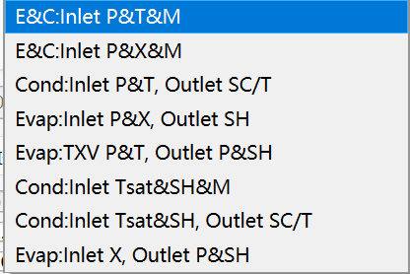
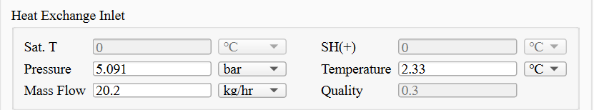
冷媒侧Boundary(蒸发器)
Refrigerant abs. pressure before valve (3)★ | psia
Refrigerant temperature before valve (3)★ | ºF
Refrigerant subcooling before valve (3) | ºF
Leaving refrigerant abs. pressure (8) ★ | psia
Leaving refrigerant temperature (8) ★ | ºF
Expected Heat rejection capacity★ | Btu/h
Refrigerant mass flow rate★ | lbm/h
Expected EER/COP
Leaving refrigerant superheat ★ | ºF
Refrigerant side pressure drop limit★ | psid
Inlet P=OutletP+Pressure drop
Inlet T=InletP对应冷媒饱和温度
客户输入冷媒侧工况信息

Slide 10
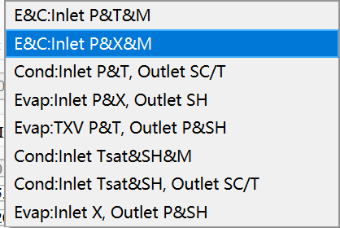
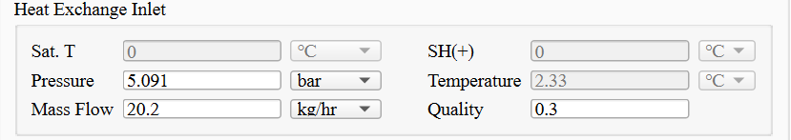
冷媒侧Boundary(蒸发器)
Refrigerant abs. pressure before valve (3)★ | psia
Refrigerant temperature before valve (3)★ | ºF
Refrigerant subcooling before valve (3) | ºF
Leaving refrigerant abs. pressure (8) ★ | psia
Leaving refrigerant temperature (8) ★ | ºF
Expected Heat rejection capacity★ | Btu/h
Refrigerant mass flow rate★ | lbm/h
Expected EER/COP
Leaving refrigerant superheat ★ | ºF
Refrigerant side pressure drop limit★ | psid
Inlet P=OutletP+Pressure drop
客户输入冷媒侧工况信息

Slide 11
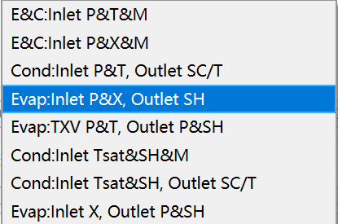
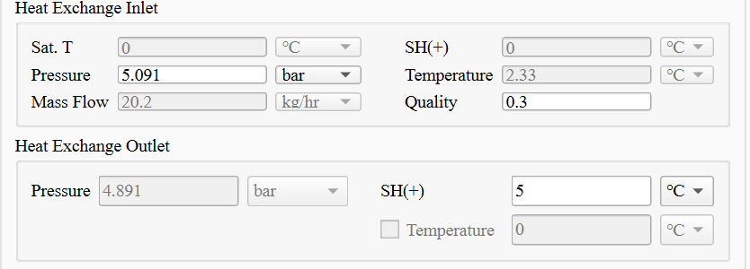
冷媒侧Boundary(蒸发器)
Refrigerant abs. pressure before valve (3)★ | psia
Refrigerant temperature before valve (3)★ | ºF
Refrigerant subcooling before valve (3) | ºF
Leaving refrigerant abs. pressure (8) ★ | psia
Leaving refrigerant temperature (8) ★ | ºF
Expected Heat rejection capacity★ | Btu/h
Refrigerant mass flow rate★ | lbm/h
Expected EER/COP
Leaving refrigerant superheat ★ | ºF
Refrigerant side pressure drop limit★ | psid
Inlet P=OutletP+Pressure drop
客户输入冷媒侧工况信息

Slide 12
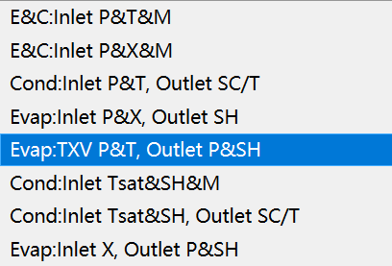
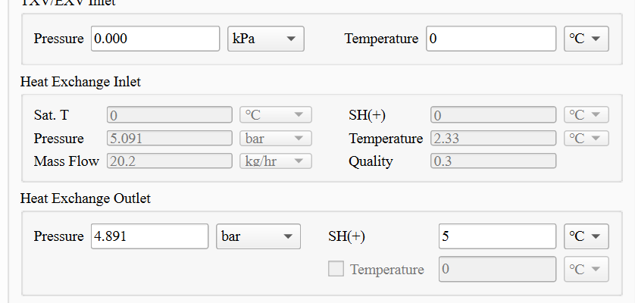
冷媒侧Boundary(蒸发器)
Refrigerant abs. pressure before valve (3)★ | psia
Refrigerant temperature before valve (3)★ | ºF
Refrigerant subcooling before valve (3) | ºF
Leaving refrigerant abs. pressure (8) ★ | psia
Leaving refrigerant temperature (8) ★ | ºF
Expected Heat rejection capacity★ | Btu/h
Refrigerant mass flow rate★ | lbm/h
Expected EER/COP
Leaving refrigerant superheat ★ | ºF
Refrigerant side pressure drop limit★ | psid
客户输入冷媒侧工况信息

Slide 13
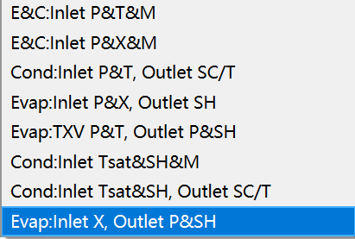
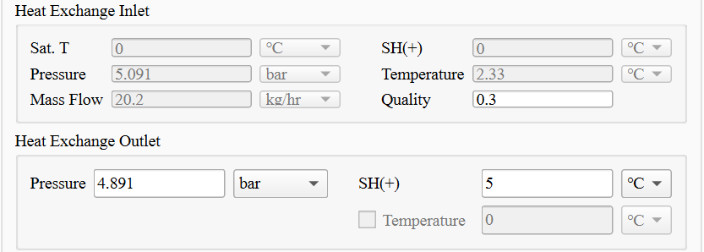
冷媒侧Boundary(蒸发器)
Refrigerant abs. pressure before valve (3)★ | psia
Refrigerant temperature before valve (3)★ | ºF
Refrigerant subcooling before valve (3) | ºF
Leaving refrigerant abs. pressure (8) ★ | psia
Leaving refrigerant temperature (8) ★ | ºF
Expected Heat rejection capacity★ | Btu/h
Refrigerant mass flow rate★ | lbm/h
Expected EER/COP
Leaving refrigerant superheat ★ | ºF
Refrigerant side pressure drop limit★ | psid
客户输入冷媒侧工况信息

Slide 14
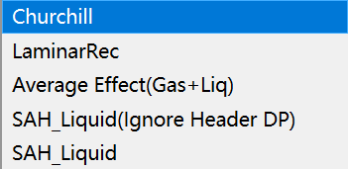
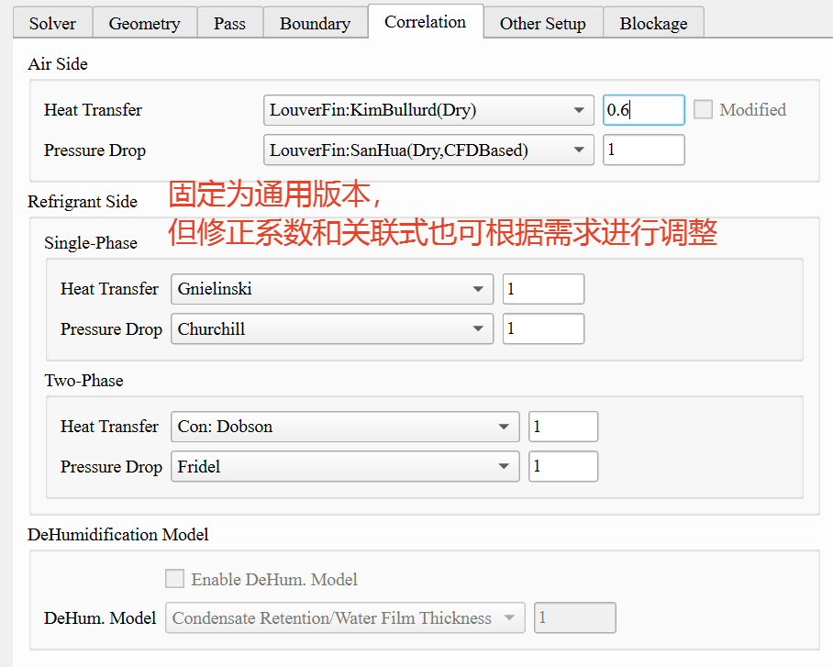
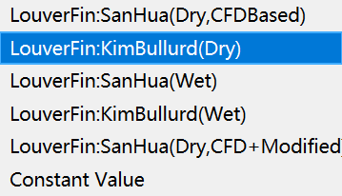

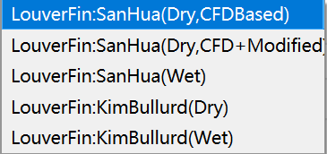
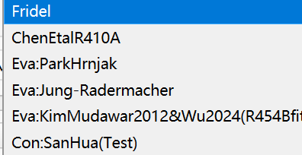
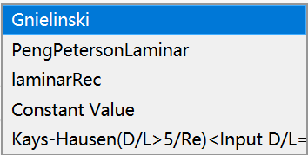
关联式（冷凝器）
关联式对应

Slide 15
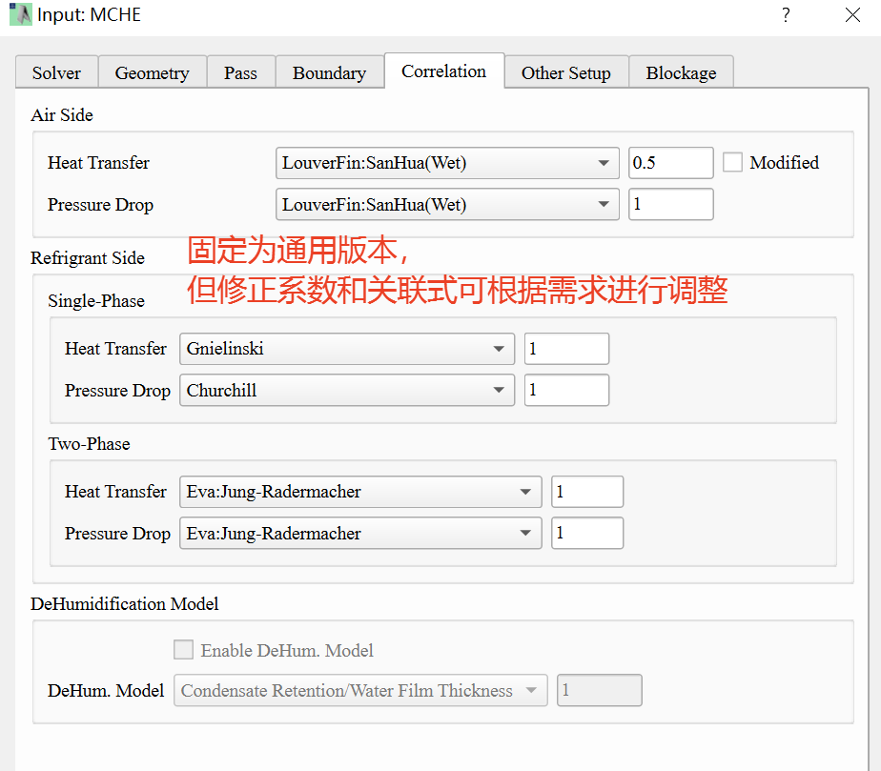
关联式（蒸发器）
关联式对应

Slide 16

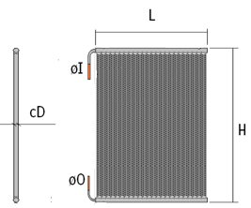
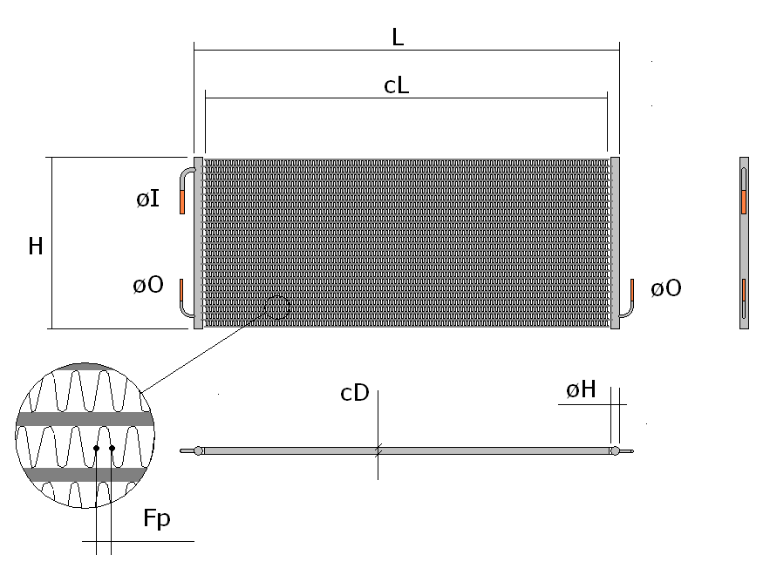
客户输入样品尺寸信息
蒸发器
冷凝器
Available Space for the Coil (Please provide coil dwg if possible)
Length (L)★ | in | mm | 600
Header Height (H)★ | in | mm | 600
需根据输入芯体长宽计算扁管翅片个数，注意单位

Slide 17
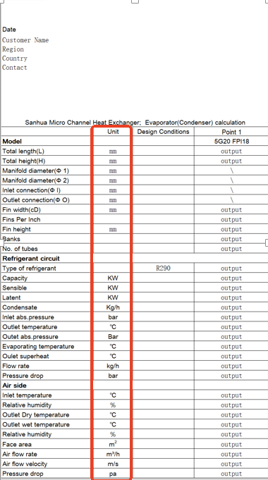
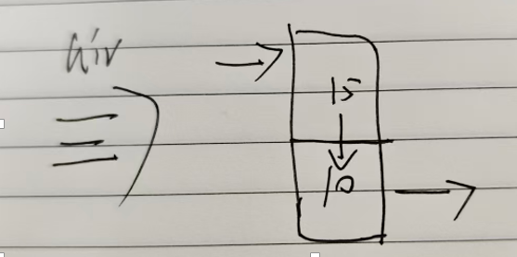
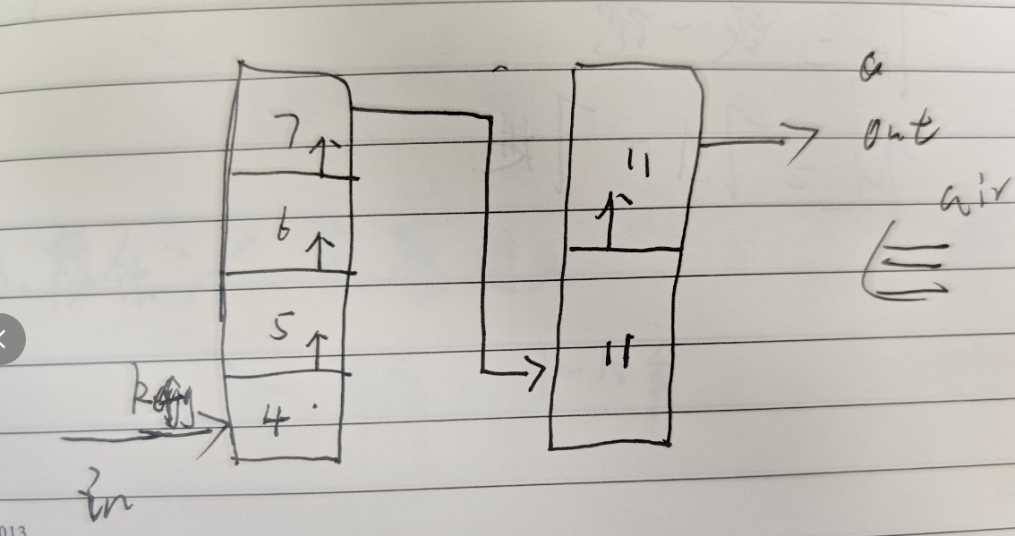
期望输出表单
流程示意（风向、
排数、流程数、冷媒流向）
日期
样品尺寸明细
冷媒侧参数
单位可切换英制、公制
空气侧参数

Slide 18
Thank you!

