Slide 1
Pattern Recognition
Homework 1 Announcement
Lastest update: 2023.03.08 13:30
Notes:
‹#›

Slide 2
Homework 1
Deadline: Mar. 22 , Wed. at 23:59
Code assignment (70%): Implement linear regression using only numpy
Questions (30%): Write your answer in detail on pdf
Question: Link
Sample code: Link
Dataset: Link
Report template: Link
Sample prediction file: Link

Slide 3
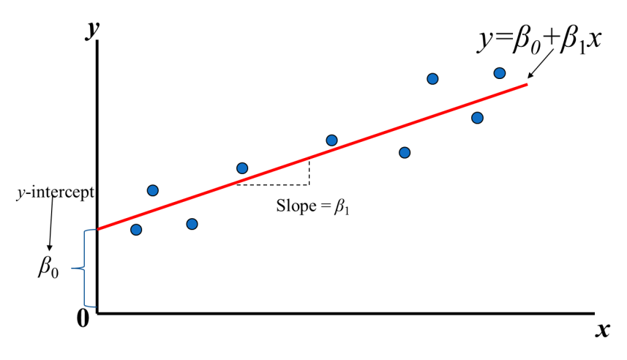
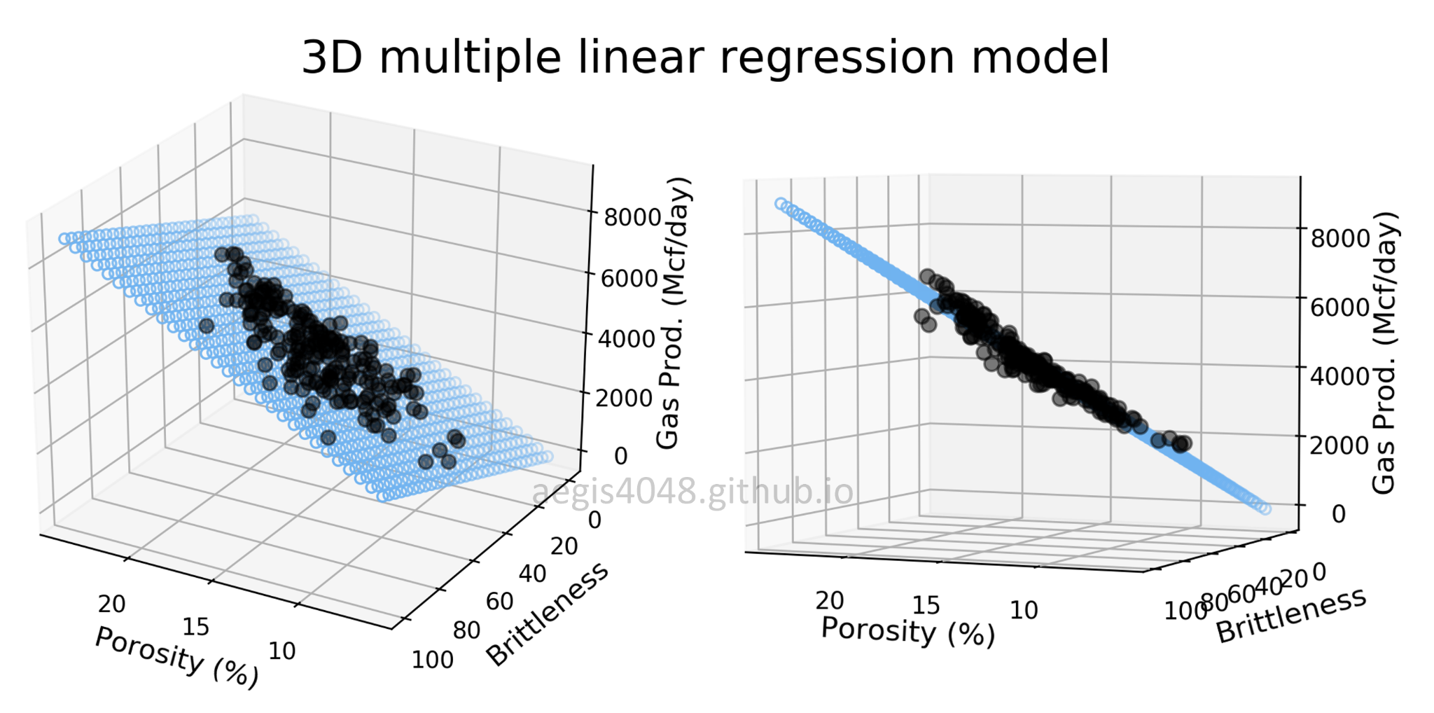
Linear Regression
Find the value of weight and intercept
https://aegis4048.github.io/mutiple_linear_regression_and_visualization_in_python

Slide 4
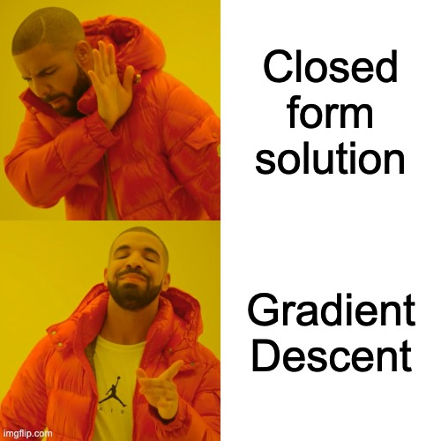
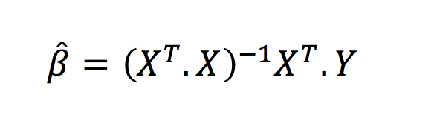
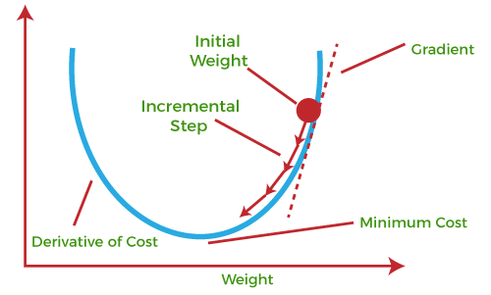
How to find β0 and β1?
Trial
and
Error
β0 = -2, -1, 0, 1, 2,...
β1 = 1, 2, 3, 4, 5,...
Closed
form
solution
Gradient
Descent
https://www.javatpoint.com/gradient-descent-in-machine-learning

Slide 5
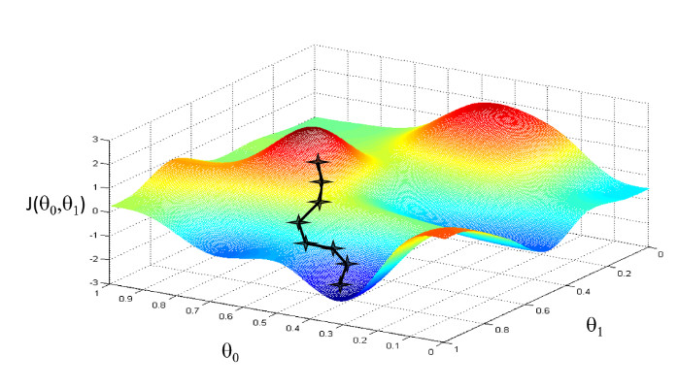
Gradient Descent
x-axis and y-axis represent the value of weights
z-axis represents the loss of the corresponding weights
Goal: Find the weights that minimize the loss
https://www.linkedin.com/pulse/gradient-descent-visualization-python-ibrahim-sobh/

Slide 6
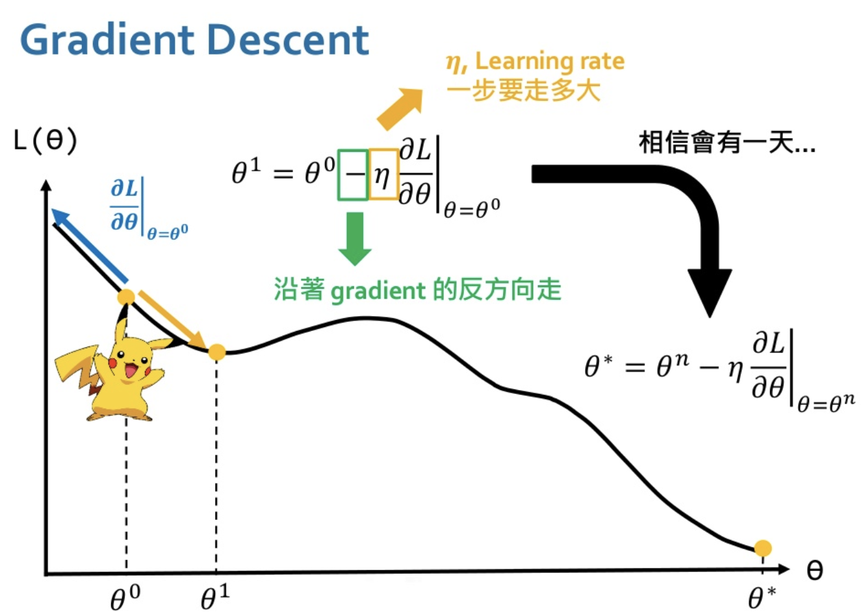
Gradient Descent
Gradient tells the direction
Learning rate: How far for one step
Believe that in one day…
Move in the opposite direction of the gradient
https://www.youtube.com/watch?v=yKKNr-QKz2Q

Slide 7
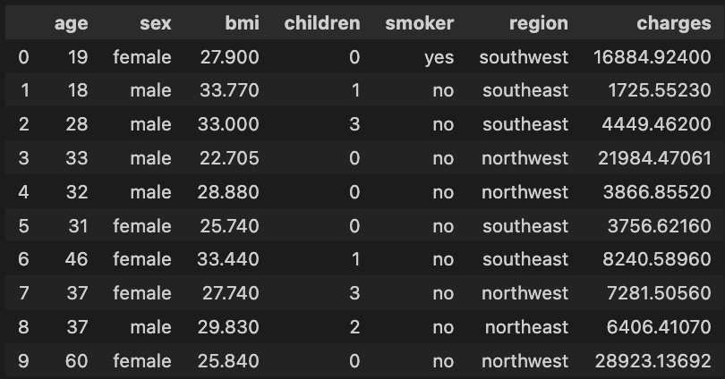
Dataset
Medical Insurance Charges Forecast
Training set: 938
Validation set: 200
Testing set: 200

Slide 8
Dataset
Medical Cost Personal Datasets:
age: age of primary beneficiary
sex: insurance contractor gender, female, male
bmi: Body mass index, providing an understanding of body, weights that are relatively high or low relative to height, objective index of body weight (kg / m ^ 2) using the ratio of height to weight, ideally 18.5 to 24.9
children: Number of children covered by health insurance / Number of dependents
smoker: Smoking
region: the beneficiary's residential area in the US, northeast, southeast, southwest, northwest.
charges: Individual medical costs billed by health insurance.
6 features, 1 target

Slide 9
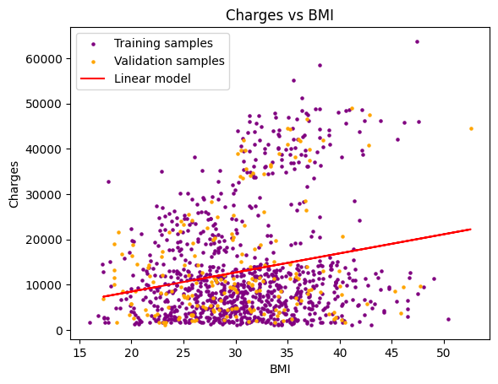
Single Feature Linear Regression (25%)
Train linear regression model by gradient descent using only bmi feature.
Tune the learning rate and epoch to get the same results as sklearn
Reference parameters from sklearn:
Intercept: 1382
Weight: 380

Slide 10
Multiple Features Linear Regression (25%)
Train linear regression model by gradient descent using all six features.
Tune the learning rate and epoch to get the same results as sklearn
Reference parameters from sklearn:
Intercepts: [-11857]
Weights: [[259] [-383] [333] [442] [24032] [-416] ]
label encoding (see sample code)

Slide 11
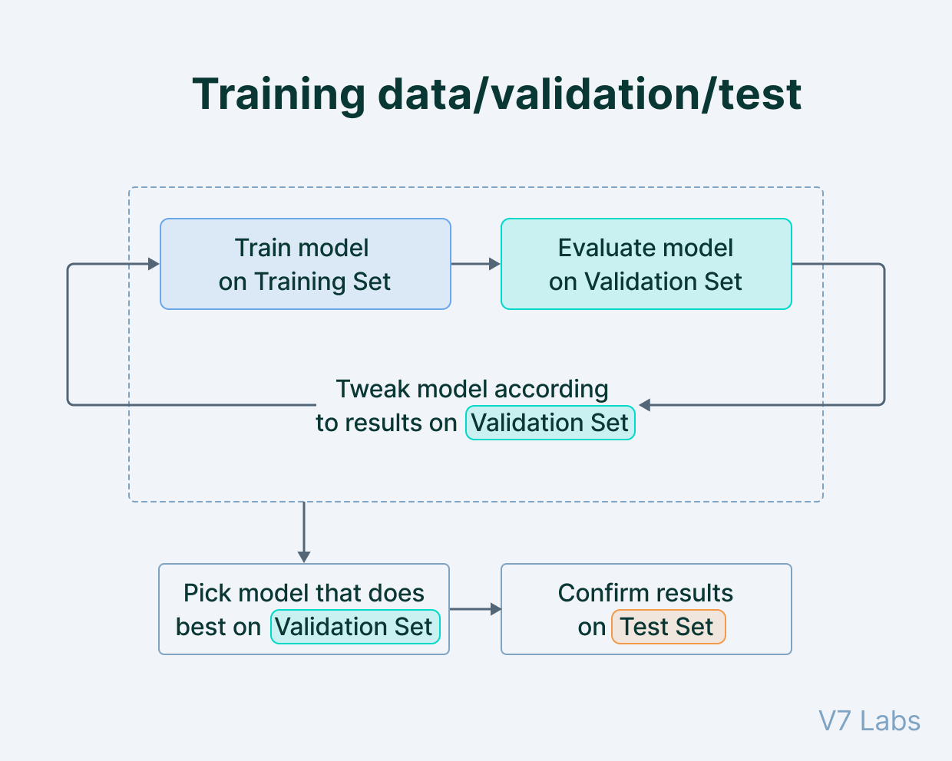
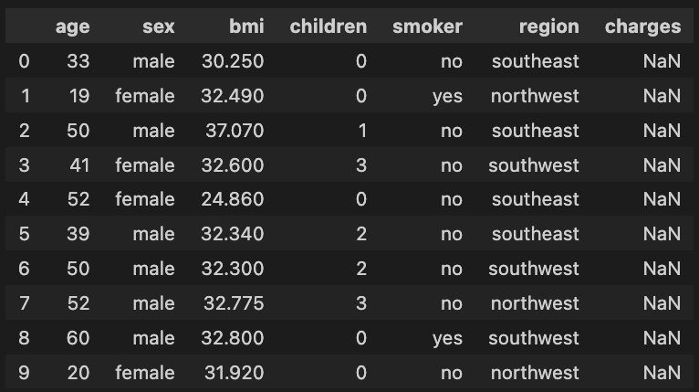
Train your own model (20%)
In this part, you can choose any learning rate, epoch, batch_size, and features you want to train your model to beat the baseline.
Explain in detail how you choose the parameters in the report.
Predict for the testing data and save the result into a csv file (refer to sample prediction.csv)
TA will evaluate your testing performance using your csv file.
https://www.v7labs.com/blog/train-validation-test-set

Slide 12
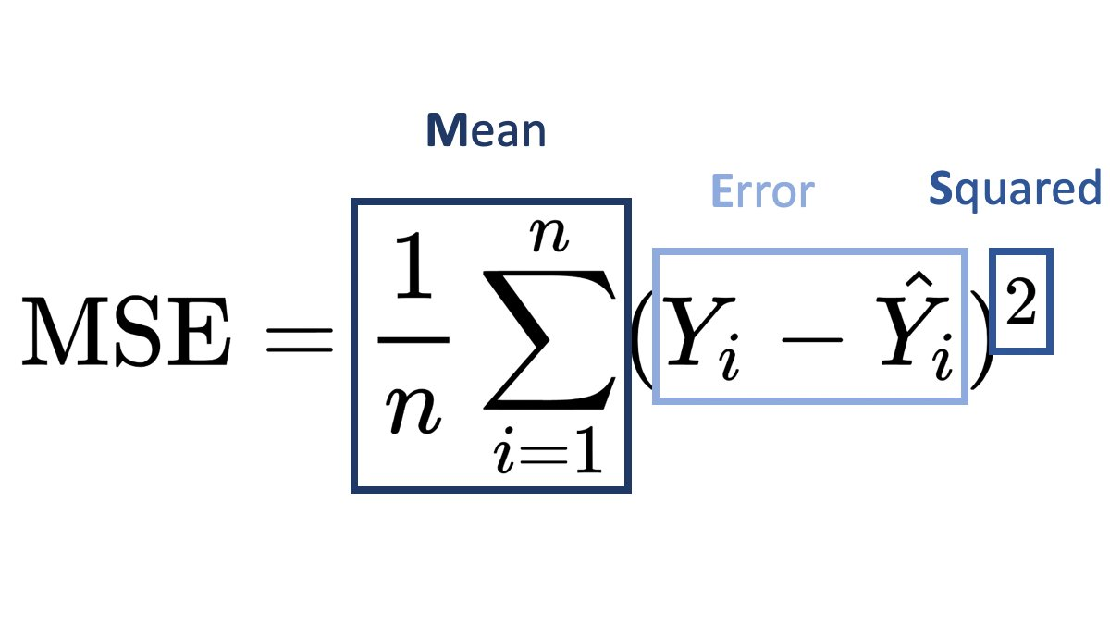
Train your own model (20%)
Evaluation will be based on the testing mse loss.
Testing data distribution is guaranteed to be similar with validation data.
Explain your method in detail in report. Otherwise, extra penalty.
Points | Test MSE
20 | < 30000000
15 | < 40000000
10 | < 50000000
5 | 50000000 ~ 100000000
0 | > 100000000

Slide 13
Data Analysis / Pre-processing
Which features to be used?
Different label encoding strategy?
Feature Importance?
Data distribution / normalization?
Different feature weights?
How to create more features?

Slide 14
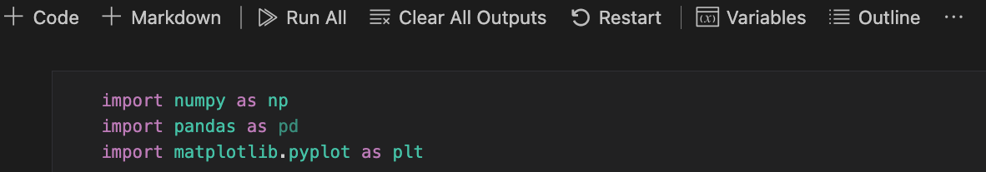
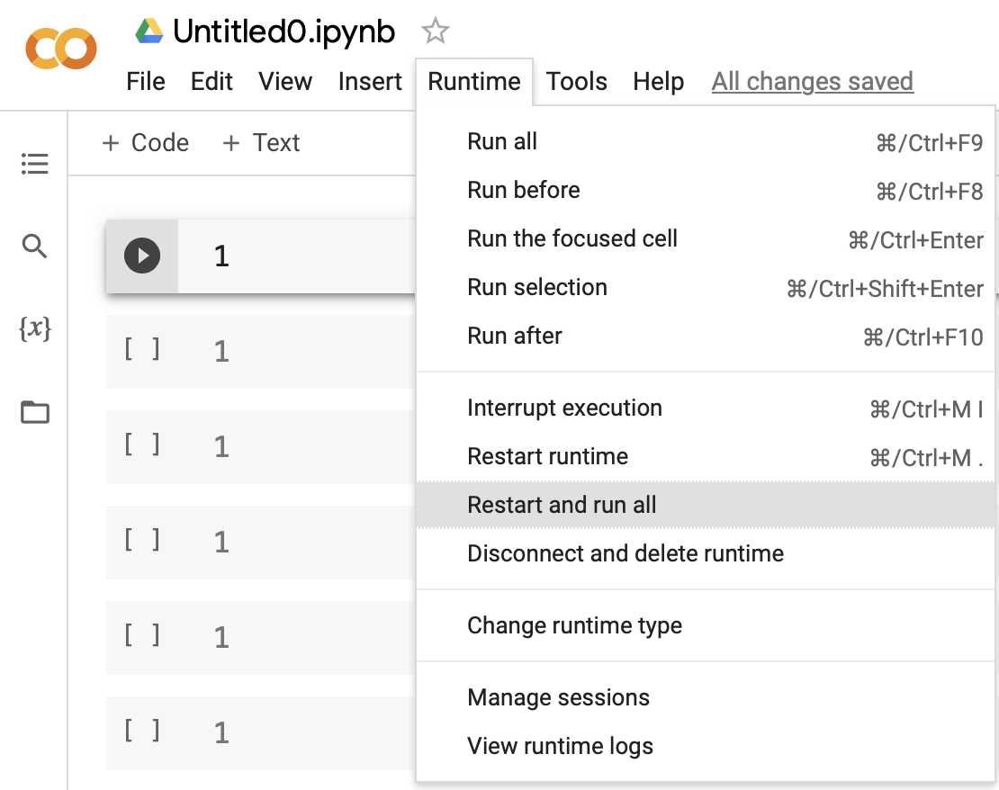
Submission
Compress your .ipynb, .pdf, and .csv into zip file and submit on E3.
Before submission:
Restart and Run All
Save and submit the .ipynb (keep all the cell outputs)
Get 0 points if you do not keep the cell outputs.
<STUDENT ID>_HW1.zip
<STUDENT ID>_HW1.ipynb
<STUDENT ID>_HW1.pdf
<STUDENT ID>_prediction.csv

Slide 15

Late policy
We will deduct a late penalty of 20 points per additional late day
For example, If you get 90 points but delay for two days, your will get only 90- (20 x 2) = 50 points!

Slide 16
FAQ
Why my loss is high and the training can not converge
Make sure you calculate the gradients correctly
Use smaller learning rate
Can I use deep learning frameworks such as TensorFlow, PyTorch?
No! In HW1, you are request using only Numpy to implement linear regression and gradien descent. You can use matplotlib to plot the results.
DO NOT CHEAT! Otherwise, you will get 0 points for the homework.
If you have any questions, ask on E3 first! We will reply as soon as possible.

Slide 17
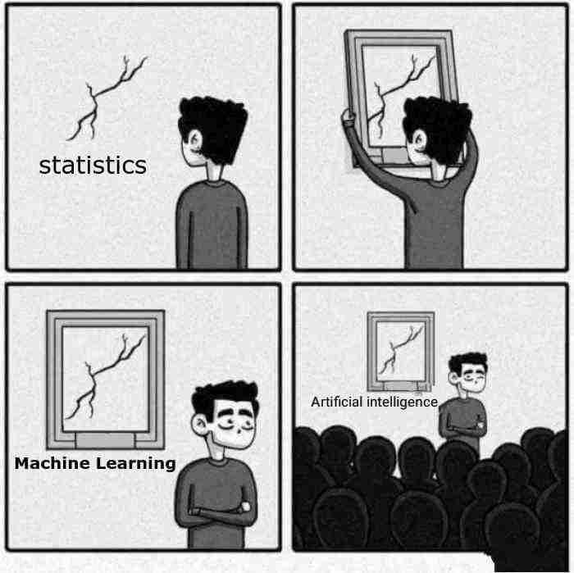
Have Fun!

