Slide 1
Pattern Recognition
Homework 4 Announcement
Lastest update: 2023.05.03 12:00
Notes:
‹#›

Slide 2
Homework 4
Deadline: May. 17, Wed. at 23:59
Code assignment (50%)
Implement Cross-Validation and Grid Search for SVM training using only NumPy.
Questions (50%)
Write your answer in detail in the report.
Question: Link
Sample code: Link
Dataset: Link

Slide 3
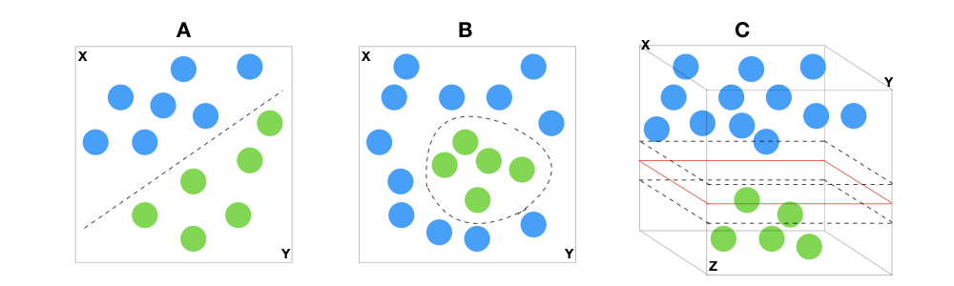
Support Vector Machines
The Support Vector Classifier aims to identify the optimal hyperplane for separating distinct classes by maximizing the distance between the sample points and the hyperplane.

Slide 4

Support Vector Machines
Since SVM involves complex mathematical operations, you are allowed to use the SVM implementation available in the sklearn library instead of implementing it from scratch.

Slide 5
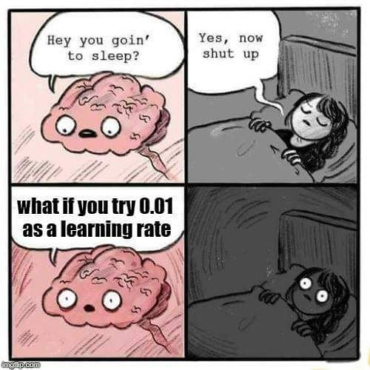
Grid Search and K-Fold Cross-Validation
There are many hyperparameters in SVM.
For this homework, you need to perform grid search and cross-validation to find the best hyperparameters for SVM on the provided dataset.

Slide 6
Grid Search
Suppose we want to find the optimal values of two hyperparameters for an RBF kernel SVM, namely C and gamma.
There are numerous combinations that need to be considered!
Interactive demo

Slide 7
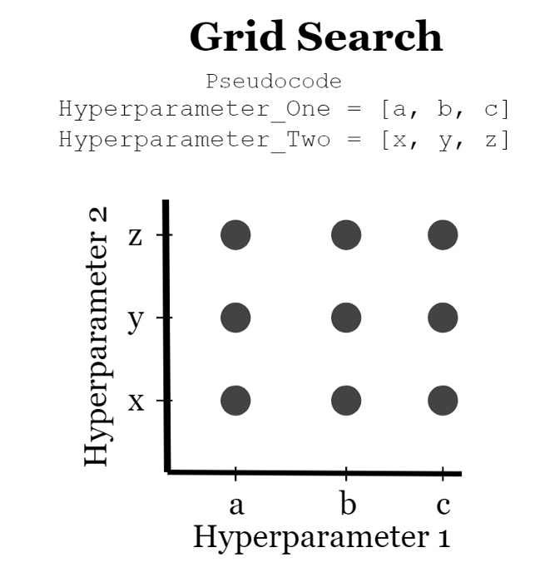
Grid Search
Grid search explores all possible hyperparameter combinations and selects the best set of hyperparameters based on the model's performance.
C = [0.1, 1, 10] #3 values
gamma = [0.01, 0.1, 1, 10] #4 values
# There are totally 12 combinations for tuning
C\gamma | 0.01 | 0.1 | 1 | 10
0.1 | [0.1, 0.01] | [0.1, 0.1] | [0.1, 1] | [0.1, 10]
1 | [1, 0.01] | [1, 0.1] | [1, 1] | [1, 10]
10 | [10, 0.01] | [10, 0.1] | [10, 1] | [10, 10]

Slide 8
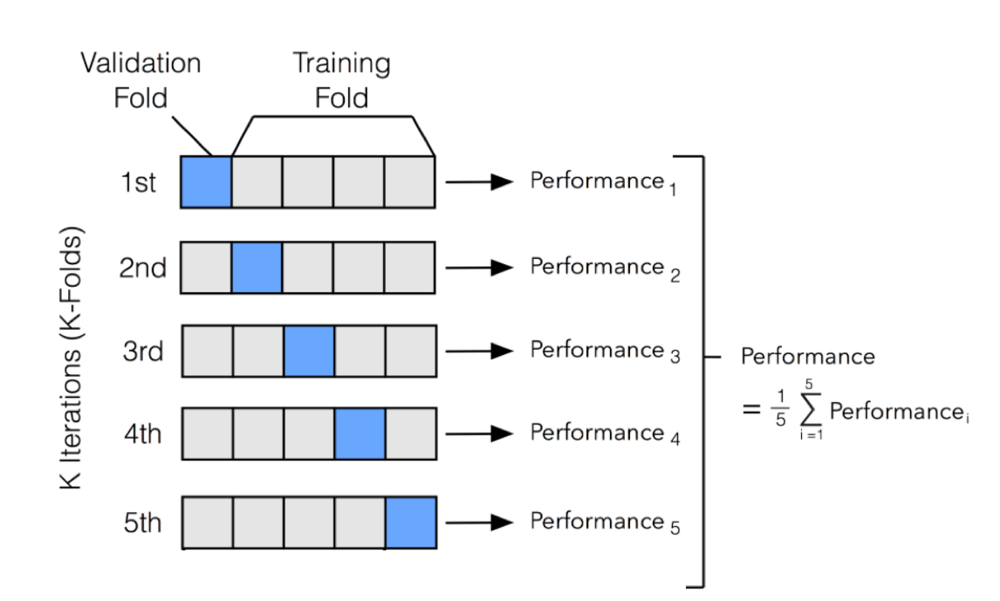
K-Fold Cross-Validation
We divide the dataset into K subsets.
One subset is used for validation.
The remaining K-1 subsets are combined to form the training set.
This process is repeated K times, with each subset used once as the validation data.
Training set

Slide 9
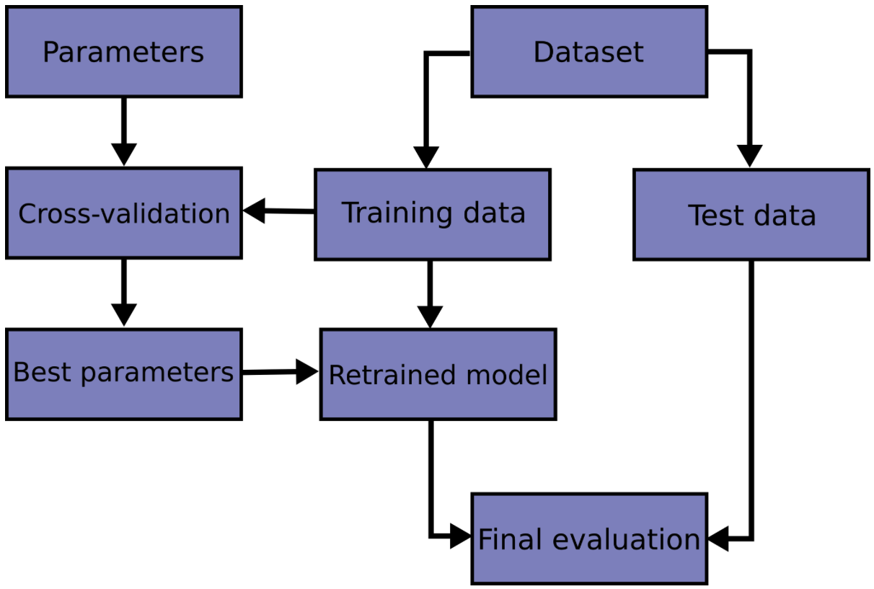
K-Fold Cross-Validation
Below is the workflow for k-fold cross-validation.

Slide 10
Grid Search and K-Fold Cross-Validation
C = [0.1, 1, 10] #3 values
gamma = [0.01, 0.1, 1, 10] #4 values
We can experiment with 12 (3 x 4) combinations of hyperparameters as defined on page 7.
For each combination, we can apply K-fold cross-validation and calculate the average performance.
Find the combination that yields the best performance.
Training set
Combination 1: [0.1, 0.01] avgerage score=0.8
Combination 2: [0.1, 0.1] avgerage score=0.91
Combination 12:[10, 10] avgerage score=0.75
Training set
Training set

Slide 11
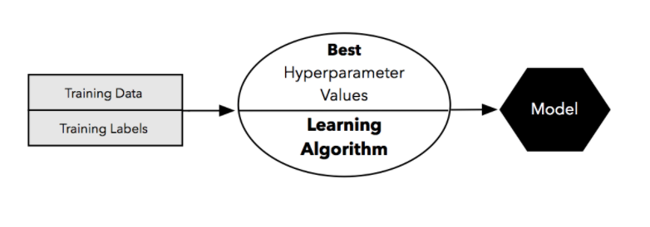
Grid Search and K-Fold Cross-Validation
Finally, train your model on the entire training set using the best hyperparameters, and evaluate the model's performance on the test set.
C=0.1, Gamma = 0.1 from combination 2
evaluate
Test set

Slide 12

Questions (50%)
(10%) Implement K-fold data partitioning using numpy.

Slide 13
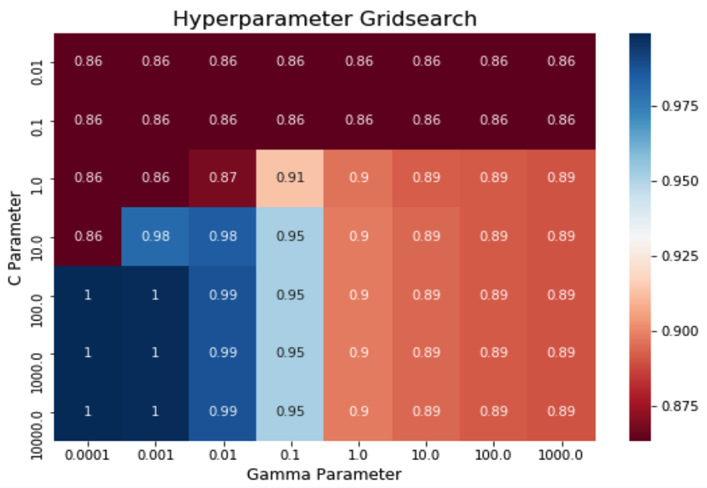
Questions (50%)
(10%) Perform a grid search on the hyperparameters C and gamma to identify the optimal values using cross-validation implemented by NumPy.
(10%) Plot the results of your SVM's grid search.

Slide 14
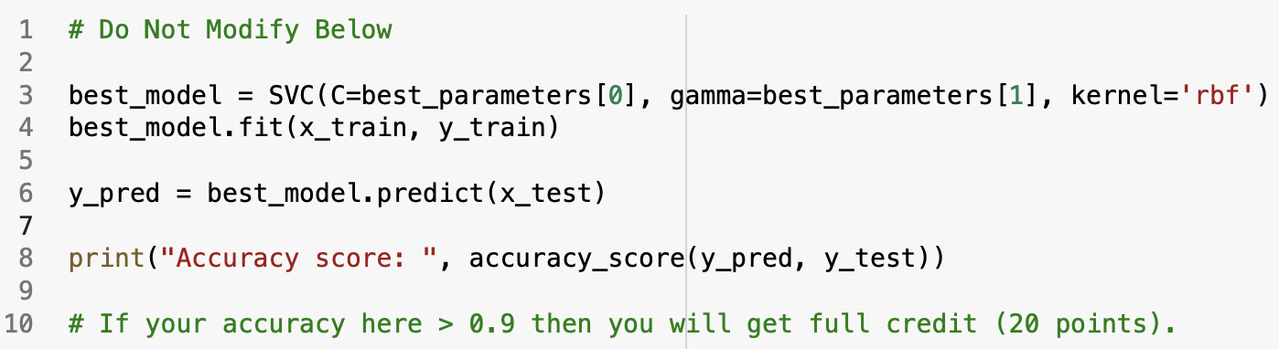
Questions (50%)
(20%) Train your SVM model using the best hyperparameters found in Q2 on the entire training dataset, then evaluate its performance on the test set. Print your testing accuracy.
Accuracy | Your scores
acc > 0.9 | 20 points
0.85 <= acc <= 0.9 | 10 points
acc < 0.85 | 0 points

Slide 15
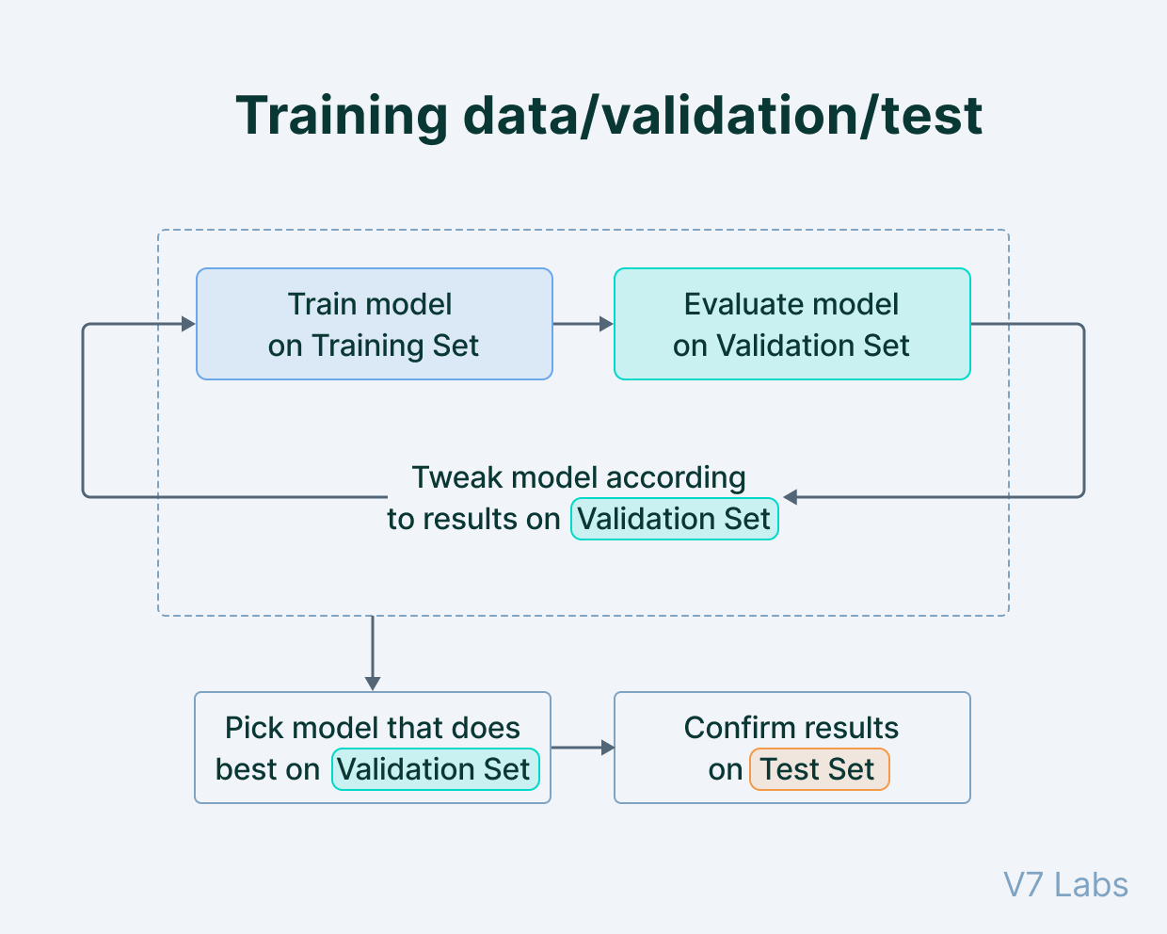
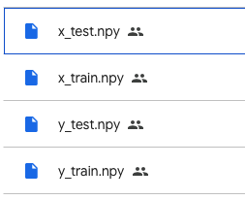
Dataset
Training set: 7000
Testing set: 3000
300 features, 2 labels

Slide 16
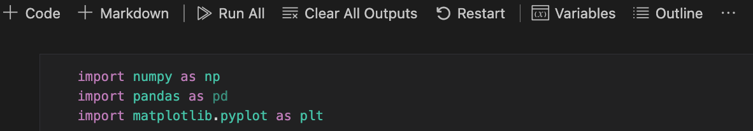
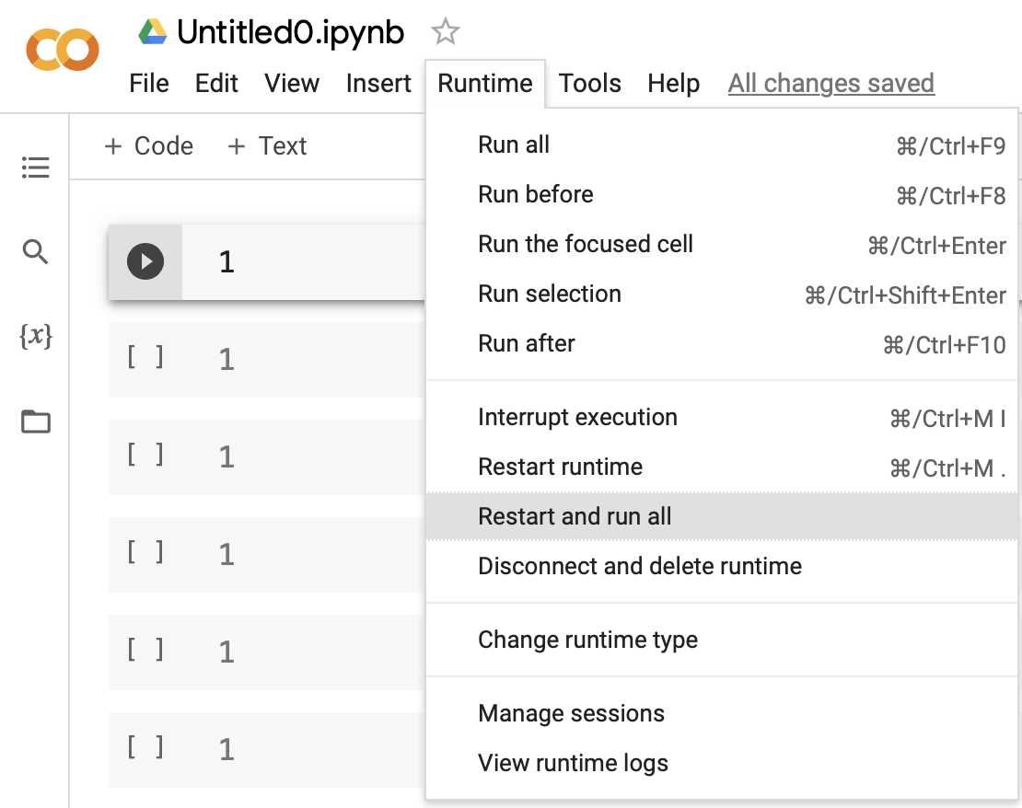

Submission
Compress your .ipynb and .pdf into a zip file and submit it on E3.
Before submission:
Restart and run All
Save and submit the .ipynb (keep all cell outputs)
Get 0 points if you do not keep the cell outputs.
<STUDENT ID>_HW4.zip
<STUDENT ID>_HW4.ipynb
<STUDENT ID>_HW4.pdf
No csv file in HW4.
For your reference

Slide 17
Report
Please write your report in English.
Please follow the HW1 report template.
You must type the answer and also screenshot at the same time for the coding part.
Answer each question as clearly as possible. You will get an extra penalty for only the brief answer.

Slide 18

Late policy
We will deduct a late penalty of 20 points per additional late day.
If you get 90 points but delay for two days, you get 90 - (20 x 2) = 50 points!
We only accept submissions that are up to 10 minutes late. Any submissions that are later than that will be considered late, regardless of the reason.

Slide 19
Reference
K-fold Cross-Validation & Grid Search
SVM hyperparameter tuning

