Slide 1
Pattern Recognition
Homework 3 Announcement
Lastest update: 2023.04.22 21:00
Notes:
‹#›

Slide 2
Homework 3
Deadline: Apr. 26,Wed. at 23:59
Code assignment (70%)
Implement Decision Tree and Random Forest using only NumPy.
Questions (30%)
Write your answer in detail in the report.
Question: Link
Sample code: Link
Dataset: Link

Slide 3
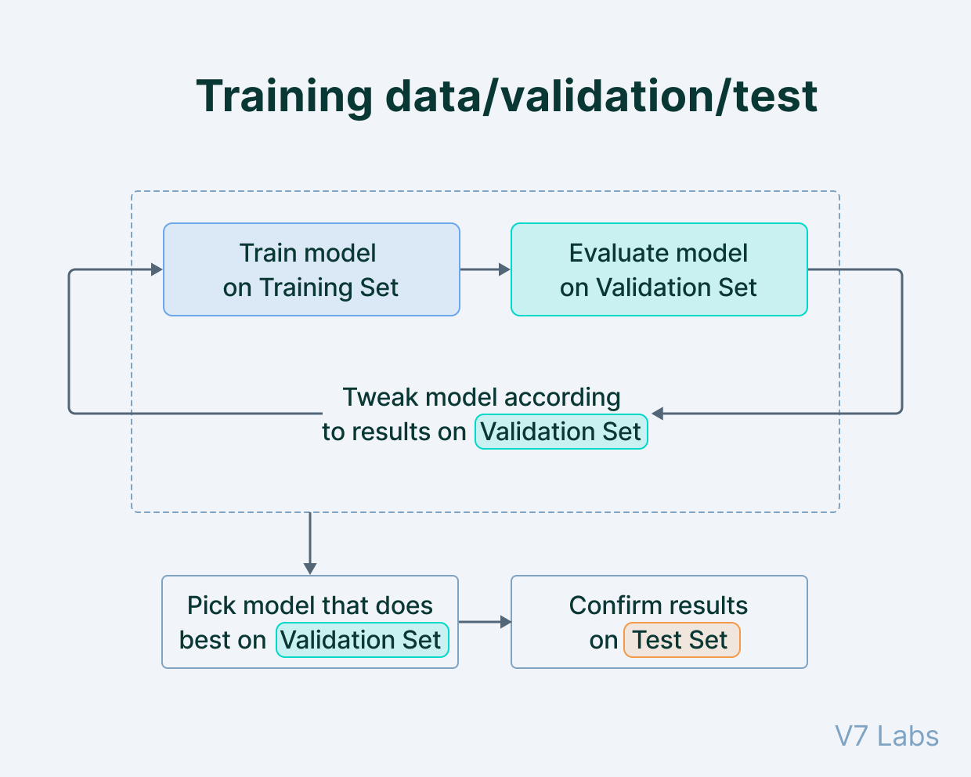
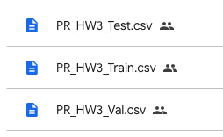
Dataset
A real world dataset
Training set (800 data)
Validation set (800 data)
Testing set (800 data)
7 features, 7 labels
https://www.v7labs.com/blog/train-validation-test-set

Slide 4
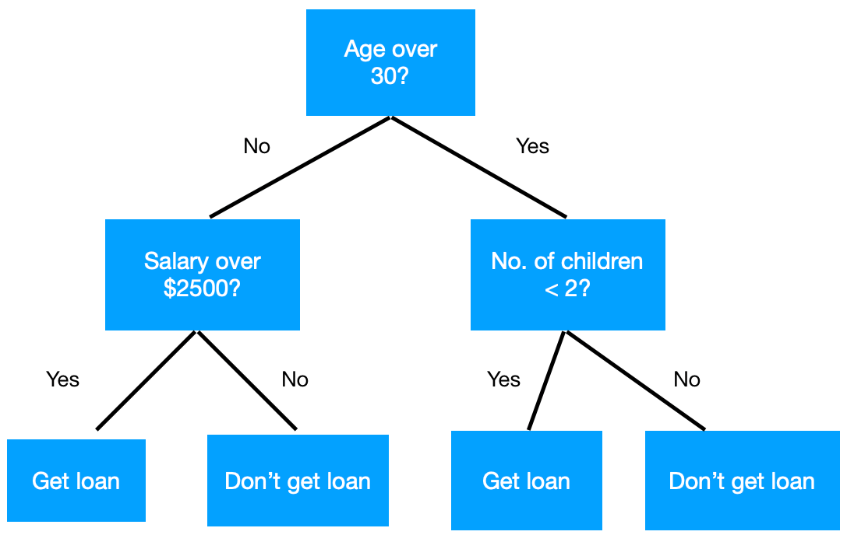
Decision Tree
The task is to determine whether to approve a loan for a customer.

Slide 5
Decision Tree
Find the feature that will split the data in a way that results in the most pure classes at the resulting nodes.
depth

Slide 6



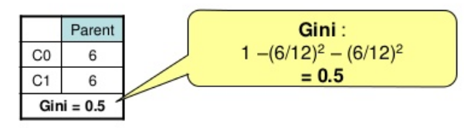
Decision Tree
How to measure “pure”?
Entropy: the smaller, the purer
Gini-index: the smaller, the purer
If all classes are the same in one node
If the classes are half-and-half

Slide 7
Decision Tree
Until stopped
Select a node
Loop through all values of all features 1) Partition the node and calculate the purity of the resulting data 2) Find the feature value that yields the lowest value of Gini or Entropy
Split the node using the feature value found in step b
Move to the next node and repeat steps a to c
Stopping criteria
The data in each leaf node belongs to the same class
The depth of the tree reaches a pre-specified limit

Slide 8
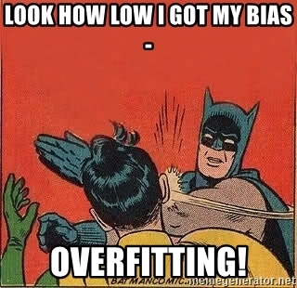
Decision Tree
Decision tree can find a unique path for each data (over-fitting) if we don’t pre-specified any limits, such as the depth of the node.

Slide 9
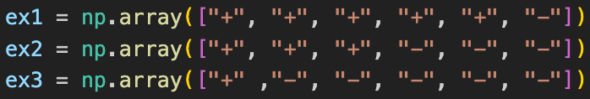
Questions for Decision Tree (30%)
Q1 (5%): Compute the Entropy and Gini Index of the following inputs.
Q2 (10%):
Fix criterion=‘gini’, max_features=None
Try max_depth=3 and max_depth=10
Q3 (10%):
Fix max_depth=3, max_features=None
Try criterion=‘gini’ and criterion=‘entropy’

Slide 10
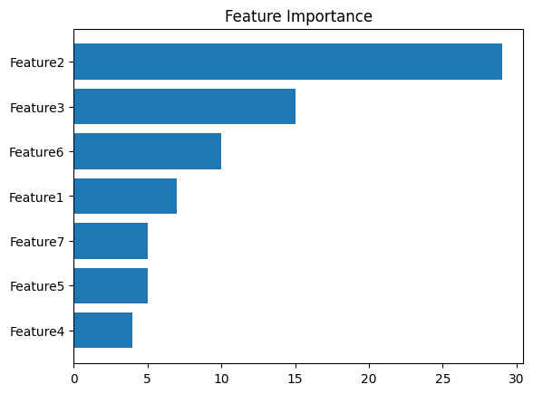
Questions for Decision Tree (30%)
Q4 (5%):
Train your model using criterion=‘gini’, max_depth=10, and max_features=None.
Plot the feature importance of your decision tree model by simply counting the number of times each feature is used to split the data.
For your reference, not the answer.

Slide 11
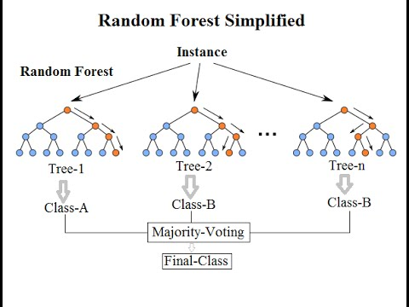
Bagging
Ensemble method of decision trees.
Bagging (Bootstrap aggregating): Fit many deep trees to bootstrap-resampled versions of the training data, and classify data by majority voting

Slide 12
Random Forest
Random forest combines multiple decision trees to make a better estimator than the individual decision trees.
Use the Decision Tree you implemented as the weak estimator.

Slide 13
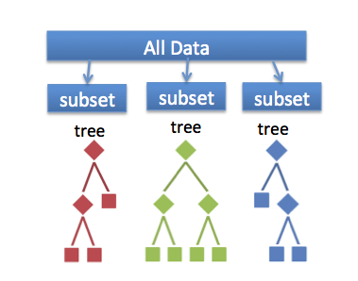
Random Forest
Where does the randomness come from in a random forest algorithm?
Bootstrapped datasets
Random feature selection during the growth of each tree in the forest.
Specifically, each tree may grow using different subsets of the original data and features, which are randomly sampled during the construction process.

Slide 14
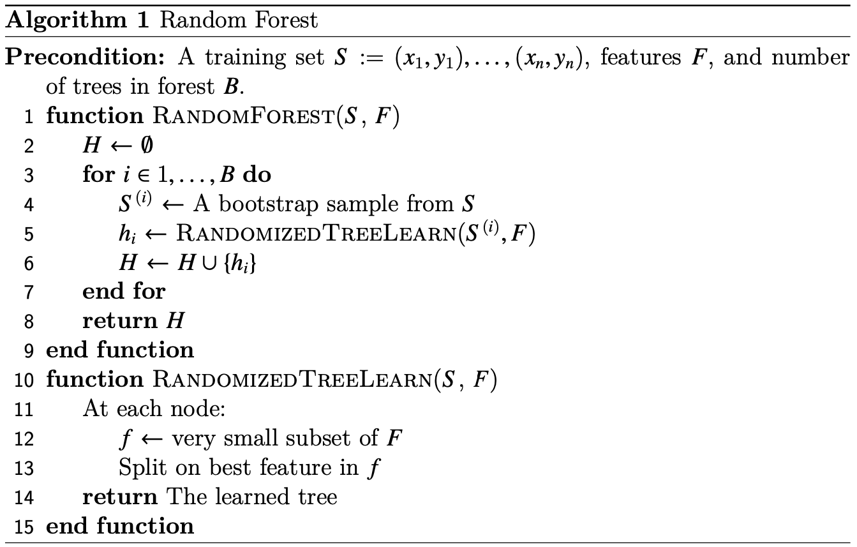
Random Forest

Slide 15
Questions for Random Forest (20%)
Q5 (10%):
Fix criterion=‘gini’, max_features=sqrt(n_features), max_depth=None, and Bootstrap=True
Try n_estimator=10 and n_estimator=50.
Q6 (10%):
Fix criterion=‘gini’, max_depth=None, Bootstrap=True, and n_estimator=10
Try max_features=sqrt(n_features) and max_features=None.

Slide 16
Train your own model (20%)
You can use nither Decision Tree or Random Forest that you implemented.
Try different parameters and features to beat the baseline.
Explain in detail how you choose the model, parameters, and features in the report. Otherwise, extra penalty.
Predict the testing data and save the result into a CSV file.

Slide 17
Train your own model (20%)
Evaluation is based on testing accuracy.
Testing data distribution is guaranteed to be similar to validation data.
Updated as of 20:30 on Apr. 22.
Points | Testing Accuracy
20 points | acc >= 0.90625
15 points | acc > 0.89
10 points | acc > 0.85
5 points | acc > 0.8
0 points | acc <= 0.8

Slide 18
Report
Please write your report in English.
Please follow the HW1 report template.
You must type the answer and also screenshot at the same time for the coding part.
Answer each question as clearly as possible. You will get an extra penalty for only the brief answer.

Slide 19
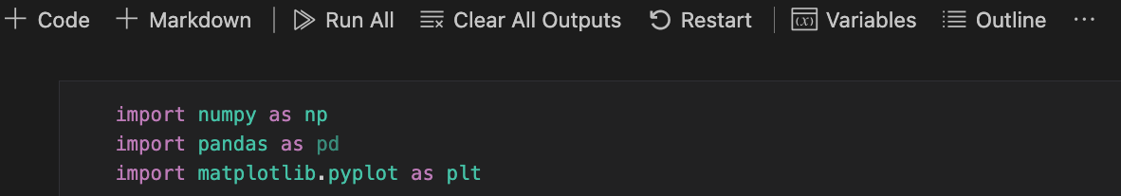
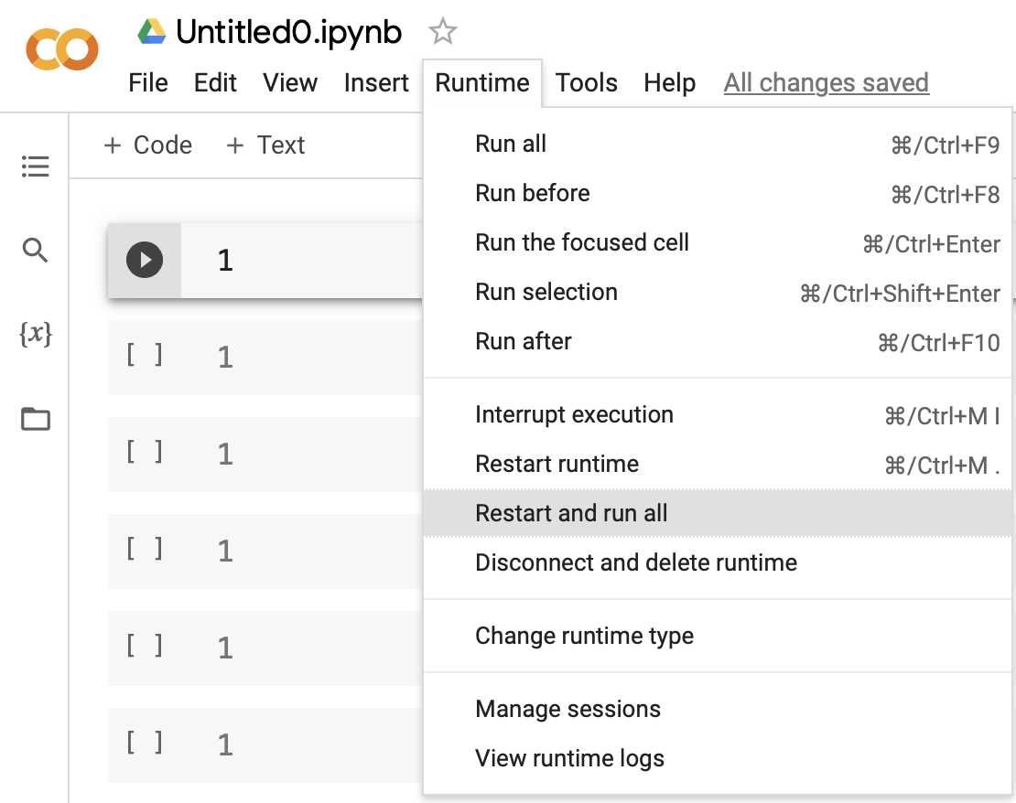
Submission
Compress your .ipynb, .pdf, and .csv into a zip file and submit it on E3.
Before submission:
Restart and run All
Save and submit the .ipynb (keep all cell outputs)
Get 0 points if you do not keep the cell outputs.
<STUDENT ID>_HW3.zip
<STUDENT ID>_HW3.ipynb
<STUDENT ID>_HW3.pdf
<STUDENT ID>_prediction.csv
For your reference

Slide 20

Late policy
We will deduct a late penalty of 20 points per additional late day.
If you get 90 points but delay for two days, you get 90 - (20 x 2) = 50 points!
We only accept submissions that are up to 10 minutes late. Any submissions that are later than that will be considered late, regardless of the reason.

Slide 21
HW2
We will announce the HW2 scores before Apr. 16.
The criterion has been adjusted from the left table to the right table.
Points | Testing Accuracy
20 | testing acc > 0.921
15 | 0.91 < testing acc <= 0.921
8 | 0.9 < testing acc <= 0.91
0 | testing acc <= 0.9
Points | Testing Accuracy
20 | testing acc > 0.921
15 | testing acc > 0.91
10 | testing acc > 0.8
5 | testing acc > 0.6
0 | testing acc <= 0.6

